Slide 1
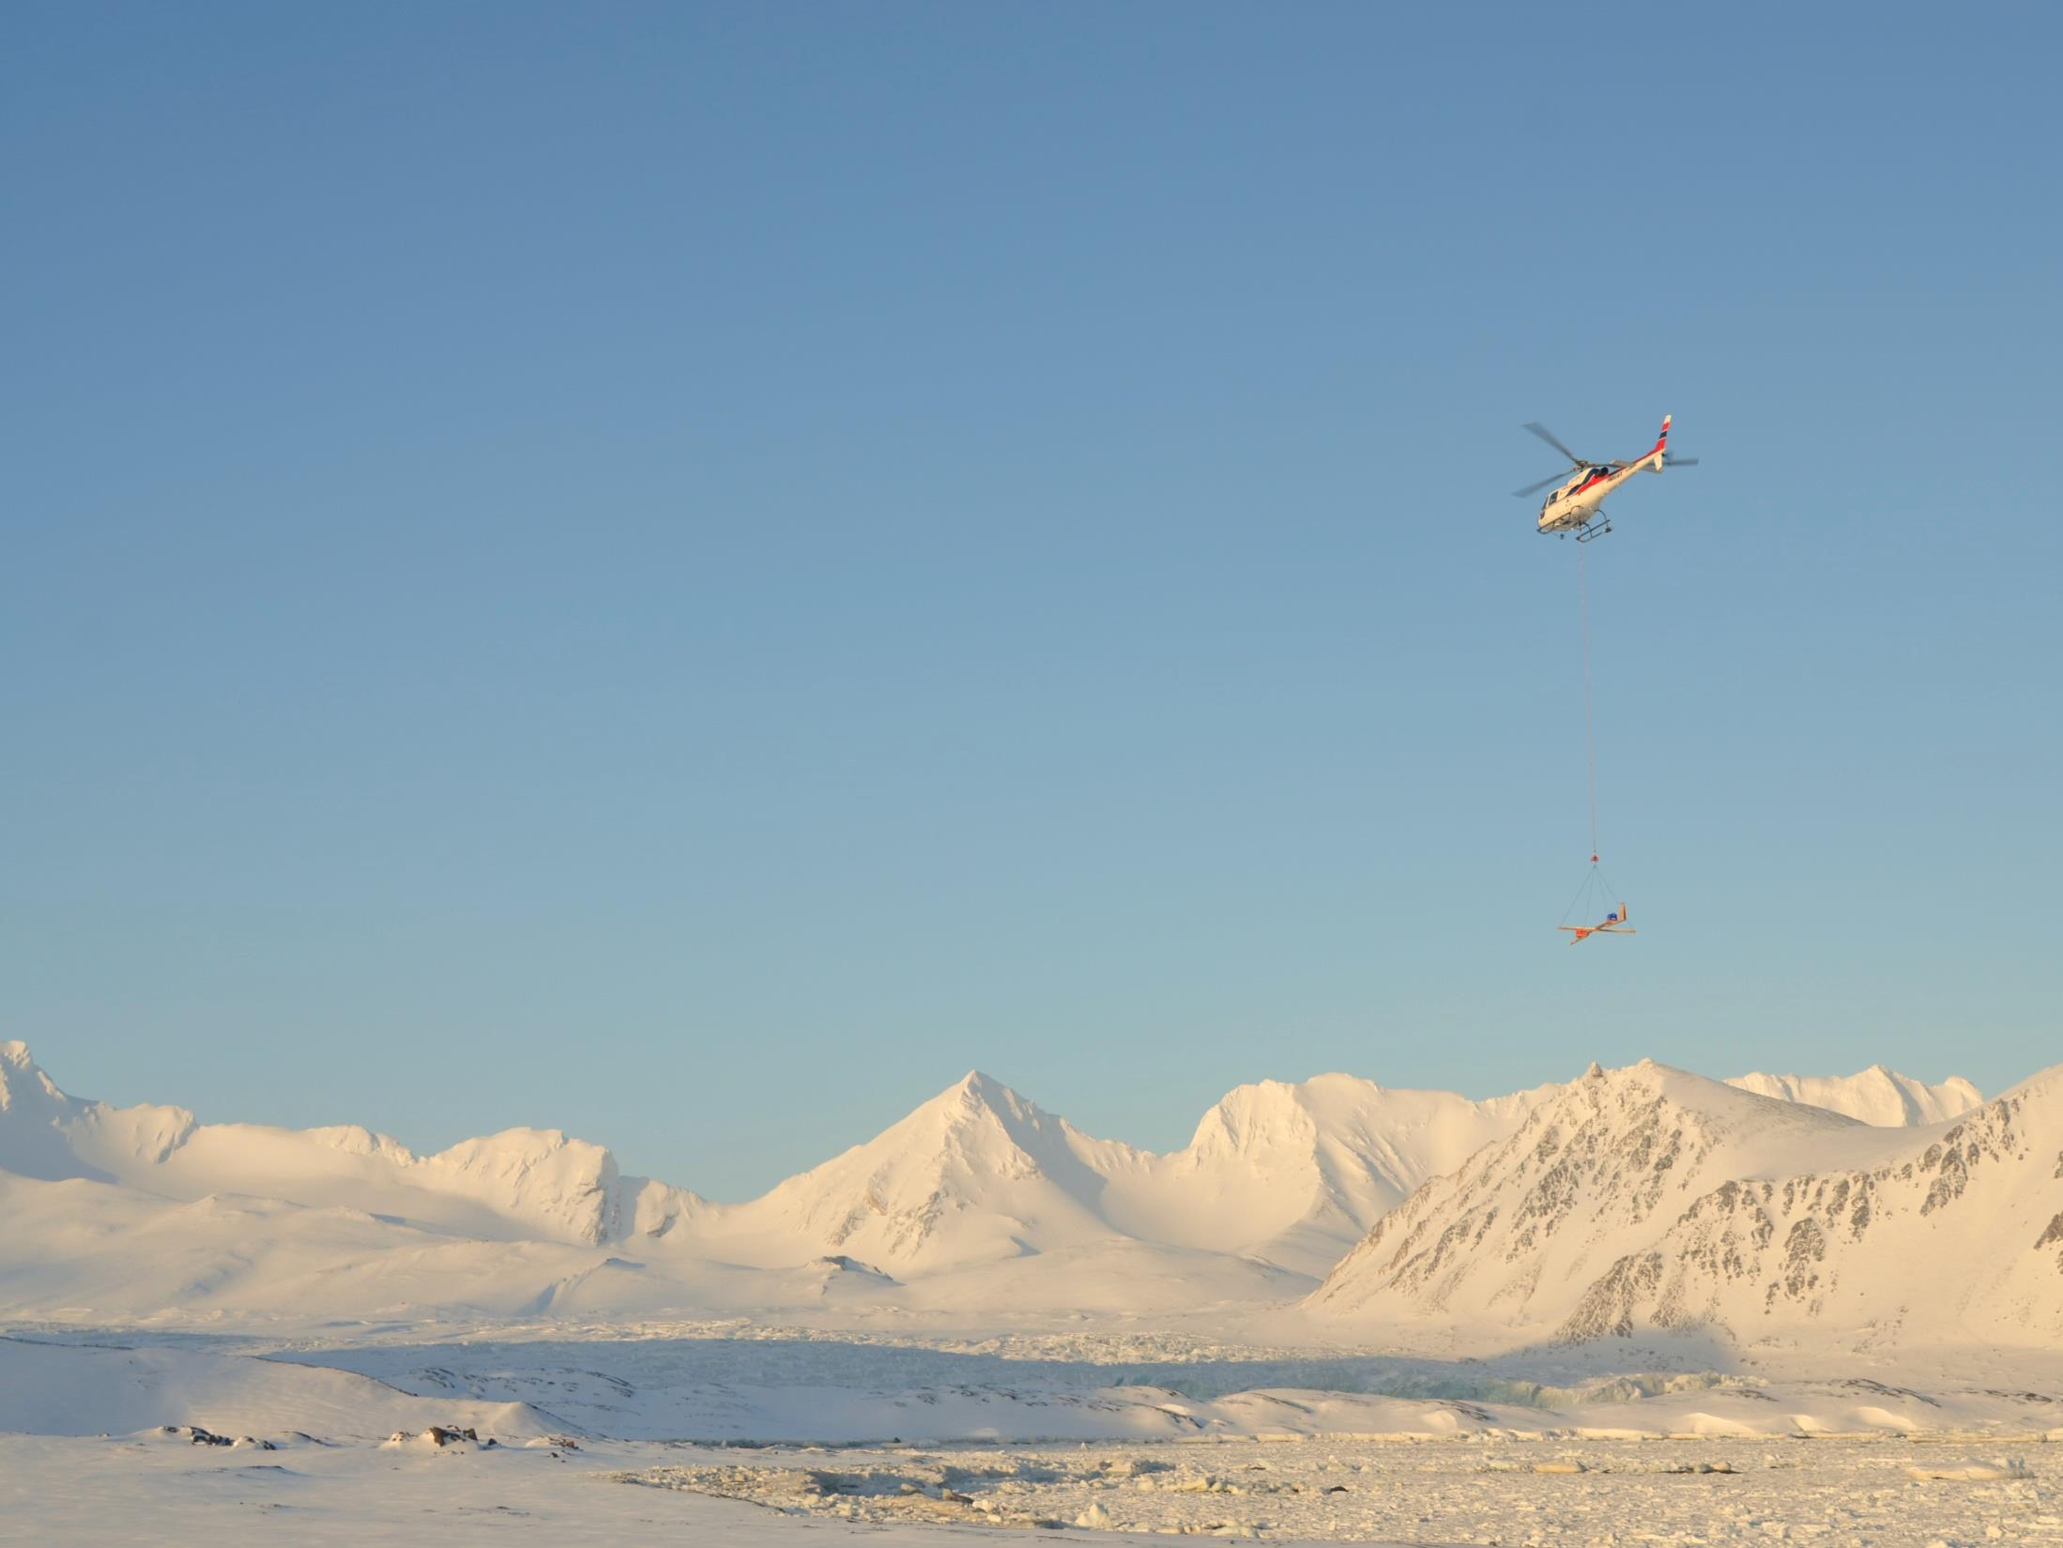



WP7 - Dissemination and outreach
Update of the first 6 months of activity & plans for the future
Donatella Zona, Ned Dwyer

Slide 2

WP 7 – Objectives
Disseminate Project Results to raise awareness of Arctic challenges
Inform and support engagement of users and stakeholders
Build capacity in using INTAROS products and services
www.intaros.eu
INTAROS SCM, Sopot, Poland, 7 June 2017

Slide 3
WP 7 – Work breakdown structure
Task 7.0 Coordination of the Workpackage; Lead: USFD
Task 7.1 Plan and support dissemination activities; Lead: EurOcean
Task 7.2 Informing decision-makers in European agencies and businesses; Lead: EurOcean
Task 7.3 Informing Arctic and international bodies; Lead: EurOcean
Task 7.4 Interdisciplinary science dissemination; Lead: USFD
Task 7.5 Capacity building for early-career scientists; Lead: EurOcean
Task 7.6 Capacity building for high-school and general public; Lead: GINR
Task 7. 7 Capacity building for local communities and civil society organizations; Lead: NORDECO
Underway Not yet started
www.intaros.eu
INTAROS SCM, Sopot, Poland, 7 June 2017

Slide 4
WP 7 – Deliverables
D7.1 Project Website; Resp. Eurocean
D7.2 Printed Materials; Resp. Eurocean
D7.3 Dissemination Plan; Resp. NERSC
D7.4 Dissemination material for use towards decision makers, stakeholders, business and general public; Resp. NERSC
D7.5 Dissemination Plan V2.0; Resp. NERSC
D7.6 OceanObs 2019 ContributionResp. EuroGOOS
D7.7 Education material V1; Resp. GINR
D7.8 Dissemination material V2; Resp. NERSC
Completed/Underway Not yet started
www.intaros.eu
INTAROS SCM, Sopot, Poland, 7 June 2017

Slide 5
WP 7 – Deliverables
D7.9 Educational material V2; Resp. IGPAN,
D7.10 Special issue; Resp. USFD
D7.11 Scientific capacity building; Resp. EurOcean
D7.12 Educational packages for scientists; Resp. EurOcean
D7.13 Arctic in a class room; Resp. USFD
D7.14 Proceedings of CBO workshop ; Resp. Nordeco
D7.15 Final summary for policy makers; Resp. EurOcean
D7.16 Final project even in Brussels; Resp. NERSC
www.intaros.eu
INTAROS SCM, Sopot, Poland, 7 June 2017

Slide 6
D7.1 Project Website; Resp. Eurocean
D7.2 Printed Materials; Resp. Eurocean
D7.3 Dissemination Plan; Resp. NERSC
Timeline

Slide 7
Activities during the first six months (Dec 2016-May 2017)
www.intaros.eu
INTAROS SCM, Sopot, Poland, 7 June 2017

Slide 8
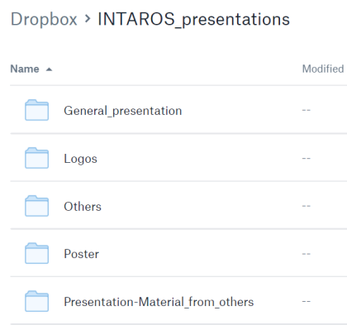
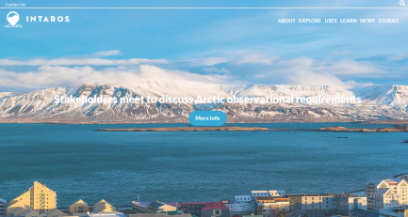
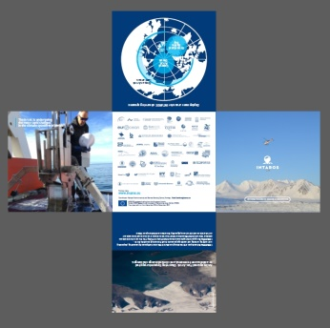
Communication to Public
Several partners uploaded presentations, photos, videos to dropbox
Initial website developed and launched
Public brochure printed; also available as pdf
www.intaros.eu
INTAROS SCM, Sopot, Poland, 7 June 2017

Slide 9
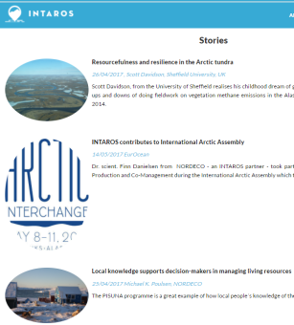
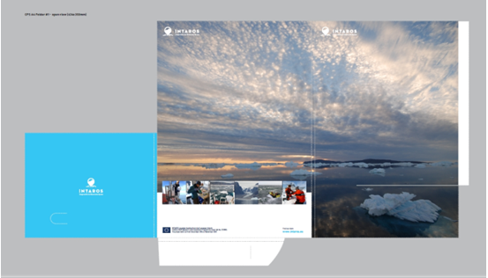
Communication to Public
Two good website “Stories” (blogs) developed. More needed!
Folders, Noteboks, pens/Pencils being developed
www.intaros.eu
INTAROS SCM, Sopot, Poland, 7 June 2017

Slide 10
Communication to Scientific Community
Interdisciplinary science dissemination
    Wide dissemination publications
    Special sessions at EGU, AGU, OceanObs, Artic Science Summit week, etc.
    Special issue in open source scientific journal
Initial discussion on the organization of EGU or AGU sessions,
Including timeline, topics, and possible people involved
iLEAPS Conference in Oxford (11-14 September 2017) Sheffield-Exeter-U Helsinki-Max Plank will participate, notice circulated to all INTAROS partners (expended deadline to 8th June)
Royal Society meeting in (12-13 October 2017)-Sheffield-invited speaker-INTAROS results
We advertised conference on the website
www.intaros.eu
INTAROS SCM, Sopot, Poland, 7 June 2017

Slide 11
Impacting Policy
Informing and engaging decision-makers in European agencies and businesses:
  EU Polarnet (www.eu-polarnet.eu)
  EEA, EMSA, and others
  Participation in regional events (e.g. European week of regions and cities)
  Project event in Brussels: key session on decision-makers and policy developers
  summary for policymakers
  Policy briefs
  summarize the roadmap for future needs and developments
Informing Arctic and international bodies
  Arctic Futures Symposium
Policymaker meeting in Brussels in May- we attended stakeholder event in Brussels and supported with brochure.
www.intaros.eu
INTAROS SCM, Sopot, Poland, 7 June 2017

Slide 12
Capacity Building
Contribution to summer schools, including one at University Centre of Svalbard
Climate Change teaching for high school students and teachers
Involvement of the indigenous organizations in community based observing in the Arctic
Short-term scientific missions for early-career scientists
www.intaros.eu
INTAROS SCM, Sopot, Poland, 7 June 2017

Slide 13

Capacity Building
Hanna K Lappalainen
Applied methodologies for improved exchange between atmospheric-science infrastructures at high latitudes Hyytiälä, 23 October – 2 November 2017
Integrated approach in data analysis and model evaluation
Application of automated data analysis routines
Application of data mining techniques
Visualization of big data
Course leader, Dr. Antti Lauri (antti.lauri@helsinki.fi),
project leaders Dr. Paul Zieger (paul.zieger@aces.su.se)
Dr. Paul Glantz (paul.glantz@aces.su.se).
www.intaros.eu
INTAROS SCM, Sopot, Poland, 7 June 2017

Slide 14
Capacity Building-
Finn Danielsen
International Arctic Assembly, Fairbanks, Alaska meeting 9-11 May 2017
Public talk & Experience exchange workshop on community-based observing (55 participants, 10 community-based observing programs in N America and Greenland)
Discussion on indigenous, local and scientific knowledge for decision-making at the May 9 2017 in Alaska (c. 600 participants).
Dialogue with Senior Arctic Observers and AC working groups on community-based observing
Mini-workshop on plans for community-based observing activities of INTAROS in Greenland was held December 2016 in Nuuk, Greenland
www.intaros.eu
INTAROS SCM, Sopot, Poland, 7 June 2017

Slide 15
Plan for the next six months-tasks
Task 7.1 Plan and support dissemination activities; Lead: EurOcean & NERSC- (Ned will discuss details in his presentation)
Actively populate webpage
Plan how we can best use social media
Task 7.2 Informing decision makers in European Agencies and Business Lead: EurOcean, (UH & NERSC) –Need some input?
Develop first eNewsletter – need material; establish mailing list
Establish protocols with EU Polarnet
Task 7.3 Informing Arctic and international bodies Lead: EurOcean, (NERSC) –Need some input?
Establish protocol with Arctic Council/Arctic Portal
Support task 6.7 (Blue Growth)
INTAROS SCM, Sopot, Poland, 7 June 2017

Slide 16
Plan for the next six months-tasks
Task 7.4 Interdisciplinary science dissemination; Lead: USFD-(no specific deliverables except for the Special issue later in the project -D. 7.10 in 2021-but on going activities)
organization of iLEAPS conference broad dissemination of INTAROS results- INTAROS results (USFD, Exeter, Max Plank, U Helsinki)
Royal Society Meeting ‘Soil-atmosphere carbon fluxes – experimentalists meet modellers’ -INTAROS results
discussion of EGU or AGU sessions organization- collaboration with WP2
Relevant meetings & activities?
INTAROS SCM, Sopot, Poland, 7 June 2017

Slide 17

http://www.cvent.com/events/5th-ileaps-science-conference/event-summary-412288f4ffc64c1eb7d0f2f151fb5882.aspx
INTAROS SCM, Sopot, Poland, 7 June 2017

Slide 18
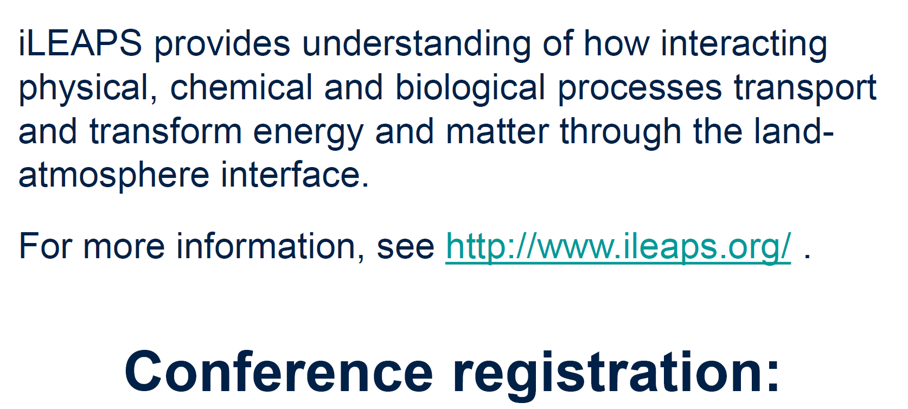
http://www.cvent.com/events/5th-ileaps-science-conference/event-summary-412288f4ffc64c1eb7d0f2f151fb5882.aspx

Slide 19
Plan for the next six months-deliverables
D7.1 Project Website; Resp. Eurocean-ongoing will continue- Project partners will be requested material (photos or videos of their field and short text of their experience to do research in the field-students and PIs)- Ned will discuss in his ppt
D7.4 Dissemination material for use towards decision makers, stakeholders, business and general public; Resp. NERSC
INTAROS SCM, Sopot, Poland, 7 June 2017

Slide 20
Discussion
Ask our help
Circulate information to us, to your students/institutions
Update us on relevant events, conference attendance and of any relevant conference (presenting or organizing a session)
COP? http://newsroom.unfccc.int/climate-action/

