Slide 1
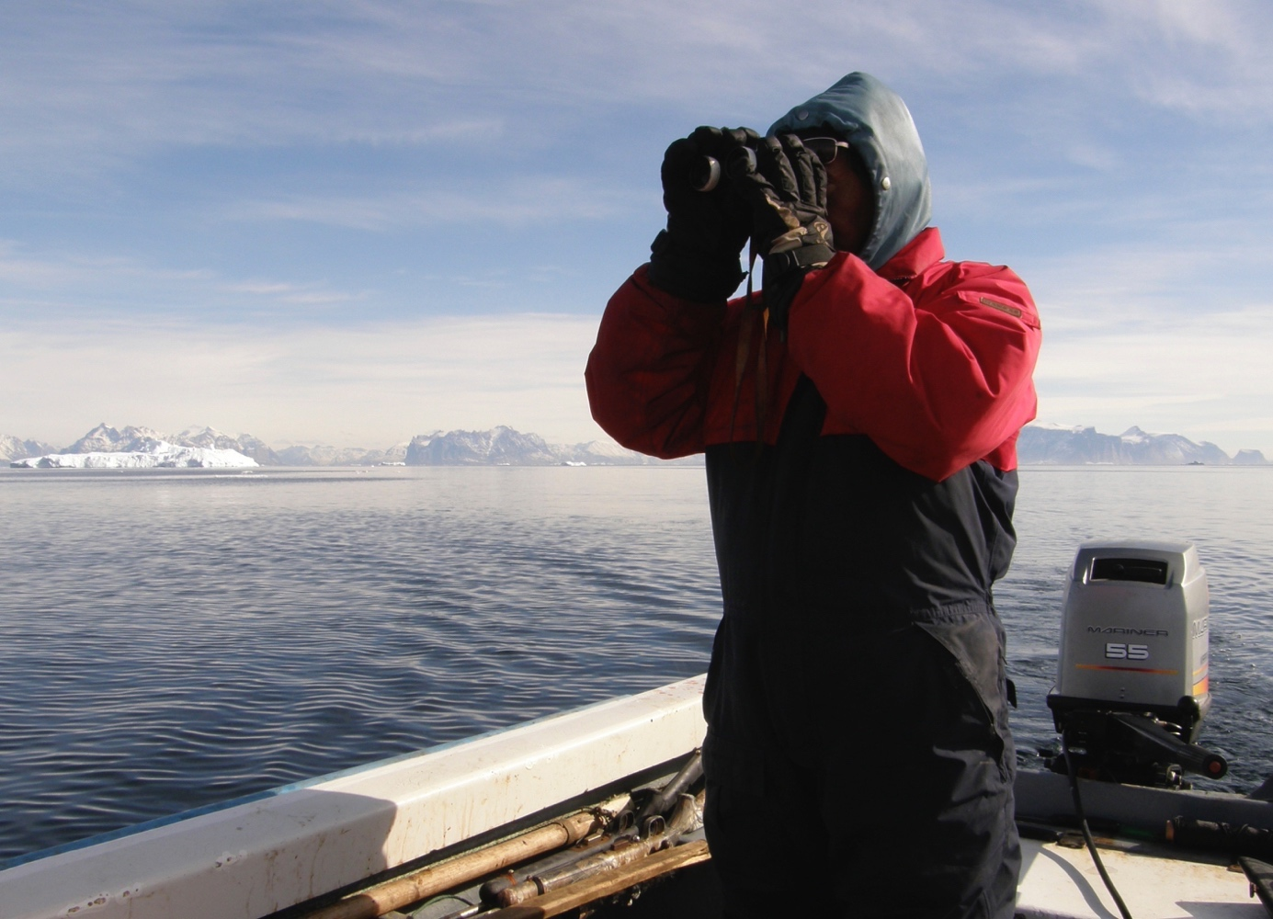

Finn Danielsen
Lisbeth Iversen
Task 6.6

Slide 2

T6.6 Policy brief to decision-makers Disko and LYB
1 Local and scientific observations for improving fisheries in Greenland
2 Natural disasters in Disko Bugt, Greenland
3 Monitoring Svalbard’s environment and cultural heritage by expedition cruises
4 Natural disasters in Longyearbyen, Svalbard
Many authors: Finn Danielsen, Martin Enghoff, Michael K. Poulsen (NORDECO), Lisbeth Iversen (NERSC), Peter H. Voss, Trine Dahl-Jensen, Tine B. Larsen (GEUS), Mathilde B. Sørensen, Zeinab Jeddi (UiB)

Slide 3
In the 1st policy brief, we summarize what we know about how user knowledge can be incorporated into fisheries management in Greenland and we provide recommendations
Comparison of assessments by local fishermen and the fisheries statistics
“. .. It is recommended that the inclusion of user knowledge be written into the aims of the new Fisheries Act. ”

Slide 4
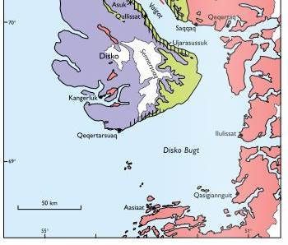
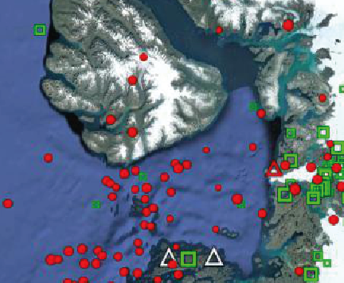
In the 2nd policy brief, we summarize what we know today about landslides and earthquakes in Disko Bay, and what can be done by authorities and contractors to adapt new buildings and roads to these conditions
T.v.: Geologisk kort over Disko Bugt³. Skraverede områder viser steder med høj risiko for fjeldskred. Rød er grundfjeld, lilla er sandsten, og grøn er skifre og vulkansk klippe.
T.h.: Kort over Disko Bugt med jordskælv (rød), og rystelser udført af isbevægelser (grøn), der er registeret i perioden 20. april 2018 til 23. september 2019. Hjemmeseismograferne er markeret med trekanter.
”.. 1) The municipal councils should look at whether the critical infrastructure is secured against strong earthquakes, landslides and tidal waves. … 3) The contractors should look at the strength of vibrations that all planned installations can withstand and whether precautions should be taken against strong tremors in the planning phase…”

Slide 5
In a 3rd policy brief, we summarize the potential that expedition cruises have for contributing to environmental monitoring , and what can be done by authorities and citizen science programs to make full use of this potential
“3) Clear lines of communication should be further developed btw. contributors, citizen science programs, the scientific community and decision-makers”

Slide 6
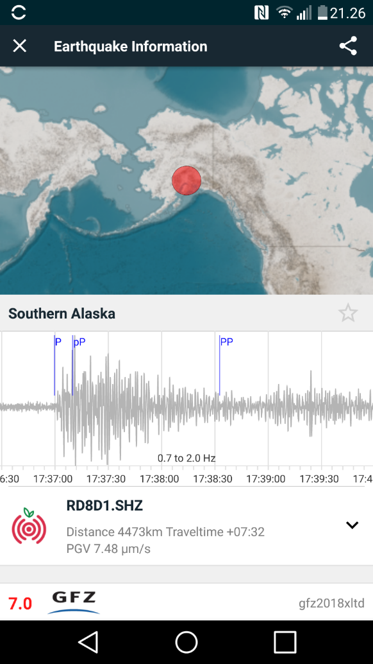
In the 4th policy brief, we summarize what we know about natural hazards in Longyearbyen, and we propose how to better understand such incidents, and how authorities and contractors can adapt new infrastructure to these conditions
"… it is recommended that: 1) The local council in Longyearbyen ensures that critical infrastructure is built outside the runways of potential landslide events and adequately secured against earthquakes. … A new experiment with the use of home seismographs should be considered, if suitable locations can be made available…"
Tremors from a 7.0 earthquake in Alaska 30 Nov. 2018 as measured by a citizen seismograph in Longyearbyen

Slide 7
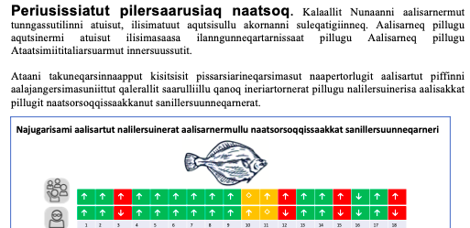
T6.6 Policy brief to decision- makers Disko and LYB
Delays: The workshops w. policymakers have been delayed
Data: All 7 datasets used are in the Intaros Data Catalogue
Plan for 2021: Discussions w/policymakers. Roadmap (w.WP4)
Translation of policy briefs, lay-outing, discussions, dissemination and outreach

