Slide 1
Task 6.3 - Ice-ocean statistics for decisions support and risk assessment.
Lead: NERSC. Contributors: UHAM, IOPAN, ARMINES, AWI, UNIS, DTU, IFREMER, UB, FMI, DNV GL.
Partners without funding: SIO, WHOI, UAF
Deliverables Year 4
D6.4 Report and model fields on ice-ocean state estimation in the Arctic Ocean. (UHAM. M36).
D6.5 Risk assessment system. First results of using integrated data from iAOS into a risk assessment system. (O) (DNV GL. Contr.: NERSC, UHAM, UB. M42)
Deliverables Year 5
D6.9 Reports on business development and economic potential: a) Report on INTAROS fitness for supporting Marine and Maritime Industry business development in the Arctic Ocean. b) Report on Economic benefits. (EuroGOOS. Contr.: NERSC. M54).
D6.14 Ice-ocean statistics and state estimation: Fram Strait and the Arctic Ocean. (NERSC. Contr.: UHAM, ARMINES, IOPAN, M58). → update of the deliverable to cover all the analysis and exploitation peforemed in the Task.
D6.15 Risk assessment system, V2. Using integrated data from iAOS into a risk assessment system (R) (DNV GL. Contr.: NERSC, UHAM, UB, M58)
D6.18 Report on Economic benefits. (EuroGOOS. M58).

Slide 2
Task 6.3 Actvity | Contributing
Activity 1: Integrative analysis: ice-ocean statistics using remote sensing and in situ measurements. | NERSC, AWI, IOPAN, DTU, FMI, IFREMER, ARMINES, CNRS-LOCEAN
Activity 2: Baseline description of Arctic Acoustic environments | NERSC, CNRS-IUEM
Activity 3: Ice-ocean modelling and assimilation experiments | U-HAM
Activity 4: Risk management system for maritime activities | DNV GL
Activity 5: Formulation of user applications in maritime sector in collaboration with stakeholders. | EUROGOOS

Slide 3
IOPAN contribution to Task 6.3 in 2020 (Activity 1):
Activities:
Work in progress on preparation of ocean state statistics along the Atlantic water inflow to the Arctic Ocean (the eastern Norwegian and Greenland seas, Barents Sea Opening and eastern Fram Strait), based on AREX data set (1996-2020). Analysis of temperature/salinity fields and derived quantities completed.
Analysis of sea ice variability north of Svalbard in relation to ocean state in the inflow region ongoing.
Following work will include ocean currents’ fields from AREX campaigns and analysis of full data sets from the A-TWAIN/INTAROS moored measurements in 2013-2020.
Delays due to COVID-19 and mitigation measures:
Due to delays in recovery of some moorings, mooring data were available later and their processing is still ongoing.
Some delays in submitting derived data products to IOPAN repository due to the lockdown/limited personnel.
Data produced and access in data repositories:
Derived data products (gridded fields and statistics) are under preparation and will be available through IOPAN data repository (or Zenodo).
Exploitation of the results:
Final data products will be used for ocean state assessments, validation of models and remotely sensed products, and partially for risk analysis (e.g. ocean currents).
Completion of work in 2021:
Preparation of ocean and sea ice statistics based on the INTAROS mooring data.
Publication of derived data products in open repository.

Slide 4
Highlight – IOPAN: Examples of derived data products based on AREX data collection (Activity 1)
Long-term means and annual maps/gridded fields of water masses properties (below shown for Atlantic water, AW)
Annual maps/gridded fields of anomalies (below shown for ocean heat content in AW)
Temperature
Salinity
AW temperature
LT MEANS
AW salinity
AW layer
Time series of derived quantities
Ocean heat
AW layer thickness
Ocean heat content in AW

Slide 5
FMI contribution to Task 6.3 in 2020:
1) Main results obtained in the last project year (1 Dec 2019 – 30 Nov 2020)
Analyses snow and ice mass balance along few SIMBA buoy drift trajectories to understand influence of oceanic heat flux at ice bottom on sea ice mass balance;
Manuscript under revision “The seasonal cycle and breakup of landfast sea ice along the west coast of Kotelny Island, East Siberian Sea”
2) Delays, deviations from the plan and mitigation measures, especially due to COVID-19
The Domain based ice thickness product and HIGHTSI snow thickness was delayed- because of home-office 3) Data produced, registration in the catalog (https://catalog-intaros.nersc.no) and access to data in repositories - N/A, or to be connected with WP3?? 4) Exploitation of the results, what has been done and what is the impact
Scientific papers, see 1) 5) Plan for completion of work during 2021, including response to the last review report, if relevant : Domain snow depth and ice thickness products to be produced.

Slide 6
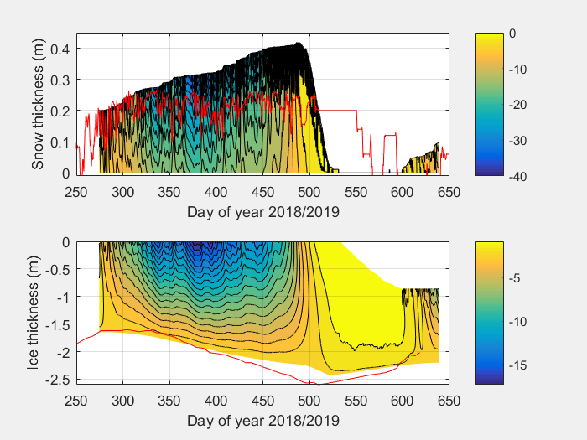
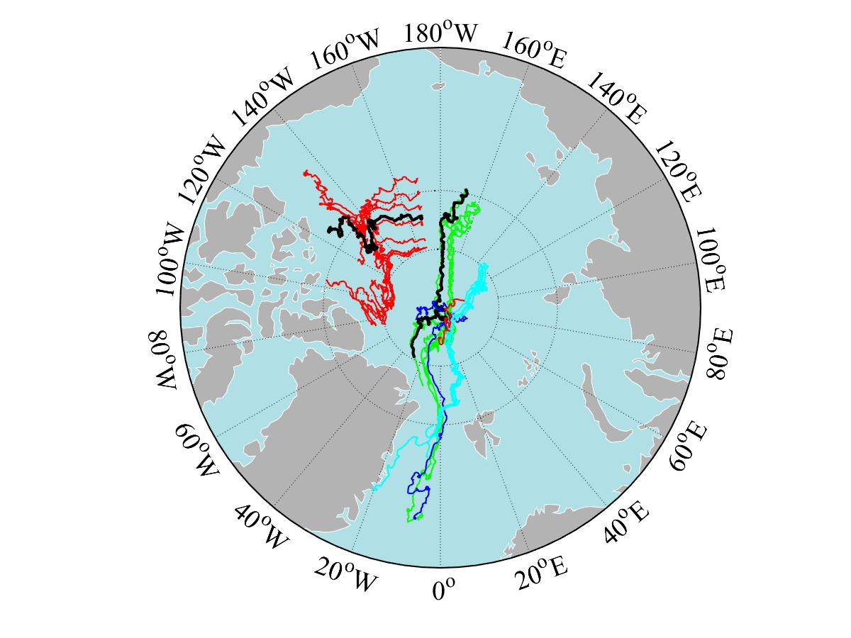
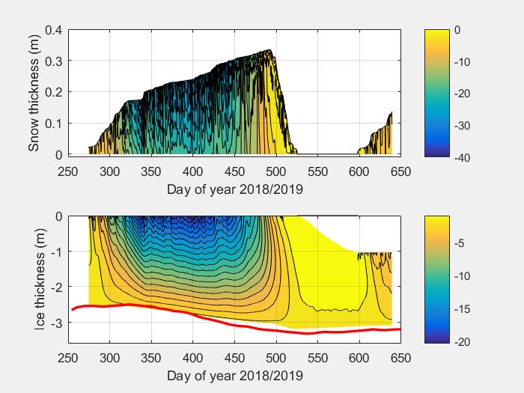
Modelled snow death and ice thickness for PRIC0805
FMI Highlight (Activity 1) : SIMBA drift pattern in the Arctic Ocean. Measured ice thickness and snow depth along two trajectories PRIC0805. and FMI0504r. Compared with HIGHTSI model simulations. Weather forcing were ECWMF reanalyses.
SIMBA snow depth
SIMBA ice thickness
Modelled snow death and ice thickness for FMI0504r
FMI0504r
PRIC0805
SIMBA ice thickness

Slide 7
IFREMER contribution to Task 6.3 in 2020 (activity 1):
1) Main results obtained in the last project year (1 Dec 2019 – 30 Nov 2020)
Long-term satellite sea ice database integrated in the catalog (1992-present), daily basis
2) Delays, deviations from the plan and mitigation measures, especially due to COVID-19
Delay due to scat. valid data availability (arrived on Fall 2020, 2 years after satellite has been launched) but very good data, usable for sea ice detection
3) Data produced, registration in the catalog (https://catalog-intaros.nersc.no) and access to data in repositories;
Long-term satellite sea ice database integrated in the catalog (1992-present), daily basis → integrated in the IAOOS catalogue
4) Exploitation of the results, what has been done and what is the impact
Used in Task 6.1.
long-term sea ice datasets to be available for the community +exploitation of the co-localisation of the different datasets (high resolution, low res. satellite datasets & buoys) in the MIZ to study one case study
5) Plan for completion of work during 2021, including response to the last review report, if relevant.
Work on CFOSAT data, which is our main activity at present

Slide 8
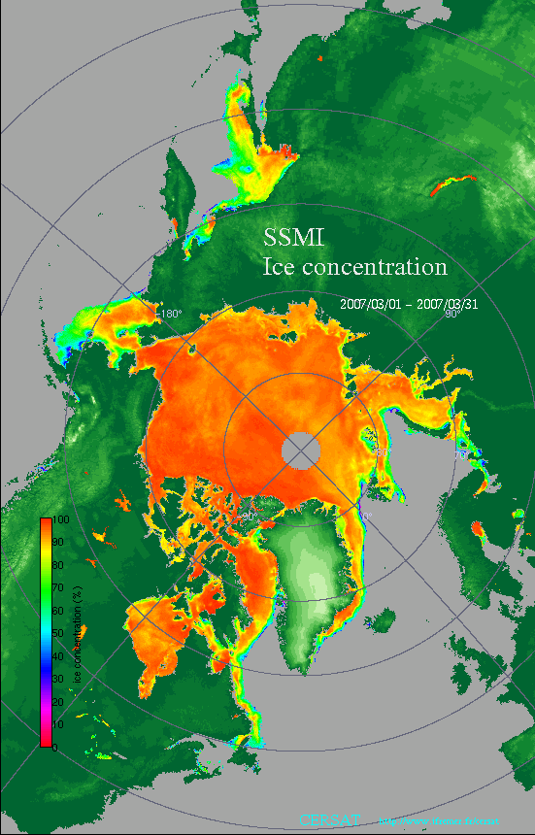
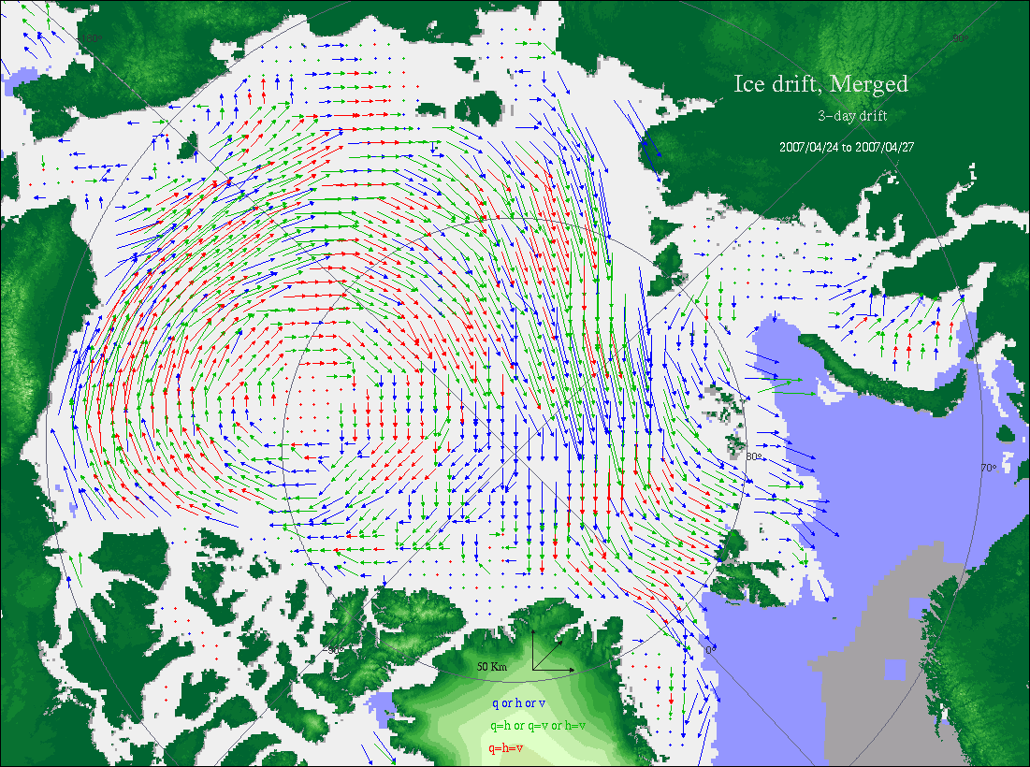
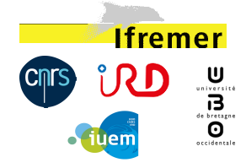
LOPS/Ifremer in INTAROS (Activity 1)
Long-term satellite sea ice database integrated in the catalog (1992-present), daily basis
Girard-Ardhuin & Ezraty, 2012
Sea ice concentration
Sea ice displacement
Using successive radiometer and scatterometer onboard satellites (CERSAT data)

Slide 9
DTU contribution to WP6.3 (Activity 1)
Main results:
Vertical land movement model (published in GRL, https://doi.org/10.1029/2020GL088144)
Essential tool for Arctic tide gauge based sea level studies (from WP2.1).
Constructed Arctic-wide sea level budget from 1995 to 2015 (in review in Ocean Sciences)
Delays:
Updated version of Arctic steric sea level product (DTU Steric)
(November 2020 → March 2021)
Data:
Vertical Land Movement model (not in data catalogue – but available through data.dtu.dk)
Steric sea level (not yet available)
Sea level budget assessment for selected Arctic Tide Gauges (not yet available - in review)
Sea level anomaly (available through data catalogue)
Plan:
Update Arctic steric sea level product (DTU Steric)
Finish review of paper in Ocean Sciences

Slide 10
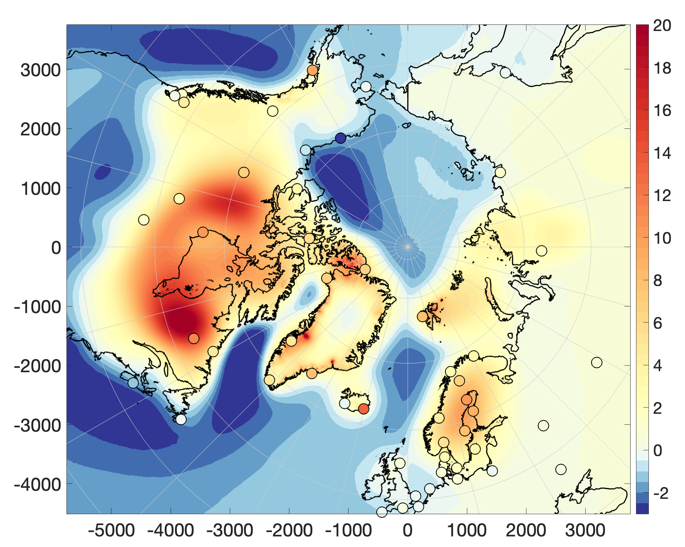
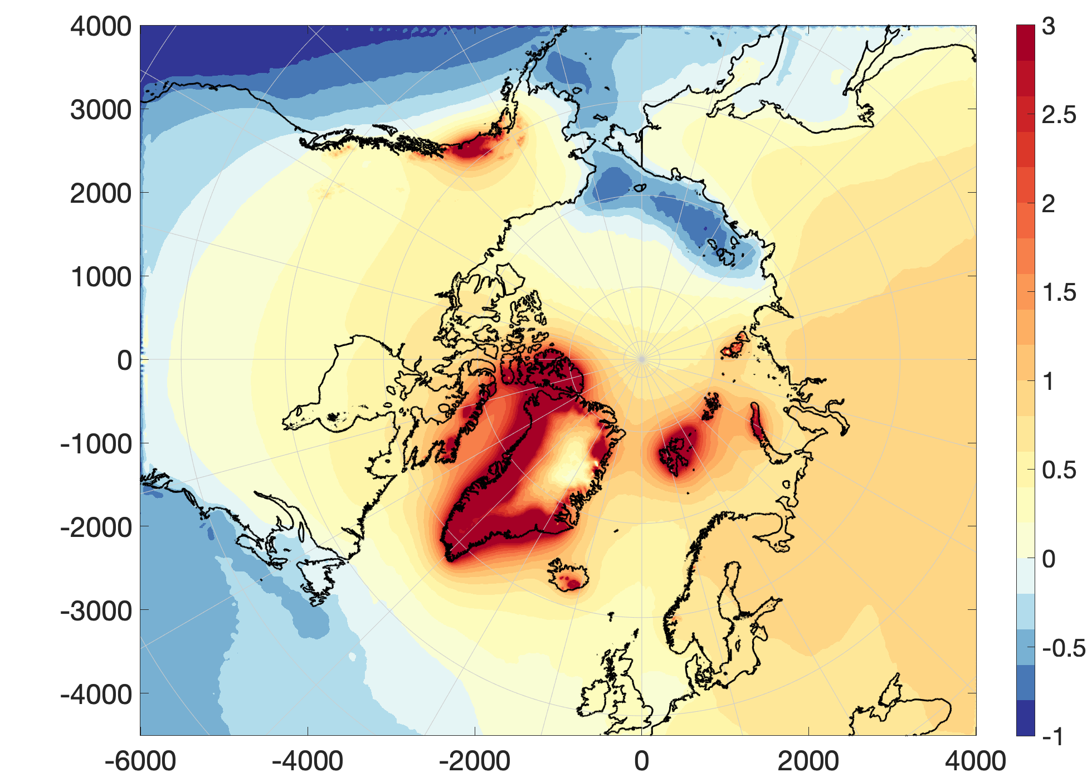
DTU contribution highlight to WP6.3 (Activity 1) High resolution annual (2003-2015) Arctic vertical land movement (VLM) model
VLM = elastic VLM from present-day ice change + Rotational Feedback + Non-tidal ocean loading + GIA (Caron2018)
GNSS = VLM + non-secular Geocenter Motion
2003-2015 High-resolution (2x2 km) VLM [mm/yr]
= GNSS trend
elastic VLM from Present Day Ice change [mm/y]

Slide 11
UHAM contribution to WP6.3 (Activity 3)
Main results:
D6.4 Report and model fields on ice-ocean state estimation in the Arctic Ocean. (UHAM. M36). This report describes OSSE experiments with results for ocean observing.
Arctic Ocean-Sea ice reanalysis for the period 2007-2016 using the adjoint method Guokun Lyu¹, Armin Koehl¹, Nuno Serra¹, Detlef Stammer¹, and Jiping Xie² submitted to QJRMS with minor revision.
Delays:
NO DELAYS
Data:
Reanalysis dataset available http://thredds.nersc.no/thredds/gecco/catalog.html
https://catalog-intaros.nersc.no/dataset/ocean-sea-ice-synthesis-from-2007-2016
Exploitation of the results:
Reanalysis used in other activities in Task 6.3. Input to Roadmap for Arctic Observing (WP1)
Plan:
Work completed
.

Slide 12
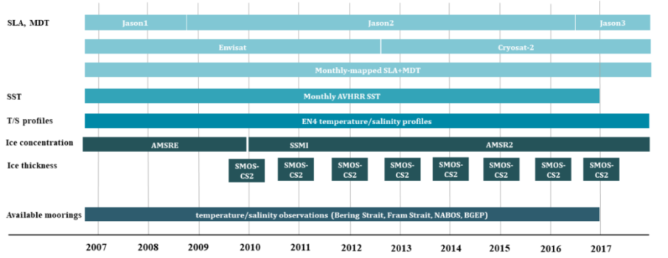
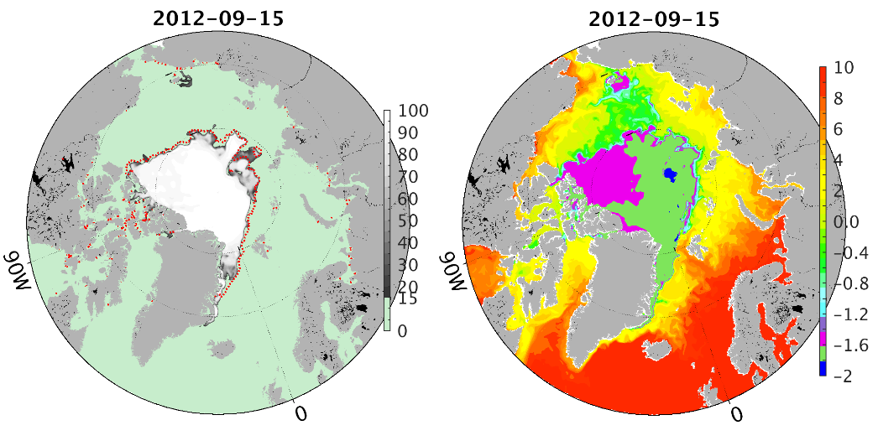
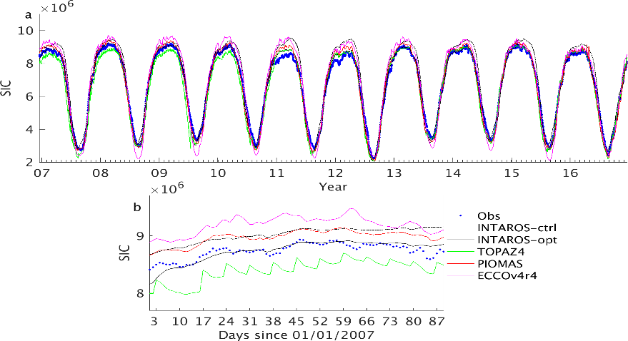
A new Arctic Ocean–Sea-Ice Synthesis (Activity 3)
assimilation of iAOS*-data into an ice-ocean model (UHAM contribution) → a 10-year Arctic Ocean—Sea-Ice Synthesis
Used in Activities 1 and 4
supports evidence-based decision-making on new observational systems
useful for improved initialization of climate predictions
assimilated observations
SIC
SST
Total sea ice concentration in observations, INTAROS-opt,
and other reanalyses. Bottom panel is for 01/01-31/03/2007
*iAOS: integrated Arctic Observation System
Notes:
Assimilation system based on adjoint technique of ECCO-framework:
MITgcm (resolution: 16km, 50 levels) covering Arctic Ocean, Bering Straight, and North Atlantic (lat > 44N)
Adjoint data assimilation approach, based on minimizing quadratic cost function
Compared with the other filter-based ocean-sea ice reanalyses（TOPAZ4,PIOMAS in right bottom panel）, our product is dynamically consistent and reproduces the sea ice parameters and the underlaying ocean state well (left top panel).
Reference: Arctic Ocean-Sea ice reanalysis for the period 2007-2016 using the adjoint method
Guokun Lyu¹, Armin Koehl¹, Nuno Serra¹, Detlef Stammer¹, and Jiping Xie²
submitted to QJRMS with minor revision.

Slide 13
NERSC contribution to Task 6.3 in 2020 (Activity 2):
Activities:
Upload of the UHAM model runs to THREDDS server.
Follow up ocean observing systems that includes ‘ocean sound ‘ measurements in ARCMAP
Couple acoustic modelling system (arctic package) to the UHAM re-analysis.
Set up for processing the UNDER-Ice processing of data is ready.
Delays due to COVID-19 and mitigation measures:
Re-arrangement of work due to mooring rescue operation in the Beaufort Sea CAATEX project.
Data produced and access in data repositories:
Passive acoustic data from ACOBAR and UAK project is available through the NMDC and presented in the INTAROS data catalogue. (NERSC)
Acoustic thermometry data from ACOBAR is available through the NMDC and presented in the INTAROS data catalogue. (NERSC)
Exploitation of the results:
Scientific publications and student master projects
Input to environmental monitoring and assessments w.r.t noise pollution.
Input to Roadmap for Arctic Observing (WP1)
Work in 2021:
Improved visualisation of acoustic predictions. Complete processing of UNDER-ICE data for characterization of ocean sound in Fram Strait. Prepare Publication of results to Journal of Acoustical Society – special issue “Ocean Acoustics in the Changing Arctic”

Slide 14
NERSC: Acoustic modelling using GECCO model fields
Ocean model data
OPeNDAP
Thredds-server @ NERSC
Download daily fields
- Temperature
- Salinity
- Sea-ice thickness
Extend profiles in depth and interpolate
Interpolate horizontally along a transect
Create model-specific input files & run simulation
Compute sound speed profile map

Slide 15
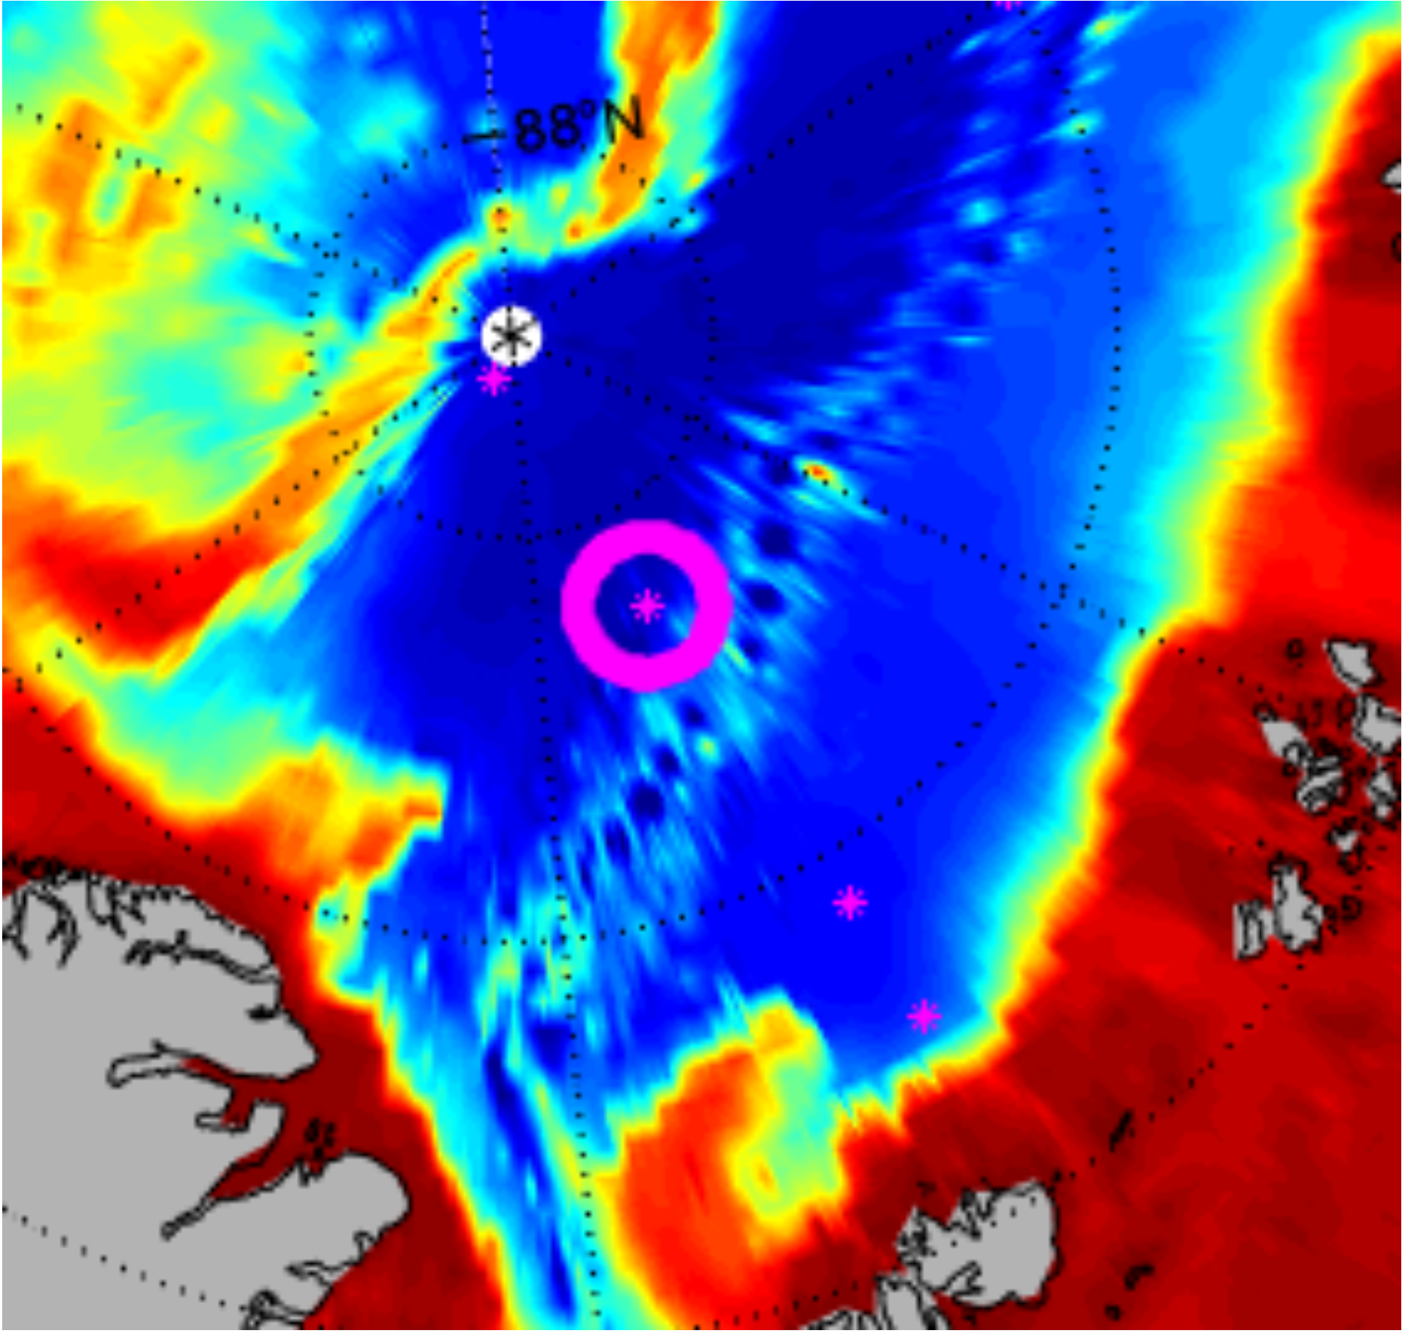
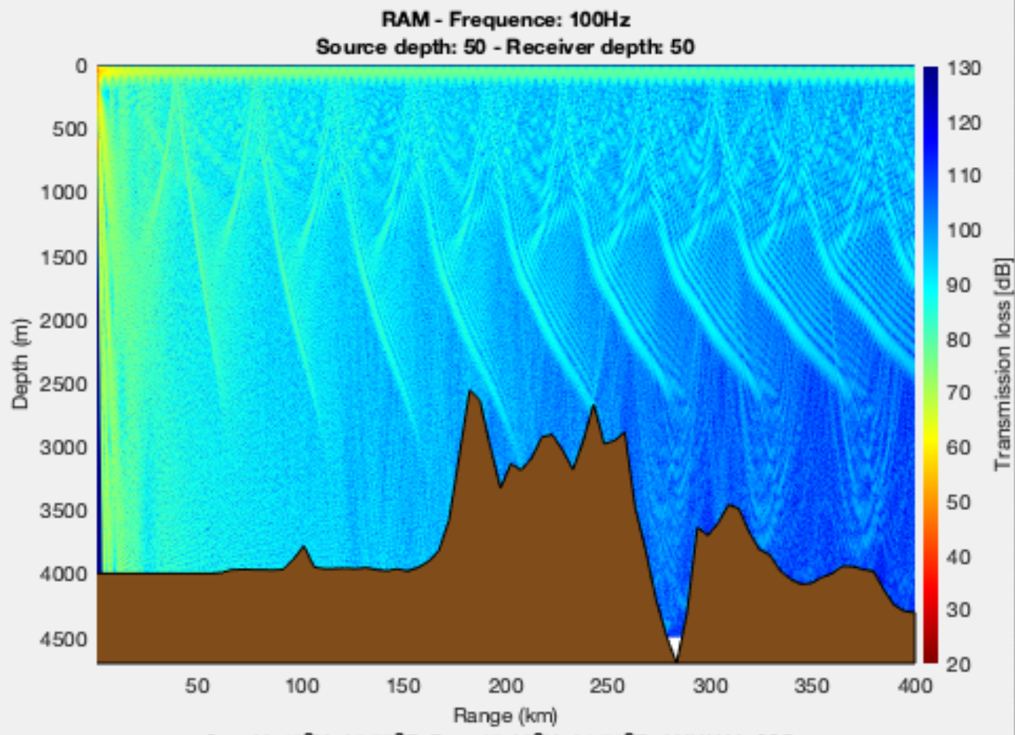
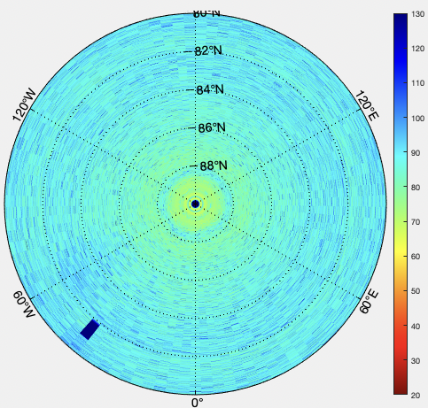
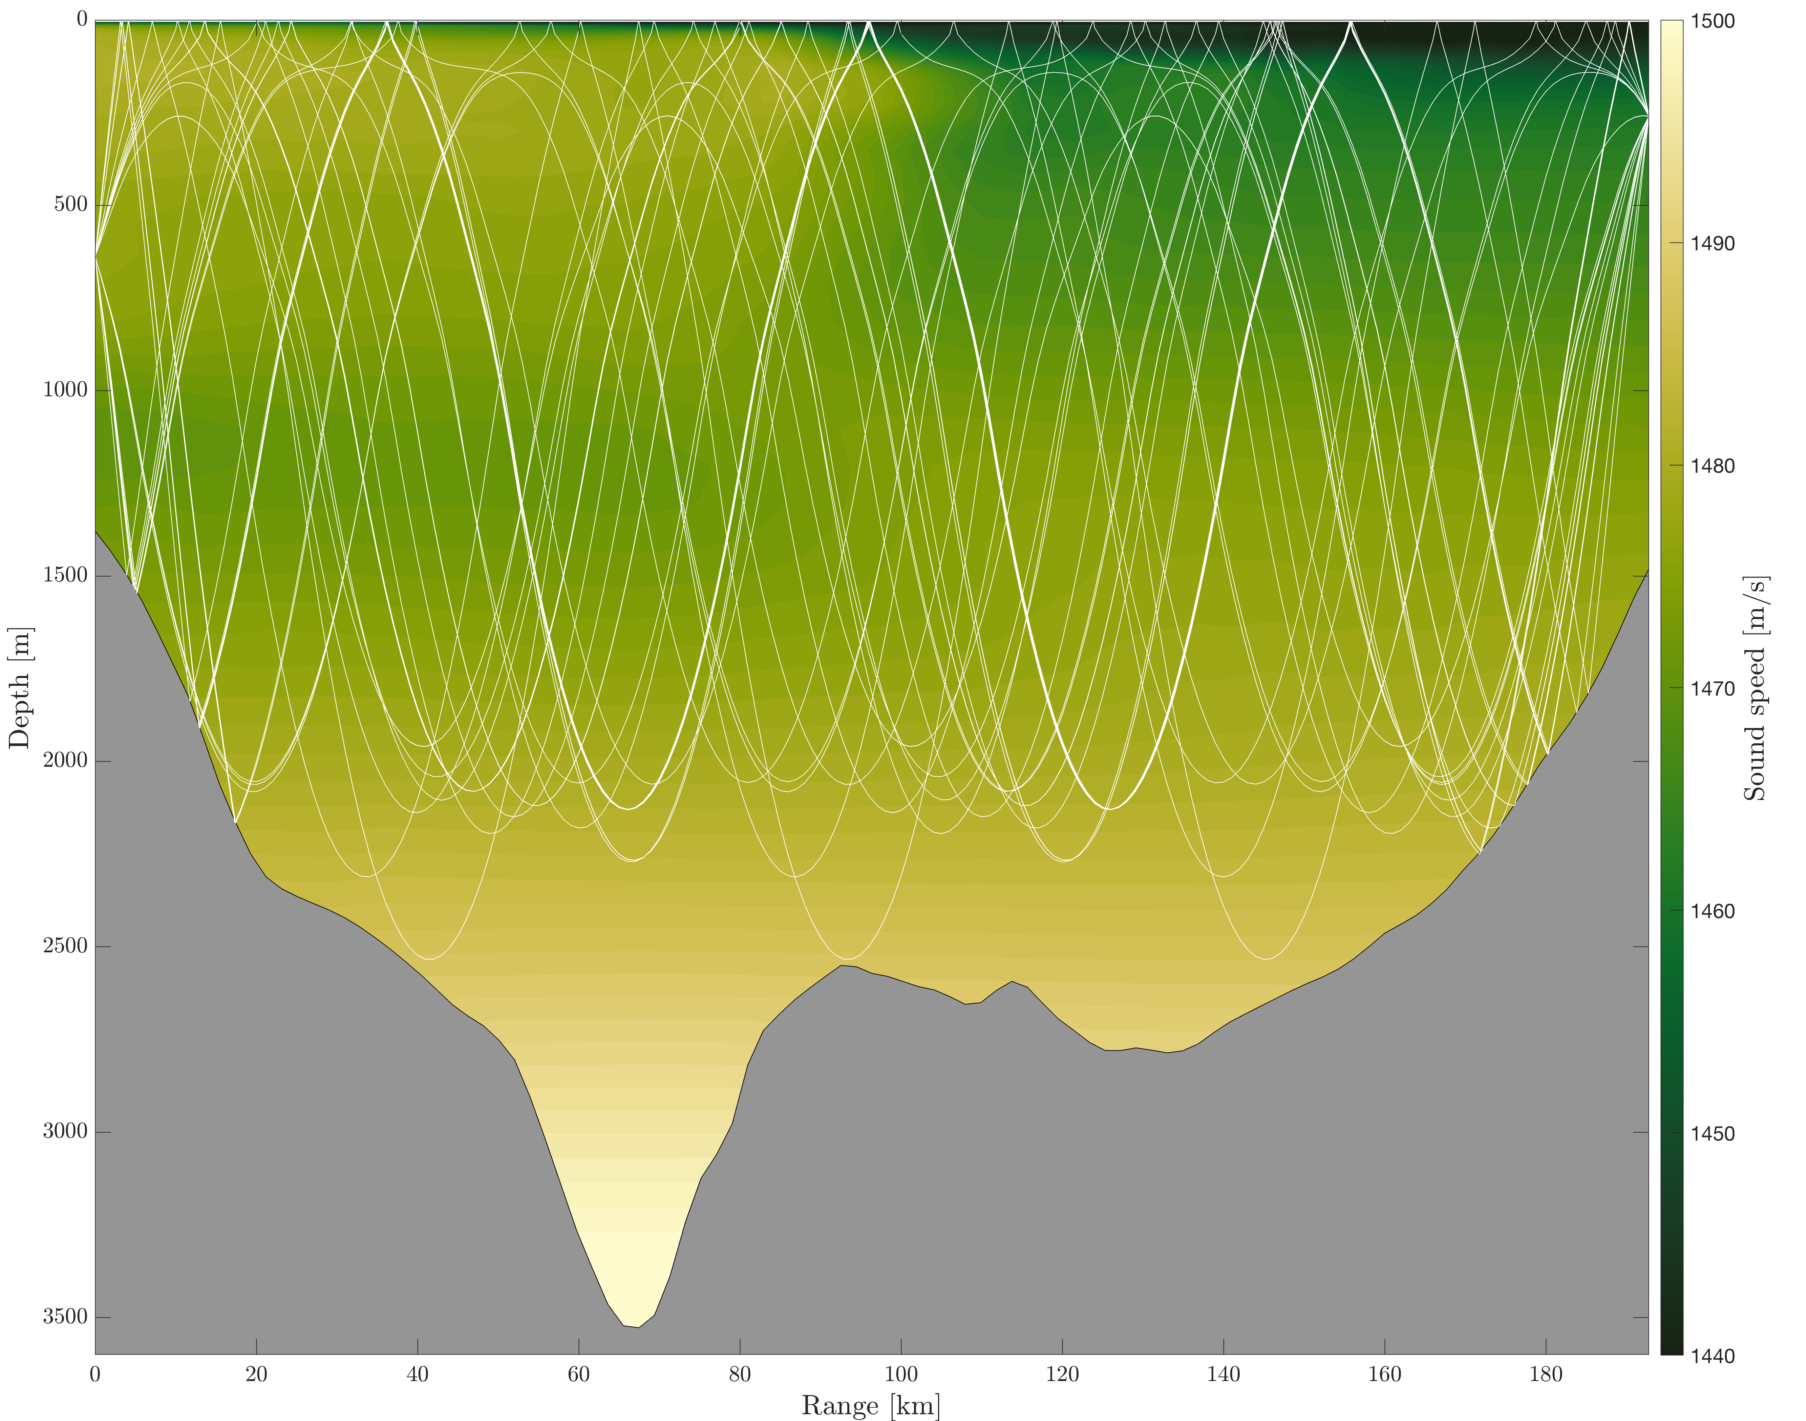
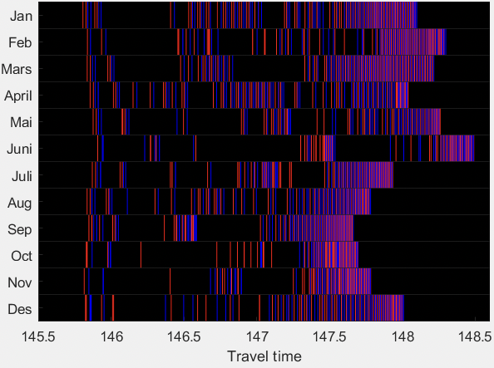
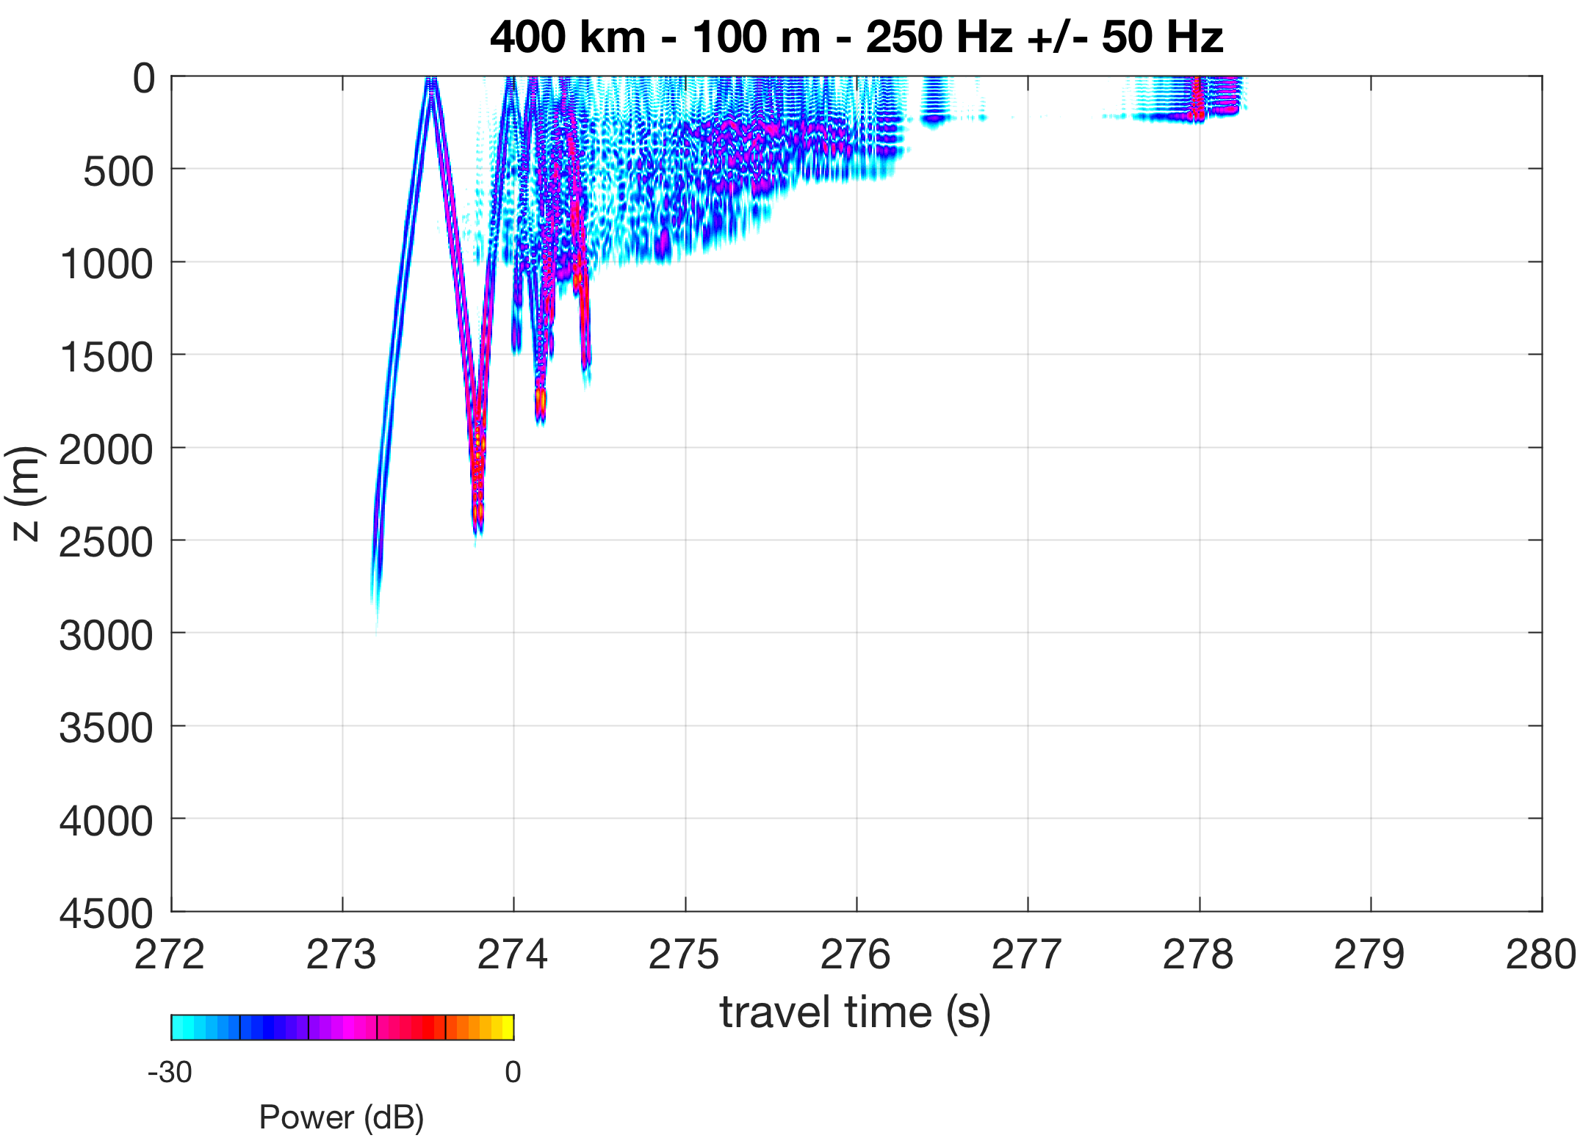
NERSC: Examples of results from acoustic modelling
PE – Transmission loss
F. Klockmann
Ray-tracing
PE – Timefronts
E. Storheim
E. B.V.d.Bergh
E. Storheim

Slide 16
Task 6.3: Report on activities in 2020 and planned work for 2021 (CNRS-IUEM)
Data produced, registration in the catalog
Dataset registered in the catalog. We will make an update with additional figures, deployments maps after the meeting.
Full raw acoustic dataset (2.2 To) on Datarmor SuperComputing Center (Ifremer Research Centre, Brest, France). Link available upon request.
Delays:
Recovery / redeployment of equipment intially scheduled in April 2020 but delayed due to Covid-19.
Recovery / redeployment of equipment intially scheduled in October 2020 but delayed due to Covid-19.
Plans
Next instrument rotation in Spring 2021 and final recovery of all equipment in October 2021.
The 2020 summer/fall acoustic dataset will allow comparing the ambient noise during the pandemic situation (and associated reduced tourist-shipping activity) with previous years.

Slide 17
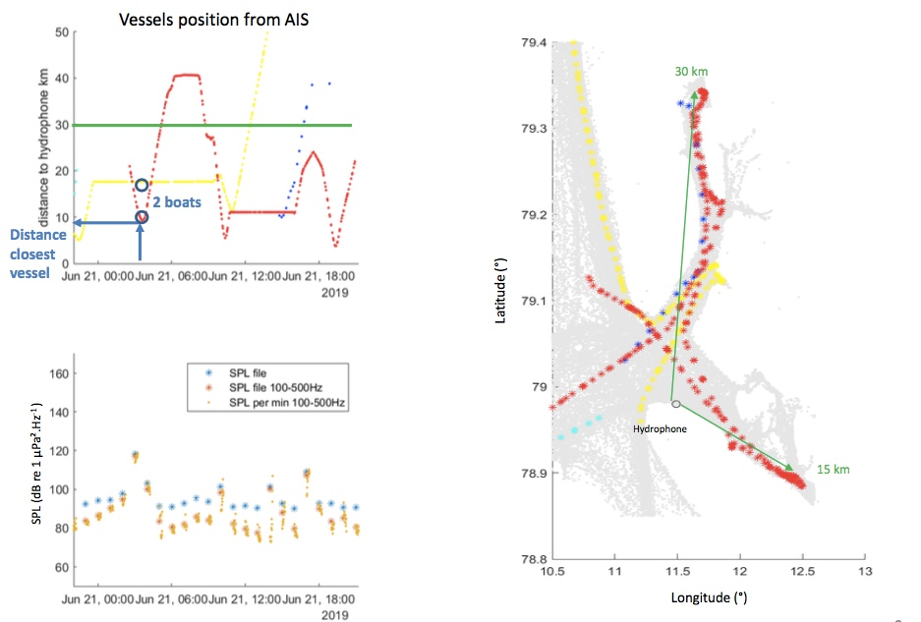
Highlight Underwater acoustics in Kongsfjorden : (CNRS-IUEM)
Describing the soundscape diversity including benthic fauna sounds, marine mammals vocalisations, ice sounds, boat noise, wind/wave noise and monitor changes over time.
1. Anthropophony
Understand the acoustic propagation within the fjord
Collaboration with Rune Roland Hansen, DNV-GL to monitor variation of shipping noises
2. Biophony : Development of a tonal detectors
Example to detect seal vocalizations.
Contour shape of the energetic event should fit with
a regression model (i.e. a polynomial regression)

Slide 18
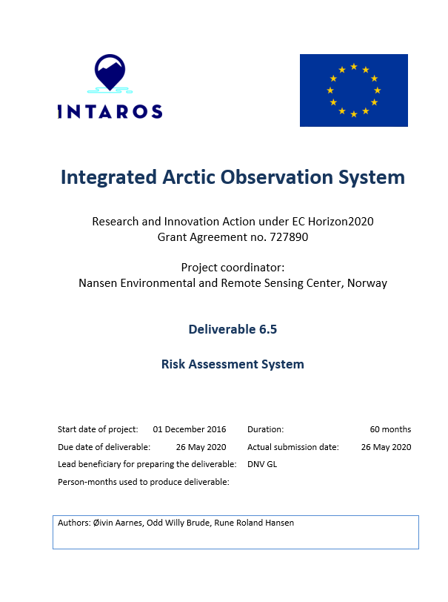
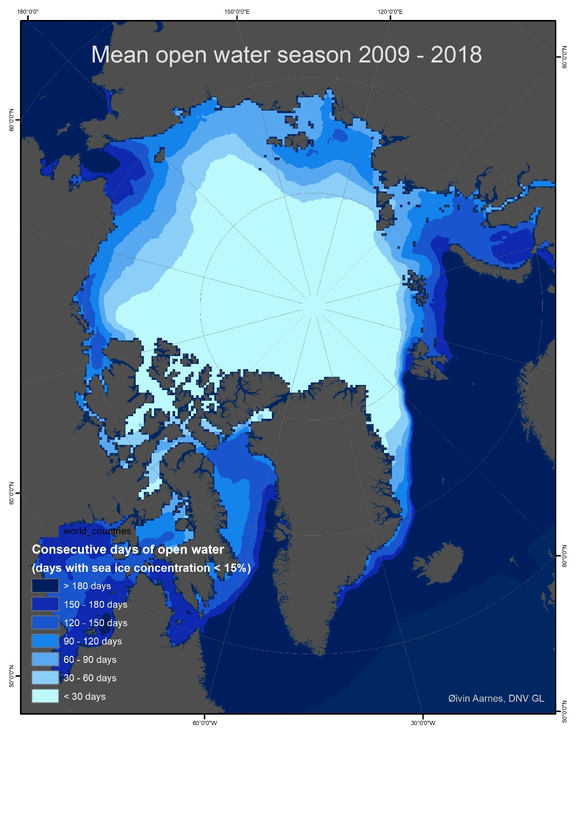
DNV GL contribution
Main results obtained in the last project year (1 Dec 2019 – 30 Nov 2020)
Deliverable 6.5 Draft of Risk Assessment System
Use case(s):
Analysis of historical high resolution ice data (main)
Anthropogenic noise (secondary)
Delays, deviations from the plan and mitigation measures, especially due to COVID-19
Postponed work Q3/Q4 2020 to concentrate effort in 2021 for finalizing Risk Assessment System
Lost main resource on “Anthropogenic Noise” use case
Data produced, registration in the catalogue and access to data in repositories
Implemented UHAM 10-years reanalysis into Risk Assessment System
Exploitation of the results, what has been done and what is the impact
None
Plan for completion of work during 2021, including response to the last review report, if relevant
Complete Risk Assessment System with use case “Sea Ice” and possibly “Anthropogenic Noise”

Slide 19
Activity 5
Activity 5 aims at demonstrating how an improved and sustained Arctic Observing System can support business development, security and efficiency of selected marine and maritime industries
D6.9 Support to Business Planning and Development
3 use cases – transarctic shipping, cruise industry and fishery analysed and described
Statistics on environmental conditions for decision support is in process – good cooperation with DNV-GL
Data sources - OSISAF, EMODNET, CMEMS, JRC
Report due May 2021 – presently no delays
D6.18 Report on Economic benefits
In planning phase
Report due September 2021 – presently no delays

