Slide 1
Task 4.1 | Community Based Monitoring program survey | Nordeco ELOKA/YRITWC/UAF NUIM (EuroGOOS) CSIPN
Activity | Time |  | Partner/place
Reviewed previous survey of CBM programs for connectivity and potential common products | M3-M4 |  | Nordeco ELOKA/YRITWC CSIPN
Discussed with CBM program facilitators and held workshops on capabilities and challenges | M6-M10 |  | Fairbanks May 2017 Nordic, Aug-Oct 2017 Russia, Oct 2017 Ottawa tbd
Draft CBM survey report | M10-M12 |  | All
Revise CBM survey report | M13-M14 |  | All
(additional steps as needed)

Slide 2
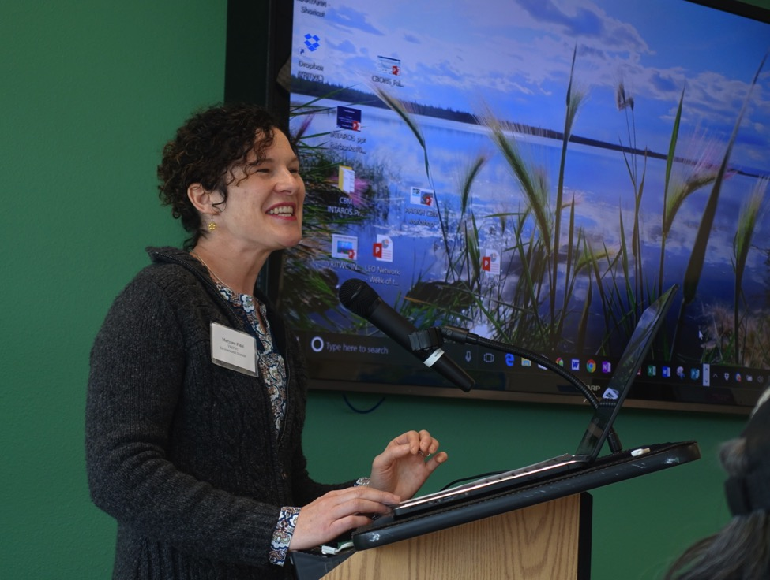

Slide 3
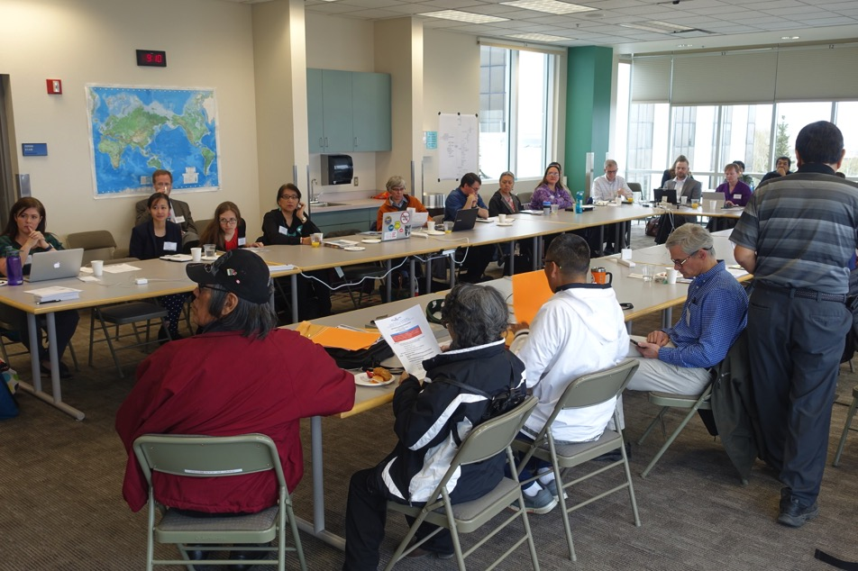

Slide 4
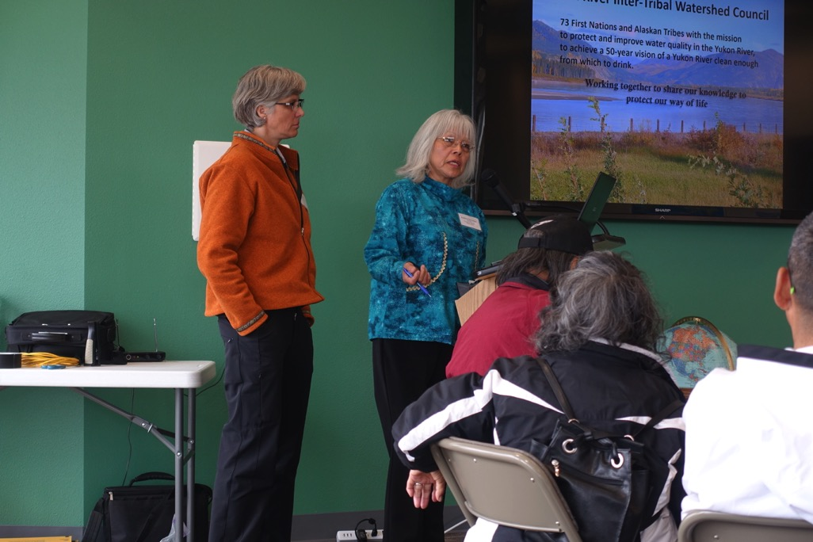

Slide 5
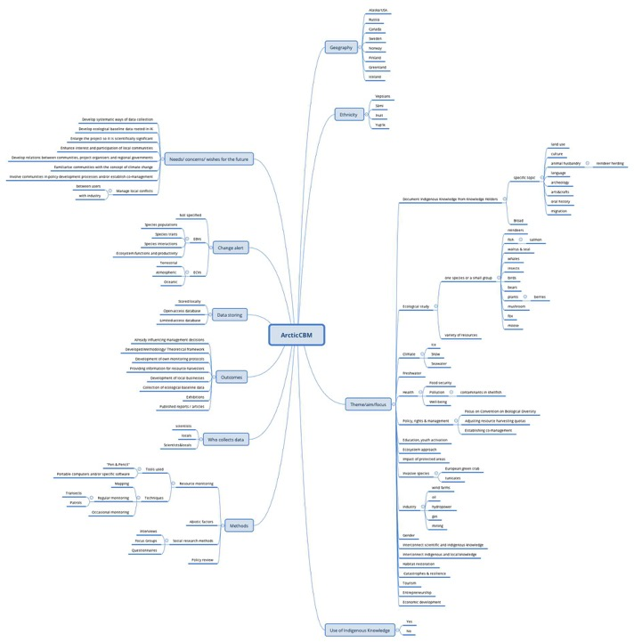

Slide 6
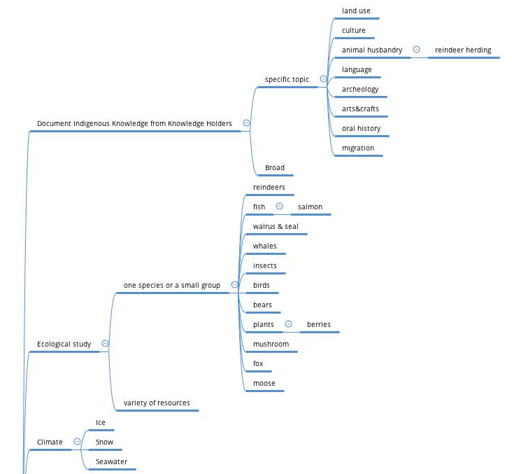

Slide 7
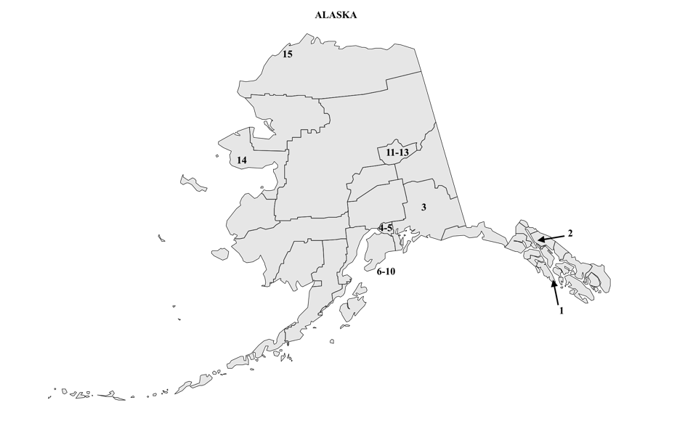
Active Community-Based Monitoring programs
1. Southeast Alaska Long-term Monitoring (SALMoN) Program
2. Discover Alaska's Whales
3. Willow Creek Research Project
4. Alaska Community Action on Toxics (ACAT)
5. Local Environmental Observer (LEO) Network
6-10. Kachemak Bay Projects
11. Community based Permafrost and active layer monitoring program
12. Sea Ice for Walrus Outlook
13. SIZONet Community Sea Ice observing Network
14. Eskimo Walrus Commission
15. COASST (one study site is coastal Alaska)

Slide 8
Active Community Based Monitoring programs
Alaska

Slide 10
Task 4.2 | Web library with examples of Community Based Monitoring program tools and lessons learnt | Nordeco ELOKA, CSIPN
Activity | Time |  | Partner/place
Identifying 5-10 CBM programs for inclusion into web library on tools and lessons learnt Sea Ice for Walrus Outlook Yukon River Community Monitoring Alaska Berries and Youth Arctic Borderlands (provisional list only…) | M3-M10 |  | Nordeco ELOKA
Liaising with CBM organizers on preparing lessons learnt | M6-M10 |  | All
Draft web library | M10-M12 |  | All
Revise web library | M13-M14 |  | All

Slide 11
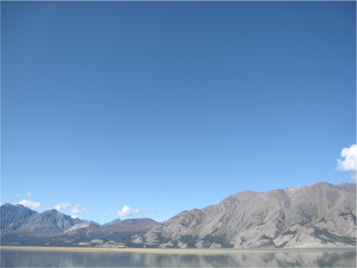
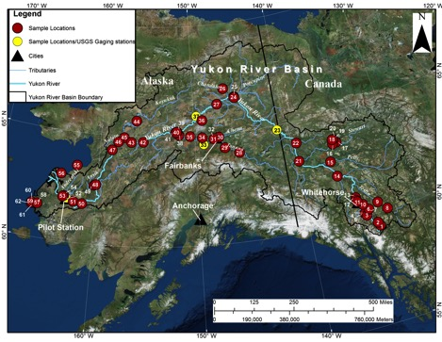
Yukon River
Community-Based Water Quality Monitoring
    - 54 sites, from Atlin to Kotlik (2,400 miles)
    - 1000 samples
    - 30 parameters, 300 community members
Year | Number of Sites | Number of Samples
2006 | 19 | 86
2007 | 27 | 135
2008 | 35 | 183
2009 | 31 | 178
2010 | 33 | 193
2011 | 41 | 139
2012 | 43 | 200
2013 | 38 | 287
2014 | 54 | 239
2015 | 26 | 39
2016 | 35 | 61
Notes:
Collected over 1000 samples
Monitors over 30 different parameters
Over 300 community members have developed capacity to conduct sampling and analysis.

Slide 12
Task 4.3- 4.4 and Task 6.6 | Disko Bugt and Svalbard: Piloting CBM tools Cross-weaving data, and policy brief | Nansen/Nordeco UiB/GEUS AU ELOKA
Activity | Time |  | Partner/place
Identify key challenges in each community with the local government authority. Jointly develop criteria for CBM tools that could be tested. Prioritize women, youth. | M10 |  | Nansen/Nordeco, UiB/GEUS, AU
Invite CBM tool facilitators to test their tools. | M12 |  | Nansen/Nordeco, UiB/GEUS, AU
Assess the proposals w/ local authorities (additional steps here) | Several |  | Nansen/Nordeco, UiB/GEUS, AU
Field testing | Yr2-3
Lessons learned report | M42 |  | Nansen/Nordeco, UiB/GEUS, AU
Workshop, cross-weaving, and policy brief | M50 |  | All

Slide 13
Task 7.7 | Experience exchange workshops | ELOKA/YRITWC/UAF Nordeco CSIPN
Activity | Time |  | Partner/place
1) Experience exchange workshop Fairbanks 2) Int’l Arctic Assembly Day (live streamed) 3) ’Open Dialogue’ w/Senior Arctic Officials + | M6 |  | Fairbanks May 2017 ELOKA/YRITWC/UAF
Experience exchange workshop, Canada | tbd |  | Ottawa ELOKA/YRITWC/UAF
Experience exchange workshop series, community level, Russia | Several |  | CSIPN Nordeco
Proceedings of experience-exchange workshops | Tbd |  | All

