Slide 1
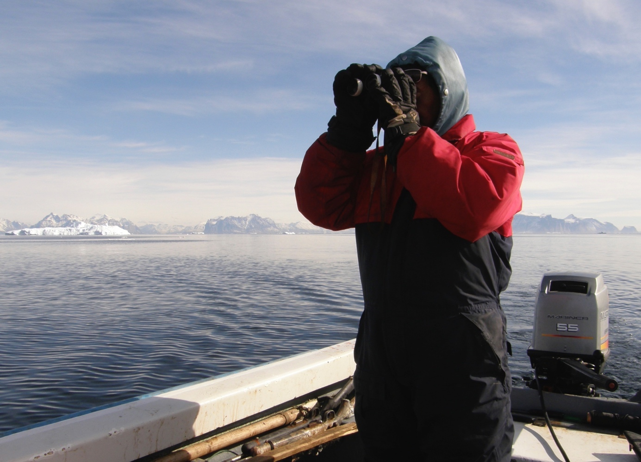
Finn Danielsen
Lisbeth Iversen
Work Package 4

Slide 2
WP4 Community-based observing
Aims Enhance community based observing programs for participatory research and capacity-building
T4.1 Survey Arctic CBM programs
T4.2 Prepare CBM toolkit
T4.3 Pilot CBM networks Greenland & Svalbard
T4.4 Enter CBM data into repositories
T6.6 Policy brief to decision-makers Disko and LYB
T7.7 Develop CBM capacity
CBM = Community Based Monitoring

Slide 3
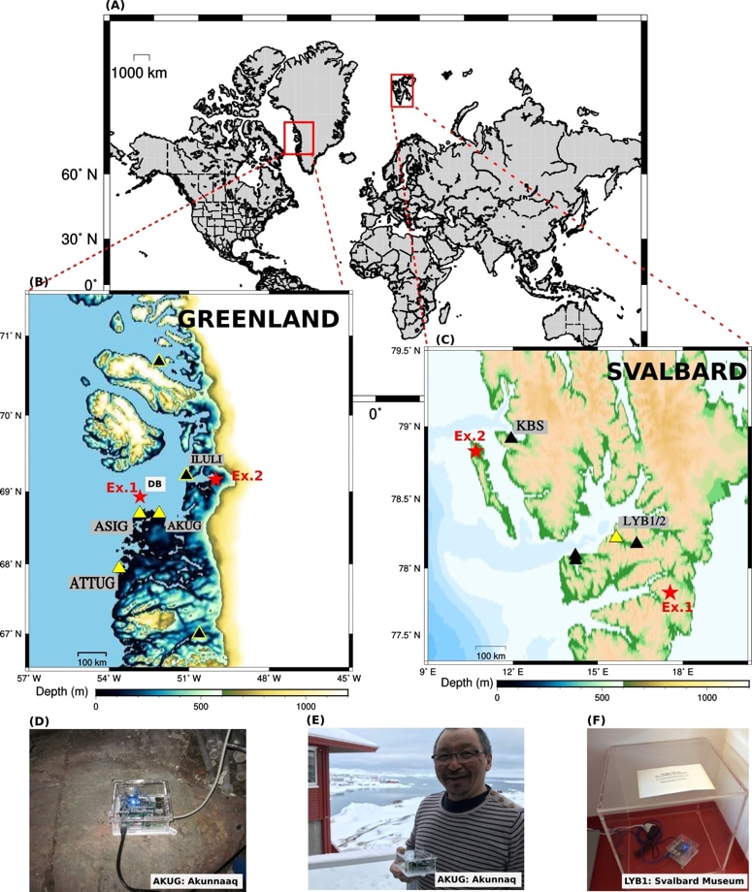
T4.3 Pilot CBM networks
With fishermen and hunters,
led by GEUS - UiB
D4.3
Improved detection and data support for understanding seismic events

Slide 4
Dialogue: cruise operators, scientists, decision-makers
T4.3 Pilot CBM networks
Photo: M.K. Poulsen
Longyearbyen, March 2019
Report available at:
http://www.intaros.eu/media/1635/2019-report-aeco-workshop-v4.pdf

Slide 5
Example of data from expedition cruise operators Anser brachyrhynchus Pink-footed Goose records in Svalbard 2002-2019 (n = 583 records) Flames: Areas with multiple records. Source: eBird database
Pilot tests of 4 CitSc programs
Improved data support for understanding the status of wildlife

Slide 6
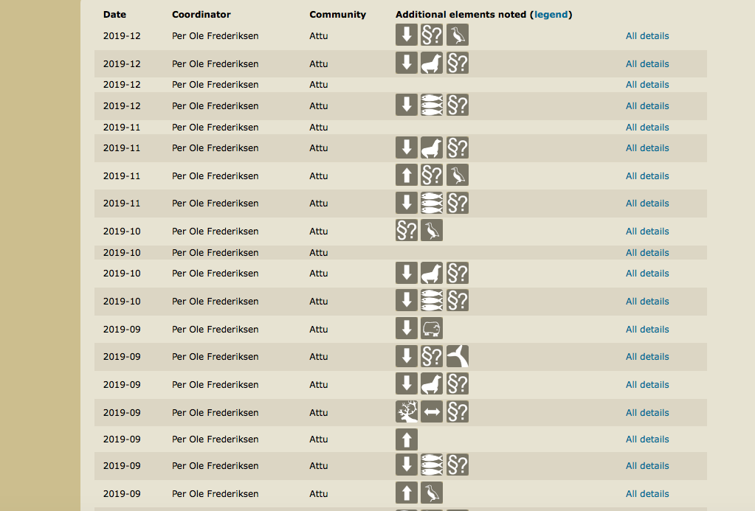
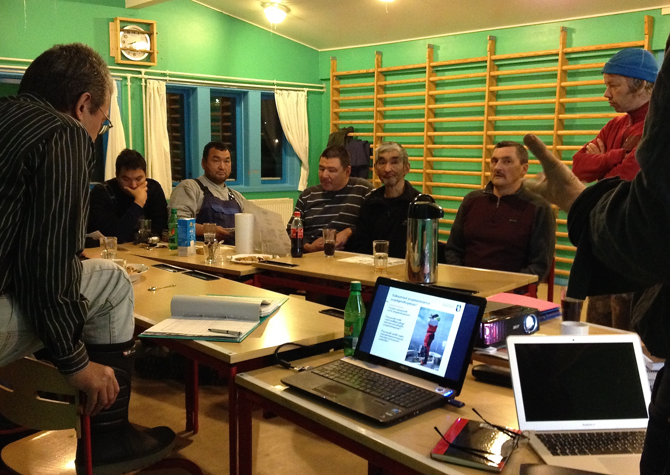
Improved detection and data support for understanding trends in resources
T4.3 Pilot CBM networks Greenland & Svalbard
D4.3
Delays and deviations

Slide 7
T4.3 Pilot CBM networks Greenland & Svalbard. D4.3 Svalbard
Local Council dialogue
Dec. 10-11 2020: Arranged the first digital part of the planned workshop granted by Svalbard Strategic Grants. The next part is planned to be hosted in Longyearbyen in Oct/Nov 2021, with local and international stakeholders.​
Oct. 21 2020: Arranged a seminar with presentation of the INTAROS WP4 activities at the Arctic Innovation Week:​
https://www.facebook.com/svalbardsocialscience/photos/gm.267765157869581/1442990775896036​
​
Oct. 2020. ECO Magazine article co-written by several SSSI members, incl. Lisbeth Iversen, about social science, humanities and arts research in Svalbard
http://digital.ecomagazine.com/publication/frame.php?i=674747&p=126&pn=&ver=html5
SSSI is supported by the Research Council of Norway, through NERSC and the UAK project, and by H2020 through INTAROS .

Slide 8
T4.3 Pilot CBM networks Greenland & Svalbard. D4.3 Svalbard
Local Council dialogue
Sep. 23 2020 Kick-off, collaboration with SVALUR
A digital kick-off meeting with the project SVALUR – Understanding Resilience and Long-Term Environmental Change in the High Arctic: Narrative-Based Analyses from Svalbard. This will combine environmental monitoring with people’s knowledge on environmental change on Svalbard
May 4 2020 Digital meeting with the planning director in the Local Council: How is life now in Longyearbyen during the Covid 19 Pandemic. Topics to addressed, collaboration to be started.​
May 2020 Launch of Longyearbyen Community Dialogues SSSI has been partner with local actors in the establishment of this forum where we can discuss various issues that are fundamental for the wellbeing of Longyearbyen as a community. Events May 27, Sep. 17 and Dec. 9, 2020​
Feb. 24 2020 Svalbard Social Science Initiative became an organization Admin support organization contact person for NERSC/ INTAROS-Iversen. New and updated webpage https://svalbardsocialscience.com/ (Led by Lisbeth Iversen)
Improved dialogue for urban environmental planning and CBM

Slide 9
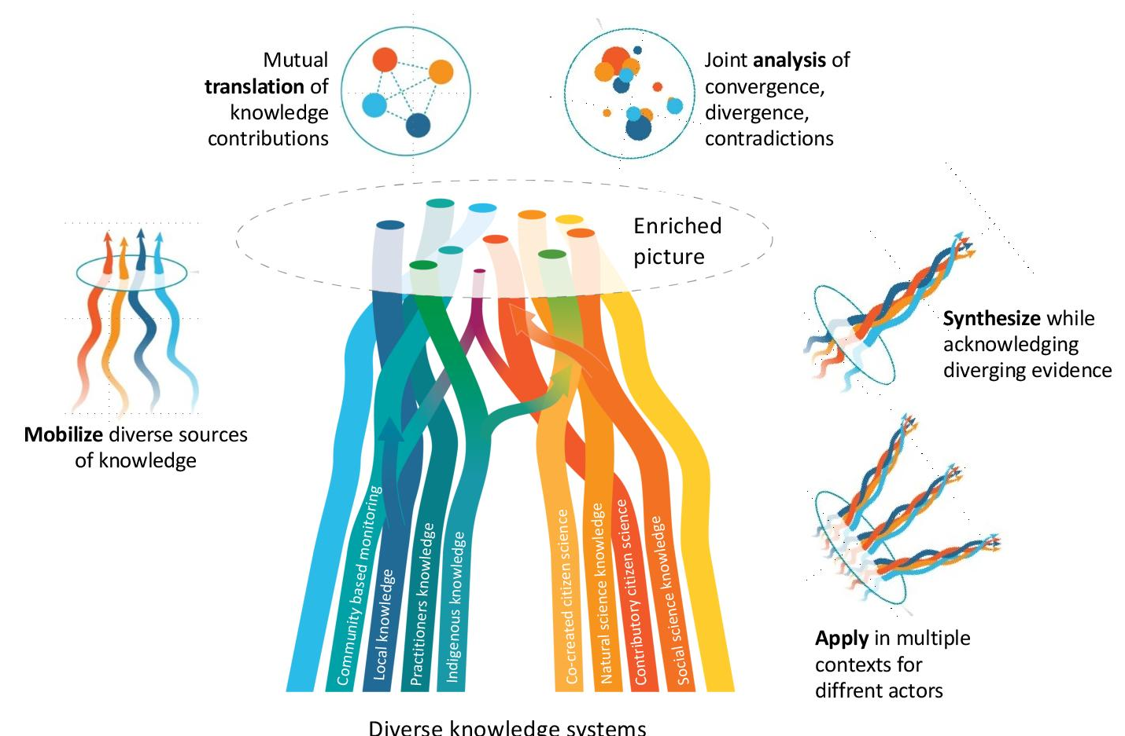
T4.4 Enter CBM data into repositories
D4.4
Illustration of a Multiple Evidence based model
for the use of knowledge for ecosystem management
Tengö et al. BioScience in press. With Stockholm Resilience Centre

Slide 10
T4.4 Enter CBM data into repositories
D4.4
INTAROS Data discovery portal
15 CBM and citizen science data collections

Slide 11
Publications
2020
Monograph
published by University of Alaska Press
(available
Feb. 2021)

Slide 12
Special Section in BioScience, four papers (3 in press)

Slide 13
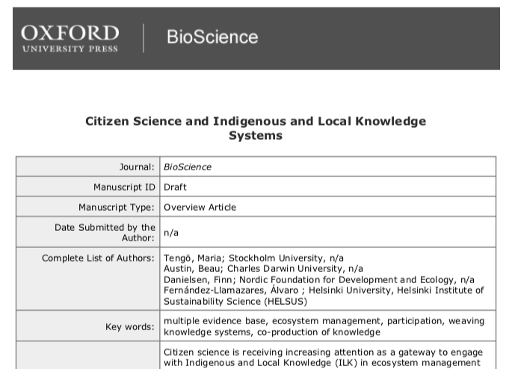

Slide 14
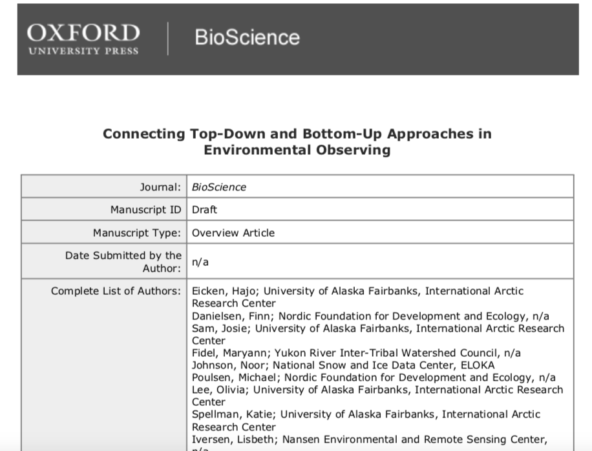

Slide 15
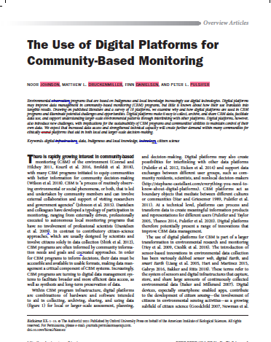

Slide 16
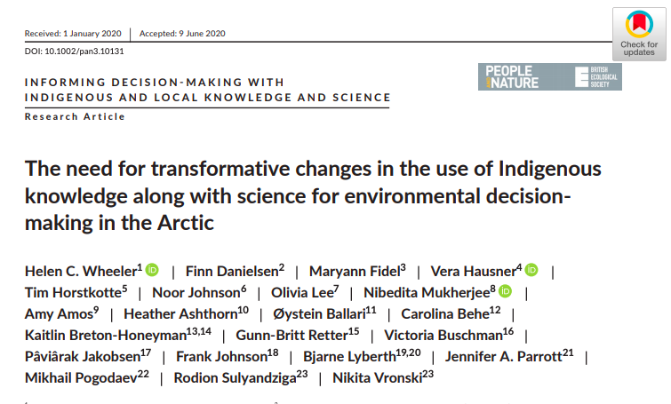
People and Nature

Slide 17
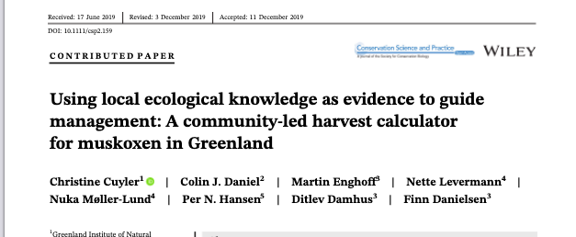
Conservation Science and Practice

Slide 18
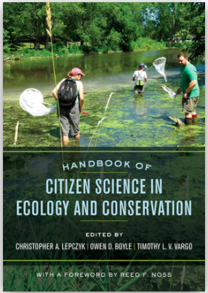
Book-chapter: ”Current approaches to Citizen Science”, published by Univ. of California Press

Slide 19
Frontiers in Earth Science led by Zeinab Jeddi of GEUS/UiB

Slide 20
Five presentations from WP4 at AOS 2020

Slide 21
Delays and deviations
Exploitation of the results, and impacts
Response to the last review report
Plan for completion of work during 2021
- Workshops, revision of D4.3
- Finalization of D7.7
- Further follow up to enhance impact

Slide 22
IMPACTS of the CBM work in INTAROS
A Changed policies
1 Fingerprints in Joint Statement of Ministers AOS2
2 National government CBM policy underway in one country
3 Yakutia examples
B New organizations
1 UArctic Thematic Network on Collab Mngt, AOS side-events
2 UN-”one step entrypoint” for citizen science (GCSP)
C International prize
Nordic Council Environment Prize
Global Entrepreneurs Prize New!
D New educational programs
New course in Greenland w. Greenland Climate Centre
E Invitations high level fora (several, eg. AOS Davos)
F Media visibility TV, radio, Prime Ministers New Year Talk,
hundreds of newspaper and social media stories
G New projects (multiple)

Slide 23
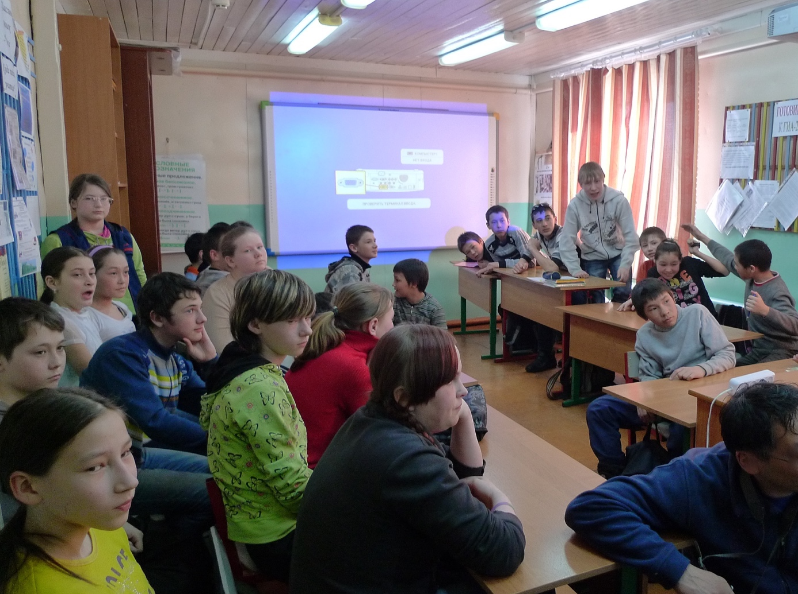

Slide 25
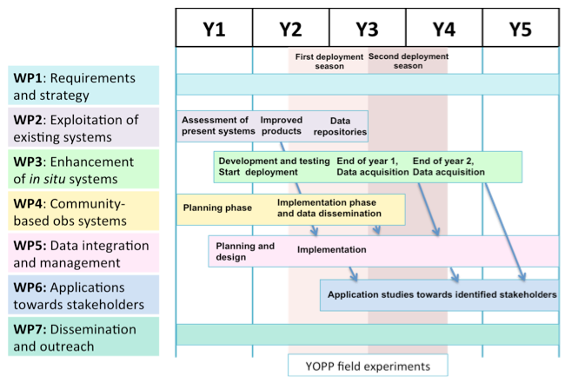
WP4 Community-based observing

