Slide 1
WP3.1
Coastal Greenland
Enhancement of multidisciplinary in situ observing systems: results and further work
Lead: GEUS, Andreas Ahlstrøm
Contributors: AU, FMI, UPM, CNRS-IUEM, CNRS Takuvik

Slide 2
WP3 report & plan
AU
Duration of sea-ice cover and input of glacial meltwater and runoff from land are key drivers of ecosystems in Greenland fjords and coastal waters. These factors also impact the uptake of CO2 by increasing vulnerability to ocean acidification. We will enhance and complement existing monitoring systems with novel solutions, both in terms of instrumentation, platforms and logistics. For the Northeast Greenland site, a combination of ocean moorings with new solutions to obtain coverage, duration, thickness and energy balance of snow cover on sea ice will increase knowledge of how freshening of the Arctic impacts the marine ecosystem. For the entire Greenland coastal zone, we will establish an essential baseline dataset on surface pCO2 and ocean acidification enabling future monitoring of the impact of freshening on CO2 uptake of the ocean. Whenever possible it will be considered if community-based approaches can contribute observations and knowledge through exchange of experiences with NORDECO, Task 4.3 of WP4, on community-based observing in Disko Bay.

Slide 3
AU –coastal Greenland
Field work (on schedule)
  Moorings retrieved in August 2020 and redeployed. Expect to retrieve in August 2021 which will result in 3 years of consecutive data. Data available at Greenland Ecosystem Monitoring Programme database
New collaboration initiated with FMI
  Simba buoy deployed in Young Sound in November 2020. Provide online data on air temperature and snow and sea ice thickness. Data at SAMS/FMI website.
(Figure by Cheng Bin, FMI)
Mooring, Young Sound Aug., 2020
Simba, Young Sound, Dec, 2020
Notes:
In Figure; red line is air temp, black line is snow depth, Green line is sea ice thickness

Slide 4
AU –coastal Greenland
Data exploitation (minor delay related to Covid-19)
  Three INTAROS papers published in 2020 and two submitted
  Paper on ocean acidification and surface pCO₂ from East Greenland shelf in prep
  Paper on sediment biogeochemistry near glaciers in prep.
  Circum-Arctic paper on drivers of coastal marine ecosystems in prep.

Slide 5
WP3 report & plan
GEUS
To monitor the meltwater output to the ocean from the Greenland ice sheet, we will implement a novel ruggedized system adding to the existing on-ice weather station network for snow-water equivalent on the ice sheet margin. This will enable us to capture meltwater retention mechanisms in the snow and firn on the ice, a main uncertainty in modelling of future ice sheet runoff.
Obtaining precise positioning of the same on-ice sheet network will provide much needed calibration for satellite-derived ice velocity maps used to calculate the ice-dynamic mass loss to the ocean. An improved methodology for correction of in-situ ice sheet albedo measurements will be developed (collaboration with FMI)

Slide 6
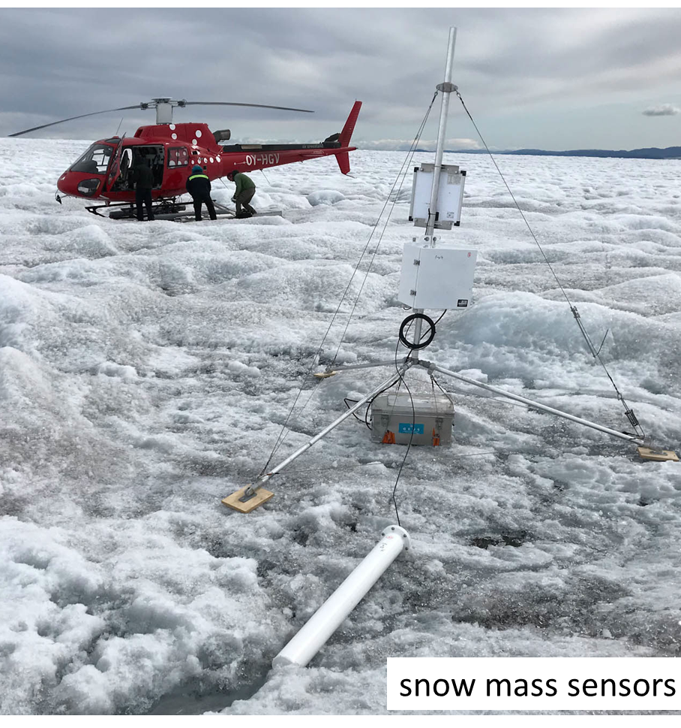
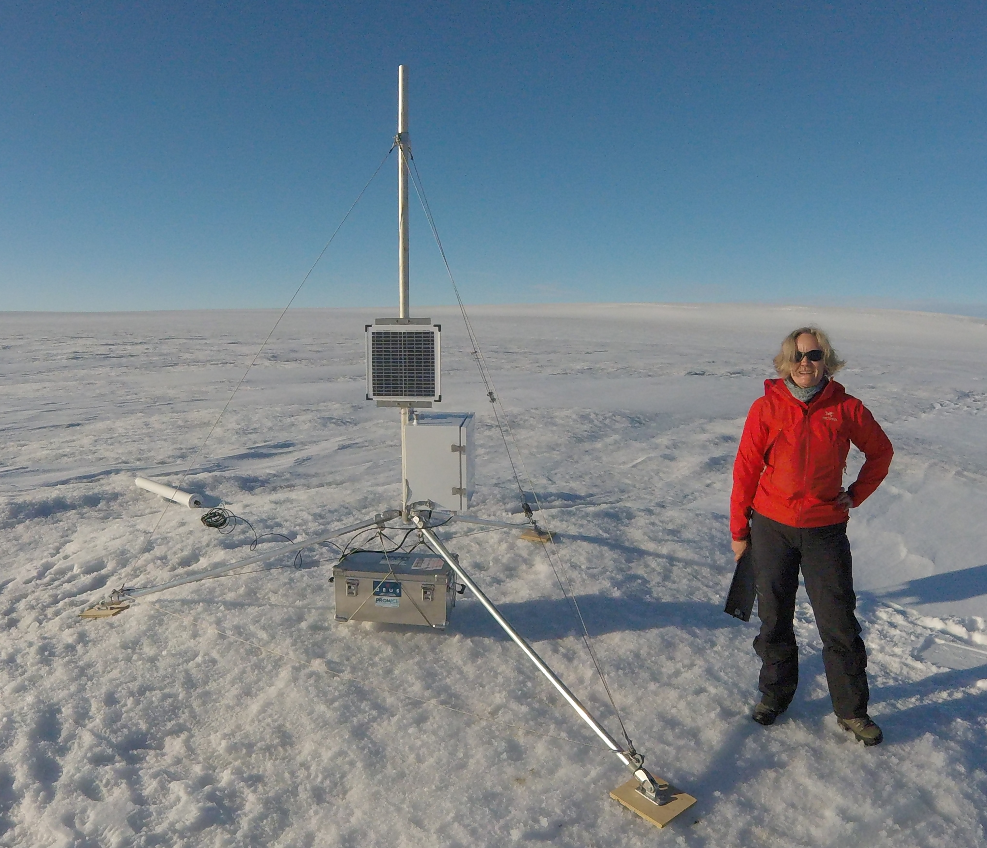
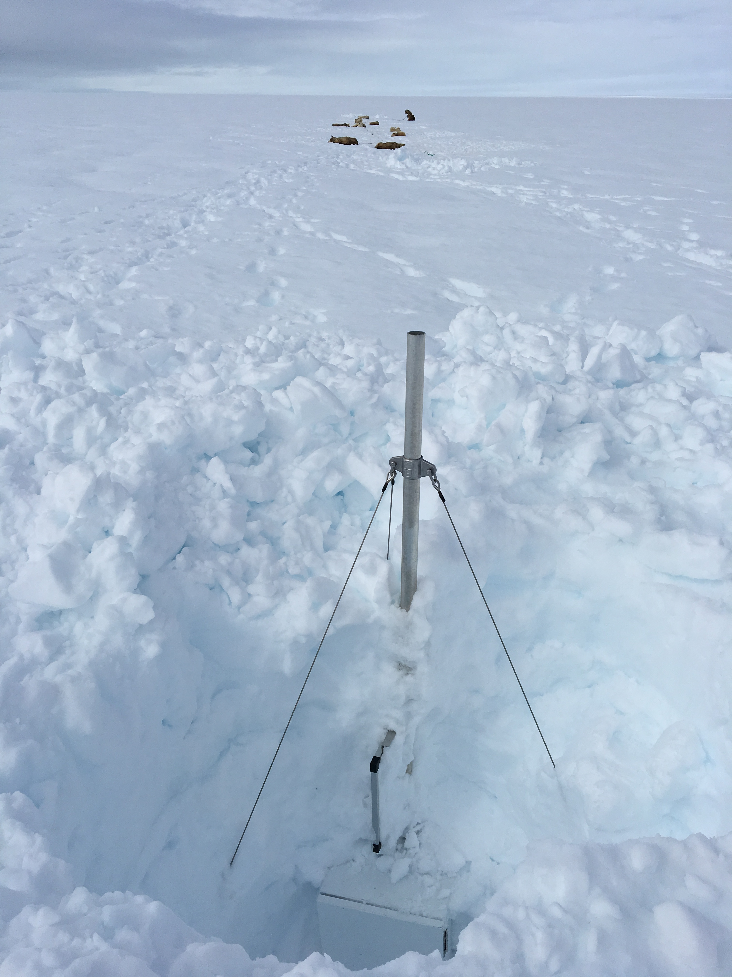
GEUS:
Snow water equivalent (SWE)
Five SnowFox instruments (water-equivalent of above-lying snow from attenuation of cosmic-ray neutrons) deployed on the Greenland ice sheet in summer 2018

Slide 7
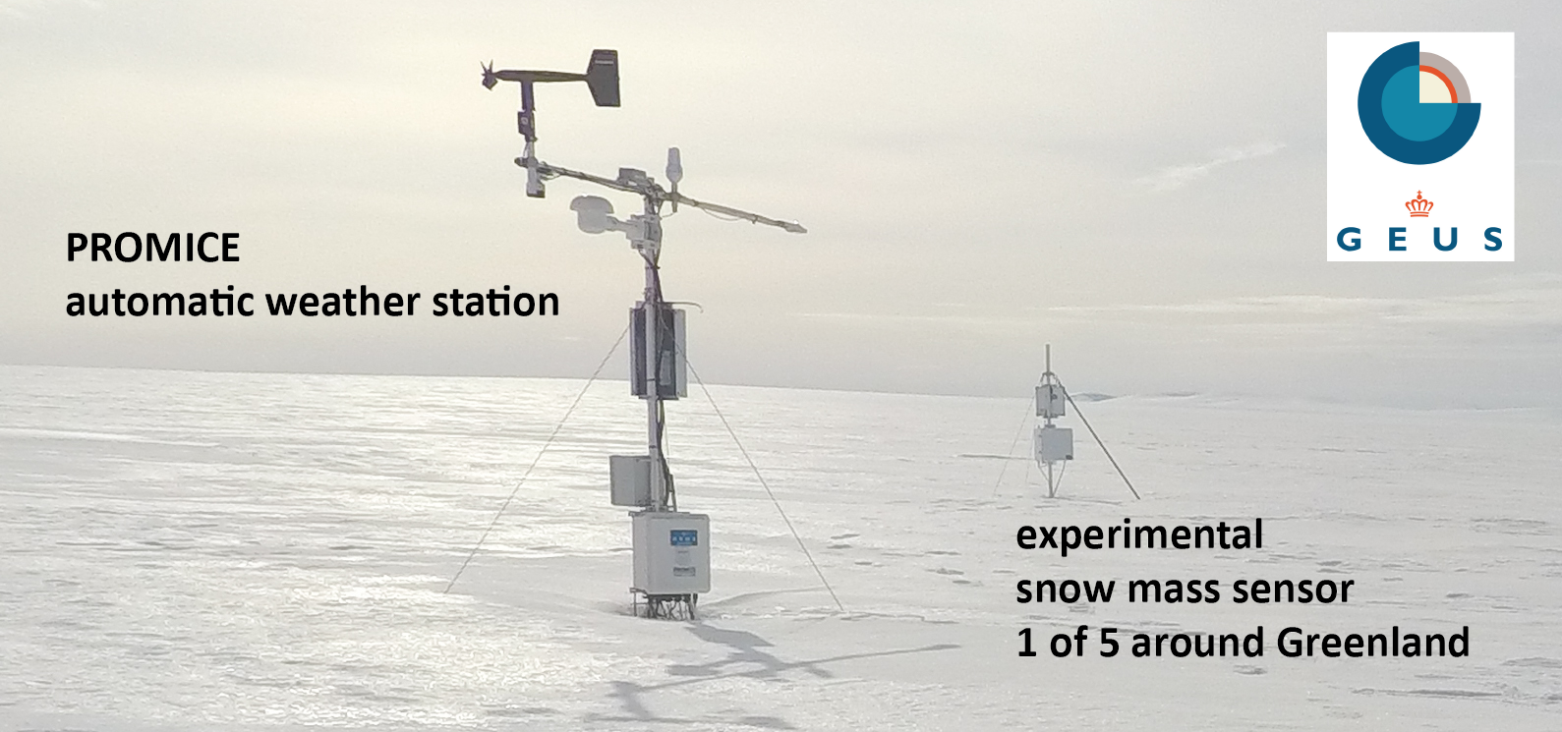

Integrated Arctic Observation System

Slide 8
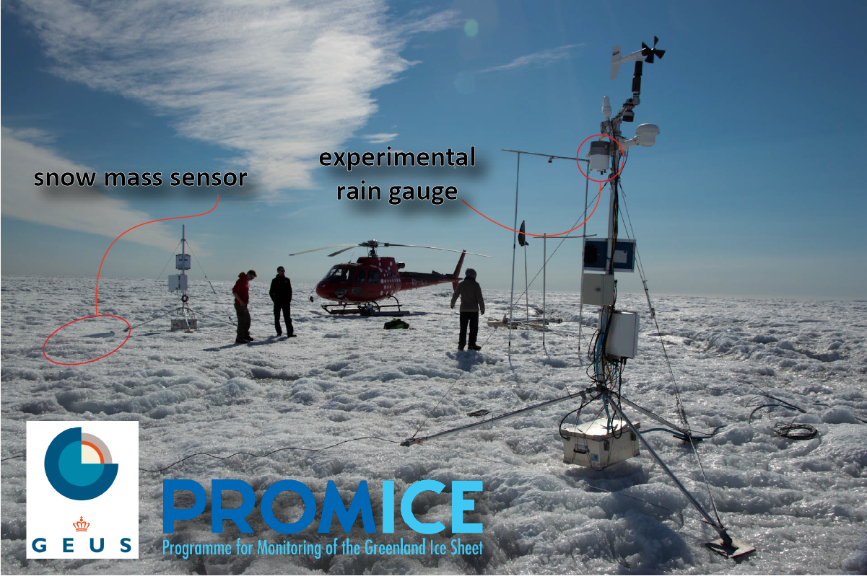
Integrated Arctic Observation System

Slide 9
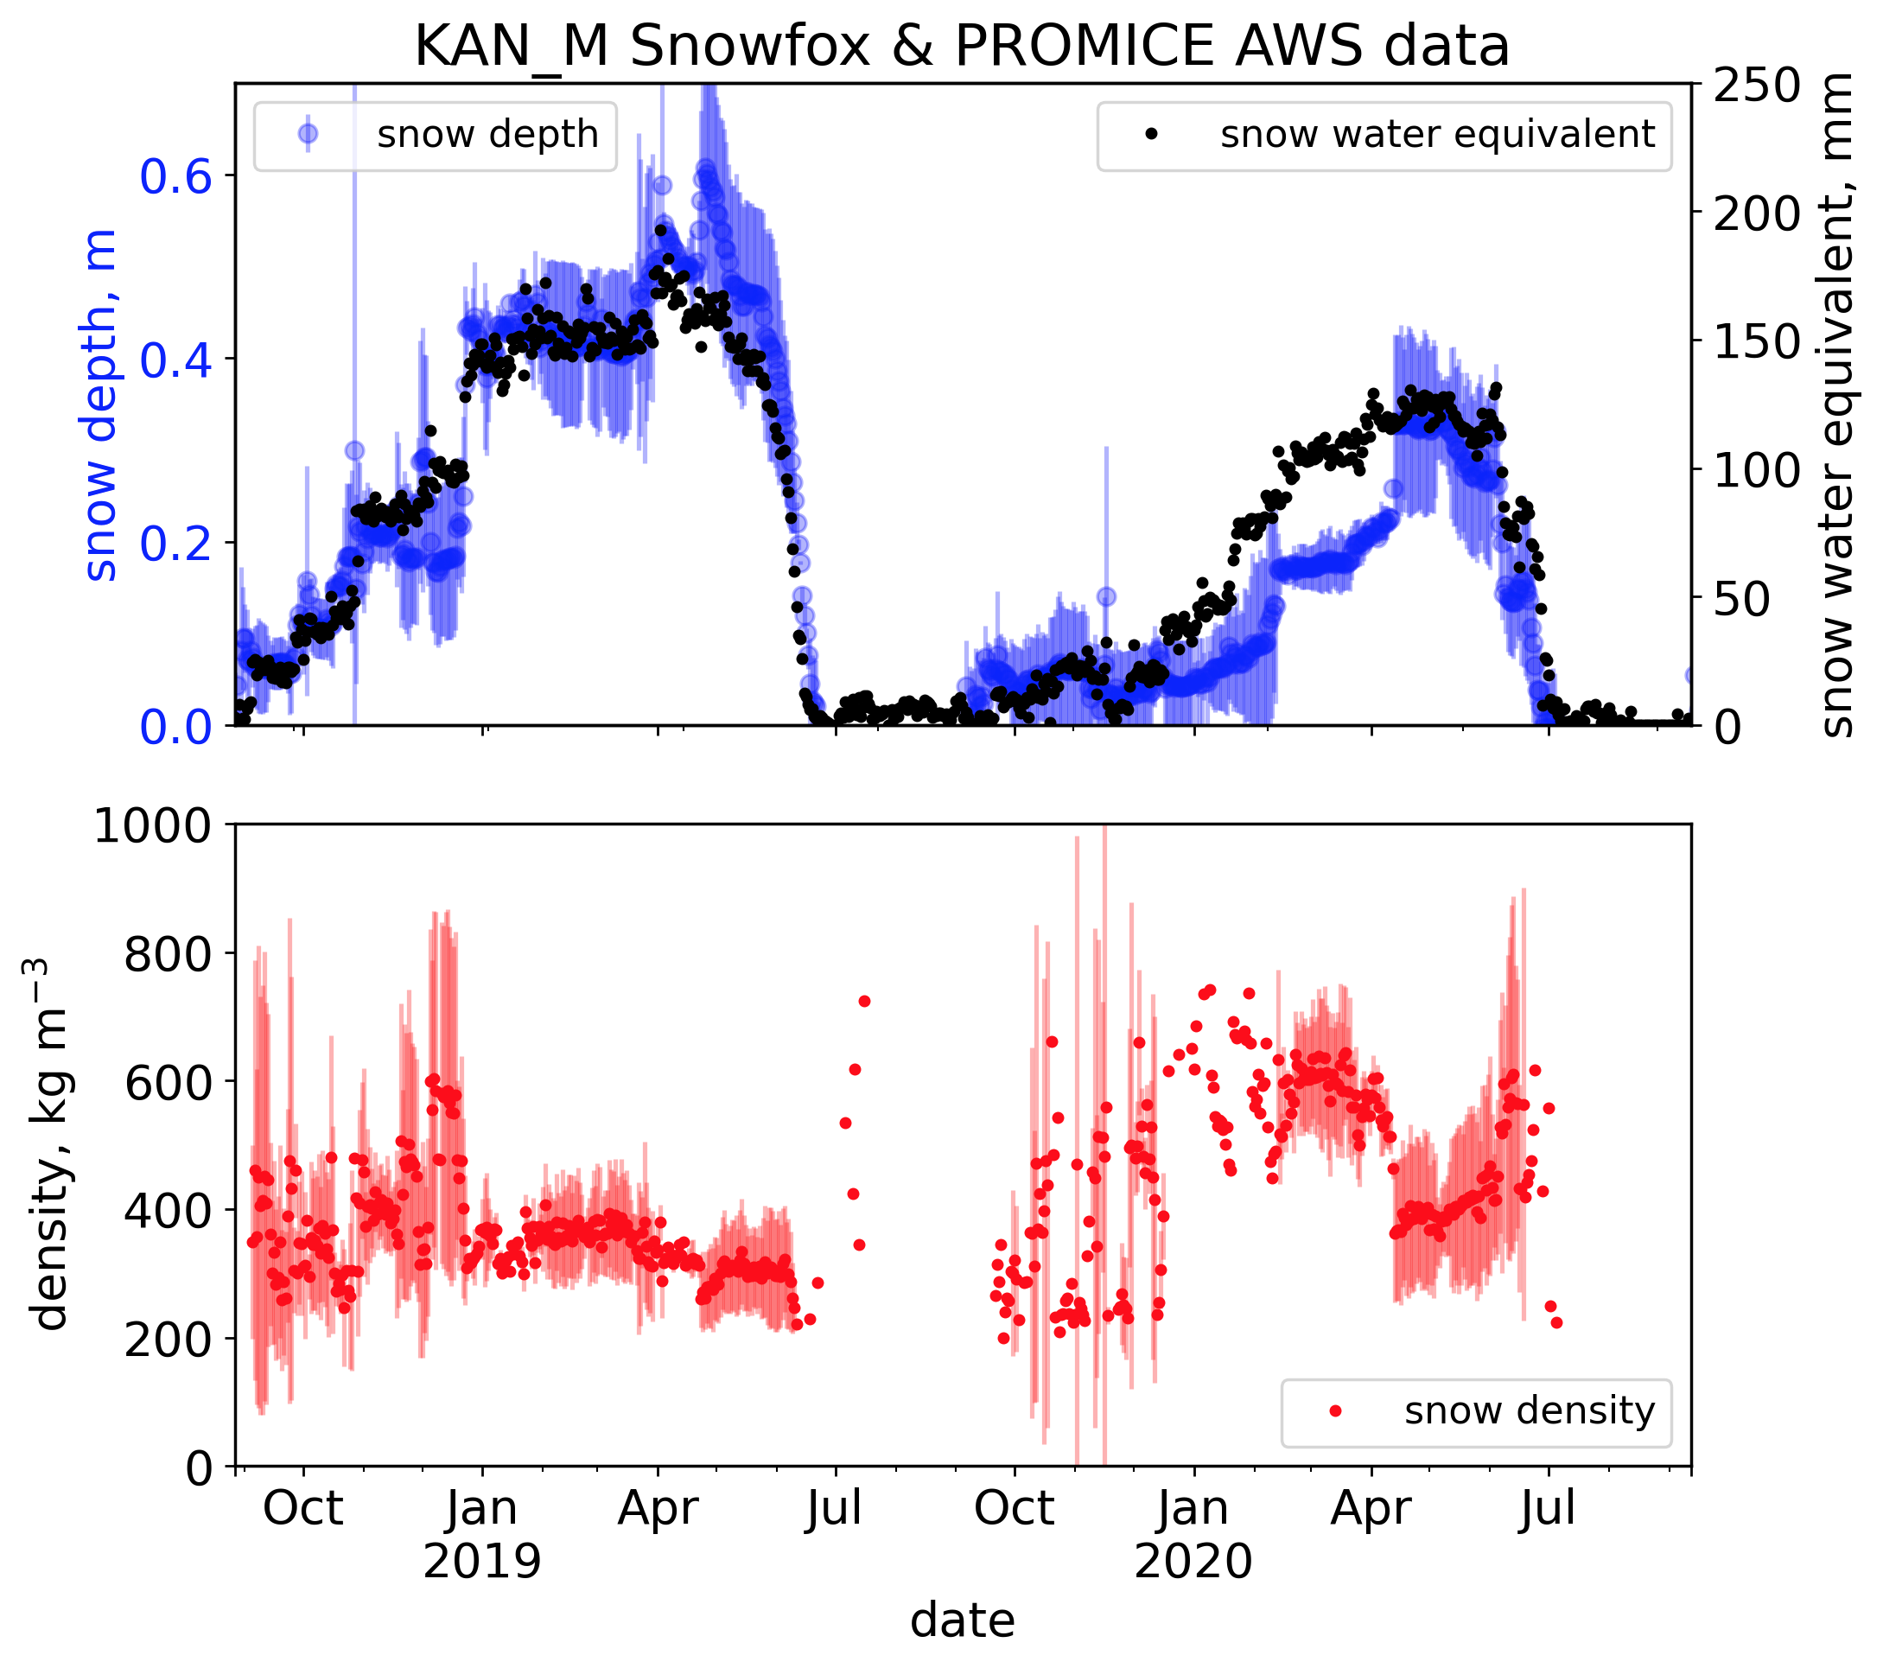
4 Snowfoxes operating in the ablation area of the Greenland ice sheet.
Successful SWE measurements from all instruments.
Power problem when the solar panel gets buried creating data gaps
Data is so far not publicly available, but is available on request
No exploitation of the data so far.
Plans for 2021
  Dataset publicly available
  Write dataset paper

Slide 10
INTAROS High Accuracy GNSS AWS positioning
Motivation
provide in situ validation data for satellite SAR velocity & altimetry products
constrain elevation of barometer for downsream weather prediction users of near real time pressure
support local strain network for ice dynamics

Slide 11
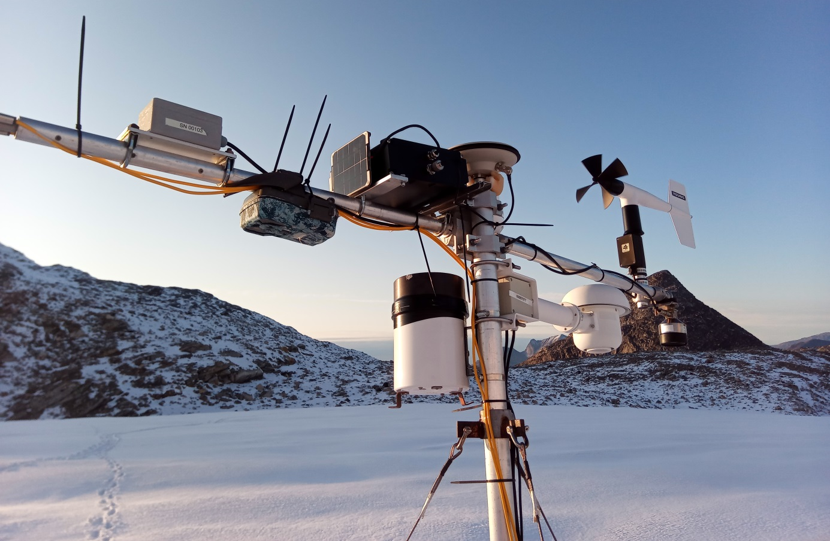
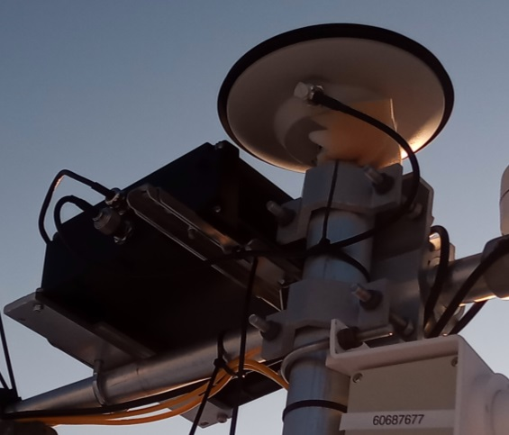
Update on GNSS development and deployment
Deployment started in summer 2019, photo shows NUK-K PROMICE/GEM station on Qasigiannguit glacier. This is a standalone version so there is no cable to the AWS datalogger.
INTAROS dual/triple freq GNSS receiver, controller and battery
2W solar panel
GNSS antenna

Slide 12
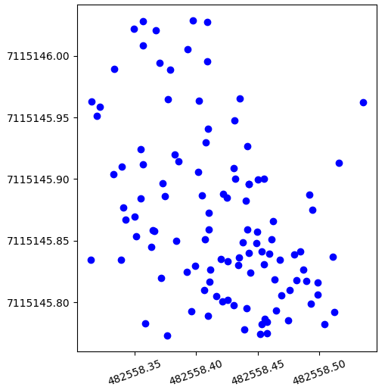
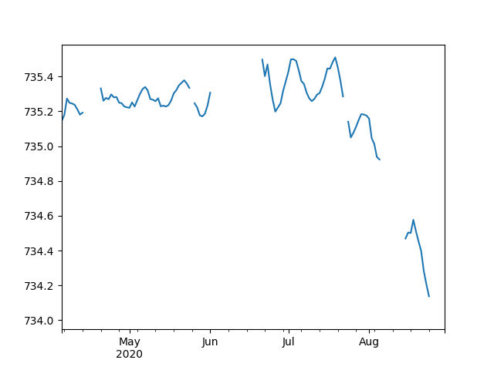
GNSS receiver 2020 test season results: postprocessed PPP positions
NUK-K PROMICE/GEM station on Qasigiannguit glacier
daily 3 hrs. acquisitions, some shorter ones and gaps
almost no ice flow: ca. 20 cm April-August
ca 1.2 m lowering matches AWS ablation meter
preliminary processing
ca. 20 cm
northing (m, UTM 22N )
eleavation (m above WGS84 ell.)
easting (m, UTM 22N)

Slide 13
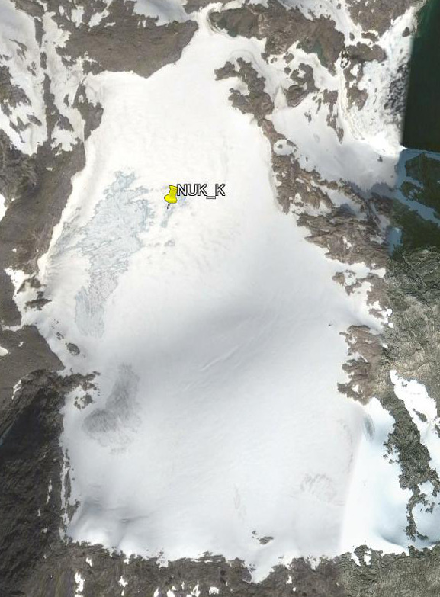
GNSS receiver 2020 test season results: postprocessed PPP positions
NUK-K PROMICE/GEM station on Qasigiannguit glacier
daily 3 hrs. acquisitions, some shorter ones and gaps
almost no ice flow: ca. 20 cm April-August
ca 1.2 m lowering matches AWS ablation meter
preliminary processing
ablation meter (m, relative)
elevation (m above WGS84 ell.)

Slide 14
GNSS receiver 2020 test season results: postprocessed PPP positions
NUK-K PROMICE/GEM station on Qasigiannguit glacier
daily 3 hrs. acquisitions, some shorter ones and gaps
almost no ice flow: ca. 20 cm April-August
ca 1.2 m lowering matches AWS ablation meter
preliminary processing
ablation meter (m, relative)
eleavation (m above WGS84 ell.)

Slide 15
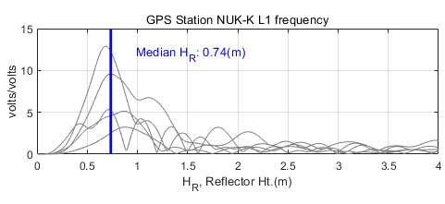
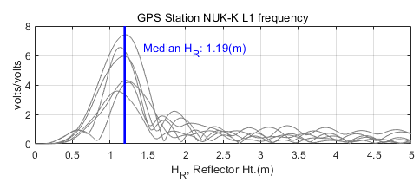
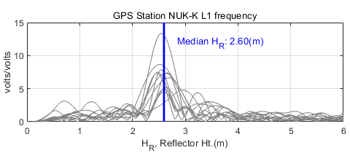
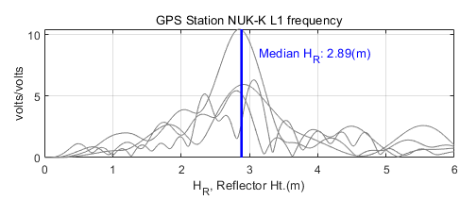
GNSS receiver 2020 test season results: snow height from reflectometry
Test retievals of NUK-K snow height from GNSS reflectometry (Trine S. Dahl-Jensen, DTU)
from interference of direct and reflected signal, samples a wider area around the station
matches well the sonic ranger (point-measurements)
preliminary processing, L1
13 April 2020
sonic ranger: 0.93 m
22 June 2020
sonic ranger: 1.17 m
20 July 2020
sonic ranger: 2.67 m
20 August 2020
sonic ranger: 2.69 m

Slide 16
INTAROS radiometer tilt and azimuth sensor to improve AWS radiation measurements
Motivation
improve the correction for radiometer tilt to account for changes in azimuth and remove alignment error between radiometer and tilt sensors. Solar radiation is the largest energy source in the surfce energy budget
provide accurate in situ validation data for satellite albedo products

Slide 17
Update on tilt and azimuth sensor development and deployment
Deployment also started in summer 2019. The sensor is not yet physically mounted on the body of the radiometer but for 2019 it is housed together with the INTAROS GNSS receiver.
also contains the INTAROS tilt and azimuth sensor

Slide 18
WP3 report & plan
FMI
Accuracy and spatial representativeness of the in-situ snow albedo observations (from PROMICE and GC-Net networks) over Greenland ice sheet will be also improved.

Slide 19

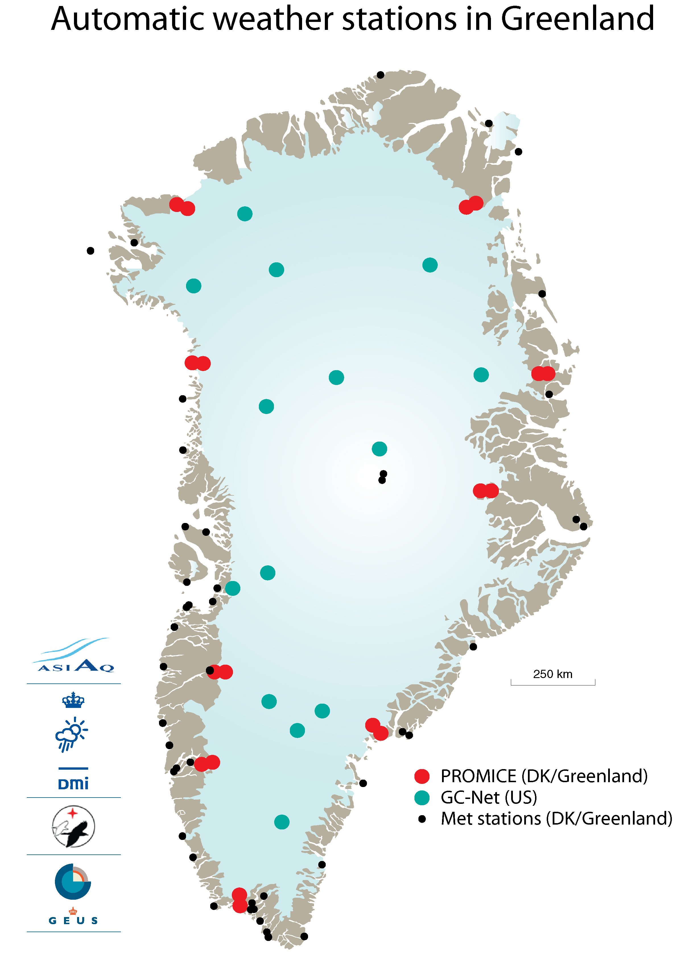
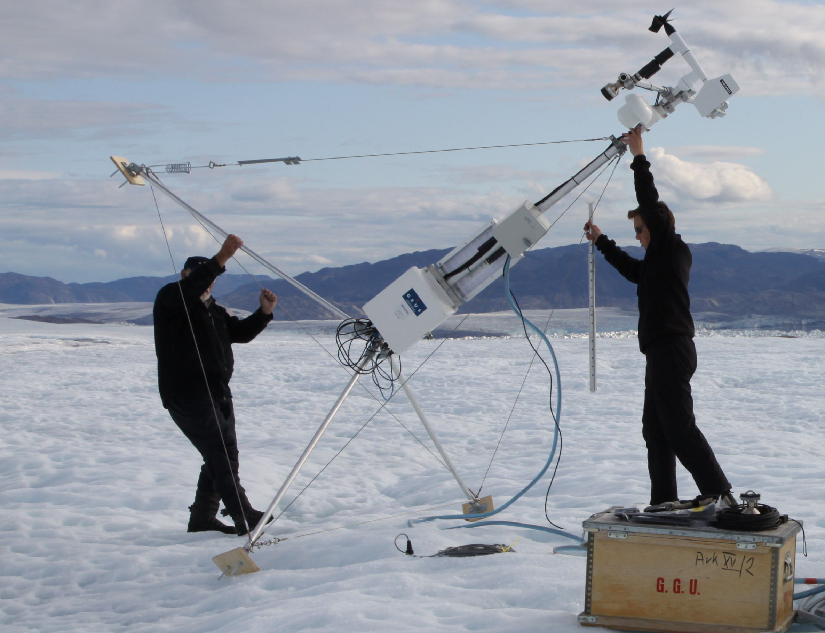


FMI – improving quality of radiometric observations

Slide 20
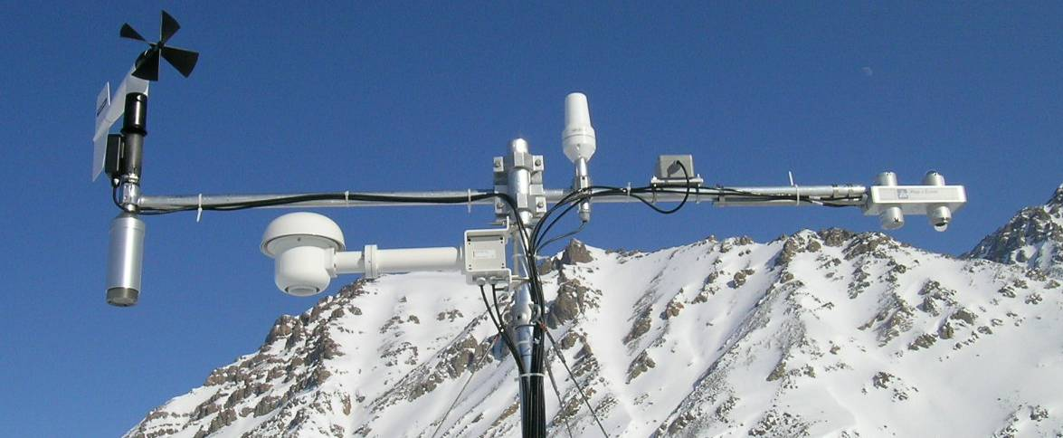
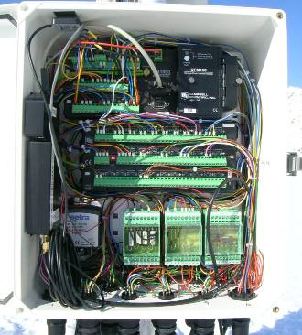
PROMICE sensors on the mast and boom
1. air temperature and humidity (aspirated)
2. SW↓, LW↓, SW↑, LW↑ radiation
3. wind speed and direction
4. snow surface level
5. two-axes tilt meter
6. Iridium satellite antenna
7. GPS receiver and Iridium modem
8. barometric pressure
Other sensors:
- ice surface level (sonic ranger on drilled stakes)
- 8-levels thermistors string (GEUS)
- hydraulic ablation meter (GEUS)
3
6
5
2
4
1
7
8

Slide 21
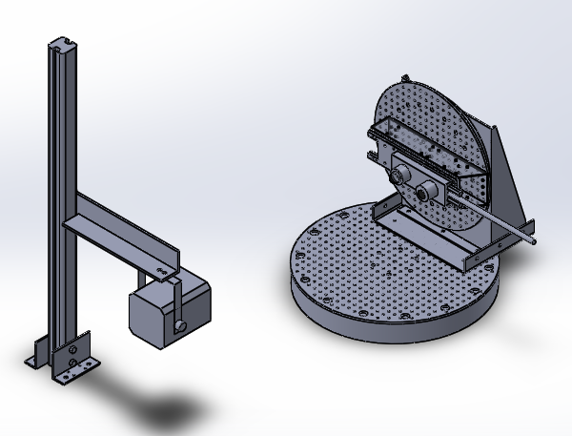
FMI: Upgrade of pyranometers of the PROMICE network (GEUS) in the FMI optical lab
Teijo Arponen and Roberta Pirazzini
Vertical rotation axis
Angular characterization
The cosine response of 8 pyranometers (belonging to 3 Kipp&Zonen CNR1 and 1 Kipp&Zonen CNR4 net radiometers) was measured at 15 different zenith angles and 4 different azimuth angles (north, east, south, west, north being the direction of the instrument’s arm).
Horizontal
rotation axis
RESULTS:
Cosine response error is similar in CNR1 and CNR4 pyranometers:
Insignificant (<1%) for zenith < 30°
Up to 3% (of underestimation) at 60° zenith
Rising to 10% (of underestimation) at 70° zenith
Exponentially increasing for zenith > 70°
Light source (250 W)
EXPLOITATION OF THE RESULTS: the cosine response characterization enables the correction of the cosine error when direct sunshine occurs. The “missing” direct radiation will be obtained by multiplying the derived correction percentage to the amount of incoming direct radiation (which can be obtained from a modelling routine).

Slide 22
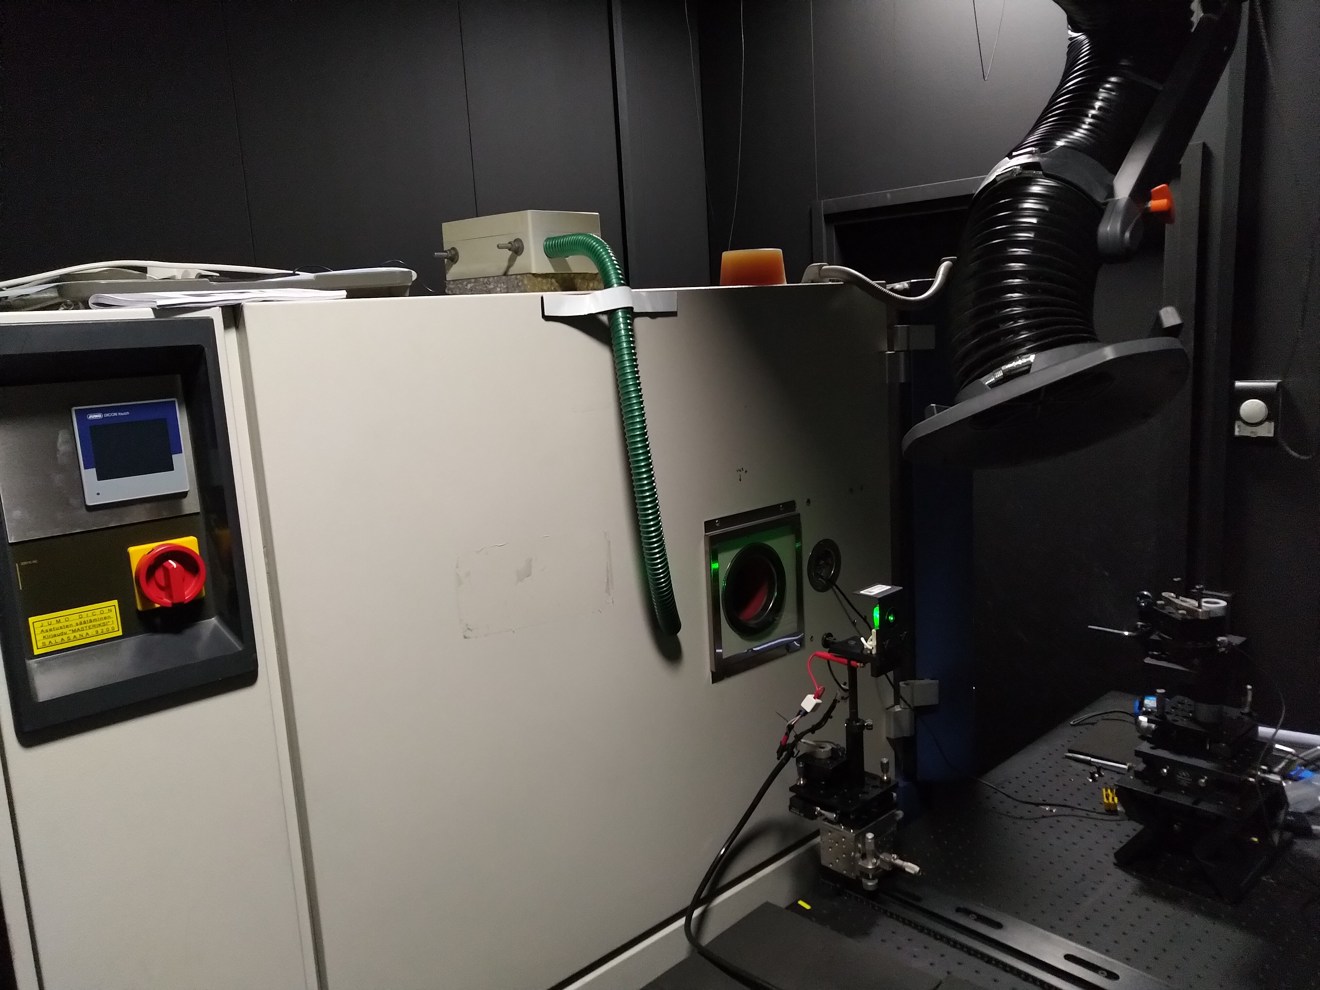
FMI: Upgrade of pyranometers of the PROMICE network (GEUS) in the FMI optical lab
Teijo Arponen and Roberta Pirazzini
Thermal characterization
The thermal drift of the zero offset and of the output 8 pyranometers (belonging to 3 Kipp&Zonen CNR1 and 1 Kipp&Zonen CNR4 net radiometers) was measured using a thermally controlled chamber operated at +30 °C, +20 °C, +10 °C, 0 °C, -10 °C, -20 °C, -30 °C.
RESULTS:
The thermal drift differed for each sensor. For instance, from the initial room temperature (~21 °C ) to -20 °C the output changed by 2-4% in the case of the CNR4 pyranometers, and by 22-23% in case of CNR1 080025 and CNR1 080069 pyranometers.
A temperature dependent equation that corrects for the thermal drift is provided for each sensor.
EXPLOITATION OF THE RESULTS: the correction equations can be included in the routines applied to generate the instrument outputs. The manufacturer (Kipp&Zonen) will be contacted to discuss these results.

Slide 23
WP3 report & plan
UPM
An improved ground-penetrating radar system will be developed.

Slide 24
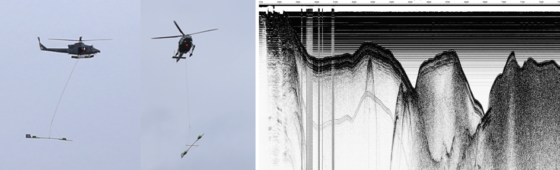
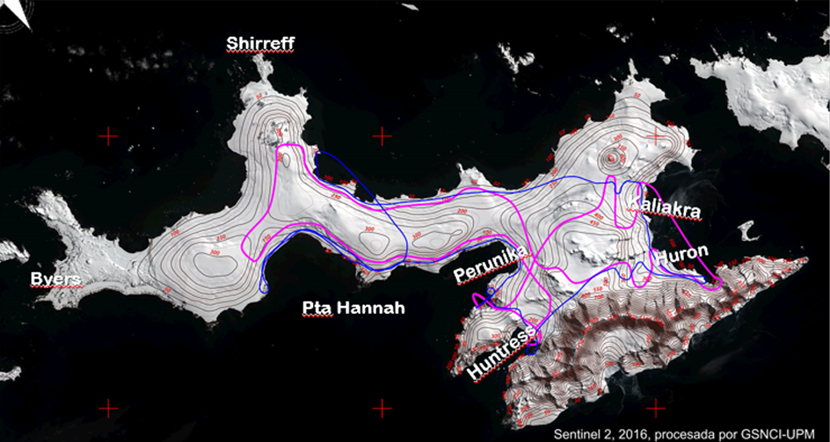

New ground-penetrating radar (GPR) system, VIRL8
Ground‐penetrating Radar system development
Remotely controlled from a helicopter cabin
Components fully interchangeable
Improved capabilities
Two fieldwork tests of the equipment
have been done in Antarctica, during
2016‐2017 and 2018‐2019 campaigns.
In both campaigns we performed
helicopter‐borne radar profiling,
retrieving the glacier thickness along
more than 200 km of radar survey lines.

Slide 25
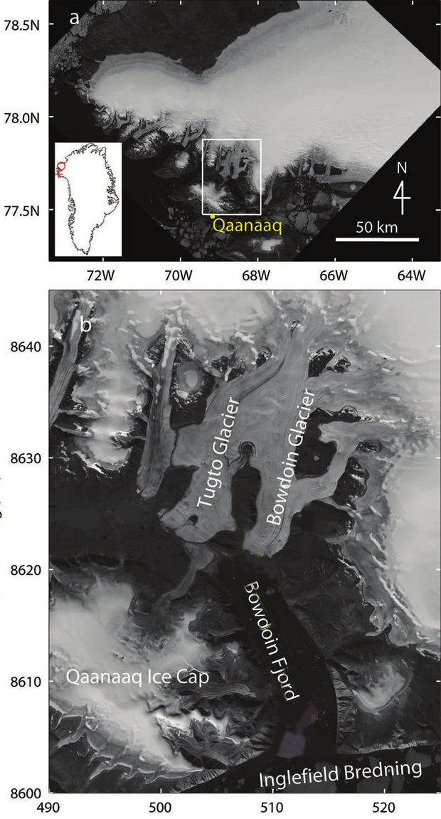
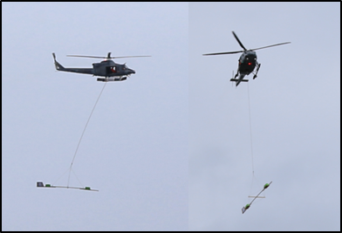
Fieldwork in
Greenland
CANCELLED
Helicopter-borne ground-penetrating radar campaign in NW Greenland was planned for spring of 2020.
With the aim of retrieving glacier thickness over highly crevassed areas, such as glacier fronts.
Necessary for calculating the ice discharge from glaciers to the ocean using the flux-gate approach, and for defining the glacier geometry to be used as model input.
Funded by Spanish State Plan for R&D.
Adapted from Sugiyama et al, 2015

Slide 26
WP3 report & plan
CNRS-IUEM
The ice-driven dynamics of the arctic coastal ecosystems will be studied in the Young Sound through a multi-disciplinary approach (with similar system in Kongsfjorden under Task 3.3 for a comparison of two contrasted fjords), by merging physical oceanography and marine biology, and using the passive acoustics non-invasive technique to characterize both physical (dynamics of sea ice and icebergs, waves-ice interactions) and biological compartments (behavior of organisms at different trophic levels).
CNRS-Takuvik
Task 3.1 will also contribute to a suite of sensors for automated monitoring of the coastal ocean at the Baffin Bay Observatory (in Qiqiktarjuak), implemented for monitoring of the spring bloom processes and the bio-optical and biogeochemical properties under the ice pack.

Slide 27



INTAROS task 3.1: sea-ice optics in coastal Baffin Bay
Year 2020:
Field work: Due to Covid Situation Takuvik postponed field expedition scheduled in May 2020 to May 2021 → no sea-ice optics measured in Baffin Bay in 2020.
However, a newly designed optical sensor was sent in Winter 2020 to MOSAIC researchers to make measurements on the Polarstern in central Arcitc in June 2020.
Data:
Sea-ice inherent optical properties in coastal Baffin Bay were collected in 2019 in central Arctic in June 2020 and are currently under data analyses. Two new optical sensors to measure in situ nutriments and angular distribution of the optical field have been developed and need to be deploy as soon as the North is accessible again due to COVID.

Slide 28
2020 publications and communications:
Perron C., Lambert Girard S. , Katlein C., Leymarie E., Marquet P. and Babin M. (2021). Spatially Resolved Diffuse Reflectance for In-Field Measurement of Sea Ice Inherent Optical Properties. Will be submitted in Jan. 2021 to The Cryosphere Journal.
Y. Alikacem, S. Lambert-Girard, D. Boudreau, S. Thibault, M. Babin. (2021). On the design of an optical sensor to measure nitrate in sea ice. Will be submitted in March 2021 to Limnology and Oceanography methods
R.Larouche, S. Lambert-Girard, C.Katlein, S. Thibault, M. Babin (2021). Measurement of in-ice radiance angular distribution, International Symposium on Sea Ice at the Interface. Will be submitted in March 2021 to Optics Express.
Notes:
28

Slide 29
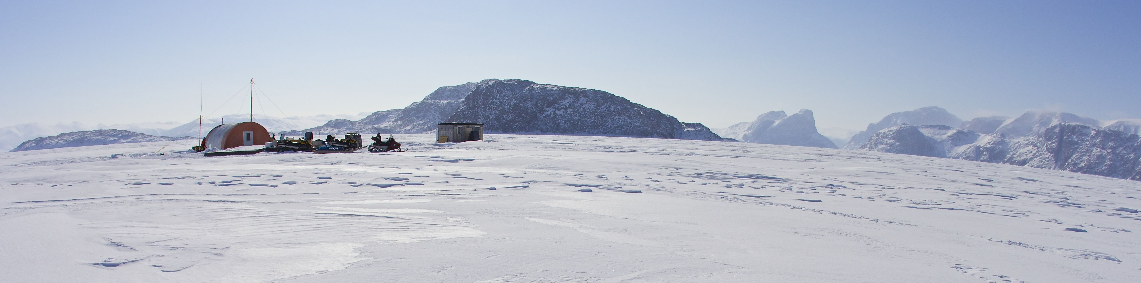
Suggestions and ideas :
Due to Covid situation: sea-ice optical measurements in 2020 had to be postponed, so that our plans go beyond the deadline of INTAROS roadmap. We would suggest to postpone the end of the project by one year to allow field sampling with newly developed sensors in 2021 and 2022 as part of this project.
Notes:
29

Slide 30
Future plans
Partner | Activity | Deployment plans & recommendations
GEUS | SWE on ice sheet | Based on the experience of initial deployments, we are fine-tuning the instrument parameters and continue to work on a solution to the power consumption/supply, currently inadequate for wintertime operation
 | Precise positioning on ice sheet | Based on successful 2020 test season, the new GNSS units will be implemented at the selected PROMICE and GEM sites visited in 2021 as part of routine maintenance
 | Tilt & azimuth of radiometers | Due to a bug in the logging of data, the test deployment in 2020 gave no data. The issue will be corrected, and the new tilt/azimuth units will be implemented at the PROMICE and GEM sites visited in 2021 as part of routine maintenance
 | Rain gauges on ice sheet | Experimental deployment of rain gauges was continued through 2020, with implementation of a new AWS system including a rain gauge at all >20 PROMICE locations starting in 2021. The implementation phase of this new AWS system is expected to be on the order of 4 years. We currently have three sites where the new AWS setup, which includes a rain gauge, is tested side-by-side with the old AWS setup.

Slide 31
Future plans
Partner | Activity | Deployment plans & recommendations
AU | Snow on sea ice | When instruments are retrieved, they are replaced by new and calibrated instruments. The added instrumentation is thus fully implemented in the monitoring program and is expected to provide data approximately 360 days a year
 | pCO2 & acidification | The retrieved data will form the basis of scientific publications and be made available on the open GEM database
FMI | Radiometer characterization | The characterization of some of the net radiometers recovered from the PROMICE network during summer 2019 was completed in spring 2020. The equations obtained from the characterization work can be applied to improve the data accuracy and will be provided to GEUS in 2021.
UPM | GPR development, testing and application | As Qaanaaq-based (NW Greenland) helicopter-borne GPR fieldwork campaign scheduled for April 2020 had to be cancelled due to COVID-19 pandemic, and it could not be rescheduled for 2021, our planned work is to complete the processing of the GPR radar testing campaign in Antarctica in January 2019. Though planned as a testing campaign, plenty of data was collected and only a small subset of it was processed (for testing). Lost the possibility to collect Greenland data, it makes sense to process the complete set of Antarctic data.

Slide 32
Partner | Activity | Deployment plans & recommendations
CNRS-IUEM | Passive acoustics | Acoustic efforts are now focused on experiments in Svalbard. There are no new missions planned in Greenland. The recorded data will be used as a point of comparison with the data acquired in Svalbard
CNRS-Takuvik | Under-ice monitoring | Deployments re-scheduled for May 2021. One of these floats will be equipped with a new sensor dedicated to measure particle size abundance.

