Slide 1
Virtual Annual Meeting, 12./13.01.2021
Report on activities in 2020 and planned work for 2021
Task 3.3: Fram Strait (Lead: Thomas Soltwedel, AWI)
Partners:
LOV - Laboratoire d'Océanographie Villefranche-sur-mer
IUEM - Institut Universitaire Européen de la Mer

Slide 2
Task 3.3: Report on activities in 2020 and planned work for 2021
“The HAUSGARTEN observatory will be extended with an experimental system to study impacts of ocean acidification on benthic organisms and communities.
The autonomous arcFOCE (arctic Free Ocean Carbon Enrichment) system will be adapted to greater water depths (4000 m), extremely low temperatures, and autonomous operation.”
Jonas Hagemann, Christiane Hasemann, Michael Hofbauer, Ulrich Hoge,
Sascha Lehmenhecker, Johannes Lemburg, Thomas Soltwedel (AWI)
“The time-series for the carbonate chemistry of Arctic coastal waters in Kongsfjorden as part of the AWIPEV Underwater Observatory will comprise continuous real-time measurements of pCO₂, continuous pH measurements and weekly discrete measurements of dissolved inorganic carbon and total alkalinity.
Samir Alliouane, Jean-Pierre Gattuso (CNRS-LOV)
An acoustic system with hydrophones will be deployed in Kongsfjorden with the aim to describe patterns of natural physical sound sources, biological sounds and anthropogenic noise.
Laurent Chauvaud, Marie-Noelle Houssais, Claudie Marec, Delphine Mathias (CNRS-IUEM)

Slide 3
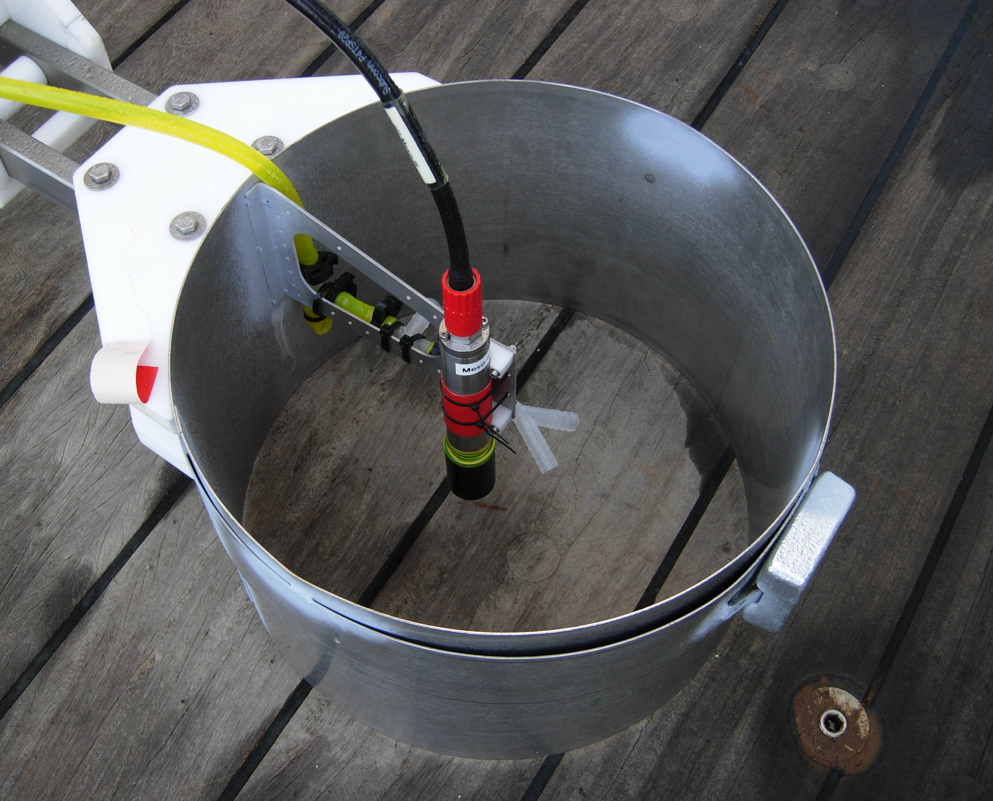
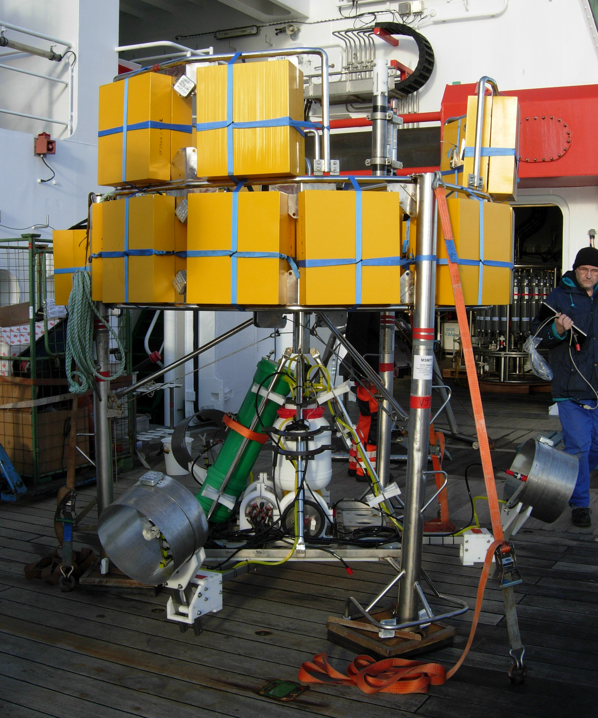
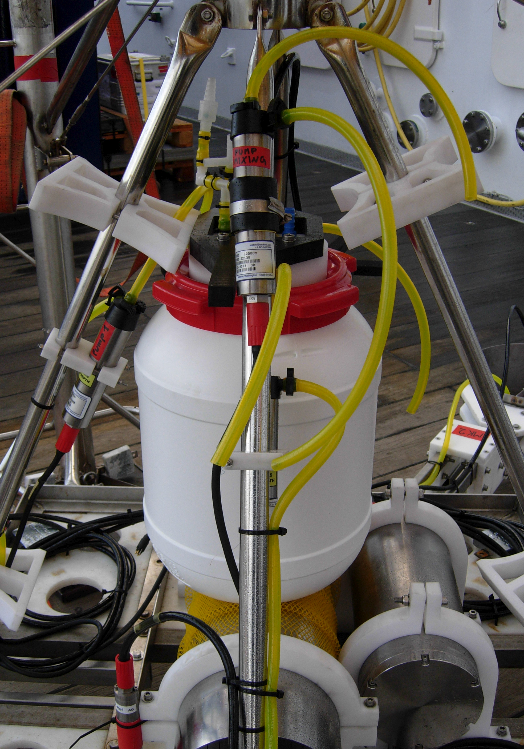
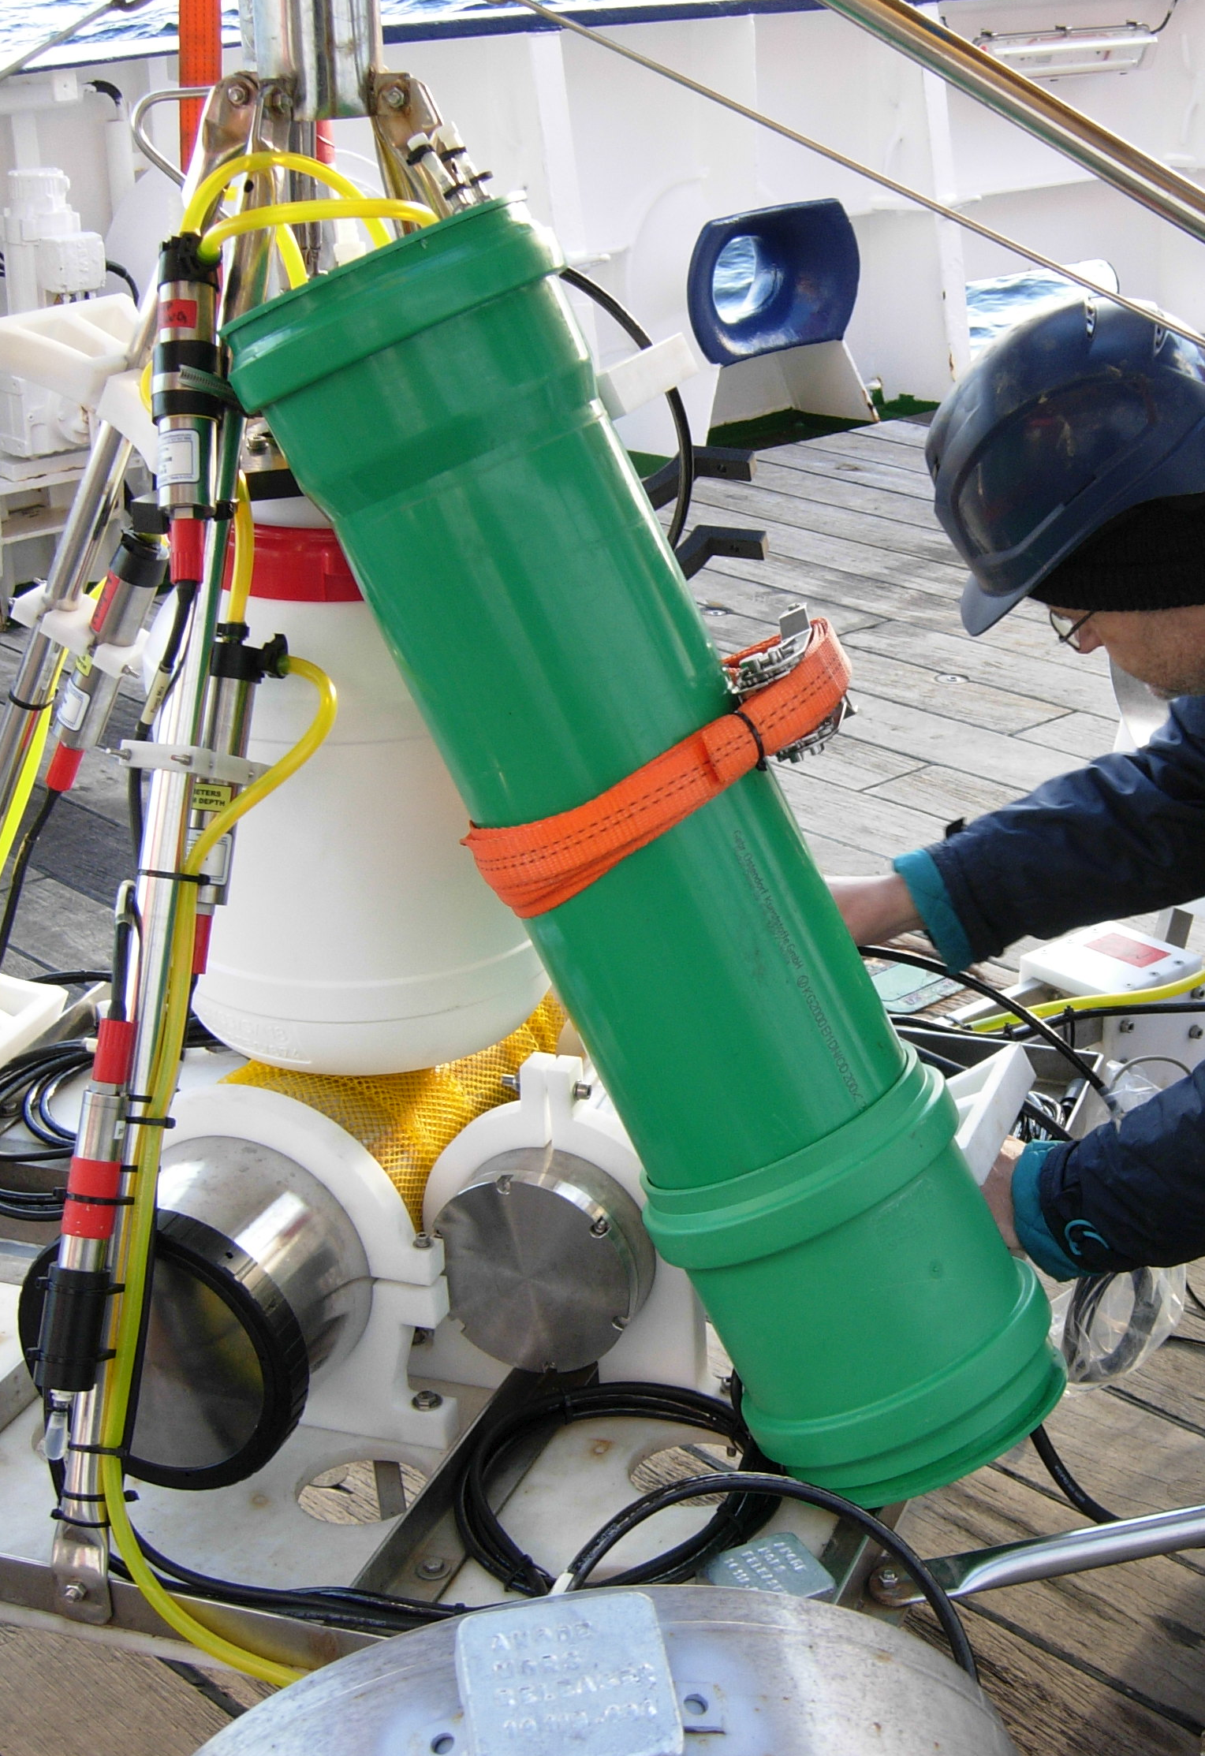
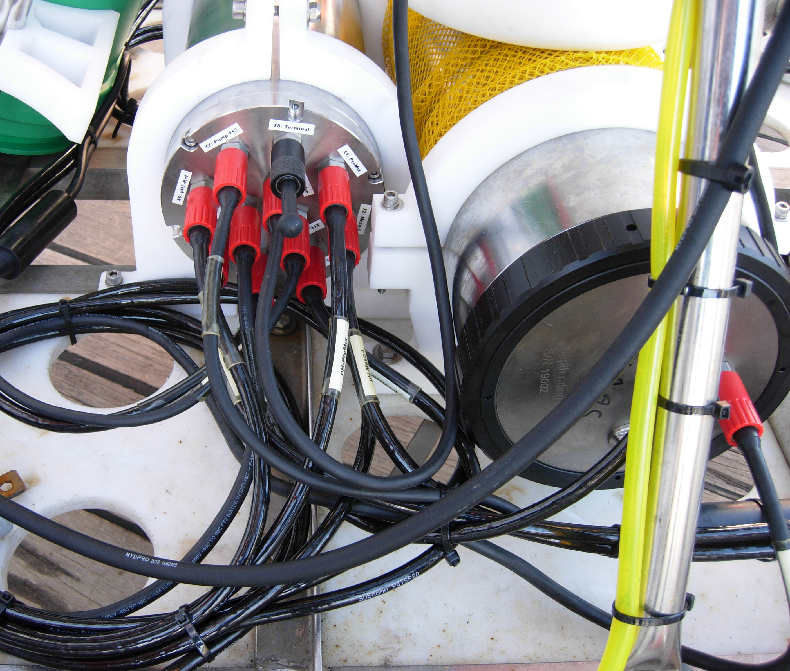
Task 3.3: Report on activities in 2020 and planned work for 2021
Acidification Experiment (arcFOCE)
Experimental set-up:
based on a free-falling system (bottom-lander)
CO₂ storage (discharge of CO₂ from pressure cylinders)
CO₂ enrichment unit (CO₂ mixed with seawater)
Experimental chamber (mesocosms)
Pump system (seawater enrichment & feed into mesocosms)
pH sensors (mesocosms, CO2-seawater mixing, reference sensor)
Energy supply (batteries)
Electronical control unit

Slide 4
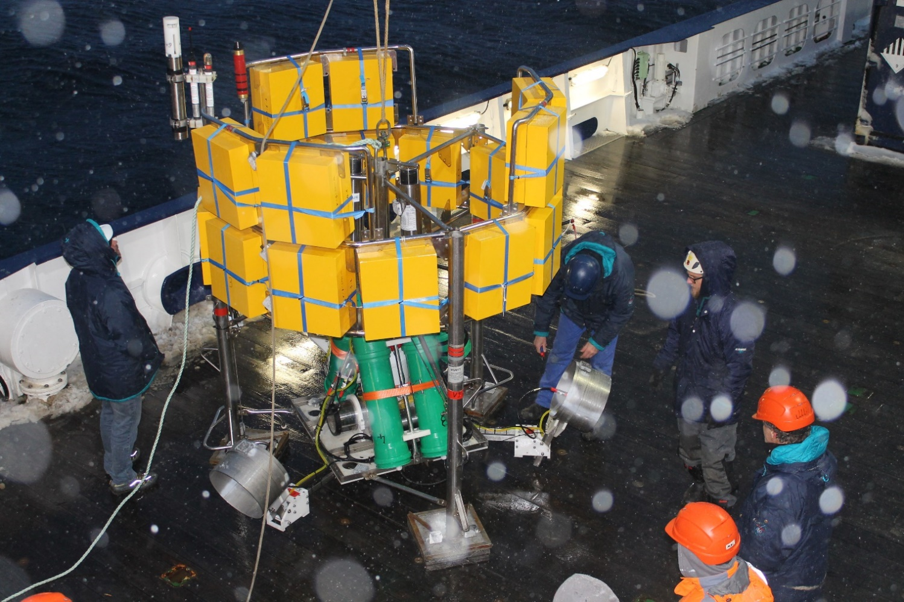
Task 3.3: Report on activities in 2020 and planned work for 2021
Acidification Experiment (arcFOCE)
First long-term deployment (1 year) at HAUSGARTEN in September /October 2018 at 1500 m

Slide 5
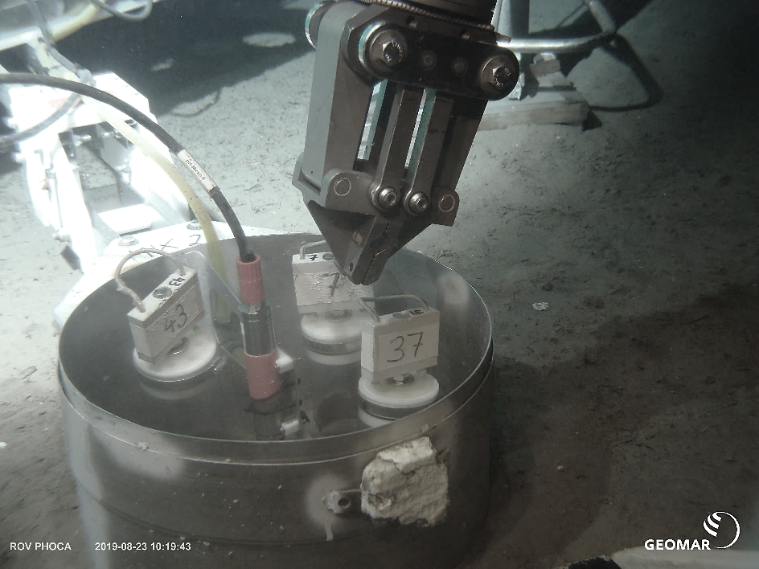
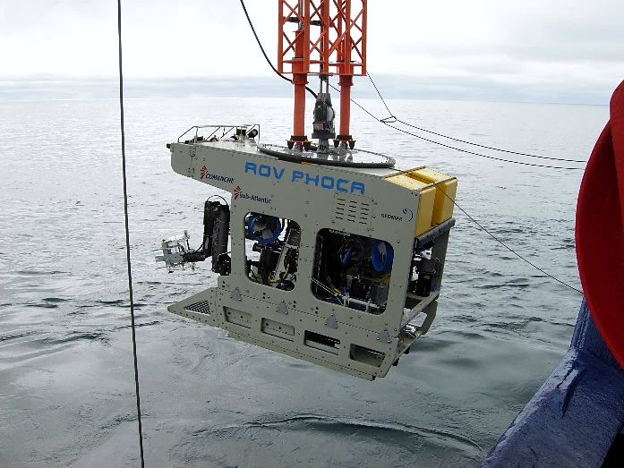
Task 3.3: Report on activities in 2020 and planned work for 2021
Acidification Experiment (arcFOCE)
Sediment sampling at the end of deployment in summer 2019 using the ROV PHOCA
Sediment sampling within and outside mesocosms:
Meiofauna (foraminiferans, metazoans)
Bacteria (numbers, biomass, composition)
Microbial activities
Organic matter

Slide 6
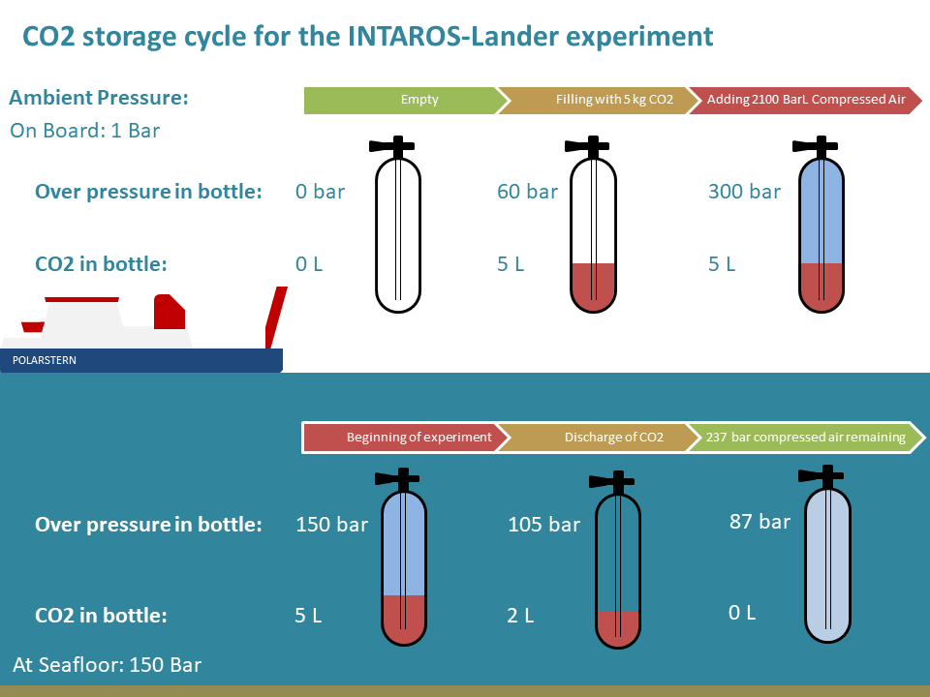
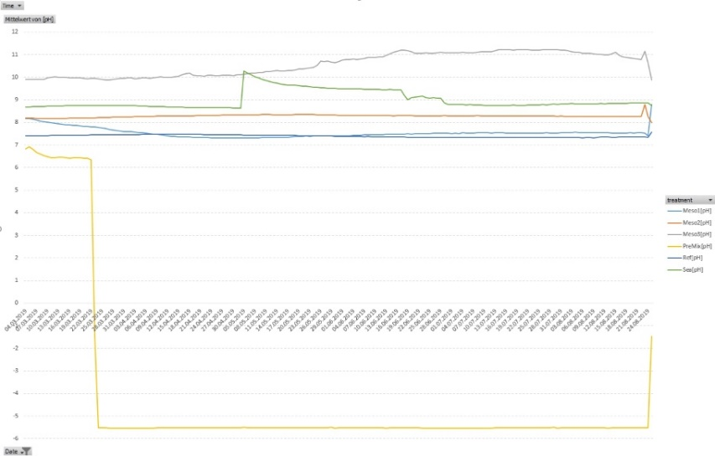
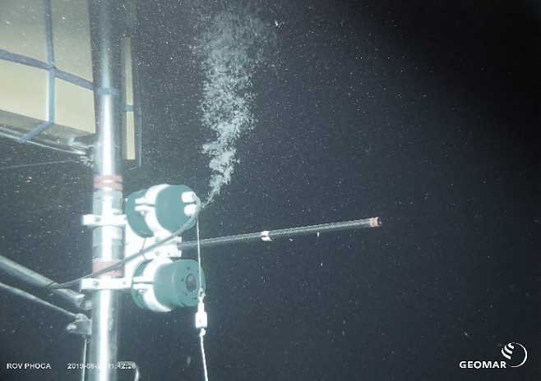
Task 3.3: Report on activities in 2020 and planned work for 2021
Acidification Experiment (arcFOCE)
After recovery of the arcFOCE system: Performance of experimental set-up
mechanical construction, power management, and electronic control ü
mixing of compressed air and CO₂ in pressure tanks ü
pressure release for excess CO₂ before surfacing ü
pH sensors did not work for the most part 

Slide 7
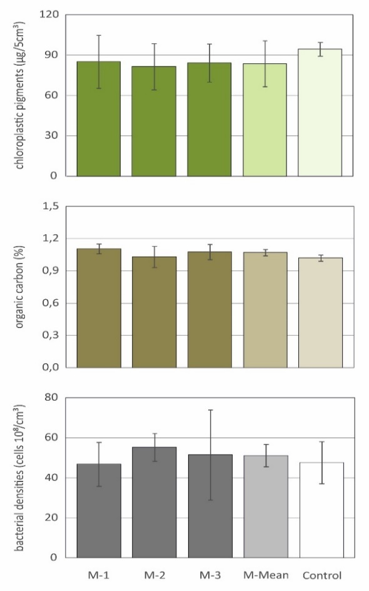
Task 3.3: Report on activities in 2020 and planned work for 2021
Acidification Experiment (arcFOCE)
Results from biogeochemical analyses and bacterial counts:
No significant differences between data from the mesocosms and control sediments taken in the vicinity of the experimental set-up
open mesocosms do not accumulate particulate matter
no need to modify the diameter / volume of the mesocosms
top: organic matter input of phytodetritus
middle: total organic matter content
bottom: bacterial densities
Mesocosms

Slide 8
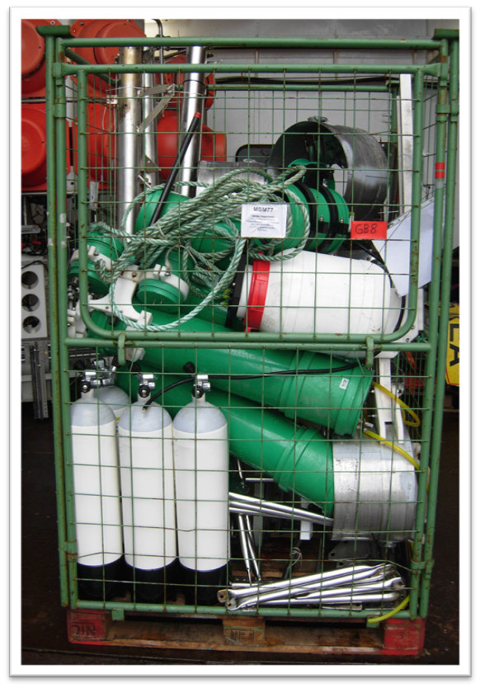
Task 3.3: Report on activities in 2020 and planned work for 2021
Acidification Experiment (arcFOCE)
Re-configuration of the experimental set-up:

Slide 9
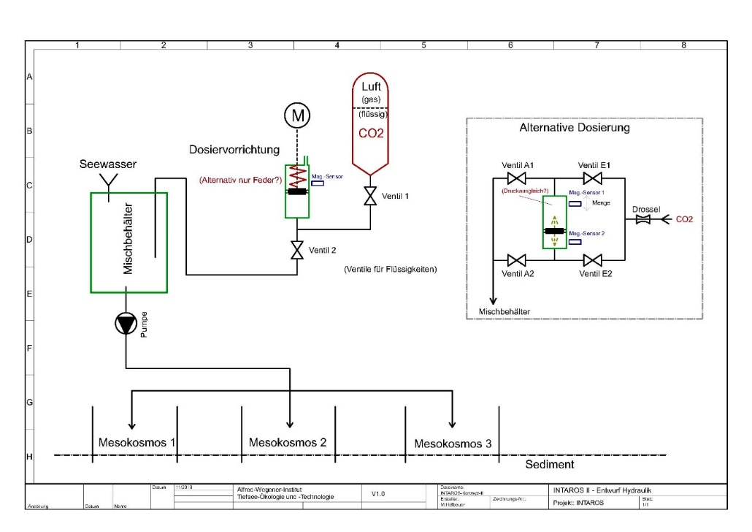
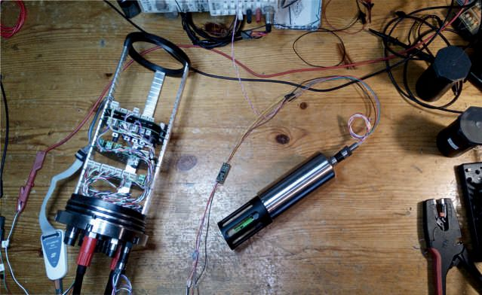
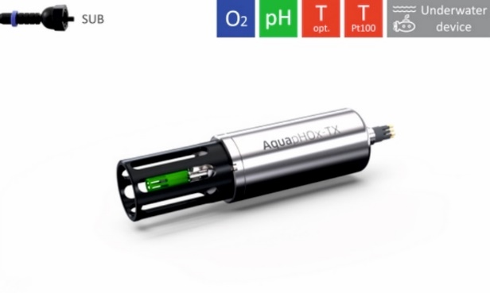
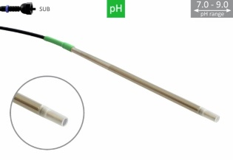
Task 3.3: Report on activities in 2020 and planned work for 2021
Acidification Experiment (arcFOCE)
Re-configuration of the experimental set-up:
Due to failure of the pH sensors
CO₂ addition into the mixing chamber no longer controlled by pH sensors
Testing new optical pH sensors in the lab (temperature-controlled pressure tank)

Slide 10
Task 3.3: Report on activities in 2020 and planned work for 2021
Acidification Experiment (arcFOCE)
Re-configuration of the experimental set-up:
Due to failure of the pH sensors
CO₂ addition into the mixing chamber no longer controlled by pH sensors
Testing new optical pH sensors in the lab (temperature-controlled pressure tank)
→ Next arcFOCE deployment during RV Polarstern expedition PS126 in 2021

Slide 11
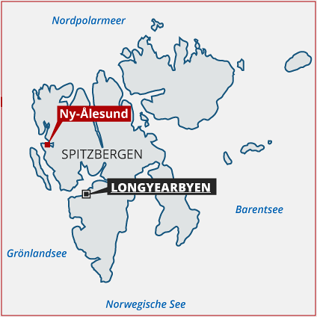
Task 3.3: Report on activities in 2020 and planned work for 2021
Time-series of carbonate chemistry in the Arctic Ocean
before INTAROS:
water pumped from 12 m water depth at Ny-Ålesund
since July 2015: pCO₂ measurements
every minute; two sensors exchanged every year
since February 2016: total alkalinity measurements
every 90 minutes – but lots of technical issues
calibration and quality insurance:
collection of discrete samples once a week for high-precision measurements of dissolved inorganic carbon and total alkalinity at the home lab.

Slide 12
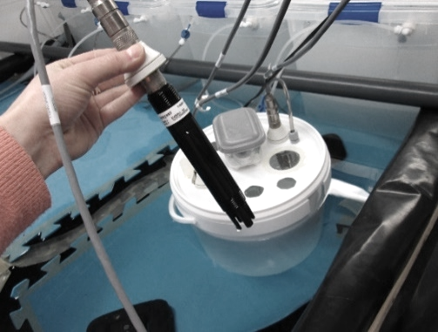
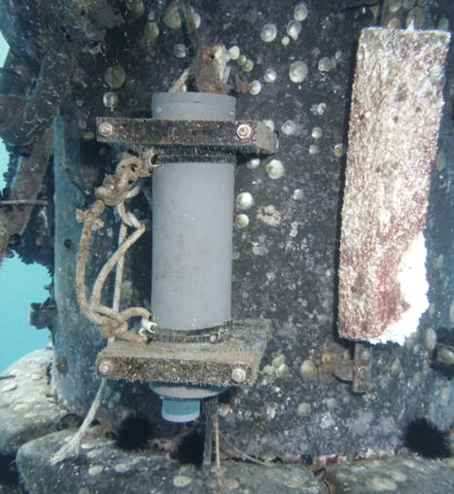
Task 3.3: Report on activities in 2020 and planned work for 2021
Time-series of carbonate chemistry in the Arctic Ocean
during INTAROS:
since August 2017: pH measurements
Durafet pH sensor in the FerryBox
continuous measurements in fjord water (seaFET)
discrete pH samples once a month for calibration
regular maintenance twice a year
calibration and quality insurance:
collection of discrete samples once a week for high-precision measurements of dissolved inorganic carbon and total alkalinity at the home lab.
2020, Covid-19 issues:
instruments could not be maintained
a FerryBox failure could not be fixed
some discrete samples collected at AWIPEV

Slide 13
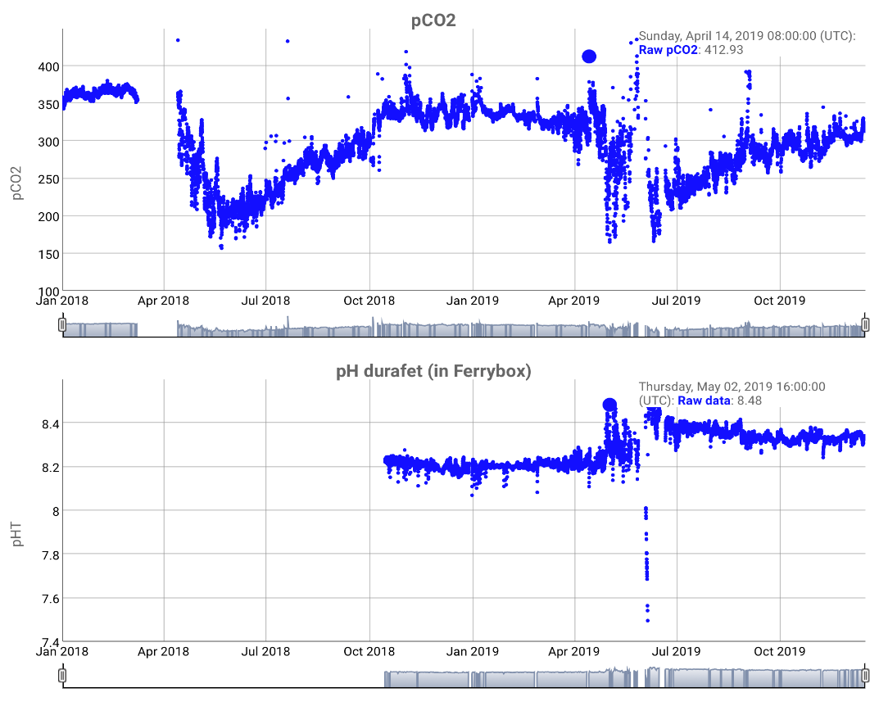
Task 3.3: Report on activities in 2020 and planned work for 2021
Time-series of carbonate chemistry in the Arctic Ocean
Data online available in near real-time (https://awipev-co2.obs-vlfr.fr)
The AWIPEV-CO₂ project was terminated in January 2021 due to the lack of support for discrete seawater sampling from the AWIPEV Research Base. Data are being analyzed and will be uploaded on the World Data Center Pangaea and published in the scientific literature.

Slide 14
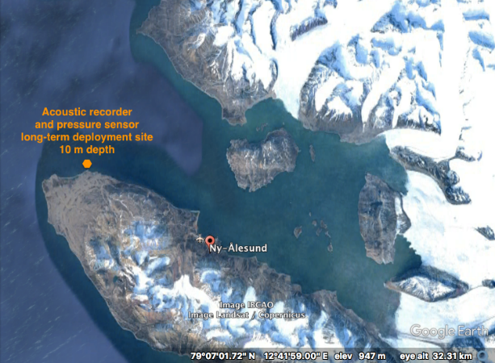
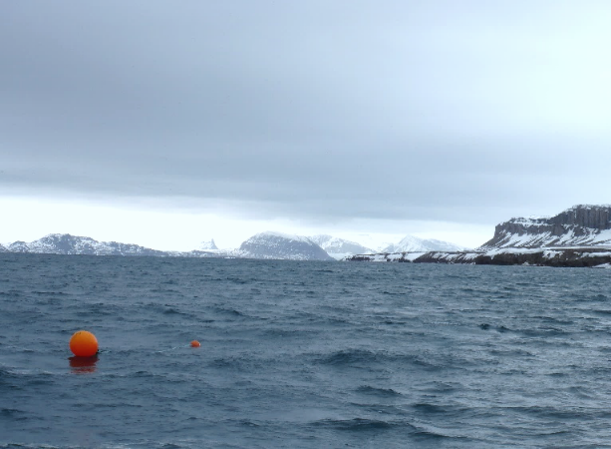
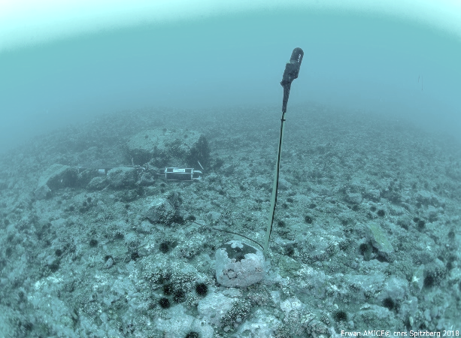
Task 3.3: Report on activities in 2020 and planned work for 2021
Underwater acoustics in Kongsfjorden
Describing the soundscape diversity including benthic fauna sounds, marine mammals vocalisations, ice sounds, boat noise, wind/wave noise and monitor changes over time.
deployment site
Long-term deployment at 10 m water depth in the fjord entrance
Same location close to Kongsfjordneset since 2013
Recovery / redeployment by divers; up to 3 acoustic recorders, 1 pressure sensor

Slide 15
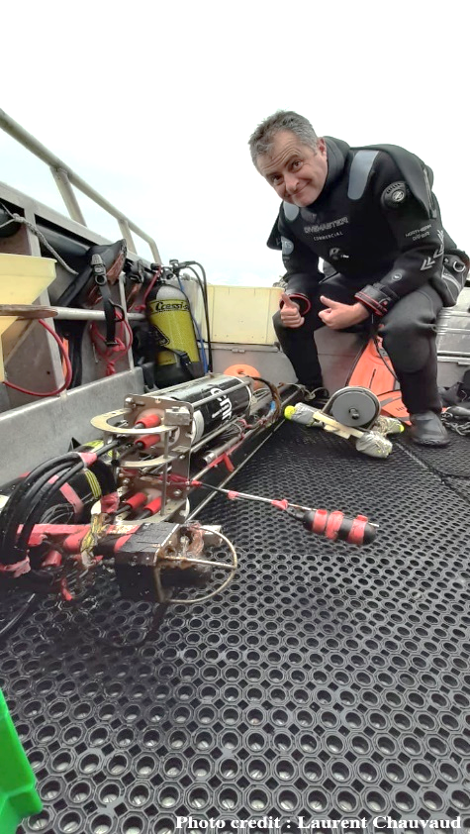
Task 3.3: Report on activities in 2020 and planned work for 2021
Underwater acoustics in Kongsfjorden
Data collection at Kongsfjordneset
Recovery / redeployment of equipment initially scheduled in April 2020 but delayed due to Covid-19
Two acoustic recorders and pressure sensor redeployed on July 29th and set up to start acquiring data (78 kHz, 15 min recording per hour)
Recovery / redeployment of equipment initially scheduled in October 2020 but delayed due to Covid-19
Next instrument rotation in Spring 2021 and final recovery of all equipment in October 2021
→ The 2020 summer acoustic dataset will allow comparing the ambient noise during the pandemic and associated reduced tourist-shipping activity with previous years.

Slide 16
Task 3.3: Report on activities in 2020 and planned work for 2021
Underwater acoustics in Kongsfjorden
Data Analysis: Anthropophony
Estimation of sound pressure levels (SPL) through time compared to AIS (Automatic Identification System) position of vessels (provided by R.R. Hansen, DNV-GL) to monitor variation of shipping noises
Preliminary insights whether the SPLs can be explained by the number of boats within a 30 km range and by the distance of the closest boat from the hydrophone

Slide 17
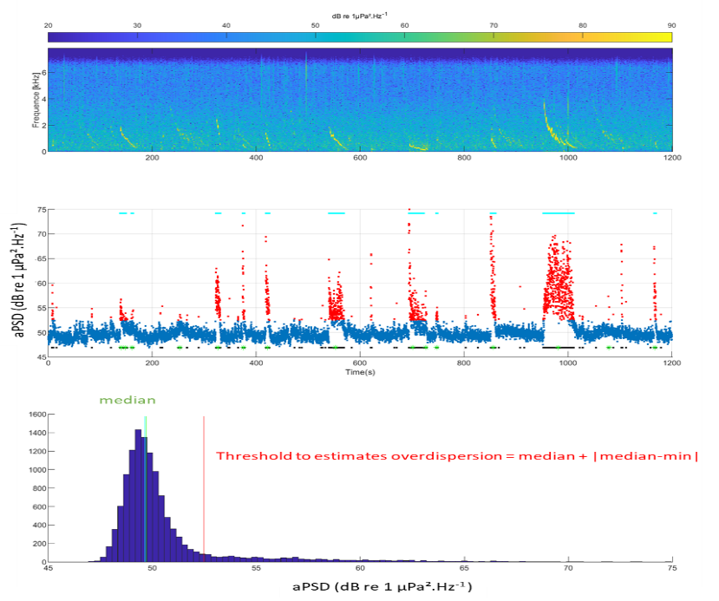
Task 3.3: Report on activities in 2020 and planned work for 2021
Underwater acoustics in Kongsfjorden
Data Analysis: Biophony
Development of a tonal detector (example to detect seal vocalizations)
Energy based detector: average sound exposure level rate within bandwidth of interest (tonal to find), with condition of duration
Contour shape of the energetic event should fit with a polynomial regression model

Slide 18
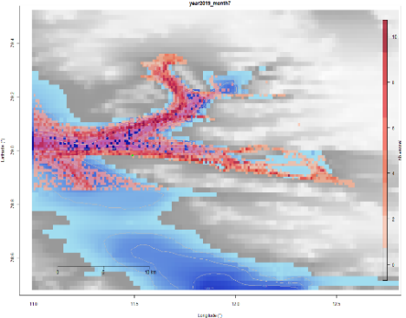
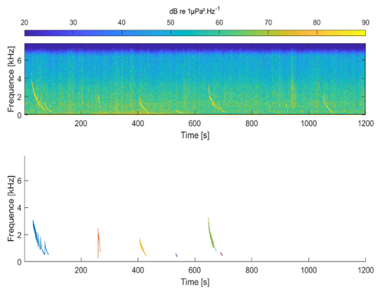
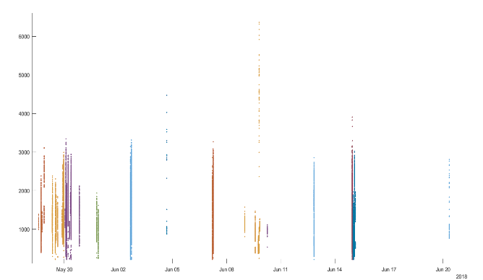
Task 3.3: Report on activities in 2020 and planned work for 2021
Underwater acoustics in Kongsfjorden
Further investigations in 2021:
Anthropophony
Assess a transmission loss model
Map the acoustic footprint of shipping activity within the fjord
Biophony
Test the detector and compare with other detectors
Detect and classify biophonic sounds in Kongsfjorden

Slide 19
Task 3.3: Report on activities in 2020 and planned work for 2021
THANK YOU !

