Slide 1



General Assembly 2021 online, January 12-13, 2020
Task 3.4 Distributed systems: ocean and sea ice
Lead: Agnieszka Beszczynska-Möller, IOPAN

Slide 2

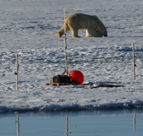
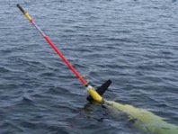
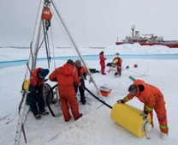
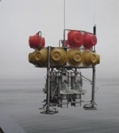
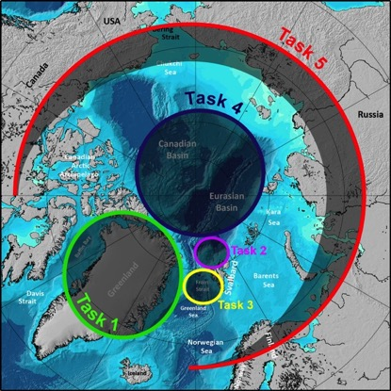
INTAROS WP3 In situ observing systems
Task 3.4
Distributed systems for ocean and sea ice:
Ice-tethered platform and deep ocean mooring
for measurements of ocean physical variables
with meteorological and biogeochemical sensors (IOPAN)
Sea-ice mass balance buoys clustered with ITPs and standalone (FMI)
Measurements of snow properties and ABL observations
from SOOs (FMI)
Quadrocopter measurements of broadband and
surface albedo (FMI)
Novel sensors for FerryBoxes (ocean acidification
and carbonate chemistry, inherent optical properties,
microplastic sampler) (NIVA)
Endurance glider lines in the open water Arctic
regions (CNRS-LOCEAN)
BioArgo floats in Baffin Bay (CNRS-Takuvik)
Task 0

Slide 3
Task 3.4 Distributed systems for ocean and sea ice:
Ice-tethered IAOOS platforms (IOPAN)
Deployed on the sea ice in the central Arctic on August 18, 2018 during the Arctic 2018 cruise of IB ODEN at the position 89.555°N 38.01°E by the EQUIPEX IAOOS team (Matthiew Labaste, LOCEAN).
Data received until September 13 when transmission stopped.
Data collected during 1 month drift:
Ocean temperature and salinity profiles between 5 and 600 m (2 profiles per day, vertical resolution 1 m)
Dissolved oxygen profiles between 5 and 600 m
(2 profiles per day, vertical resolution 2 m)
SIMBA temperature profiles through air, snow, sea ice and surface ocean (temporal resolution 2 h, vertical resolution 2 cm)
Air temperature and atmospheric pressure (1 hour)
Microlidar profiles (temporal resolution 6 h, vertical range 327 progressively increasing altitude bins)
Raw data available upon request on the IOPAN ftp server (IP: 153.19.130.250, user: iaoos-data, pass protected).
Processed ocean and meteo data will be available from IOPAN data base after processing is finalized.
SIMBA data processing – ask FMI (Bin Cheng)?
Photo: Matthiew Labaste
Photo: Matthiew Labaste

Slide 4
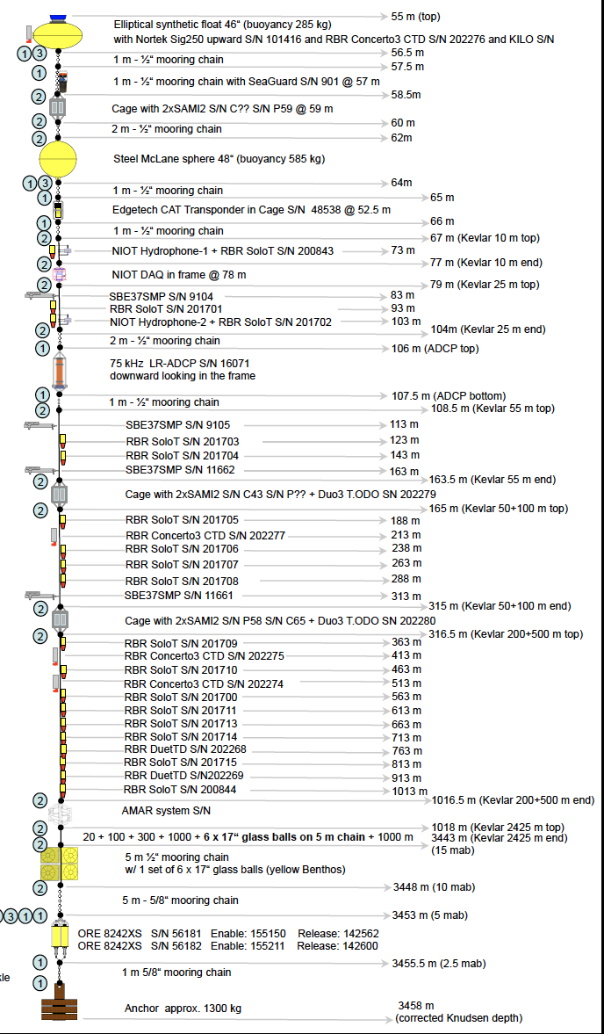
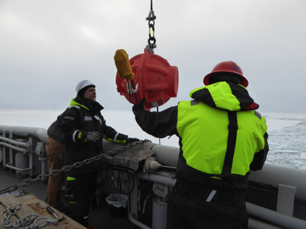
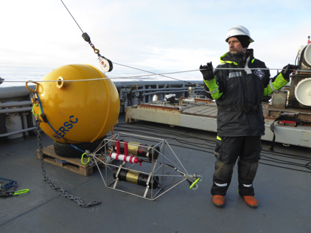
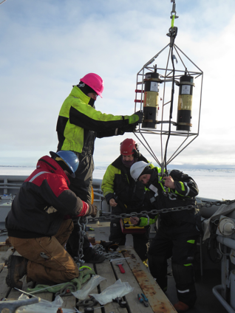
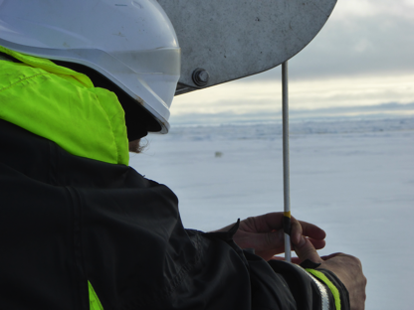
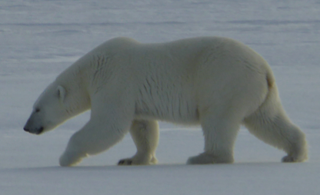
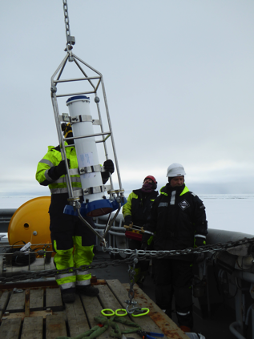
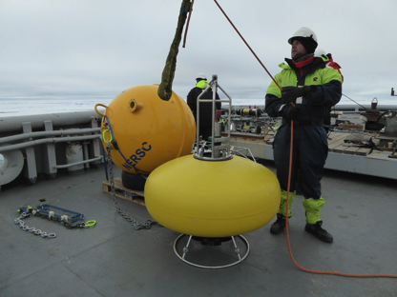
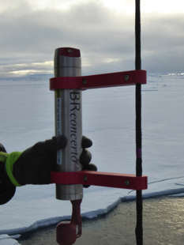
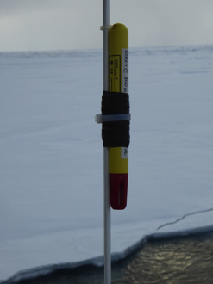
Task 3.4 Distributed systems for ocean and sea ice:
Deep ocean mooring NERSC4
Mooring NERSC4 deployed in the deep Nansen Basin
on September 5, 2019 during the CAATEX cruise on KV Svalbard
PAR
pH/pCO2 sensors
Nortek Sig250
for currents
and sea ice
CTD/TDO
sensors
LR-ADCP
for ocean
currents
T/TD
sensors

Slide 5
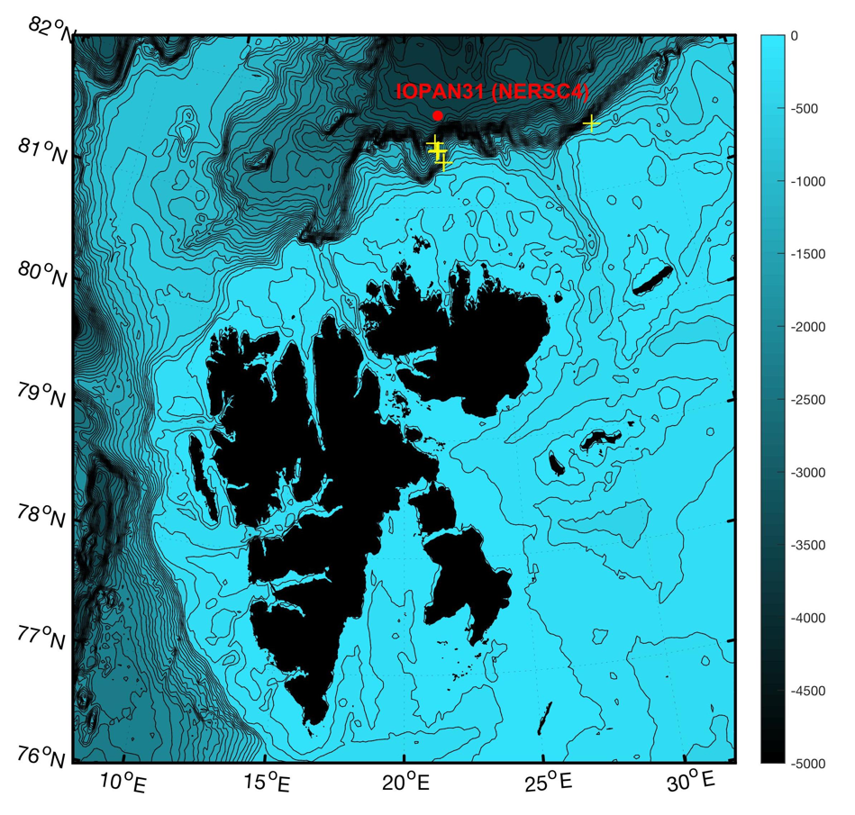
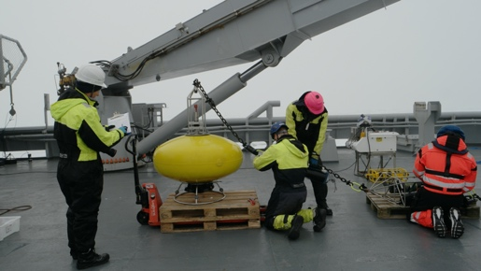
Task 3.4 Distributed systems for ocean and sea ice:
Deep ocean mooring NERSC4
Mooring NERSC4 deployed in the deep Nansen Basin
on September 5, 2019 during the CAATEX cruise on KV Svalbard
Recovery of NERSC4
from KV Svalbard
Photo credit:
Hanne Sagen, NERSC
Successfully recovered on July 24, 2020
during the CAATEX 2020 cruise on KV Svalbard
by the French-Norwegian team: Hanne, Matthiew, Nick, Espen
Thank you !!!

Slide 6
Task 3.4 Distributed systems for ocean and sea ice:
Deep ocean mooring NERSC4
Summary of physical data collected from September 2019 to July 2020 by 35 instruments:
Instruments | Measurement type | Variables measured | Temporal resolution | Vertical resolution | Vertical range | Data processing
Signature 250 time series (1) (recovered flooded but data rescued) | Profiles | Currents Sea ice drift and draft Temperature (point) | 1 h / 1 min | 2 m bins for current profiles | 0-33 m | Still experimental, very challenging in particular for sea ice
TRDI LR-ADCP time series (1) | Profiles | Currents Temperature (point) | 1 h | 16 m bins | 90-500 m | Standard Best practice exist
AADI SeaGuard SW (1) | Point | Temperature Salinity, Pressure, Dissolved oxygen, Turbidity | 1 h | - | - | Under development
SBE37 time series (@4 levels) | Point | Temperature Salinity, Pressure | 10 min | 4 depths | - | Standard Best practice exist
RBR Concerto3 (@4 levels) | Point | Temperature Salinity, Pressure | 10 min | 4 depths | - | Under development
RBR Solo/Duet time series (@ 22 levels, one lost) | Point | Temperature (Solo) Temperature and pressure (Duet) | 5 sec | 22 depths | - | Standard
RBR T.ODO (@ 2 levels) | Point | Temperature Dissolved oxygen | 20 min | 2 depths |  | Under development
Data will be registered in the INTAROS catalogue and available from the IOPAN data base after processing is finalized and DOI is prescribed.
Due to COVID-19 limitations and additional cruise in October-November post-cruise logistics was more difficult and took longer time than usual, data recovery from instruments was finalized just recently and processing only started.
Data will be used for ocean-ice statistics in T6.3 (in combination with data from T3.2), for process studies (shelf slope-deep basin exchanges) and for validation of numerical models and remote sensing products.
No plans to sustain the deep basin mooring beyond the INTAROS period but if possibility arises it can be deployed on opportunistic basis.

Slide 7
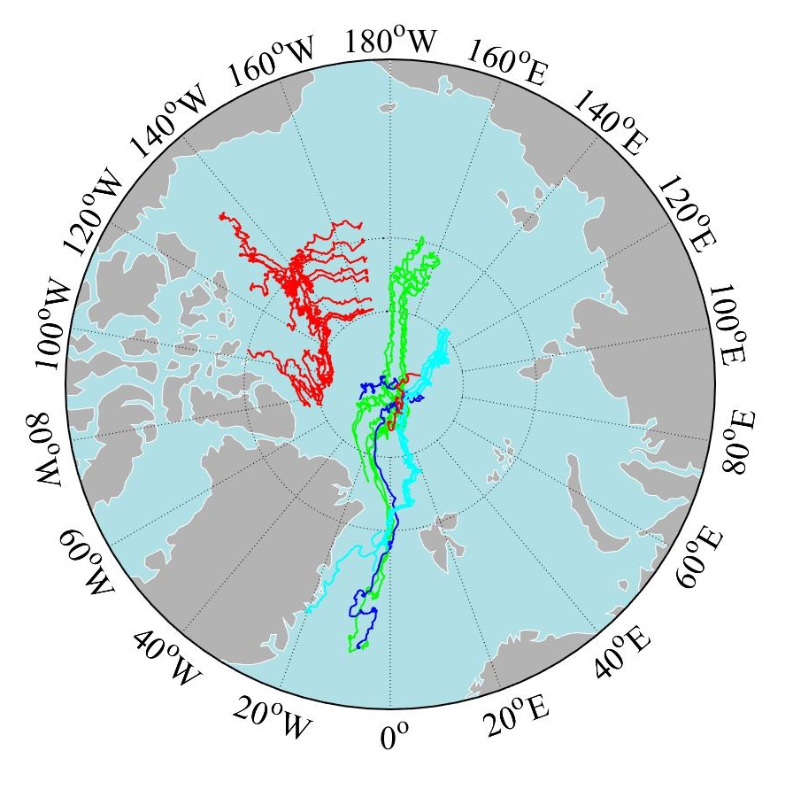
Task 3.4 Distributed systems for ocean and sea ice:
Snow and Ice Mass Balance Arrays (SIMBA) measurements (FMI)
SIMBA deployment in the Arctic Ocean
and the latest status (4 January 2021) by Bin Cheng
SIMBA buoys trajectories
The red colour cluster lines were those SIMBAs deployed during CHINARE2018; The green ones were deployed during NABOS2018; light blue ones are those deployed during MOSAiC2019 (leg1); blue ones were deployed during CAATEX2019; the red drift trajectories in the central Arctic were SIMBAs deployed during MOSAiC2020 (leg 5).
All those SIMBAs are terminated except SIMBA deployed during MOSAiC2020 (leg 5); the red line represented two SIMBAs (FMI0607; FMI0608) drift trajectories, those are very close to each other.
SIMBA deployments are done and 2-3 times more SIMBA buoy data was produced than we initially agreed, thanks for the collaboration with other international partners. There are roughly 3-5 SIMBAs are still working in the Arctic Ocean, e.g. FMI0607, FMI0608 and FMI0606 + few more from PRIC(China).
MOSAiC 2019 (leg 1)
MOSAiC 2020 (leg 5)
Young Sound 2020, landfast ice
CHINARE2018
NOBAS2018
CAATEX2019

Slide 8
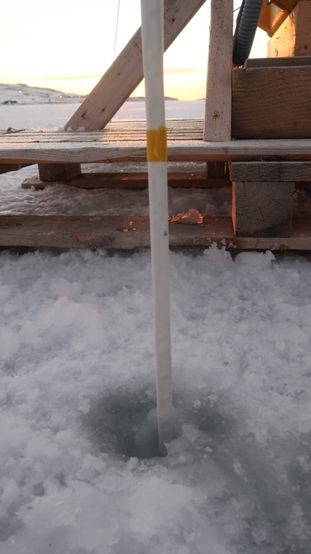
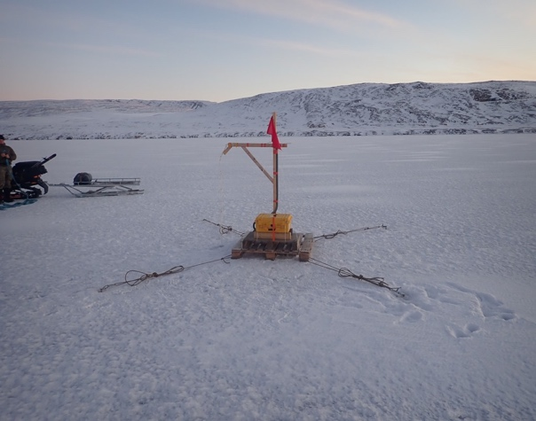
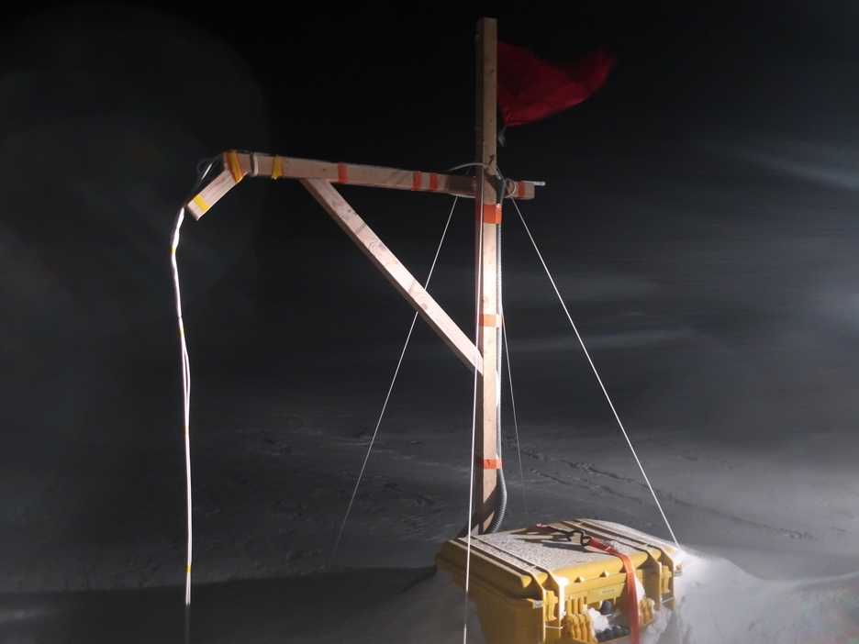
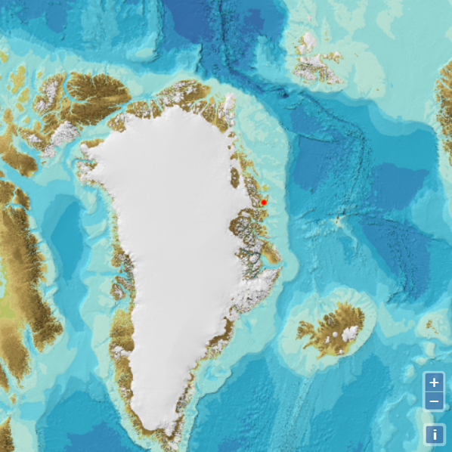
Task 3.4 Distributed systems for ocean and sea ice:
Snow and Ice Mass Balance Arrays (SIMBA) measurements (FMI)
SIMBA deployment in Young Sound, Greenland coastal land fast ice in 2020
in collaboration with Dr. Mikael K. Sejr
from Arctic Research Centre (ARC),
Aarhus University, Danmark
with great help from Danish Navy.

Slide 9
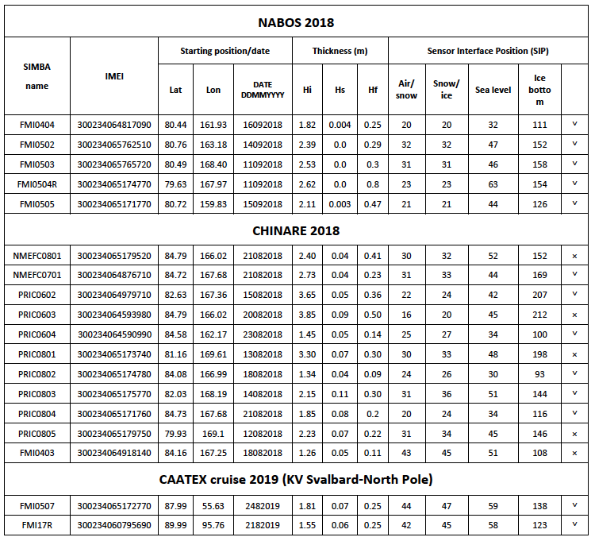
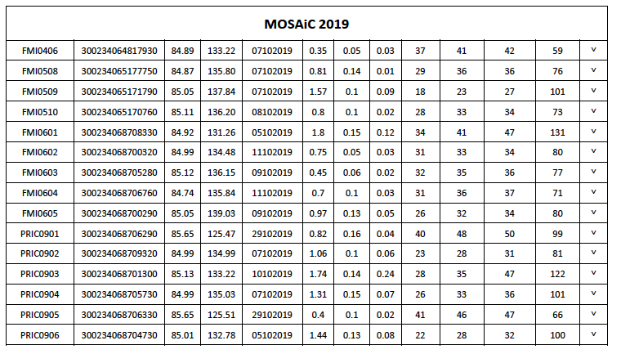
Task 3.4 Distributed systems for ocean and sea ice:
Snow and Ice Mass Balance Arrays (SIMBA) measurements (FMI)
SIMBA temperature (air-snow-ice-ocean) field and heating temperature regime and GPS positioning data will be released for open access after quality control. The SIMBA measurements made during MOSAiC field campaign are part of the MOSAiC data collection.
The SIMBA algorithm is under further improvement and we still need validation of the robust of the algorithm,, a paper was published with lake data and the results are promising.
https://simba.srsl.com/fmi/
https://simba.srsl.com/pric/
https://simba.srsl.com/nmefc/
Some SIMBA raw data are at data portal:
https://data.meereisportal.de/
Technical problems with PANGAEA

Slide 10
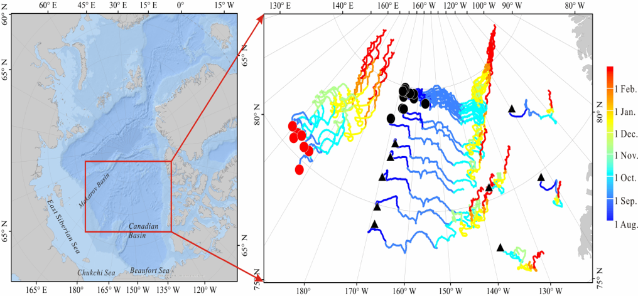
Task 3.4 Distributed systems for ocean and sea ice:
Snow and Ice Mass Balance Arrays (SIMBA) measurements (FMI)
Two papers including SIMBA data
Submitted to the Remote Sensing of Environment: under review
Comparison of CryoSat-2 and ICESat-2 sea ice freeboard observations with MOSAiC SIMBA buoy data during the freezing season of the central Arctic
YoungHyun Koo¹, Ruibo Lei², Yubing Cheng³, Bin Cheng⁴, Hongjie Xie¹, Mario Hoppmann⁵, Nathan T. Kurtz⁶, Stephen F. Ackley¹, Alberto M. Mestas-Nuñez¹
¹NASA MIRO Center for Advanced Measurements in Extreme Environments, University of Texas at San Antonio, San Antonio, TX, USA
²Key Laboratory for Polar Science of the MNR, Polar Research Institute of China, Shanghai, China
³Institute of Atmospheric Physics, Chinese Academy of Sciences, Beijing, China
⁴Finnish Meteorological Institute, Helsinki, Finland
⁵Alfred-Wegener-Institut Helmholtz-Zentrum für Polar- und Meeresforschung, Bremerhaven, Germany
⁶Cryospheric Sciences Laboratory, NASA Goddard Space Flight Center, Greenbelt, MD, USA
Seasonal changes in sea ice kinematics and deformation
in the Pacific Sector of the Arctic Ocean in 2018/19
Ruibo Lei1, Mario Hoppmann2, Bin Cheng3, Guangyu Zuo1,4, Dawei Gui1,5,
Qiongqiong Cai6, H. Jakob Belter2, and Wangxiao Yang4
1Key Laboratory for Polar Science of the MNR, Polar Research Institute of China, Shanghai, China
2Alfred-Wegener-Institut Helmholtz-Zentrum für Polar- und Meeresforschung, Bremerhaven, Germany
3Finnish Meteorological Institute, Helsinki, Finland
4College of Electrical and Power Engineering, Taiyuan University of Technology,
Taiyuan, China
5Chinese Antarctic Center of Surveying and Mapping, Wuhan University, China
6National Marine Environmental Forecasting Center of the MNR, Beijing, China
https://tc.copernicus.org/preprints/tc-2020-211/
Conditionally accepted

Slide 11
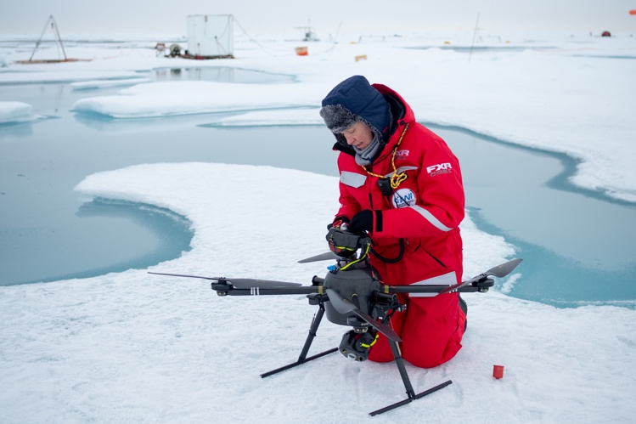
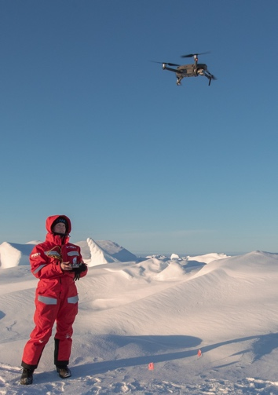
Task 3.4 Distributed systems for ocean and sea ice:
Drone-based surface albedo measurements in the Central Arctic
during the MOSAiC Leg 5 expedition (FMI)
Roberta Pirazzini and Henna-Reetta Hannula
Research questions:
How the spatial heterogeneity of surface types and microstructural properties relates to surface albedo at different spatial scales? What
is the area averaged albedo in satellite footprints and model grids?
Roberta with SPECTRA
Henna with Mavic
@Ian Rohde
@Lianna Nixon
Drones:
SPECTRA: equipped with paired Kipp and Zonen CM4 pyranometers measuring broadband albedo and paired Ocean Optics STS VIS and NIR micro-radiometers measuring visible and near-infrared spectral albedo.
Mavic 2 Pro: equipped with camera to perform photography mapping of the surface.
17 flights with SPECTRA in 8 days, ~5 flight hours
35 flights (maps) with Mavic in 18 days, ~11,5 flight hours
Track of MOSAiC Leg 5 expedition onboard Polarstern

Slide 12
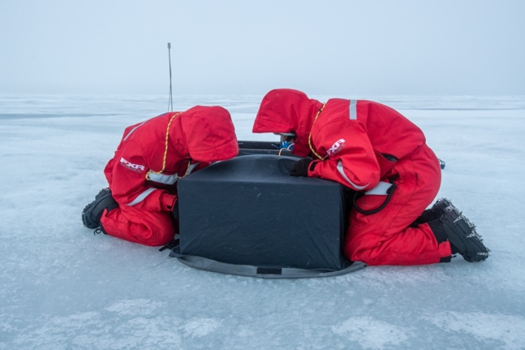
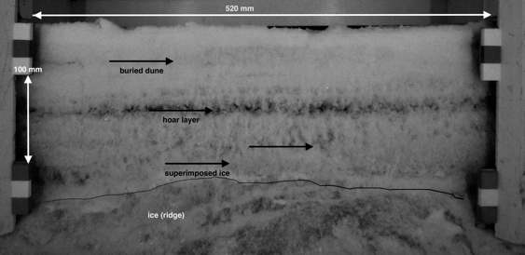
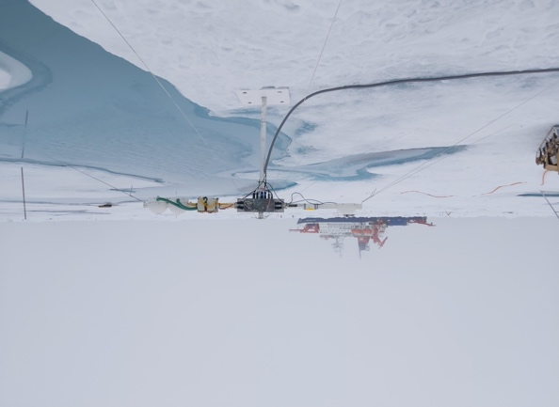
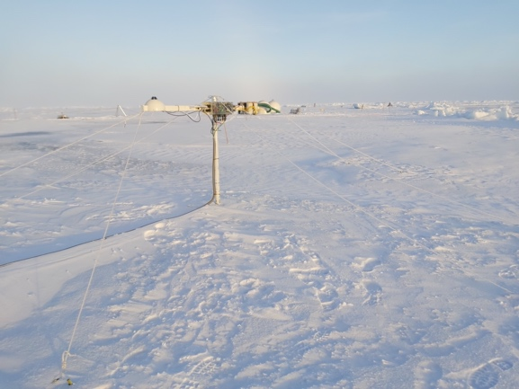
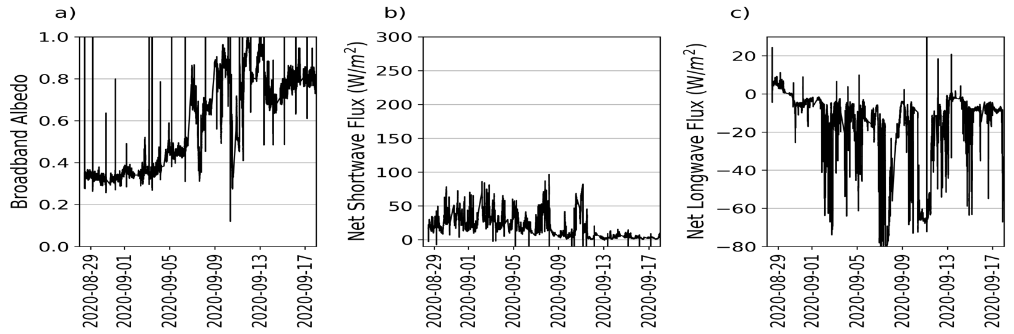
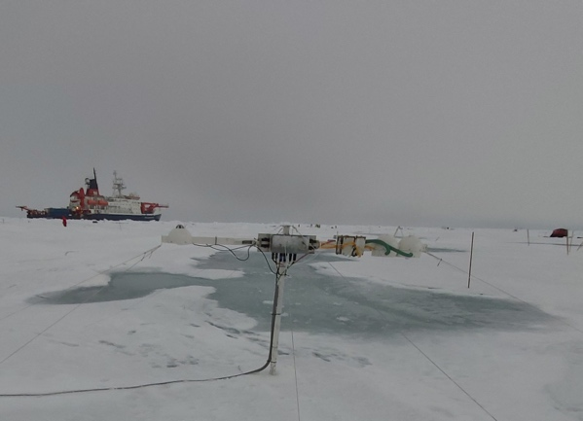
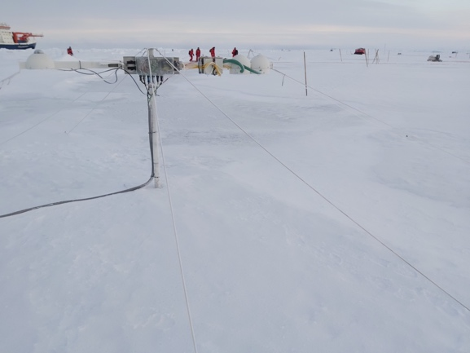
Task 3.4 Distributed systems for ocean and sea ice:
Additional measurements during the MOSAiC Leg 5 expedition (FMI)
FMI and SLF measurements of Snow and Sea ice Scattering Layer (SSL):
Near infrared images -> snow and SSL optical properties
Snow Micro Pen -> snow and SSL optical and structural properties
MicroCT -> 3D snow and SSL microstructure
Structure from motion -> surface roughness
Density, temperature, SWE, salinity, δO¹⁸
Dielectric properties
Chemical sampling
FMI broadband radiation station:
The station captured the change in radiative fluxes over a melt pond
during the autumn freeze up, when in two weeks albedo rose from 0.3 to 0.8
Henna and Ruzica (SLF) with the NIR camera
Near infrared images (SSA)
@Lianna Nixon
28.08.2020
10.09.2020
14.09.2020
18.09.2020
12

Slide 13
Task 3.4 Distributed systems for ocean and sea ice:
MOSAiC data management and recommendation for the Arctic roadmap
Data management:
All data are handled, documented, archived and published following the MOSAiC data policy.
The data will be stored at the PANAEA data repository and openly accessible after two years from their collection.
Recommendation for the Arctic roadmap:
Role of big field experiments such as MOSAiC in the Arctic Observing System:
The key aspect of these experiments is their multidisciplinarity: intense observations of multiple processes linked to each others will enable a breakthrough in their understanding.
Moreover, because of their multidisciplinarity, these experiments also provide the ideal ground truth
to validate and develop models and remote sensing products.
In conclusion: drifting platforms (ships or others) enabling field activities should be part of the sustained Arctic observing system. They are expensive, but costs can be shared among different disciplines.

Slide 14
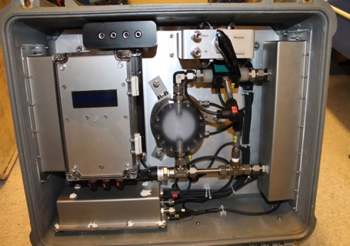
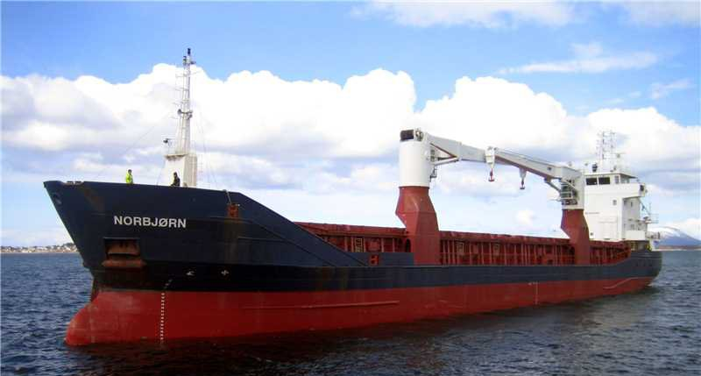
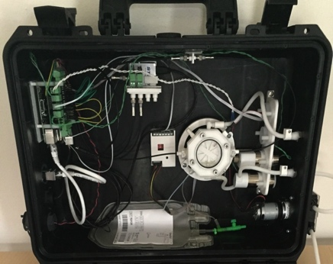
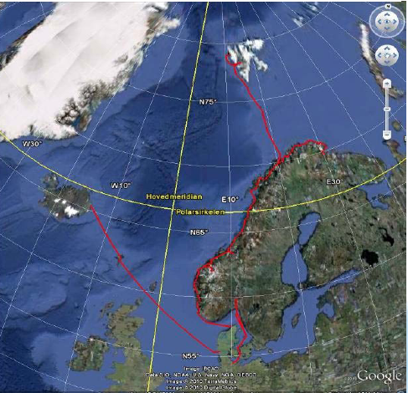
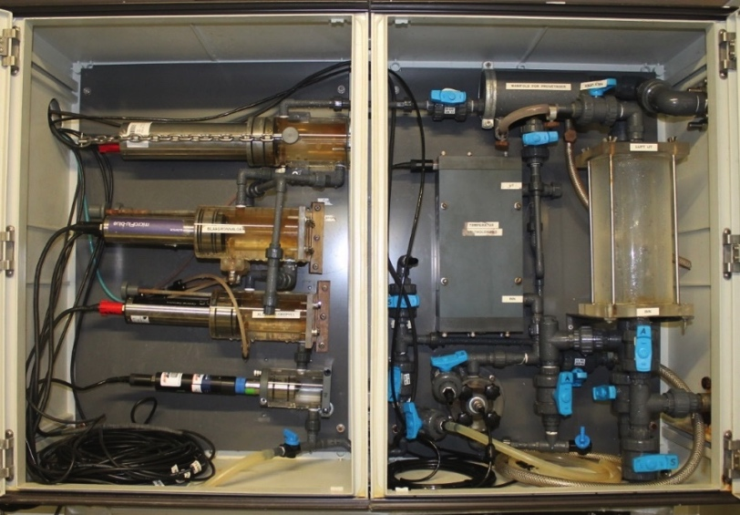
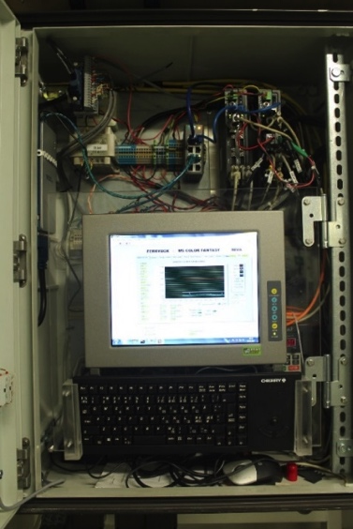
Task 3.4 Distributed systems for ocean and sea ice
Novel sensors for FerryBoxes (NIVA)
Barents Sea Opening: Tromsø, Norway-Longyearbyen, Svalbard
(some stops at Bear Island and Kings Bay)
Northernmost regular shipping route in the world
25-30 roundtrip voyages /year
FerryBox system with clean seawater intake at ~5 m
M/S Norbjørn: Bring A/S; Marine Supply
pCO₂
pH
Andrew King, Kai Sørensen, Sabine Marty, Elizaveta Protsenko, Bert van Bavel
PC, electronics
cDOM
Chl a
Turbidity
PC + LabView
CTD
Oxygen

Slide 15
Task 3.4 Distributed systems for ocean and sea ice
Novel sensors and samplers for FerryBoxes (NIVA)
Update on 2020 activities:
Good progress has been made on Task 3.4 sensors deployment on the Tromsø-Longyearbyen FerryBox, despite COVID-19 limitations (see below)
COVID-19 strongly negatively affected NIVA’s activities in Task 3.4
  Limited access to labs and field station reduced time for developing hardware
  Restricted travel in spring/summer for maintenance on the ship and when field work was planned
  Limited access to M/S Norbjørn due to ship’s COVID-19 protocol meant limited ship visits and no one allowed to sail with the ship
Combined pH/CO₃²⁻ sensor now installed on M/S Norbjørn and operating; some cruises are required for collecting validation samples
Integrated sphere absorption meter is now installed on M/S Norbjørn, but the sensor portion has
a component failure (LED source), so it is back in the lab for in-house or manufacturer repair (TBD)
Microplastics sampler collected samples in summer 2019, but no operation was possible in 2020 since it requires an operator to sail and operate the sampler

Slide 16
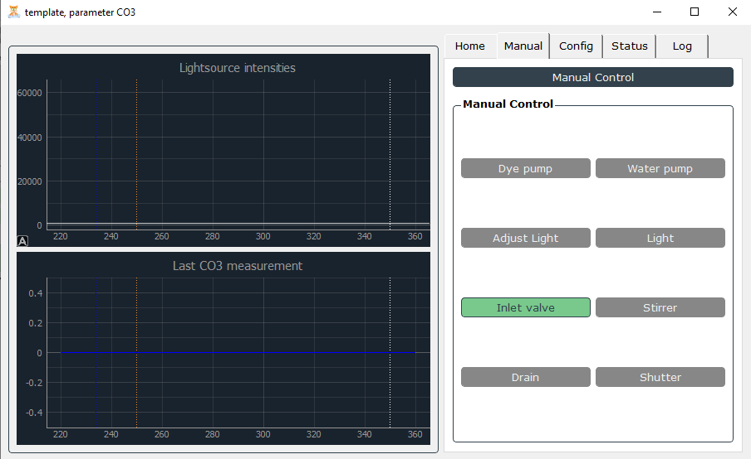
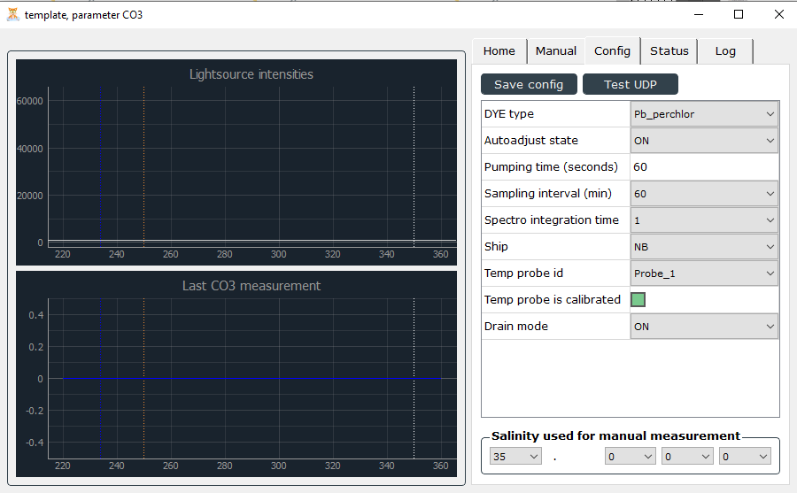
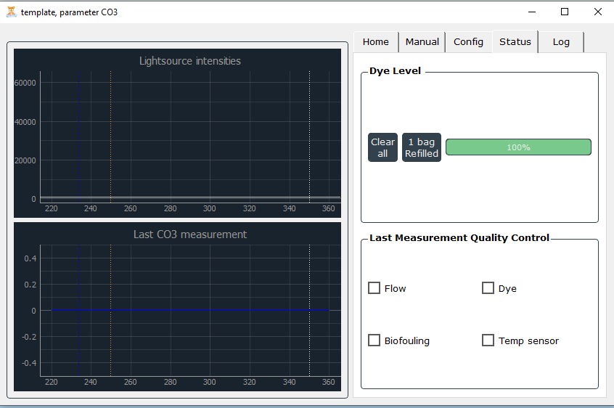
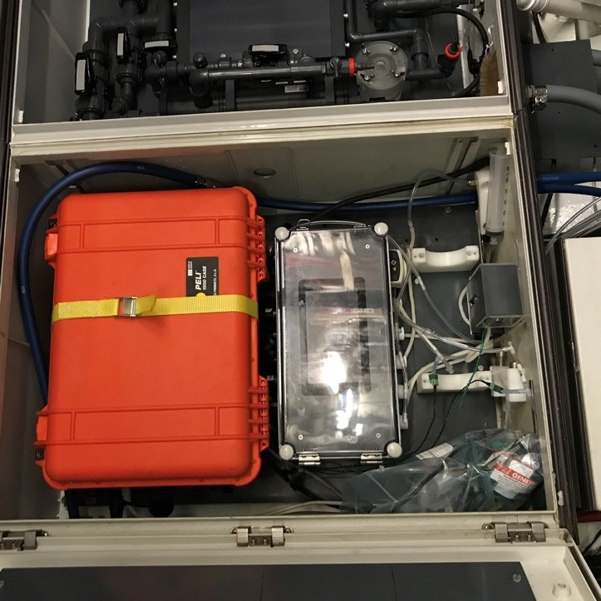
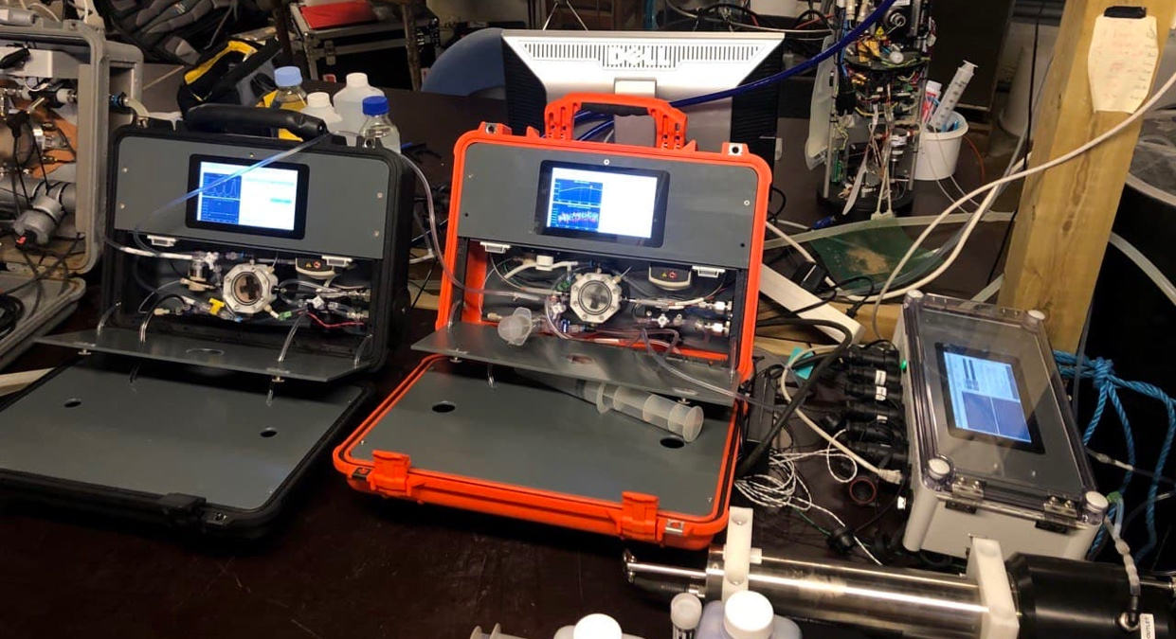
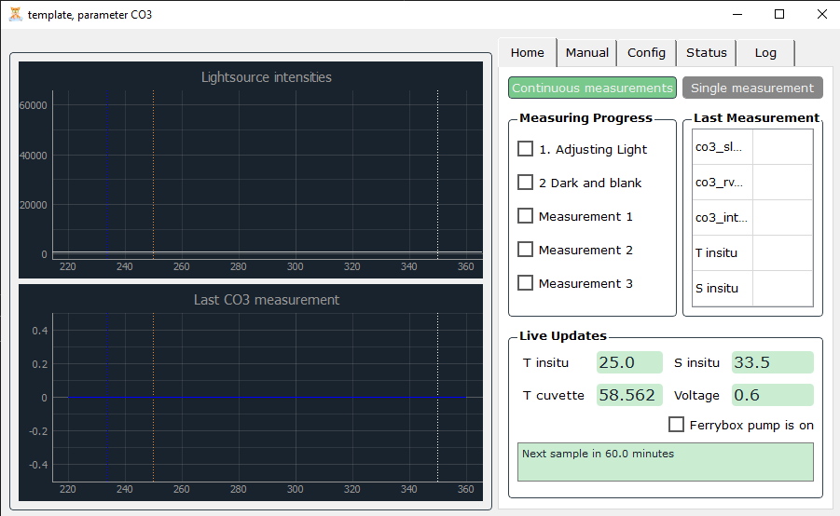
Task 3.4 Distributed systems for ocean and sea ice
Novel sensors and samplers for FerryBoxes (NIVA)
Combined pH/CO₃²⁻ sensor: UV-Vis spectrophotometric detection
pH sensor (black pelicase to the left, CO₃²⁻ sensor (orange pelicase to the right), and a peek of the PSICAM (lower right, and described in next slide) testing at field station
CO₃²⁻ sensor based on UV detection of CO₃²⁻ complexes; sourcing components, troubleshooting, and developing
the UV source and UV spectrometer took more time than expected!
Custom Raspberry Pi/Python 3 software that controls reagent pump, valves, UV source, spectrometer, and data processing
CO₃²⁻ sensor installed on M/S Norbjørn FerryBox at end of 2020
COVID-19 travel/boarding restrictions limited shipboard work in 2020

Slide 17
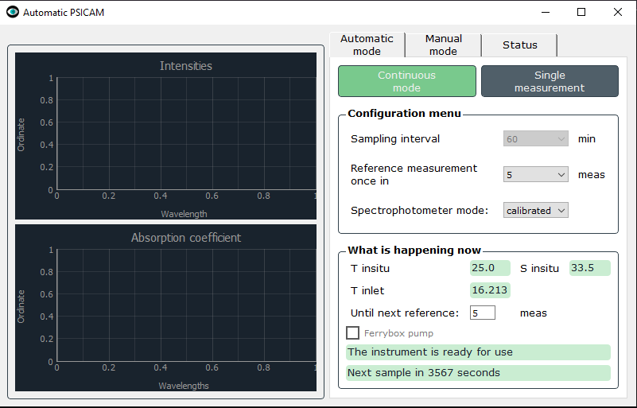
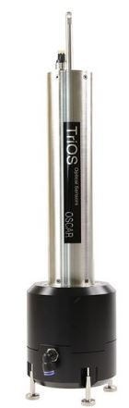
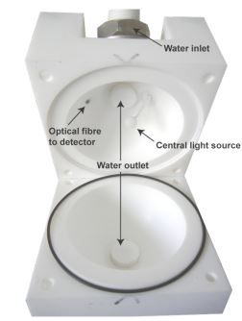
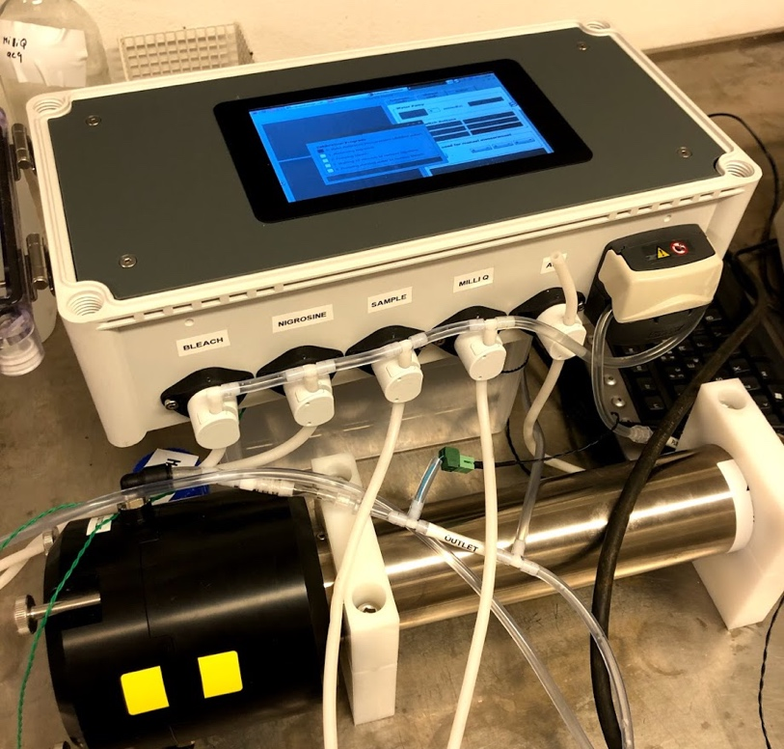

Task 3.4 Distributed systems for ocean and sea ice
Novel sensors and samplers for FerryBoxes (NIVA)
Integrated sphere absorption sensor: cDOM, chl, and phytoplankton accessory pigments
Integrated with custom Raspberry Pi-driven control unit for autonomous operation on FerryBox
Tested at field station, installed on ship, but LED failure delayed ship deployment
Custom python 3 GUI that controls pump, rinsing, sampling, calibration, data processing
Schematic of how the stand-alone point source integrated absorption meter (PSICAM) sensor works

Slide 18




Task 3.4 Distributed systems for ocean and sea ice
Novel sensors and samplers for FerryBoxes (NIVA)
Two collection cruises in summer 2019
On average ~5±4 total number of plastic particles m⁻³ (>~50 µm)
Higher concentration closer to land; majority (>~75%) of plastics in the form of fibres
Previous studies in the region found ~3±3 particles m⁻³
(Lusher et al., 2015 Scientific Reports)
Microplastics sampler: 3 size fractions
All metal (non-plastic) sampling unit installed capable of sampling 10,000 L hr⁻¹
Some samples are quite full of zooplankton that are in the same approx. size fraction
total number of plastic, n/m³
Svalbard
5.7
fragments
fibers
Norway
Salinity

Slide 19




Task 3.4 Distributed systems for ocean and sea ice:
Endurance glider lines around Svalbard (CNRS-LOCEAN)
Marie-Noelle Houssais and Christophe Herbaut
Deploy gliders in the Atlantic Water Current in ice-free waters west and north of Svalbard.
Mission duration : ca. 2 months.
Glider equipped with Seabird T,C,P sensors, DO optode, Chl-a and CDOM fluorimeters, optical backscatter. Dives to max. 1000 m.
Repeat sections across in eastern and northern Fram Strait
Deployment strategy for two gliders
in the Atlantic Water Current
(ice edge as of September 7, 2017)

Slide 20



Task 3.4 Distributed systems for ocean and sea ice:
Endurance glider lines around Svalbard (CNRS-LOCEAN)
Glider mission, July-September 2020
One Seaglider borrowed from and operated by Cyprus University (collaboration with D. Hayes and colleagues)
Deployment from RV Oceania on July 25, 2020 (c/o W. Walczowski)
Recovery in Kongsfjorden onboard Jean Floc’h (c/o L. Biljdorp, French Polar Institute)
Seaglider Pheidippides (July 25-September 25, 2020)
Color change every 5th day,
Sea ice as of July 27, 2020 (MODIS Terra, 500 m resolution)

Slide 21








Task 3.4 Distributed systems for ocean and sea ice:
Endurance glider lines around Svalbard (CNRS-LOCEAN)
0-1000 m depth-averaged velocity
Zonal sections across the WSC - 78°N
2020
Summer 2017
August 2020
2019
Summer 2019
2017
Freshening continues
Processed glider data will be published
through SEANOE https://www.seanoe.org/

Slide 22





Task 3.4 Distributed systems for ocean and sea ice:
BGC Argo floats in Baffin Bay (CNRS-Takuvik)
Claudie Marec and Marie-Helene Forget
Year 2020:
Field work: Due to Covid Situation Takuvik couldn’t take part to the ice breaker Amundsen expedition → no BGC Argo float deployed in 2020.
Nevertheless, one BGC float recovered after its 15 months navigation.
Data:
So far almost 2000 BGC profiles were acquired (temp, sal, O2, nitrates, fluo chla, fluo CDOM, 3 radiometers+PAR, backscatter.) representing 3780 days of navigation for the total fleet.
Real time data available on Argo database GDAC
Delayed mode qualification for Temperature and Salinity have been processed
by Coriolis for floats that were deployed in 2016, 2018 and 2019.
Takuvik proceeds with the final checks and quality control of BGC parameters.

Slide 23

Task 3.4 Distributed systems for ocean and sea ice:
BGC Argo floats in Baffin Bay (CNRS-Takuvik)
Plans for continuation in in situ observations:
A fleet of 7 BGC floats are still to be deployed by Takuvik (thanks to recoveries of 3)
3 floats are currently being refurbished and upgraded
Takuvik intends to deploy 3 BGC Argo in 2021 (initially scheduled in 2020) and 4 in 2022
One will be equipped with a UVP6 by Hydroptics - a new sensor dedicated to measure particle size abundance → give a complementary information to characterize
the ecosystem.
A “premiere” on an ARGO float in Arctic.
Takuvik works also on a high sensibility radiometer
to quantify very low levels of light under ice that
floats encounter in early spring blooms conditions.
Proice float equipped with an UVP6
Picture courtesy LOV

Slide 24

Task 3.4 Distributed systems for ocean and sea ice:
BGC Argo floats in Baffin Bay (CNRS-Takuvik)
2020 publications and communications:
Randelhoff, A., Lacour, L., Marec, C., Leymarie, E., Lagunas, J., Xing, X., et al. (2020). Arctic mid-winter phytoplankton growth revealed
by autonomous profilers. Sci Adv 6, eabc2678. doi:10.1126/sciadv.abc2678.
André, X., Le Traon, P.-Y., Le Reste, S., Dutreuil, V., Leymarie, E., Malardé, D., et al. (2020). Preparing the New Phase of Argo: Technological Developments on Profiling Floats in the NAOS Project. Front. Mar. Sci. 7, 577446. doi:10.3389/fmars.2020.577446.
Le Traon, P.-Y., D’Ortenzio, F., Babin, M., Leymarie, E., Marec, C., Pouliquen, S., et al. (2020). Preparing the New Phase of Argo: Scientific Achievements of the NAOS Project. Frontiers in Marine Science 7, 838. doi:10.3389/fmars.2020.577408.
Achim Randelhoff e-poster Arctic-change " Phytoplankton can grow in Arctic winter" dec 2020
A total of 6 communications in public journals, including Science News and New Scientist
Suggestions and ideas:
Due to Covid situation all floats deployments in 2020 had to be postponed, so that our plans go beyond the deadline of INTAROS roadmap. We would suggest to postpone the end of the project by one year.

Slide 25
Task 3.4 Distributed systems for ocean and sea ice - summary
COVID-19 impact and mitigation measures:
Difficult and more time consuming pre- and post-cruise logistics for mooring operations, limited access to the vessel
More demanding logistics for the MOSAiC field campaign
No/limited access to ship for FerryBox measurements
No BGC Argo floats deployments in 2020
Exploitation of the results:
Processed data and derived products are/will be registered in the INTAROS catalogue and published in open data repositories,
depending on data type
Processed data and derived products will be used in WP6 (e.g. T6.3)
Several research papers published already
Plans for completion of work during 2021 and beyond INTAROS:
Finalizing processing and publishing of collected data sets
No more deep mooring deployment planned at the moment but if the opportunity arises, it will be considered
Glider endurance lines planned to be continued by LCOEAN beyond the INTAROS period
SIMBA deployments will be take place depending on other projects (TBD)
Continuation of tuning and troubleshooting the new FerryBox sensors and operating the microplastic sampler
BGC Argo floats deployments scheduled for 2021 and 2022
Preparation of two deliverables D3.13 ‘Final implementation and data: distributed systems for ocean and sea ice’ and
contribution to D3.16 ‘Synthesis and technical recommendation’, both due in month 54 (possible extension?)

