Slide 1
INTAROS Annual Meeting
Stakeholder Interactions
13 January 2021

Slide 2
Stakeholder Task Force
Agreed on STG meeting 28 May 2020
Objective to coordinate INTAROS stakeholder activities:
  Task 1.2 responsible for three stakeholder meetings – of which two has been implemented
  WP4 – several activities toward indigenous people groups and organisation
  WP6 – several Tasks has obligations on contacts/meetings with dedicated stakeholder communities
  Generally, INTAROS has an obligation to inform on its activities and achievements and specially to promote the importance of a sustained Arctic Observing System towards authorities in nations with an Arctic interest and international cooperative bodies

Slide 3
Stakeholders
Focus groups
  Private sector (stressed by reviewers)
    Transport
    Tourism
    Fishery
    Energy – oil, wind
    Instrument producers
    Service providers
  Public administration and decision making
    Environment – EEA, AMAP
    Climate change
    Fishery – ICES
    Natural hazards
    Met. Services
    Ice services
  Search and rescue
  Science community
    Copernicus services
    ESA and EUMETSAT
    EU Polar Expert Group
    EU polar cluster projects
    Research Infrastructures
    Selected universities
  Indigenous people organisations
  International bodies
    WMO, IOC/GOOS + ocean Decade, GEO, GCOS, GCW,

Slide 4
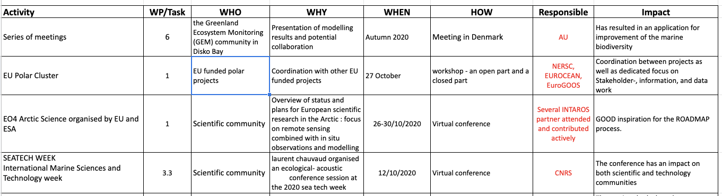
Task Force activities
Overview of past events:
  Around 340 events reported

Slide 5
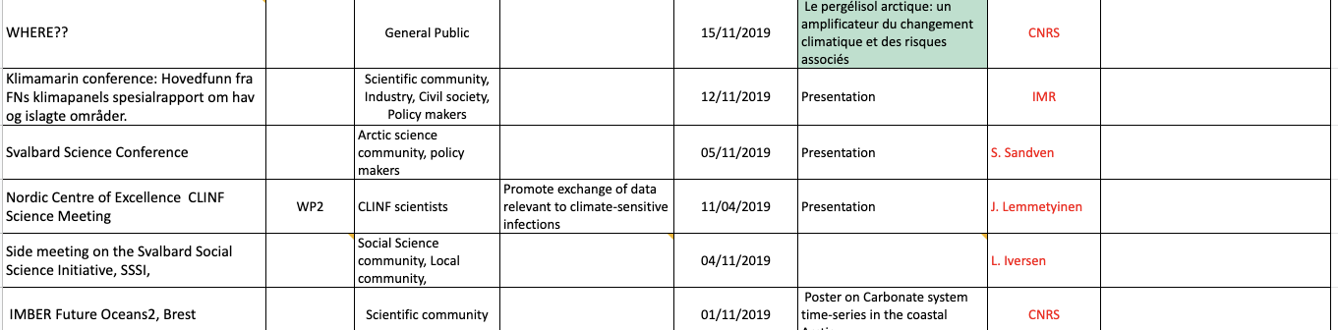
Task Force activities
Overview of past events:
  Several miss basic information
  INTAROS partners have been asked for help
    Limited response
    Please complete (google drive)
it will be a powerful demonstration in our final report

Slide 6
Task Force activities 2021
3. stakeholder meeting
  Support the Roadmap process
  Split in minor activities
    Instrument and sensor manufactures survey
    Dialog meetings with relevant European Research Infrastructures
    Dialog with Arctic Council WG’s
    WP4 and WP6 dialogs with Indigenous people, fishery sector, cruise and shipping
    Follow SAON ROADS process
  Report due ultimo May 2021

Slide 7
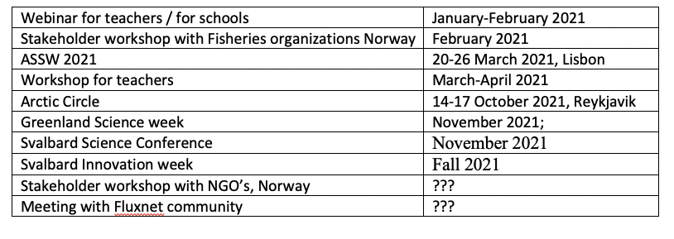
Task Force activities 2021
Work affected by the covid 19 situation
  Delays or cancellations
  Virtual meetings
Other events???

Slide 8

Thank you for your attention

