Slide 1
Progress report on WP1 by month 6
Lead: Stein Sandven, NERSC, co-lead: Erik Buch, EuroGOOS
The overall objectives of WP1 are to
Review the high-level requirements and develop the strategy for the Pan Arctic Observing system based on present initiatives^{(i)}
Plan and coordinate the INTAROS activities in agreement with AOS recommendations and stakeholder requirements, and
Strengthen European participation in Arctic Observing Networks
(i) GEO Cold Region Initiative (CRI), SAON and other international initiatives, related to the Arctic and European Blue Growth strategy;

Slide 2
WP1 Specific objectives
Formalize collaboration with other EU projects, programmes and infrastructures contributing to Arctic observing systems (EU-PolarNET, ALLOCATE, BLUE ACTION, ATLANTOS, INTERACT, ++
Establish cooperation with US Arctic programmes (ONR, NSF), Canadian programmes, Russia, China, Japan and Korea.
Establish and maintain links to stakeholder groups such as Arctic Council working groups (AMAP), global programmes (WCRP), Copernicus services, industries, ++
Formulate an Engagement strategy and establish a Pan-Arctic Observation Forum (e.g. Arctic Observing Summit)
Include indigeneous and local perspectives and knowledge in project planning and implementation
Prepare data management plan and data governance framework ( e.g. through the IASC Arctic Data Committee)
Develop a roadmap for future sustainable Arctic Observing System

Slide 3
WP1 Tasks and task leaders
Tasks | Task leaders
1.0 Scientific coordination | S. Sandven, NERSC
1.1 Consolidation of high-level requirements | E. Buch, EuroGOOS
1.2 Establish cooperation with stakeholders | E. Buch, EuroGOOS
1.3 Collaboration development, Pan-Arctic Forum. | N. Dwyer, EurOcean
1.4 Data management and governance | T. Hamre, NERSC
1.5 Roadmap for sustainable Arctic Observing System. | S. Sandven, NERSC
Contribution to the work from Theme leaders and other WP-leaders

Slide 4
Summary of activities
Planned and participated in conferences, workshops and meetings where INTAROS has been presented
Established contacts and networks with many projects and programmes including ESA
Clustering with other EU polar projects
Collaboration with the SAON committees ADC and CON
Collaboration with YOPP and MOSAIC, time-limited intensive efforts
Collaboration with infrastructure projects: ICOS, INTERACT, ACTRIS, Euro_ARGO, FRAM, EMSO (ENVRI-PLUS, is an overarching coordination)
Meetings and dialogue with USA and Canada: INTAROS partners, other institutions and funding agencies
Meetings and dialogue with partners in China, Japan and South Korea

Slide 5
INTAROS presentations autumn 2016
5-7 Sept: YOPP planning meeting, ECMWF Reading UK (S. Sandven, Y. Gao)
5-7 Sept: The 5th Nordic ENVRI workshop on Arctic RI collaboration, Longyearbyen (H. Sagen)
14 Sept: Polar Day in Bergen (Hanne Sagen)
07 Oct: Polar Circle, Iceland: Session: Operational Marine Service in the Arctic (A. B. Möller, S. Sandven)
17 Oct: Visit to ONR in Washington (H. Sagen, S. Sandven)
18 Oct: MEOPAR expert meeting in Ottawa (S. Sandven)
08 Nov: Presentation at Research Council of Norway, Oslo (H. Sagen, S. Sandven)
08 Nov: GEO Plenary, St. Petersburg, side meeting of GEOCRI (L. H. Pettersson)
08-09 Nov: Polar Connections Interoperability Workshop at ESRIN (T. Hamre - participant)
10-11 Nov: YOPP data meeting, Oslo (T. Hamre)
12 Nov: COP22, Marakesch, Arctic Day organized by Nordic Council of Ministers (H. Sagen)
16-17 Nov: ENVRI-Copernicus meeting in Prague (H. Sagen)
17 Nov: Norwegian Scientific Academy for Polar Research, Bergen (S. Sandven)
12-16 Dec: Poster presentation at AGU, San Fransisco (S. Sandven, H. Sagen)

Slide 6
Presentation of INTAROS in 2017 (1)
Date | Event | Attended by
11-12 Jan | KO-meeting in Bergen with invited guests | ≈ all partners
18-19 Jan | Presented INTAROS at Blue Action KO-meeting, Berlin | S. Sandven, Y. Gao
25 Jan | Meeting with ArCS director M Fukusaw at Arctic Frontier | S. Sandven
8-9 Feb | APPLICSATE KO-meeting, Berlin | S. Sandven
16 Feb | Presented INTAROS at Ministry of Env and Climate | S. Sandven
27 Feb – 01 March | Invitation to PPP SG Meeting and the YOPP Buoys and Floats Task Team, Maryland | A. B. Möller
01-06 March | Visited and presented INTAROS to Chinese partners (PRIC in Shanghai, RADI and NMEFC in Beijing) | S. Sandven, Y. Gao
29-30 March | Arctic Workshop of the Transatlantic Ocean Research Alliance, Brussels, collaboration USA and Canada | S. Sandven, H. Sagen
3 April | EU-Polarnet GA meeting in Prague | S. Sandven, H. Sagen
4-7 April | Arctic Science Summit Week (ASSW), poster presentation | S. Sandven, H. Sagen, T. Hamre
7 April | Invited to SAON Board meeting | S. Sandven, H. Sagen, T. Hamre

Slide 7
Presentations of INTAROS in 2017 (2)
Date | Event
23-28 April | EGU session "Cross Disciplinary Observations for an Integrated Understanding of the Arctic System” | A. B. Möller presented poster
24 – 28 April | International Conference on Arctic Science: Bringing Knowledge to Action Reston, Virginia, oral and poster | A. Ahlström presented
05 May | INTAROS Stakeholder Workshop in Brussel, 25 invited participants, several partners from INTAROS | Hosted by EuroGOOS
8-10 May | OceaNoise 2017. Invited presentation on data management of acoustic data | T. Hamre and H. Sagen (co-chair )
8 - 12 May | Arctic Interchange, Week of the Arctic, Fairbanks, including workshop on community based observing | Finn Danielsen, Hajo Eicken
23-24 May | Modelling workshop, Brussels, coordination between Blue Action, APPLICATE, INTAROS and others | Virgnie Guemas
30 May | Meeting in Norwegian Research Council on H2020, Oslo | S. Sandven
31 May | EuroGOOS General Assembly, Brussel | S. Sandven
11-15 June | ESSAS Open Science Meeting on Subarctic and Arctic Science (http://www.imr.no/essas/en) | G. Ottersen
11–16 June | POAC 2017 in Busan, South Korea | S. Sandven
19-21 June | 11th GEO European Projects Workshop, Helsinki | S. Sandven, E. Buch
Date | Event
23-28 April | EGU session "Cross Disciplinary Observations for an Integrated Understanding of the Arctic System” | A. B. Möller presented poster
24 – 28 April | International Conference on Arctic Science: Bringing Knowledge to Action Reston, Virginia, oral and poster | A. Ahlström presented

Slide 8
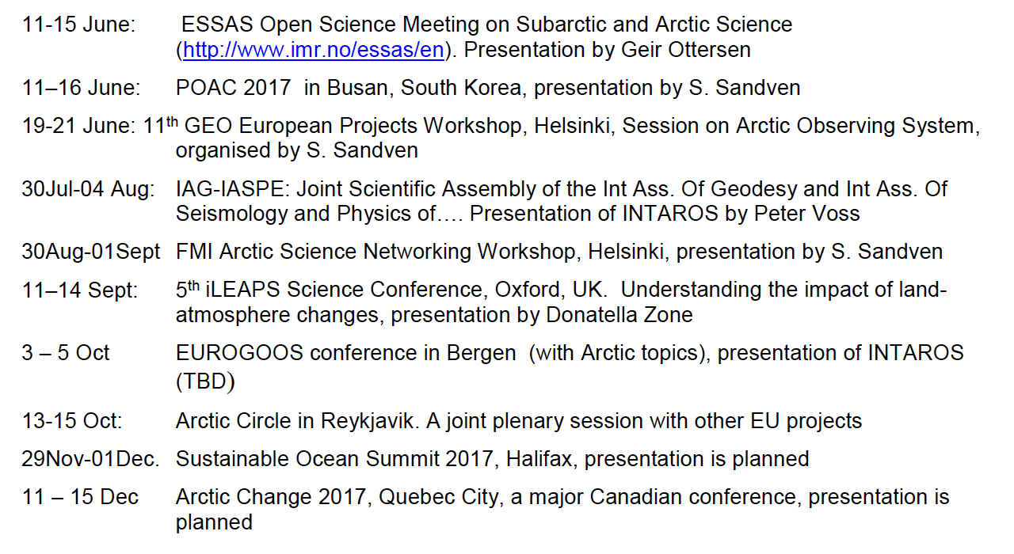
Planned conferences and workshops in 2017

Slide 9
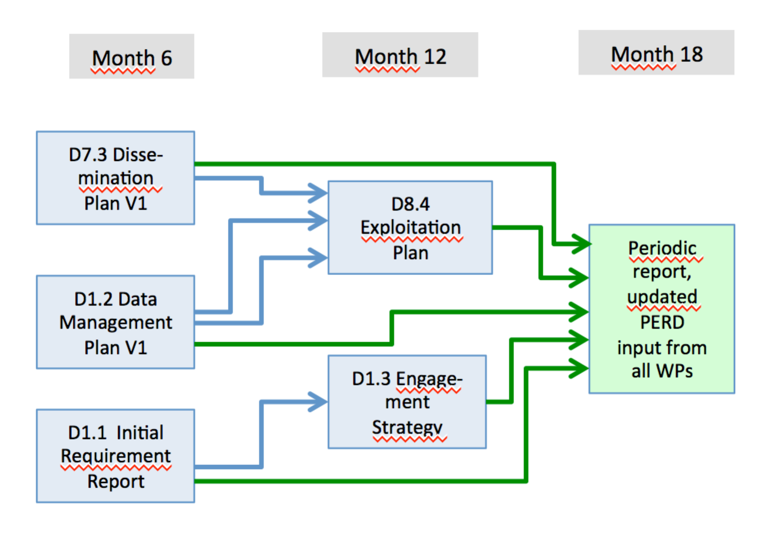
Dissemination and Exploitation documents

