Slide 1
Developing Arctic observing systems –
the role of Norwegian institutions:
The workshop is a back-to-back meeting with the
Svalbard Science Conference 06 – 08 November 2017
Research Council of Norway 09 November 2017
Introduction by Stein Sandven,
Nansen Environmental and Remote Sensing Center
The workshop is organised as part of the H2020 INTAROS project. INTAROS aims to develop Pan-Arctic observing systems based on ongoing efforts by European, North American and Asian countries. INTAROS is therefore working in close collaboration with SIOS and other international initiatives to develop and implement long-term observing systems in the Arctic

Slide 2
Agenda (1)

Slide 3
Agenda (2)

Slide 4
Arctic Science Ministerial – Washington Sept 2016
Joint statement from science ministers in 24 countries:
Arctic-Science Challenges and Their Regional and Global Implications
2. Strengthening and Integrating Arctic Observations and Data-Sharing
3. Applying Expanded Scientific Understanding of the Arctic to Build Regional Resilience and to Shape Global Responses
4. Empowering Citizens through Science Technology, Engineering, and Mathematics (STEM) Education Leveraging Arctic Science

Slide 5
Observing system components
This workshop
Data production:
Observing platform and sensors
Data management: data repositories
Data users: science intsitutions and operational agencies
Collect
Ingest
Store
Search -
retrieve
Analyse
Visualise +

Slide 6
Data production
Sensors / Platforms
Observed variables
Localisation / deployment areas
Data collection scheme (continuous, periodic, irregular, etc.)
Data storage in platform and/or transmission to repositories
Retrieval of physical/biogeochem. variables (processing facilities)
Responsible institution(s)
Data processing and management steps
Collect
Ingest
Store
Search -
retrieve
Analyse
Visualise +

Slide 7
The landscape of Arctic observing networks
1. Broad networks such as the U.S. NSF AON and Arctic- Net in Canada that include a broad range of interdisciplinary observations and projects;
2. Focused networks that are confined to specific themes or disciplines such as marine ecological monitoring;
3. Commercial networks that provide observational data for profit
4. Operations or service-oriented networks such as the Global Atmosphere Watch (GAW) feeding data to weather service and forecasting entities; and
5. Resource-extraction networks that conduct monitoring or baseline observations to support resource extraction activities.
Ref. Lee et al., 2015 (http://dx.doi.org/10.14430/arctic4450)
SAON developes inventories of programs and networks: https://www.arcticobserving.org/inventories

Slide 8
Arctic data directories and initiatives
Arctic data directories and initiatives (from SAON)
Arctic data directories and initiatives
General:
Level 1: General International (GEOSS, GCMD)
Level 2: General Polar (Arctic Portal, Polar Data Catalogue, WMO GCW)
Level 3: National Polar (Polar Knowledge Canada)
Arctic Region:
International:
Arctic Data Centre (WMO IPY legacy)
Arctic Data Explorer (cross-domain discovery tool)
Arctic Observing Viewer
Arctic Research Mapping Application
International Arctic Systemes for Observing the Atmosphere (IASOA)
Sustaining Arctic Observing Networks (SAON)
National:
Arctic Data archive Systems, Japan (ADS)
National Environment Research Council Arctic Office, UK
Norwegian Polar Data Centre, NPI, Norway
Svalbard Integrated Arctic Observing Systems (SIOS)
Disciplinary:
Atmospheric, cryospheric, oceanographic, biodiversity, terrestrial, social science
(from Arctic Data Committee: https://arcticdc.org/products/partner-data-products)

Slide 9
What is INTAROS doing ?
Monitoring programmes, science programmes, global and regional networks, SAON, etc.
INTAROS
atmosphere,
ocean & seafloor, sea ice,
marine ecosystem, glaciology, terrestrial themes, natural hazards, and community-based monitoring
Observing systems:
operational, semi-operational, ad hoc, research-funded, community-based observing, etc.
Technology development, research projects, pilot systems
Notes:
Observing systems are highly variable, from operational to semi-operational, ad hoc and to pure research activity.

Slide 10
INTAROS – Integrated Arctic Observation System
A project funded by EC - H2020-BG-09-2016
Coordinator: Stein Sandven
Nansen Environmental and Remote Sensing Center, Norway
Total budget: 15.5 mEuro - 49 partners from 20 countries
Start date: 01 December 2016 - Duration: 5 years
Notes:
Two Russian partners: All Russian Research Institute for Hydro-meteorological Information (RIHMI-WDC) and Nansen International Environmental and Remote SEnsing Center (NIERSC).
Three Chinese partners: Institute of Remote Sensing and Digital Earth – Chinese Academy of Science (RADI CAS) , National Marine Environmental Forecasting Center (NMEFC) and Polar Research Institute of China (PRIC)

Slide 11
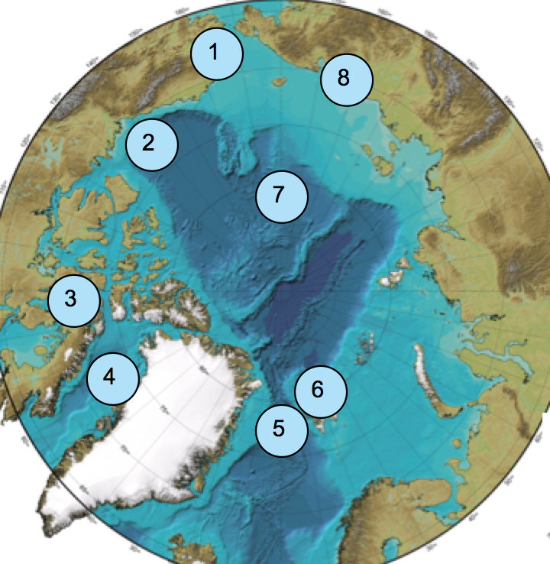
INTAROS overall objective
Location of field work in 2017
to develop an efficient integrated Arctic Observation System by
extending,
improving and
unifying
existing and evolving systems in the different regions of the Arctic

Slide 12
Workpackage structure
WP1: Requirements and strategy for a Pan-Arctic system
WP2: Exploitation of existing observing systems
WP3: Enhancement of in situ systems
WP4: Community-based observing systems
Scientific data
Scientific data
WP5: Data integration & management - IAOS
Community data
Integrated data, prepared for applications
Feedback to requirements, strategy and roadmap
WP6: Applications towards stakeholders
Feedback to requirements, strategy and roadmap
Climate modelling
Ice – ocean statistics
fisheries, marine ecosystems
WP7: Dissemination and outreach

Slide 13
EU’s Arctic project cluster 2017-2021
EU PolarNET
Coordination action
APPLICATE
Modelling – forecasting
INTAROS
observing systems
BLUE ACTION
Modelling – forecasting
60 MEuro
NUNATARYUK permafrost
ARICE
infrastructure
INTERACT
reseach station network
ARC-ICE
FP7
Other infrastruture projects:
ACTRIS, ICOS, SIOS, ENVRI PLUS, ++

Slide 14
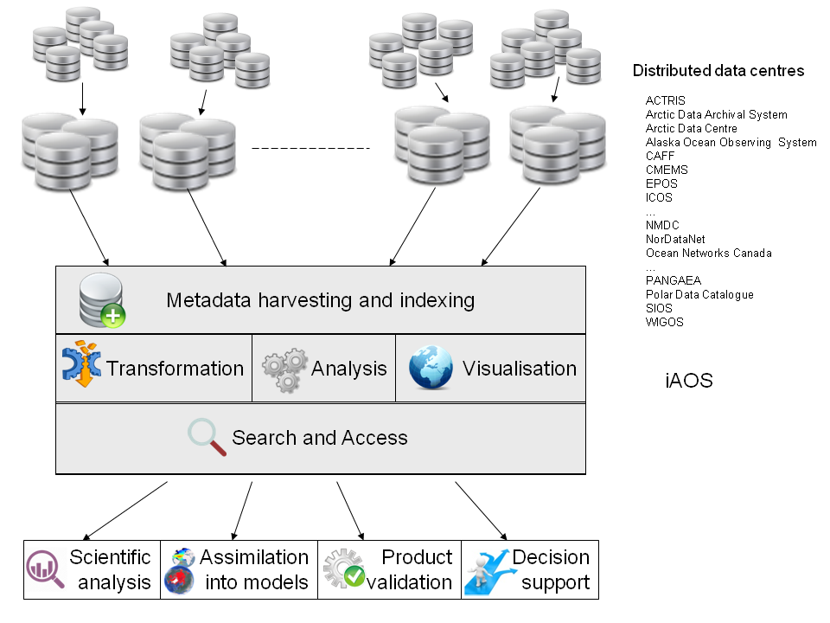
Concept of an integrated Arctic Observation System - iAOS

Slide 15
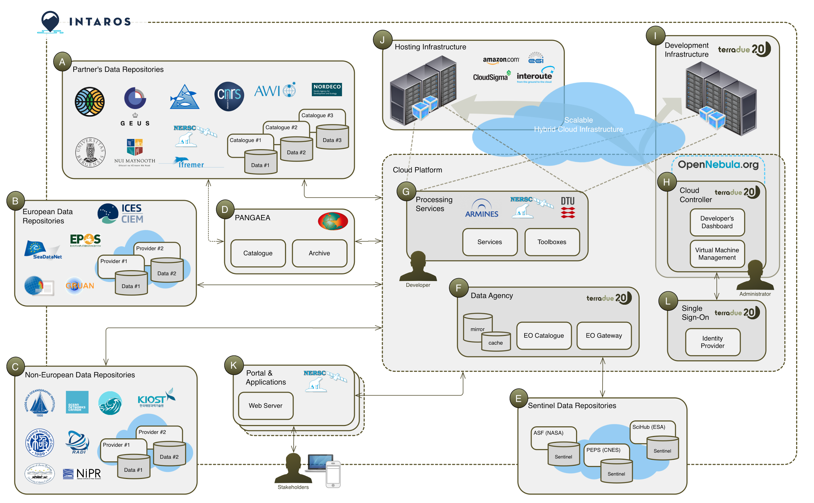
iAOS flowchart Overview
WP5
Hosting infrastructure
Development infrastructure
Partners’ data repositories
Scalable Hybrid
Cloud Infrastructure
Cloud Platform
European data repositories
Processing services
Cloud controller
PAGAEA
Satellite data agency
Non-European data repositories
Portal and applications
Satellite data repositories
User

Slide 16
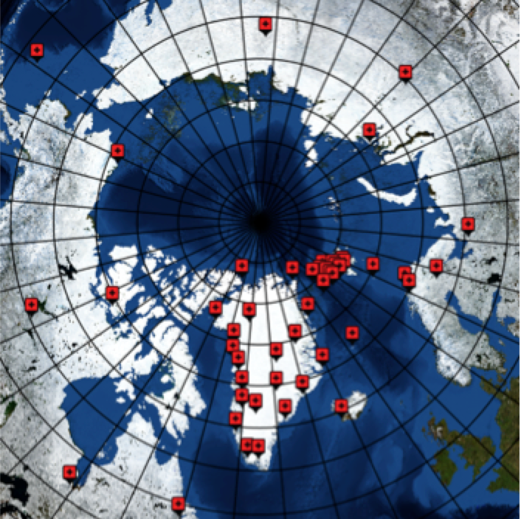
Survey of existing observing systems
The aim of the survey is to evaluate the status of present observing systems with respect to the requirements to build the integrated Arctic Observing System (iAOS) Thhe survey is conducted through a set of online questionnaires at
https://intaros.nersc.no/node/125
Preliminary map of in situ observing systems with site location for data collection, presently being surveyed. Each icon represent a station or an observing platform

Slide 17
Scope of the survey
The survey is designed to serve the objectives of WP2: Exploitation of existing data. The survey will:
Collect information needed to assess the existing Arctic in-situ observing systems (including airborne systems) in terms of data production and delivery chain, accessibility, spatial-temporal coverage, etc. (questionnaire A),
Assess the technological readiness, coverage, resolution, uncertainty, metadata and documentation of selected in-situ data collections that may or may not belong to established networks and catalogue them for use in the integrated system in WP5 (questionnaire B), and
To assess the usage, management, coverage, resolution, uncertainty, metadata and documentation of selected satellite-based products and catalogue them for use in the integrated system in WP5 (questionnaire C).

Slide 18
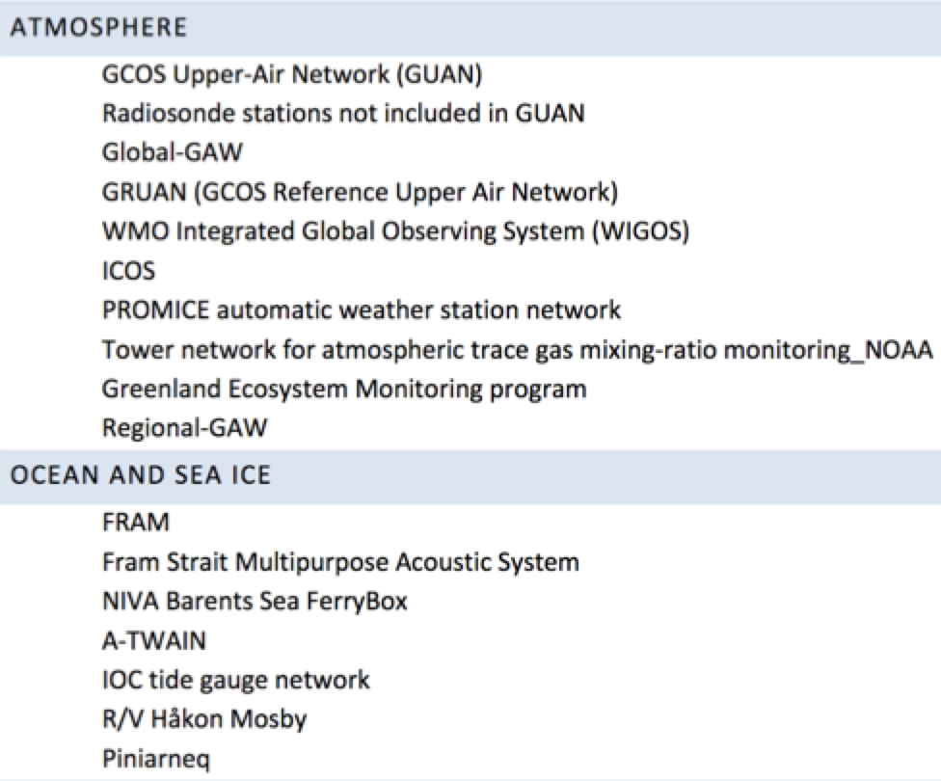
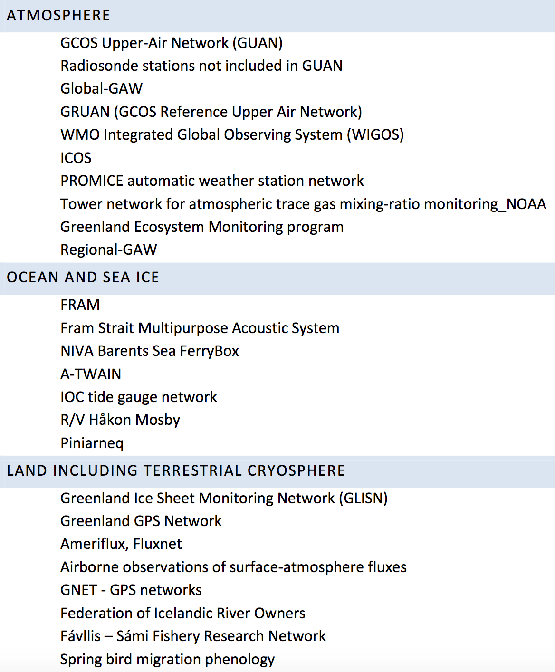
List of selected observing systems in the survey

Slide 19
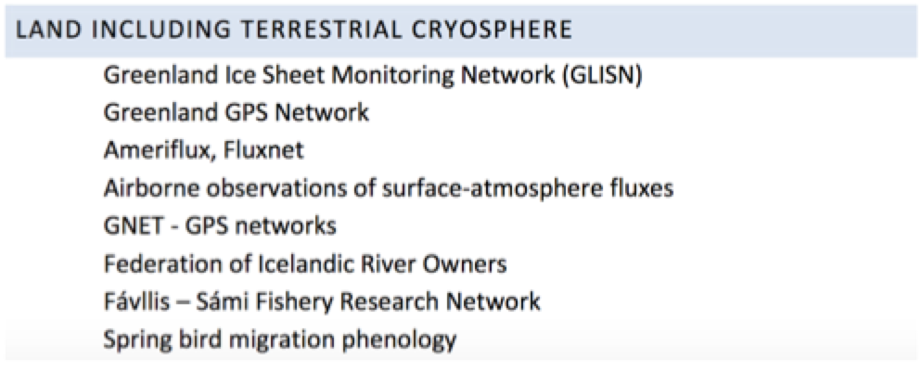
List of selected observing systems in the survey

Slide 20
Questions to be addressed in the workshop (I)
What are the most important observation systems in the Arctic where Norwegian institutions play an active role ? Observation systems covering different scientific disciplines should be addressed, both the space component and the in situ component, as well as users of the data
The satellite component of the Arctic observation systems is now developing rapidly under the Copernicus programme, while the in situ component is lagging behind. How can we improve the in situ component, which is needed to observe the numerous variables that cannot be obtained from satellite data

Slide 21
Questions to be addressed in the workshop (II)
3. A large part of the Arctic observations are provided by time-limited research activities, while only minor parts are collected through operational or semi-operational monitoring systems. How can more of the research-based data collection become long-term, sustainable observations ?
4. Strengthen collaboration between the Norwegian institutions, including establishment of a network or forum that can address cross-disciplinary challenges and engage stakeholder institutions. Who are the actors who should be involved ?

Slide 22
Guidelines for the presentations at the INTAROS workshop 09 November 2017
Address one or more observing systems that are established or in the process of being established
Describe what your institution or project is doing (in connection with national and/or international programmes)
Focus on the upstream part of the observing system (the data collection part, see next slide). The downstream part related to project management, dissemination and exploitation will be addressed in follow-up workshops.
How do you envisage Arctic observing systems in your thematic area to evolve in the coming years ?
What are the main obstacles in building observing systems in the Arctic ?
Each presentation should be not more that 15 minutes.

Slide 23
Challenges in building Arctic observing systems
(1) Develop coordination and collaboration between data providers and stakeholders in the pan-Arctic region in order to better use existing systems and resources (Organisation)
(2) Improvement of the observing platforms and sensors, filling of gaps in the observing network and facilitate for year-round operation, how to go from research to operational systems (Technology)
(3) Data sampling, transmission, calibration, processing, archiving and retrieval of required variables and build distributed and connected databases (Data dissemination)
(4) How to develop sustainability of the observing systems, and what are the funding mechanisms ? (Funding)

Slide 24
What is an observing system ?
(an attempt to define what it is or should be )
An observing system consists of (1) data collection (physical) infrastructure) and (2) data management (e-infrastructure).
The data collection component is comprised of multiple sensors either belonging to a common fixed platform (such as tower, mooring, glider, buoy), which can be a single unity or a collection of units forming a network, or installed on a temporary platform (ship, aircraft, UAV, ocean/sea ice/land station). The data collection component stores the datasets internally or transmits them to the data management component.

Slide 25
The data management component
The data management component includes hardware and software for data repositories, processing, discovery and visualization of data. Data management can be centralized in a single institution or distributed among several institutions, which, in many cases, have agreed on common standards for the data and metadata formats, documentation, etc. An observing system can be multidisciplinary or focused on a specific discipline, and it serves a clearly identified scientific or operational purpose.

