Slide 1
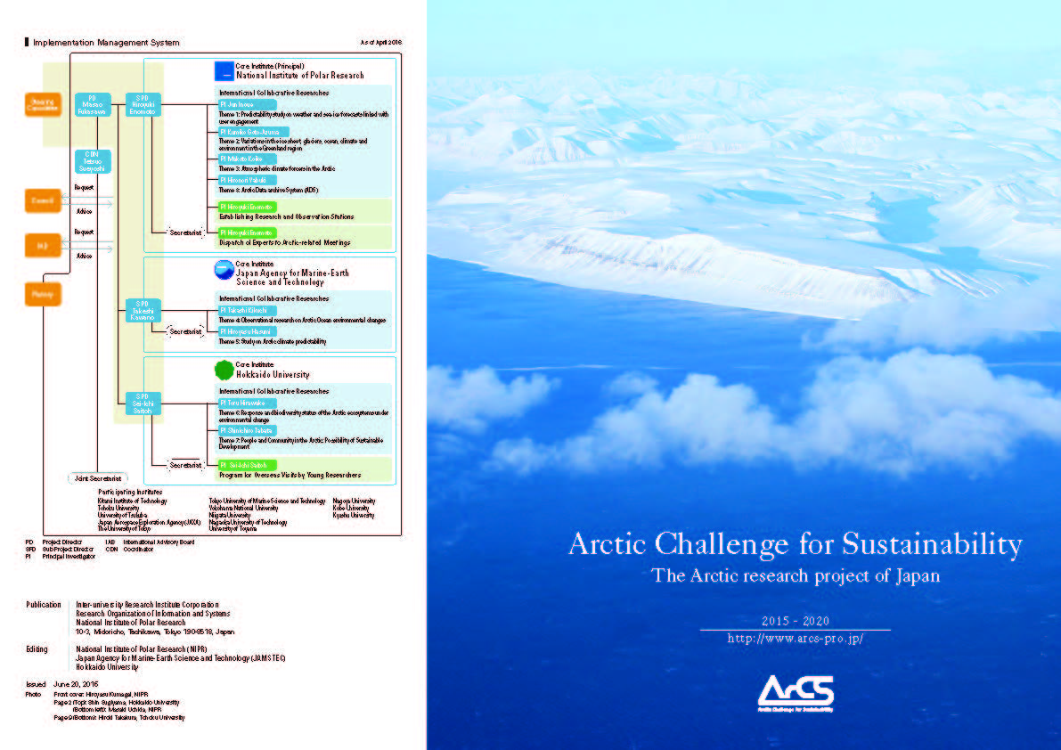

ArCS
Arctic Challenge for Sustainability
Hiroyuki Enomoto
National Institute of Polar Research
Research Organization of Information and Systems

Slide 2
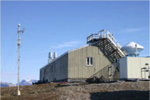
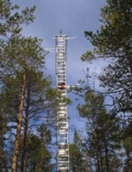

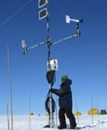
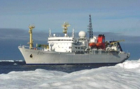
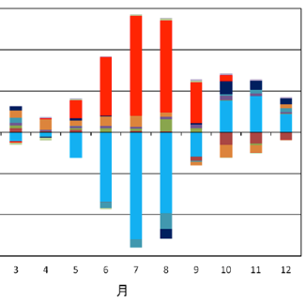
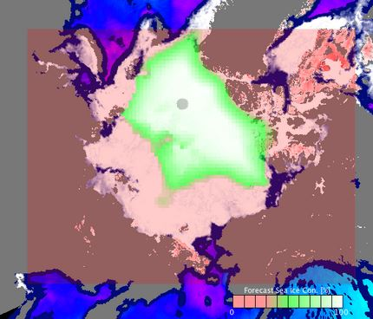
Background of “ArCS” (activity of Japan’s science in the past)
Arctic Research of Japan (Bilateral or Internationally collaborated)
Atmospheric and ecological studies in Ny-Alesund (25 years)
    Greenland Ice cores (NGRIP，NEEM)
    Observation in the Arctic Ocean by R/V Mirai (20 years)
    Climate and Ecosystem change modeling/projection
    Observational studies in eastern Siberia (Yakutsk region, 20 years)
    Vegetation and carbon budget studies in Alaskan boreal forests
    SIGMA Project (snow and albedo study) → Contribution to GCW
Experts contribution to AC Committees
  AMAP, SWIPA, AACA: Sending experts to contribute to making reports
  CAFF, PAME, SCTF: Participating as an observer
  IASC: Participating as Council member and WG member (1991- )
  PAG: Working as the chair (2016-)
GRENE Arctic Project (2011-2015) (35 inst. 4.9 MUSD /year)
Coordinated activities towards new scientific knowledge:
・ Mechanism: polar amplification (precise feedback analysis)
・ Projection: seasonal projection of summer sea ice condition
・ Mechanism: physical relation between the Arctic Ocean
and Winter climate in Japan
Snow/ice Albedo
Ocean Warming
Feedback analysis of monthly heat
source for the Arctic atmosphere
Six-months projrction
of sea ice in the Arctic Sea
http://www.nipr.ac.jp/grene/doc/grene-seika-e20160909.pdf
Notes:
Japan has been engaged in Arctic research, using bi-lateral collaborations with arctic countries. Some of these actions have continued linger than 30 years. Also Japan scientific community dispatched science experts to frameworks under Arctic Council and IASC. So Japanese scientific community has quite a few relationships with Arctic countries and frameworks. However, these activities were carried out by individual institute university and individual scientist.
THE Arctic Project of GRENE started to coordinate these activities so that we could pursue new scientific knowledge. In fact many new and important scientific results came out from GRENE Arctic project, for example the physical mechanism of polar amplification, method for summer sea ice condition and relationship between changes in Arctic climate and mid-latitude climate.

Slide 3
Background of “ArCS”(Japan’s Arctic Policy)
2013 Participation of Japan to AC as an observer
2015 Japan’s Arctic Policy
AS basic perspective of the policy; Japan will …..
1) Make full use of Japan’s strength in the area of science and technology from global viewpoint
2) Give full consideration of the Arctic environment, which is fragile, with a lower ability to recover
3) Ensure the rule of law, and promote international cooperation in a peaceful and orderly manner
4) Respect the right of indigenous peoples to continuity in their traditional economic and social foundations
5) Aim to economic and social compatibility with climate and environmental changes
6) Seek possible economic chances for the use of the Arctic Sea Route and development of resources
7) Pay full attention to security development in the Arctic
Specific Initiatives
1）Research and Development
Promoting Arctic Research to contribute to global policy decision-making and problem solving（via ArCS）
Strengthening observation and analysis systems and develop the most advanced observation instruments
Establishment of Research network in Japan
Establishment of Research station in Arctic states
Considering the design of research vessel
2）International Cooperation
Advocating scientific findings and contributing to formulation of International rules
Further contribution to activities of the AC
Expansion of International and bilateral cooperation with Arctic and other countries
3）Sustainable Use
Promoting preparation for utilization of the Arctic Sea Route
Resource development (mineral/JOGMEC/ and marine living resources）
Notes:
On the other hand, in 2013 Japan participated in AC as an observer state to be expected more contribution to the Arctic and in 2015, Japan adopted its arctic Policy in which Japan’s scientific contribution to the Arctic is the main assertion.
In the policy, seven basic perspective are stated. They are summarized in a short story that scientific knowledge and technology development are expected to ensure the Arctic resilience, give basis of rule of law, keep human security of indigenous people, asses economic compatibility with climate change including the usage of the Arctic Sea Route and resources.
These perspective lead to following three initiatives of Research and Development, International cooperation and Sustainable use. Nine effective actions are listed under initiative, and ArCS was expected to implement eight of these nine actions from the start of the project. So, it can be said that ArCS is one of embodiments of Japan’s Arctic Policy itself (though I am not sure all researchers are aware of this fact or not…. )

Slide 4
Structure of ArCS
Period of project : September 2015 through March 2020
Budget : 2.5 M€ (2015), 7.5 M€/year (fy2016-fy2019)
Participants : More then 200 scientists from 17 institutions and universities
NIPR, JAMSTEC and Hokkaido Univ. are core institutes of ArCS
ArCS aims to;
Understand changes in the Arctic climate, physical-chemical-biological processes,
biodiversity and human dimensions
Predict the changes occurring in future and try to assess impacts of them upon
socio-economy.
Deliver robust scientific information to social communities (including
stakeholders, namely Japanese tax payers and indigenous people and world
decision/policy-makers) as often as possible for decision making and solving
problems
・ArCS is requested strongly to promote cooperation with Arctic countries not only on natural science but also on socio-humane/economic
・ArCS is expected that our scientific actions will help to secure the resilience of the Arctic for the possible sustainable development of the region.
Notes:
Now I would like to step forward the inside of ArCS. 2.6 7.6 ８ｘ３ ＝34
The arctic research project “Arctic Challenge for Sustainability; ArCS” started in 2015. ArCS is 5 years project. Expected budget is 7.5 MＥＵ per year. 17 institutes and universities join in ArCS. And three main institutes drive the project jointly, namely NiPR, JAMSTEC and Hokaido university, respectively. Aims of ＡrＣＳs are , of course, to pursue newest scientific knowledge, and at the same time, to deliver robust scientific information to wider society, decision and policy makers, private sector and indigenous people.
Also ArCS is requested strongly from MEXT to promote cooperation especially in the science field of the Arctic with not only AC countries but also with non-arctic countries for possible sustainability of the Arctic. These aims and requests seems rather difficult for scientists to realize for themselves, however, they characterize ArCS well as an embodiment of Japan’s Arctic policy.

Slide 5
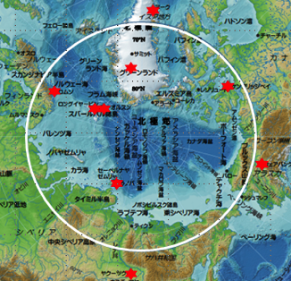
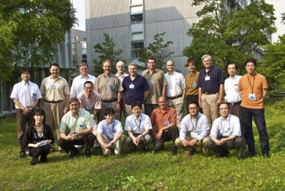
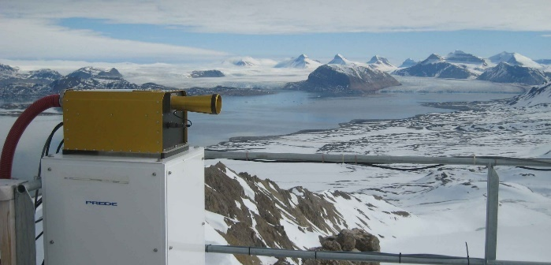
Activity of ArCS (three groups of action themes)
ArCS will strengthen the scientific cooperation with AC and non-AC countries which recognizes the importance of the Arctic. The project aims to provide opportunities of research co-designing with domestic and international stakeholders, with the ideas of social and cultural studies, for future bridging industry and the Arctic.
Expansion of research
base/stations
Sending experts and
young scientists
International research
collaborations
Long-term research cooperation through the exchange of young researchers. Interdisciplinary human resource development.
Sending experts to International committees and meetings.
Carrying out the international joint research project Considering the social and cultural impacts, providing information appropriately.
Improving the basic research facilities for long-term stay and/or monitoring studies, which can be used by inter- national collaborative studies.

Slide 6
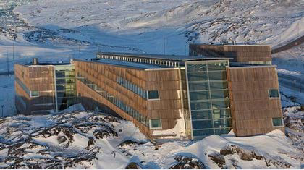
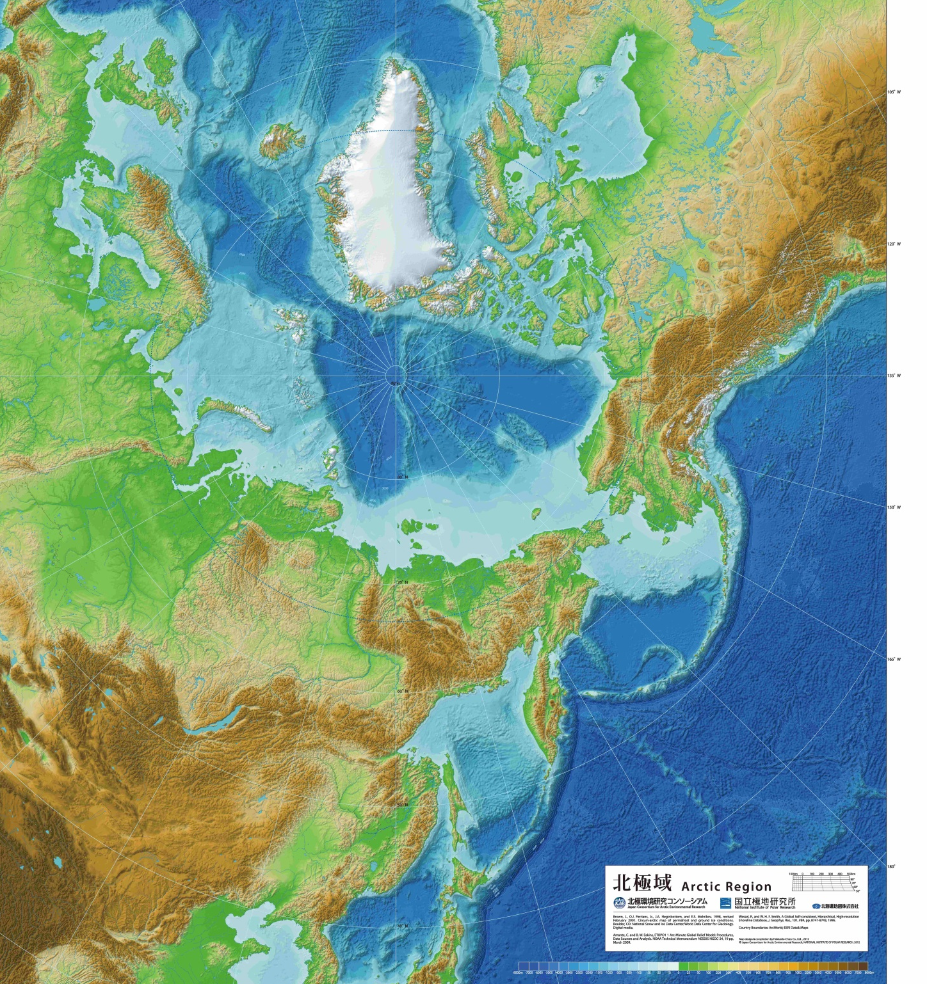

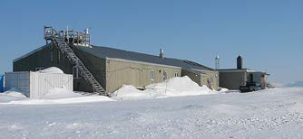

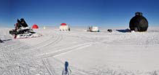
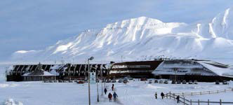

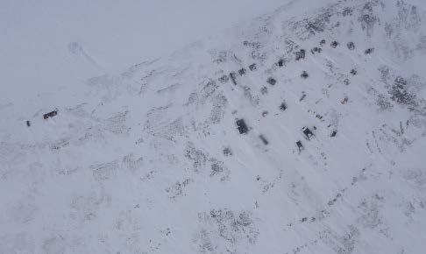

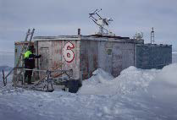

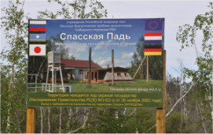
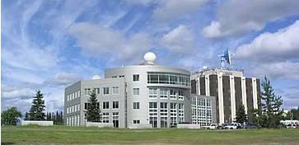

Expand research base/collaborations
Ny-Alesund
GINR
UNIS
EGRIP
CHARS
Cape Baranova
IARC
NE State Univ.
Spasskaya Pad

Slide 7
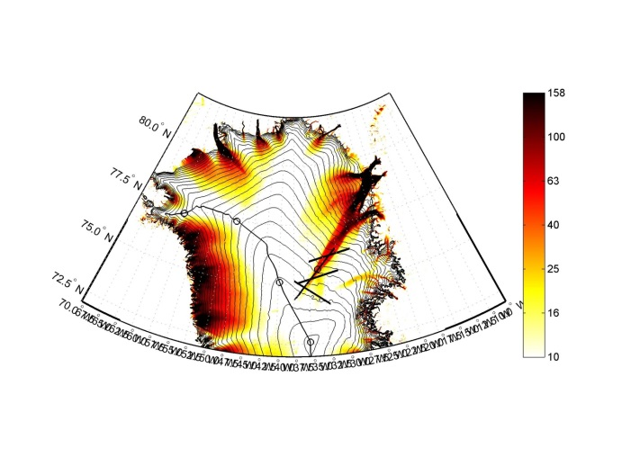
Expand research base/collaborations
Ny-Alesund
GINR
EGRIP
UNIS
EGRIP
CHARS
Cape Baranova
IARC
NE State Univ.
Spasskaya Pad
Improving the basic research facilities for long-term stay and/or monitoring studies, which can be used by international collaborative studies.

Slide 8


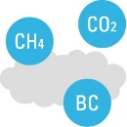



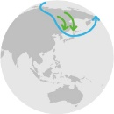


Promoting international cooperated research
Natural Sciences
Social and Human Sciences
Government
Private Sectors
Indigenous Peoples
International frameworks (e.g. WMO)
Arctic Council-related Organizations
Scientists
Society
Prediction & Navigation
Ice sheet/glacier and environment changes
Climate forcer
People and Community
in the Arctic
テーマ
Arctic Ocean observational research
Climate predictability
Arctic ecosystems
Data Management
Data Management
Natural scientific data, result and other outputs are supplied to social and human science theme. (Also, human science theme requests natural science themes for specific data and knowledge.)
At the same time, scientific data and results are archived and disseminated by Data Management
theme aiming to help the establishment of Interoperability of Arctic data.
All of these knowledge and information are prepared to be accessible freely through web, mail
lectures and conferences.
Notes:
Under the third group, there are six research themes from natural science. And two themes are located between the natural science and society.
Social and Human science theme work to form a information for society from scientific knowledge. Also possible impacts of Arctic environmental changes on society and socio-economy are tackled mainly by this themes.

Slide 9
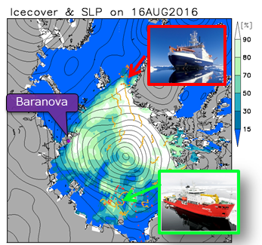
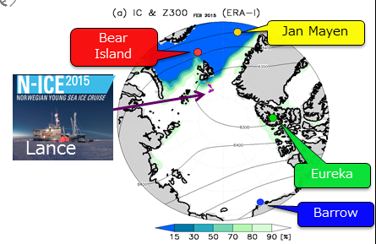

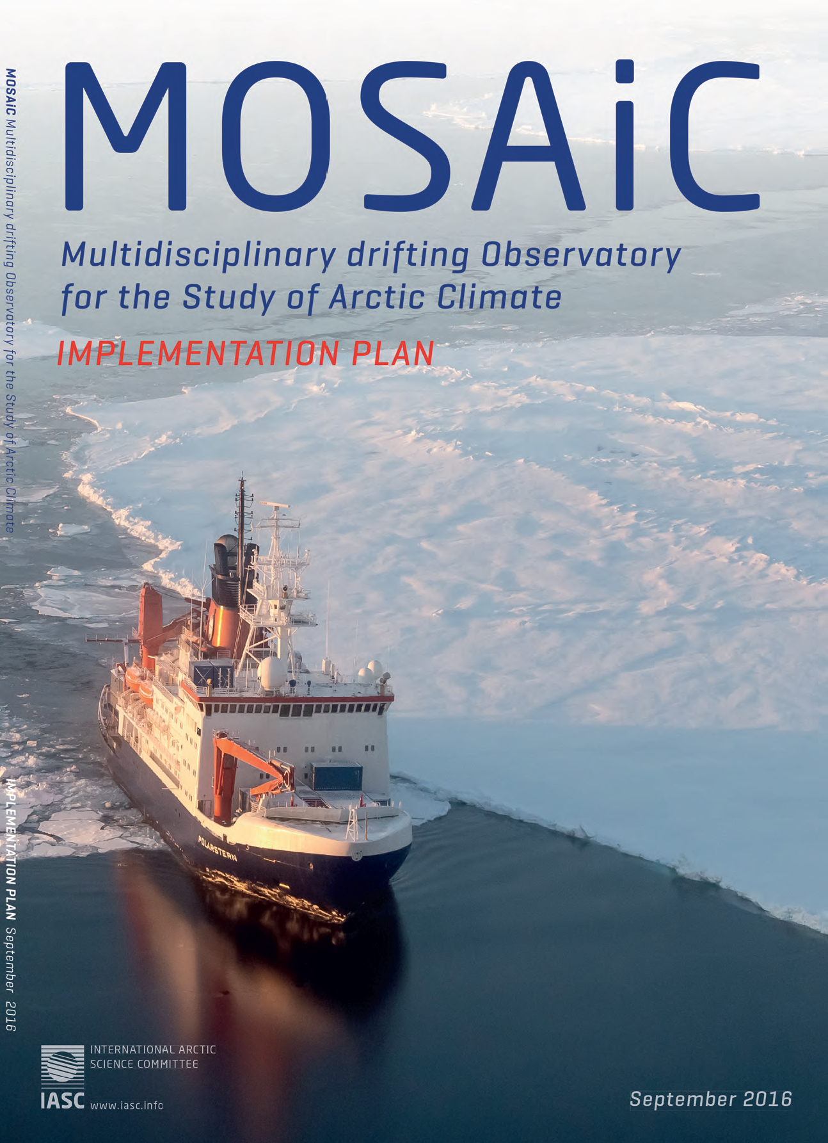
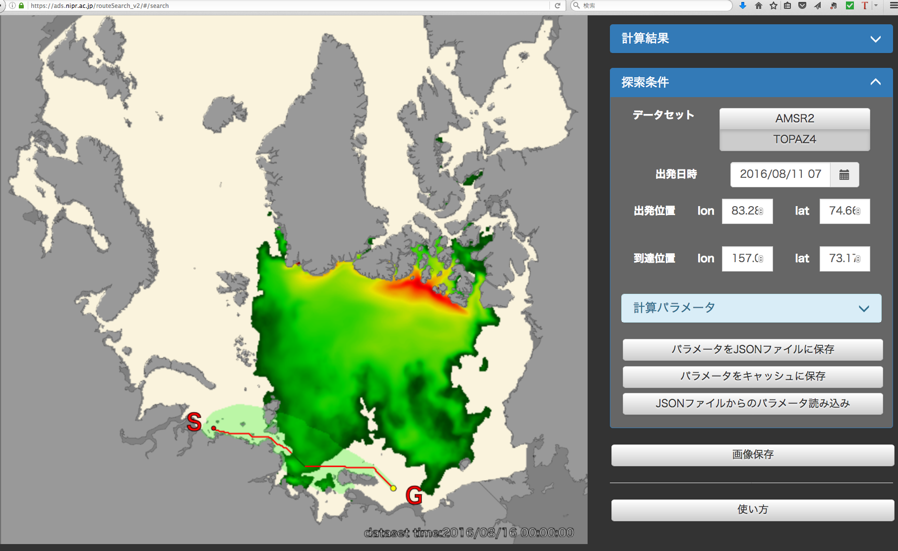
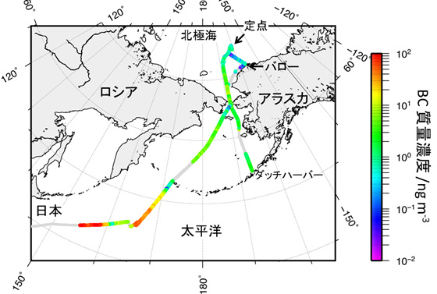
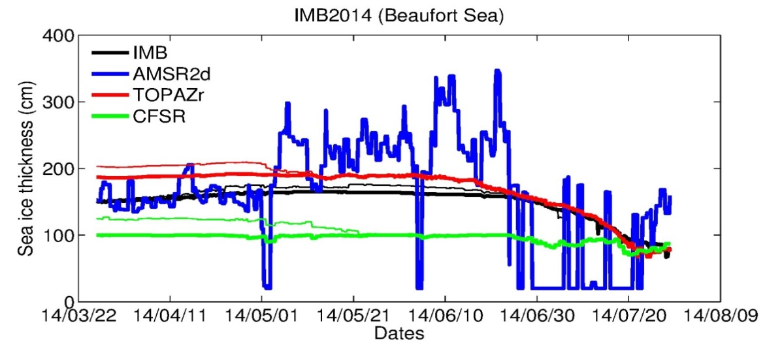
Promoting international cooperated research
GAC2016:
Upper air obs. to numerical experiment
Data: R/V Mirai, Germany, Russia, Korea
+ FMI, Alaska
2015 winter Upper air observation
and weather and climate in middle latitudes weather
Example of data stream: Enhance Observation, Data network,
Assimilation, Numerical Experiment, Social services
Observation
AMSR2
TOPAZ4
CFSR
GEO 2016 Plenary @ Saint P
Navigation
Climate forcer (BC) over ocean Marine safety requires
Improvement of ice data
Notes:
Under the third group, there are six research themes from natural science. And two themes are located between the natural science and society.
Social and Human science theme work to form a information for society from scientific knowledge. Also possible impacts of Arctic environmental changes on society and socio-economy are tackled mainly by this themes.

Slide 10
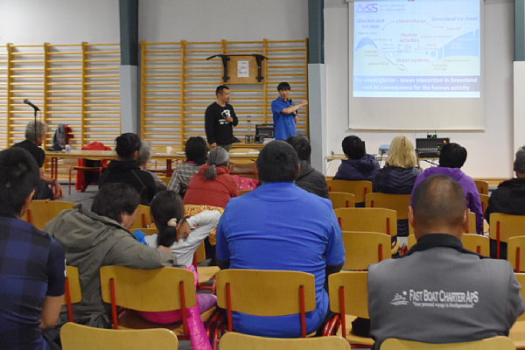
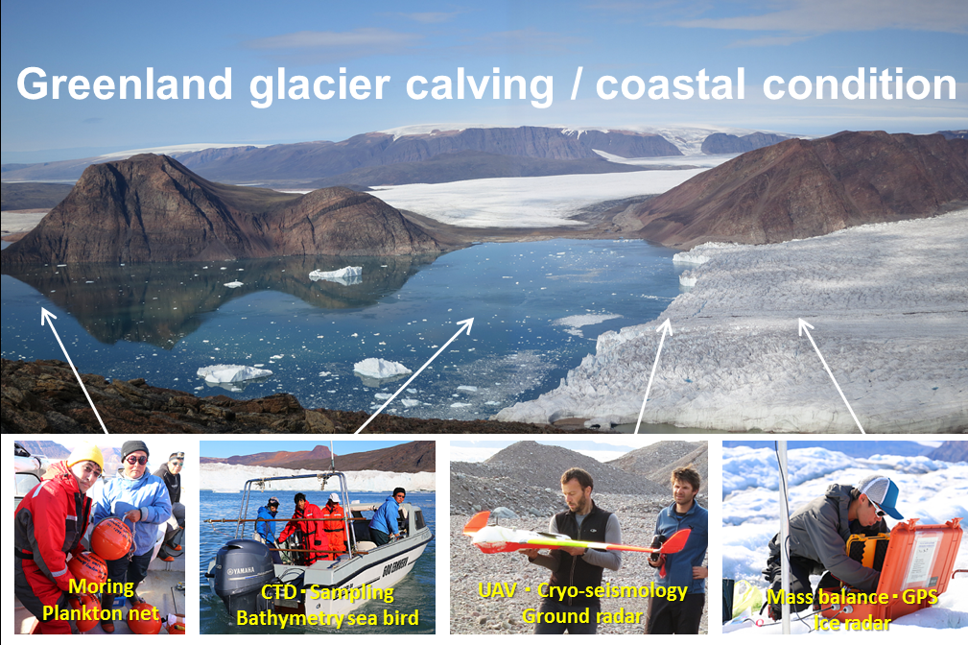
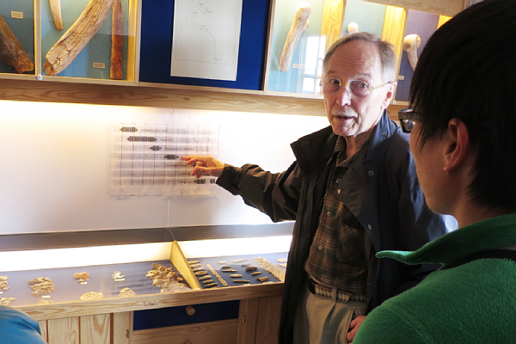
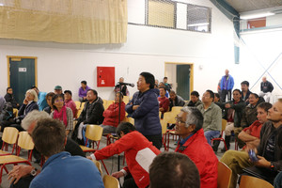
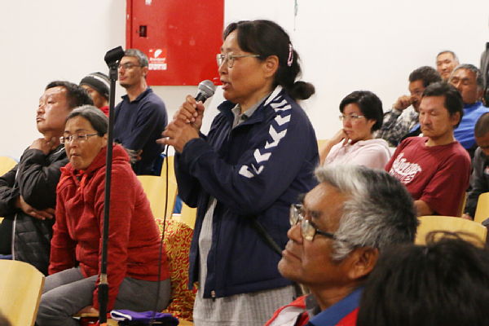
Promoting international cooperated research
Natural Sciences
Social and Human Sciences
Government
Private Sectors
Indigenous Peoples
International frameworks (e.g. WMO)
Arctic Council-related Organizations
Scientists
Society
Prediction & Navigation
Ice sheet/glacier and environment changes
Climate forcer
People and Community
in the Arctic
Discussion with
community
Qaanaaq, Greenland Sept. 2016
テーマ
Arctic Ocean observational research
Climate predictability
Arctic ecosystems
Data Management
Data Management
Natural scientific data, result and other outputs are supplied to social and human science theme. (Also, human science theme requests natural science themes for specific data and knowledge.)
At the same time, scientific data and results are archived and disseminated by Data Management
theme aiming to help the establishment of Interoperability of Arctic data.
All of these knowledge and information are prepared to be accessible freely through web, mail
lectures and conferences.
Notes:
Under the third group, there are six research themes from natural science. And two themes are located between the natural science and society.
Social and Human science theme work to form a information for society from scientific knowledge. Also possible impacts of Arctic environmental changes on society and socio-economy are tackled mainly by this themes.

Slide 11
Promoting international cooperated research
Natural Sciences
Social and Human Sciences
Government
Private Sectors
Indigenous Peoples
International frameworks (e.g. WMO)
Arctic Council-related Organizations
Scientists
Society
Prediction & Navigation
Ice sheet/glacier and environment changes
Climate forcer
People and Community
in the Arctic
テーマ
Arctic Ocean observational research
Climate predictability
Arctic ecosystems
Data Management
Data Management
Natural scientific data, result and other outputs are supplied to social and human science theme. (Also, human science theme requests natural science themes for specific data and knowledge.)
At the same time, scientific data and results are archived and disseminated by Data Management
theme aiming to help the establishment of Interoperability of Arctic data.
All of these knowledge and information are prepared to be accessible freely through web, mail
lectures and conferences.
Notes:
Under the third group, there are six research themes from natural science. And two themes are located between the natural science and society.
Social and Human science theme work to form a information for society from scientific knowledge. Also possible impacts of Arctic environmental changes on society and socio-economy are tackled mainly by this themes.

Slide 12




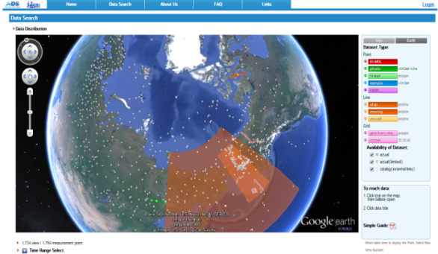
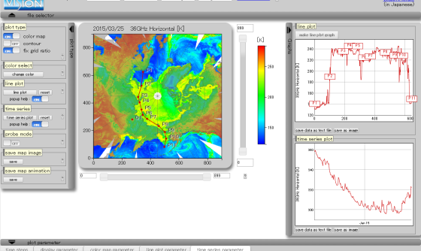
Data Management
All data and results
from Arctic Research
(at least of Japan)
https://ads.nipr.ac.jp/portal/index.action
(Visualization service to view satellite data)
Data and plans registration system
and Metadata search service.
Registered more than 250 datasets
Online visualization application for
Climate, Satellite and Simulation data
Semi-real-time polar environ. obs. Monitor and Sea Ice prediction
.
Collection and Archiving
Working bench
Dissemination
Utilizing satellite data. Collaboration with JAXA Request & report to JAXA.
Support for ship navigation, incl. R/V. Interface btw field data - GTS.
Data from the previous projects are also archived (Data rescue).
The doi number are prepared for each dataset. NIPR Science Data Base (2016 Oct-)
Notes:
As for data management, ArCS has the data center called ADS. Action plans of other themes, observed data, assimilated data and results from prediction models are gathered and archived by this theme. Some of data, namely data without any regal constraint, are processed into so called “easy to understand” information for society. ADS is registered to GCI last year and started its work toward interoperability of Arctic research.

Slide 13
ArCS and EU Project
“International collaboration and “Linkage with society”
are very important characteristics of ArCS.
# Arctic research in Japan has developed through bi-lateral collaboration mostly by Individual scientist and individual institutes.
# ArCS will try to promote Japan’s scientific activity more INTERNATIONALLY based on foregoing bi-lateral cooperation.
# New Arctic Policy of EU is simple to be understood (three main policy objectives focused on three key areas: knowledge, responsibility and engagiment), nevertheless, it covers essential issues of “Arctic Problem” for not only AC countries but also non-AC countries including the linkage of science/technology with society.
# Collaboration between EU and Japan should be enforced ever than before (especially from Japanese side). ArCS will be able to support and promote the collaboration.
# Collaboration with INTAROS through exchange of knowledge, observation system and data, and experience of management system.
Notes:
It’s time to close my talk.
This time, I confined my talk to ArCS, which does not include geophysical themes. However, I heartily hope collaboration between Norway and Japan will be extended much wider in near future.

Slide 14
Thank you for your attention
Please visit http://www.arcs-pro.jp/en/index.html

