Slide 1




Optimizing and Enhancing the Integrated Atlantic Ocean Observing System
#AtlantOS
Prof. Dr. Martin Visbeck
Dr. Johannes Karstensen
Dr. Anja Reitz
GEOMAR Helmholtz Centre for Ocean Research Kiel, Germany

Slide 2
Optimizing and Enhancing the
Integrated Atlantic Ocean Observing System
Budget: 21 Mio. Euros in 4 years
Coordinator: GEOMAR; Partner: 62
Horizon 2020 call BG-8-2014: Developing in-situ Atlantic Ocean Observations for a better management and sustainable exploitation of the maritime resources.
The project: AtlantOS is a research and innovation project that proposes the integration of ocean observing activates across all disciplines for the Atlantic, considering European as well as non-European partners.
Goal: Integration of the so far loosely-coordinated set of existing ocean observing activities to a more sustainable, more efficient, and fit-for-purpose Integrated Atlantic Ocean Observing System.
www.atlantos-h2020.eu

Slide 3


The vision of AtlantOS initiative is to improve and innovate Atlantic observing by using the Framework of Ocean Observing to obtain an international, more sustainable, more efficient, more integrated, and fit-for-purpose system.
Hence, the AtlantOS initiative will have a long-lasting and sustainable contribution to the societal, economic and scientific benefit arising from this integrated approach.
This will be achieved by improving the value for money, extent, completeness, quality and ease of access to Atlantic Ocean data required by industries, product supplying agencies, scientist and citizens.
www.atlantos-h2020.eu

Slide 4
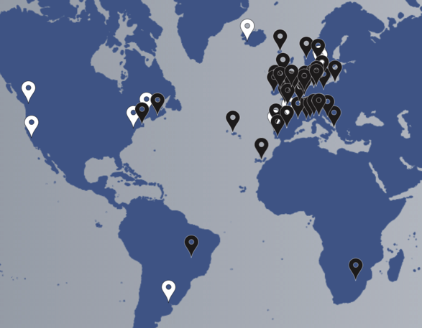





AtlantOS members (white)
and 62 H2020 consortium partners (black)
www.atlantos-h2020.eu

Slide 5
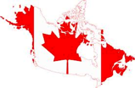
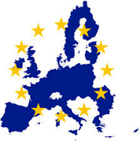
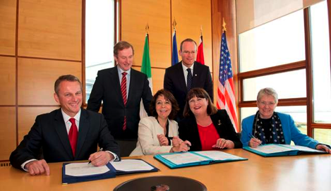


Galway Statement on Atlantic Ocean Cooperation
The European Union, the United States and Canada agreed to join forces on Atlantic Ocean research. The agreement focuses on aligning the ocean observation efforts of the three partners.
The goals are to better understand the Atlantic Ocean and to promote the sustainable management of its resources. The work will also study the interplay of the Atlantic Ocean with the Arctic Ocean, particularly with regards to climate change.

Slide 6
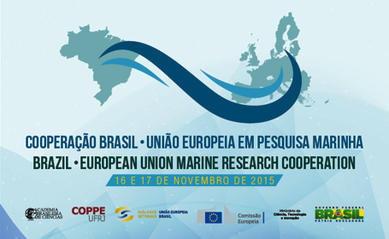

South Atlantic Ocean Cooperation
This cooperation is intended to increase our joint knowledge of the Atlantic Ocean and its dynamic systems, conducting joint research efforts and reciprocal access to infrastructures …
In details, it is intended to organize a workshop with the participation of marine scientists, representatives of the Government and other stakeholders from Brazil, South Africa, Europe and other countries to be invited (Argentina, Uruguay, Namibia, Angola, Cape Verde, among others).

Slide 7

G7 Science Minister call for:
Enhanced Global Ocean Observing
G7 Science and Technology Ministers, meeting in 15-17 May 2016 The Future of the Seas and Oceans: Toward Science‐Based Management, Conservation and Sustainable Use of the Oceans, Seas and Marine Resources
Support the development of an initiative for enhanced global sea and ocean observation …
Support an enhanced system of ocean assessment …
Promote open science and the improvement of the global data sharing infrastructure …
iv. Strengthen collaborative approaches to encourage the development of regional observing capabilities …
Promote increased G7 political‐cooperation by identifying additional actions needed to enhance future routine ocean observations.

Slide 8




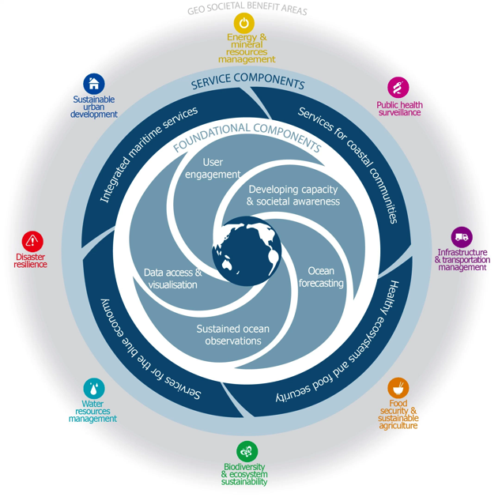

Notes:
WP5: Integrated regional observing systems: This component has the potential to facilitate improved observational logistics (e.g. ship and platform sharing) to make sampling more complete and efficient. Furthermore, there is significant innovation potential by exploiting collocated physical, chemical and ecological data to support an improved assessment of fish stocks and their reaction to climate change. The merging of different types of data across platforms and combining them with process models has the potential to create new information as well as products with improved quality/accuracy, when compared to the current system. New process models promise significant innovation potential when they can be integrated at a later stage into more complete ocean modelling systems

Slide 9


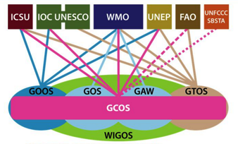

Contribution to GOOS
GOOS is a permanent global system for observations, modelling and analysis of marine and ocean variables to support operational ocean services worldwide.
GOOS provides accurate descriptions of the present state of the oceans, including living resources; continuous forecasts of the future conditions of the sea for as far ahead as possible, and the basis for forecasts of climate change.
GOOS is a system of programmes, each of which is working on different and complementary aspects of establishing an operational ocean observation capability for all of the world's nations.
Notes:
WP5: Integrated regional observing systems: This component has the potential to facilitate improved observational logistics (e.g. ship and platform sharing) to make sampling more complete and efficient. Furthermore, there is significant innovation potential by exploiting collocated physical, chemical and ecological data to support an improved assessment of fish stocks and their reaction to climate change. The merging of different types of data across platforms and combining them with process models has the potential to create new information as well as products with improved quality/accuracy, when compared to the current system. New process models promise significant innovation potential when they can be integrated at a later stage into more complete ocean modelling systems

Slide 10
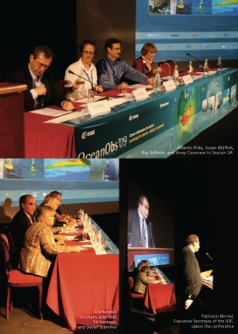
Future of Sustained Observations
OceanObs’09 identified tremendous opportunities, significant challenges
Called for a framework for planning and moving forward with an enhanced global sustained ocean observing system over the next decade, integrating new physical, biogeochemical, biological observations while sustaining present observations
Notes:
What is this Framework for Ocean Observing?
Its genesis comes from the OceanObs’09 conference, which took place 21-25 September 2009 in Venice, Italy. It brought together more than 600 participants from 36 countries, focused on defining a collective vision for the coming decade of ocean observations for societal benefit. The papers from this conference, which form an excellent resource reviewing progress and identifying opportunities and community plans, are all available at its website www.oceanobs09.net
The conference identified tremendous opportunities to expand ocean observing capabilities, and noted significant challenges. There are many players in a potential integrated sustained ocean observing system.
The conference, amongst other things, called for the development of a Framework for planning and moving forward with an enhanced global sustained ocean observing system over the next decade, integrating new physical, biogeochemical, and biological observations while sustaining present observations.
It is this Framework that I’ll describe in the next portion of the talk.

Slide 11


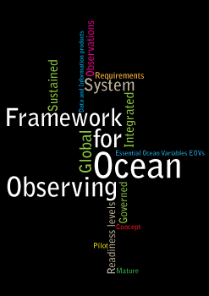
Framework for Ocean Observing
A simple system
Input
(Requirements)
Output
(Data &
Products)
Process
(Observations)
http://www.oceanobs09.net/foo/

Slide 12
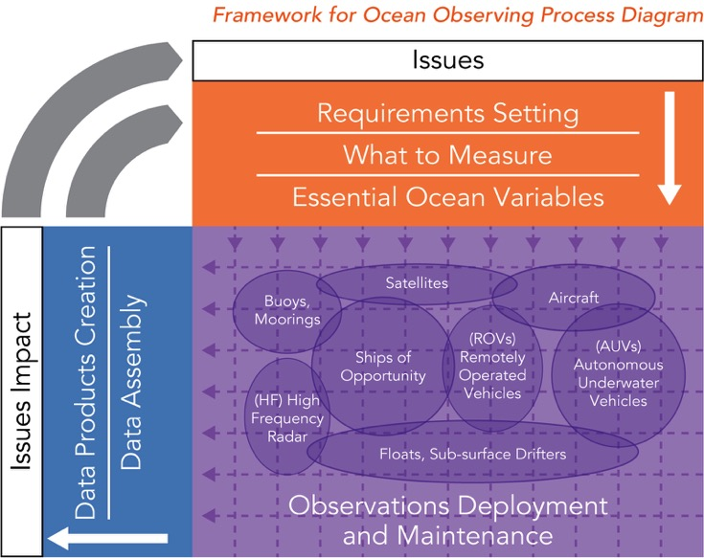
Framework for Ocean Observing

Slide 13
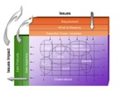
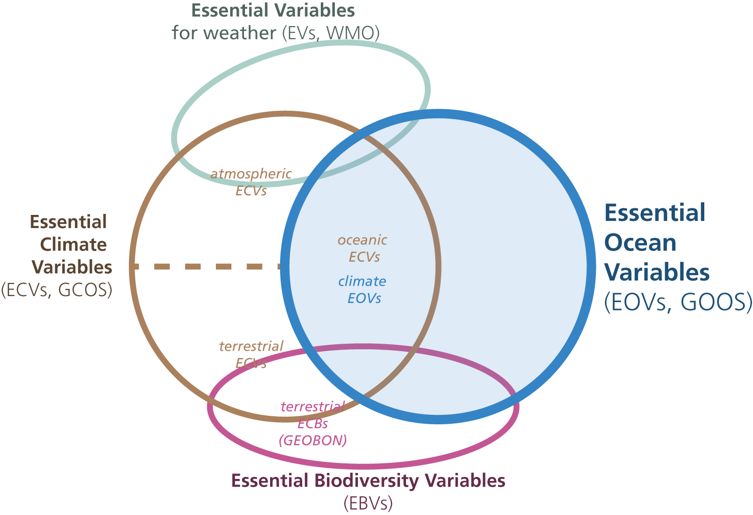
Driven by requirements, negotiated with feasibility in mind
Essential Ocean Variables
We cannot measure everything, nor do we need to
basis for including new elements of the system, for expressing requirements at a high level
Driven by requirements, negotiated with feasibility
Allows for innovation in the observing system over time
http://www.oceanobs09.net/foo/
Notes:
A key idea in the Framework is the definition of Essential Ocean Variables, which some overlap with other types of essential variables that have been defined, such as Essential Climate Variables defined by GOOS and GCOS, Essential Variables defined by WMO for weather forecasting, and Essential Biodiversity Variables that are being defined by GEOBON (although largely focused on terrestrial variables).
The idea is that for the key societal and scientific drivers of sustained ocean observations, we cannot measure everything, nor do we need to. Essential Ocean Variables should respond to these high-level drivers, related to climate, to understanding and managing ecosystem services, to conserving biodiversity, to managing living marine resources, to safety and protection of life and property at sea and on the coasts.
Aligning the coordination processes of the observing system on variables, rather than by platforms or observing techniques, stays truer to the natural system which we are trying to observe, while allowing for innovation of observing techniques over time as technology and capability develop.
The definition of an EOV must be driven by these requirements, but be rooted in reality, its measurement must be feasible. We may not be ready to measure all EOVs, but this assessing and encouraging the development of readiness is also a part of the Framework.

Slide 14
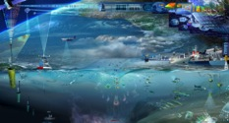
Global to Regional to Coastal
Time
Coastal
Regional
Global
Centuries
Decadal
Inter-
annual
Seasonal
Daily
hourly
Repeat Trans-Basin Sections
Subsea observatories
Region
Ship
Time
Series
Remote Sensing
Floats
Ferrybox
FisherMan Vessel
VOS Surface Data
Moored
Time
series
In network
Gliders
HF Radars
Space
1Km² Regional/10⁶ Km² Ocean bassin Globe
Notes:
The ocean is complex and we must really a variety of platforms to observe it. Depending of the phenomena one wants to sample , it often requires combination of platforms and there is no real frontiers between global/regional and coastal in the ocean , often only different communities using the observations!

Slide 15

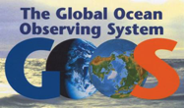
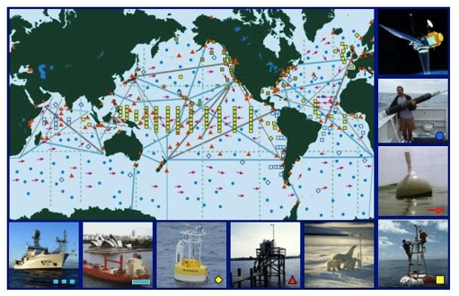

The Current Global
Ocean Observing System
Integrated system designed to meet many requirements:
  Climate
  Weather prediction
  Global and coastal ocean prediction
  Marine hazards warning
  Transportation
  Marine environment and ecosystem monitoring
  Naval applications
  8 of 9 Societal Benefits
60% complete
Dedicated Ship Support
Data & Assimilation Subsystems
Management and Product Delivery
Satellites -- SST, Surface Topography, Wind, Color, Sea Ice
Tide gauge stations
Drifting Buoys
Tropical Moored Buoys
Profiling Floats
Ships of Opportunity
Ocean Reference Stations
Ocean Carbon Networks
Notes:
ADD the mission and objectives for the global component

Slide 16
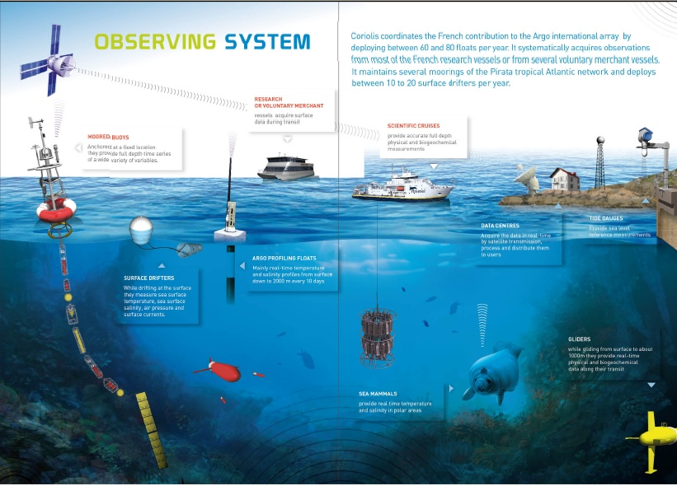

Operational oceanography and ocean and
climate change research rely on an
integrated sustained multidisciplinary observing system
Satellite
JERICO
EUROFLEETS
JERICO
FIX03
SeaDataNet
Euro-Argo
CMEMS INSTAC
EMODNet
E-Surfmar
GROOM/EGO
JERICO
EMSO
Notes:
In Europe we are organizing the observation ber network of platforms , some being sustained ( Satelite, Drifters , Argo soon Seabed observatories ) because managed by infrastructure committed at high level , some are developping through projects maily I3 ( Fixed platforms, Gliders, Coastal observing system , research vessels ) inclunding data management aspects with Dseadataet for scientfic data, Copernicus/Myocean for Operational Oceanography and EMODNEt …

Slide 17

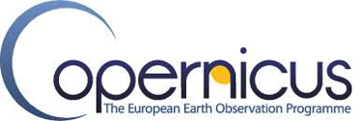
European Space Agency
Notes:
17

Slide 18
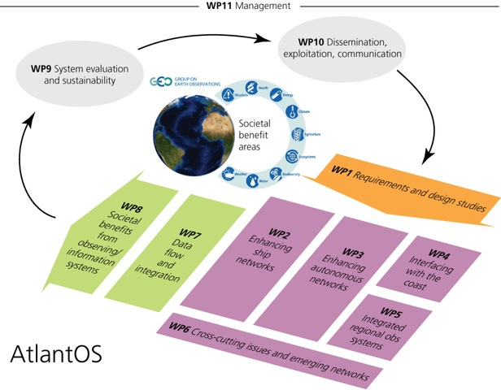
Project Structure
Notes:
WP5: Integrated regional observing systems: This component has the potential to facilitate improved observational logistics (e.g. ship and platform sharing) to make sampling more complete and efficient. Furthermore, there is significant innovation potential by exploiting collocated physical, chemical and ecological data to support an improved assessment of fish stocks and their reaction to climate change. The merging of different types of data across platforms and combining them with process models has the potential to create new information as well as products with improved quality/accuracy, when compared to the current system. New process models promise significant innovation potential when they can be integrated at a later stage into more complete ocean modelling systems

Slide 19

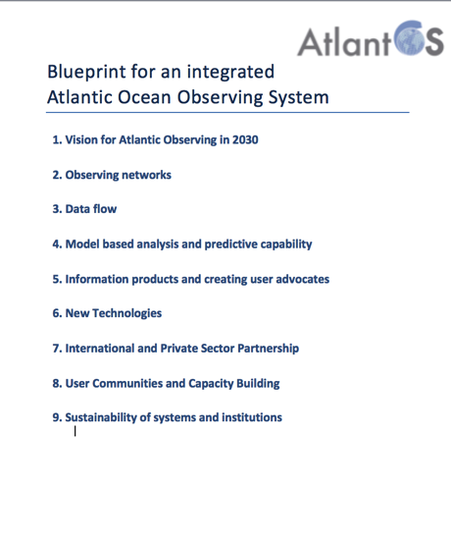
#AtlantOS
Outcome of AtlantOS and related initiatives:
Blueprint for OceanObs19
An international, multi-disciplinary and multi-sectoral team is currently established
www.atlantos-h2020.eu

Slide 20



This project has received funding from the European Union's Horizon 2020 research and innovation programme under grant agreement No 633211.

