Slide 1


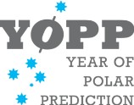
H2020 Blue-Action:
Arctic Impact on Weather and Climate
What?
Blue-Action is a research and innovations project funded by the European Union’s Horizon 2020 programme
Responded to the Blue-Growth BG-10-2016 Arctic call
Why?
To actively improve our ability to describe, model, and predict Arctic climate change and its impact on Northern Hemisphere climate, weather and their extremes.
To deliver valuated climate services of societal benefit.
To make a significant contribution to YOPP and AR6.
How?
Through synthesising observations, assessing model performance, designing and performing coordinated multi-model sensitivity experiments, developing innovative initialization techniques.

Slide 2

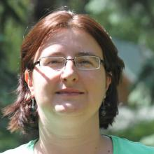
H2020 Blue-Action:
Arctic Impact on Weather and Climate
Who are we?
We bring together experts from 40 organizations in 17 countries on three continents
We work directly with local communities, businesses operating in the Arctic and industrial organizations, local authorities and maritime industries.
Blue-Action is coordinated by Steffen M. Olsen (DMI) and Daniela Matei (MPI).
When?
Blue-Action started 1 December 2016 and is a 4-year project.
The Kick-off event will take place in the Harnack-Haus, Berlin 18-20 January 2017!

Slide 3
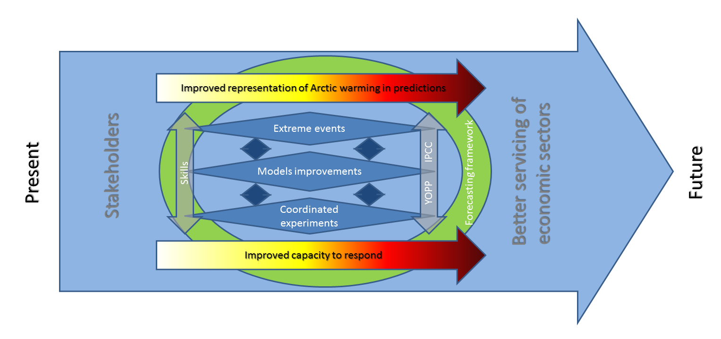
Overarching Objective
- The concept
To actively improve our ability to describe, model, and predict Arctic climate change and its impact on Northern Hemisphere climate, weather and their extremes, and to deliver valuated climate services of societal benefit.

Slide 4
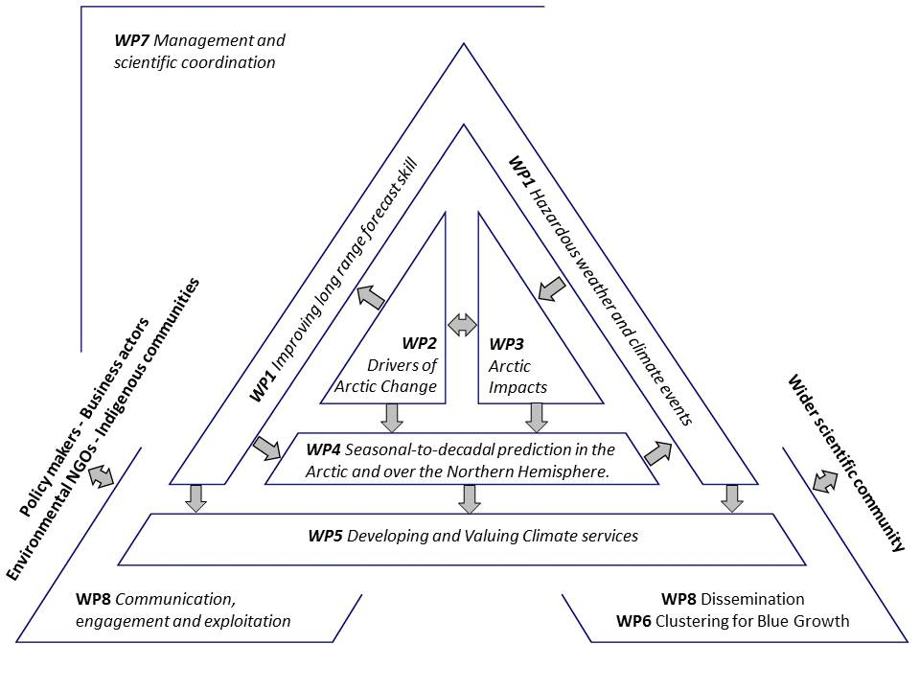
Project Structure

Slide 5
WP1: Improving seasonal long range forecast skill of risks for hazardous weather and climate events
Johanna Baehr (UHAM), Jens Hesselbjerg Christensen (DMI)
Methodology: To develop and apply novel statistical and dynamical approaches to quantify predictability of weather and climate extremes
Motivation:
Extreme or hazardous weather events themselves have low predictability, but the conditions in which they form might be predictable at sub-seasonal-to-seasonal time scales
… and these conditions are identifiable in global climate models (e.g., Ramos et al., 2015).
In addition, future Arctic warming may drive atmospheric and oceanic teleconnections that precondition the occurrence of such extremes providing a degree of predictability (Yang and Christensen, 2012).
Process-based (seasonal) prediction studies can enhance not only our understanding but also yield higher predictability (Domeisen et al., 2015).

Slide 6
WP2: Lower latitude drivers of Arctic changes
Karin Margretha H. Larsen (FAMRI)
Gerard McCarthy (NERC)
Objectives
Enhancing the predictive capacity beyond seasons through assessment of oceanic anomalies of predictive potential
Reanalysis to serve as input to WP4 (Enhancing the capacity of s2d prediction)
Optimizing observational systems
  Near real time data access from TMAs (NACLIM, AtlantOS, NERC)
  Integrate New Earth Observation into TMA estimates.
Reducing and evaluating the uncertainty in prediction systems
  Improve simulations of poleward flow (model development)
  Observations and newest reanalyses products to be compared with climate models

Slide 7
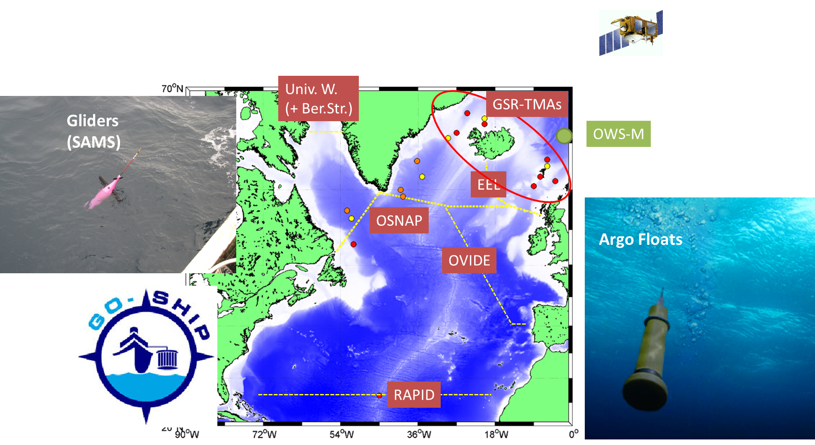
WP2 Observations/Data

Slide 8
WP3: Linkages of Arctic climate changes to lower latitudes
Yongqi Gao (NERSC) and Guillaume Gastineau (CNRS)
Objective:
To investigate the Arctic warming impacts and its modulation by the Atlantic Multi-decadal Oscillation (AMO) and Inter-decadal Pacific Oscillation (IPO) using specifically-designed coordinated multi-model experiments.
Approach:
Coordinated experiments seeking to disentangle:
Arctic warming by atmospheric pathways (AGCM’s)
Oceanic influence on Arctic warming (Coupled Climate Models)
Experimental modelling and developments
Improve representation of surface heat flux in Arctic (AGCM’s)
  Representing the effect of leads (sea-ice)
  PBL depth, especially in shallow PBLs

Slide 9
WP4: Enhancing the capacity of seasonal-to-decadal predictions in the Arctic and over the Northern Hemisphere
Daniela Matei (MPI) and Noel Keenlyside (UiB)
Motivation:
Observations and ocean, atmosphere, and coupled modelling studies indicate a two-way link between the North Atlantic and Nordic Seas/Arctic that implies:
a potential for skillful prediction in Nordic Seas and the Arctic
a potential for enhanced prediction skill in the North Atlantic, and
a potential for enhanced prediction skill of climate over adjacent continental regions and the Northern Hemisphere on seasonal-to-decadal timescales by better capturing variations in the oceans and in sea ice.
This apparent predictive potential of Arctic-lower latitude linkages has yet to be explored in a coordinated manner within the state-of-art multi-model ensemble predictions.

Slide 10
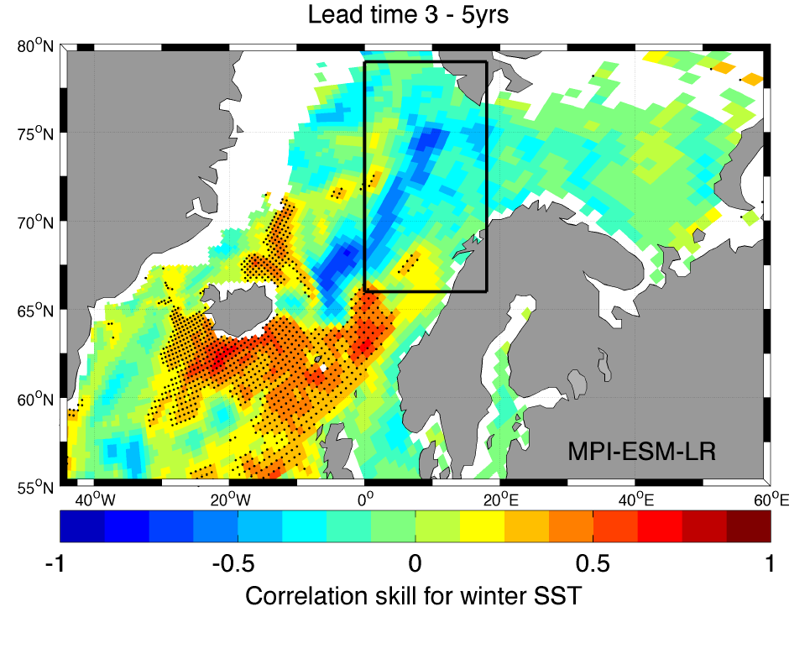
WP4: Any predictive skill for of winter SST in the Nordic Seas and Barents Sea?
Langehaug et al. (2016)
Yes! – but the predictive skill and representation of mechanisms differ widely among models!

Slide 11
WP5: Developing and Valuing
Climate Services
Mark R. Payne (DTU-Aqua) and Kathrin Kell (IASS)
Objective:
Translate the skill of forecast models into products that are relevant to stakeholders
Demonstrate the value of these products to stakeholders and estimate their economic value
Five cases will be developed (next slides)

Slide 12


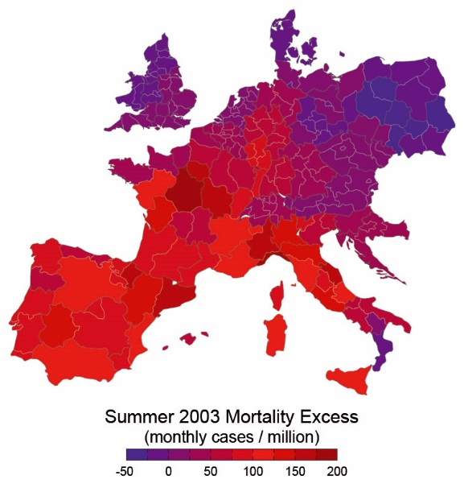
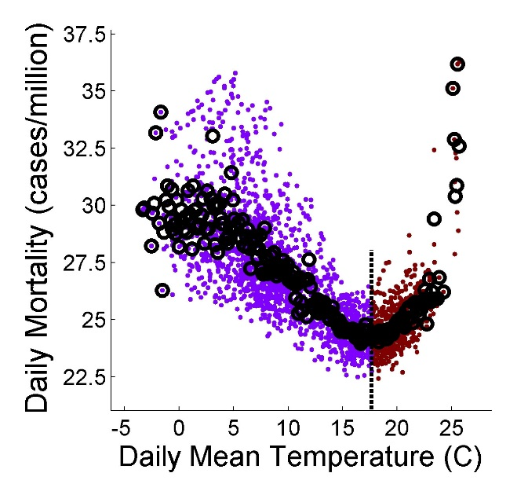
WP5: Temperature Related Mortality (TRM)
Develop forecast scheme for thermal stress and TRM for 160 administrative units across Europe
e.g. Excess Mortality due to
2003 Summer Heatwave
Both summer and winter
temperatures are important

Slide 13




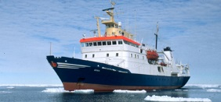
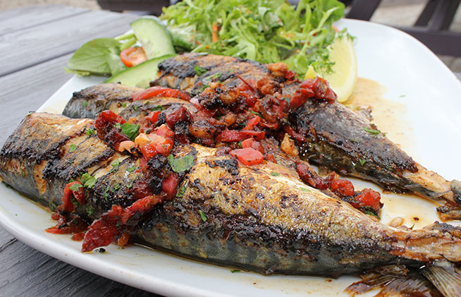
WP5: Climate Services for Fisheries
Develop forecasts for the distribution and timing of commercially important fish stocks (e.g. Mackerel, Sandeel)
Applications in scientific
monitoring of fish stocks
Planning and performance
of commerical fisheries

Slide 14



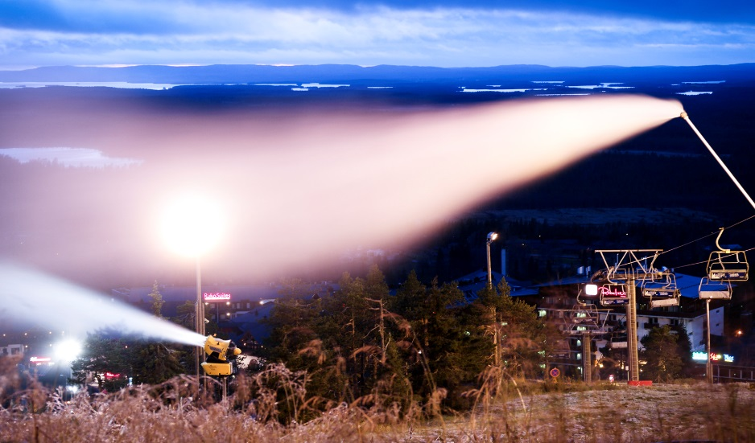
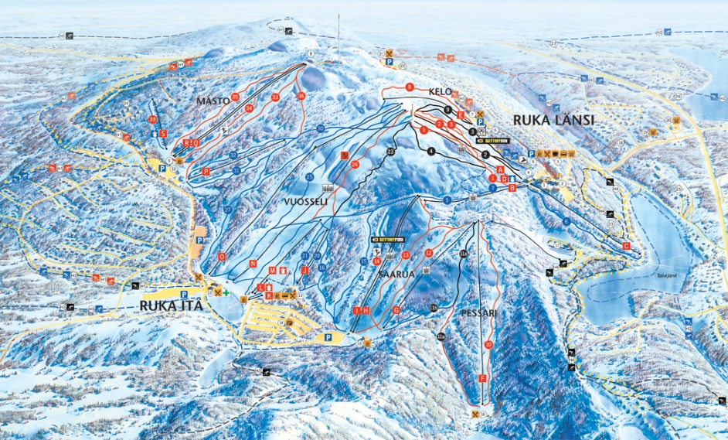
WP5: Winter Tourism Industry in Lapland
Seasonal forecasts of winter conditions to (i) allow for planning of activities and (ii) compare with Alps to establish competitiveness of Lapland
Planning of snow-making
and storage requirements
Planning of alternative activities

Slide 15


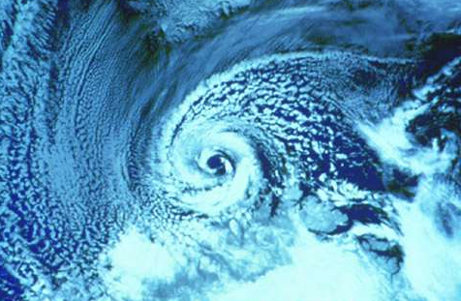
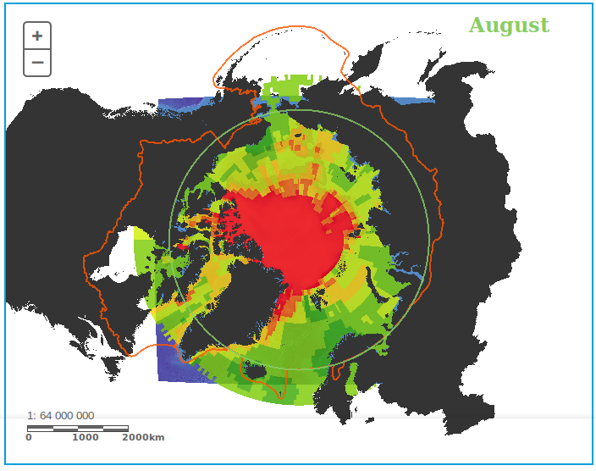
WP5: Polar Low forecasts
Prediction of cold air outbreaks and polar low environments to incorporate into shipping risk assessment tools
Polar Low in Barents Sea
Safety risk map for August

Slide 16



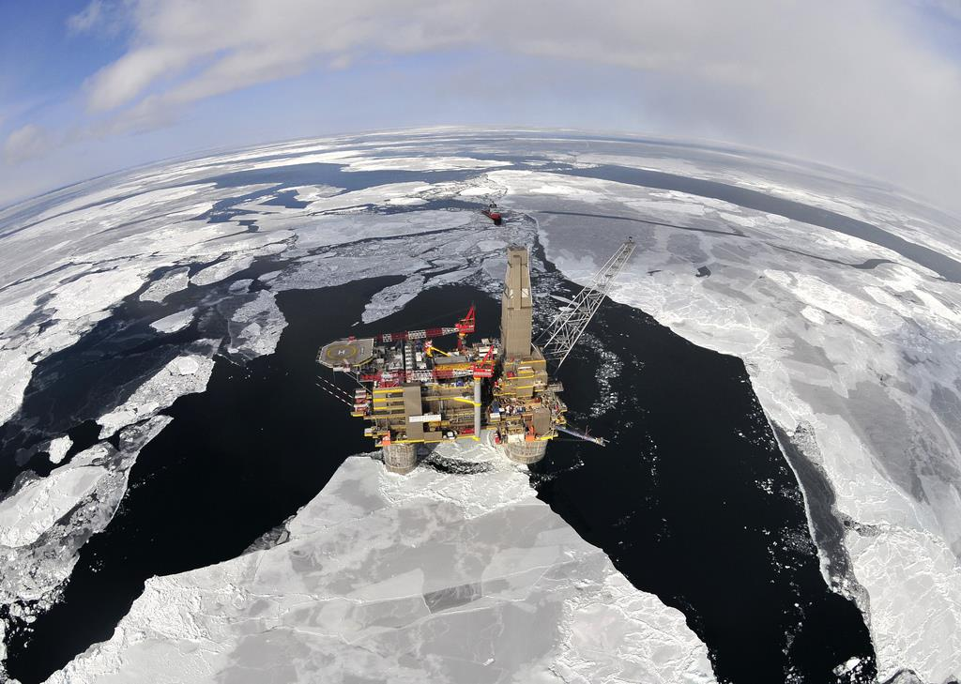
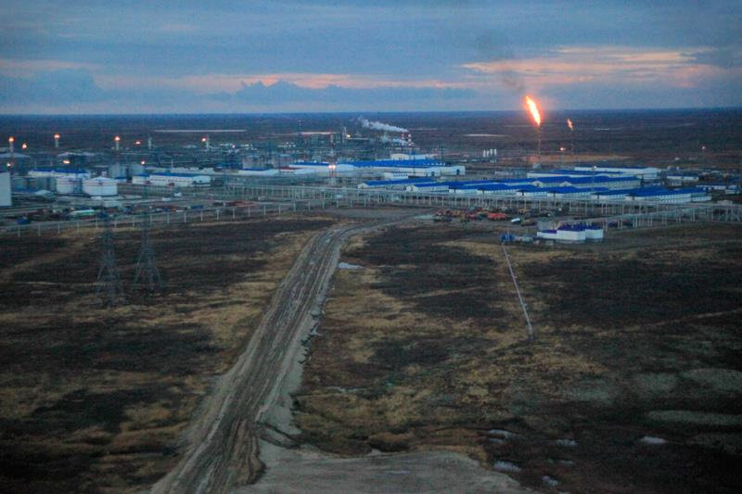
WP5: Impacts of resource extraction on Russian Arctic
Collaboratively develop scenarios outlining possible impacts of climate change on stakeholders in the region

Slide 17

Thank you!
Follow us here:
www.Blue-Action.eu
Blue-Action
@BG10Blueaction

