Slide 1
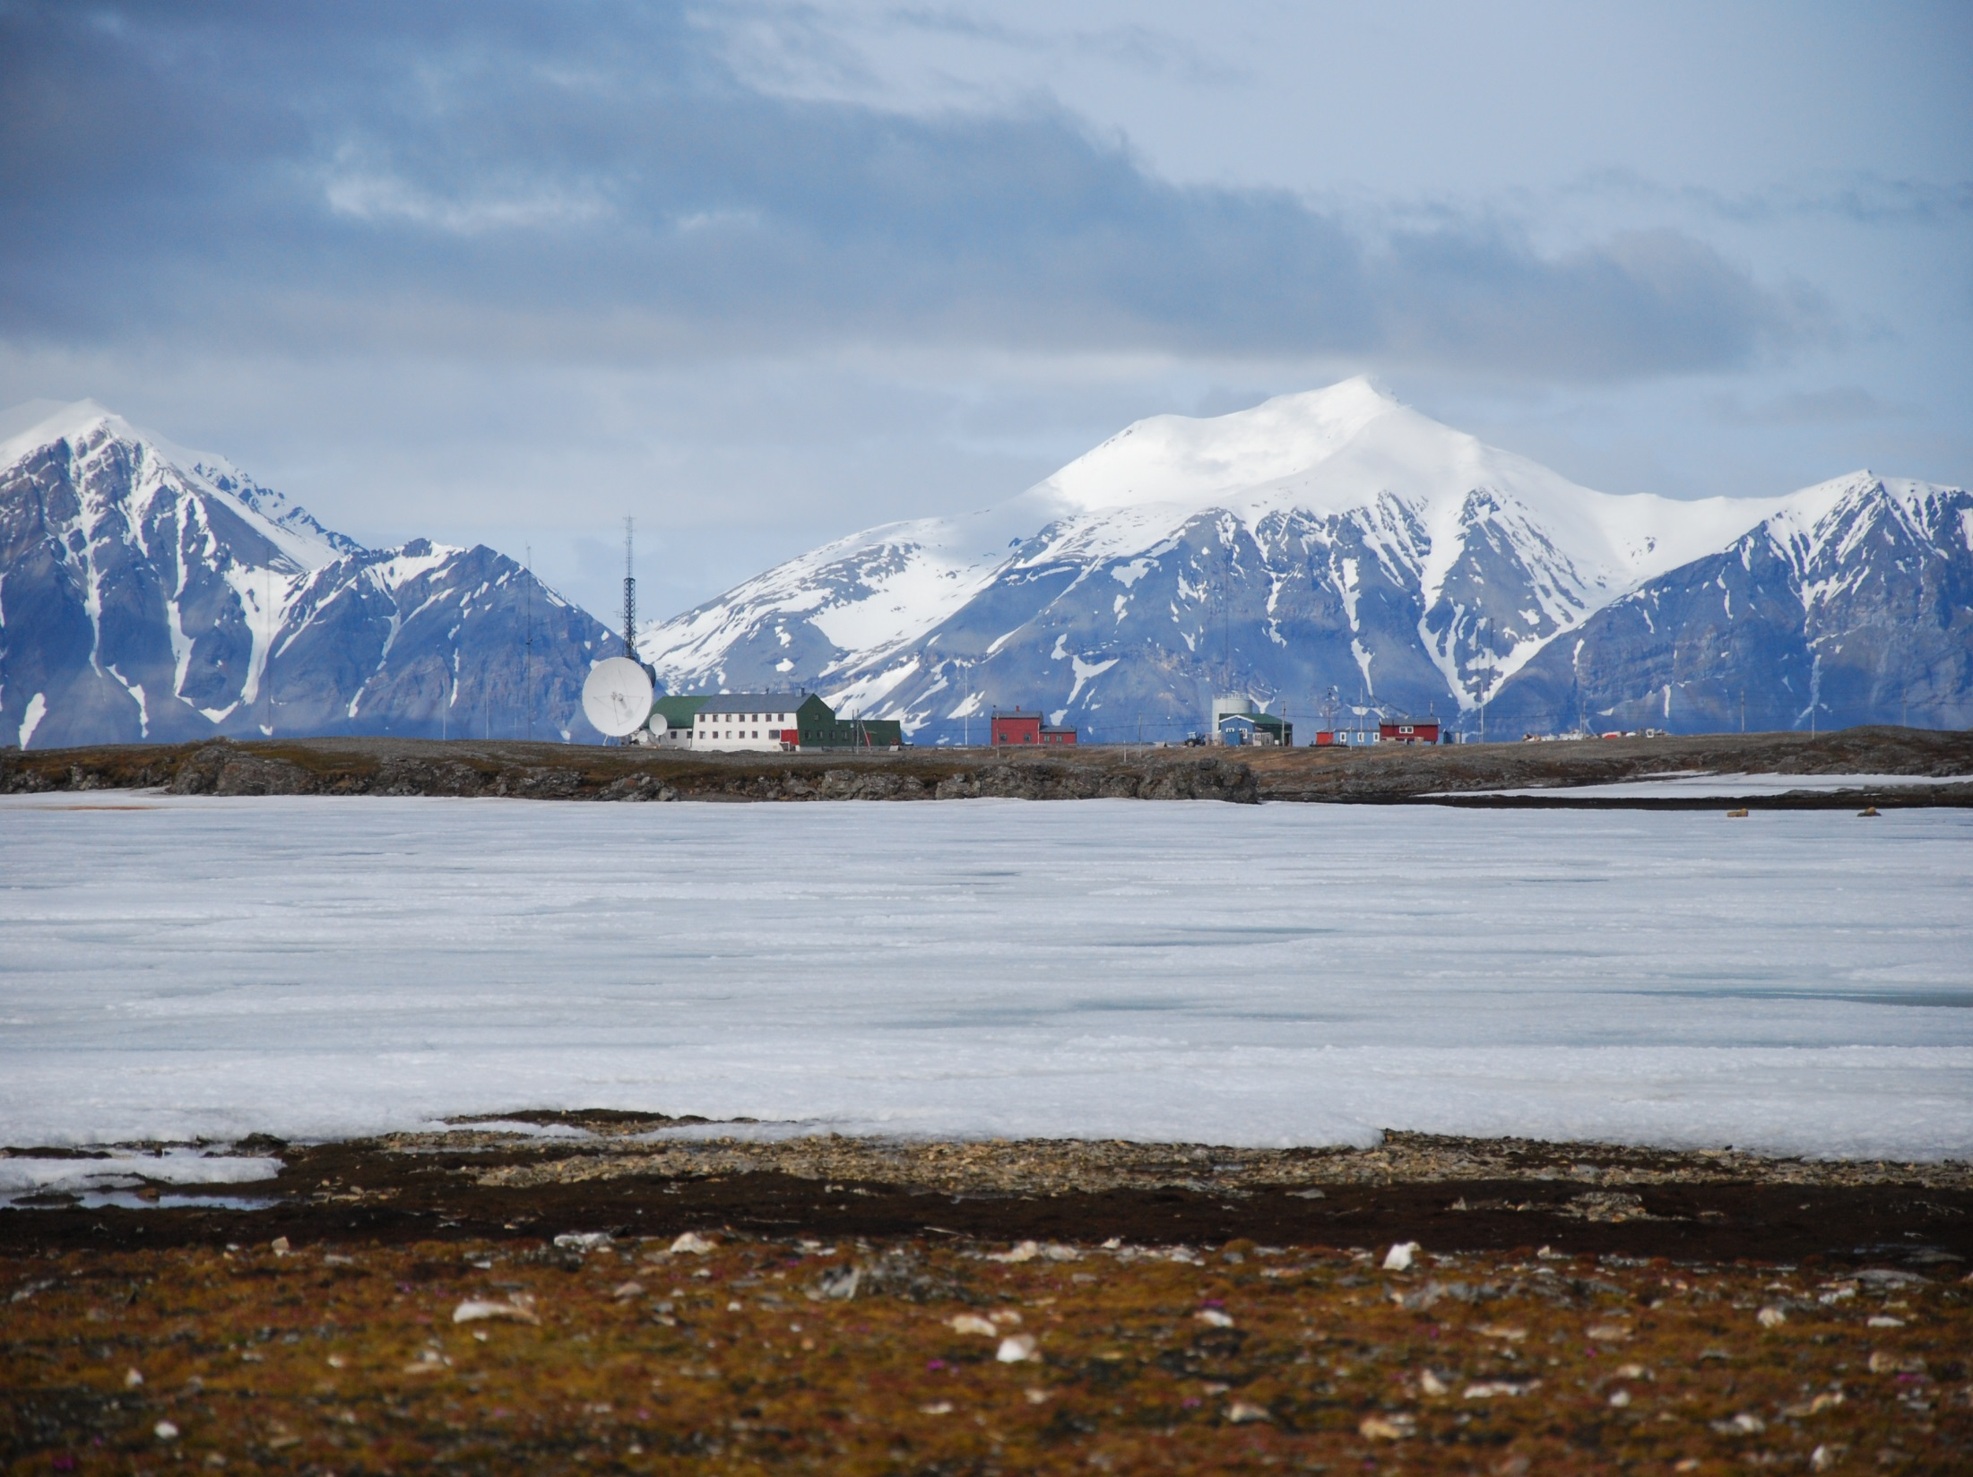
INTERACT goes viral: an advanced community steps into a global role
Margareta Johansson on behalf of INTERACT Friends
Dept. of Physical Geography and Ecosystem Science, Lund University

Slide 2
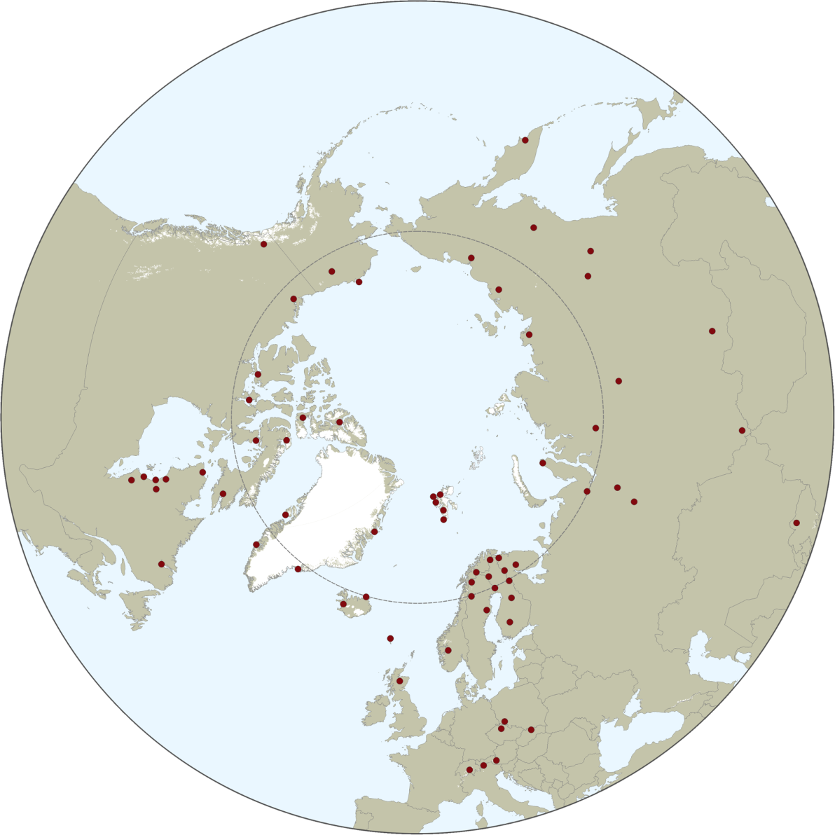
INTERACT - Building capacity for monitoring, research and education throughout the Arctic
79 Research Stations
- Biodiversity
- Glaciology
- Permafrost
- Climate
- Hydrology
- Ecology
- Biogeochemistry
Human dimension
Etc.

Slide 3
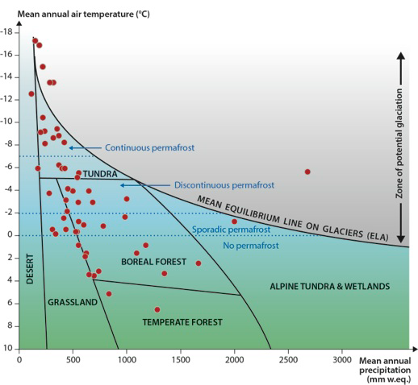
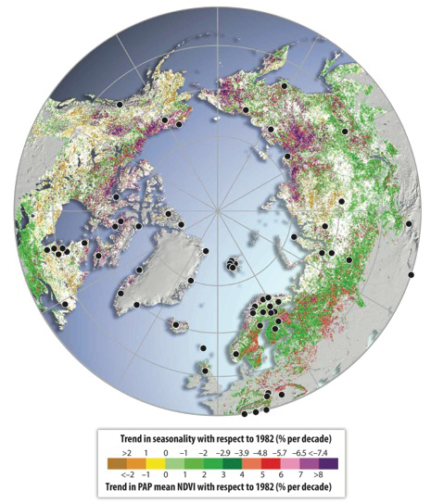
INTERACT vision: Strategically sampling the northern environmental envelope and changes

Slide 4
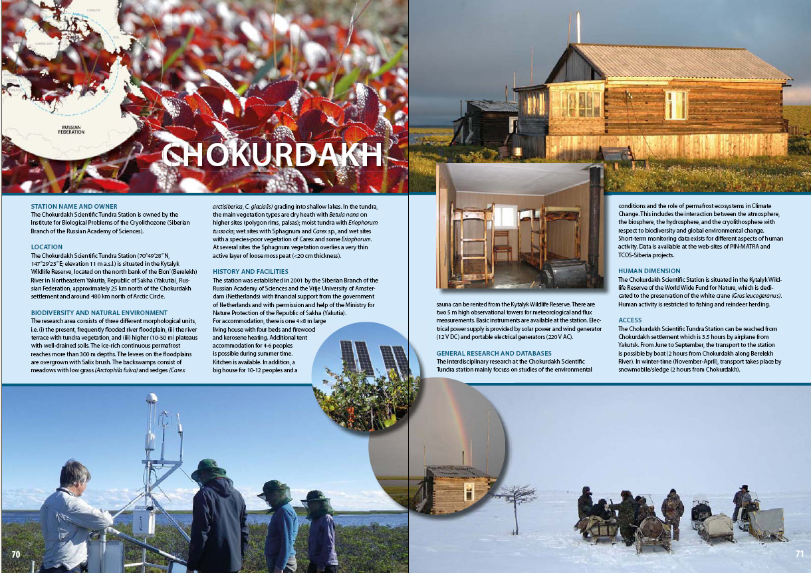
The first phase of INTERACT: Presentation of Research Stations

Slide 5
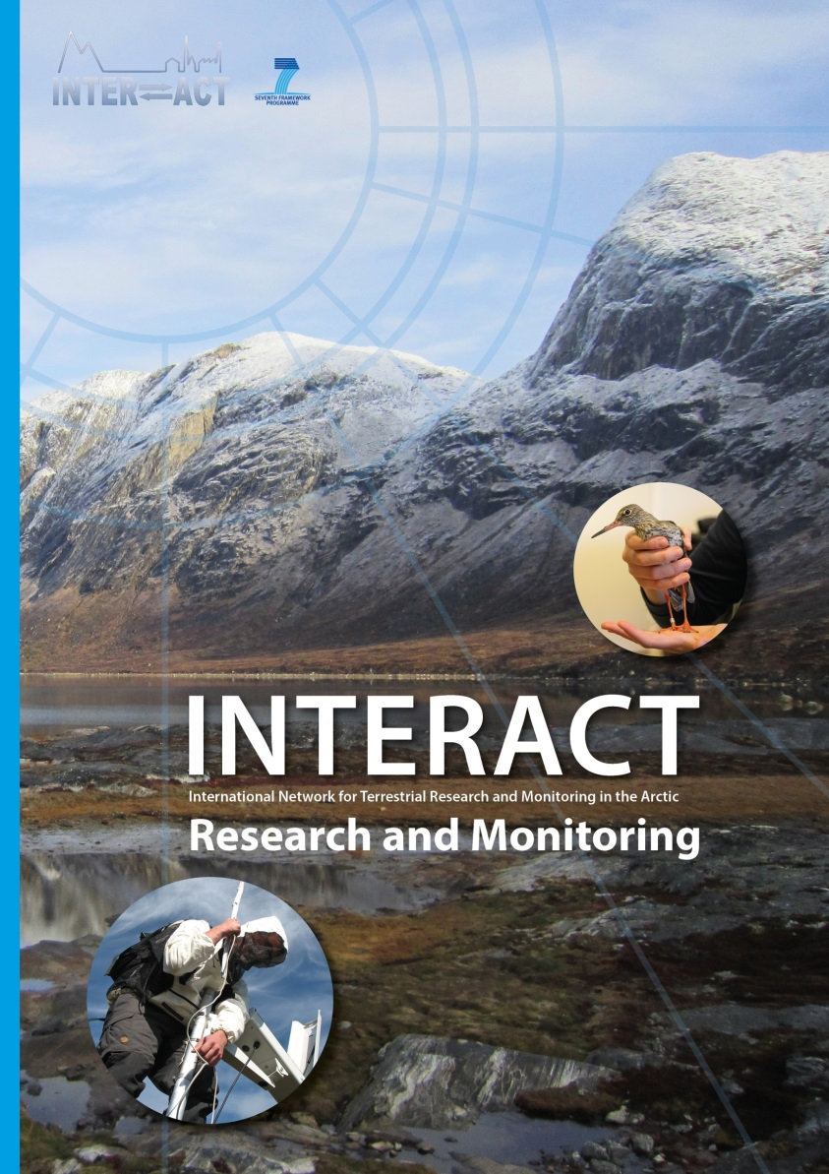
The First phase of INTERACT: Inventory of Research and Monitoring

Slide 6
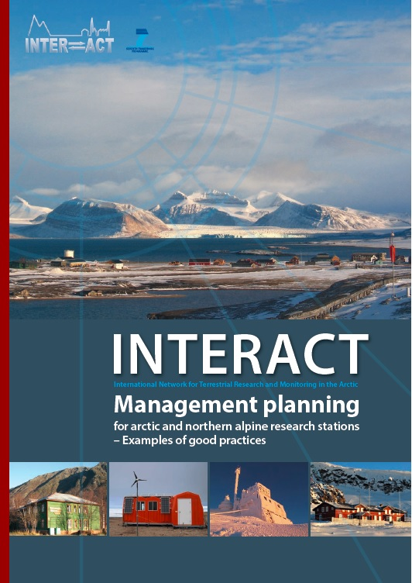
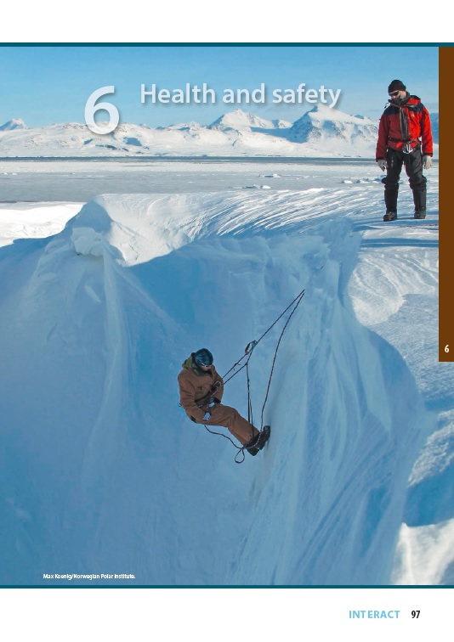
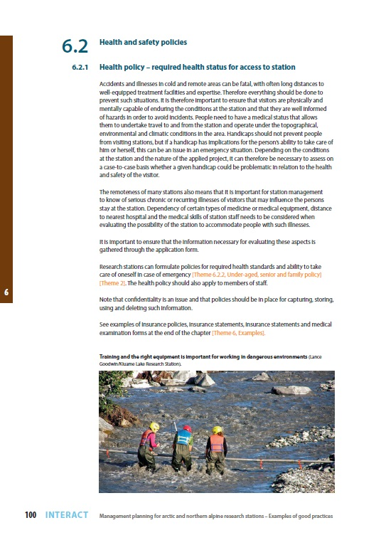
The First phase of INTERACT: Best practices report on management

Slide 7
Between 2011 and 2015 - Increased Access to the Arctic through Transnational Access to 24 stations – pan Arctic!
Russia 5 Stations
Finland 4 Stations
Sweden 2 Stations
Norway 2 Stations
Scotland 1 Station
Faroe Islands 1 Station
Iceland 1 Station
Greenland 4 Stations
Canada 2 Stations
US 2 Stations
>520 researchers
=10,000 Research days
150 journal publ. since 2010

Slide 8
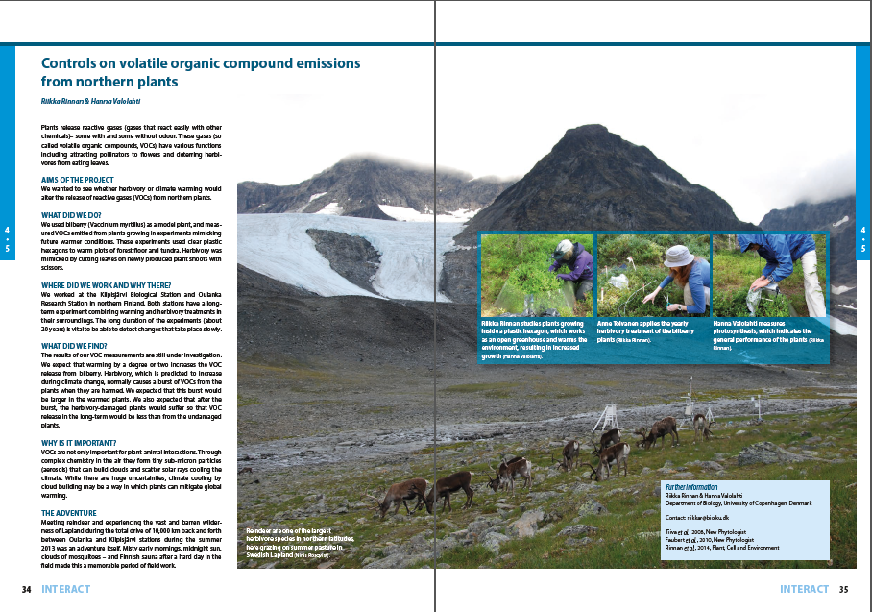
Outreach of Arctic Science: Stories from TA project
Cross your fingers!
- Aims of the project
- What did we do?
- Where did we work and why there ?
- What did we find?
- Why is it important?
- The adventure
- Contact info
Thanks for your attention
www.eu-interact.org

Slide 9
2nd phase of INTERACT – An advanced community!
4 yr project in Horizon 2020
Starting date 1 Oct 2016
9 WP

Slide 10
INTERACT will continue to offer access to the Arctic
In the second phase of INTERACT, transnational access will be offered to 43 research stations, in total ca 7800 days.
In addition, virtual access will be offered to 29 research stations.

Slide 11
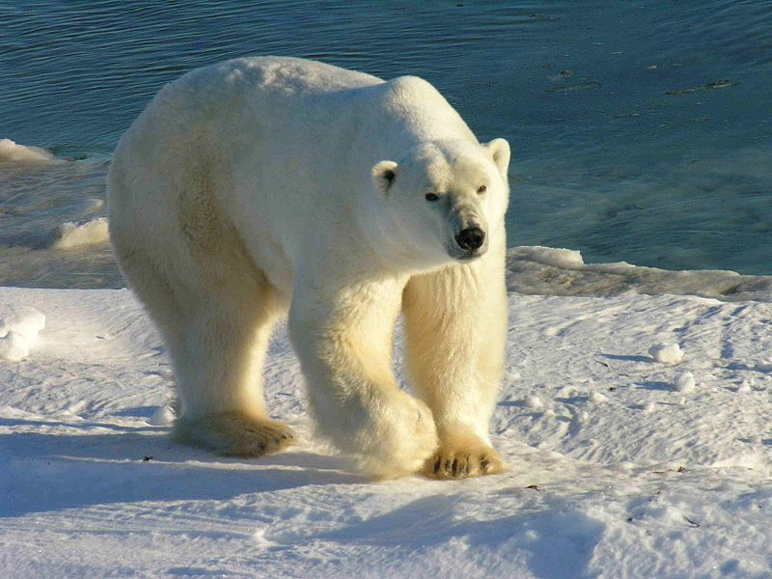
Station Managers Forum
Working with Safety
Zero Emission Stations
Ansgar Walk

Slide 12
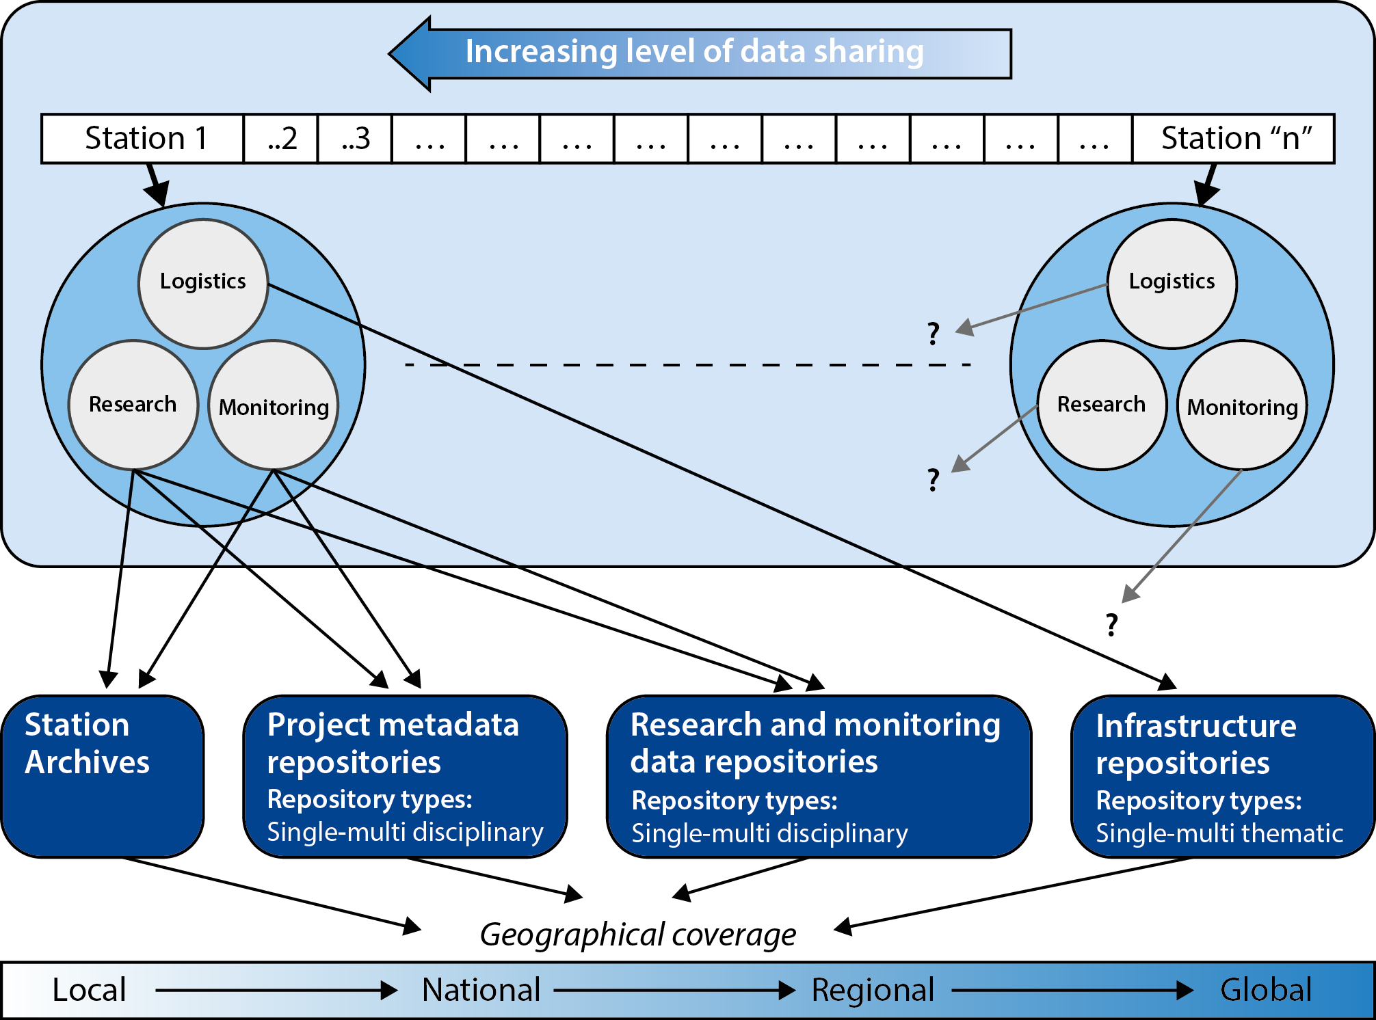
Data Forum

Slide 13
Data Forum

Slide 14
Red Phone work package

Slide 15
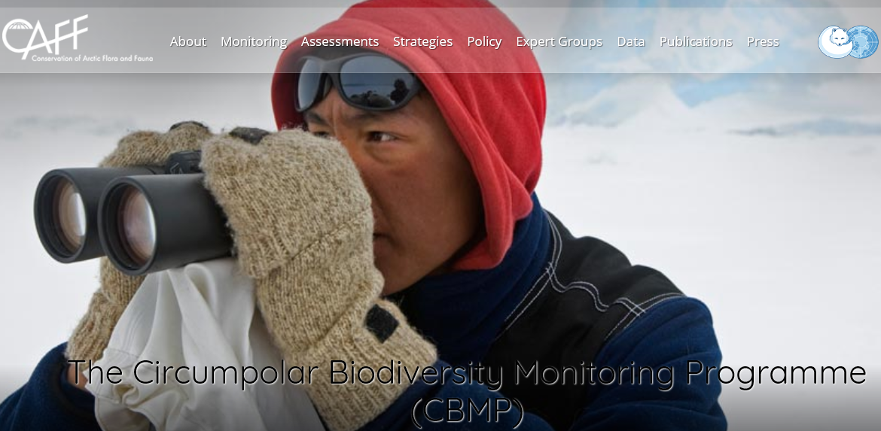
Monitoring scheme for biodiversity

Slide 16
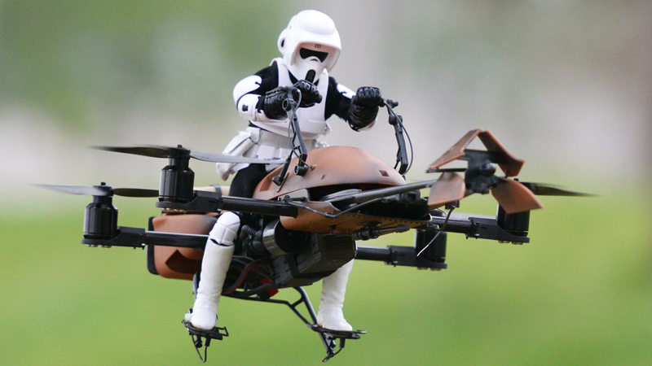
Drone development

Slide 17
Local Adaptation

Slide 18
Outreach

Slide 19
Thanks for your attention
We are very much looking forward to collaborate with INTAROS
www.eu-interact.org

