Slide 1

INTAROS WP6
Demonstrate the performance of
the IAOS towards stakeholders
Geir Ottersen, IMR, lead Mikael Sejr, AU, co-lead

Slide 2
Main objective
To demonstrate the economic value and societal benefit of the IAOS through a suite of selected applications towards industry, governance,
local communities and research

Slide 3
Ambition
Show the IAOS’ capability for providing:
enhanced search and retrieval
scientific analysis
assimilation into models
validation of estimated and
projected climate parameters
decision-support and policy-making
on local, regional and global scale

Slide 4
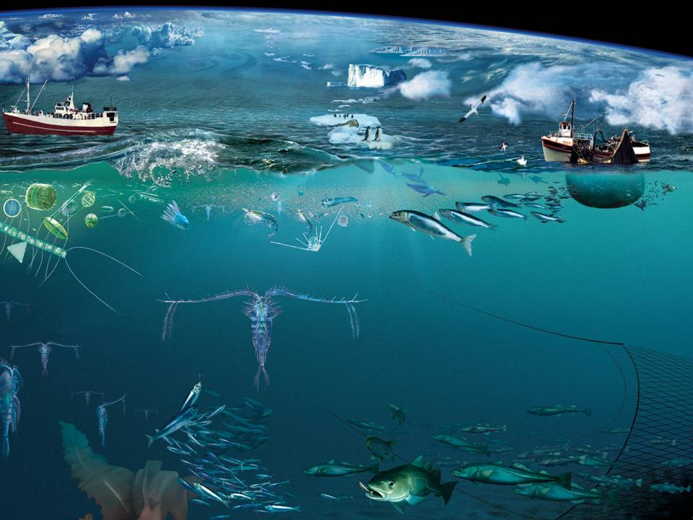
Improved ecosystem
understanding and management

Slide 5
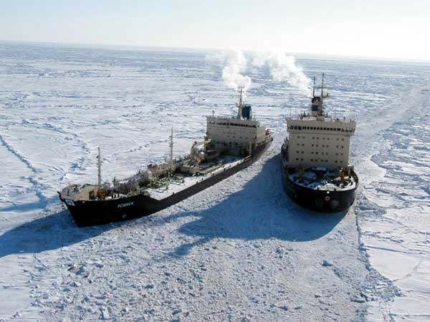
Support to Marine and Maritime Industry

Slide 6
Workpackage structure
WP1: Requirements and strategy for a Pan-Arctic system
WP2: Exploitation of existing observing systems
WP3: Enhancement of in situ systems
WP4: Community-based observing systems
Scientific data
Scientific data
WP5: Data integration & management - IAOS
Community data
Integrated data, prepared for applications
Feedback to requirements, strategy and roadmap
WP6: Applications towards stakeholders
Feedback to requirements, strategy and roadmap
Climate modelling
Ice – ocean statistics
WP7: Dissemination and outreach

Slide 7
Workpackage structure, seen from WP6
International bodies
Pan-Arctic and other networks
National management plans
Other policy requirements
Stakeholders
Industry
Managment
Models:
Climate, Forecasting,
Ecosystem,
Data assimilation
NGOs
Science
WP6
Demonstrations of
IAOS applications for stakeholders
Other
Planning and coordination
Multidisciplinary data from existing and new observing systems
Integrated observing system
Outreach, Roadmap
WP1
WP 2,3,4
WP5
WP7,1

Slide 8
WP6 TASKS
6.0 Coordination of WP 6
6.1 Improving climate models
6.2 Ecosystem understanding
6.3 Ice-ocean statistics and timeseries
6.4 Natural hazards in the Arctic
6.5 Arctic greenhouse gases
6.6 Cross-fertilize local and scientific observations
6.7 Marine and maritime industries
6.8 Fisheries and environmental management

Slide 9
WP6 TASK LEADERS
Task Task leader
6.0 Coordination G. Ottersen and M. Sejr
6.1 Climate models Ralf Döscher, SMHI
6.2 Ecosystem Gro van der Meeren, IMR
6.3 Ice-ocean statistics Hanne Sagen, NERSC
6.4 Natural hazards Anne Solgaard, GEUS
6.5 Greenhouse gases Mathias Göckede, MPG
6.6 Local and scientific observations Lisbeth Iversen, NERSC
6.7 Marine and Maritime industries Erik Buch, EuroGOOS
6.8 Fisheries and env. Management Marie Maar, AU

Slide 10
IMPACT – GENERAL
support international assessments of global
challenges such as climate change, scarceness
of natural resources and global scale hazards
enhance the societal and economic role of the Arctic
support the EU strategy for the Arctic
and related maritime and environmental policies
contribute to OSPAR actions in Arctic waters
contribute to WMO Year of Polar Prediction (YOPP)

Slide 11
IMPACT
Use existing environmental and fisheries reporting and management systems of the Barents Sea and off West Greenland to demonstrate how an IAOS may be applied
to other parts of the Arctic

Slide 12
IMPACT – GENERAL
Contribute to enhanced weather and climate services
Advance the integration of regional products and
services through down-scaling to coastal systems
Improve downstream applications by resolving
system specific issues on local scale

Slide 13
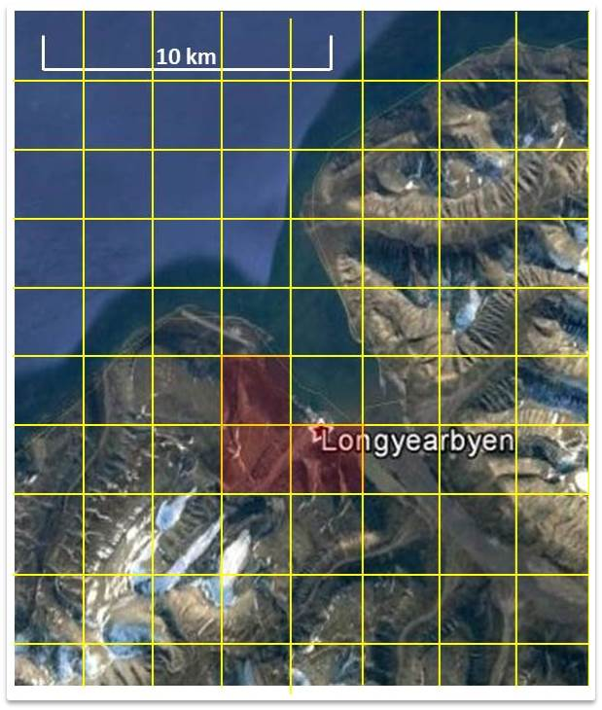
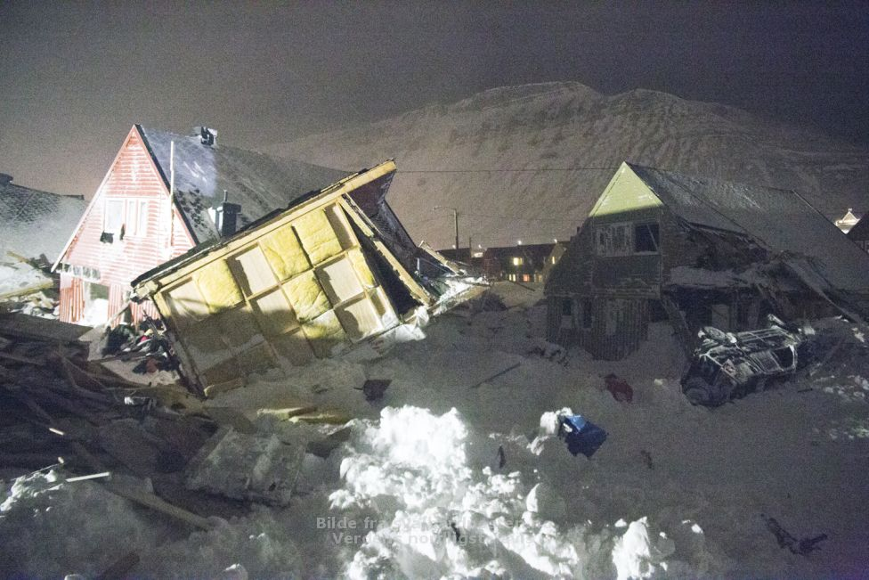
IMPACT – CONCRETE PRODUCT
Improvement of extreme precipitation forecasts for Longyearbyen, Svalbard area to the benefit of
avalanche forecast models (FMI; Task 6.4)
AROME model grid (yellow lines) Downscaled area marked in red.

Slide 14
IMPACT – GENERAL
Produce decision support tools for a variety of sectors by integrating data from the Copernicus Marine Service and EMODnet in the Arctic, enhanced by new INTAROS data
Enhance integration of data from a range of in-situ and remote sensing platforms into process and climate models and forecast systems

Slide 15
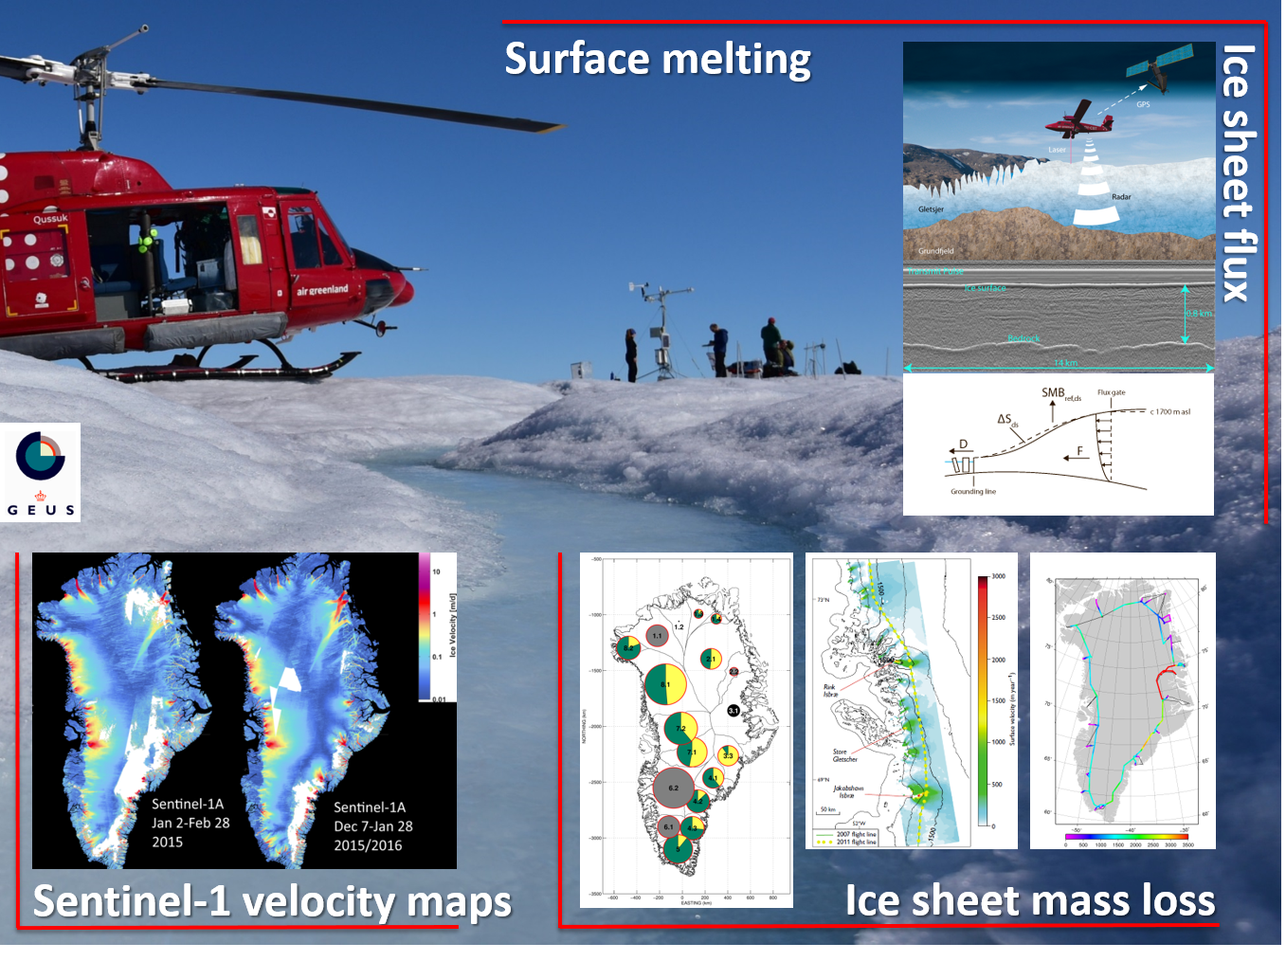
IMPACT – CONCRETE PRODUCT
Freshwater flux to ocean from Greenland ice sheet (GEUS; T6.4)
Notes:
GEUS will utilize satellite data from Sentinel-1 to produce ice sheet velocity maps which together with observed flux gates and in-situ calibrated surface mass balance maps will provide the total seasonal freshwater flux to the ocean from the Greenland ice sheet.

Slide 16

WP6
Demonstrations of
IAOS applications for stakeholders

