Slide 1
INTAROS WP5 Data integration and management
Pedro Gonçalves, Terradue Srl (lead)
Torill Hamre, NERSC (co-lead)
INTAROS Project Kickoff, January 12th 2017, Bergen

Slide 2
Objectives
the iAOS concept

Slide 3
WP5 main objectives:
➽ To integrate multidisciplinary and distributed data repositories into a scalable and resilient Pan-Arctic observing system, iAOS
➽ To offer seamless access to observations and derived parameters provide a set of tools for data analysis, transformation and visualization of spatiotemporal datasets
Collect
Ingest
Store
Search
Analyse
Visualise
➽ build on present observing systems developed over several years and operated with funding from countries and international agencies to ensure that the iAOS is maintained as a platform for SAOS
➽ leverage on existing data repositories for storage and curation of new data collected during INTAROS and provide seamless access to distributed data repositories through a common ICT platform with embedded processing and analysis tools
How to achieve them...

Slide 4
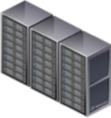
INTAROS WP5 specific objectives:
Deploy underlying infrastructure for the Integrated Arctic Observing System (iAOS) and operate associated tools for IT management and user support
Provide a framework to ease the discovery and retrieval of dataset collections from existing spatial data infrastructures
Develop new geo-statistical methods for interpolation of spatiotemporal datasets, and provide a set of tools for data analysis, transformation and visualization
Process new observations from WP2-4, and store the
generated datasets in an IAOS enabled repository
Notes:
Search icon: https://www.iconfinder.com/icons/314689/search_icon#size=128
Map layer: https://www.iconfinder.com/icons/64437/layers_map_icon#size=32

Slide 5
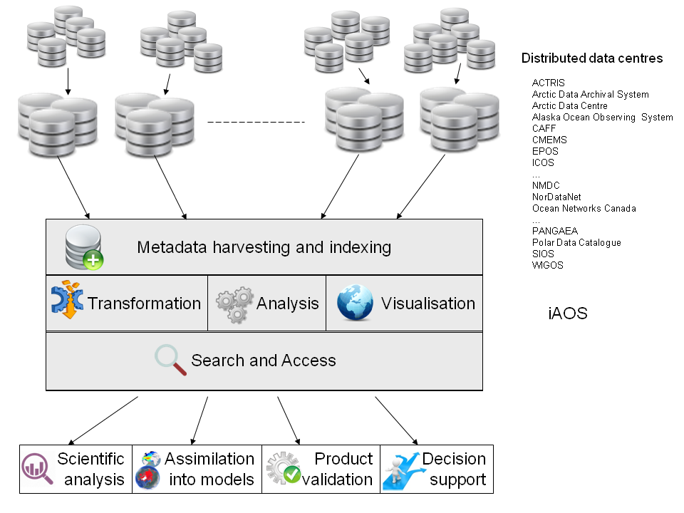
iAOS - Conceptual View

Slide 6
Data infrastructure
multidisciplinary and distributed data repositories

Slide 7
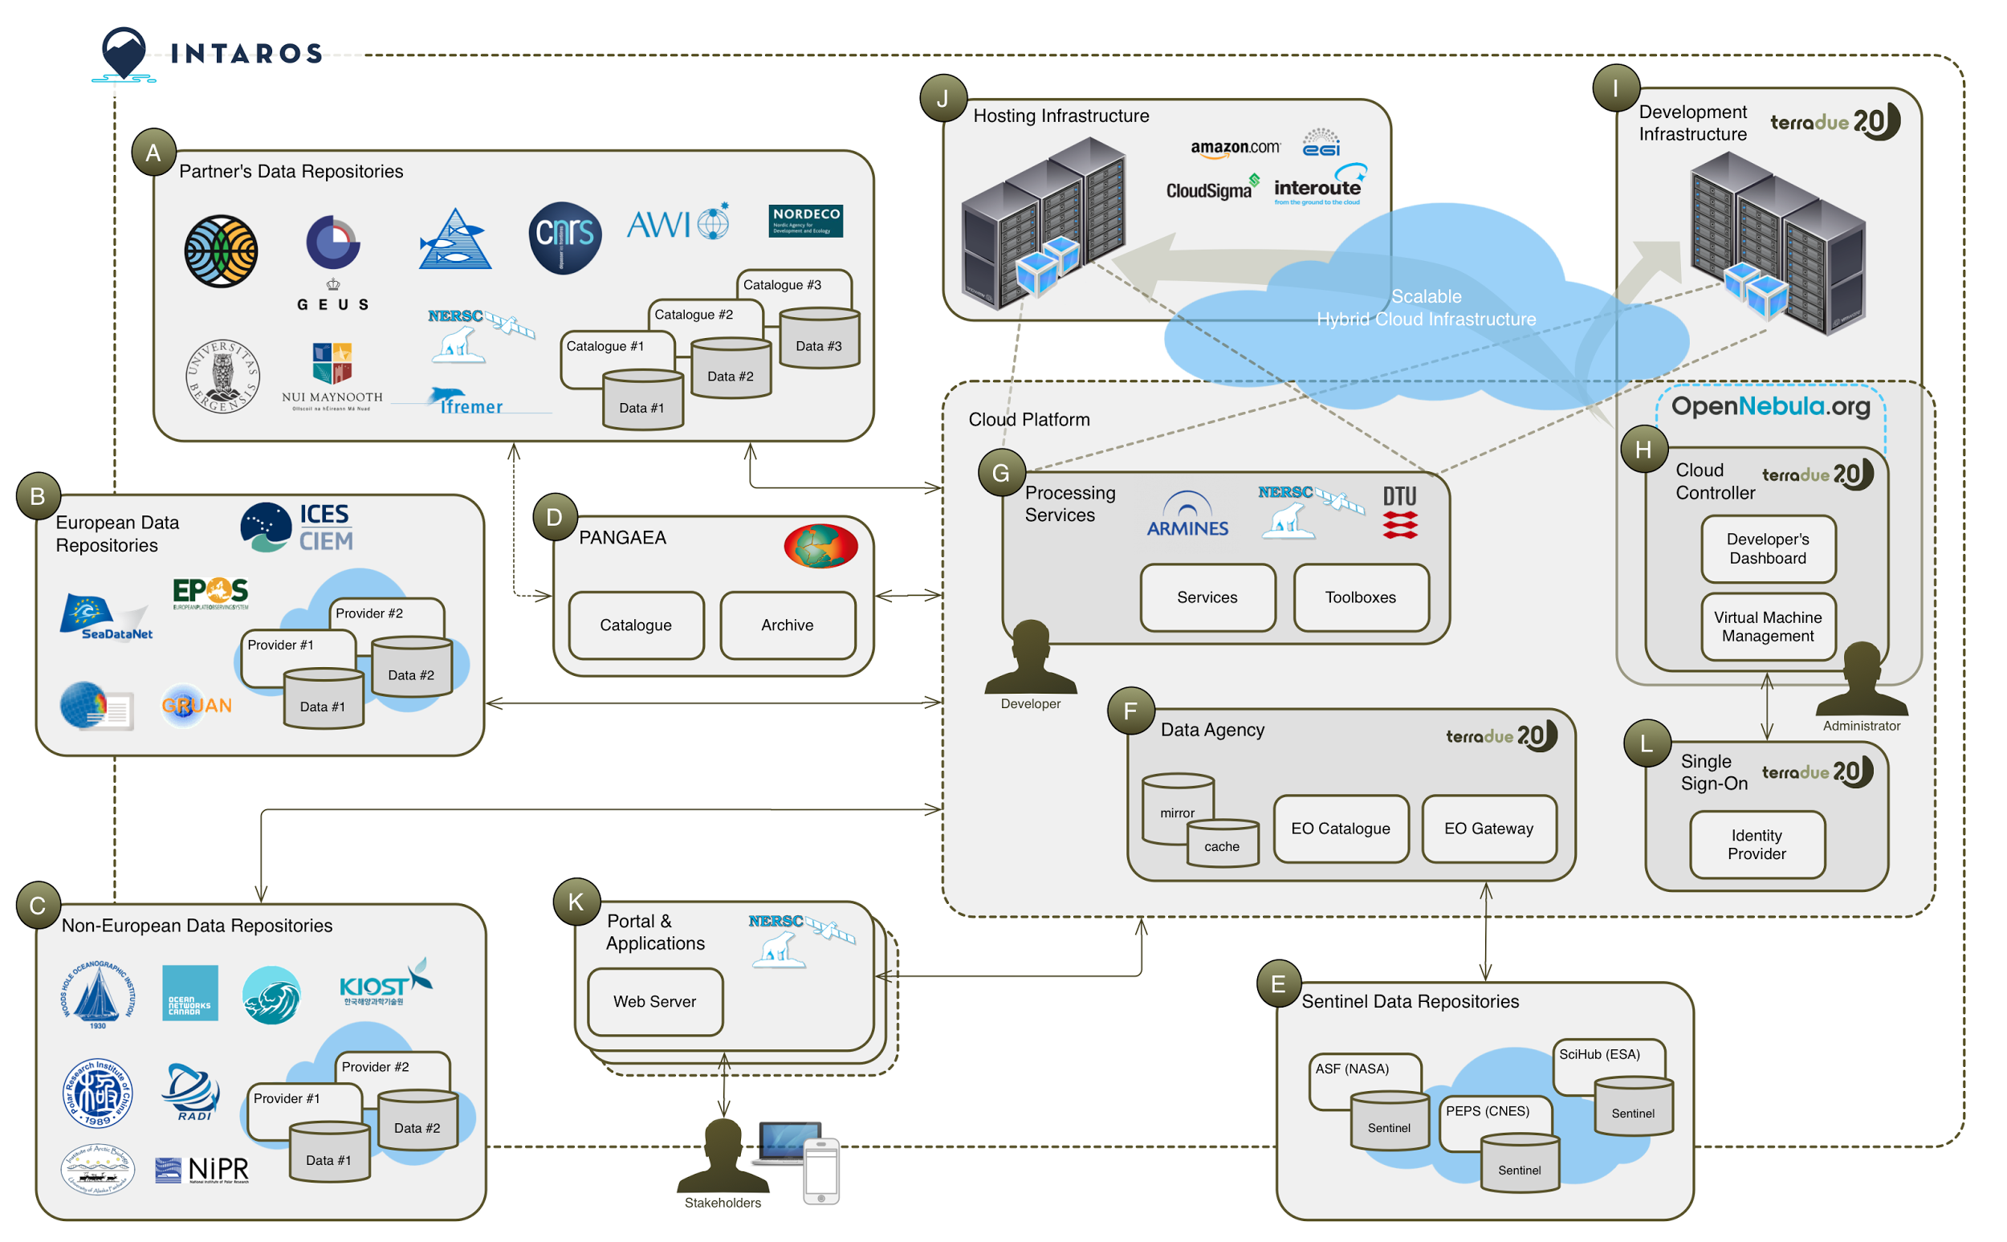
iAOS – Systems Overview

Slide 8
Data infrastructure approach
Interoperability
Scalability
support the protocols harmonization
support the mandated standard metadata
access to observations and derived parameters
provide a common entry point to data
integrate distributed databases holding ocean, atmosphere, cryosphere, terrestrial, and community based data
integrate scalable processing services
process new observations from WP2-4 and store the generated datasets

Slide 9
WP5 scope of work
Work Package Tasks

Slide 10
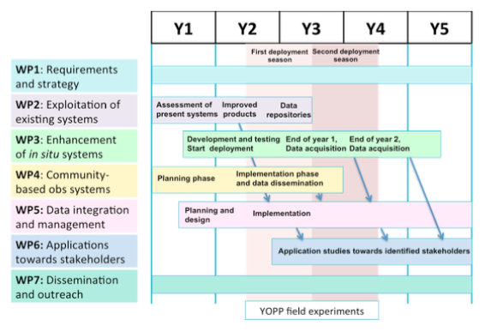
WP5 Tasks
T5.1 - Requirements and architectural design
T5.2 - iAOS platform and tools
T5.3 - Integrate data from existing repositories into iAOS
T5.4 - Development of geo-statistical methods for data integration
T5.5 - Processing services
T5.6 - iAOS Portal
T5.7 - Synthesis of the IAOS infrastructure - experiences and challenges

Slide 11
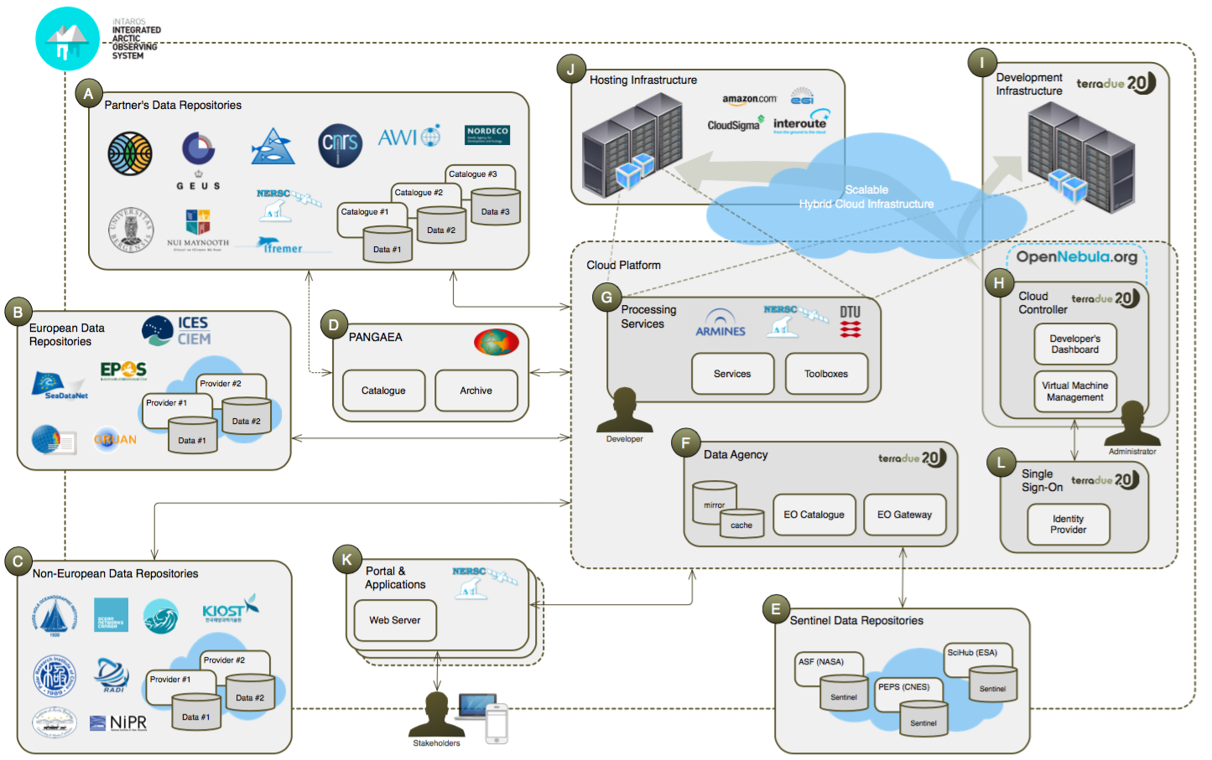
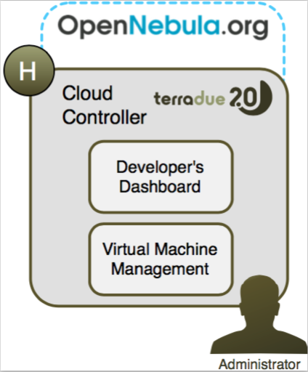
INTAROS WP5 Data integration and management
Task 5.1 System requirements and architecture consolidation:
Analyse interfaces of the databases selected in WP2
Define the data search and access services in iAOS.
Define essential user functionality for data discovery view, download, transformation, and workflows
Define the architecture driven by a cloud infrastructure
Task 5.2 IAOS platform deployment and operation:
provide the underlying infrastructure for iAOS
offer a Cloud Developer Sandbox for algorithm and service developers
include cloud orchestration, storage virtualisation, Virtual Machine (VM) provisioning, scaling & cloud bursting---
operate on Cloud Platform under a virtualized data center
define, execute and manage services of interconnected VMs

Slide 12
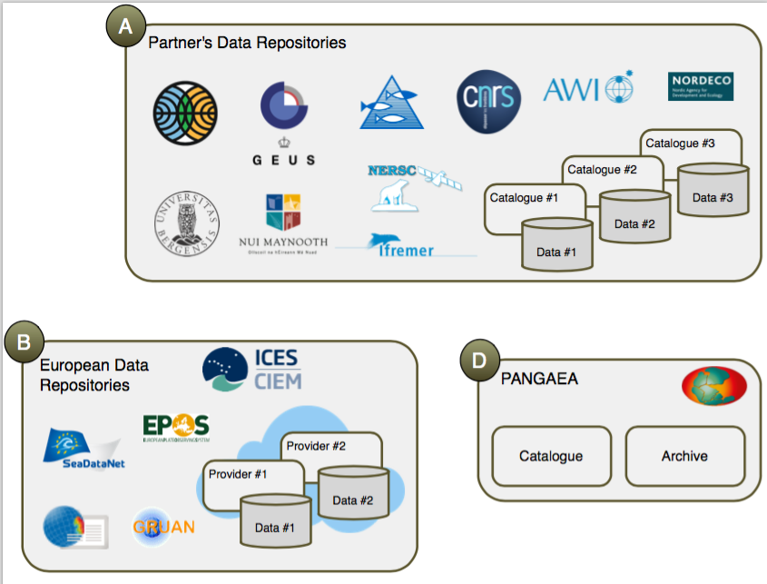
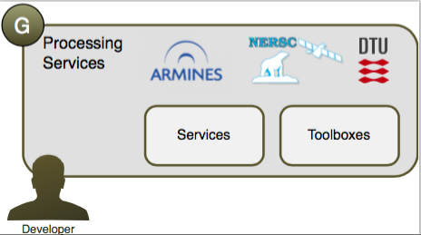
INTAROS WP5 Data integration and management
Task 5.3 Integrate data from existing repositories into iAOS:
provide a framework to ease the discovery (i.e. search) and retrieval (i.e. access) of data (remote-sensing, in situ) using best practices for search services (e.g. OpenSearch)
selected tools to support data access to the relevant archives will be made available on the Cloud Sandbox environment
define the roadmap to support a federated cloud solution for existing data infrastructures
Task 5.4 Development of geo-statistical methods for data integration:
exploits the data processing tools in the plaform
Develop new geo-statistical algorithms for combining multi-source data into new data products
Implement the developed algorithms as part of a geo-statistical library RGeostats
Implement toolboxes to increase performance
Make the developed algorithms available for service development in Task 5.5
Notes:
Variogram: http://gpss.cc/mock09/slides/wackernagel.pdf

Slide 13
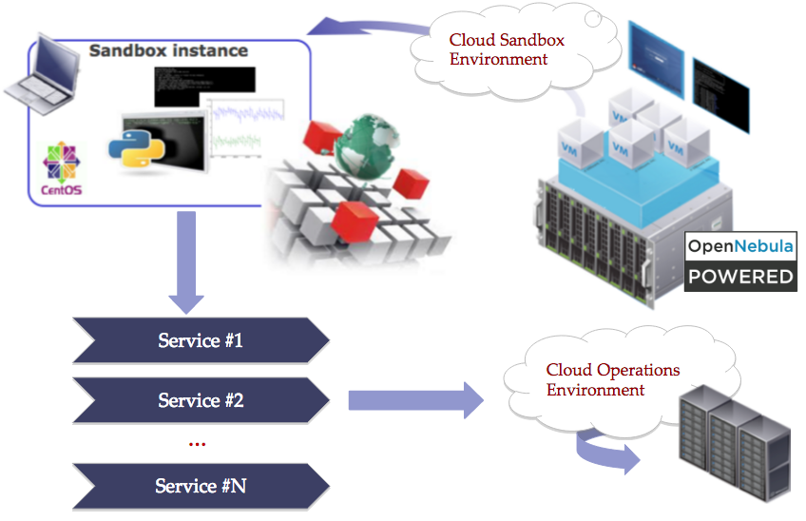
INTAROS WP5 Data integration and management
Task 5.5 Integration of new processing services:
Exploit the data processing tools and geo-statistical algorithms in the Cloud Developer Sandboxes
Support the full life cycle of the integration of new processing services offering simultaneous access to data , tools and processing resources
Implement services within a Platform as a shared Service (PaaS)
Selected data processing services will be developed and made available to demonstrate the iAOS platform
Service Design
Service Implementation
Service Testing
Service Deployment
Service Validation

Slide 14
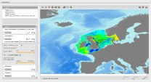
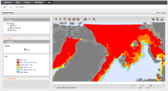
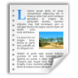
INTAROS WP5 Data integration and management
Task 5.6 iAOS portal development:
provide an intuitive user interface to the search, access and processing services in iAOS
provide a joint entry point to the integrated data repositories and the developed services
visualize retrieved multi-source data in a common map projection with basic GIS operations
enable execution of the developed processing services
Task 5.7 Synthesis of IAOS infrastructure deployment and operation:
summarize the experiences with deploying and operating the iAOS infrastructure
identify technical and non-technical challenges that need to be addressed to establish a sustainable pan-Arctic integrated observing system
make recommendations for the roadmap for a Sustainable Arctic Observing System (SAOS)

Slide 15
Key milestones
M12 - Design
M24 - 1st Deployment
M36 - Design Update with services
M42 - 2nd Deployment
Deliverables
D5.1 - Requirements and architectural design (M12, 36)
D5.2 - Platform and tools (M24, 42)
D5.3 - Data integrated from existing repositories (M24, 54)
D5.4 - Geostatistical library (M36, 54)
D5.5 - Processing services (M36, 54)
D5.6 - Portal with user manual (M24, 54)
D5.7 Synthesis of the IAOS infrastructure - experiences and challenges (M54)

Slide 16
Deliverables
Deliveries
D5.1 - iAOS requirements and architectural design (M12, 36)
D5.2 - iAOS platform and tools (M24, 42)
D5.3 - Data integrated from existing repositories (M24, 54)
D5.4 - Geostatistical library (M36, 54)
D5.5 - Processing services (M36, 54)
D5.6 - iAOS Portal (M24, 54)
D5.7 Synthesis of the IAOS infrastructure - experiences and challenges (M54)

Slide 17
Upcoming Actions
Identify teams for each task
Initiate task organisation
Monthly WP Telcos
Start collaborative activities between the different institutions
Define Intermediate Releases Plan
Deliveries
D5.1 - iAOS requirements and architectural design (M12, 36)
D5.2 - iAOS platform and tools (M24, 42)
D5.3 - Data integrated from existing repositories (M24, 54)
D5.4 - Geostatistical library (M36, 54)
D5.5 - Processing services (M36, 54)
D5.6 - iAOS Portal (M24, 54)
D5.7 Synthesis of the IAOS infrastructure - experiences and challenges (M54)

