Slide 1


Finn Danielsen
Ecologist, dr. scient.
Lisbeth Iversen
Social scientist

Slide 2

Community Based
Monitoring (CBM) in the Arctic

Slide 3
Community-based Monitoring
Characteristics
Activities of INTAROS

Slide 4
Community-based Monitoring
Characteristics
Activities of INTAROS

Slide 5
Decision-making from natural resource monitoring
n = 104 monitoring schemes
J. Appl. Ecol. 47:1166
J Appl Ecol 47:1166-1168

Slide 6
Scale of decision-making and
implementation time differ

Slide 7
Without involvement of local people:
the monitoring may sometimes be
isolated, academic exercises
with limited impacts in the ’real’ world

Slide 8
Community-based Monitoring
Characteristics
Activities of INTAROS

Slide 9
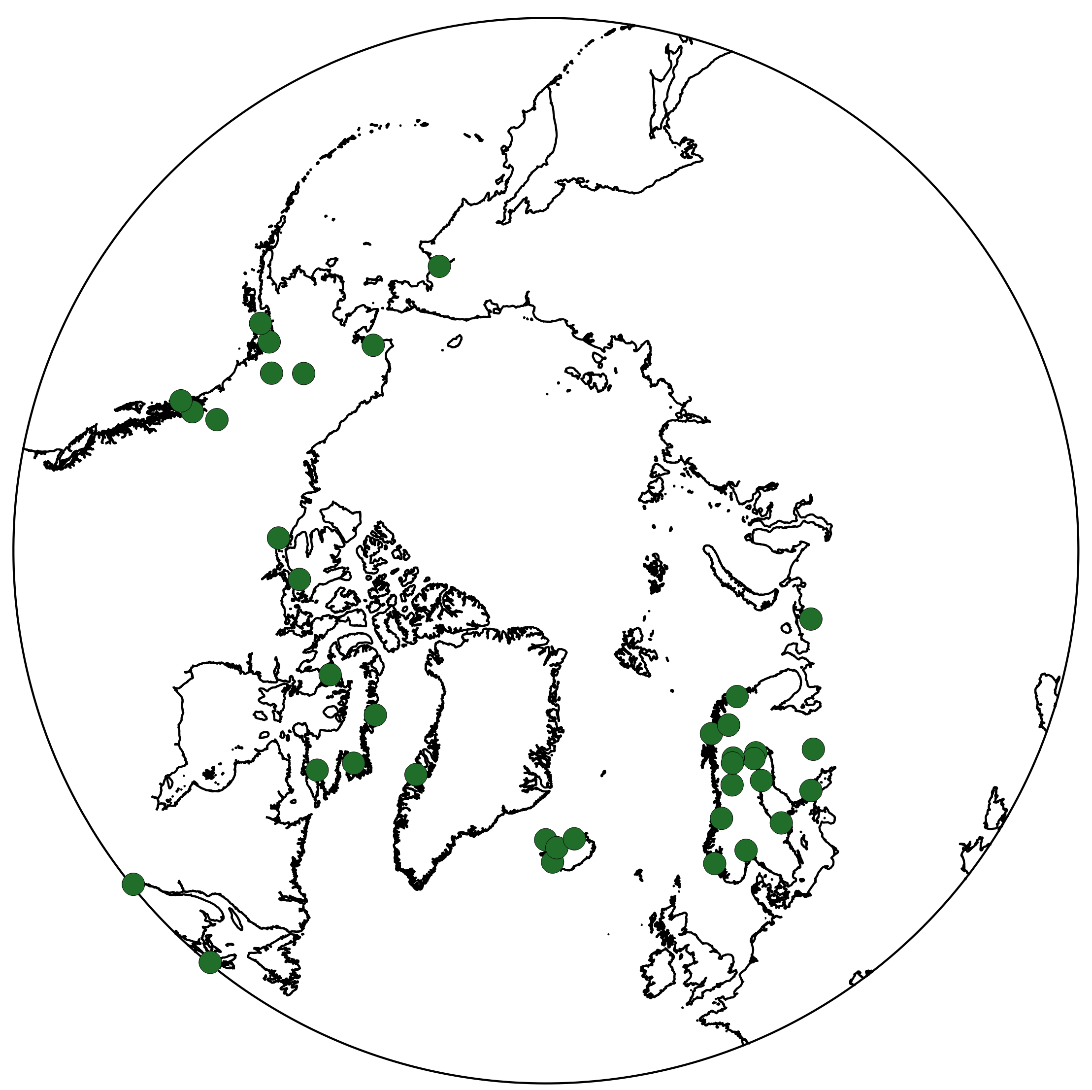
Existing known CBM programs
Johnson et al. 2016
n = 81

Slide 10
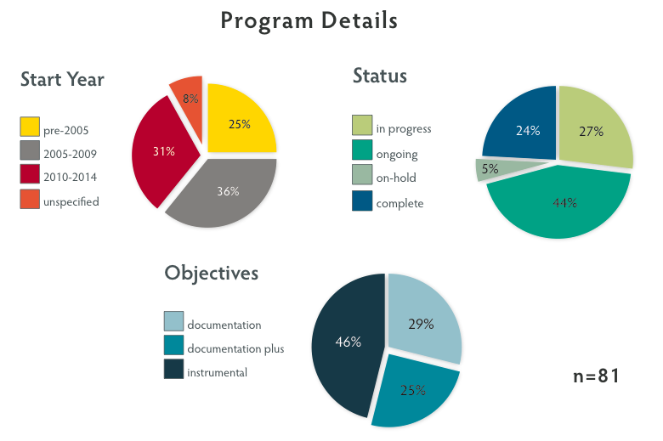
Johnson et al. 2016

Slide 11
Report from survey of existing CBM programs
Web-based library of ’good practice’ guidelines
Proceedings of experience-exchange workshops
D4.1
D4.2
D7.7

Slide 12
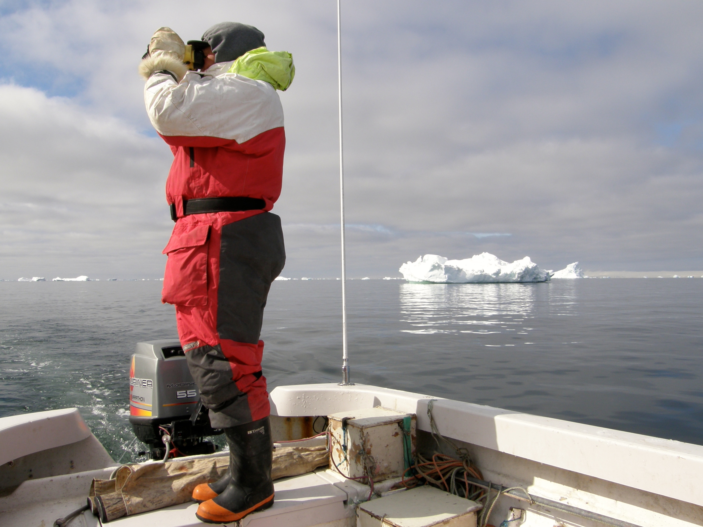
Disko Bay
Greenland

Slide 13
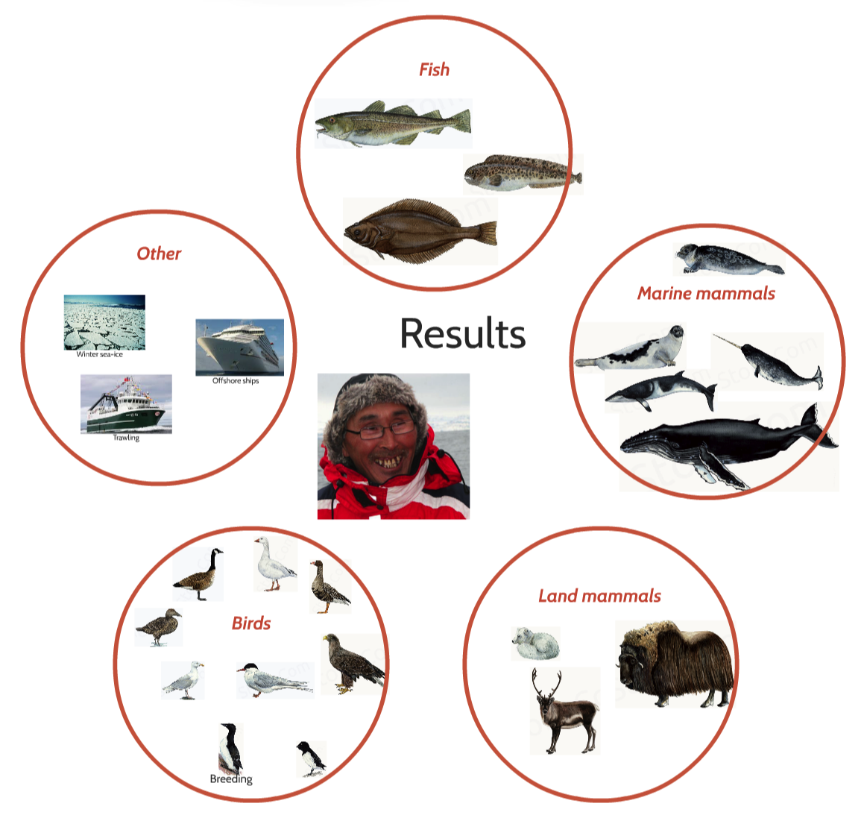

Slide 14
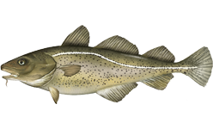
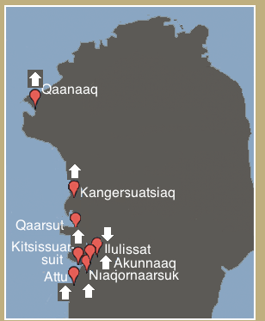
Disko Bay CBM
Example results: Cod
Most communities report regularly on Cod
Numbers are increasing
Spreading northward

Slide 15
Svalbard

Slide 17
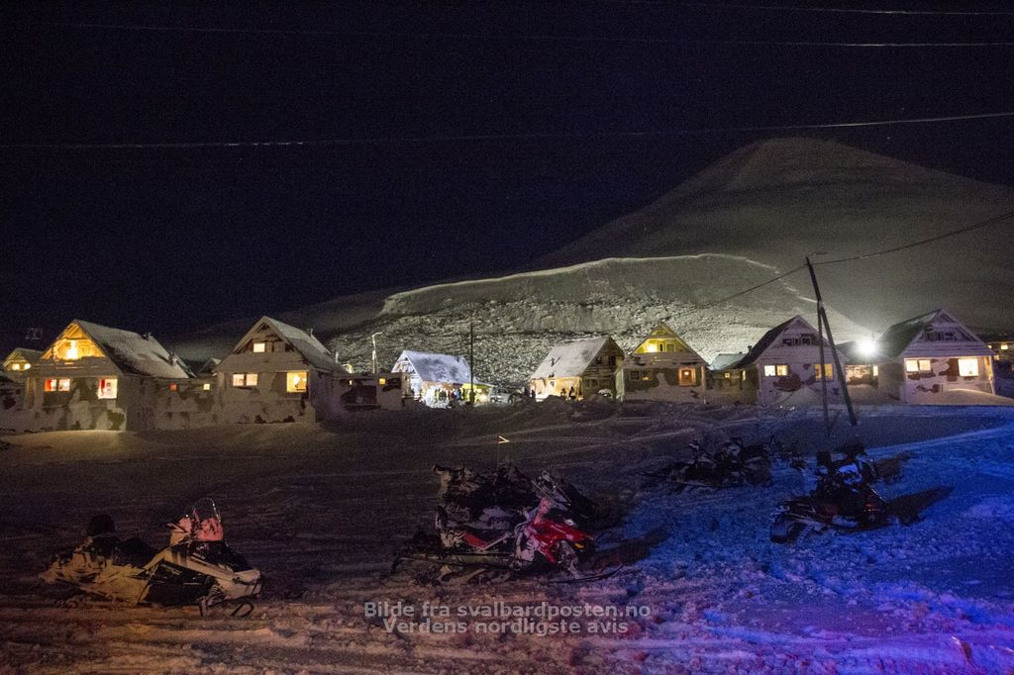
Geir Barstein/Svalbardposten.no

Slide 18
Disko Bay, Greenland and Svalbard:
Lessons learned report on piloting CBM tools
CBM data accessible for iAOS - using model for cross-weaving of data
Policy briefs
for local decision-makers
D4.3
D4.4
D6.6

Slide 19
Community-based Monitoring
Characteristics
Activities of INTAROS

Slide 20
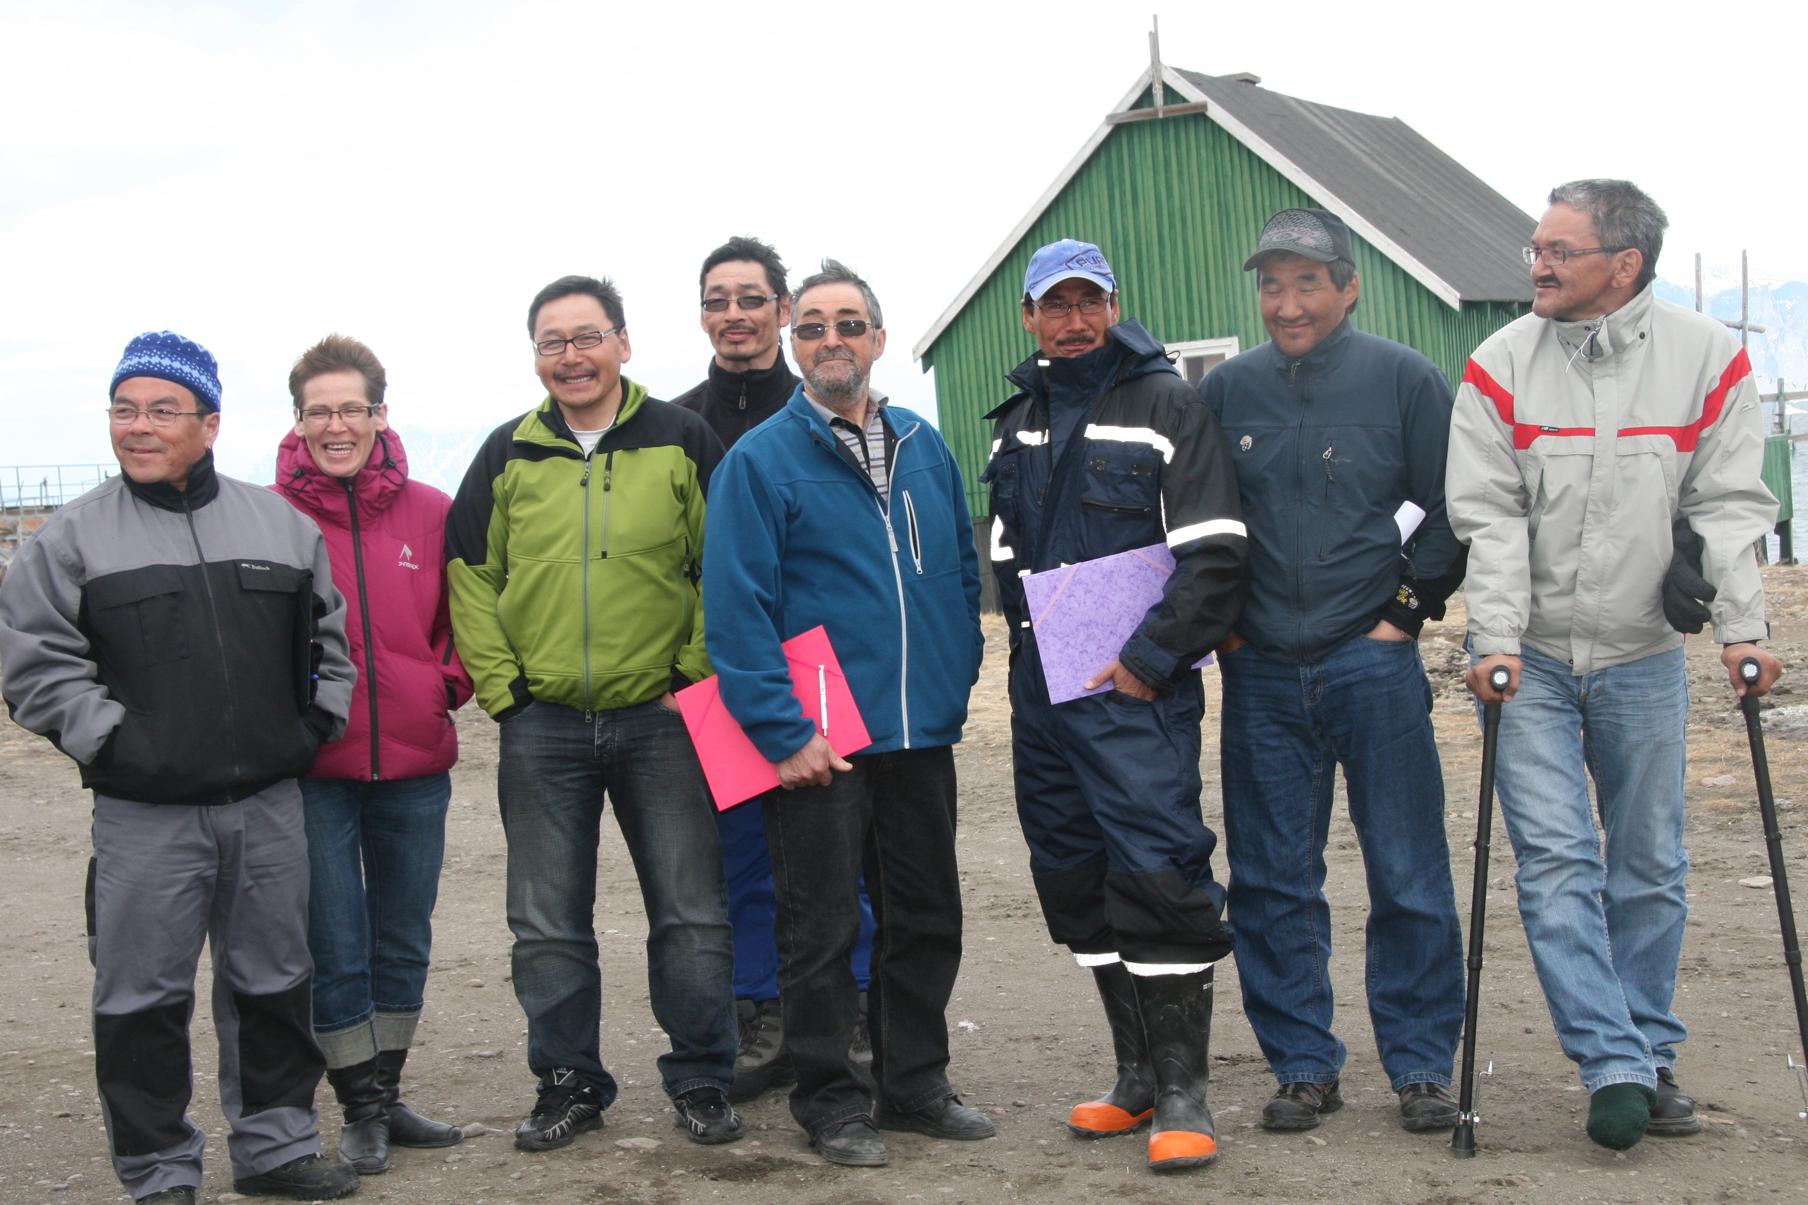
Qujanaq!

