Slide 1


WP2
Exploitation of existing observing systems
Roberta Pirazzini, FMI (lead) & David Gustafsson , SMHI (co-lead)

Slide 2
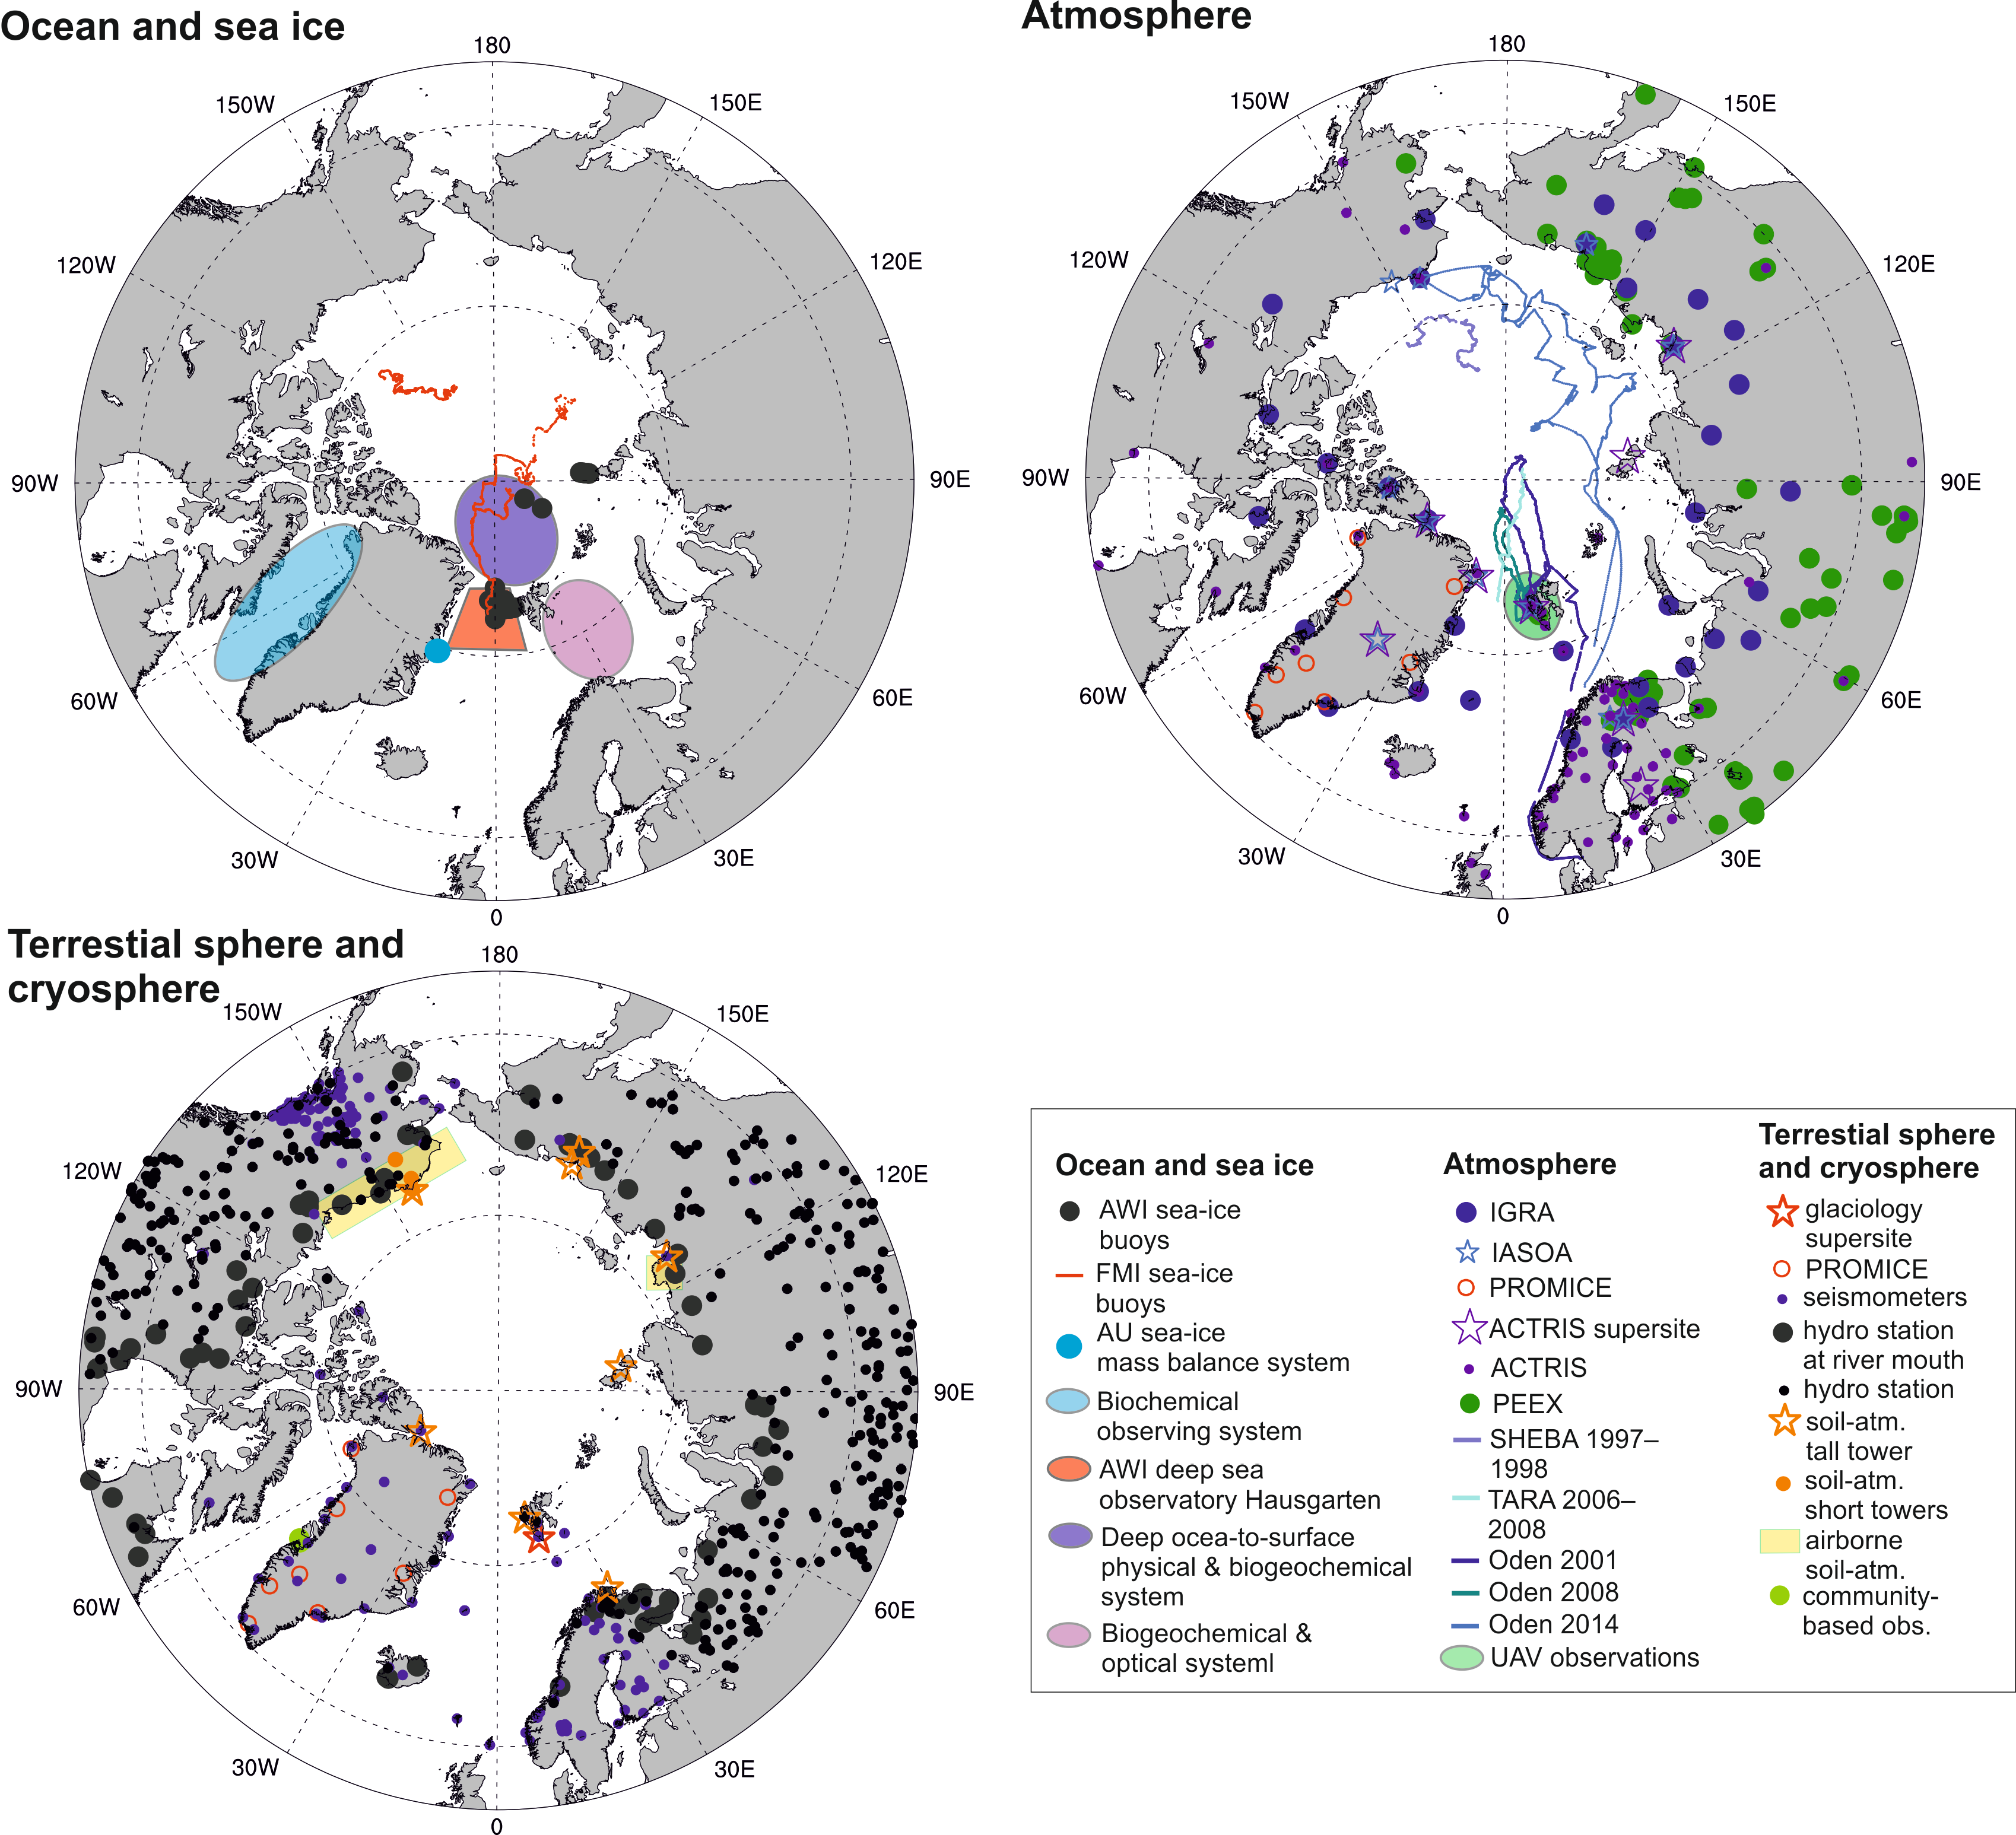
Assess, exploit, and standardize the existing Arctic observing systems
Overall objective
26 EU partners
9 Non-EU partners/collaborators:
  UAF (USA)
  WHOI (USA)
  SIO (USA)
  JPL (USA)
  ONC (Canada)
  RADI (China)
  NIPR (Japan)
  NIERSC (Russia)
  RIHMI (Russia)

Slide 3
Task 1. Analyze strengths, weaknesses, and gaps of the existing observation networks and databases.
Specific objectives:
Task 2. Exploit selected datasets in order to increase the quality and number of data products
Task 3. Enhance standardization of data and metadata to ensure that best practices are followed, and integrate
sparse in situ data into established networks, preparing their delivery to the iAOS

Slide 4
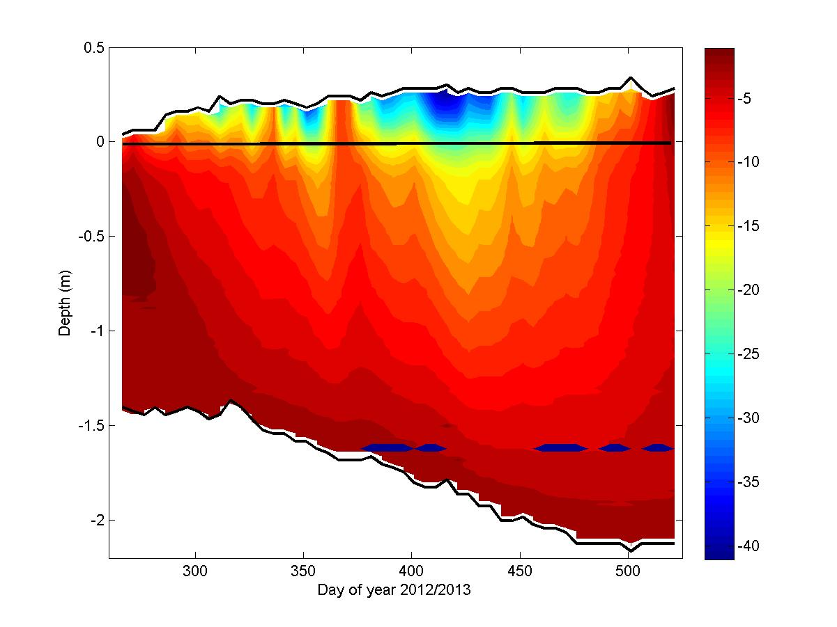
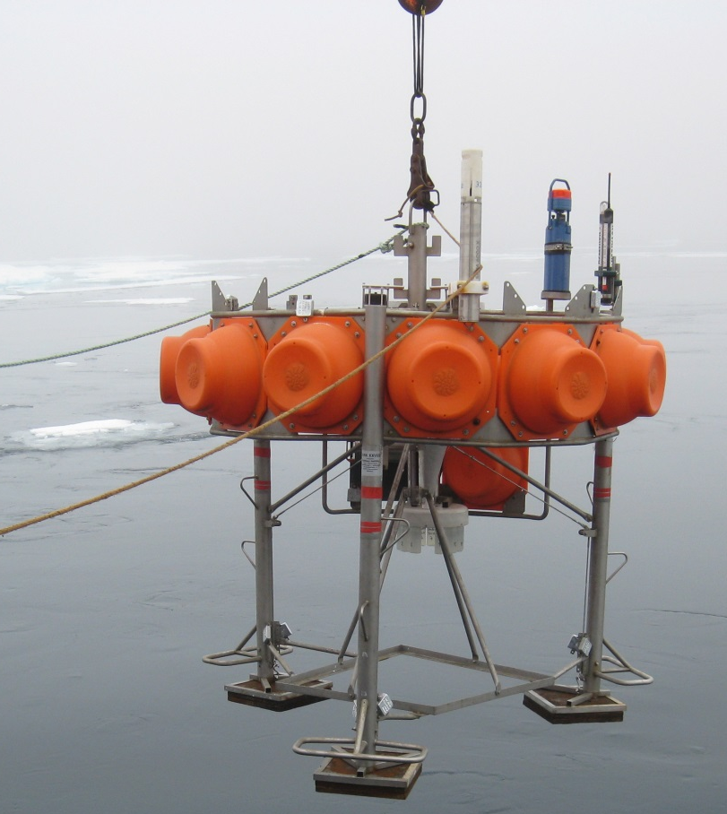
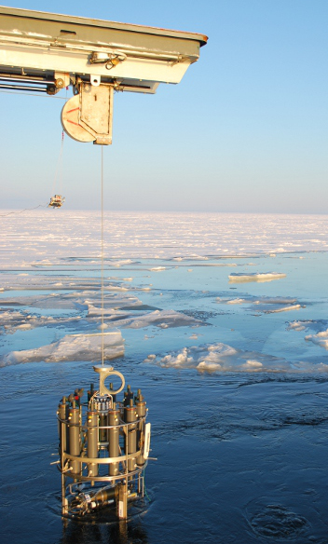
Evaluation of data from moored arrays, mobile platforms, tide gauge network, on-ice measurements, ocean bottom-mounted sensors, and remote sensing.
Task 1. Analyze strengths, weaknesses, and gaps of the existing observation networks and databases.
Ocean and sea ice
Benthic Lander
Time series of vertical profile of snow and ice temperature from Arctic buoy
CTD sampler

Slide 5
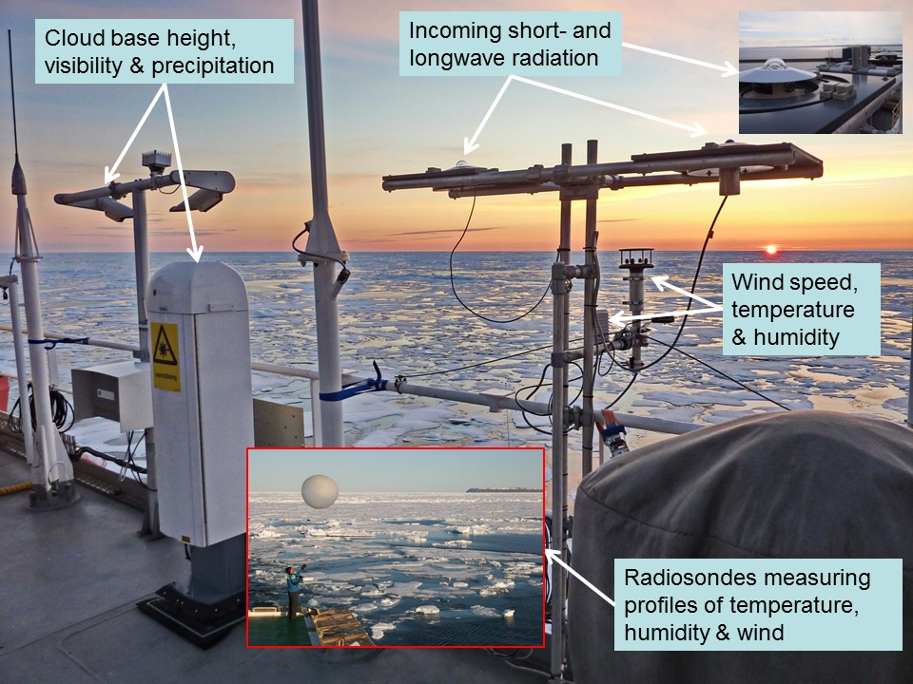
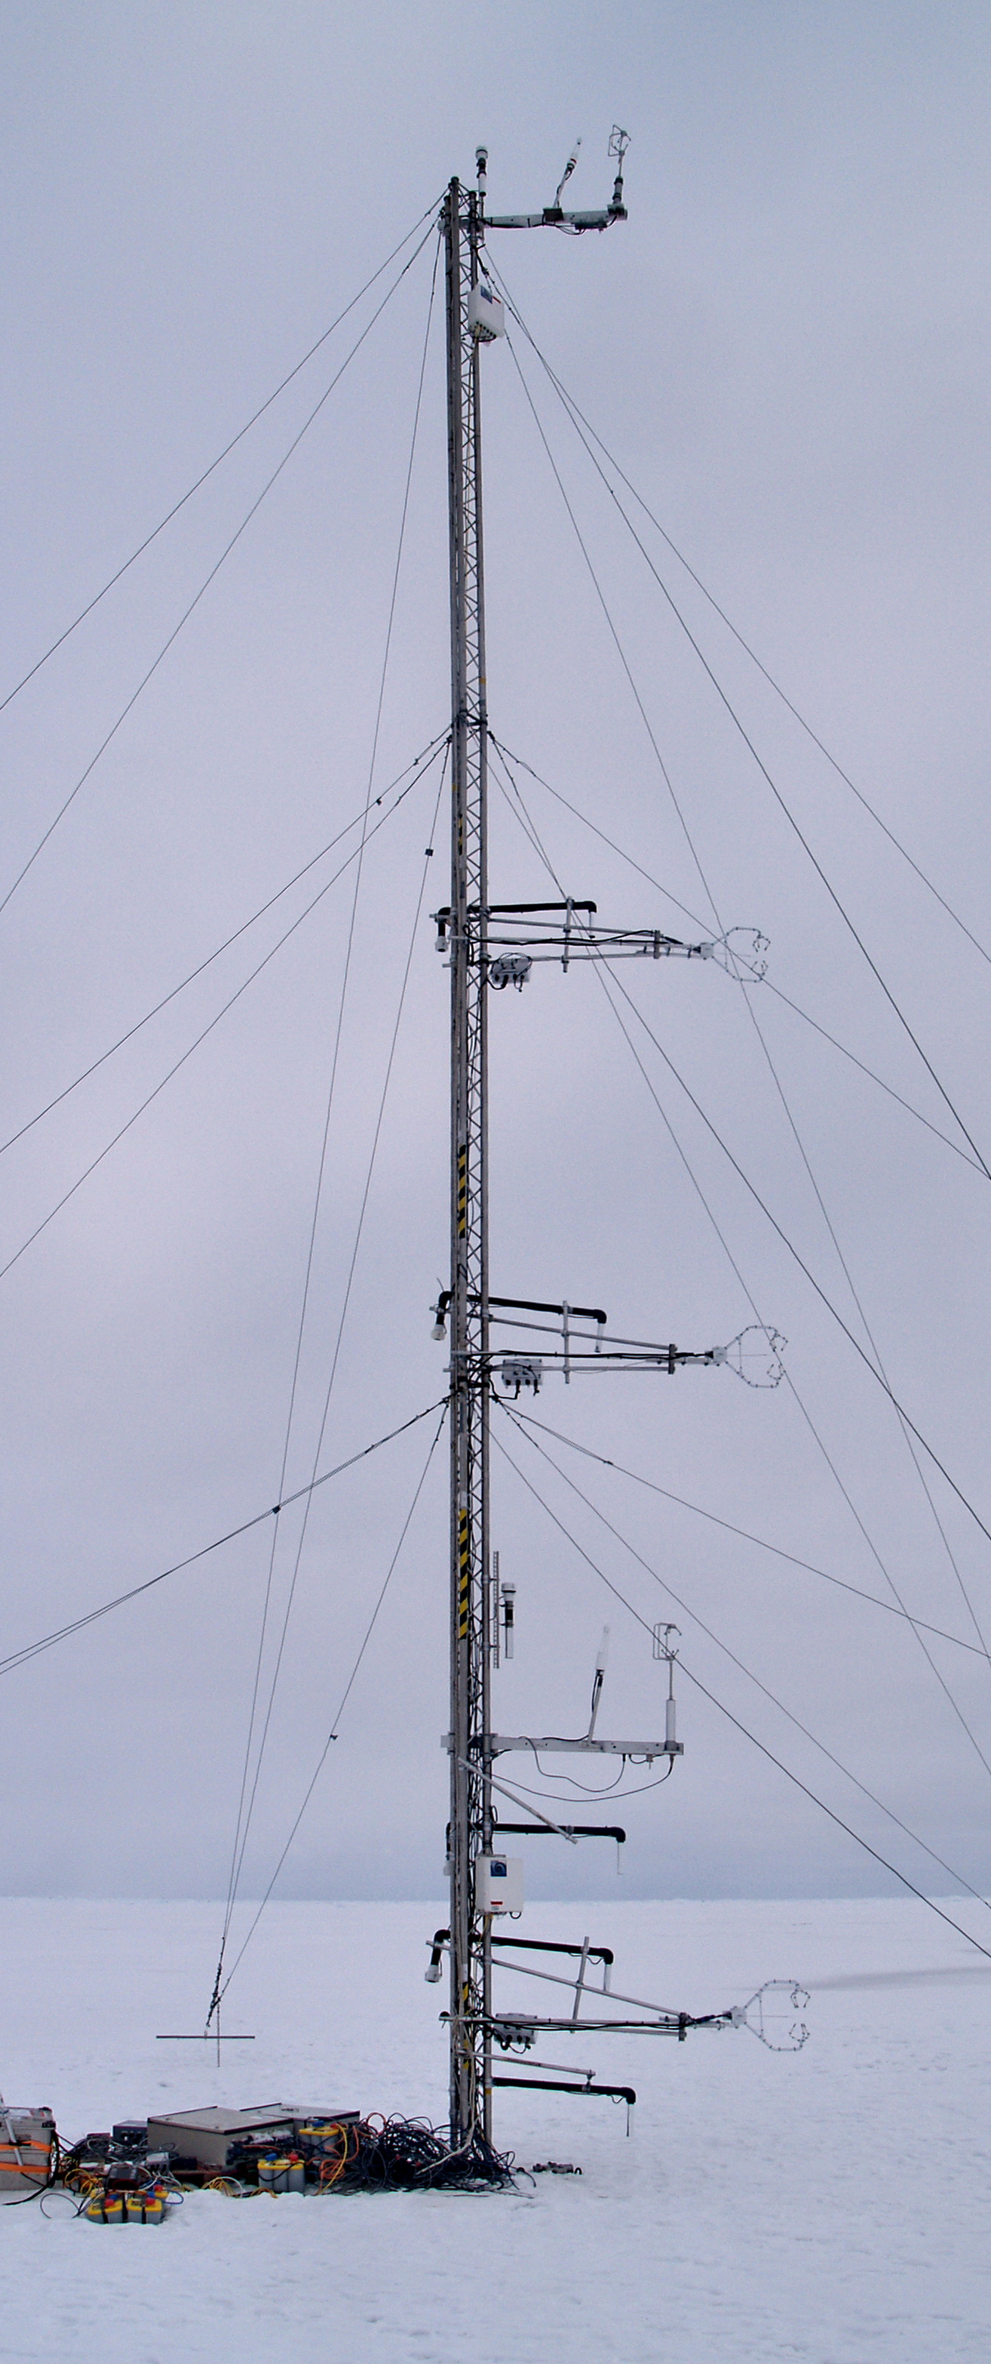
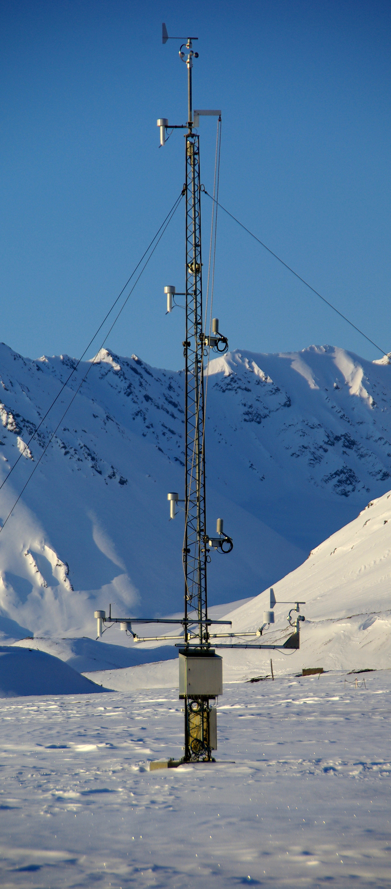
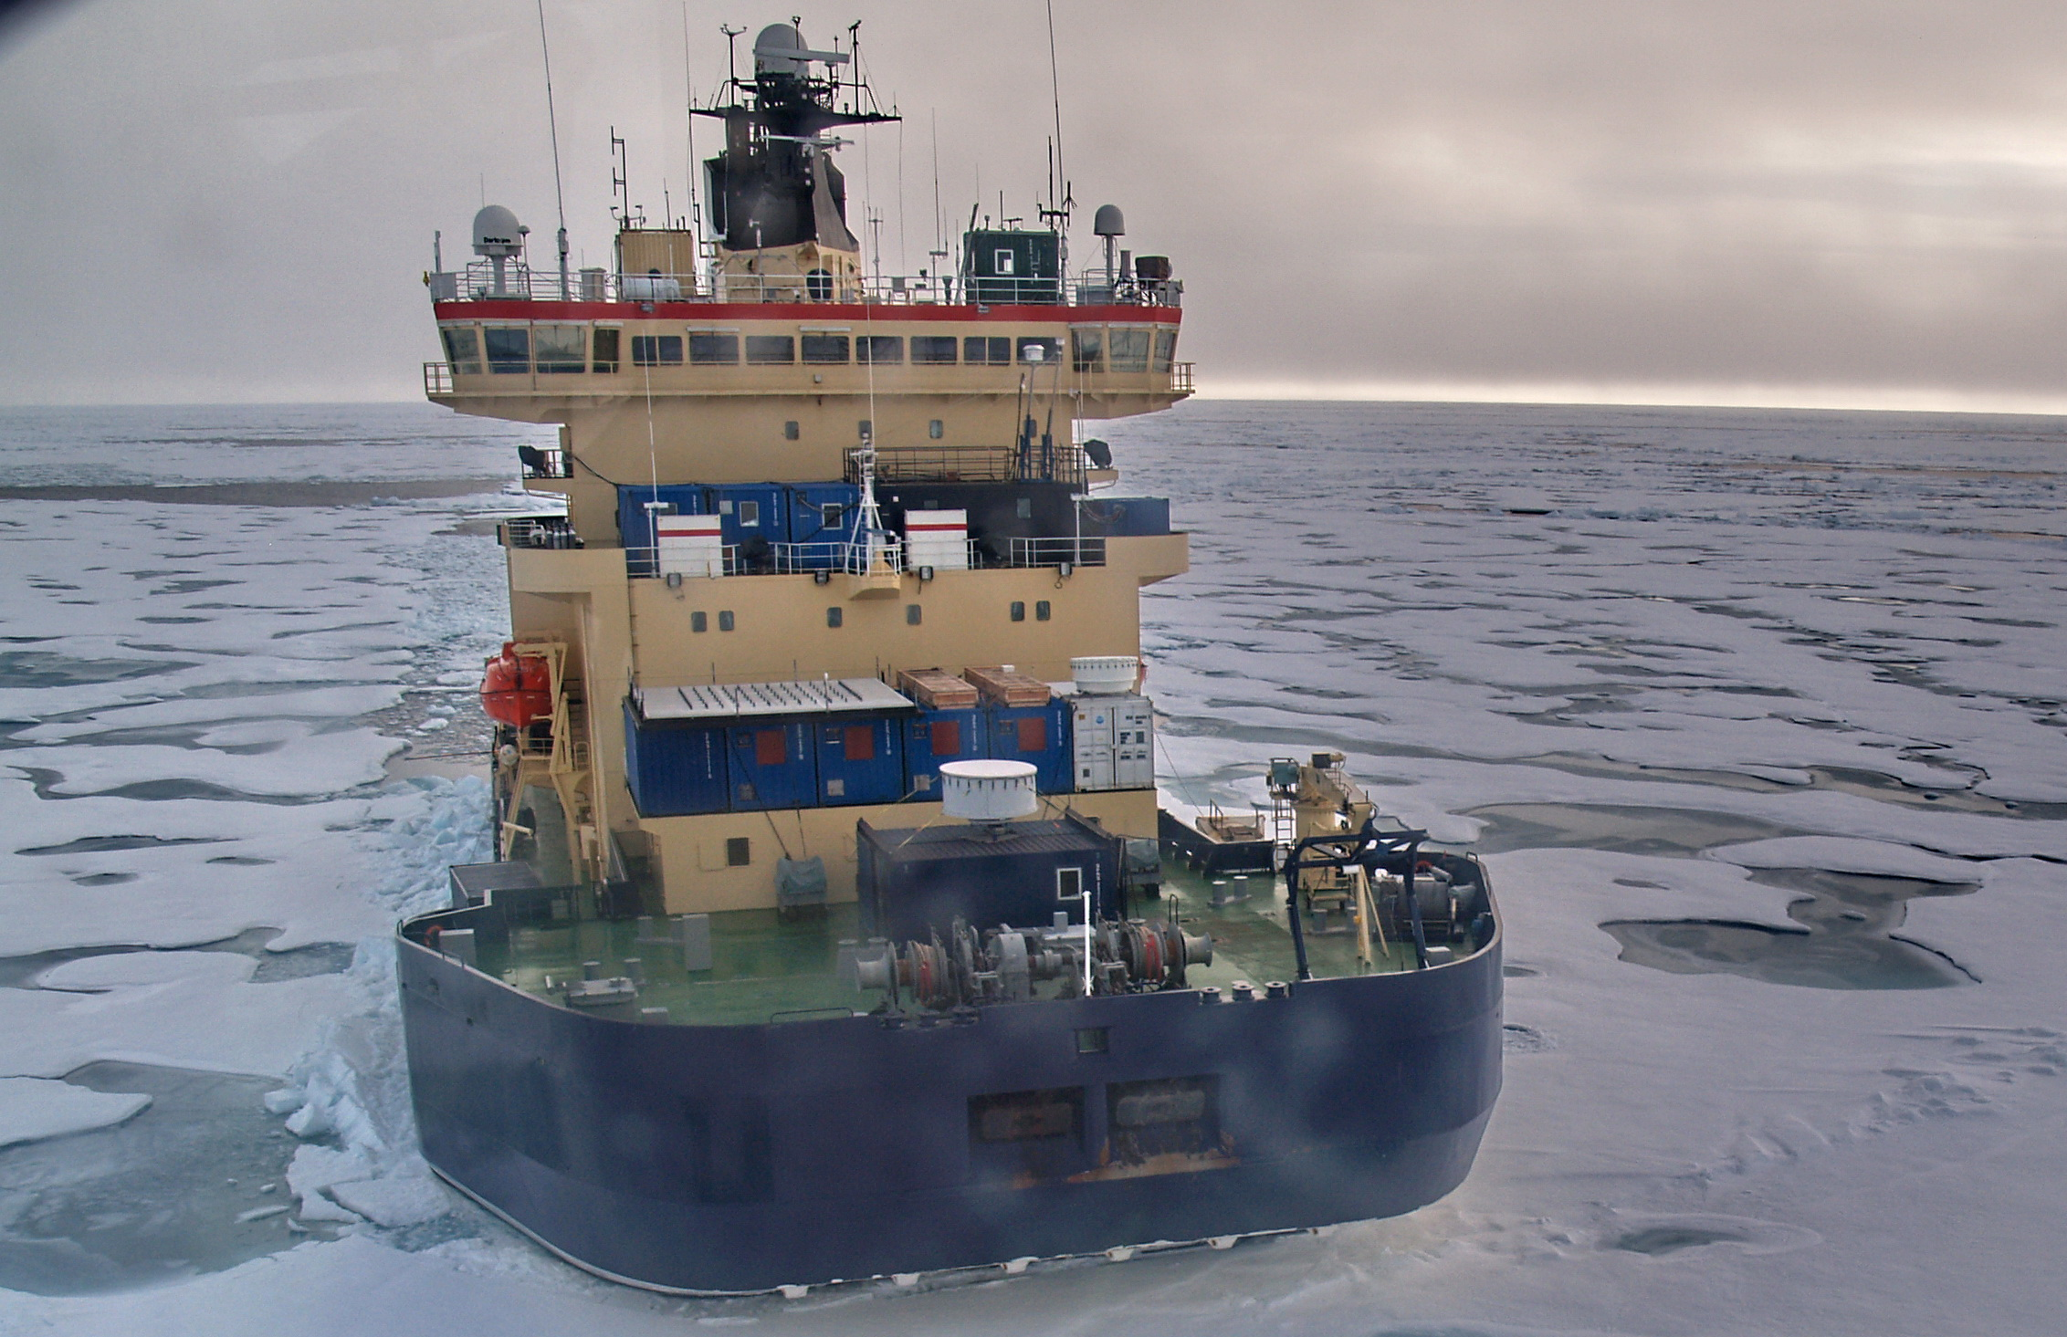
- Assessment of in-situ observations from supersites, field campaigns, buoys, research vessels.
- Assessment of satellite-based products using in-situ data
Task 1. Analyze strengths, weaknesses, and gaps of the existing observation networks and databases.
Atmosphere
Arctic Ocean
Sodankylä, Finland
Ny Ålesund, Svalbard
©Jürgen Graeser

Slide 6
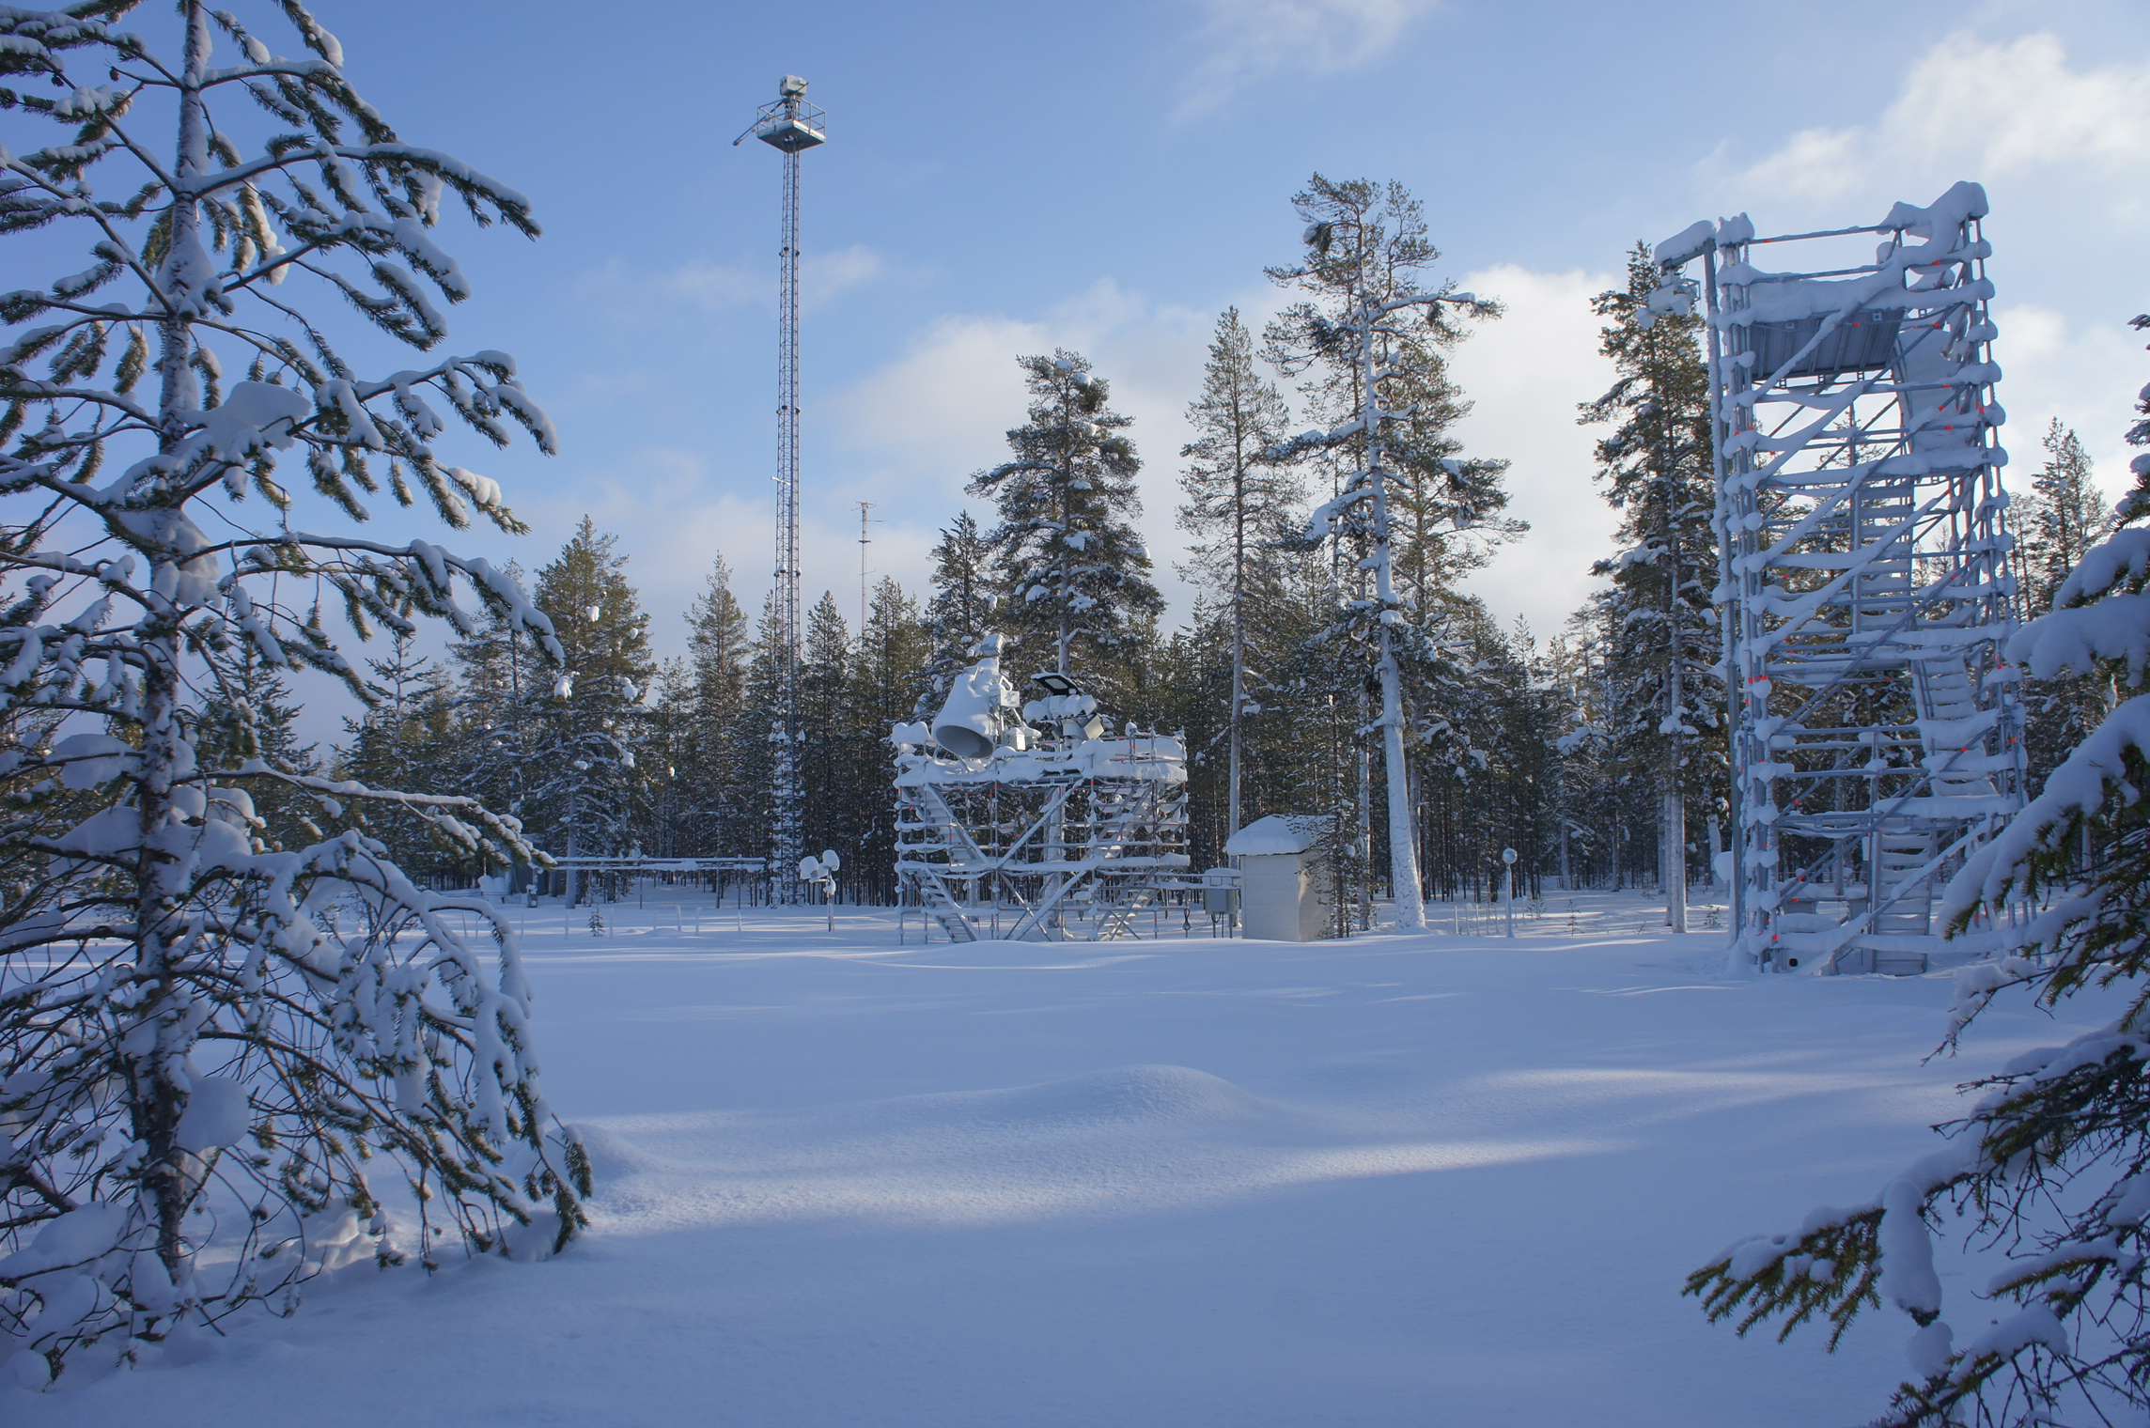
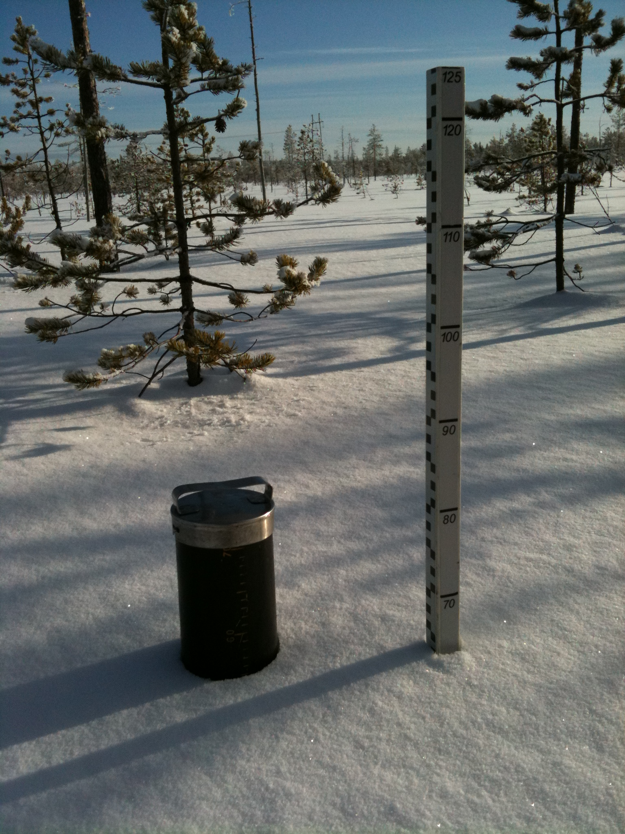
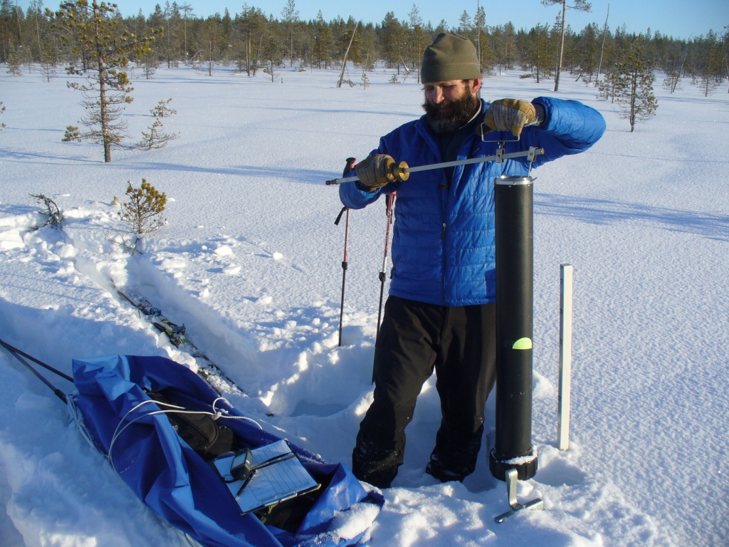
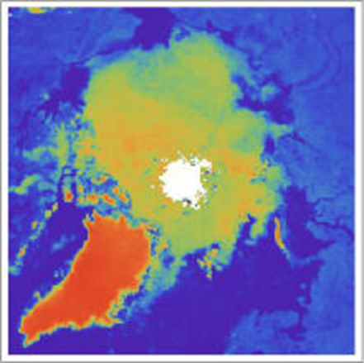
Task 1. Analyze strengths, weaknesses, and gaps of the existing observation networks and databases.
Cryosphere and land
Assessment of in-situ cryospheric and land observations stored in national and international databases
Evaluation of satellite snow, hydrological, and ice mass change products
Snow thickness
Radiometers
© Christian Mätzler
SWE measurement
© Serdar Sürer
©Tania Casal

Slide 7
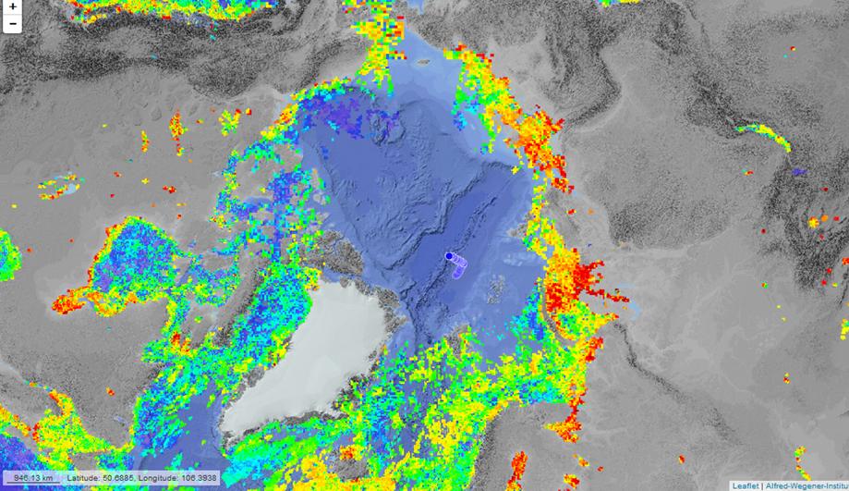
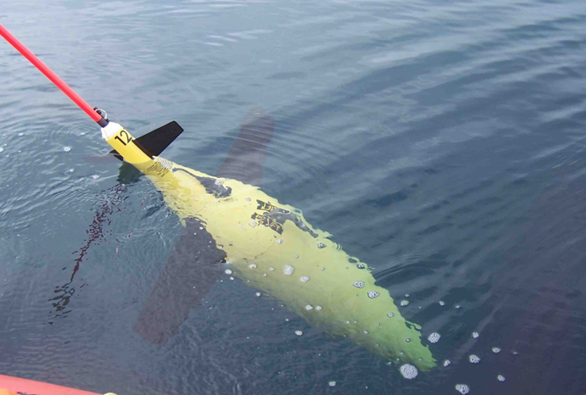
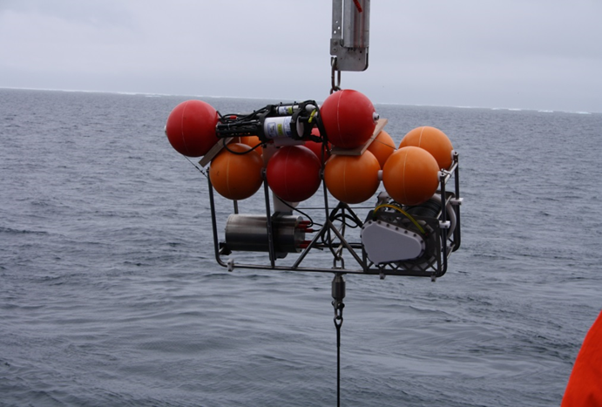
Task 2. Exploit selected datasets in order to increase the quality and number of data products
Ocean and sea ice
Chlorophylla layer, daily averages
Gliders
Harmonization and combination of existing datasets
Development of routines to retrieve new ocean and sea ice satellite products with improved accuracy and resolution
Profiling mooring

Slide 8
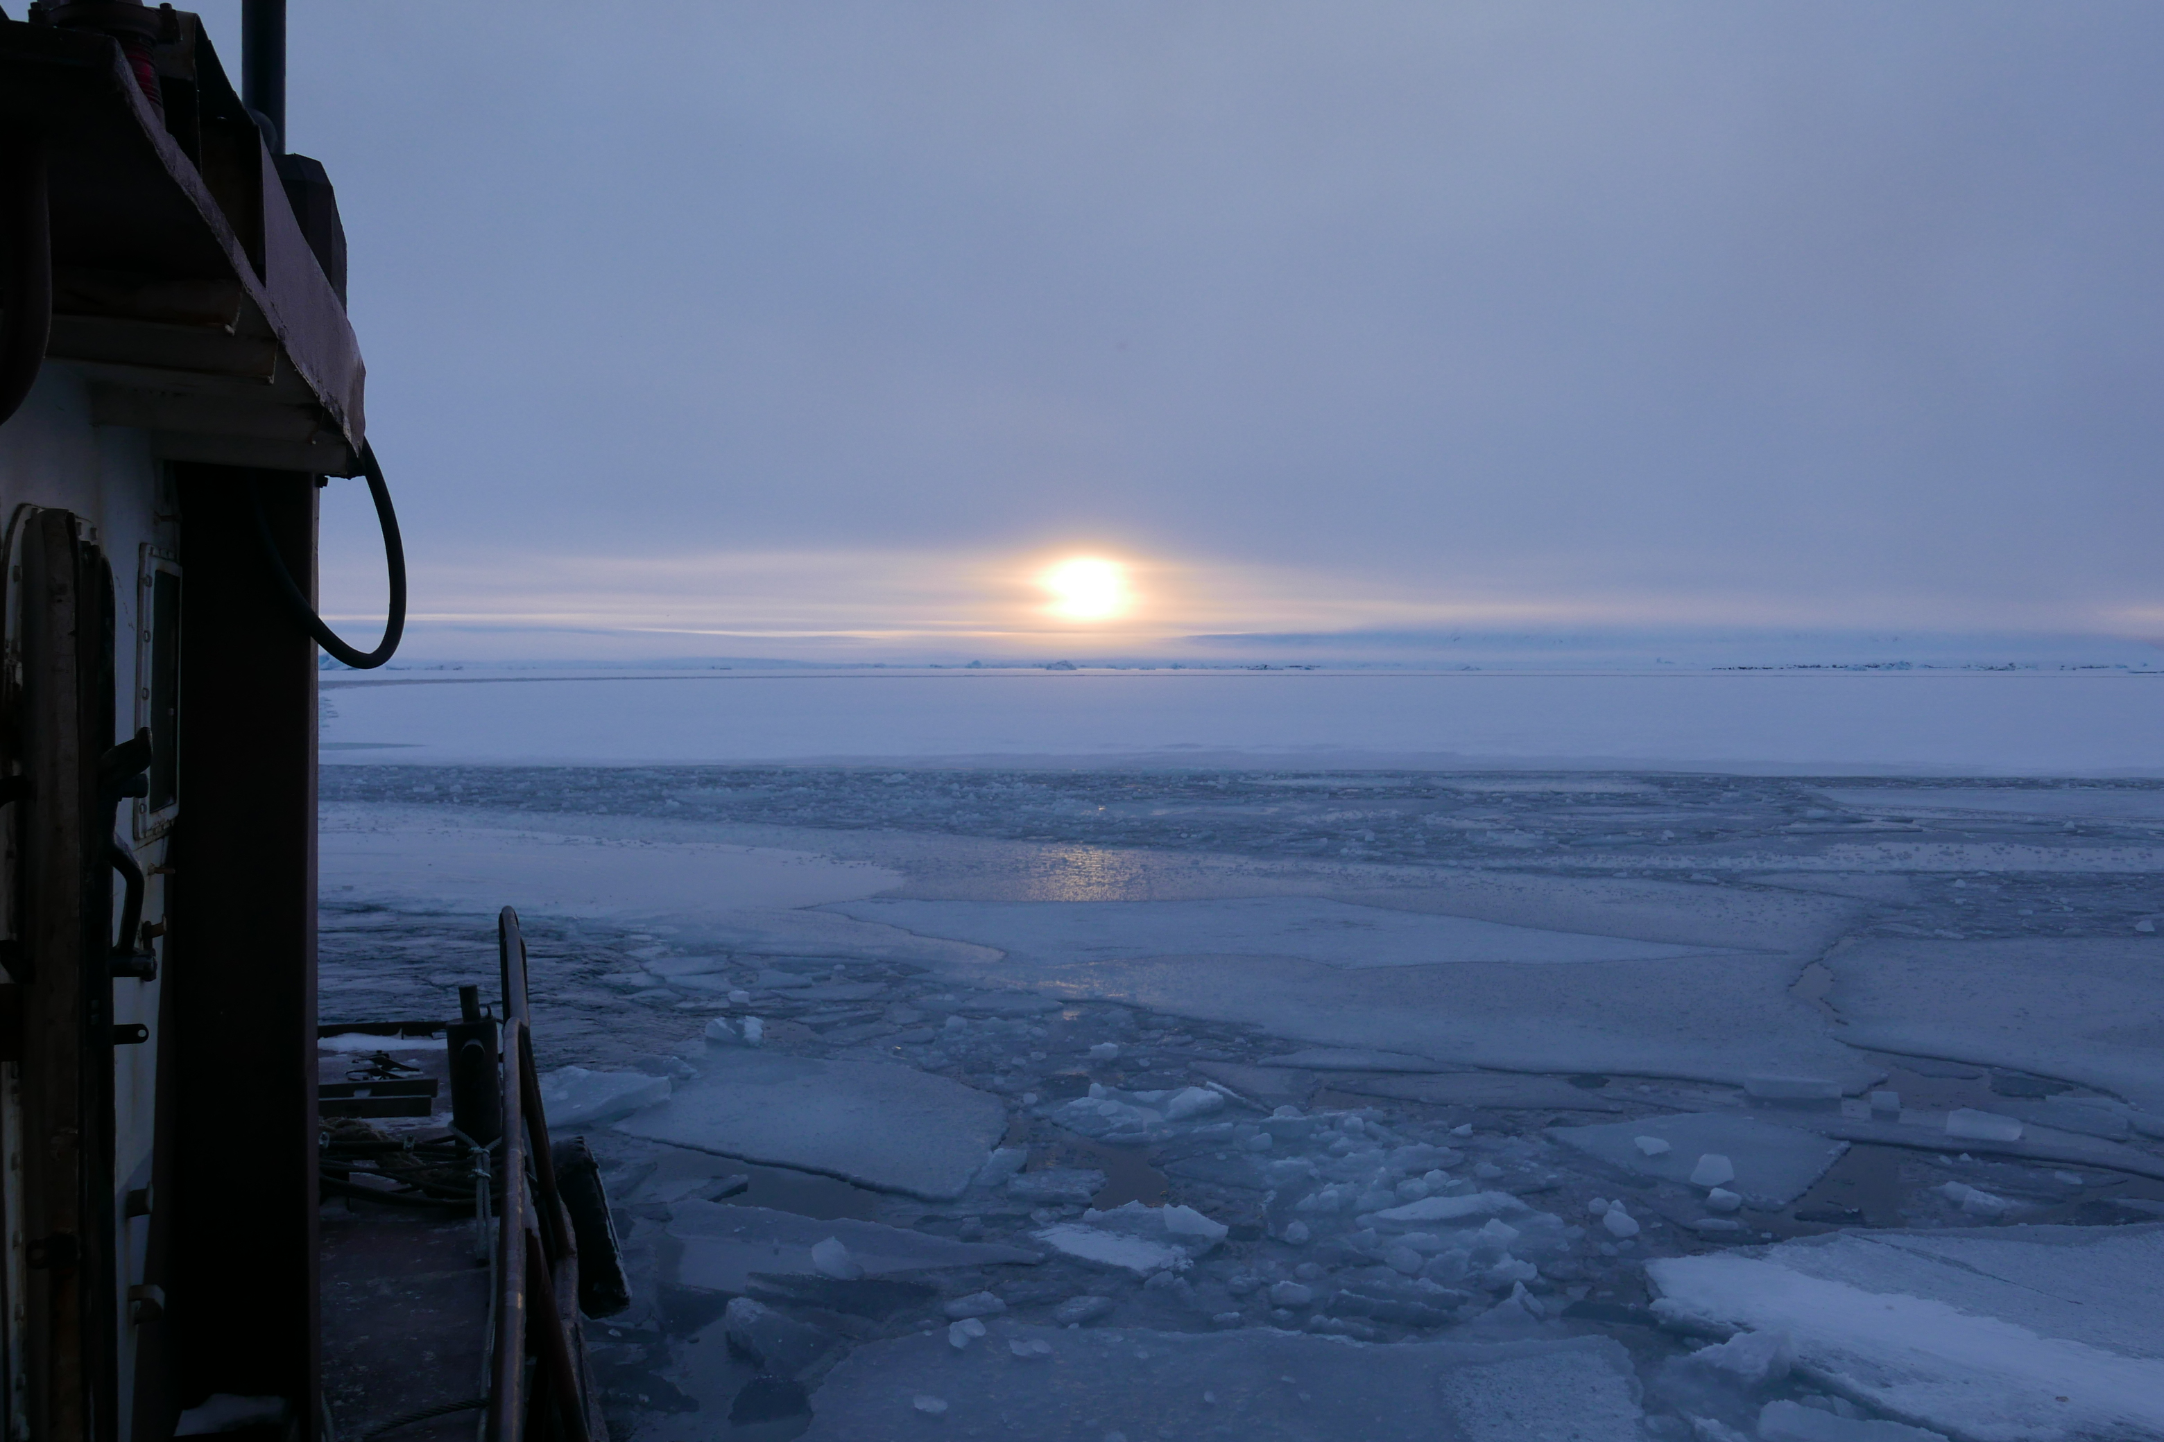
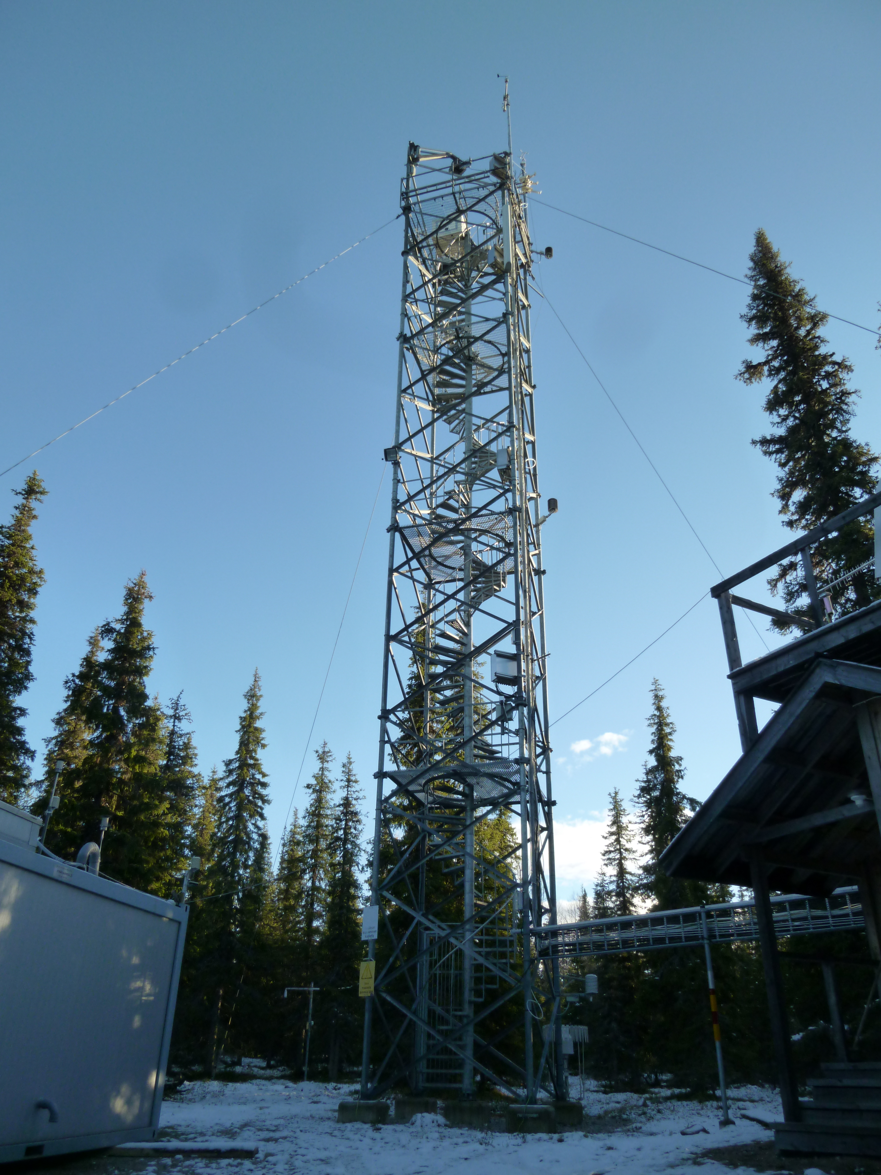
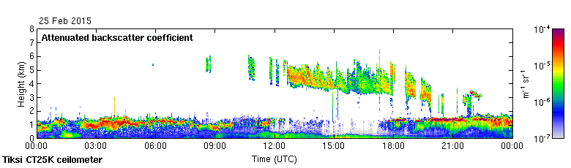
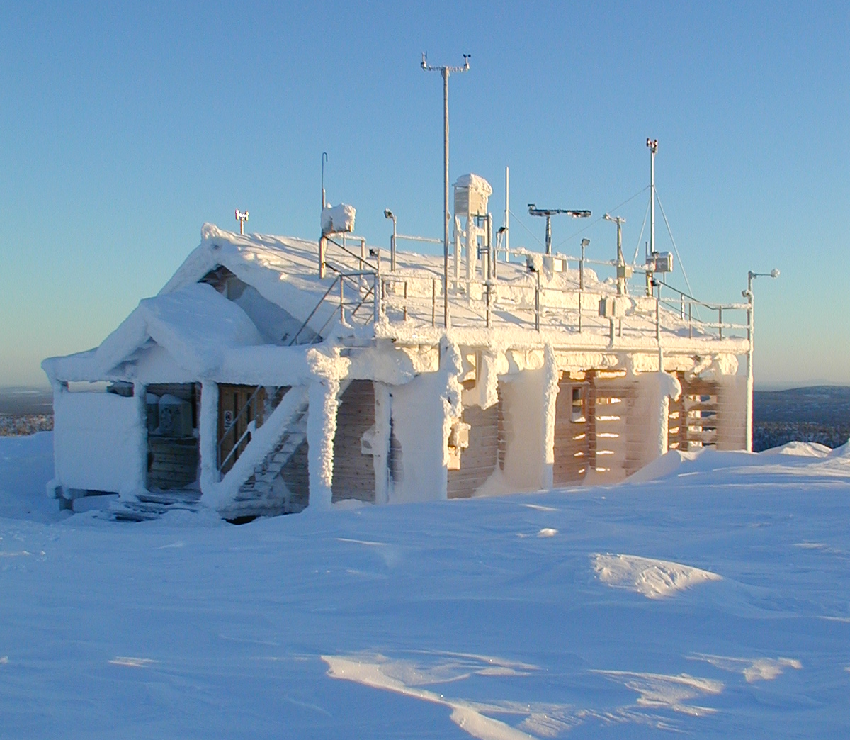
Task 2. Exploit selected datasets in order to increase the quality and number of data products
Atmosphere
Different observation platforms
and networks
Snowfall
Mixed-phase
Aerosol
Cirrus
Application of new algorithms to exploit in-situ and remote sensing observations

Slide 9
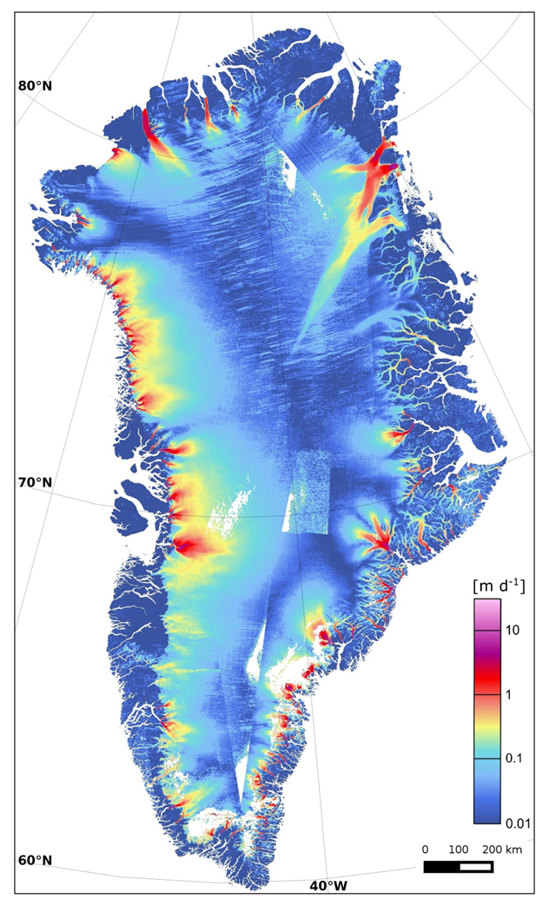

Task 2. Exploit selected datasets in order to increase the quality and number of data products
Cryosphere and land
Airborne CH₄ measurements
Surface velocity mapping
Advanced data processing following improved protocols
New satellite products
Application of new algorithms to exploit in-situ and remote sensing observations

Slide 10
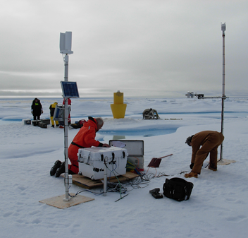
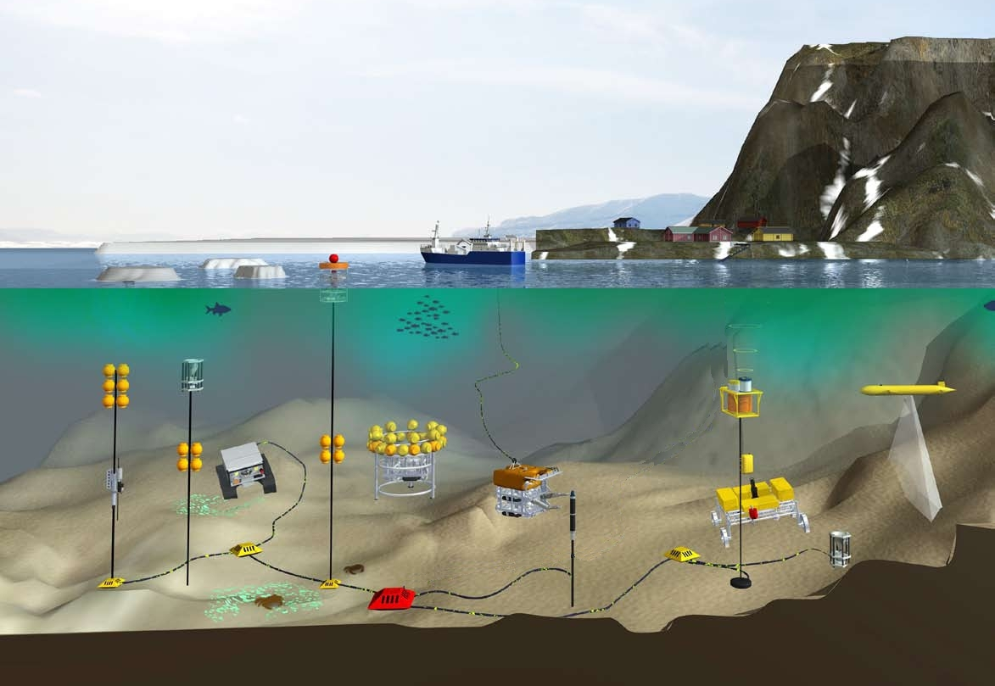
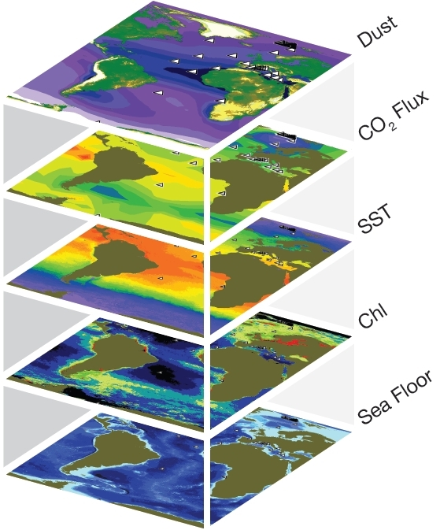
Task 3. Enhance standardization of data and metadata to ensure that best practices are followed, and integrate
sparse in situ data into established networks
Ocean and sea ice
© Rick Krishfield
© Rick Krishfield
Provision and integration of sea ice and ocean data collated from various open ocean observatories

Slide 11
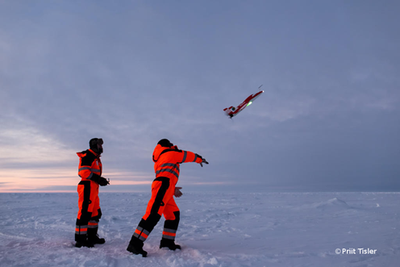
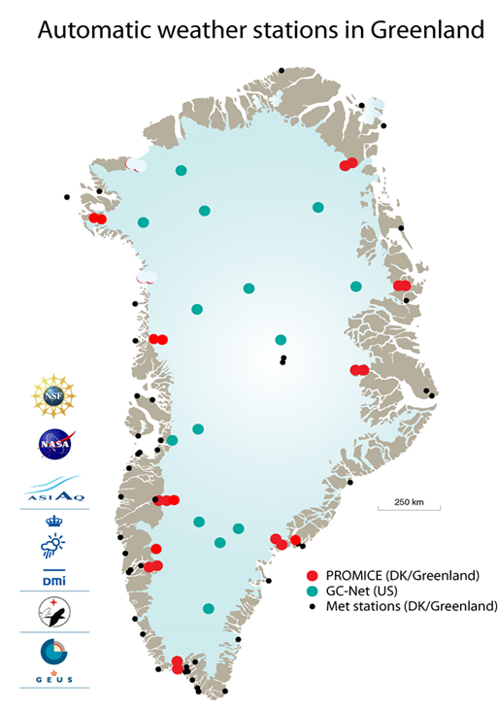
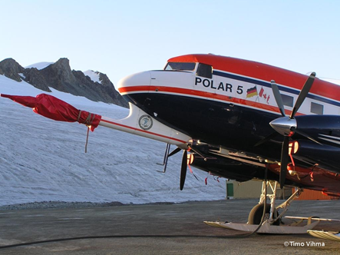
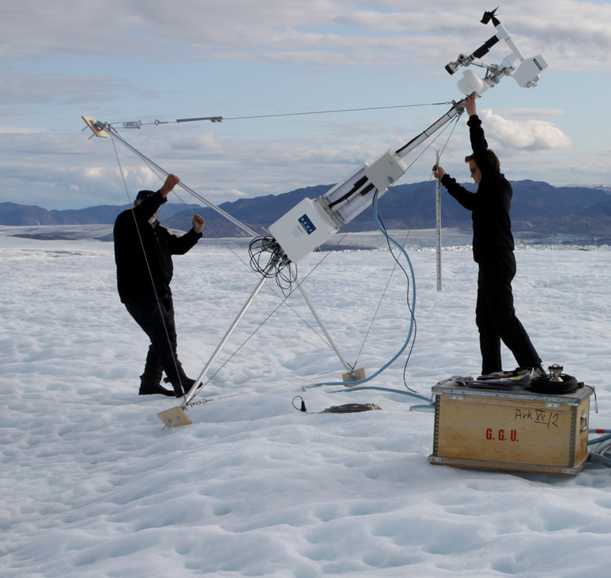
Task 3. Enhance standardization of data and metadata to ensure that best practices are followed, and integrate
sparse in situ data into established networks
Atmosphere
Sparse near-surface data will be harmonized following ACTRIS and other relevant protocols

Slide 12
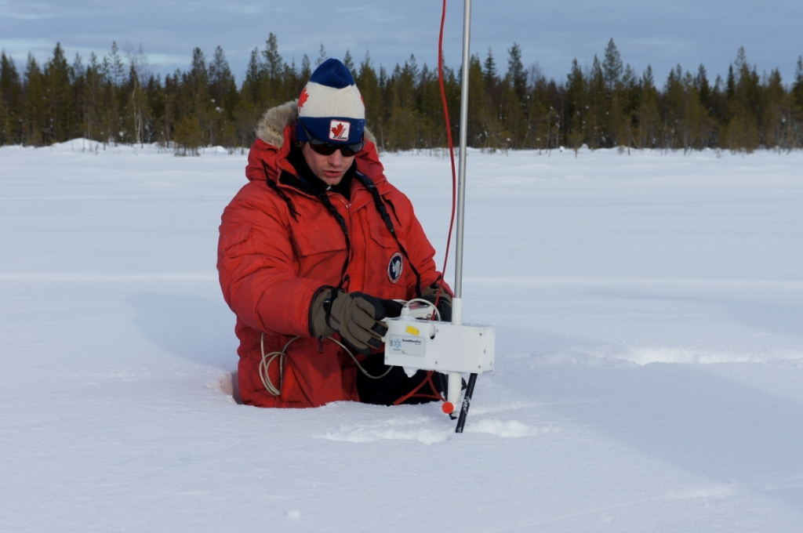
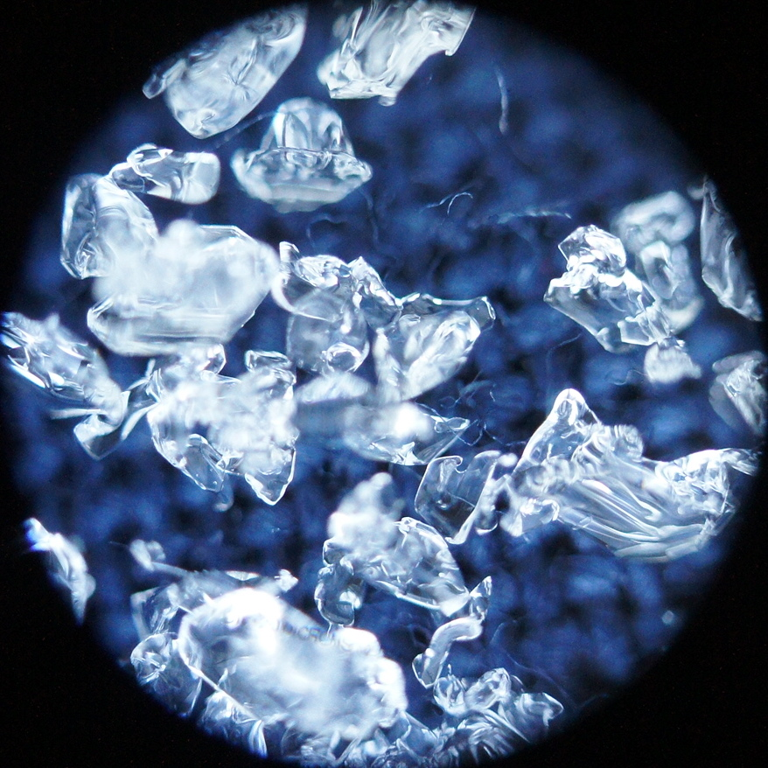
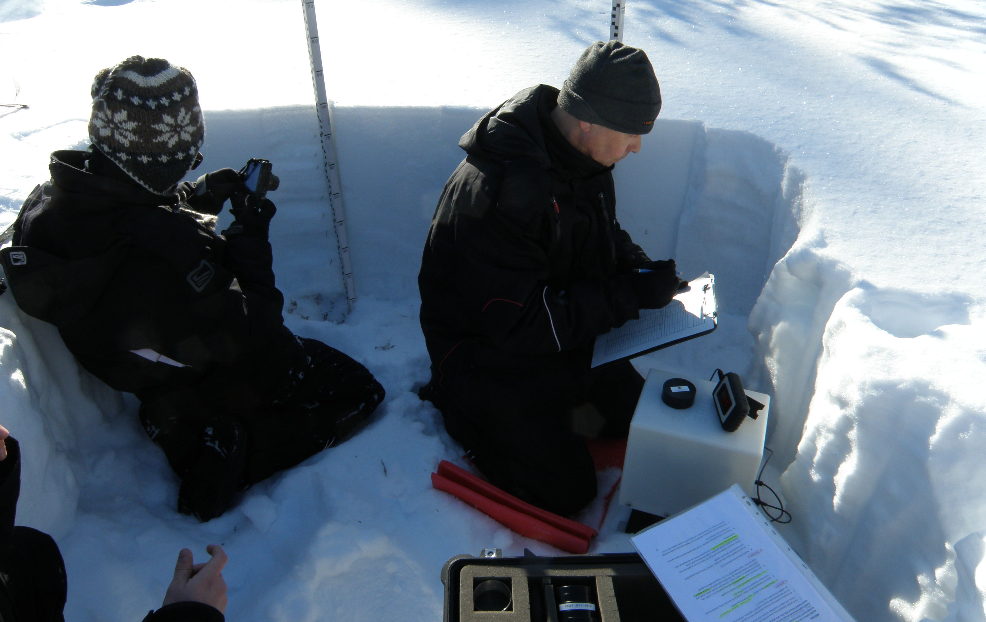
Task 3. Enhance standardization of data and metadata to ensure that best practices are followed, and integrate
sparse in situ data into established networks
Cryosphere and land
Cryospheric data will be harmonized and made available through open access databases
A metadata catalogue of all Arctic terrestrial environmental, and seismological data will be made with links to existing databases.
Direct links will be established to tailored satellite data archives and services.

Slide 13
In situ and EO data assessed in Task 2.1
New data exploited in Task 2.2
Sparse data standardized in Task 2.3
Will be integrated into the iAOS (WP5)

Slide 14

Task 4. Synthesis
Recommendations on:
  how to fill the gaps, improve the sampling strategies and data management
  How to sustain and further enhance the integration of multidisciplinary data repositories.
Maturity assessment of the existing observing systems

