Slide 1
INTAROS
Context of implementation/monitoring
Gaëlle LE BOULER
Project Adviser, EASME B.2.2
H2020 Climate Action
INTAROS Kick-off meeting
Bergen, 11-12 January 2017

Slide 2
Content
EASME
BG 9 - Intaros
Project implementation: key aspects + administrative, financial and legal issues
Looking forward

Slide 3
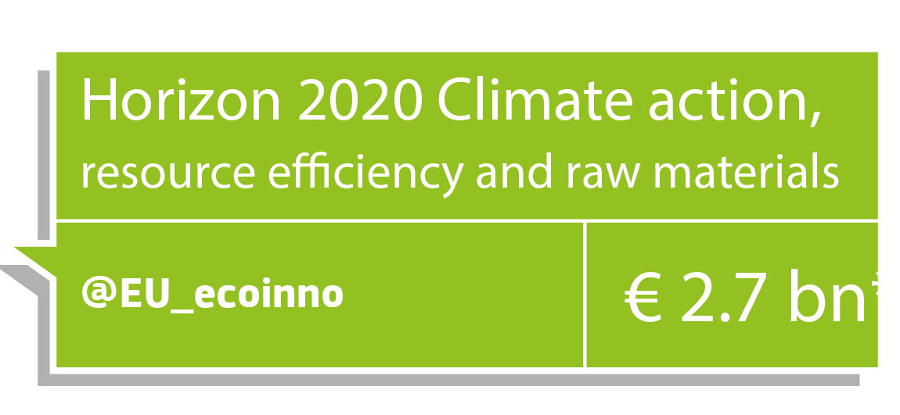

Slide 4
H2020 - Societal challenges
Health, demographic change and wellbeing | 7 472
Food security, sustainable agriculture and forestry, marine and maritime and inland water research and the Bioeconomy (+Blue Growth calls) | 3 851
Secure, clean and efficient energy * | 5 931
Smart, green and integrated transport | 6 339
Climate action, environment, resource efficiency and raw materials | 3 081
Inclusive, innovative and reflective societies | 1 310
Secure societies | 1 695
Science with and for society | 462
Spreading excellence and widening participation | 816
Additional funding for nuclear safety and security from the Euratom Treaty activities (2014-2018)

Slide 5
SC5 - Climate Action, Environment, Resource Efficiency and Raw Materials
Harnessing Earth/Ocean observation data- GEO
To achieve a resource – incl. water - efficient and
climate change resilient economy and society,
The protection and sustainable management of natural
resources and ecosystems,
A sustainable supply and use of raw materials,
in order to meet the needs of a growing global population within the sustainable limits of the planet's natural resources and eco-systems

Slide 6
EASME's role
Evaluation
Grant Agreement Preparation
Project follow-up
Policy feedback
In charge of the whole cycle of project implementation:
Evaluation of Proposals
Grant Agreement Preparation
Scientific/Technical and Financial monitoring of projects
Supporting exploitation and dissemination of project results – policy feedback

Slide 7
Content
EASME
BG 9 - Intaros
Project implementation: key aspects + administrative, financial and legal issues
Looking forward

Slide 8
Call - Blue Growth - Demonstrating an ocean of opportunities - H2020-BG-2016-2017
The Blue Growth Focus Area addressing cross-cutting marine and maritime research is based on four interlinked pillars:
The Arctic dimension: the objective is to deepen
knowledge and identify sustainable and innovative approaches to tackle the challenges that climate change is posing in the Arctic region and on a global scale. Climate change represents a risk but also opens opportunities. Sustainability issues in the Arctic must also consider indigenous communities and the use of traditional knowledge. Moreover, international scientific cooperation is necessary as, due to the complex logistical constraints, no single country can work on its own. The Arctic may become a test bed for sustainable innovation and science diplomacy.

Slide 9
Call - Blue Growth - Demonstrating an ocean of opportunities - H2020-BG-2016-2017
Boosting innovation for emerging Blue Growth
activities: the objective is to test, demonstrate, scale-up and bring to the market existing or new sustainable marine and maritime technologies, and support innovative products and the development of new services while respecting marine ecosystems.
Linking healthy oceans and seas with healthy people: the objective is to explore the interactions between the human dimension, ocean health and marine ecosystem services.
Valorising the Mediterranean Sea Basin

Slide 10
Synergies with other projects/initiatives like the BG projects or …
BG-8-2014: Developing in-situ Atlantic Ocean Observations for a better management and exploitation of the maritime resources
AtlantOS
BG-09-2016: An integrated Arctic observation system
INTAROS
BG-10-2016: Impact of Arctic changes on the weather and climate of the Northern Hemisphere
BLUE ACTION + APPLICATE
BG-12-2016: Towards an integrated Mediterranean Sea Observing System
BG-11-2017: The effect of climate change on Arctic permafrost and its socio-economic impact, with a focus on coastal areas

Slide 11
… the GEO-related projects 2014-2015
SC5-16-2014: Making EO and Monitoring Data usable for ecosystem modelling and services ECOPOTENTIAL, SWOS
SC5-18a-2014: Coordinating European Observation Networks to reinforce the knowledge base for climate, natural resources and raw materials ConnectinGEO
SC5-15-2015: Strengthening the European Research Area in the domain of EO ERA-PLANET
SC5-18b-2015: Integrating North African, Middle East and Balkan Earth Observation capacities in GEOSS – GEOCRADLE
SC5-17-2015: Demonstrating the concept of 'Citizens‘ Observatories' GROW, SCENT, LANDSENSE, GROUNDTRUTH2.0

Slide 12
… the GEO-related projects 2016-2017
SC5-20-2016: European data hub of the GEOSS information system (Data access) NEXTGEOSS
SC5-18-2017: Novel in-situ observation
SC5-19-2017: Coordination of citizen observatories initiatives
… AND OTHERS
SFS-43-2017: EO services for the monitoring of agricultural production in Africa
SMEinst-11-2016-2017: Boosting the potential of small businesses in the areas of climate action, environment, resource efficiency and raw materials (inc. EO)

Slide 13
11th GEO European Projects Workshop 2017
From 19th to 21st June 2017 in Helsinki
co-organised by the Finnish Meteorological Institute and the European Commission. Please book these dates in your calendars!
We will provide you more information about the venue, the programme and registration very soon. All the details on the workshop will also be found here https://ec.europa.eu/easme/en/11th-geo-european-projects-workshop-2017

Slide 14
Content
EASME
BG 9 - Intaros
Project implementation: key aspects + administrative, financial and legal issues
Looking forward

Slide 15
H2020 – Focus on Innovation
The successful exploitation of new ideas to produce tangible benefits, satisfying needs and wants
Technological or non-technological innovation
a system-wide transformation affecting the economic, social and environmental dimensions.
Integration of users in the process is crucial in a participatory approach through co-design, co-development and co-implementation.
Source: Dr. Eugene Sweeney Impact&Innovation in H2020, https://www.iprhelpdesk.eu/sites/default/files/events/04%20Preparing%20Proposals%20and%20Managing%20Projects.pdf

Slide 16
Standards - a major driver of innovation
Benefits:
worldwide trade
quality assurance
environmental protection
security
communication
Source: DIN study "Economic Benefits of Standardization", updated in 2011
Link your project with ongoing standardization work
Involve standardisation partner (formal or informal)

Slide 17
Earth observation and spatial data
INSPIRE
"All activities related to Earth observation data and other spatial data should comply at best with and build upon the existing Infrastructure for Spatial Information in the European Community (INSPIRE)". (SC5 work programme introduction)
JRC: http://inspire.ec.europa.eu
OGC: www.opengeospatial.org/pressroom/marketreport/inspire
GEO – GEOSS
Follow the GEOSS Data Sharing Principles
Register data in the GEO data portal

Slide 18
Open Access
Open access to scientific publications (GA Article 29.2)
Each beneficiary must ensure open access (free of charge, online access for any user) to all peer-reviewed scientific publications relating to its results by
Self-archiving: in online repository (depositing)
Open access publishing
Support: www.openaire.eu

Slide 19
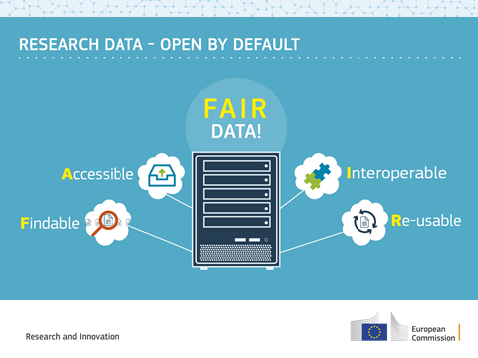
Open Access
Open access to research data (GA Article 29.3 )
Open Research Data applies by default to whole H2020

Slide 21
Open Access
Open access to research data (GA Article 29.3 )
Requirements in GA:
deposit data in a research data repository
take measures to make it possible for third parties to access, mine, exploit, reproduce and disseminate — free of charge for any user
provide information about tools and instruments at the disposal of the beneficiaries and necessary for validating the results

Slide 22
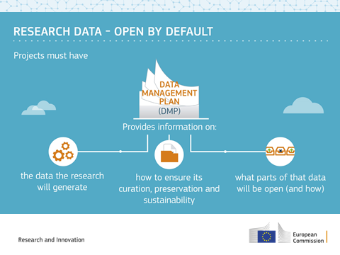
Open Access
Open access to research data (GA Article 29.3 )
data management plan (DMP) = deliverable at M6
Support
http://ec.europa.eu/research/participants/data/ref/h2020/grants_manual/hi/oa_pilot/h2020-hi-oa-pilot-guide_en.pdf
http://ec.europa.eu/research/participants/docs/h2020-funding-guide/cross-cutting-issues/open-access-dissemination_en.htm

Slide 23
Communication in H2020
Legal obligation to promote project (Art. 38.1.1)
The beneficiaries must promote the action and its results, by providing targeted information to multiple audiences (including the media and the public) in a strategic and effective manner". […]
Before engaging in a communication activity expected to have a major media impact, the beneficiaries must inform the Agency (see Article 52).

Slide 24
Communication in H2020
Acknowledgement of EU funding (Art. 38.1.2)
Use EU emblem
High-resolution emblems are available here: http://europa.eu/about-eu/basic-information/symbols/flag/
Use text as indicated in GA
"This project has received funding from the European Union’s Horizon 2020 research and innovation programme under grant agreement No [number]."

Slide 25
Communication in H2020
Inform the Agency about your communication activities, we can help you spread the word.
Check out our Communication Toolkit for more information
60-minute workout to increase the communication impact of your project - webinar

Slide 26
Project timeline and payments
Start of project
01/12/2016
End of 1st reporting period
31/05/2018
End of 2nd reporting period
30/11/2019
End of 3d reporting period
30/11/2021
Pre-financing € 8,261,368.95
Submitted max. 60 days after the end of the reporting period (M18)
Paid within max. 90 days of receipt of 1st periodic report
Submitted max. 60 days after the end of the reporting period (M36)
Paid within max. 90 days of receipt of 2nd periodic report
Submitted max. 60 days after the end of the reporting period (M60)
Paid within max. 90 days of receipt of 3d periodic report

Slide 27
Periodic and continuous reporting
Periodic and final reports to EC, payment requests
3 reporting periods (18-36-60)
Article 20 (GA)
Continuous submission of deliverables, milestones, etc.
Throughout the action
Article 19 (GA)

Slide 28
Content
EASME
SCENT and H2020-SC5-17-2015
Project implementation: administrative, financial and legal issues
Looking forward

Slide 29
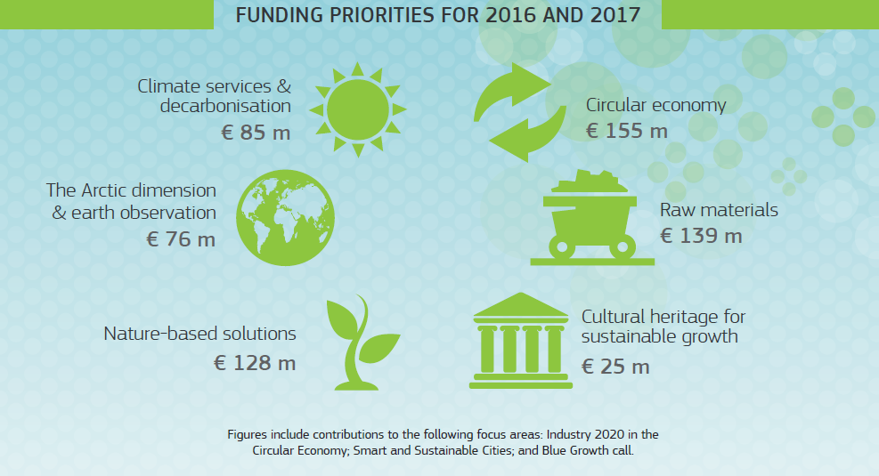
More info on Horizon 2020: ec.europa.eu/programmes/horizon2020
@EU_ecoinno ec.

Slide 30
WP 2018-2020
April 2016 – Stakeholders' consultation
Dec 2016-June 2017 – WP drafting
End of 2017 – WP adoption
More info on the SC5 WP preparation https://ec.europa.eu/programmes/horizon2020/en/climate-action-environment-resource-efficiency-and-raw-materials-work-programme-2018-2020#Article
SC5 – Infoday – 9/11/2017

Slide 31
Become an independent expert
25% new experts
Read excellent proposals
Network with fellows
Academia
Private sector / innovation agencies
Local / national authorities / agencies
Call for experts:
http://ec.europa.eu/easme/en/call-experts-climate-action-environment-resources-management

Slide 32
gaelle.le-bouler@ec.europa.eu

