Slide 1
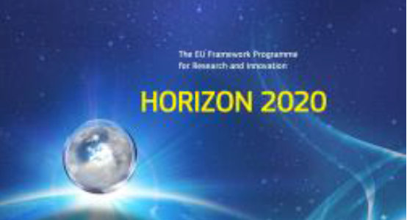
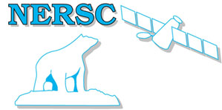
INTAROS – Integrated Arctic Observation System
A Research and Innovation Action
funded by EC - H2020-BG-09-2016
Coordinator: Stein Sandven
Nansen Environmental and Remote Sensing Center, Norway
Total budget: 15.5 mEuro
49 partners from 20 countries
Start date: 01 December 2016
Duration: 5 years

Slide 2
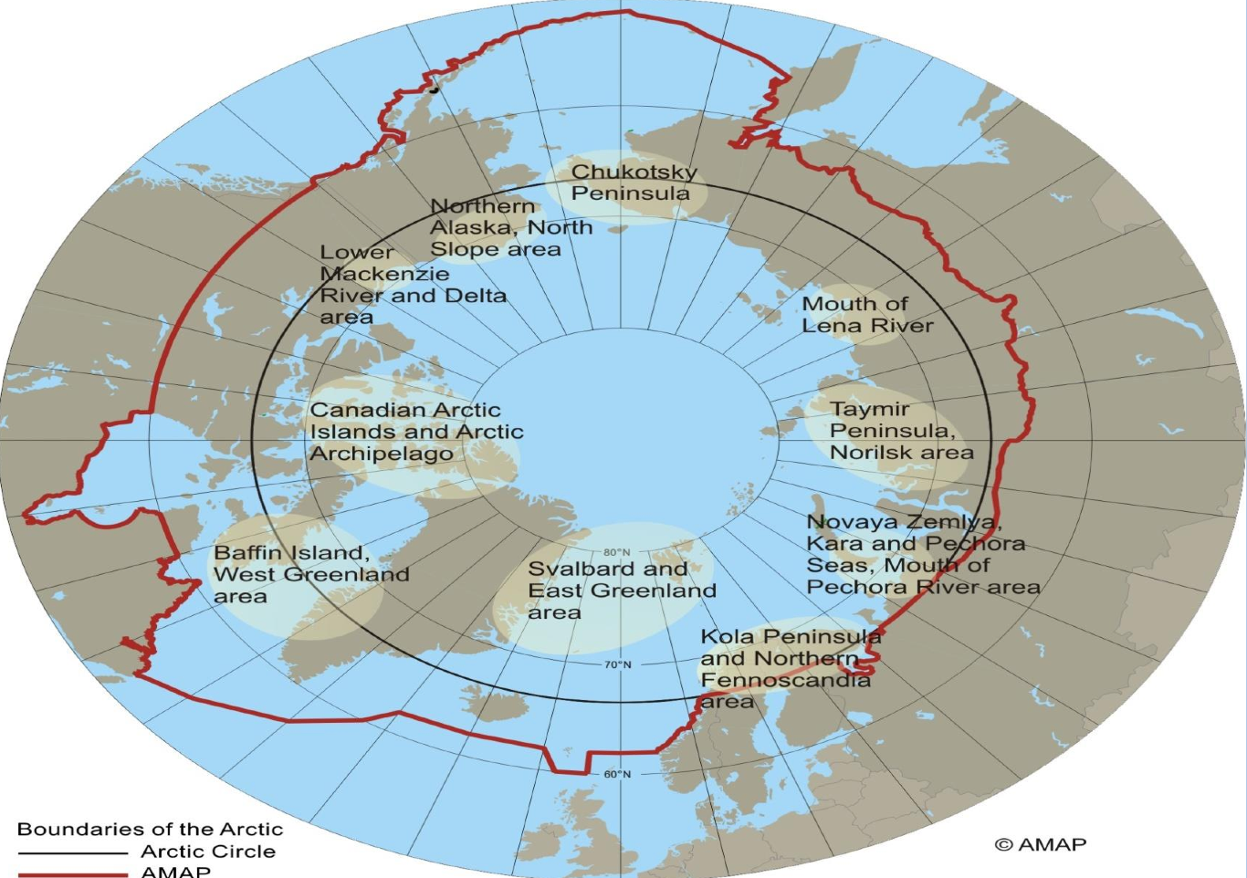
INTAROS overall objective:
to develop an efficient integrated Arctic Observation System by extending, improving and unifying existing and evolving systems in different regions of the Arctic covering several scientific disciplines

Slide 3
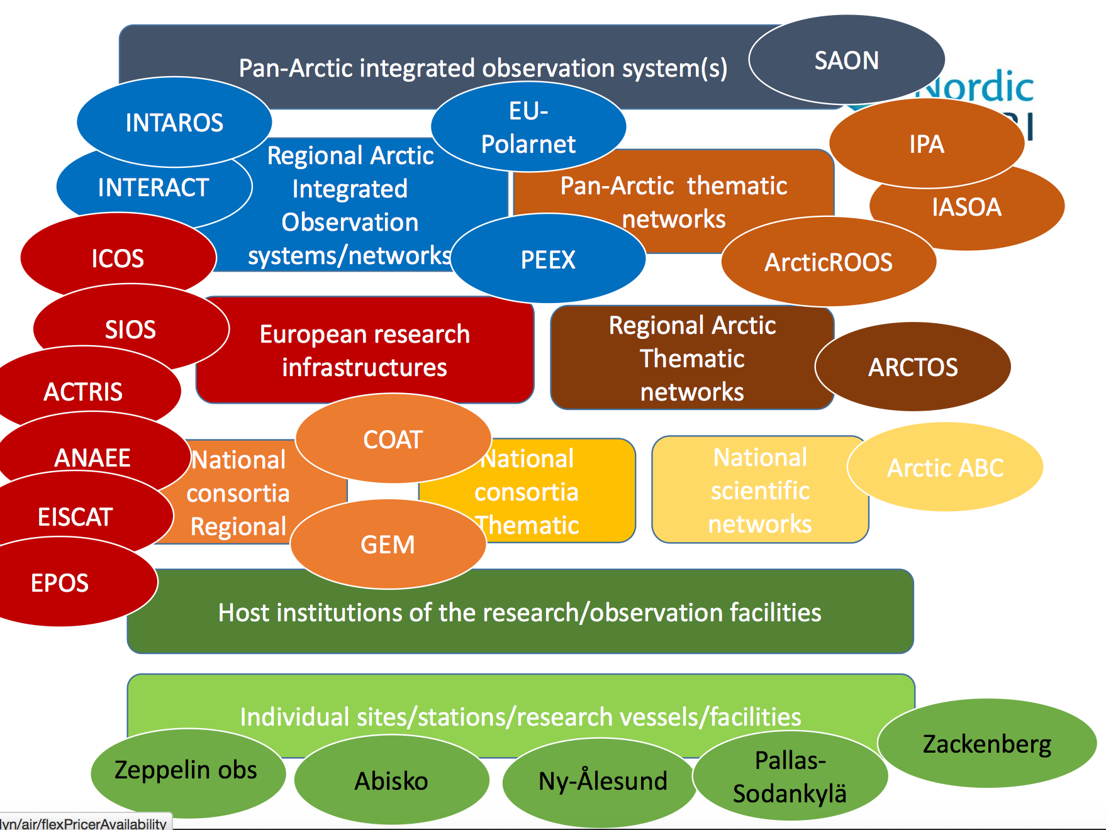
https://www.nordic-envri.fi/meetings/

Slide 4
Connected Arctic projects presently funded by EU
EU PolarNET
Coordination action (AWI: N. Biebow)
INTAROS
Observing Systems
(NERSC)
APPLICATE
Modelling – forecasting
(AWI: T. Jung)
Arctic permafrost
Multi-disciplinary
(open call)
BLUE ACTION
Modelling – forecasting
(DMI: S. Olson)
Infrastruture projects: ENVRI, INTERACT, ACTRIS, ICOS, SIOS, ++

Slide 5
An integrated Arctic Observing System needs to collect data from:
Atmosphere
Ocean (including sea ice)
Terrestrial themes
at appropriate temporal and spatial scales and resolution (depending on the usage of the data)
The largest gaps are in the in-situ observation network.
INTAROS has focus on in situ data and integrate remote sensing from other projects and programmes

Slide 6
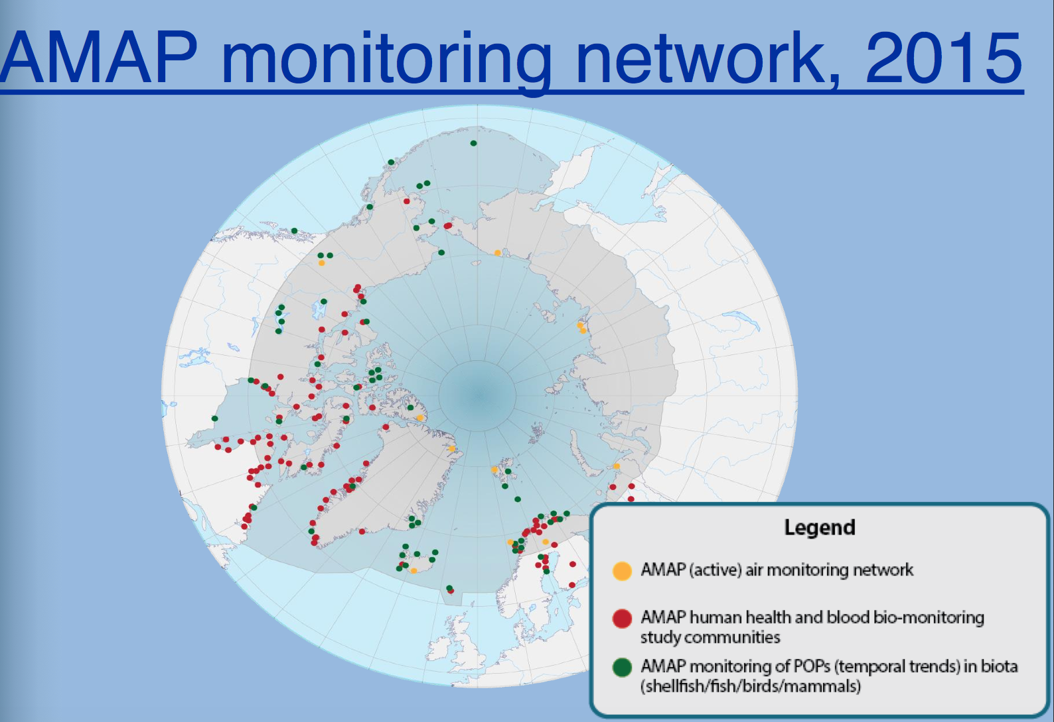
POP: persistent organic pollutants

Slide 7
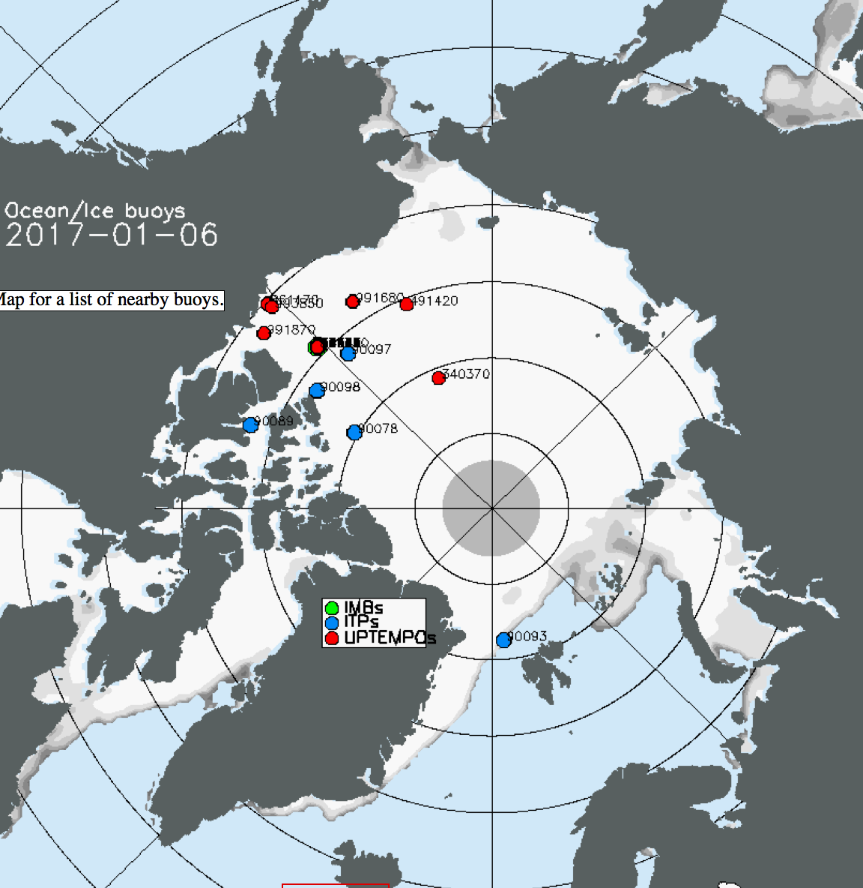
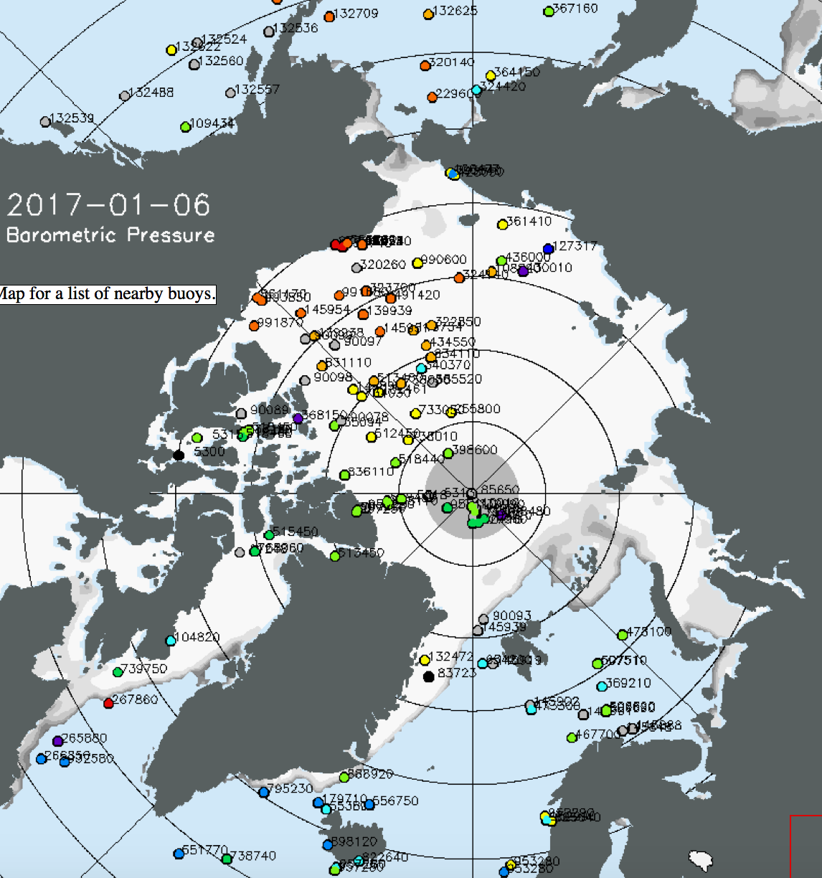
Example: Atmosphere and ocean data from sea ice platforms and coastal stations disseminated through the International Arctic Buoy Program
What is status in ice-covered seas ?
Ocean – ice buoys
Air pressure
http://iabp.apl.washington.edu/maps_daily_table.html

Slide 8
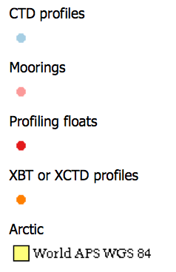
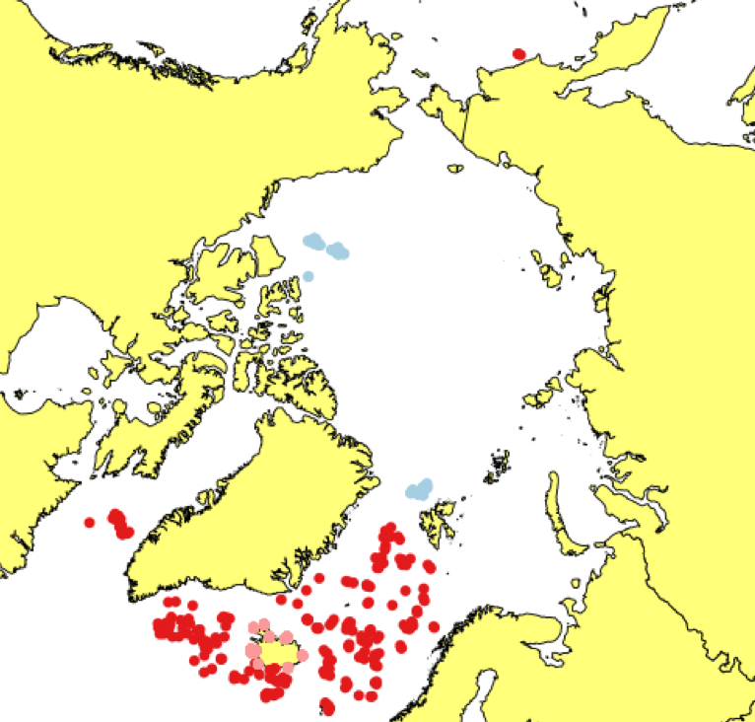
Oceanographical data
Profile data available in near-real time, north of 60 N, last 30 days from 08 Jan 2017. Ref. http://arctic-roos.org

Slide 9
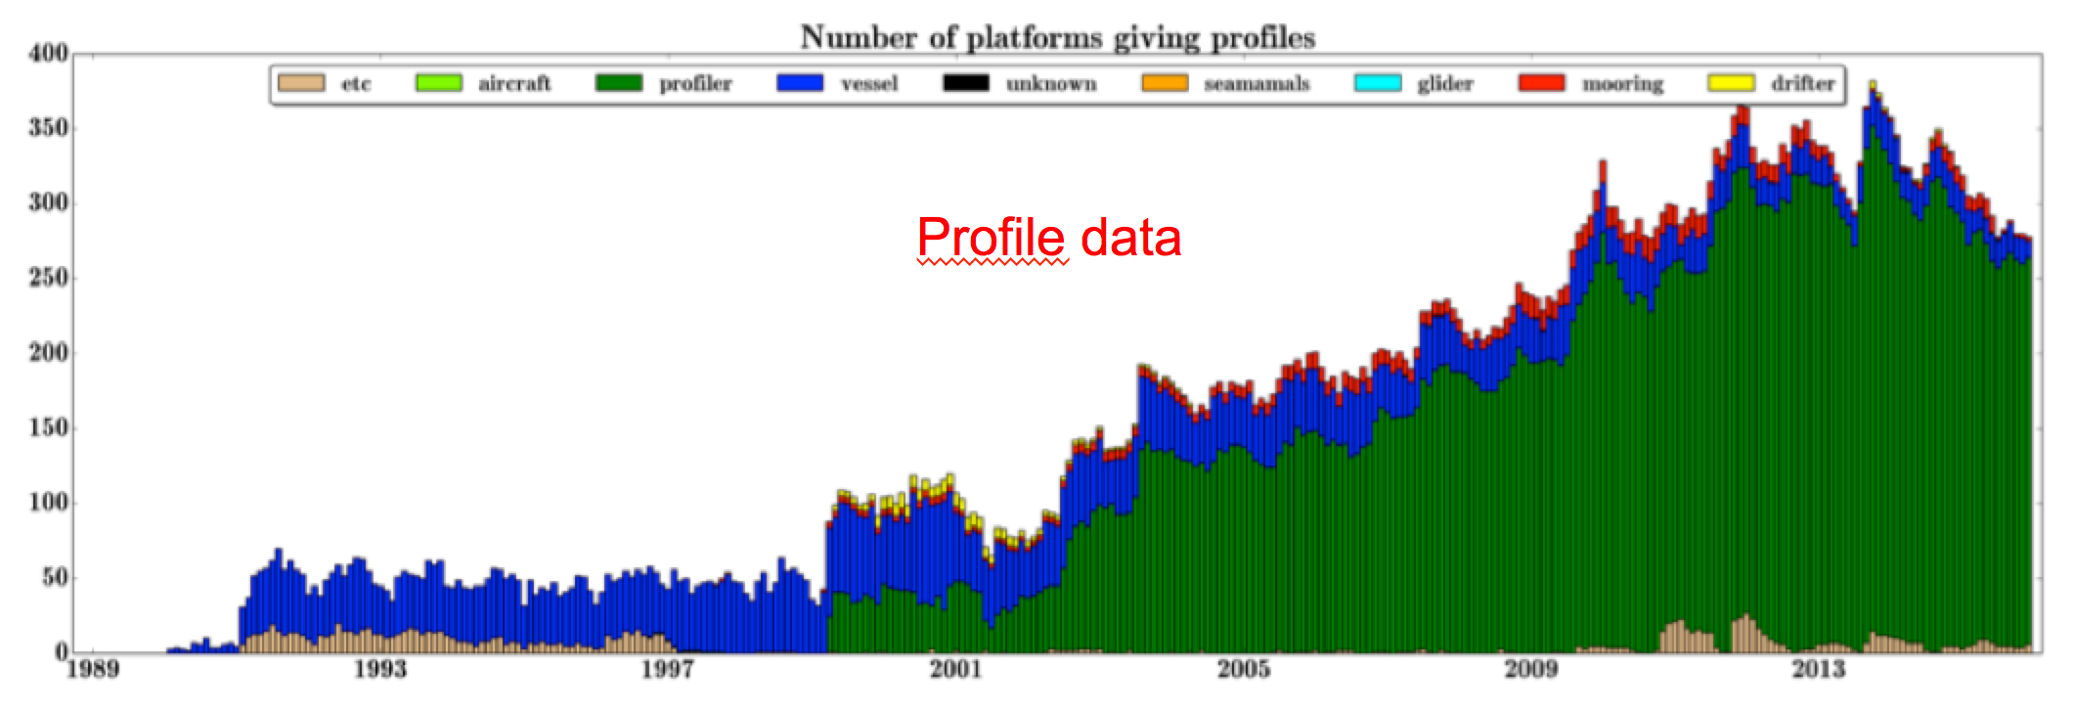
Number of ocean observing platforms north of 60N from 1989 to 2015
From: Copernicus marine and environmental services (CMEMS) quality document

Slide 10
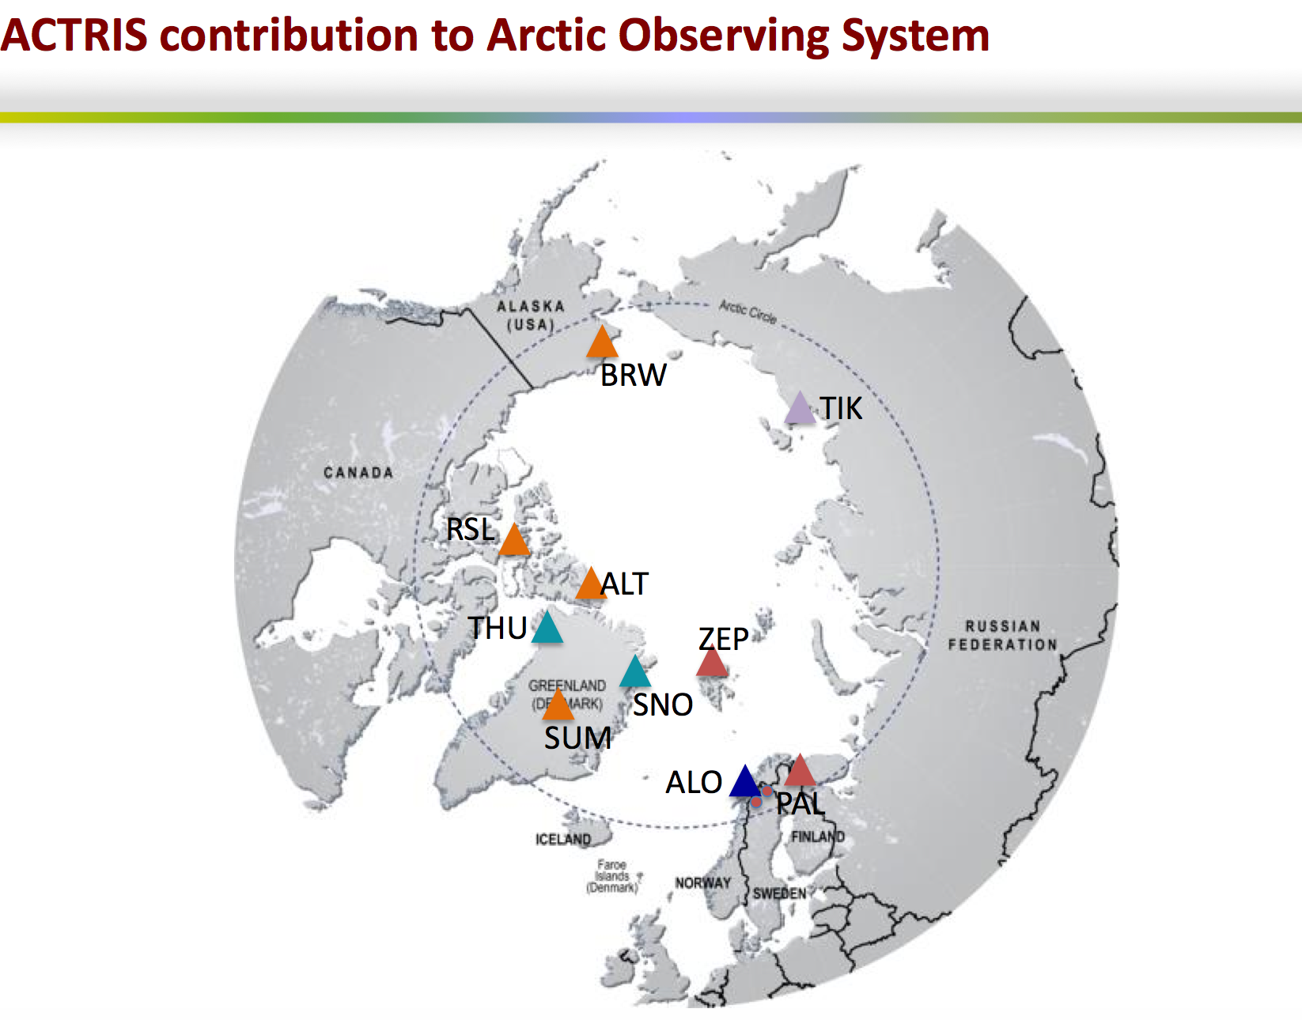
Resarch infrastructure funded by H2020
http://www.actris.eu/
Ref. Paolo Laj, ACTRIS Coordination team, University of Helsinki

Slide 11
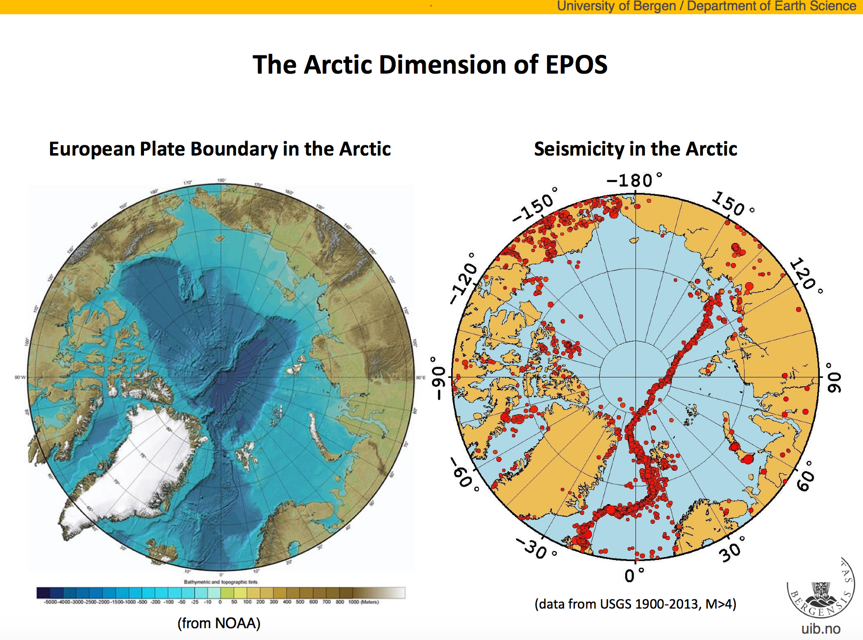
The European Plate Observing System (EPOS) is the integrated solid earth sciences research infrastructure (RIs) approved by the European Strategy Forum on Research Infrastructures (ESFRI). EPOS is a long-term integration plan of national existing RIs.

Slide 12


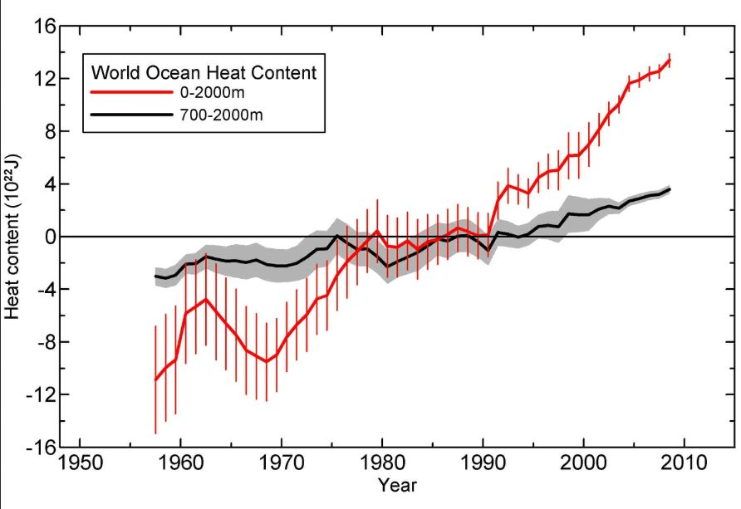
INTAROS Specific objectives (1)
Establish a Pan-Arctic forum for collaboration across EU and non-EU countries and transnational organisations (WP1)
Develop a Roadmap for building a sustainable Arctic observing system (WP1)
Exploit existing observing systems and databases, including remote sensing data (WP2)

Slide 13
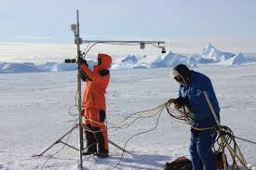
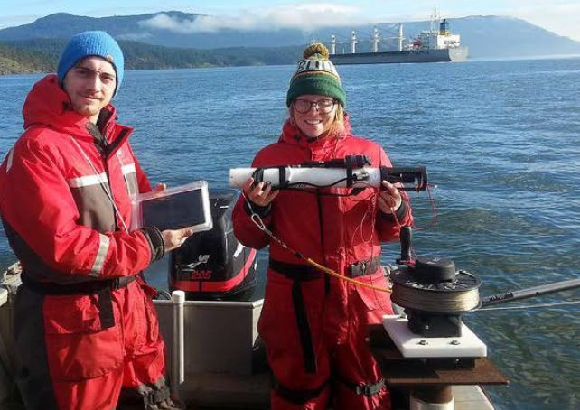

INTAROS Specific objectives (2)
Fill gaps of the present in situ observing systems with new sensors and platforms (WP3)
Enhance community-based observing programmes for participatory research (WP4)
Develop and implement the iAOS platform for integration of multidisciplinary data from distributed repositories (WP5)

Slide 14
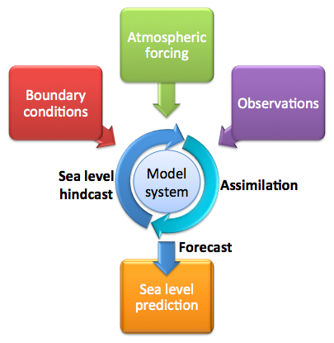
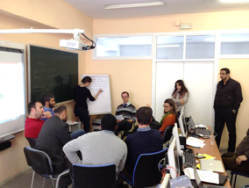
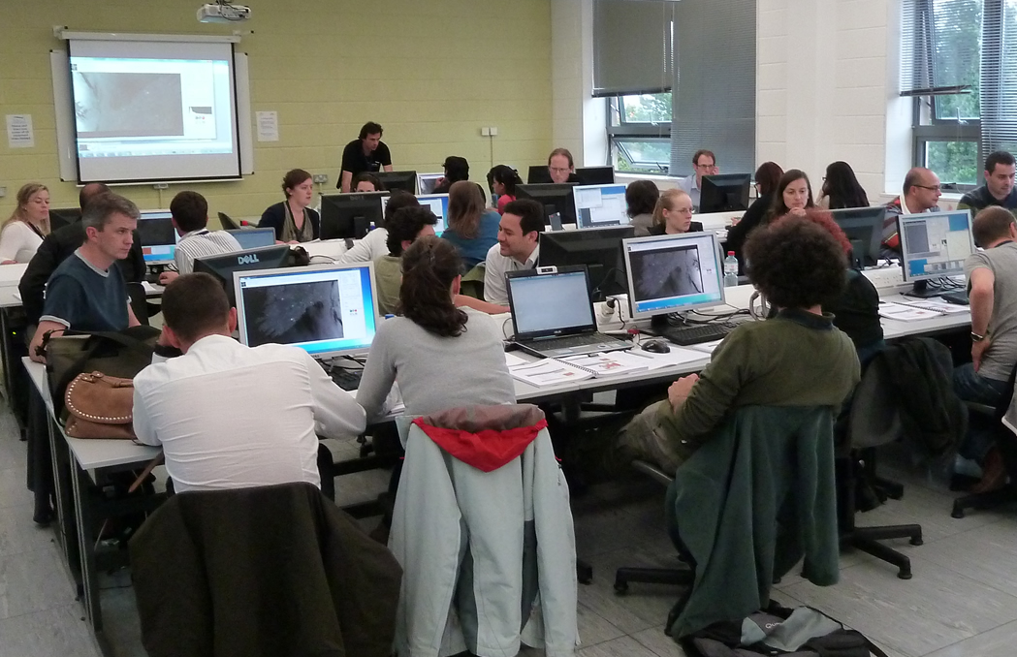
INTAROS Specific objectives (3)
Develop professional skills in using the iAOS platform with tools for data analysis, transformation and vizualisation (WP5)
Use of data in numerical modelling* for climate research and Copernicus services (WP6)
Demonstrate benefit of data from INTAROS for different stakeholder groups (WP6)
* in collaboration with APPLICATE and BLUE ACTION

Slide 15
Workpackage structure
WP1: Requirements and strategy for a Pan-Arctic system
WP2: Exploitation of existing observing systems
WP3: Enhancement of in situ observing systems
WP4: Community-based observing systems
Scientific data
Scientific data
WP5: Data integration & management - IAOS
Community data
Integrated data, prepared for applications
Feedback to requirements, strategy and roadmap
WP6: Applications towards stakeholders
Feedback to requirements, strategy and roadmap
Climate modelling
Ice – ocean statistics
WP7: Dissemination and outreach

Slide 16

Copernicus: data providers and stakeholders
Copernicus consists of a complex set of systems which collect data from multiple sources: earth observation satellites and in situ sensors such as ground stations, airborne and sea-borne sensors.
The services address six thematic areas: land, marine, atmosphere, climate change, emergency management and security. The services provides users with reliable and up-to-date information related to environmental and security issues.
The main users of Copernicus services are policymakers and public authorities who need the information to develop environmental legislation and policies or to take critical decisions in the event of emergencies
The Copernicus programme is coordinated and managed by the European Commission.
http://www.copernicus.eu/main/copernicus-brief

Slide 17
Stakeholder groups
Theme | Stakeholder groups
Atmosphere | Climate modelling and monitoring, weather forecasting services, Copernicus Atmosphere Services (CAMS), Year of Polar Prediction (YOPP), industries and local communities
Ocean | As above plus Copernicus Marine Services (CMEMS), safety of marine operations, pollution, acidification
Sea ice | As above plus sea ice services, ice navigation, oil and gas exploration, arctic tourism
Marine ecosystems | environmental monitoring, fisheries, aquaculture, pollution, acidification
Terrestrial themes | hydrological monitoring and modelling, greenhouse gas monitoring and modelling, snow monitoring, water resource management, industries, transportation and communities
Glaciology | climate monitoring and modelling of glaciers, local communities
Natural hazards | earthquakes (EPOS), extreme weather and ice conditions and snow/ice avalanches (local communities, industries, tourism)

Slide 18
INTAROS as seen from the stakeholders
International bodies
Pan-Arctic and other networks
Management
Climate research
Copernicus services
Industries
Local communities
Dissemination and Outreach
APPLICATE, BLUE ACTION and other modelling projects on
Climate, Forecasting,
Ecosystems,
Data assimilation
WP7
WP6: Applications
of iAOS towards stakeholders
Other related projects: AtlantOS, INTERACT, ++
Requirements - strategy
Data integration and management
Multidisciplinary data from existing and new observing systems
WP1
WP5
WP 2,3,4

Slide 19

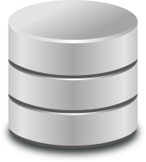


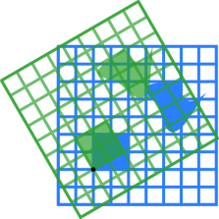

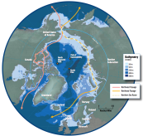


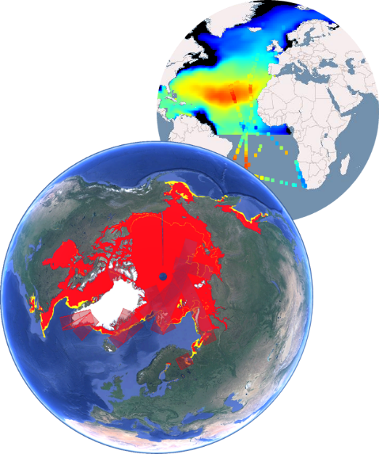



Data integration: the iAOS concept
Distributed
Data Centres
iAOS
Metadata harvesting and indexing
Transformation
Analysis
Visualisation
Search and Access
Applications
Scientific
analysis
Data
assimilation
Product validation
Decision
support

Slide 20
Schedule
2017
2018
2019
2020
2021
WP1: Requirements and strategy
First deployment season
Second deployment season
WP2: Exploitation of existing observing systems
Assessment of present systems
Improve data delivery chains
and data products
WP3: Enhancement of in situ observing systems
Deployment, data collection and data dissemination
Planning and testing
WP4: Community-based observing programmes
Planning phase
Implementation phase and data dissemination
WP5: Data manage-ment & integration
Planning and design
Incremental implementation
WP6: Applications towards stakeholders
8 application studies
WP7: Dissemination and outreach
YOPP field experiments

Slide 21
Themes
Biogeo-chemistry
Climate modelling
Data mana-gement
Natural hazards
Community-based obs
Glaciology
Ocean
Terrestrial
Atmosphere
Sea ice
WPs
WP1: Requirements and strategy
WP2: Exploitation of existing obs. systems
WP3: Enhancement of in situ obs. systems
WP4: Community-based obs. progr.
WP5: Data manage-ment & integration
WP6: Applications towards stakeholders
WP7: Dissemination and outreach

Slide 22
Themes and theme leaders
The INTAROS workpackages are mainly multidisciplinary. To ensure that the thematic areas are adequately represented, a group of theme leaders will follow the progress of the project and check that the results are useful in each of the themes
Theme | Name | Institution
Atmosphere: | Michael Tjernstrøm | Stockholm University
Ocean: | Thomas Soltwedel | AWI
Glaciology: | Andreas P. Ahlstrøm | GEUS
Sea ice: | Georg Heygster | University of Bremen
Terrestrial: | Shaun Quegan | Sheffield University
Biogeochemistry | Truls Johannessen | UiB Geophysics
Climate modelling | Ralf Doescher | SMHI
Data management | Torill Hamre | NERSC
Natural hazards | Mathilde Sørensen | UIB Geosciences
Community based systems | Finn Danielsen | NORDECO

Slide 23
Expected impact (1)
Increase temporal and geographic coverage and usefulness of observational data in the Arctic with a view to improving the assessment and prediction capacity of Arctic and planetary changes.
Support standardization and calibration/validation activities, and improve the inter-operability of Arctic observational data
Improve the sustained integration of space-based and in-situ Arctic observations into process models and forecast systems showing benefit to the Copernicus monitoring services
Contribute to the long-term improvement of Arctic observation systems and related services
Integrate with existing pan-Arctic monitoring networks by building additional capacity and adding monitoring parameters to current programmes.

Slide 24
Expected impact (2)
Improve the cost-effectiveness of data collection in support of economic and societal activities in the Arctic or connected to the Arctic
Support to local communities through participatory research and capacity-building
Strengthen the societal and economic role of the Arctic region and support the EU strategy for the Arctic and related maritime and environmental policies
Support to assessments of global challenges such as climate change, scarcity of natural resources and global scale hazards

Slide 25

WP1: Requirements and strategy for Pan-Arctic Observing Systems
Lead: Stein Sandven, NERSC, co-lead: Erik Buch, EuroGOOS
Participants: WP-leads/co-leads and Theme leaders
The overall objectives:
Review the high-level requirements and develop the strategy for the Pan Arctic Observing system based on present initiatives^{(i)}
Plan and coordinate the INTAROS activities in agreement with Arctic Observing Summit recommendations and stakeholder requirements
Strengthen European participation in Arctic observation networks (with USA, Canada, Japan)
(i) GEO Cold Region Initiative (CRI), SAON and other international initiatives, related to the Arctic and European Blue Growth strategy;

Slide 26
WP1 Specific objectives
Formalize collaboration with other EU projects, programmes and infrastructures (EU-PolarNET, ALLOCATE, BLUE ACTION, ATLANTOS, INTERACT, ENVRIplus, + +)
Establish cooperation with US Arctic programmes (ONR, NSF) and other Arctic programmes in Canada, Russia, Japan, China, Korea
Establish and maintain links to stakeholder groups such as Arctic Council working groups (AMAP), global programmes (WCRP), Copernicus services, industries, ++
Formulate an Engagement strategy and establish a Pan-Arctic Observation Forum (e.g. Arctic Observing Summit)
Include indigeneous and local perspectives and knowledge in project planning and implementation
Prepare data management plan and data governance framework ( e.g. through the IASC Arctic Data Committee)
Develop a roadmap for future sustainable Arctic Observing System

Slide 27
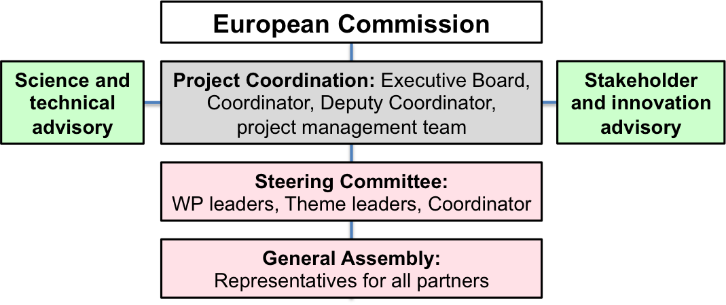
Organisation

Slide 28
Partners
Country | Partner
Norway | NERSC, University of Bergen, IMR, UNIS, NIVA, NORUT, DNV-GL
Denmark | GEUS, DTU, NORDECO, Aarhus University
Sweden | SMHI, Stockholm University
Finland | FMI, University of Helsinki
Germany | AWI, University of Hamburg, University of Bremen, MPG, GFZ
UK | Sheffield University
Ireland | Maynooth University
Poland | IOPAN, IGPAN, University Slaski
France | CNRS, Ifremer, ARMINES
Spain | Polyt. University Madrid, Barcelona Supercomputing Centre
Portugal | Eurocean
Belgium | EuroGOOS AISBL
Italy | Terradue, JRC
Greenland | GINR
Russia | RIHMI-WDC, NIERSC
USA | University of Alaska Fairbanks, University of California San Diego/SIO, WHOI, JPL
Canada | Université Laval, ONC
China | RADI, NMEFC, PRIC
Japan | NIPR
South Korea | KOPRI
Consortium members
Norway: NERSC, UIB, IMR, UNIS, NIVA, DNV-GL
Denmark: GEUS, DTU, NORDECO, Aarhus University
Sweden: SMHI, Stockholm University
Finland; FMI, University of Helsinki
Germany: AWI, U. Hamburg, U. Bremen, MPG, GFZ
UK: University of Sheffield, Open University
Ireland: Maynooth University
Consortium members
Norway: NERSC, UIB, IMR, UNIS, NIVA, DNV-GL
Denmark: GEUS, DTU, NORDECO, Aarhus University
Sweden: SMHI, Stockholm University
Finland; FMI, University of Helsinki
Germany: AWI, U. Hamburg, U. Bremen, MPG, GFZ
UK: University of Sheffield, Open University
Ireland: Maynooth University

Slide 29
WP-leaders and co-leaders
WP | Person-months | Leader | Co-leader
WP1 | 50 | S. Sandven, NERSC | E. Buch, EuroGOOS
WP2 | 262 | R. Pirazzini, FMI | D. Gustavson, SMHI
WP3 | 318 | A. Beszczynska-Möller, IOPAN | P. Voss, GEUS
WP4 | 34 | F. Danielsen, NORDECO | L. Iversen, NERSC
WP5 | 119 | P. Gonçalves, Terradue | T. Hamre, NERSC
WP6 | 316 | G. Ottersen, IMR | M. Sejr, AU
WP7 | 52 | D. Zona, USFD | N. Dwyer, Eurocean
Total RTD | 1211

Slide 30
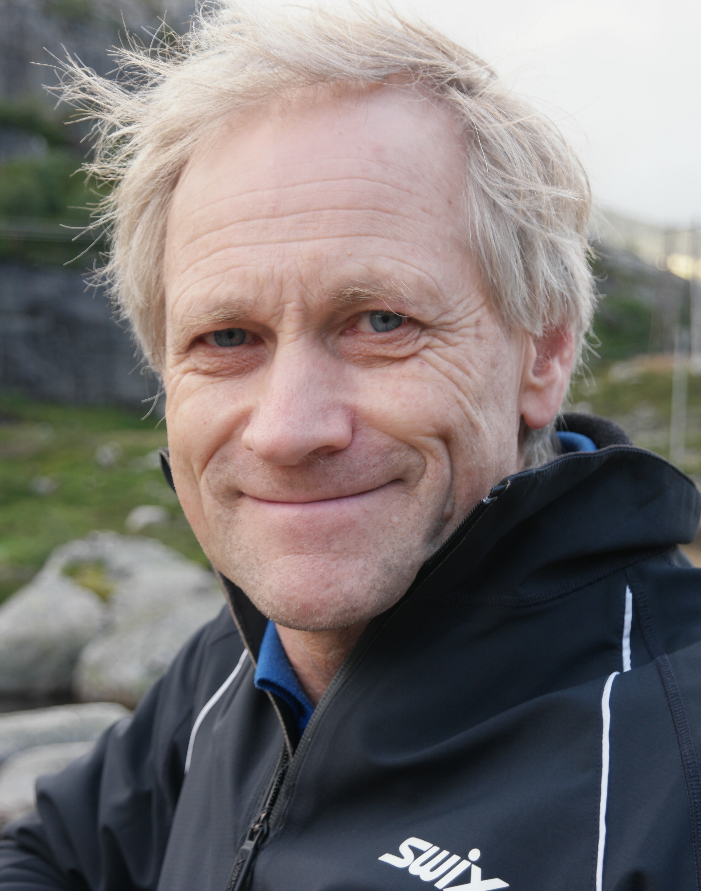
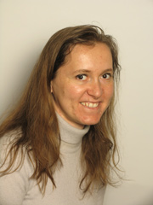
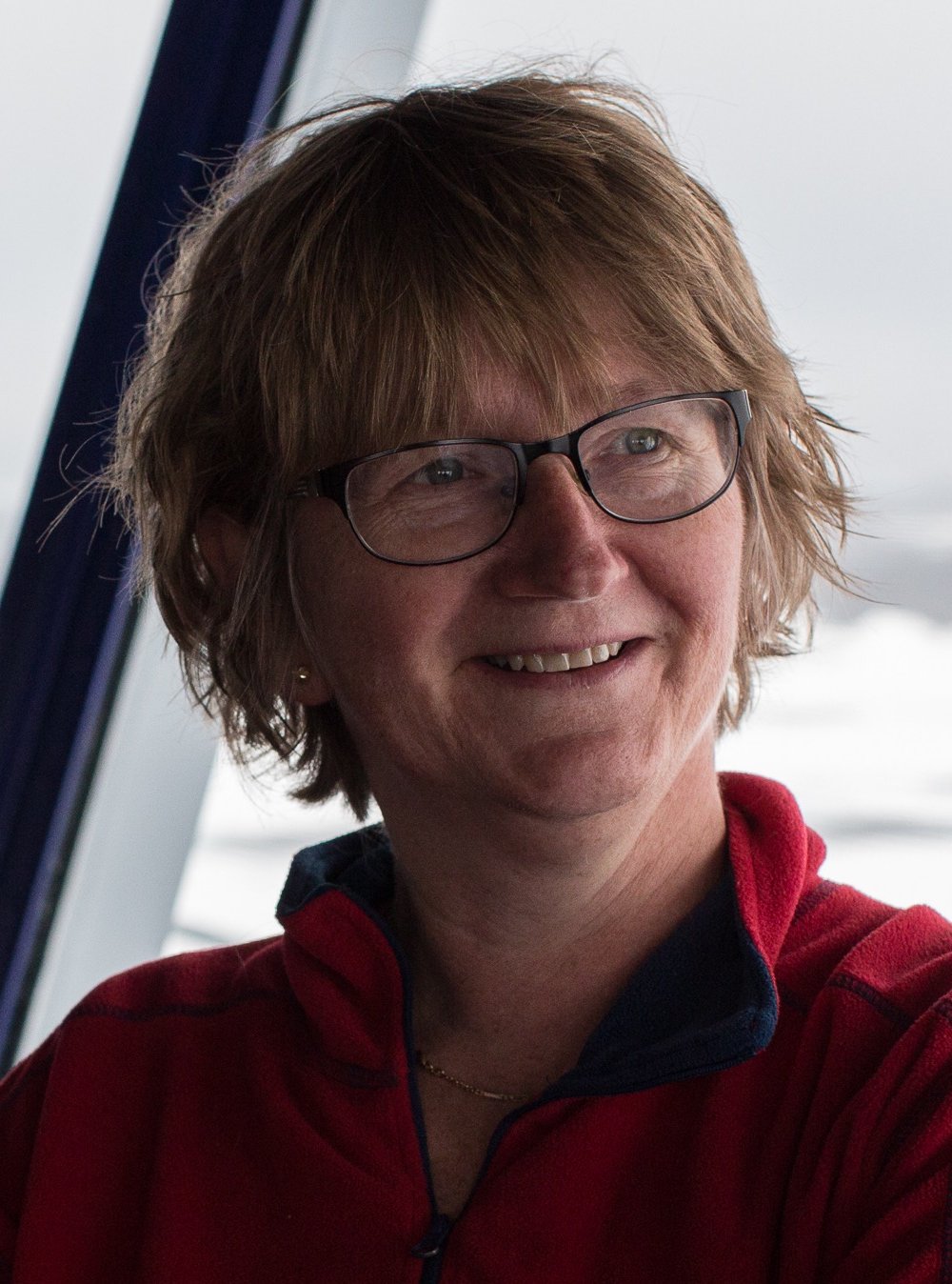
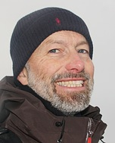
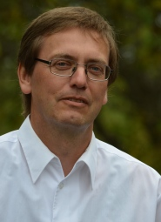
INTAROS: Executive board
Stein Sandven,
Coordinator, (NERSC)
Hanne Sagen, Deputy Coordinator (NERSC)
Agnieszka B. Möller
(IOPAN)
Roberta Pirazzini
(FMI)
Finn Danielsen
(NORDECO)
Ralf Doescher
(SMHI)

