Slide 1
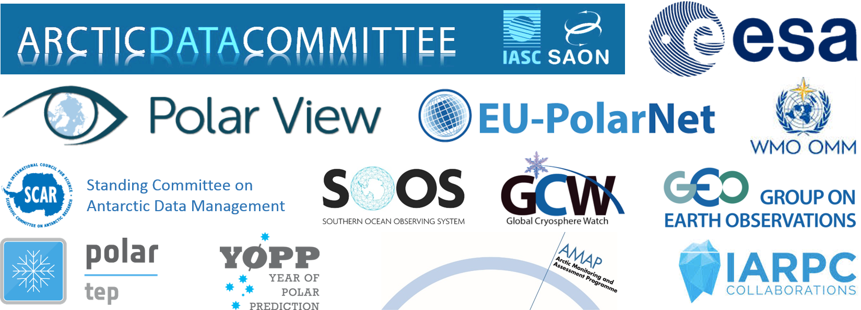



IASC-SAON Arctic Data Committee
Peter L. Pulsifer
Chair, IASC-SAON Arctic Data Committee
Co-Chair, IARPC Data Coordination Team
Co-Lead,, GEO Cold Regions Initiative
Research Scientist, National Snow and Ice Data Center,
CIRES, University of Colorado

Slide 2
Data and Arctic Data

Slide 3
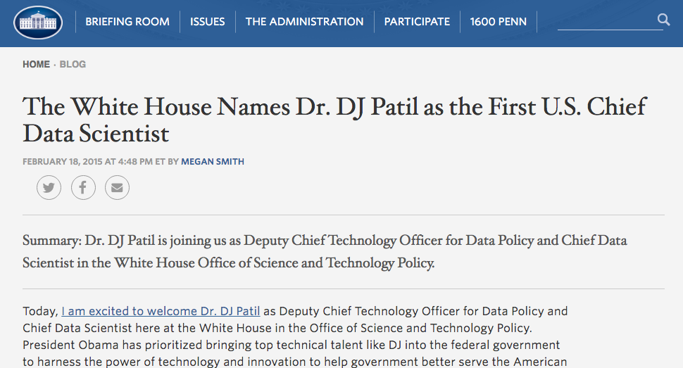
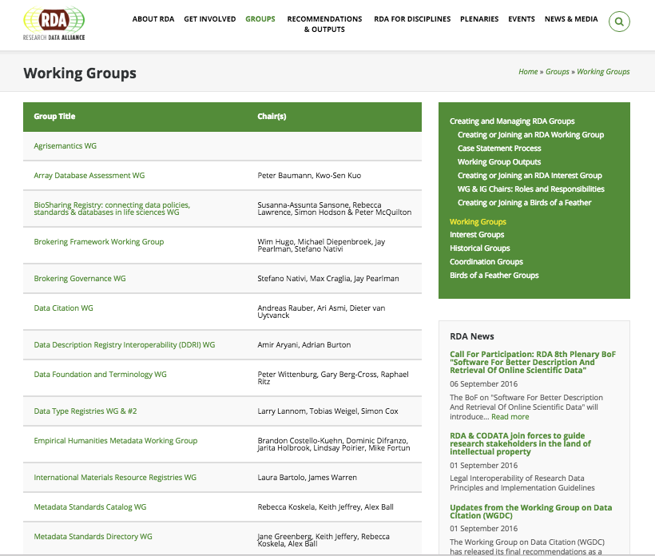
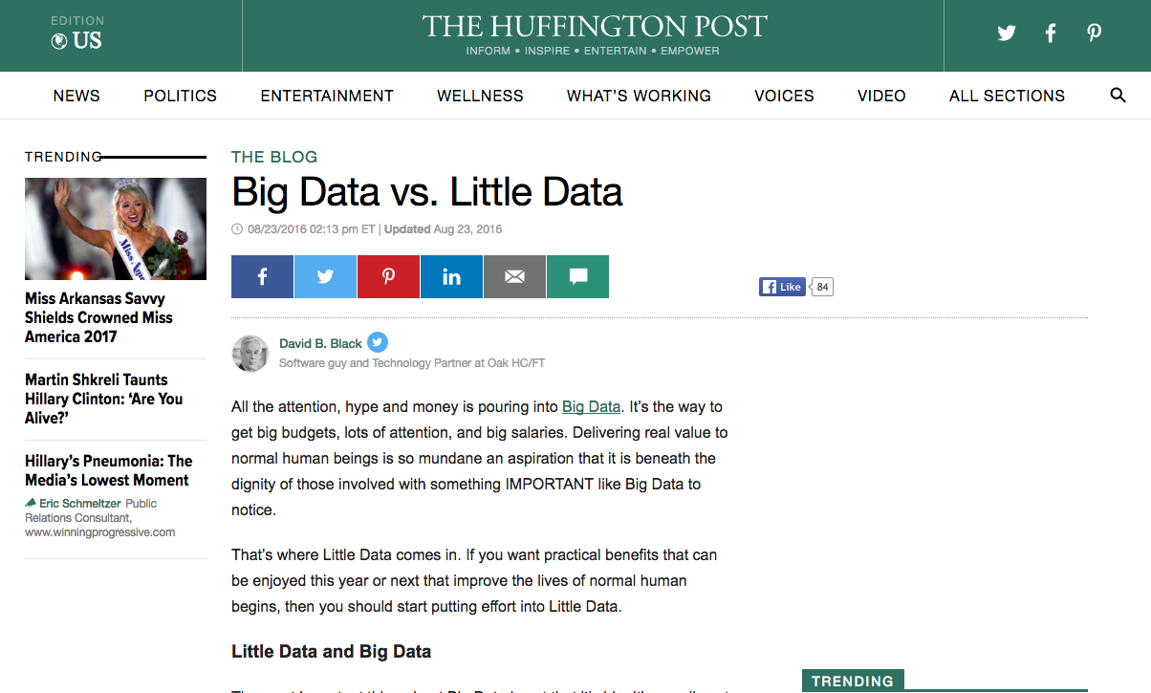
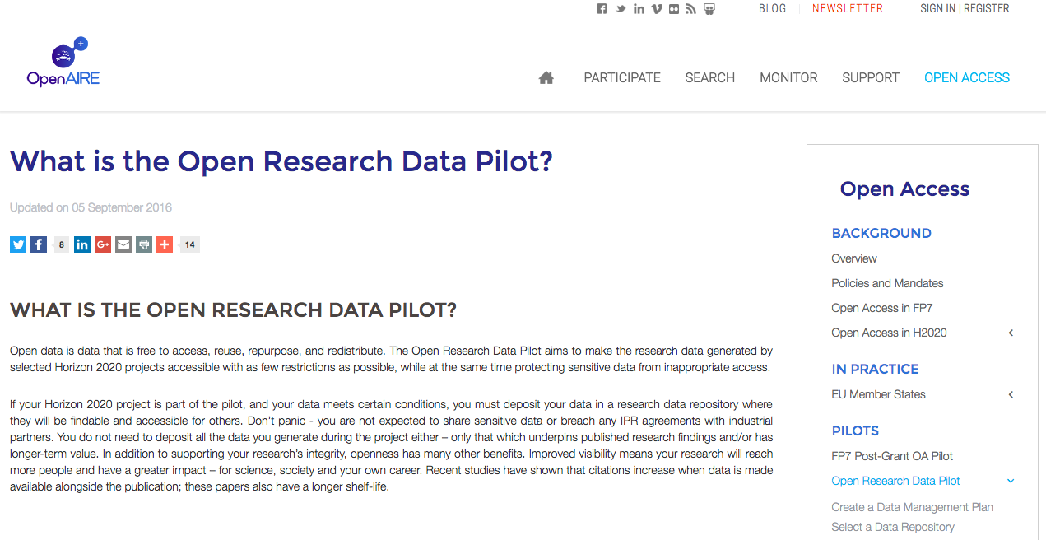
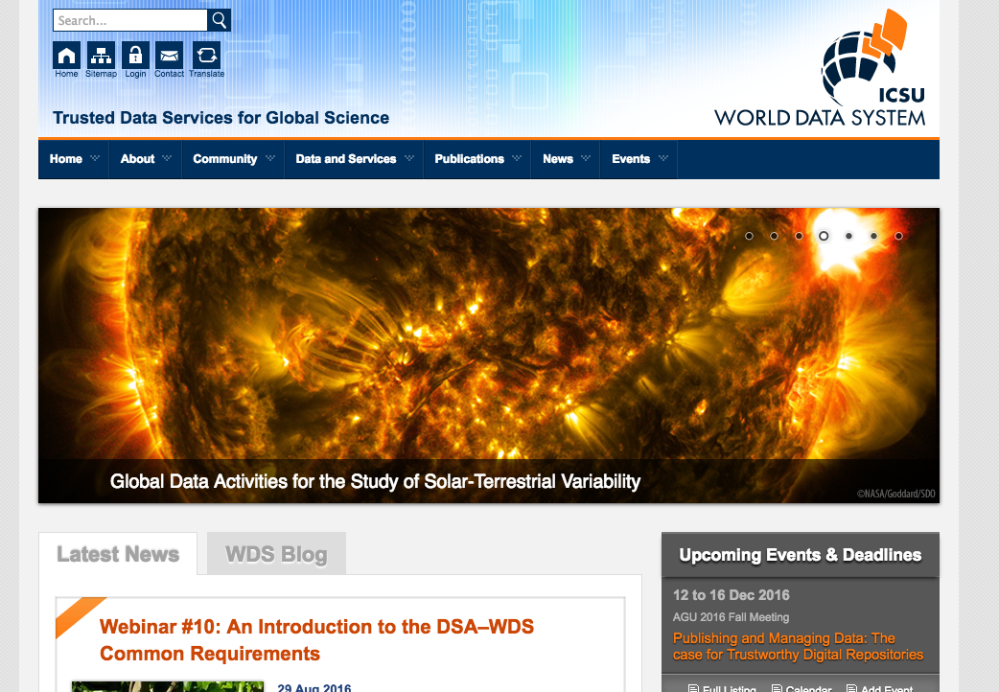
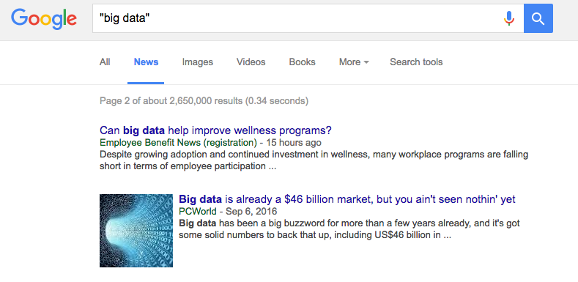
Data is Big

Slide 4
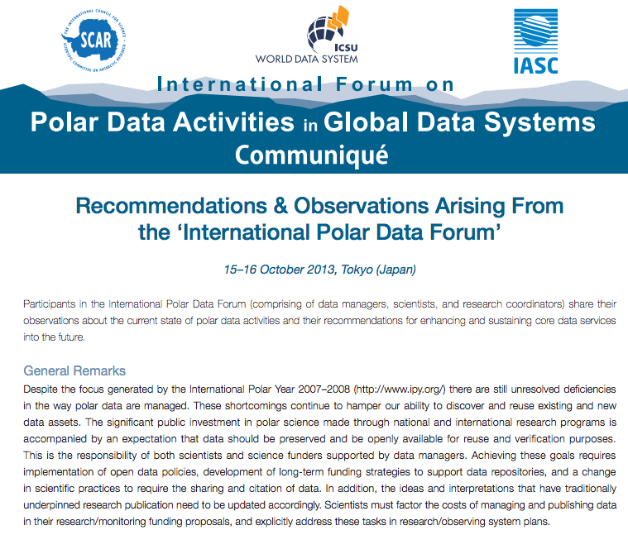
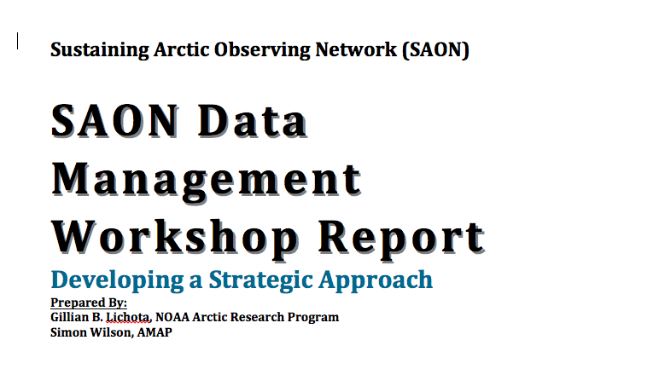
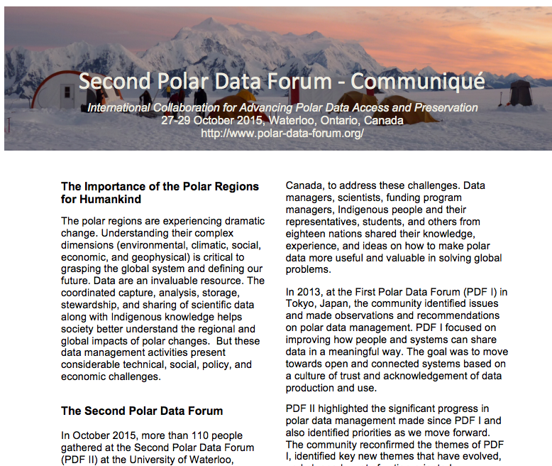
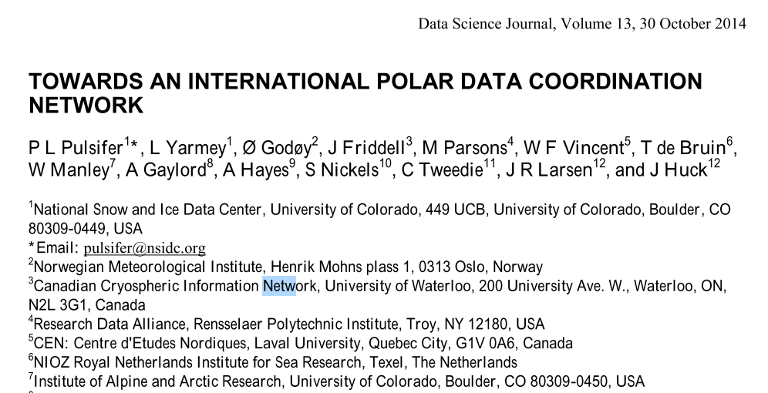
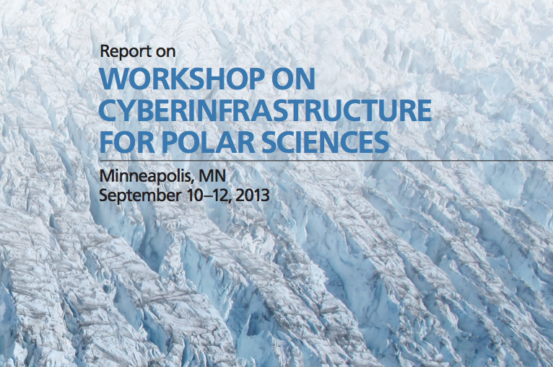
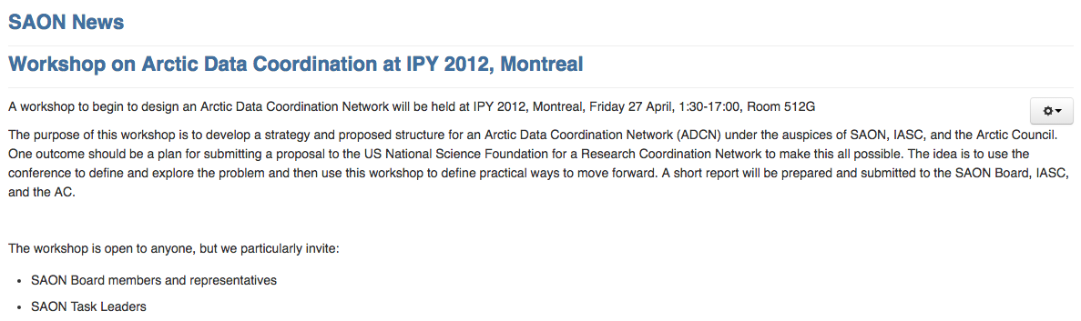
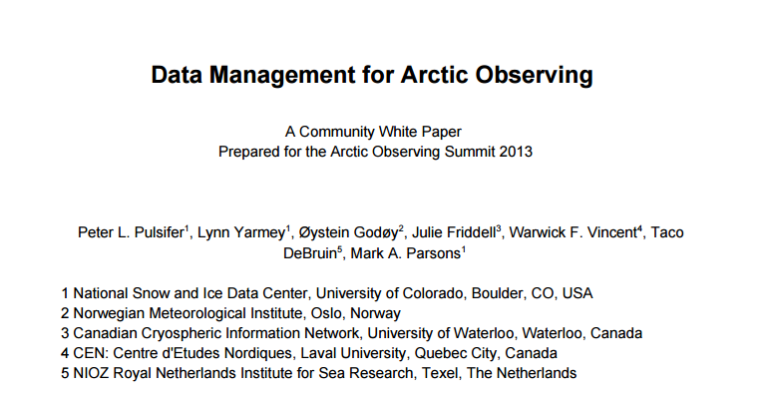
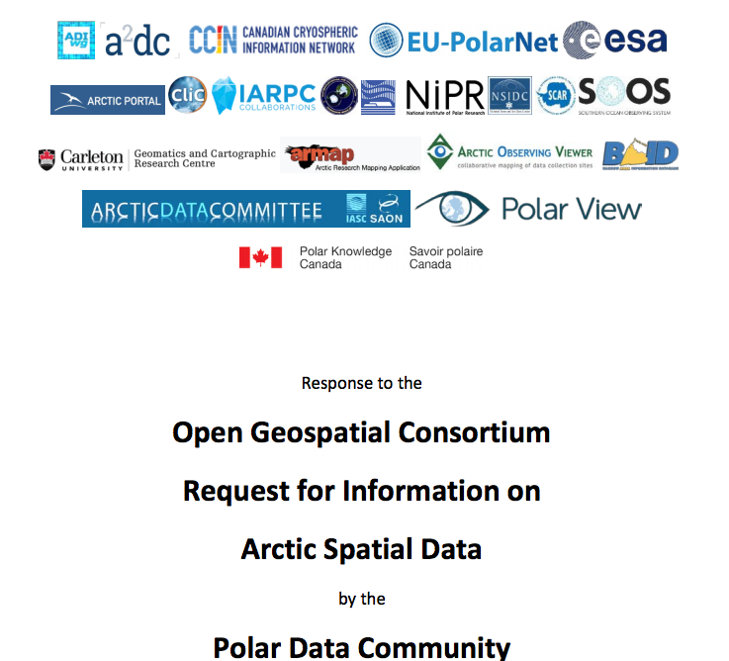
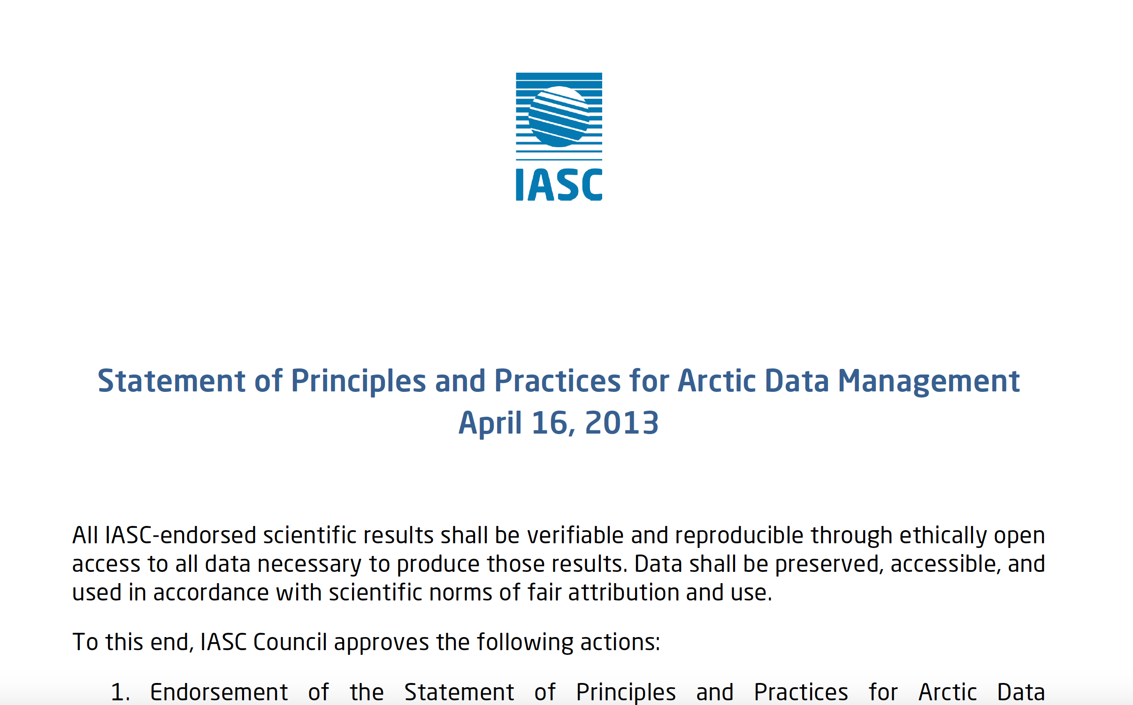
Arctic Data: Opportunities, Challenges and the Way Forward

Slide 5
The Arctic Data Committee

Slide 6
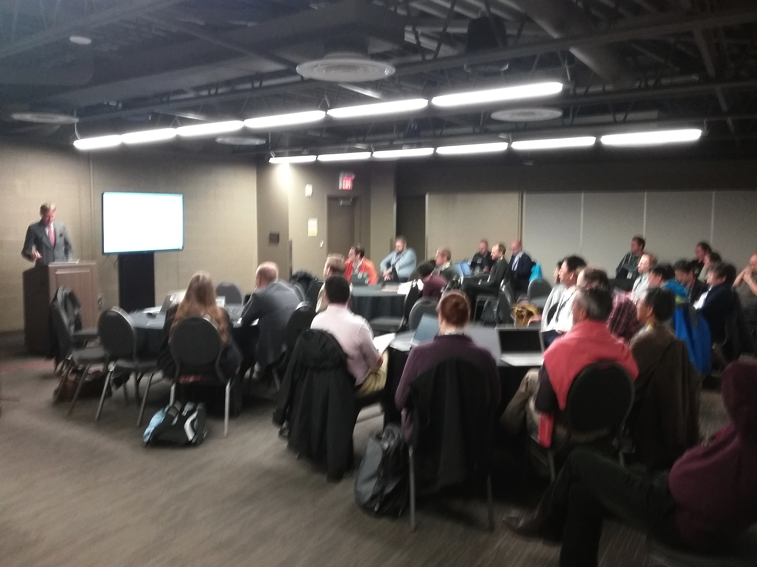
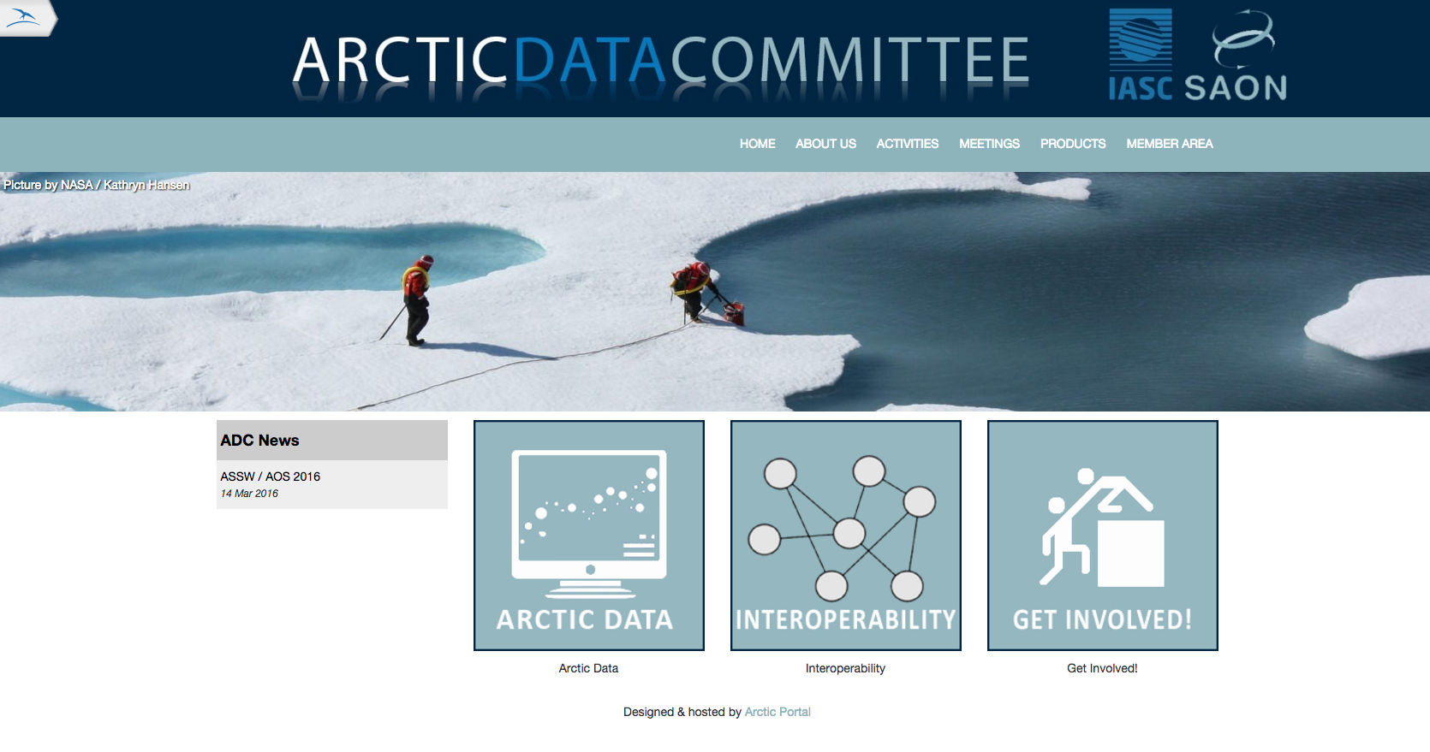
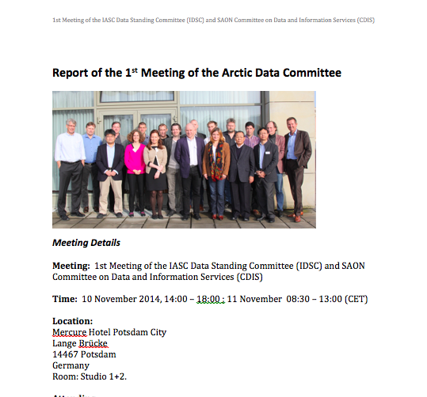
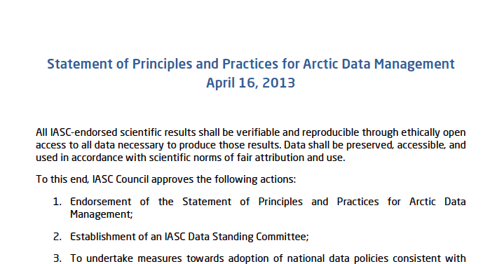
Arctic Data Committee
Formed Nov ‘14
IASC-SAON partnership
National and voluntary members
Promote and enable:
  Ethically open access
  Attribution
  Standards and interoperability
http://arcticdc.org

Slide 7
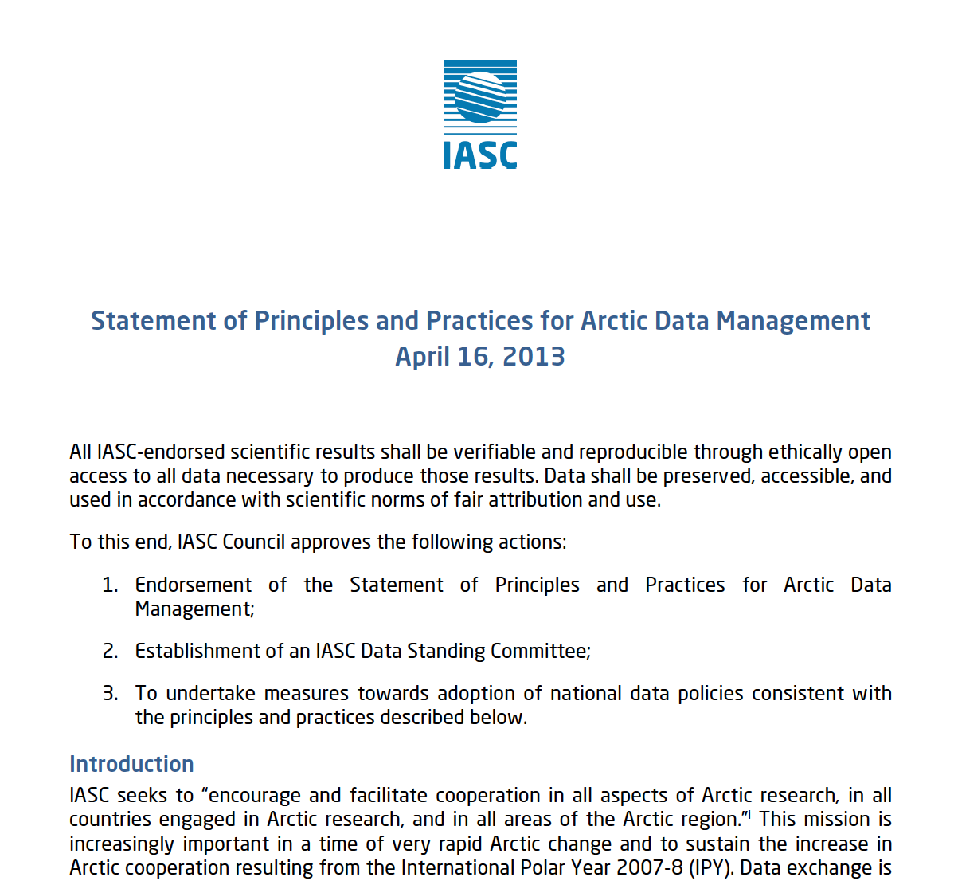
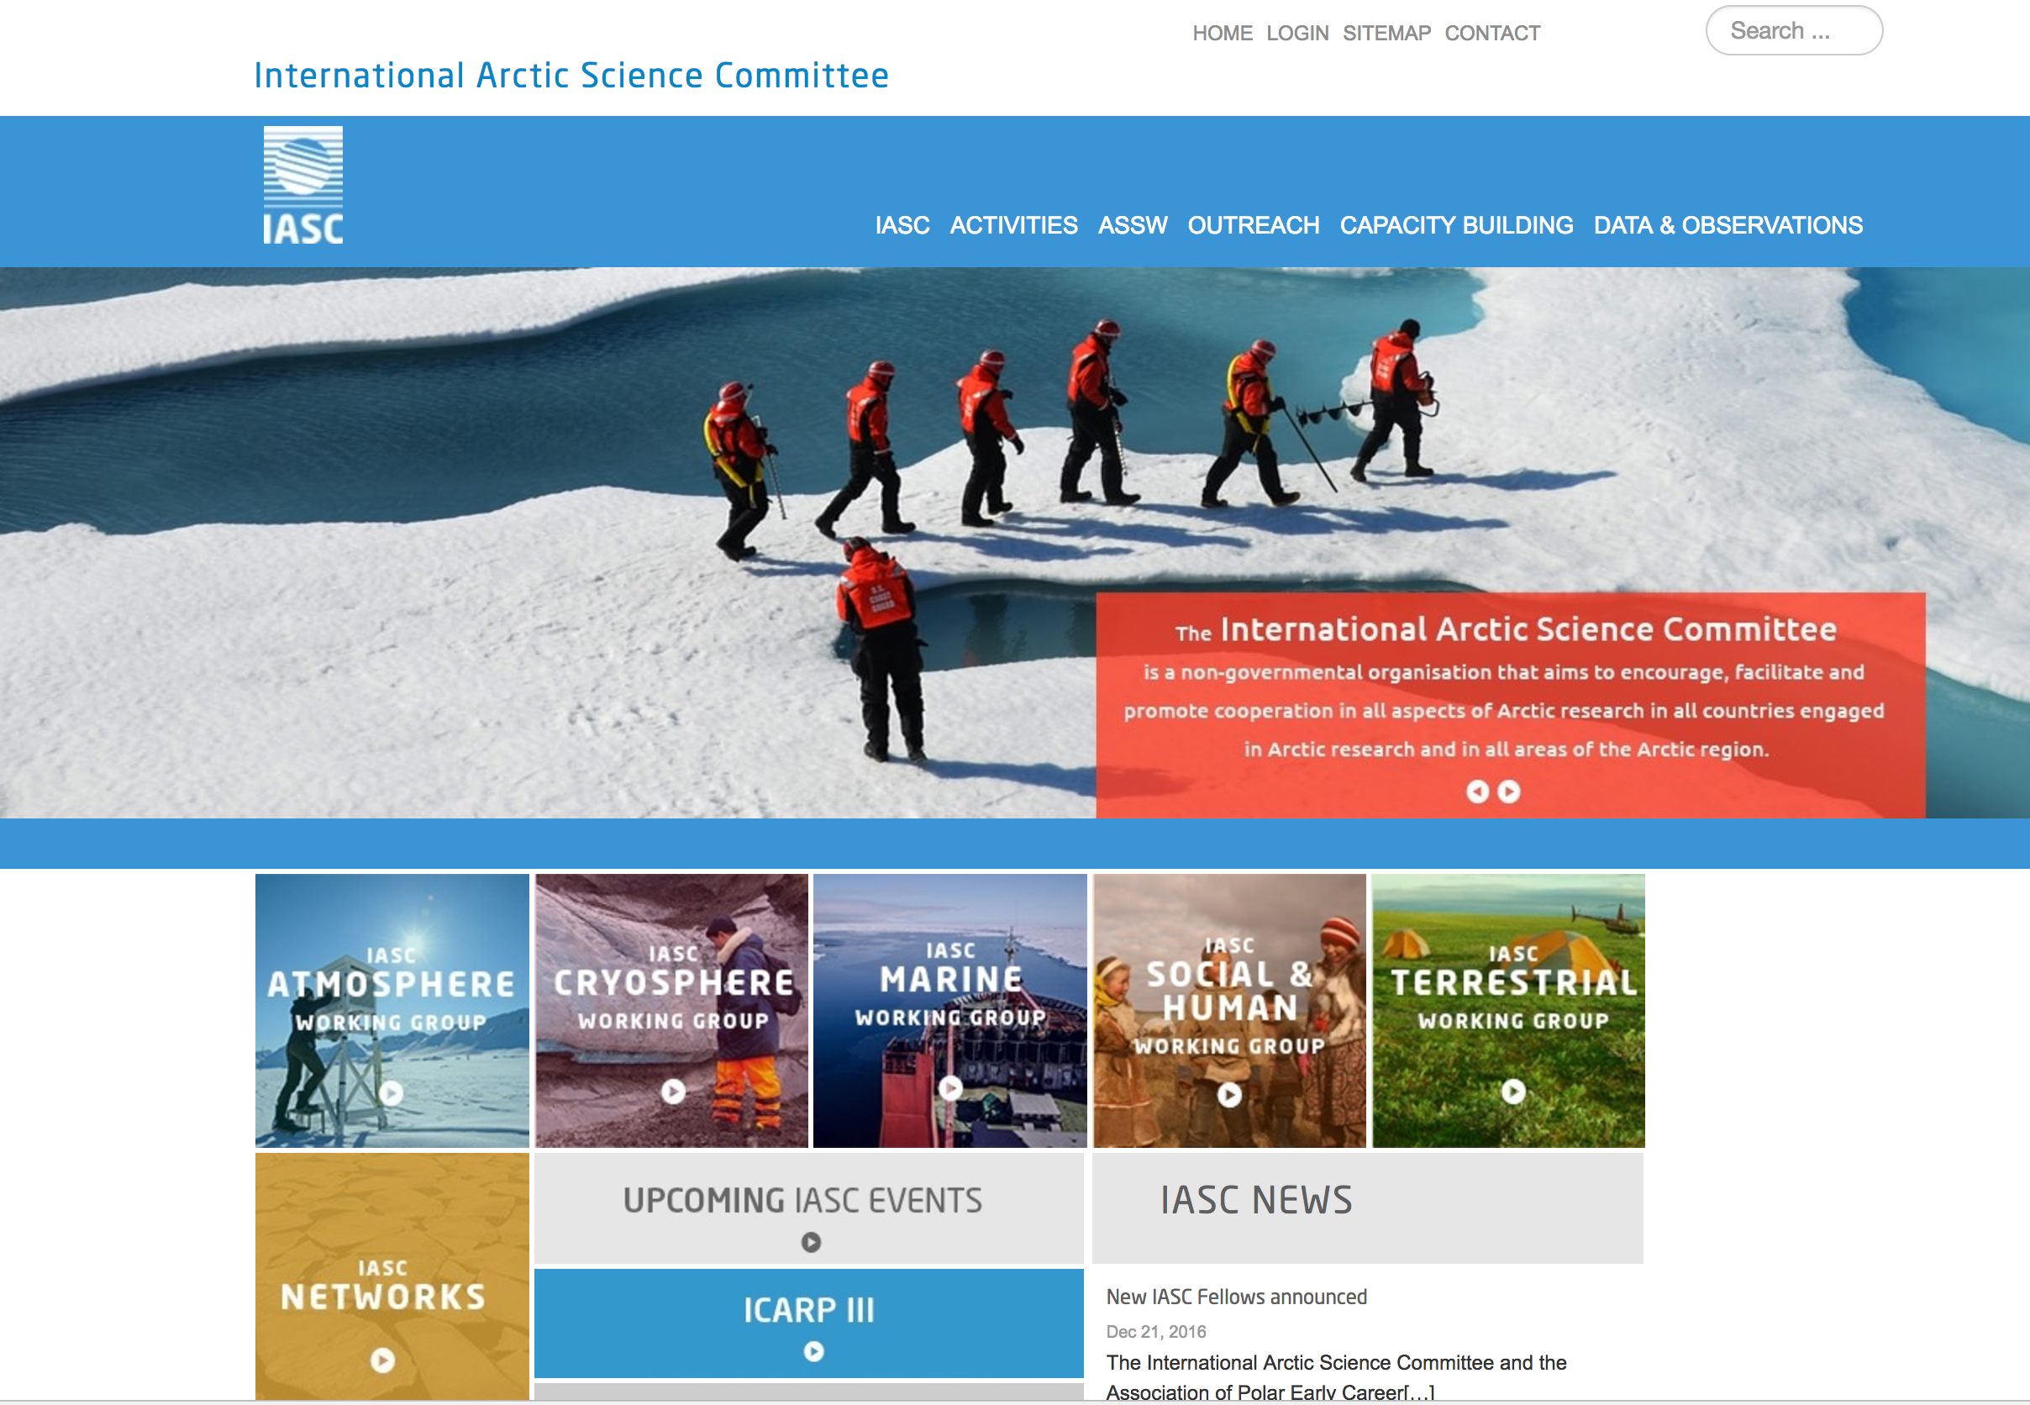
IASC
Encouraging and facilitating cooperation in all aspects of Arctic research
Built on scientific working groups
Seeks to ensure that scientific data and information from the Arctic are safeguarded, freely exchangeable and accessible;

Slide 8
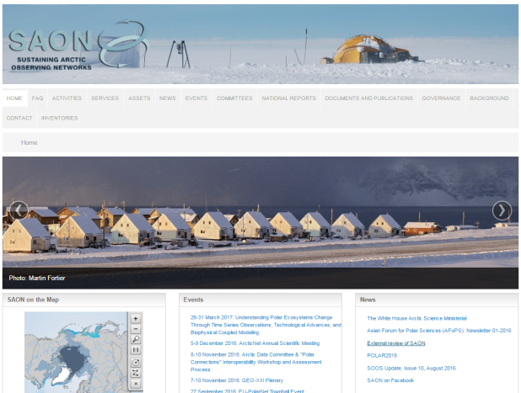
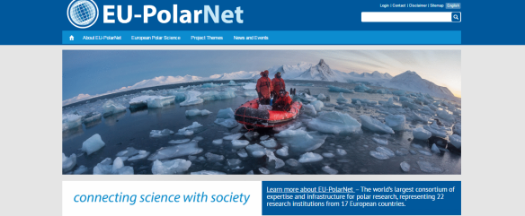
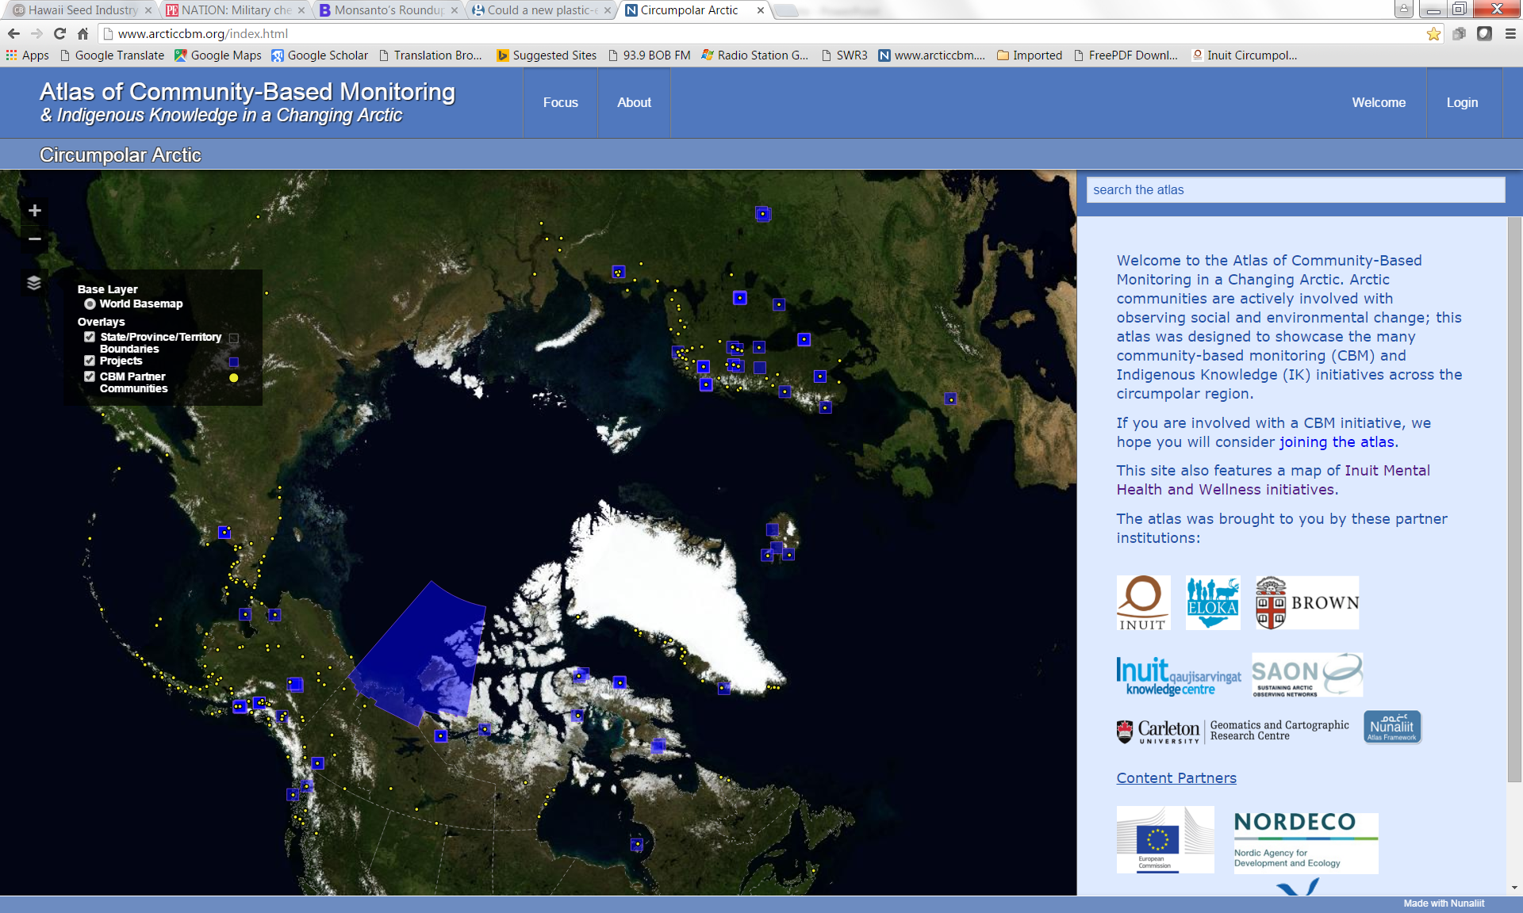

SAON
Facilitates development of well-defined observing networks that enable users to have access to free, open and high quality data that will realize pan-Arctic and global value-added services and provide societal benefits
coordination
integration
sharing and synthesis of data
Joint effort of Arctic Council and IASC
Membership
  Nations
  Permanent Participants
  AC Working Groups
  Orgs: European Commission, EEA, GEO, ICES, IPA, ISAC, WMO, others
  Networks: IASOA, INTERAC, others

Slide 9
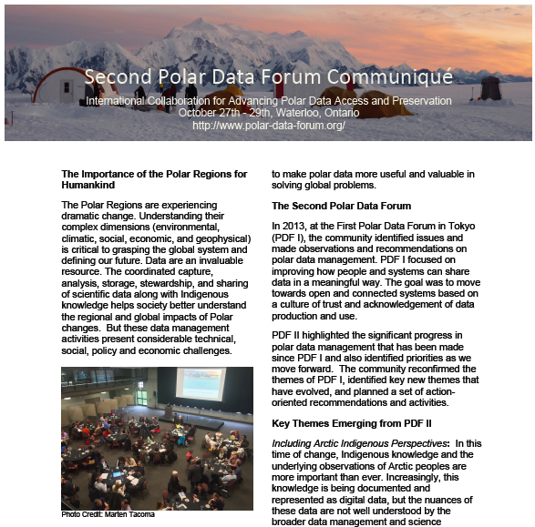

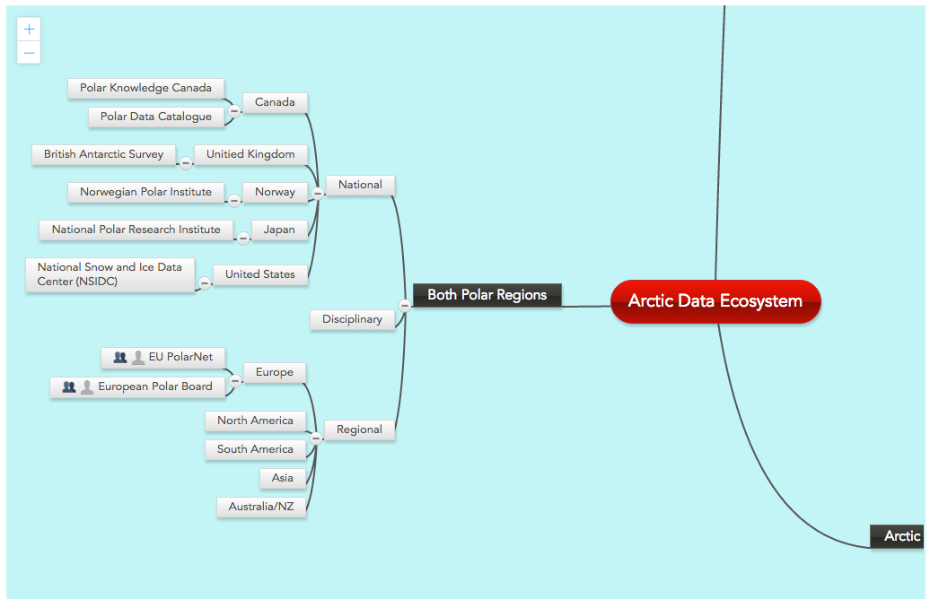

ADC Work Plan and Activities
Advises IASC and SAON on matters related to data management and data sharing
Mapping Arctic Data Ecosystem initiative
Metadata and discovery initiative
Workshops

Slide 10
The Community

Slide 11
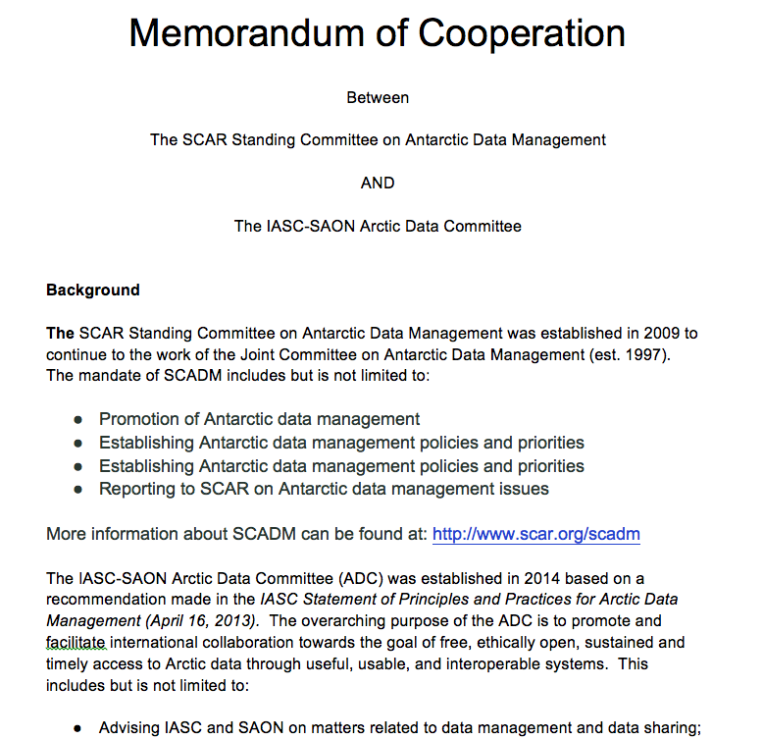
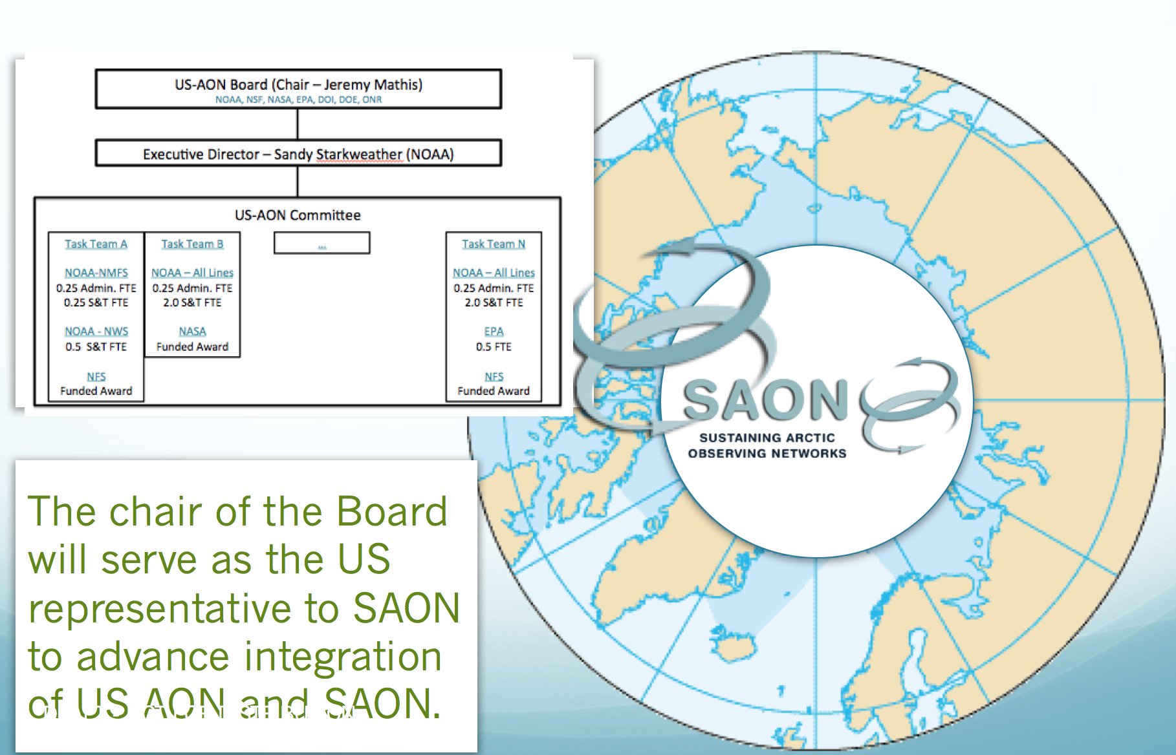
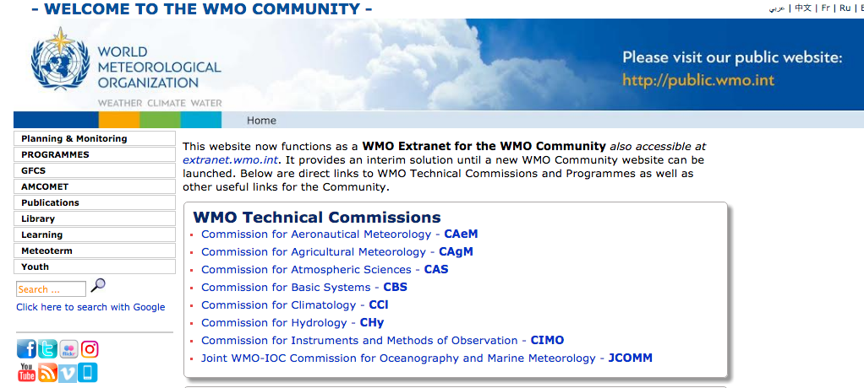
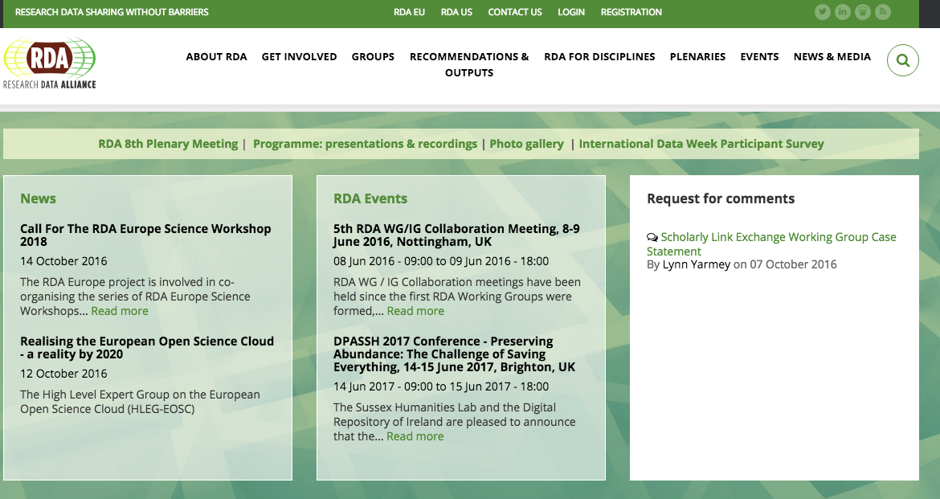
ADC Part of a Network
Working with initiatives from local to global
Leading where appropriate, but promoting other initiatives to ensure broad awareness of capacity across the community

Slide 12
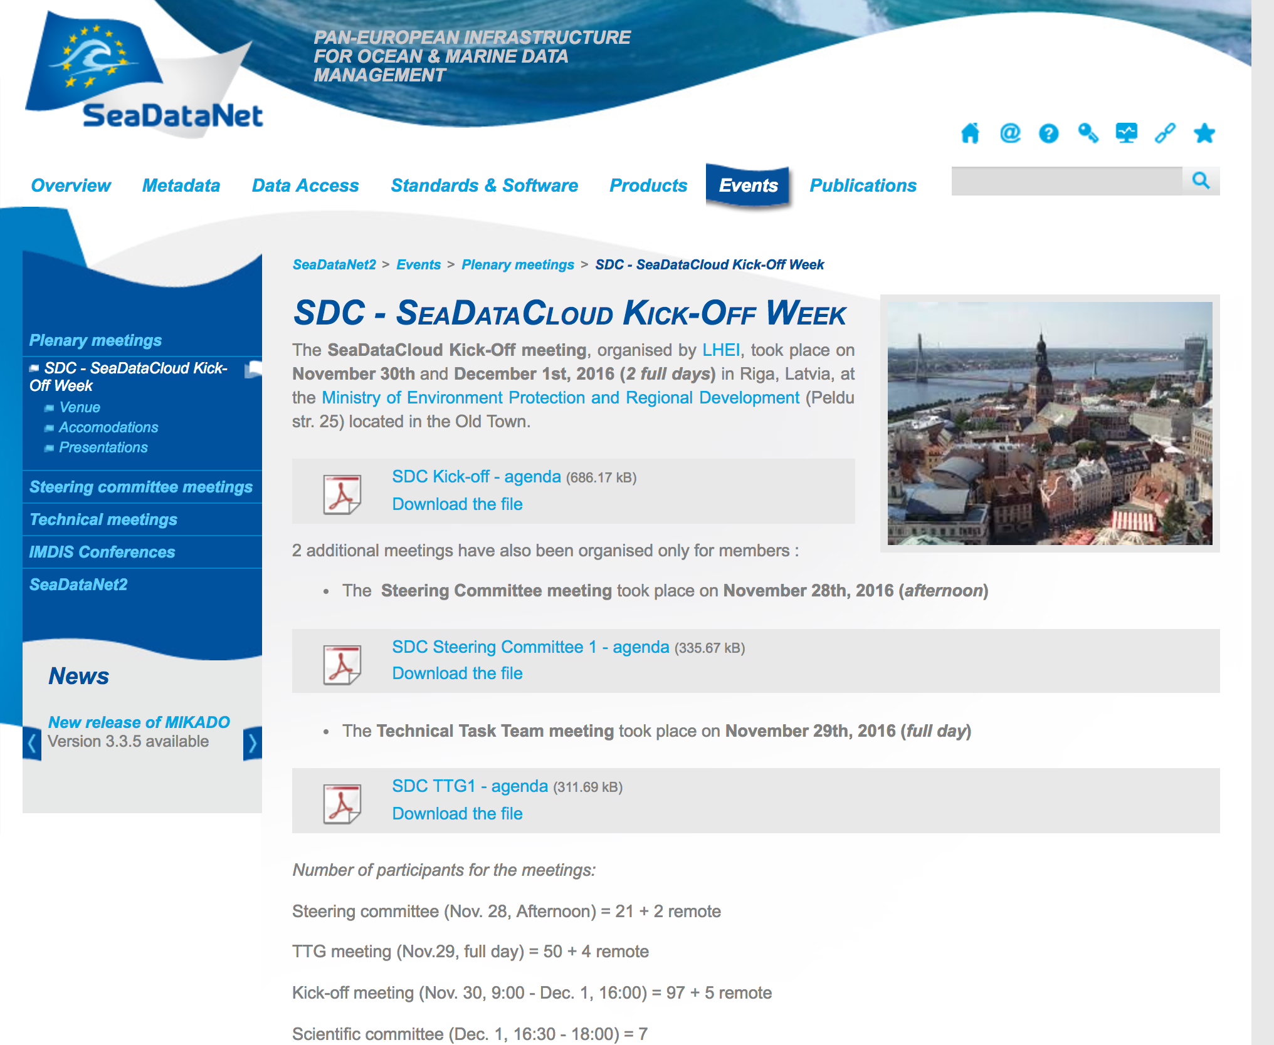
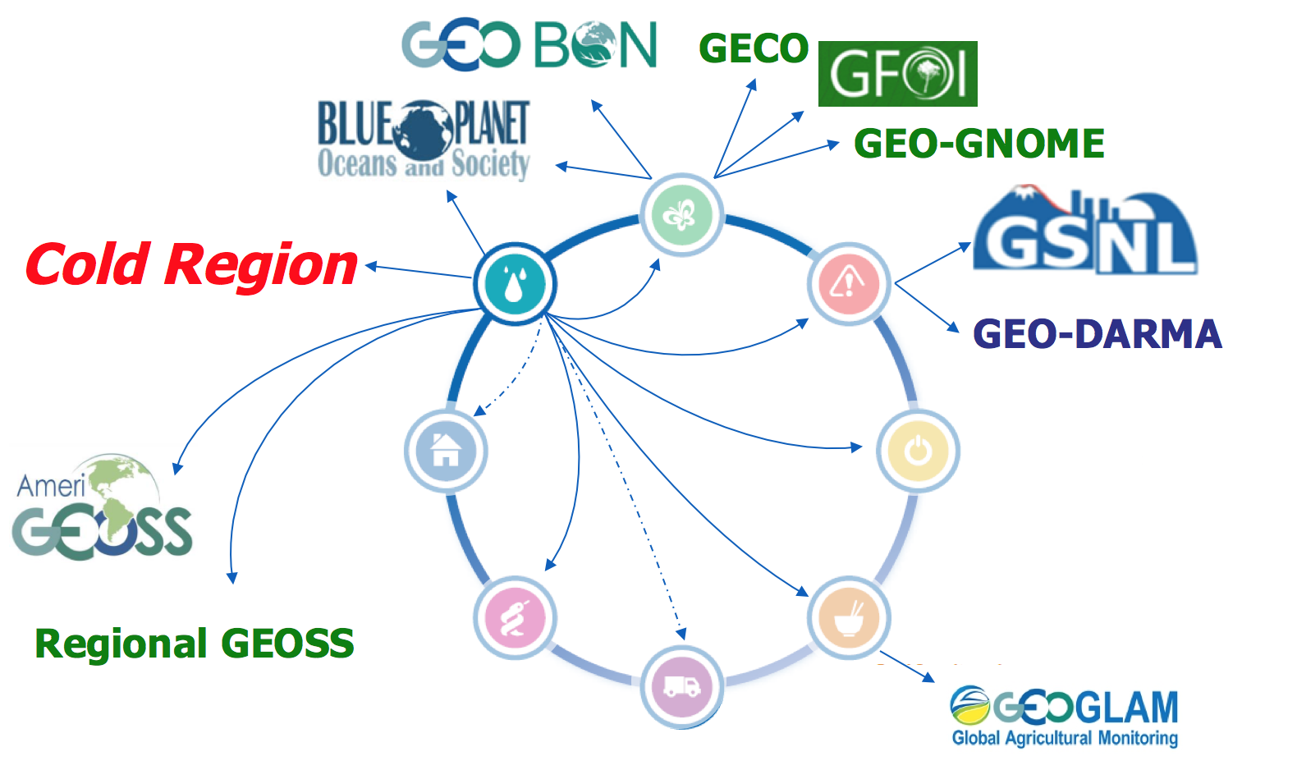
Linking with Global/Regional Initiatives
GEO (GEOCRI)
WMO
RDA
WDS
CODATA
SeaDataCloud
…

Slide 13
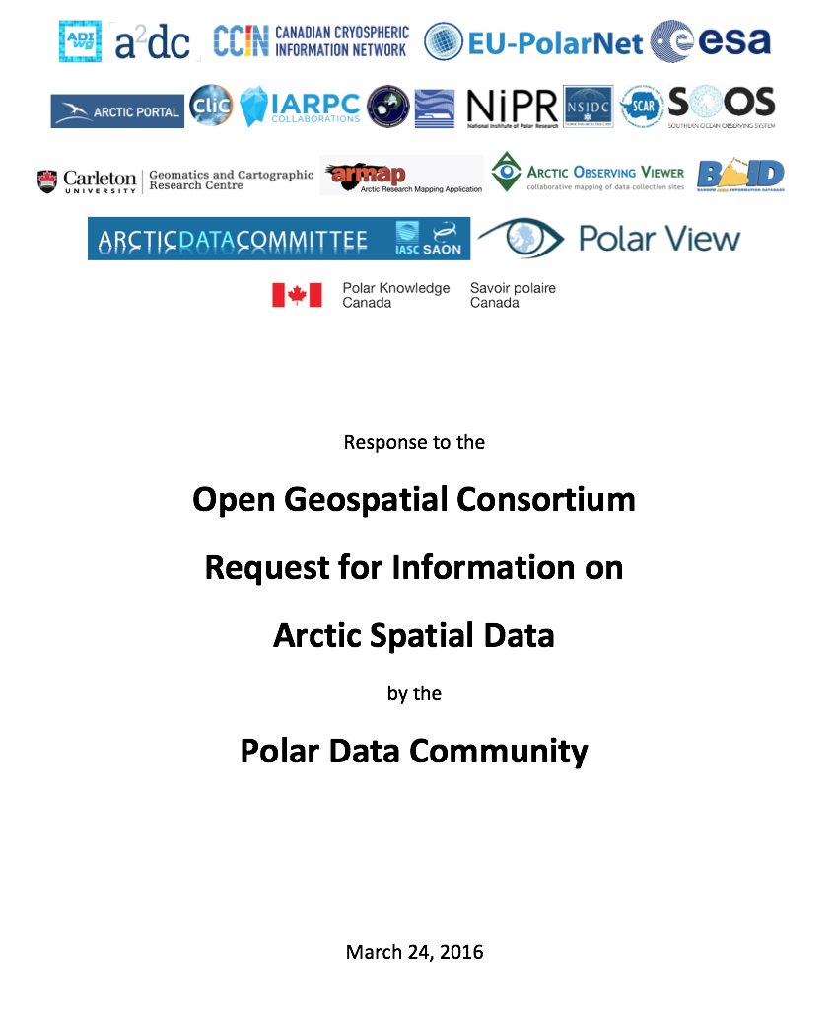
Linking with Polar Initiatives
GEOCRI
EU-PolarNet
Polar View / Polar TEP
OGC ASDP
Arctic SDI
GCW
SCADM
SOOS
AMAP
…

Slide 14
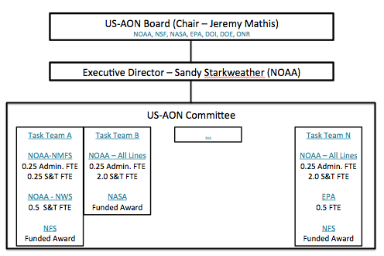
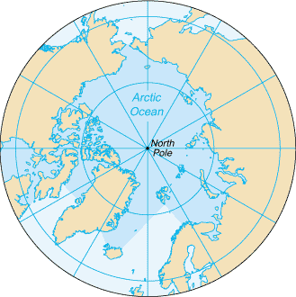

Linking with National Initiatives
The chair of the Board will serve as the US representative to SAON to advance integration of US AON and SAON.

Slide 15
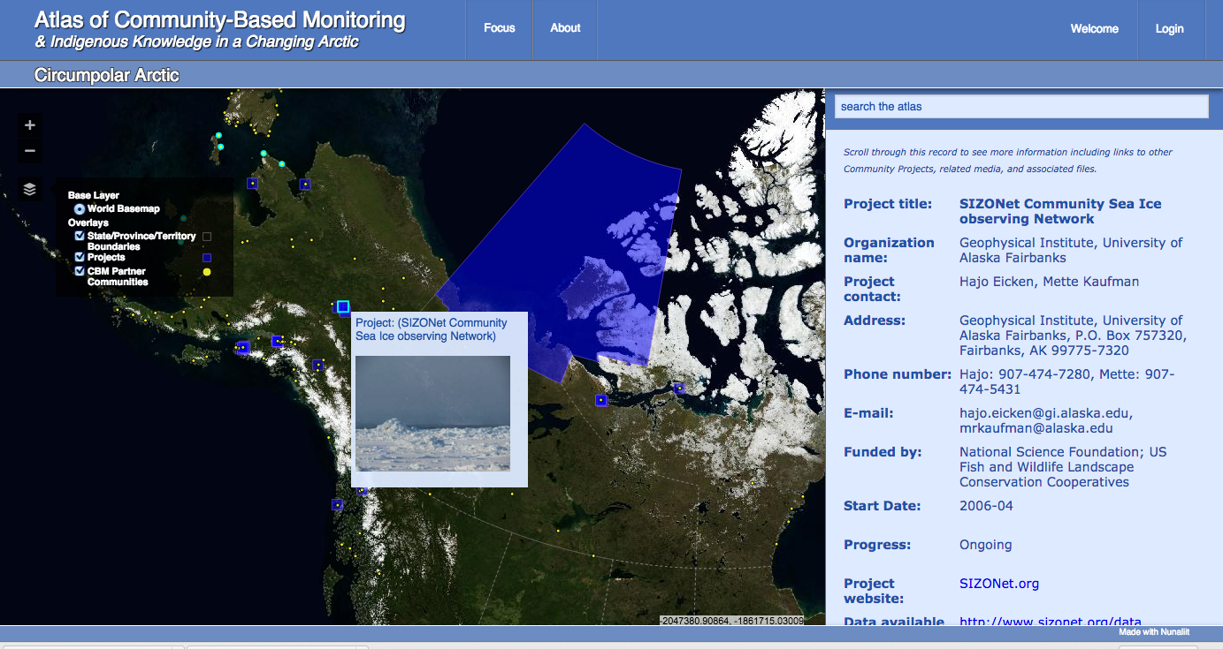
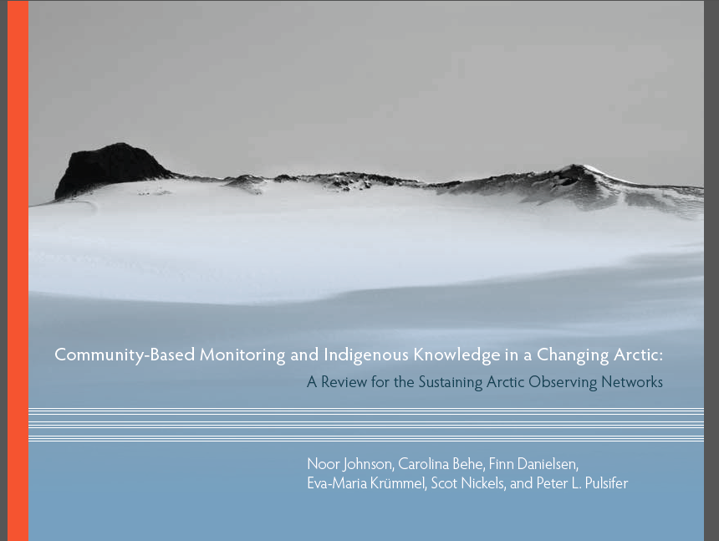
Linking with Local Communities
Focus on Community Based Monitoriing
Partnerships with groups such as ELOKA…
… ELOKA is a part of INTAROS
Dedicated Indigenous representatives to be added to ADC

Slide 16
Recent Activity: Polar Connections Interoperability Workshop
(in addition to work plan)

Slide 17
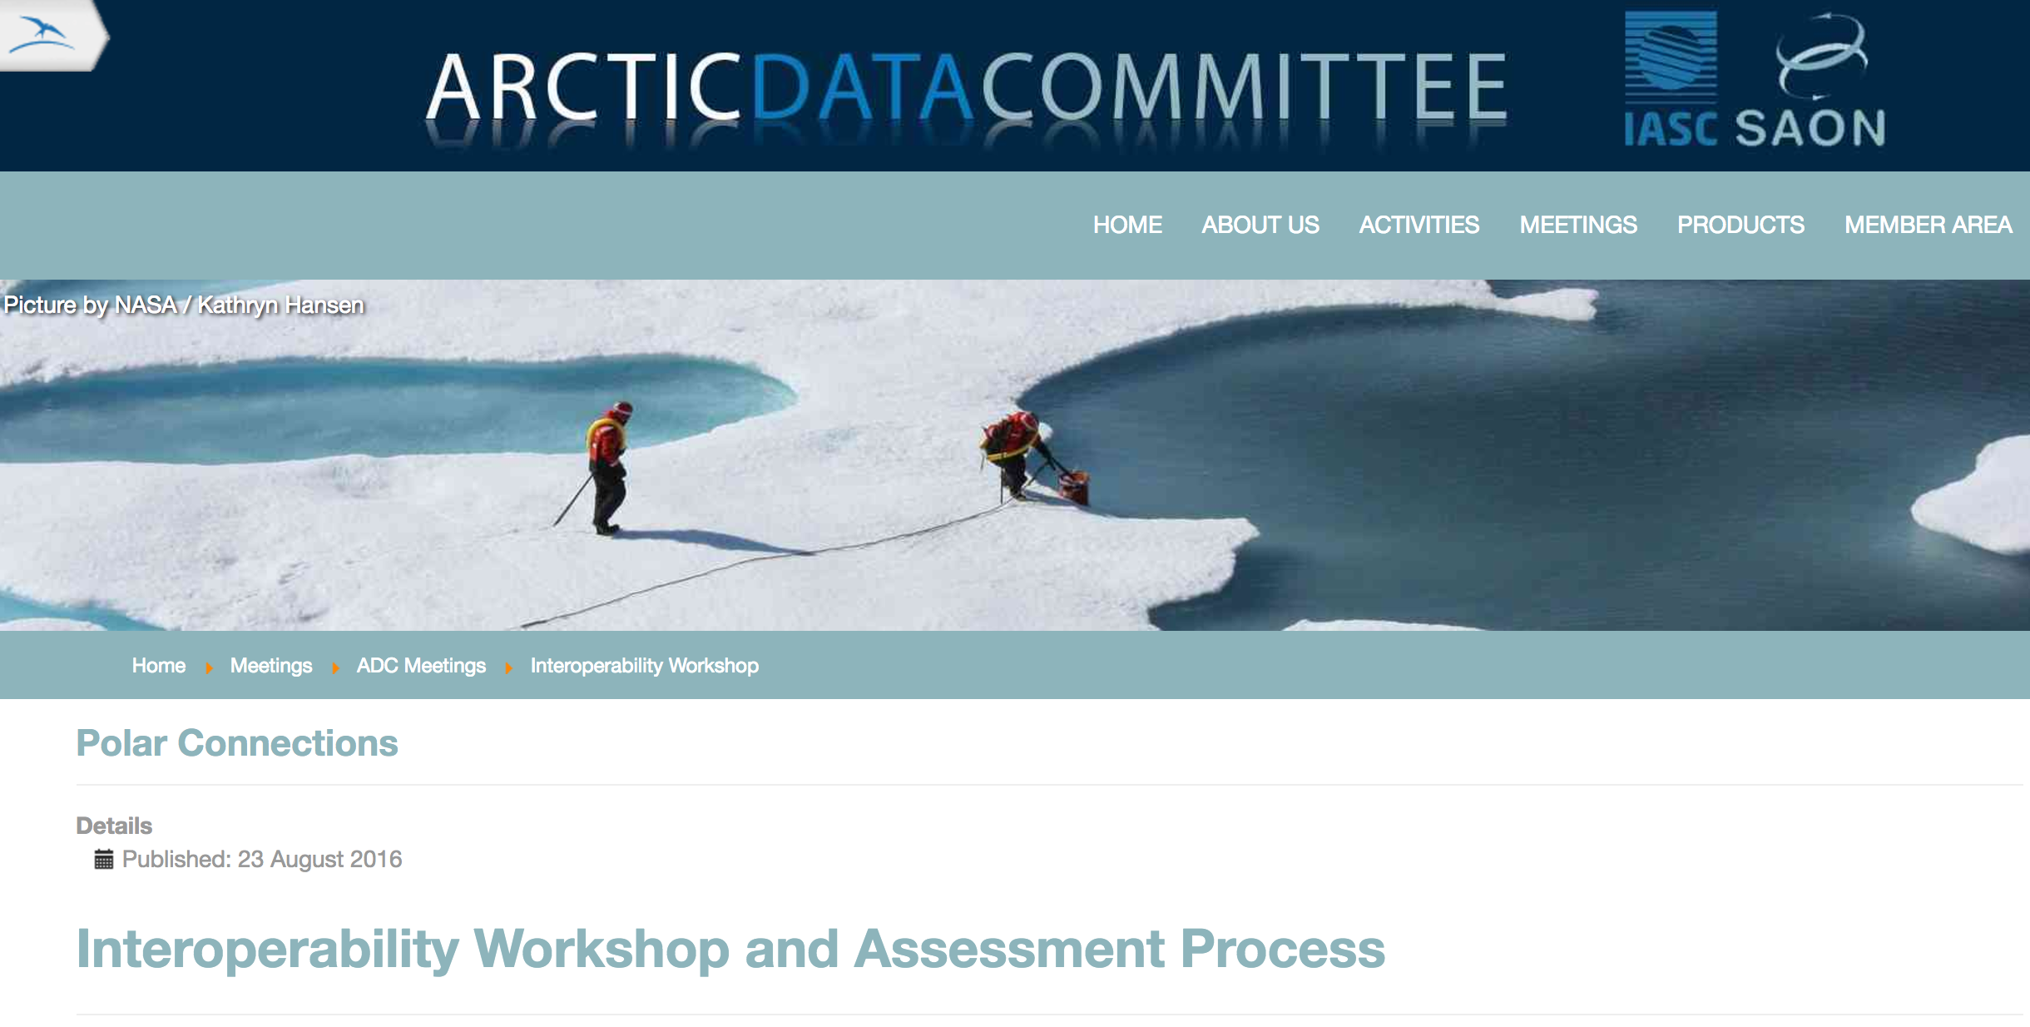
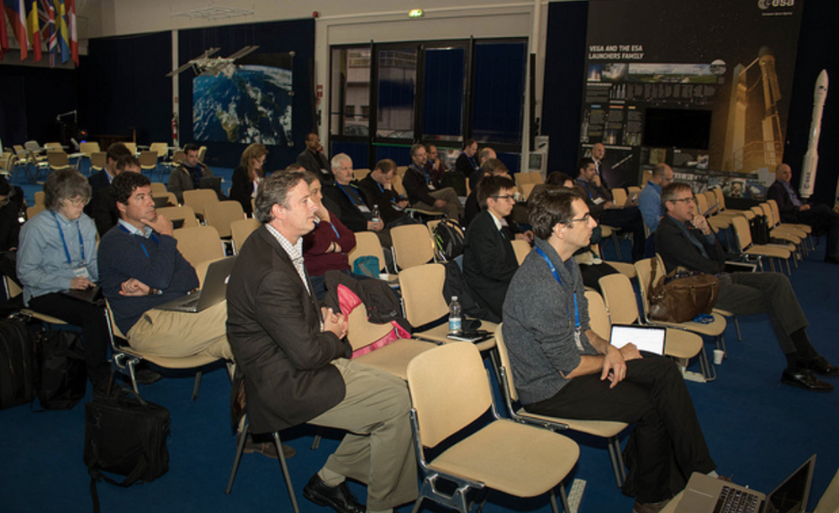
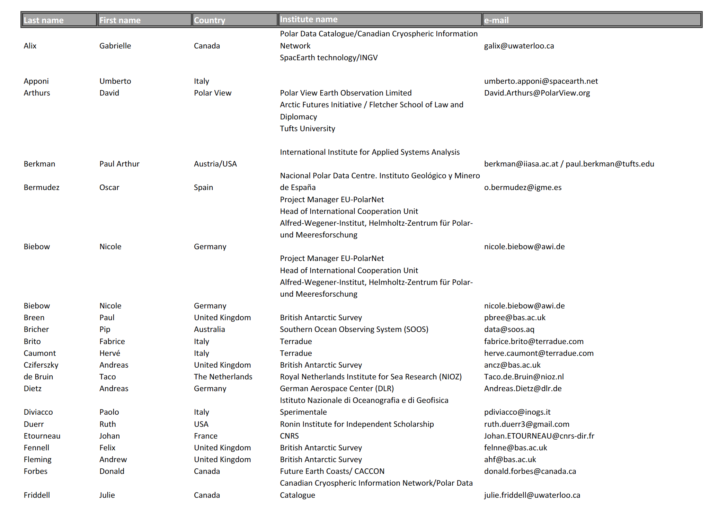
Polar Connections Workshop
8-9 November, 2016, Frascati, Italy (ESA ESRIN)
Co-Organized w EU-PolarNet and ADC meetings
60 representatives from 17 countries and fifteen polar data organizations
7 Themes.
Focus on working sessions
Report under development

Slide 18

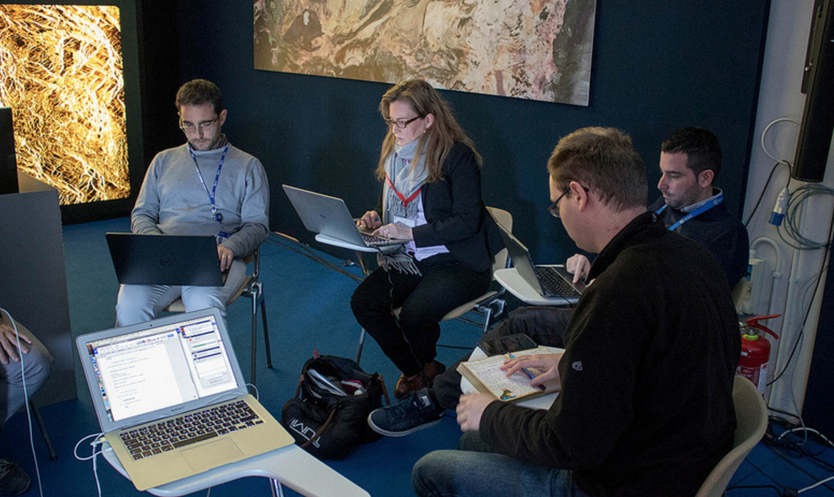
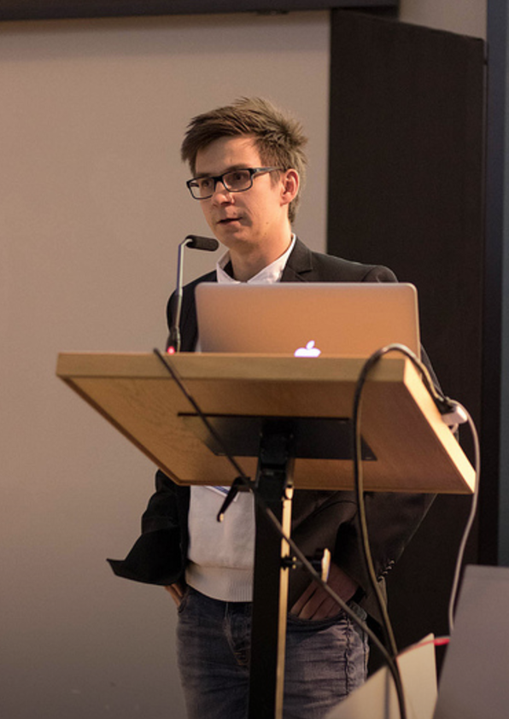
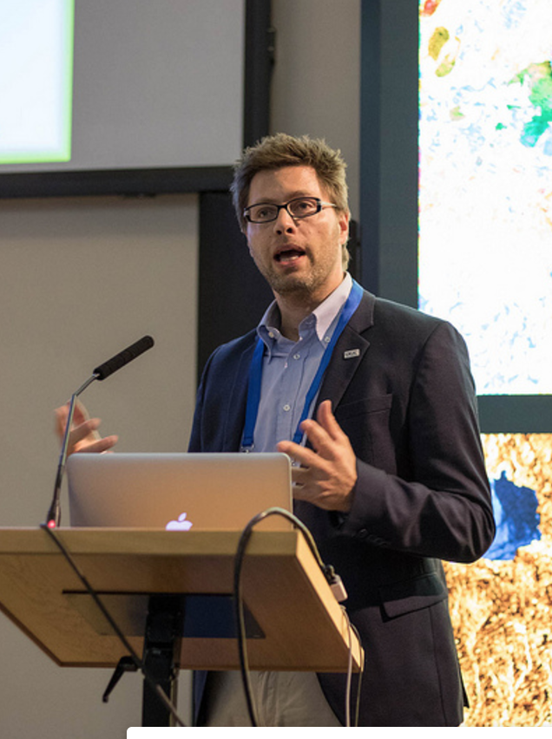
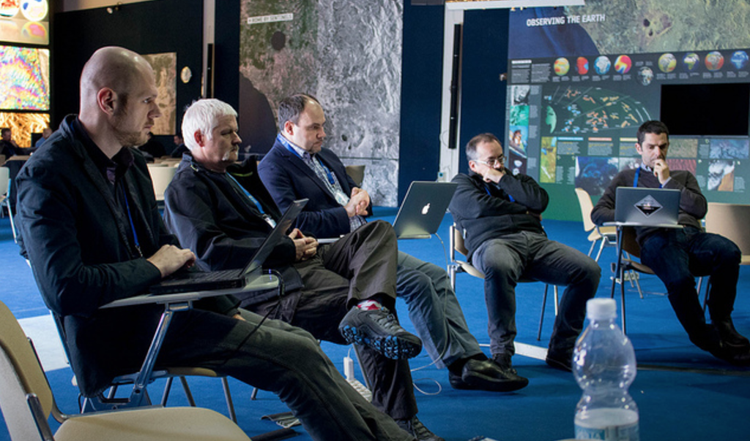
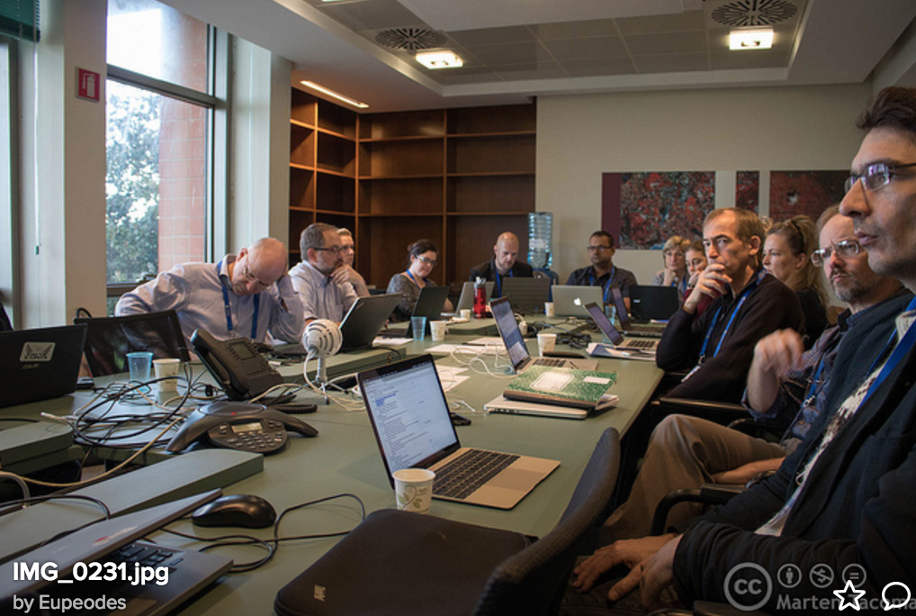
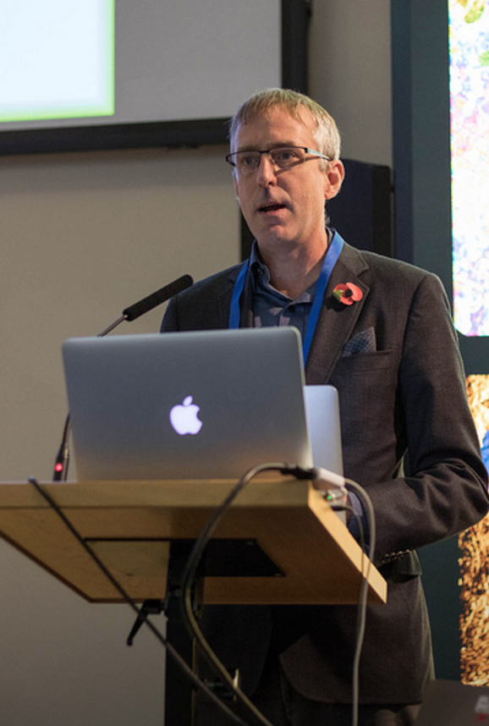


Slide 19
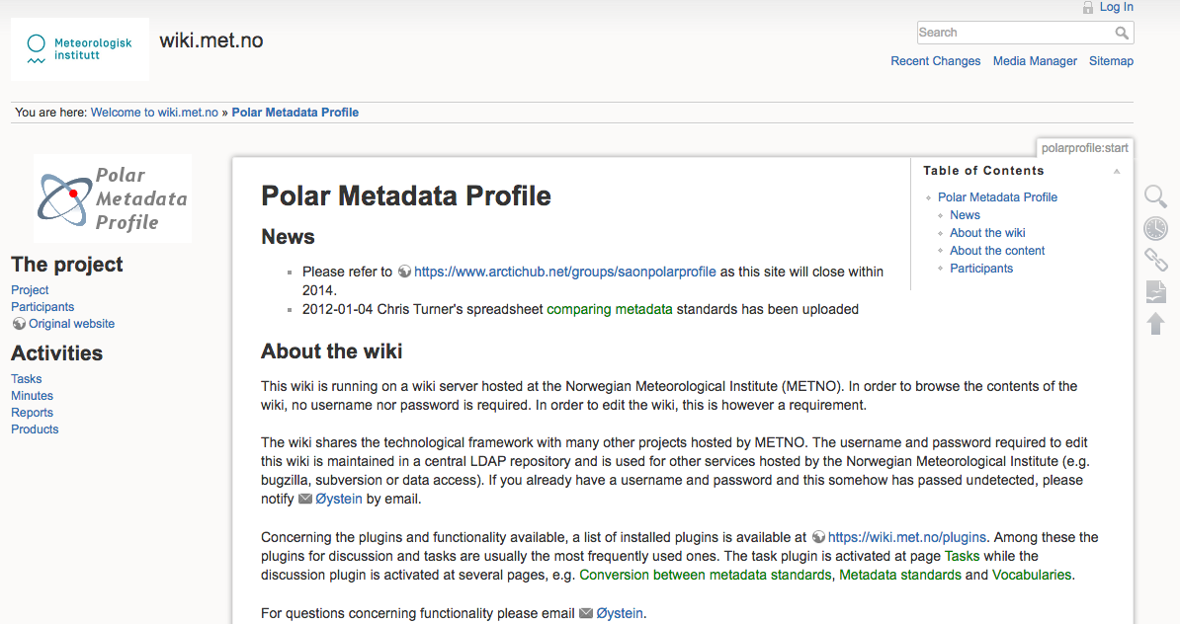
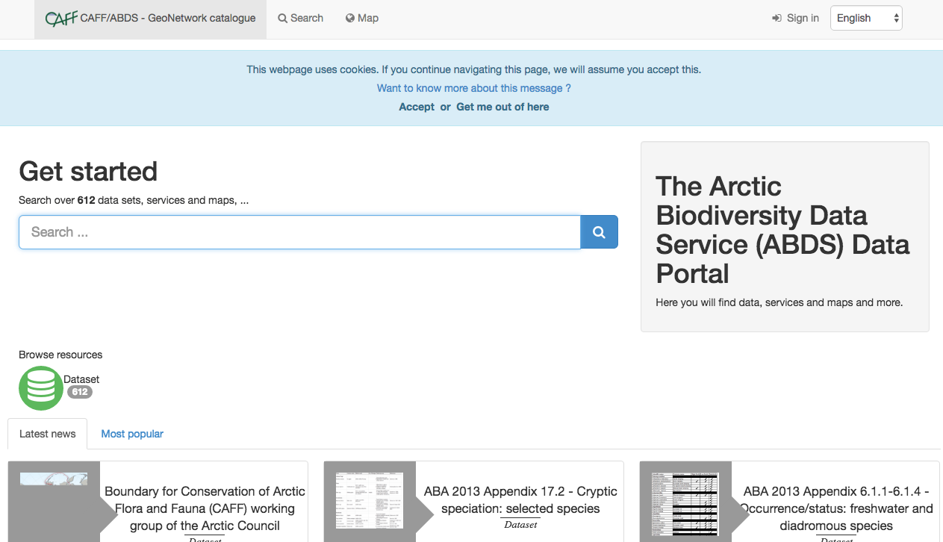
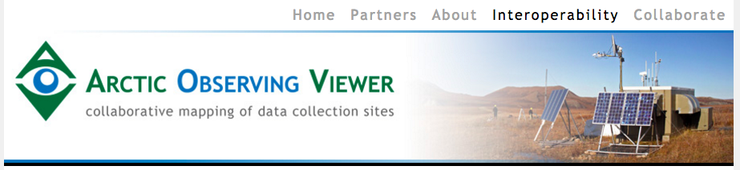




Data Discovery and Documentation

Slide 20




Data as a Service

Slide 21







Social Sciences, Indigenous Knowledge, Community Based Observing

Slide 22




Cloud Data and Computing Platforms

Slide 23




Governance & Sustainability

Slide 24
Highlights of Results
Key current challenges are social and organizational rather than technical : supporting human networks, promoting standards, and aligning policy with implementation
Federated search a priority – multi-partner initiative developing – leveraging existing platforms (ADE, PDC, GEOSS etc), sharing code
Formation of Cloud/VRE group (A. Fleming)
Formation of RDA partnership
Publication of results including recommendations (ASSW Prague)

Slide 25
Summary

Slide 26
Mobilizing Data Through Collaboration
An active, collaborative community has been established and is growing
ADC is about promoting connections and interoperability through SAON, IASC and strong, working partnerships with many other initiatives (e.g EU-PolarNet, SCADM/SOOS, ESA, Polar View, GEOCRI, RDA, many others)
Promote and leverage existing or emerging capacity while identifying and working to fill gaps
INTAROS stands to play a major role in the Arctic (polar) data community! How?

