Slide 1
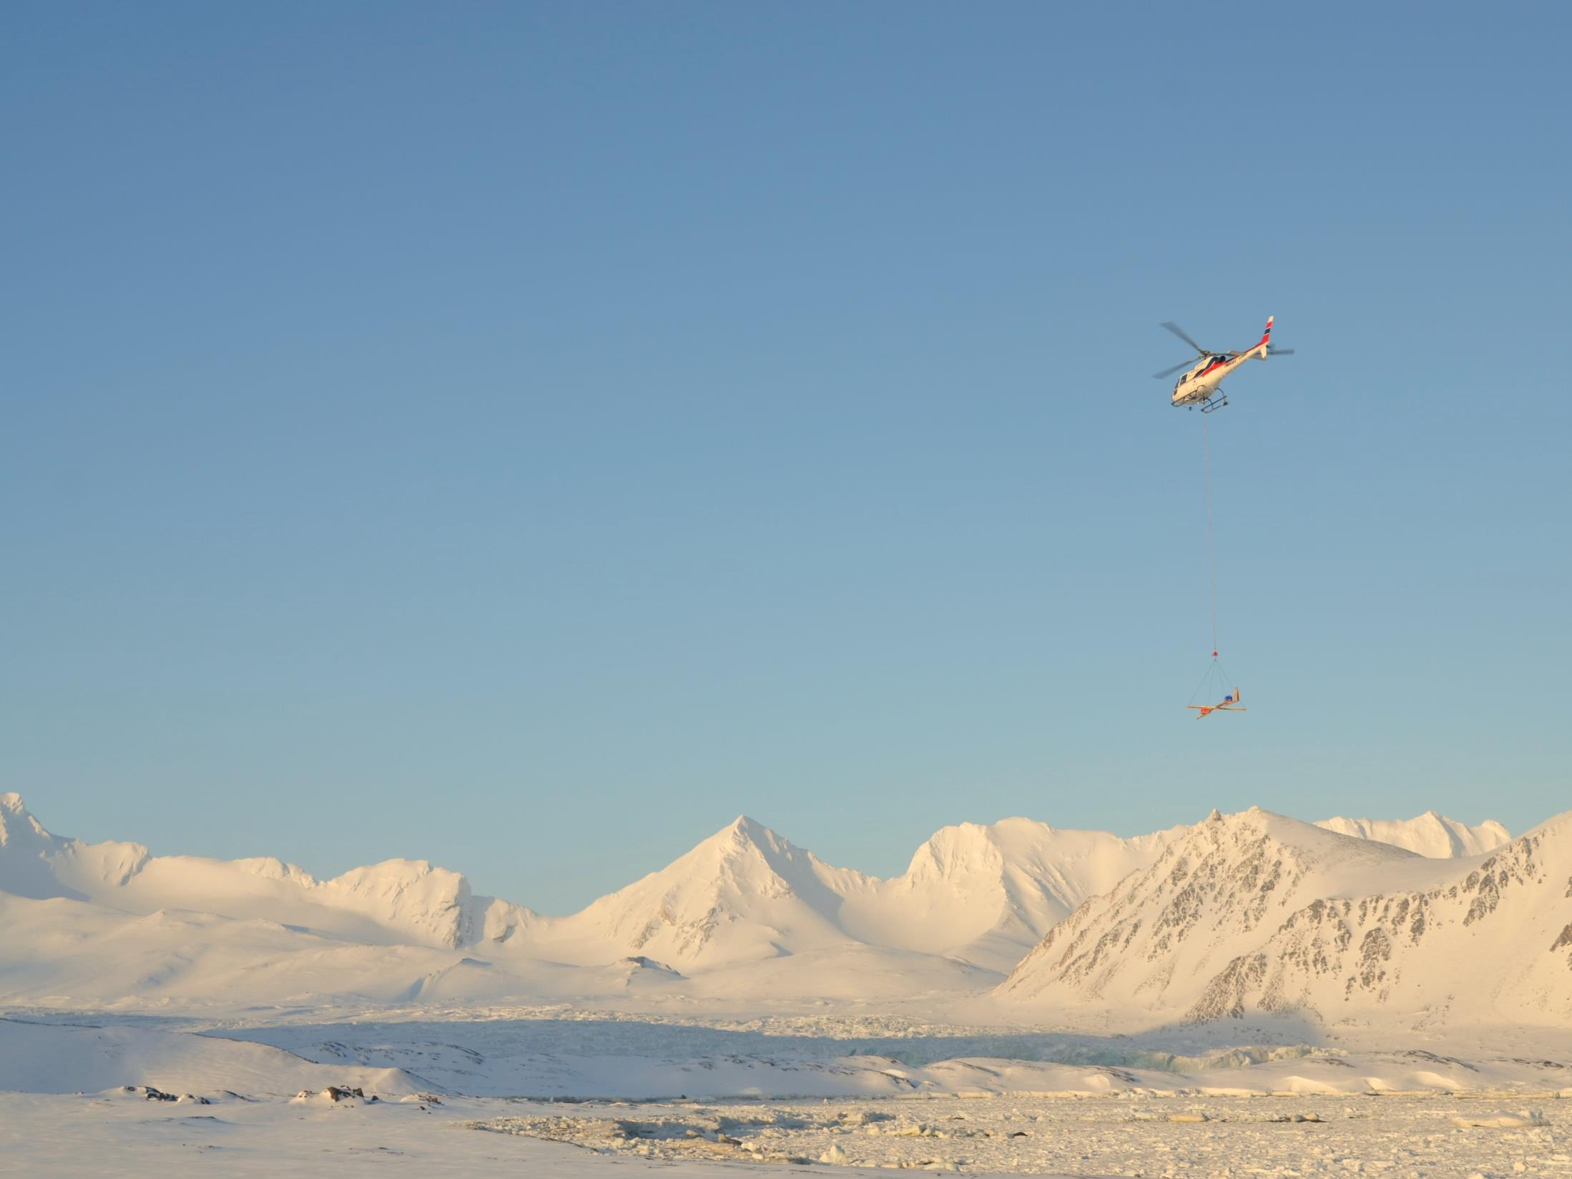





WP7 – Contribution to INTAROS Roadmap
Ruth Higgins & Donatalla Zona
Online Meeting
27th May 2020
This project has received funding from the European Union’s Horizon 2020 research and innovation programme under grant agreement No 727890.
This project has received funing from the European Union’s
Horizon 2020 research and innovation programme under
grant agreement No 727890.

Slide 2
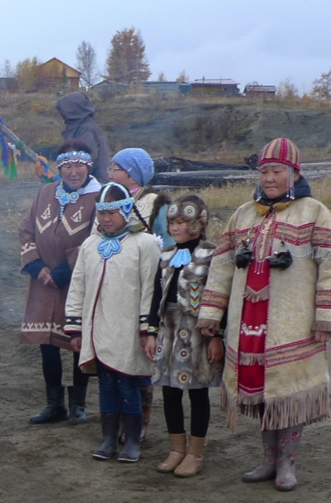
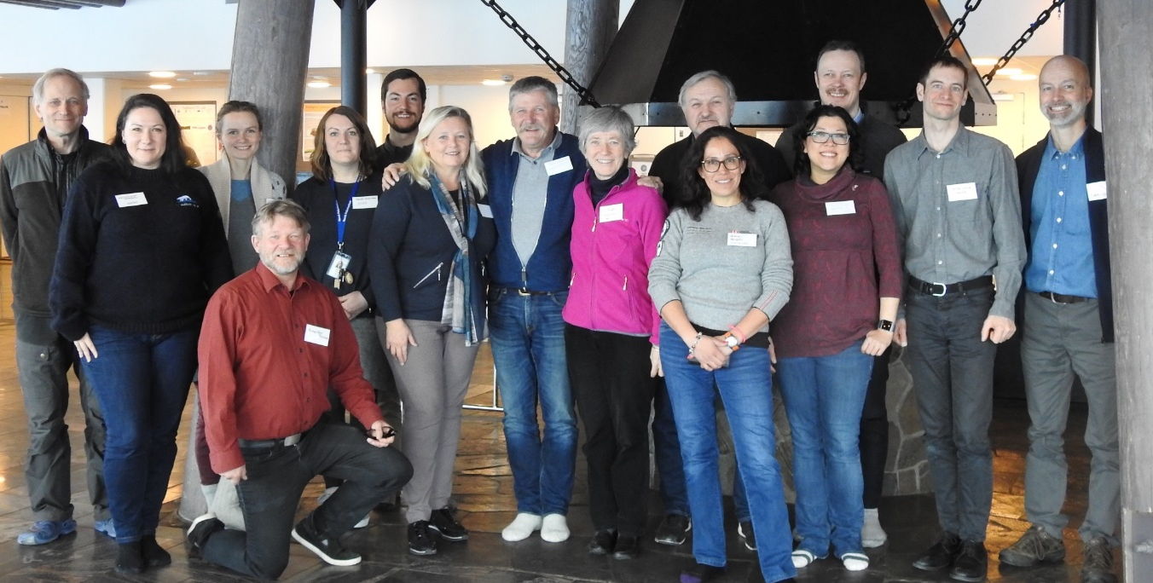
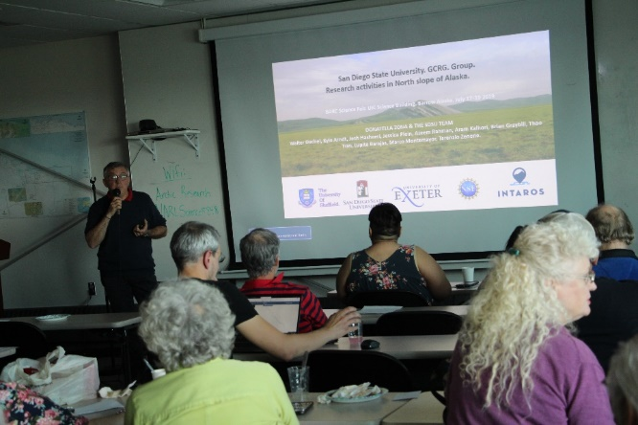
Engagement with local communities and civil society organizations.
Community-based monitoring.

Slide 3
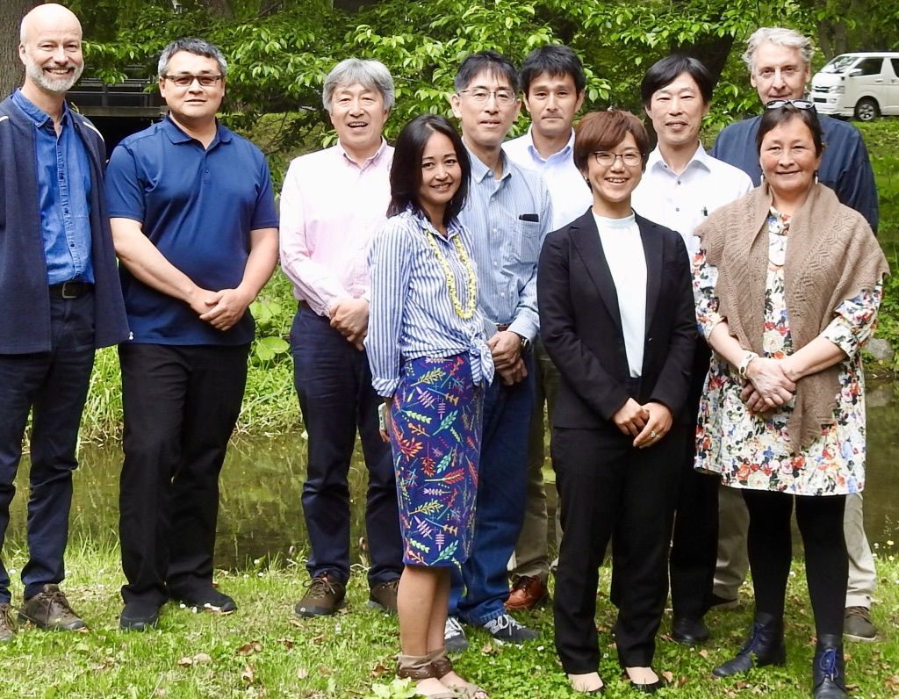
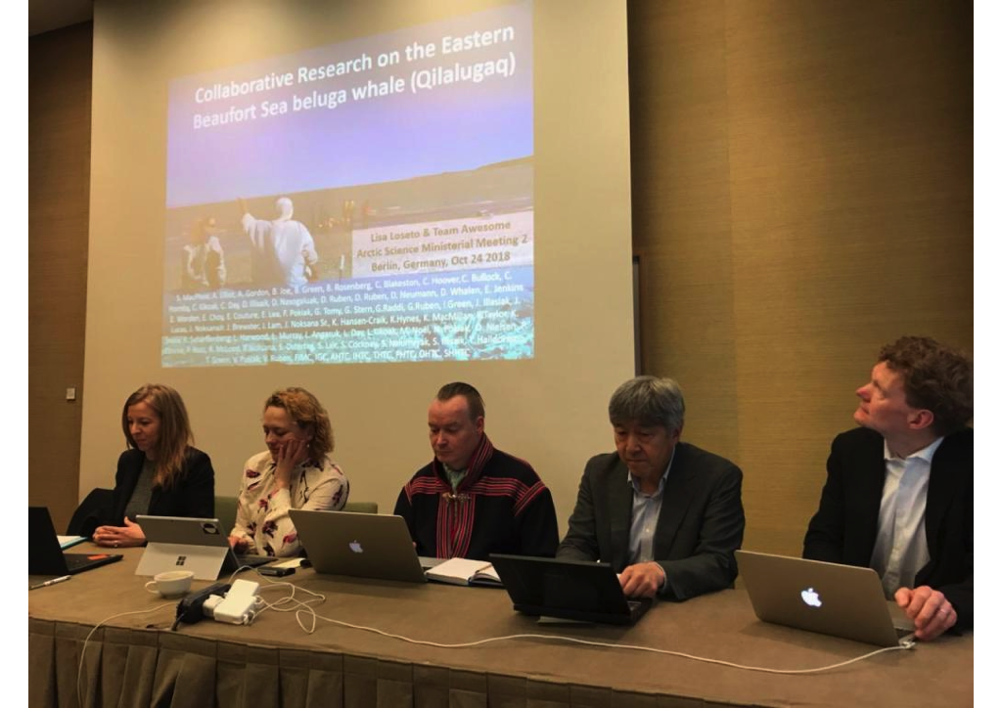
Creating opportunities for knowledge exchange.
Creating opportunities for multi-sector engagement: decision makers, industry, communities.
Creating opportunities for debate and discussion.

Slide 4
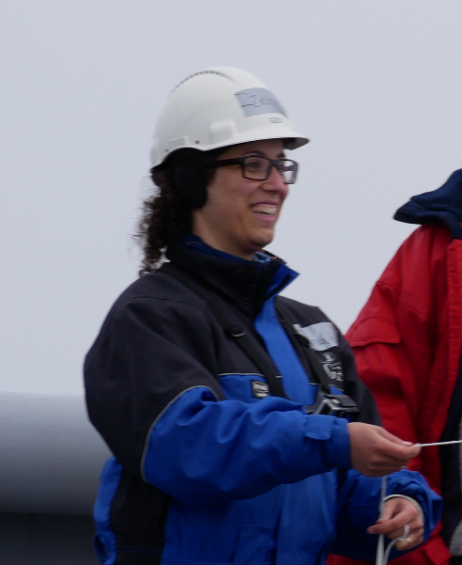
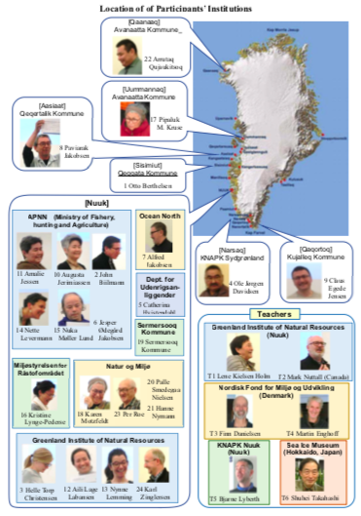
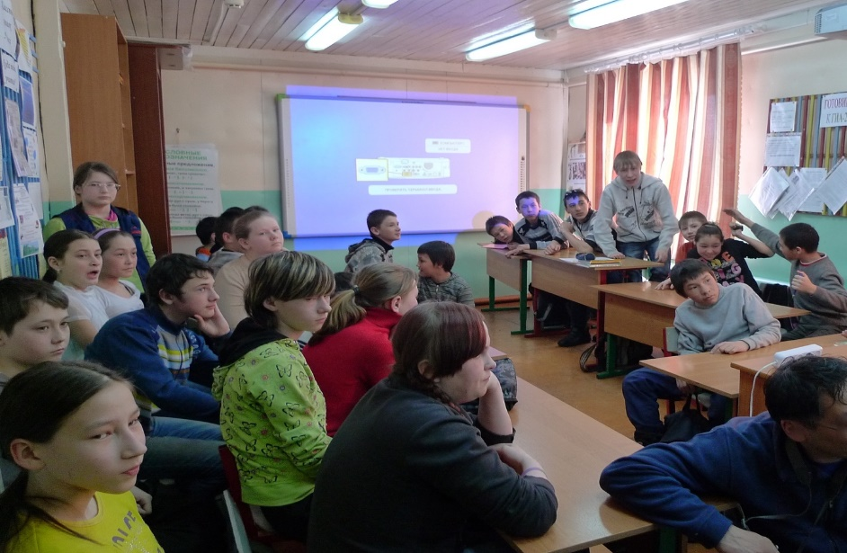
Provide training opportunities at many levels: academic, user, and community/youth.

Slide 5
Roadmap
Should evaluate the landscape, describe the destination, provide a plan on how to get there.
Comprehensive and succinct – short and to the point.
Efficient and focussed process of development.
Focus on societal benefits/Arctic services/essential variables, etc. Define the focus early on.
Added value provided through INTAROS.
Final event to celebrate and launch the Roadmap.

