Slide 1

  NMEFC work that related to the MARIS
Polar Environmental Research & Forecasting Division
Xi Liang, Lu Zhang, Lin Zhang

Slide 2
  Task:
  1. Ensemble data assimilation scheme
  2. Arctic sea ice forecasting system
  3. Snow/Ice thermodynamic

Slide 3
Background: Early Stage(2010 - 2017)
Sea ice forecasting system（MITgcm+nudging）
Atmospheric forcing：
NCEP GFS 120h Data
DA module:
nudging to AMSR2
sea ice concentration
Horizontal resolution:18km
Viscous-Plastic rheology
Zero-layer thermodynamics
MITgcm
ice-ocean model
Output：
120h sea ice concentration
and thickness forecasts

Slide 4

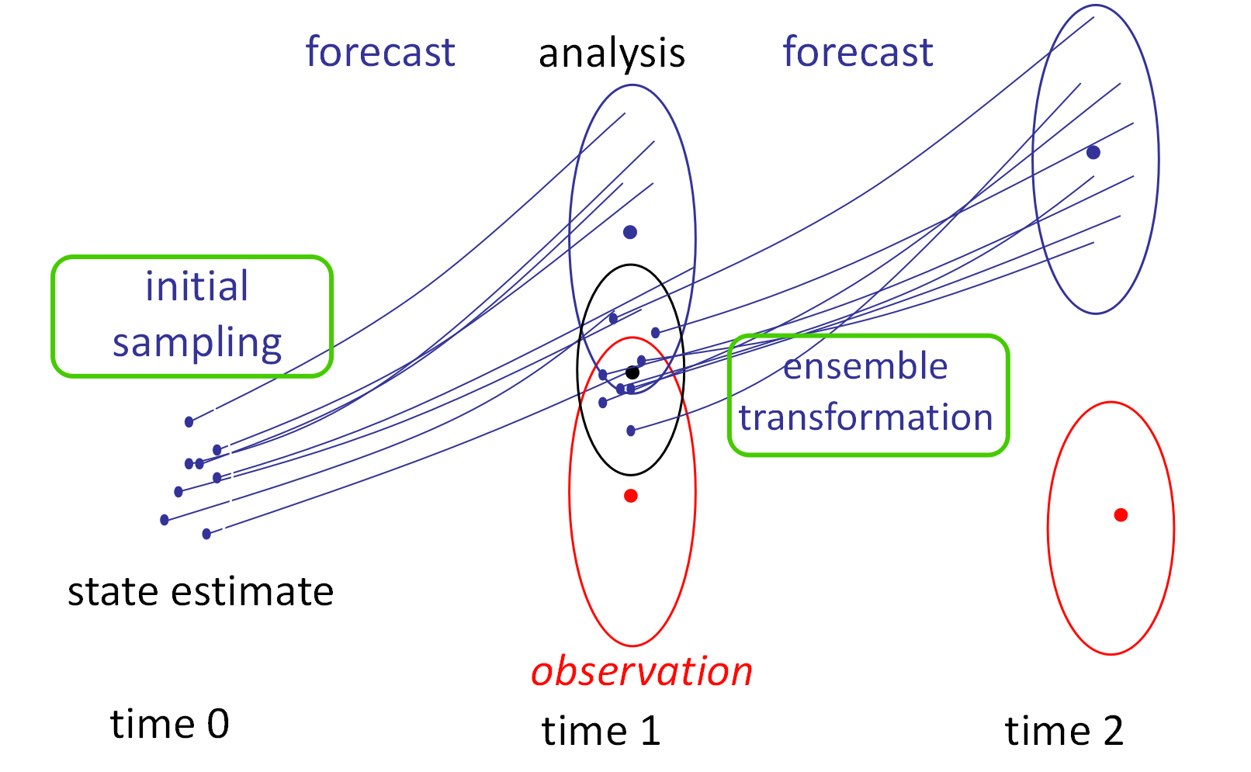
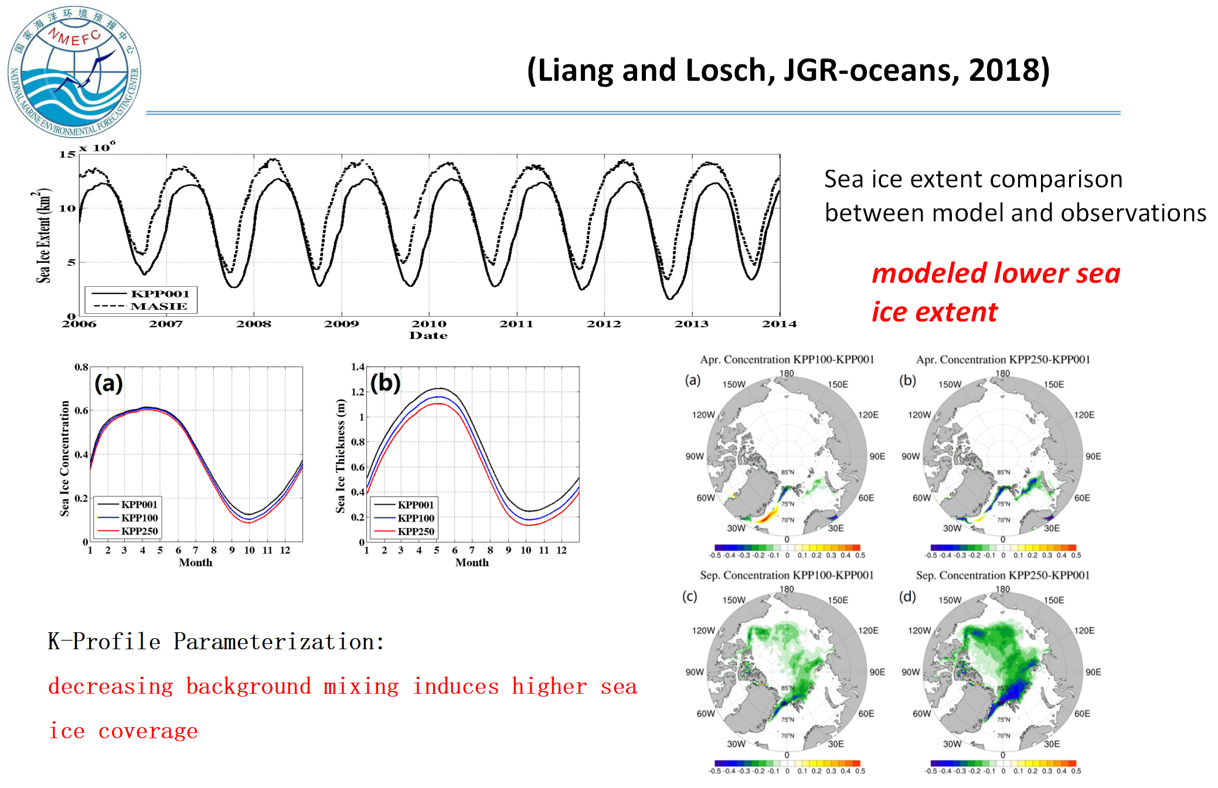
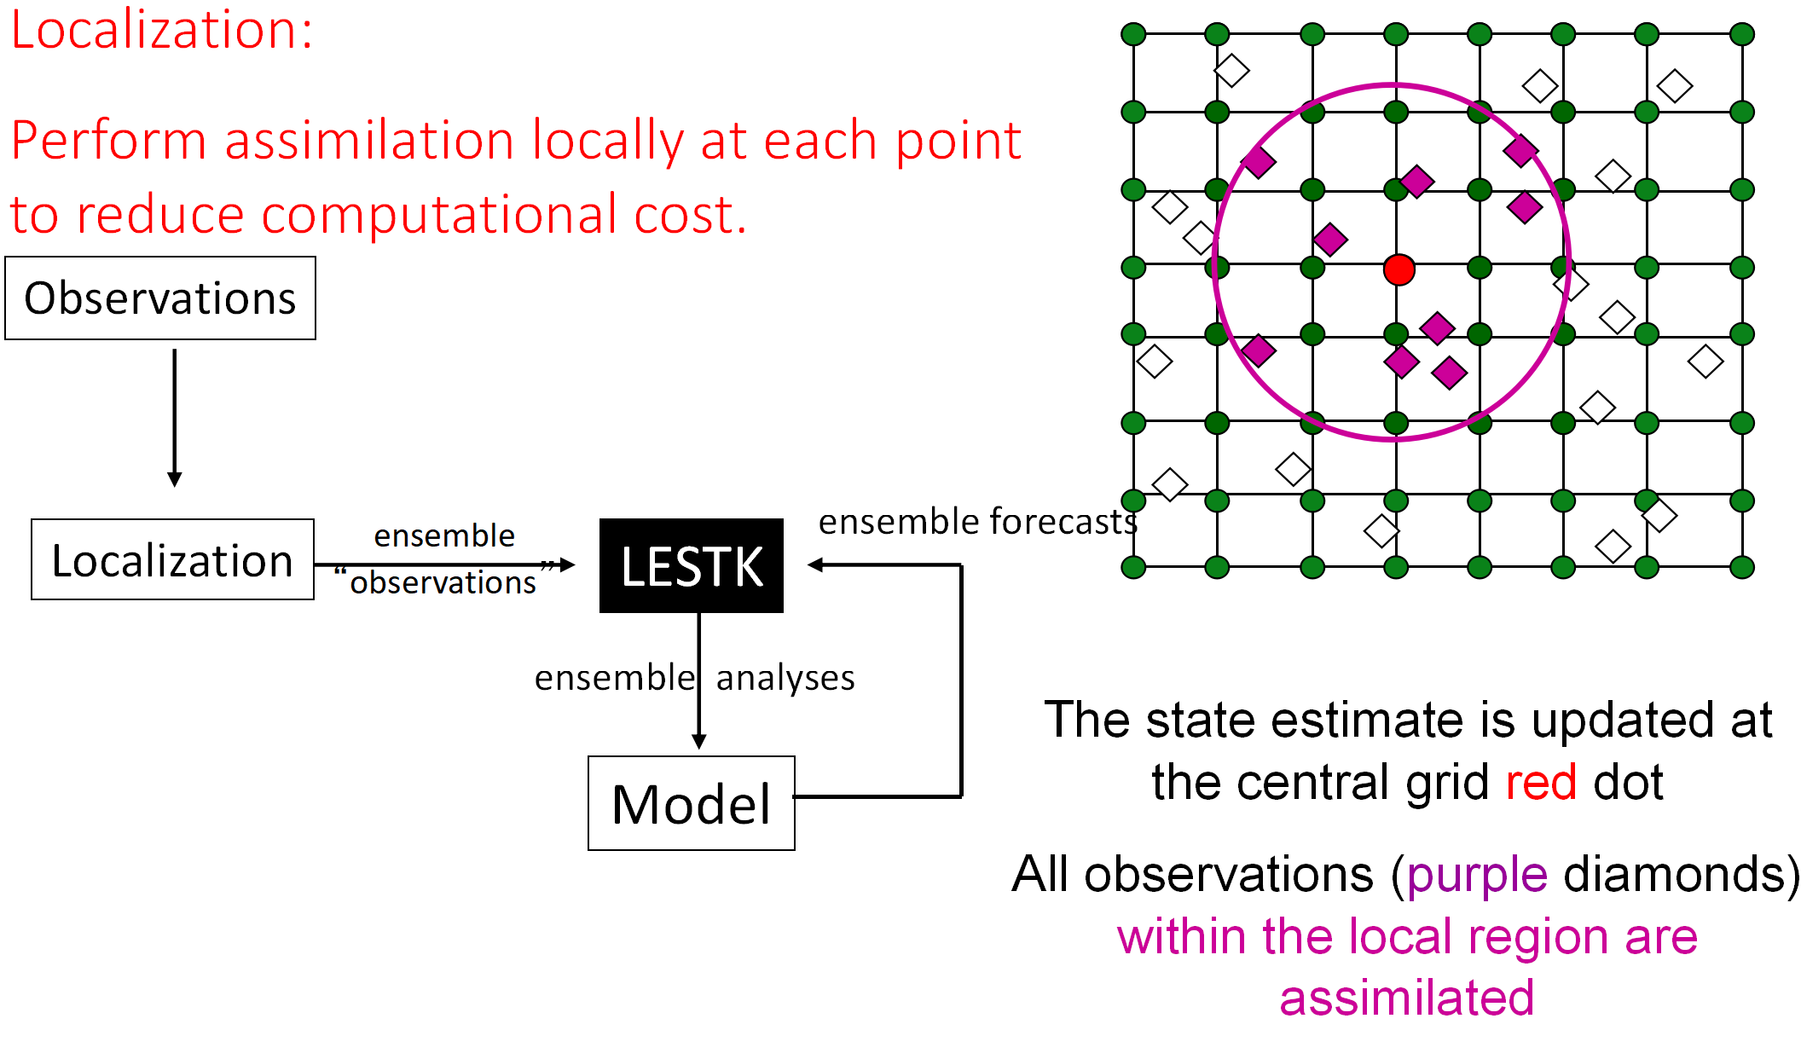
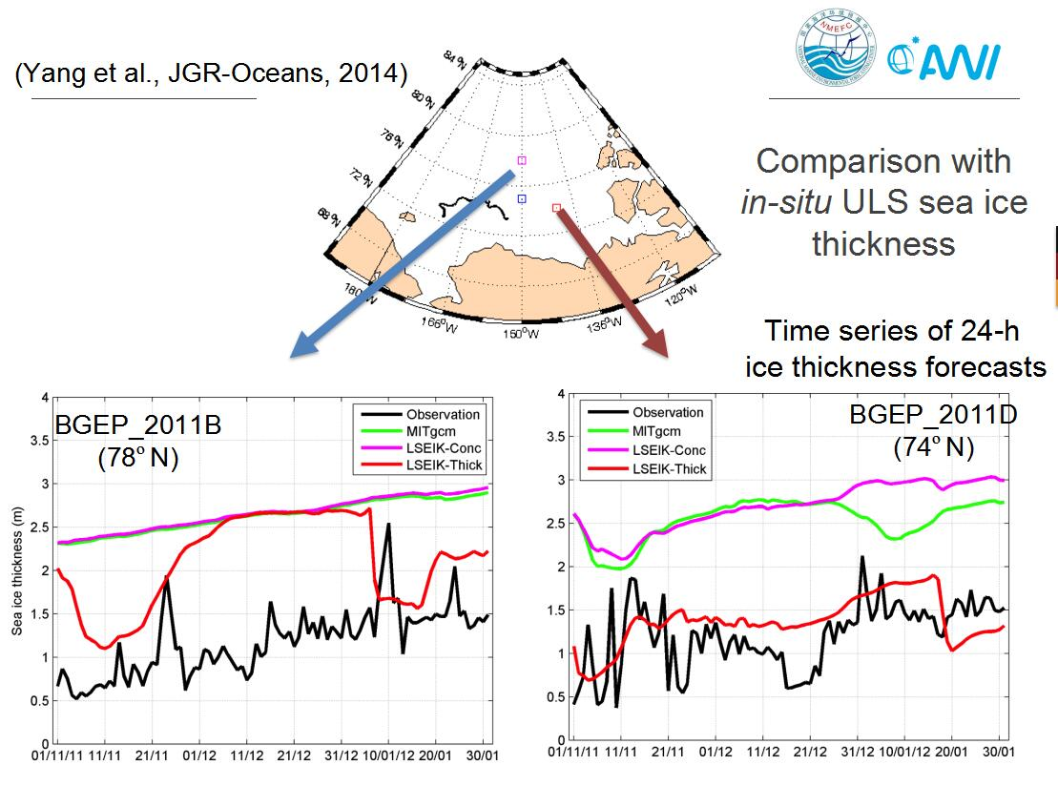
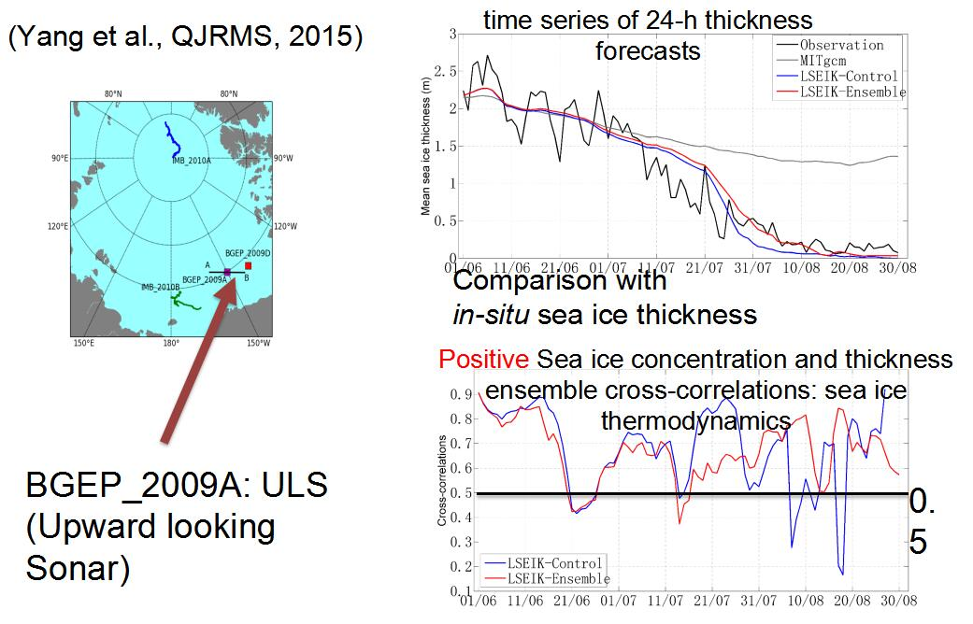
Background: Collaboration with AWI
Ensemble kalman filter
Model tunning
Localization algorithm
Sea ice concentration+thickness DA test
Sea ice concentration DA test

Slide 5
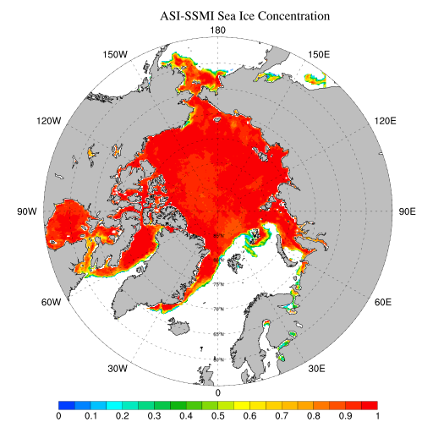
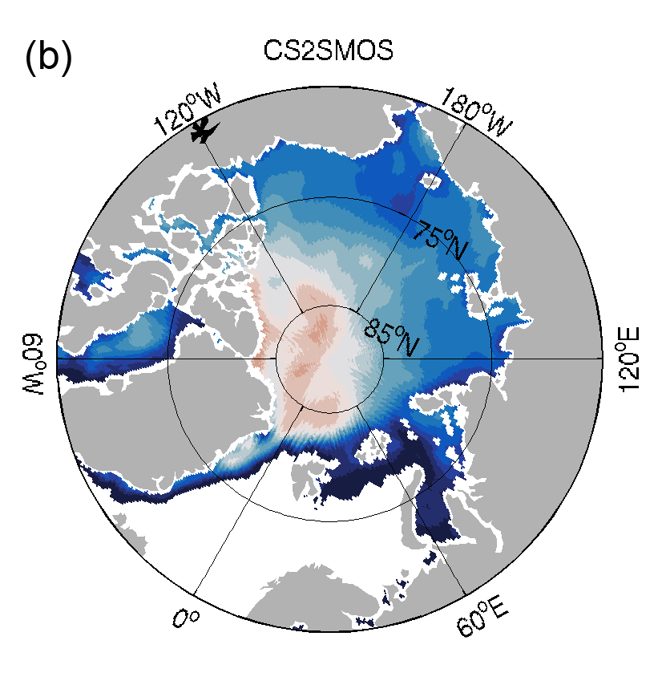
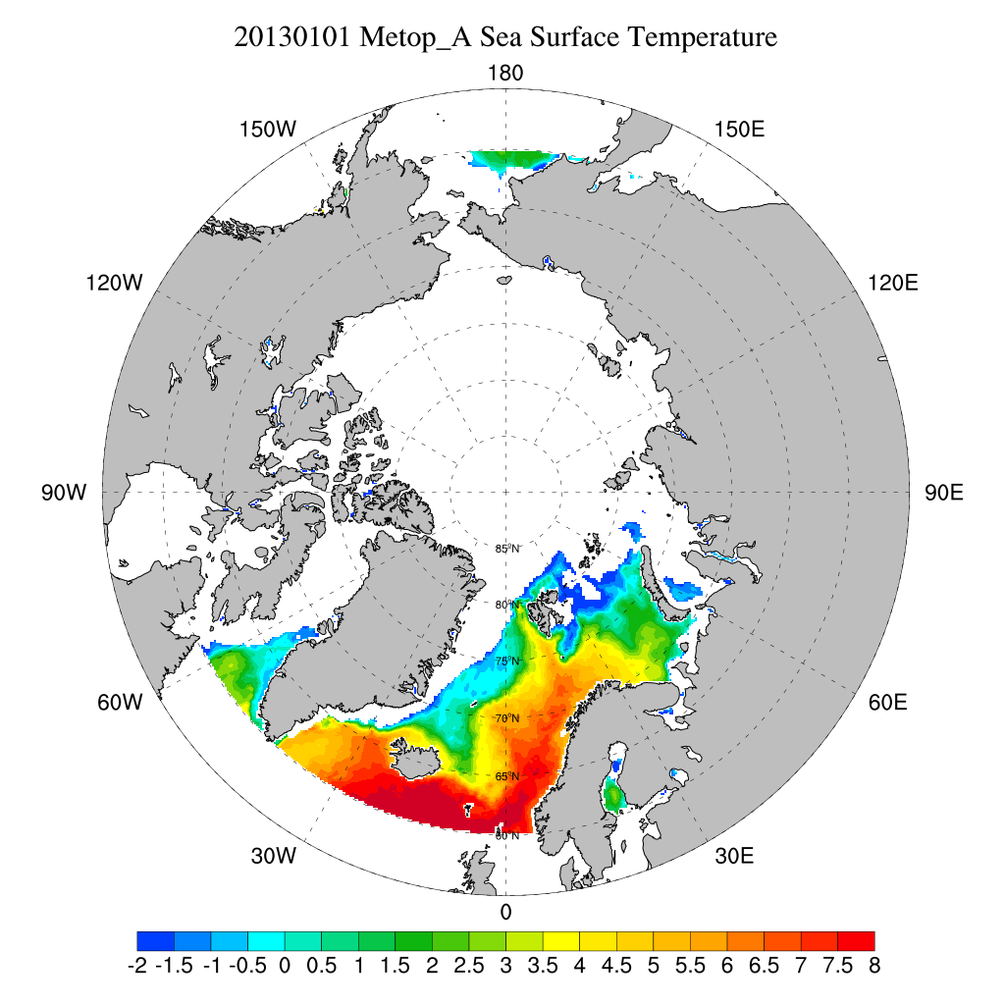
Background: ArcIOPS v1.0 (2017-2019)
AMSR2 sea ice concentration
Operational Service
From Aug 2017 To Jul 2019
Numerical Model: MITgcm
Horizontal Resolution: 18 km
Ensemble Size: 12
Atmospheric Forcing：NCEP GFS
DA Model: PDAF
DA part 1: using Ensemble Kalman Filter to assimilate daily AMSR2 ice concentration and weekly CS2SMOS ice thickness
DA part 2:Nudging model SST to METOP_A SST
Output:
168h
sea ice concentraton
thickness
drift
Ocean
temperature current
MITgcm
ocean
module
MITgcm
seaice
module
ArcIOPS v1.0
CS2SMOS sea ice thickness
AMSR2
CS2SMOS
METOP_A

Slide 6
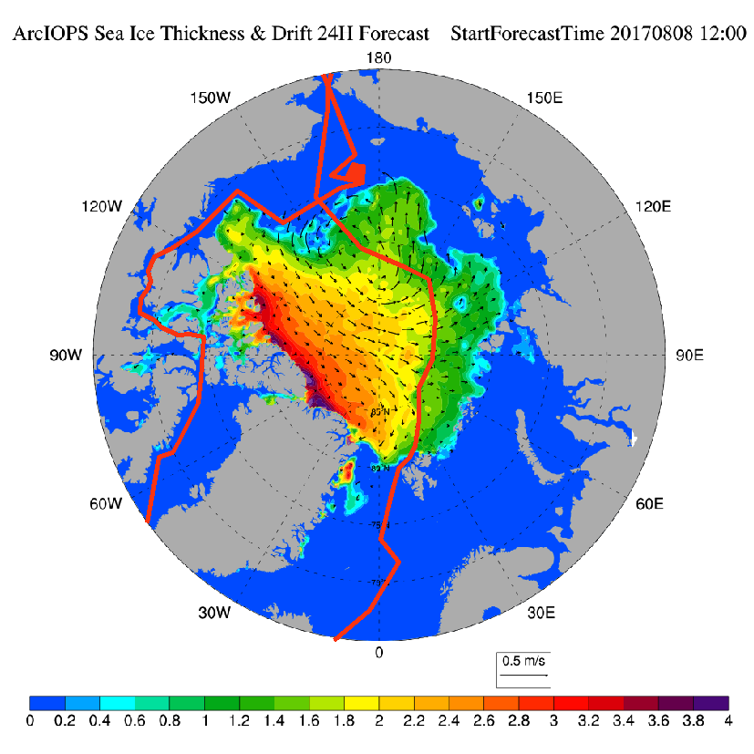
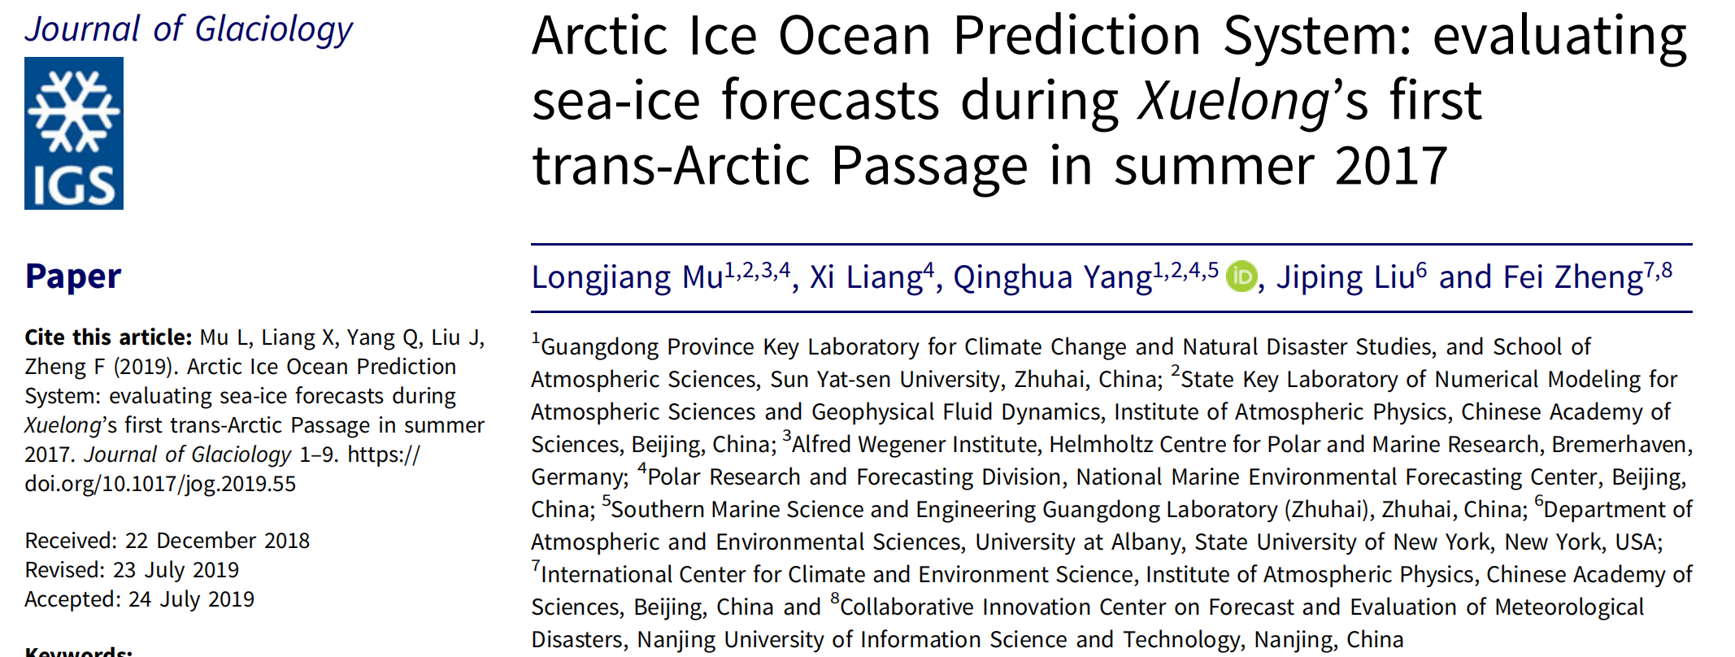
Background: Validation of sea ice forecasting products during CHINARE8
20170809 sea ice thickness forecasts
ArcIOPS v1.0 provides reliable sea ice thickness forecasts
Sea ice thickness comparison between forecasts and shipboard EM31 observations

Slide 7
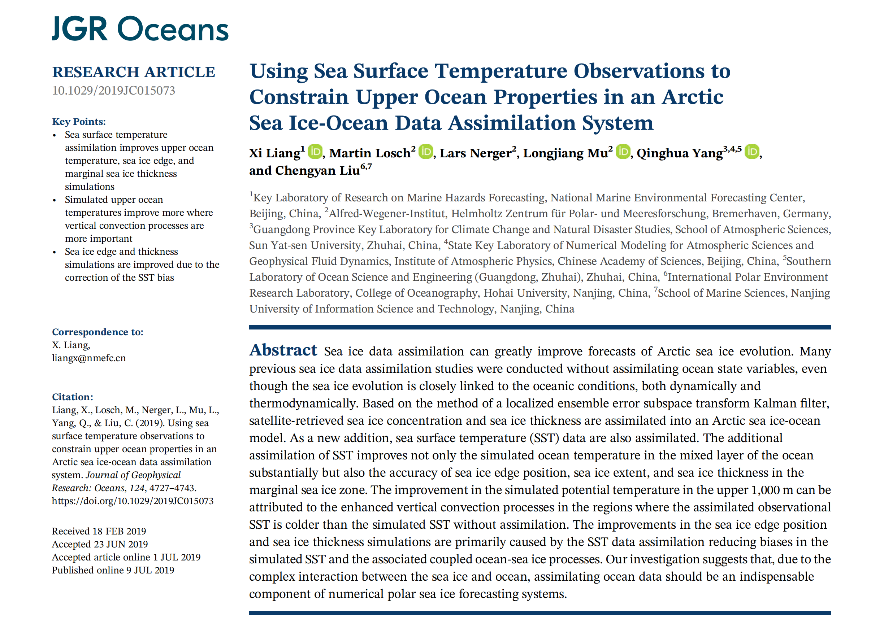
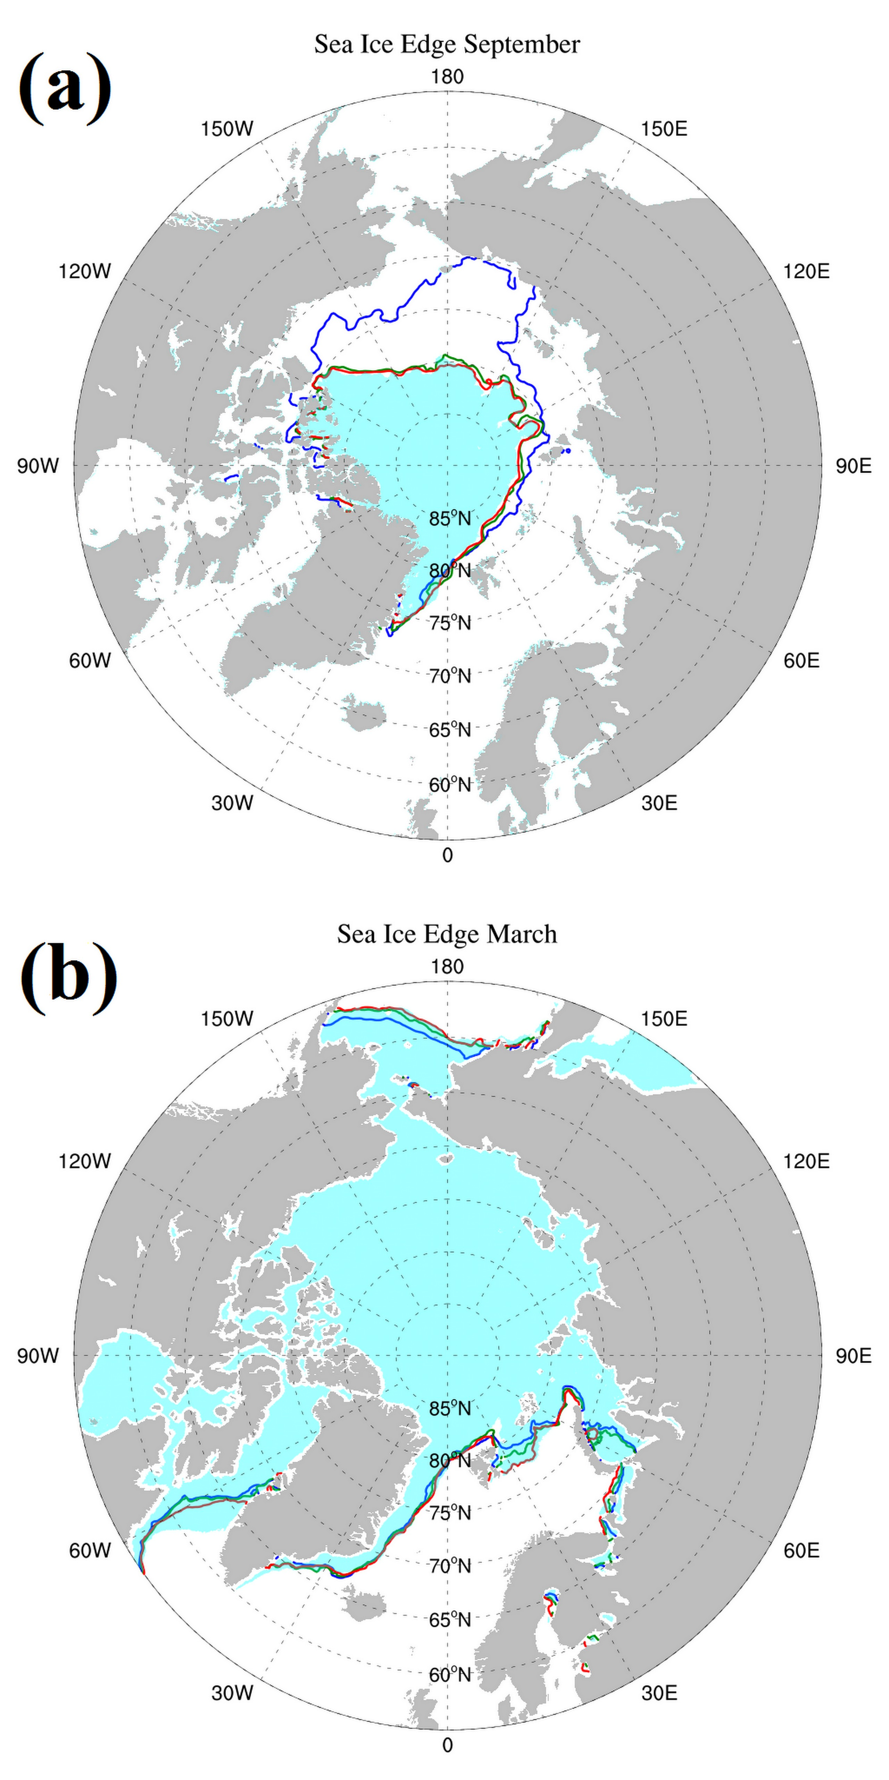
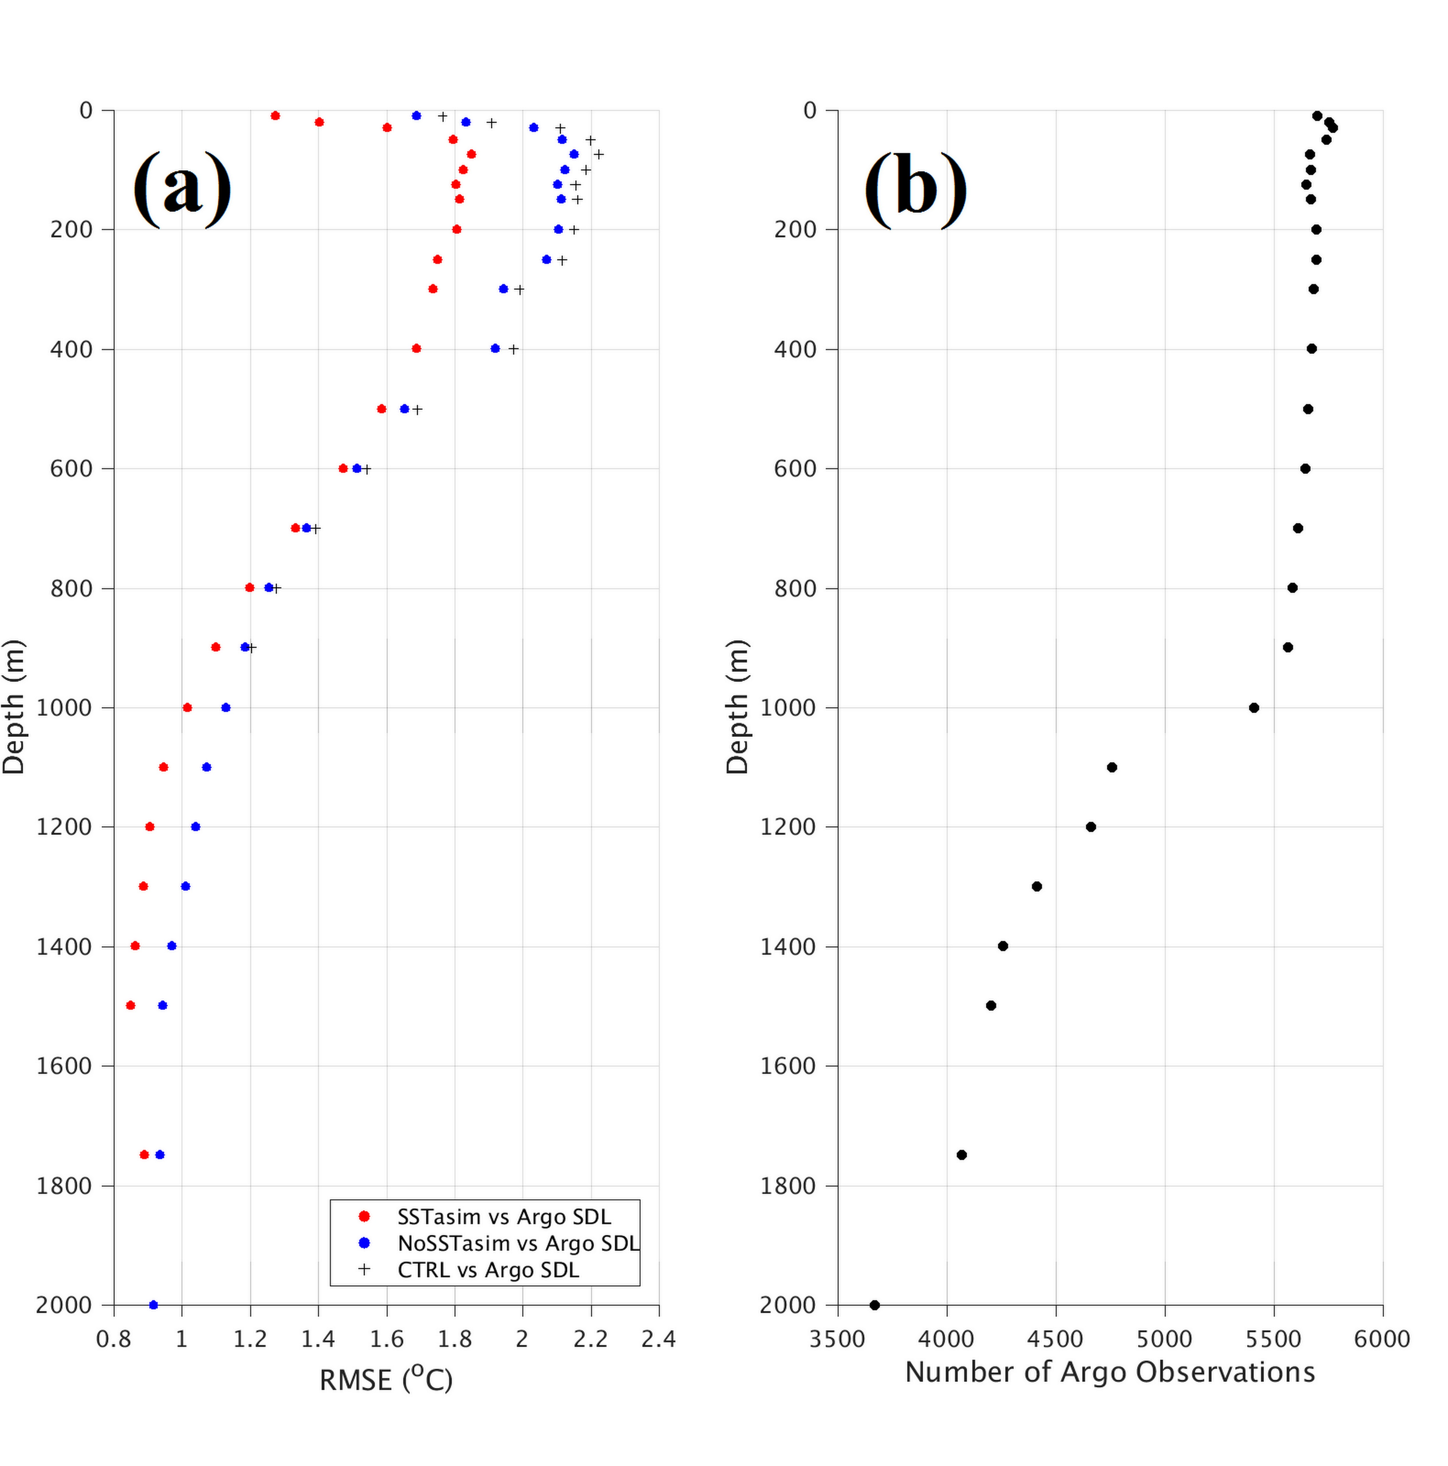
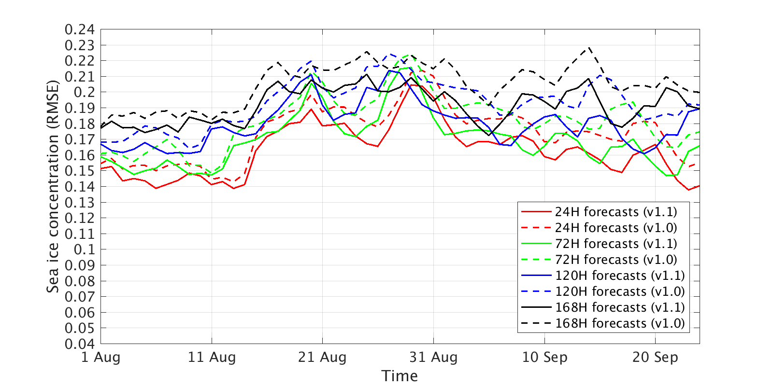
Task 1：sea ice concentration-thickness-SST DA test
ArcIOPS v1.0
ArcIOPS v1.1
assimilating sea ice concentration and thickness
assimilating sea ice concentration, thickness and SST
Sea ice edge comparison between model and the AMSR2 observations
Temperature comparison between model and Argo SDL observations
Sea ice concentration forecasts are
strongly improved in ArcIOPS v1.1
1. SST assimilation improves upper ocean temperature, sea ice edge, and marginal sea ice thickness simulations.
2. Simulated upper ocean temperature improves more where vertical convection processes are more important.
3. Sea ice edge and thickness simulations are improved due to the correction of the SST bias.
(ArcIOPS v1.1) 168H forecasts (RMSE)
SIC<20% compare with OSISAF
SIT<0.36m compare with EM31
Liang et al. 2019. Advance in Polar Science. in press

Slide 8
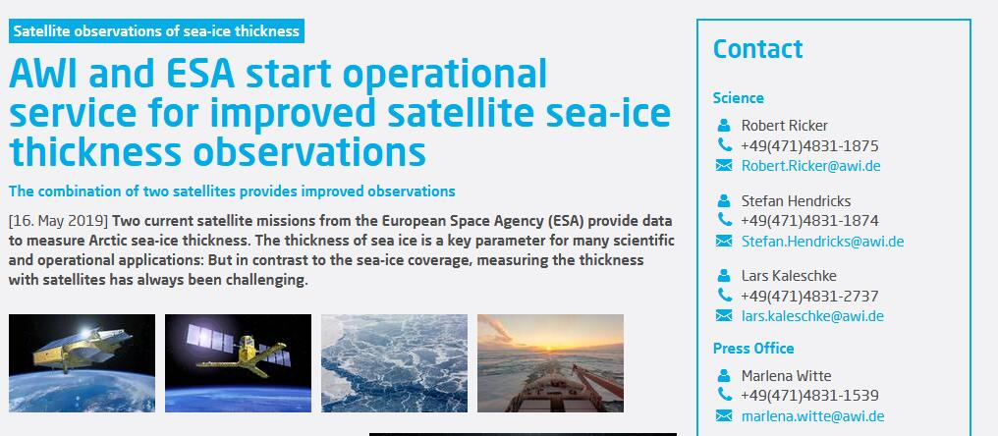
Task 2：Arctic Ice Ocean Prediction System (ArcIOPS v1.1)
AMSR2 sea ice concentration
Operational Service
From Aug 2019 To Now
Main Updating：
1、LESTKF based daily AMSR2 ice concentration-weekly CS2SMOS ice thickness-GMPE SST data assimilation
2、Localization radius increases from 126 km to 216 km
Output:
168h
sea ice concentraton
thickness
drift
Ocean
temperature current
LESTK
MITgcm
ocean
module
MITgcm
seaice
module
CS2SMOS
ArcIOPS v1.1
CS2SMOS sea ice thickness
AMSR2
CS2SMOS
GMPE

Slide 9
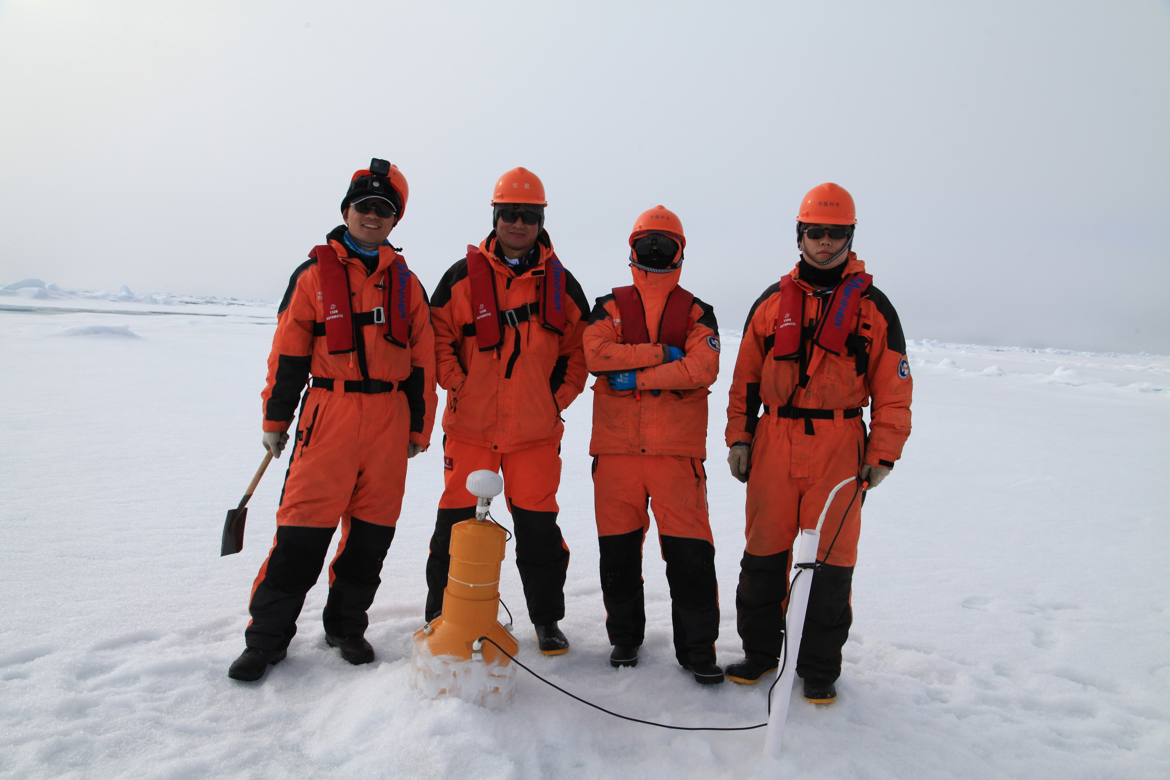
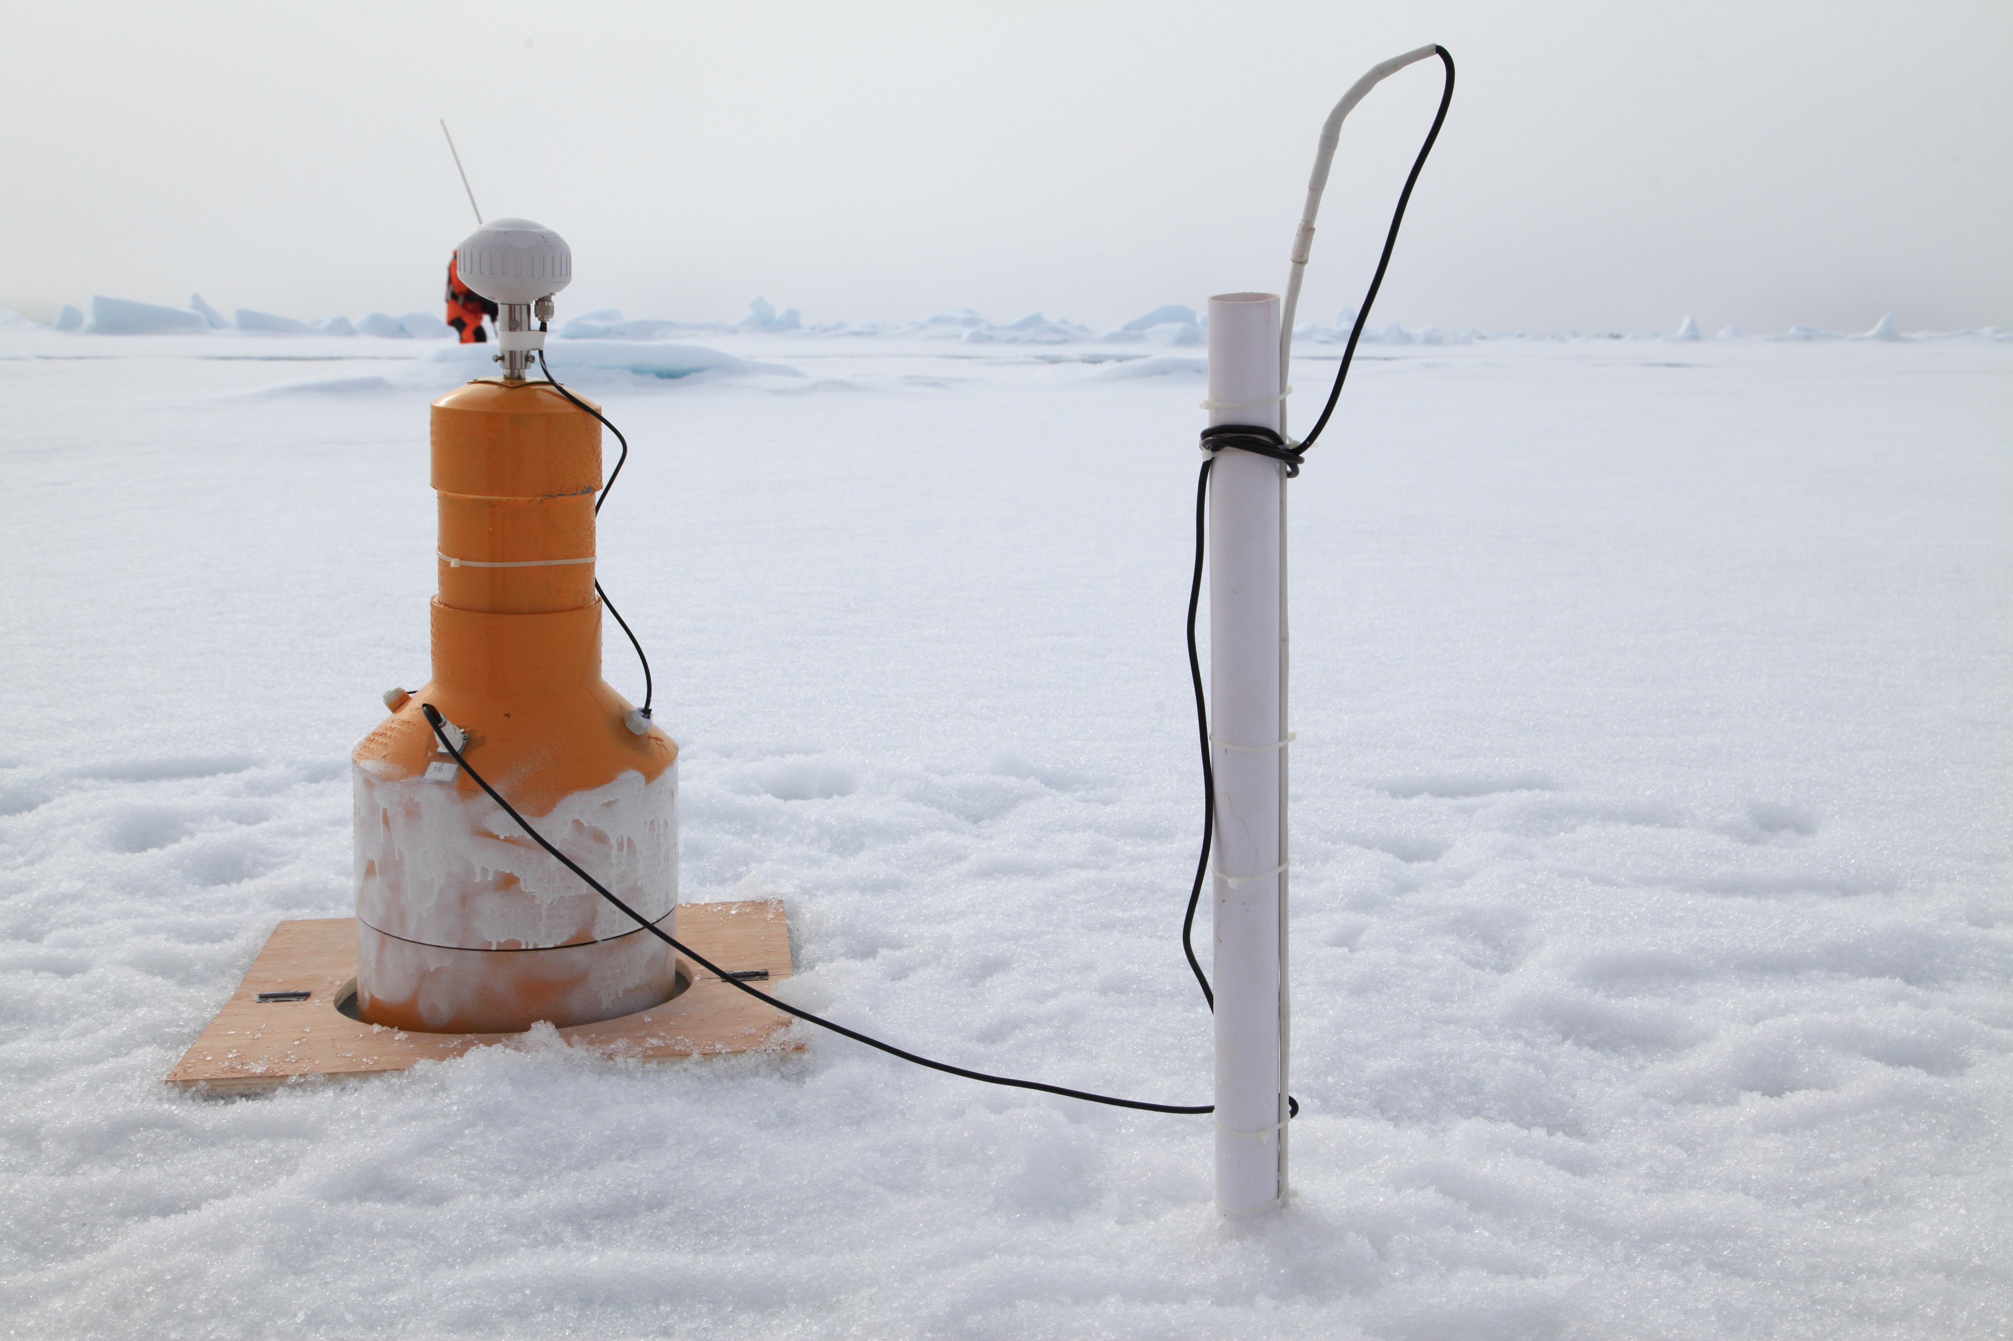
Task 3：Snow/Ice thermodynamics
CHINARE9 2018.08.10
Zhao et al., COLD REG SCI TECHNOL, 2019
Zhao et al., ANN GLACIOL, 2017

Slide 10

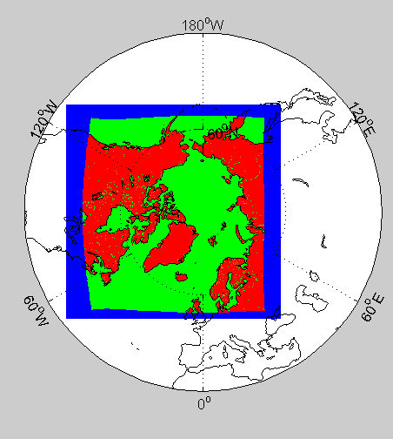


Other work: Arctic sea ice-ocean-atmosphere coupled model
Model domain: blue-PWRF
green-MITgcm
Coupler：C-coupler2
ATMOSPHERE
Polar WRF
horizontal resolution：27km
time step：120s
grid：306*306*60
Uwind, Vwind, Tair,swdown, lwdown, rain, huminity
Uwind, Vwind, Tair,swdown, lwdown, rain, huminity
Ccoupler2
SIC, SIH, snow depth, ice flag, snow precip
Ccoupler-2
SST
MITgcm:
ocean model
horizontal resolution：18km
time step：1200s
grid：420*384*50
MITgcm:
sea ice model
VP dynamics+zero-layer thermodynamics
grid：420*384
SIC, SIH, ice stress,salt flux, heat flux
MITgcm
SST, SSS, surface current,swflux
OCEAN
Sea Ice

Slide 11
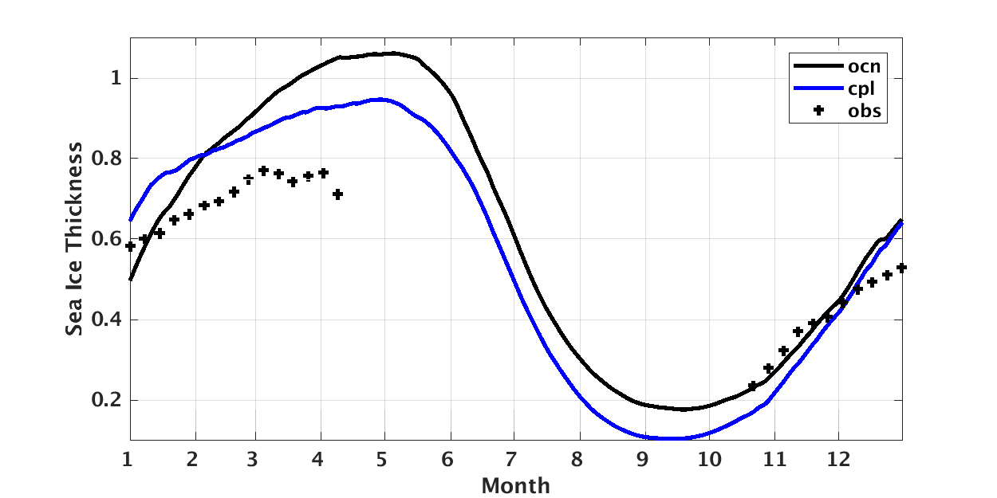
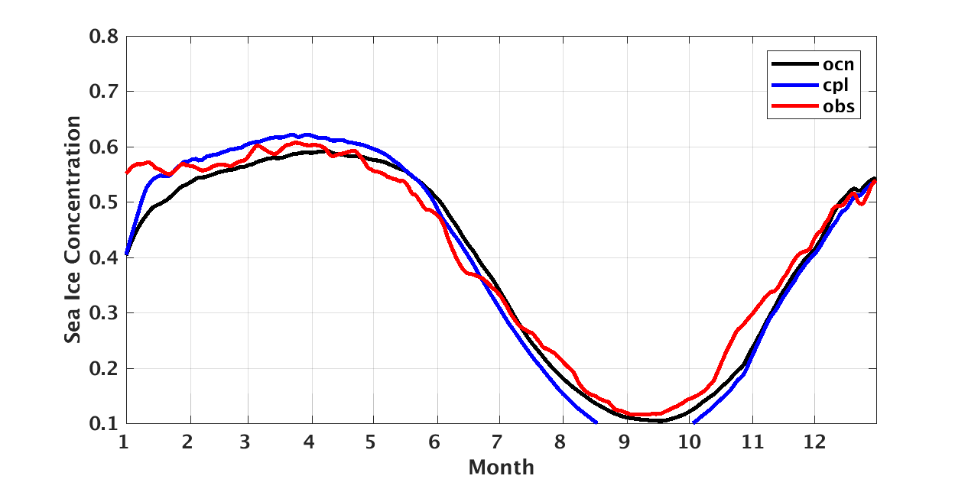
Other work: Arctic sea ice-ocean-atmosphere coupled model
Configuration Phase：
  model grids matching（Done）
  land-sea matching（Done）
  coupling flux testing（Done）
  model tunning（Doing）
  prediction system configuration（...）
2. Preliminary results（2012）:
sea ice thickness
sea ice concentration
OSISAF
CS2SMOS

Slide 12
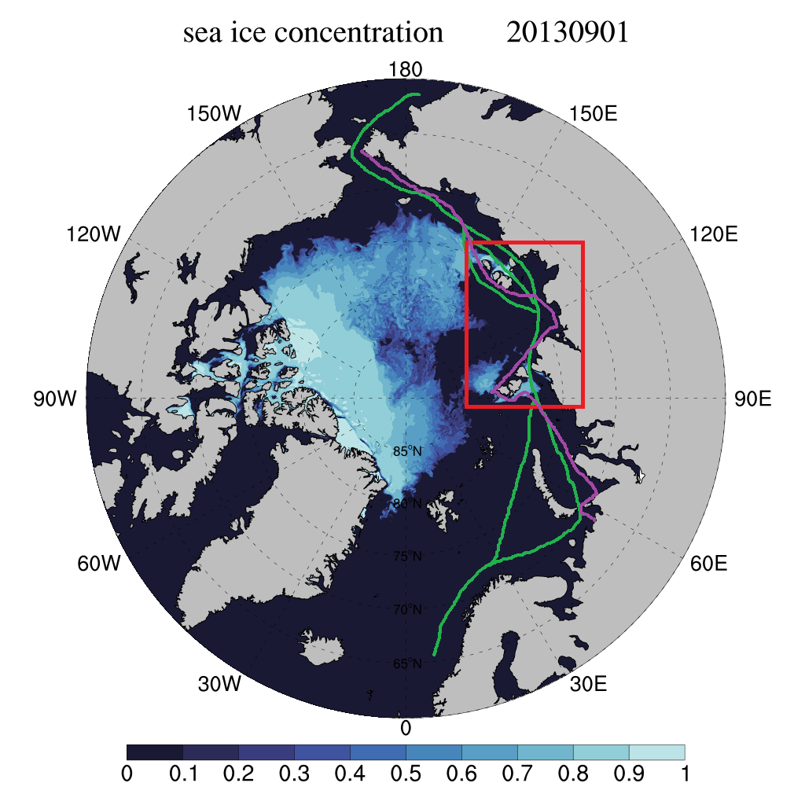
Future plans：
Arctic sea ice-ocean-atmosphere coupled prediction system，horizontal resolution: 18 km：seasonal sea ice prediction (supported by a Project of MOST)
ArcIOPS v2.0, horizontal rsolution: 4.5km: pan-Arctic synoptic sea ice forecasting (MARIS)
Laptev Sea sea ice forecasting system, horizontal resolution: 1 km：seaway synoptic sea ice forecasting (maybe supported by a Chinese-Norwegian Collaboration Project of MOST)
Integrated sea ice service from seasonal sea ice prediction, to pan-Arctic synoptic sea ice forecasting, to seaway synoptic sea ice forecasting.

