Slide 1
Timely · Accurate · Pioneering · Dedicative
For the Socio-economic Well-being
—The Mission and Activities of NMEFC
Lu Zhang

Slide 2
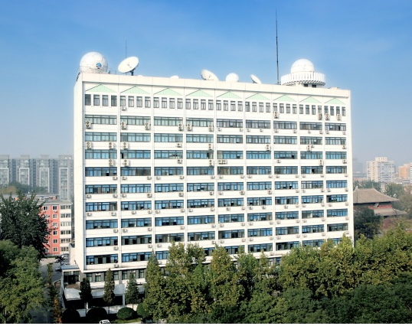
Overview
NMEFC, Chinese state-level center for ocean forecasting.
Affiliated to the Ministry of Natural Resources that receives full financial support from the Chinese government.
315 staffs.
Authorized by the State Council Academic Degrees Committee of Physical Oceanography and Meteorology to grant Master’s degrees.
Leading authority that specializes in marine environmental and disaster forecasting and warning systems, scientific research, and consulting services.
Actively engaged in partnerships with international scientists and agencies.

Slide 3
NMEFC
Marine Hazards warning Division
Marine Environmental Forecasting Division
Numerical Forecasting Division
Marine Weather Forecasting Division
Climate Prediction Division
Polar Environment Forecasting Division
Tsunami Warning Division
Network and Computing Service Division
Marine Information Management Division
Public Production Services Division
Key Laboratory of Research on Marine Hazards Forecasting
Operation divisions
Products & Service divisions
R & D division

Slide 4
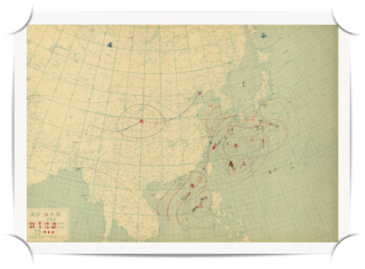
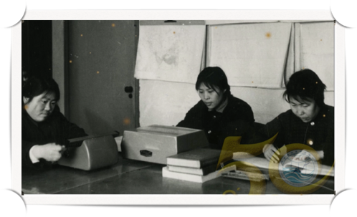
1965: established as the Marine Hydro-meteorological Forecasting General Observatory
1966: marine weather and wave forecast(China seas)
1969: sea ice forecast(Bohai Sea)
1970: tropical cyclone storm surge forecast
1972: extra-tropical storm surge forecast
1975: sea temperature forecast (East China Sea)
1983: renamed as the National Marine Environmental Forecasting Center
1986: release forecasts to public by radio and TV
1996: El Niño forecast

Slide 5
2000: numerical temperature-salinity-currents and ocean wave forecasting systems for the China Sea and Northwest Pacific Ocean
2001: red tides forecast
2002: tour and beach environment forecast
2006: tsunami forecast
2010: Establishment of Key Laboratory of Research on Marine Hazards Forecasting
2013: Establishment of Tsunami Warning Center of SOA
2013: Chinese Global Operational Oceanography Forecasting System(CGOFS)
2018: IOC/UNESCO South China Sea Tsunami Advisory Center starts its trial operation

Slide 6
Mission
To provide timely and accurate marine forecasts, warnings and services, to the government, society and industry for the socioeconomic well-being through real-time observation network, high-performance computer and operation-based research.

Slide 7
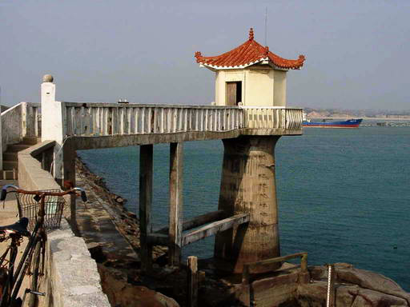
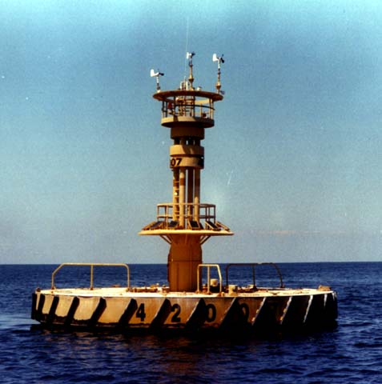
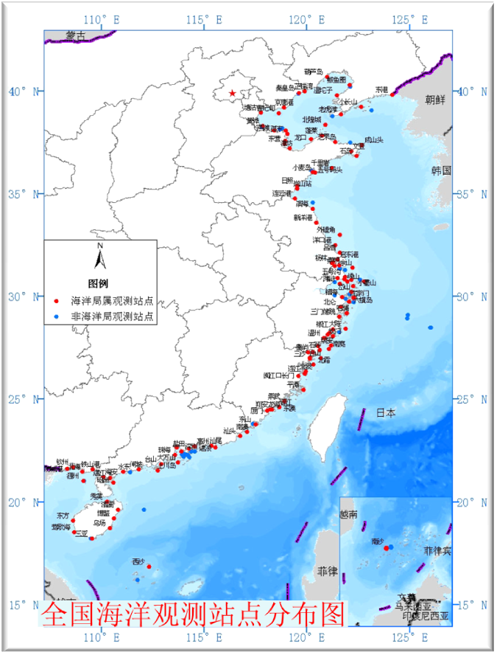
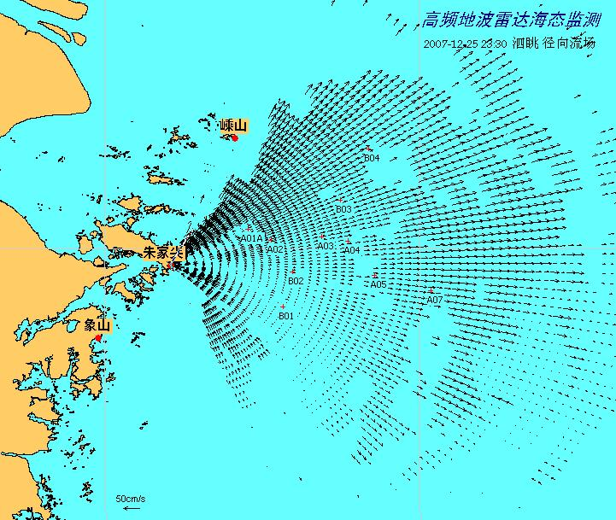
Observation
Coastal observing stations
more than 20 key marine stations, including 109 observing points:
Temperature, Salinity, Tide, Wave, Wind, Marine chemistry…
Buoys
25 large-size buoys for meteorology and wave height, temp.,
2 offshore small-size buoys；
2 Deep-sea Moorings；
4 offshore bottom-mounted moorings；
2 tsunami buoys.
Radars
5 Ground wave Radar for current, wave field;
2 X-band Marine Radar for wave field;
1 Radar Ice Sounder for Sea ice regime, thickness.
International sources
GTS, Agro,…

Slide 8
High Performance Computation Systems
Sunway Cluster
IBM Cluster
Peak Performance ~ 350 TFlops
Online Storage ~ 1000 TB
Supporting ~ 100 numerical forecast systems
Notes:
We have the high performance computation systems such as Sunway and IBM HPC cluster, total Peak Performance about 350 (teraflops), and total disk storage capacity of more than 400TB. Those HPCs support our various numerical forecast systems.
By aids of the data network and VSAT satellite communication, we can transfer realtime oceanic monitoring data and forecast products.

Slide 9
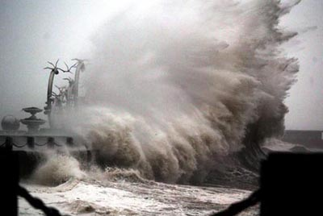
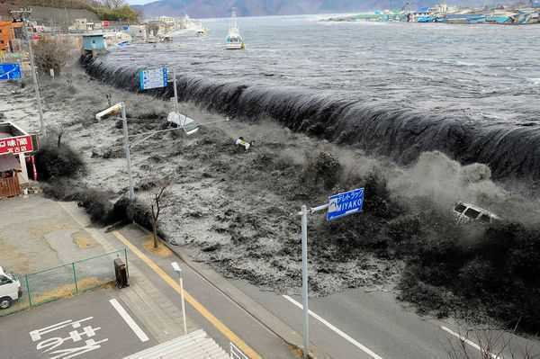
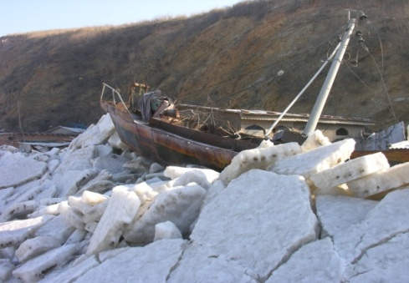
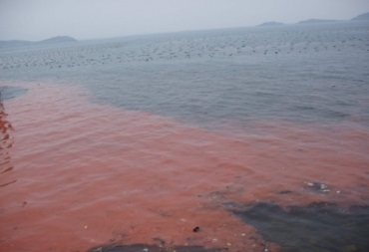
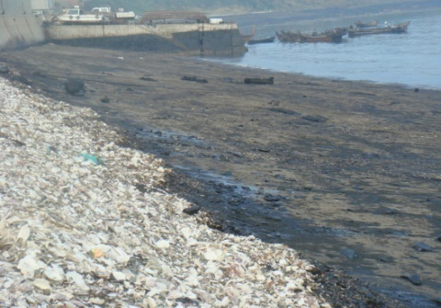
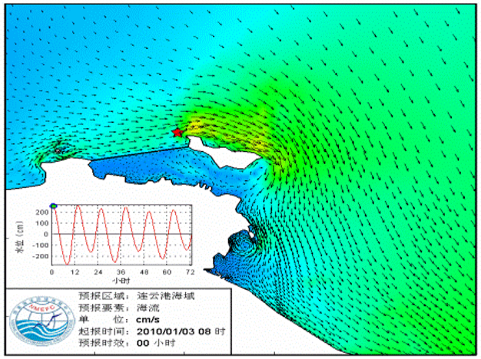
Products
Storm surge
Huge wave
temperature
tsunami
sea ice
current
marine Envi. forecast
storm surge
marine disaster warning
wave
red tide
oil spill
products
海冰
marine weather
tsunami
sea ice
emergency forecast
oil spill
current
Coastal tourism
search and rescue

Slide 10
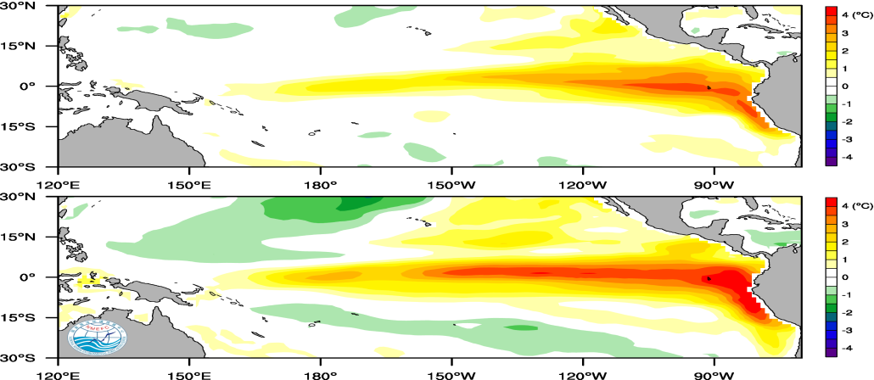
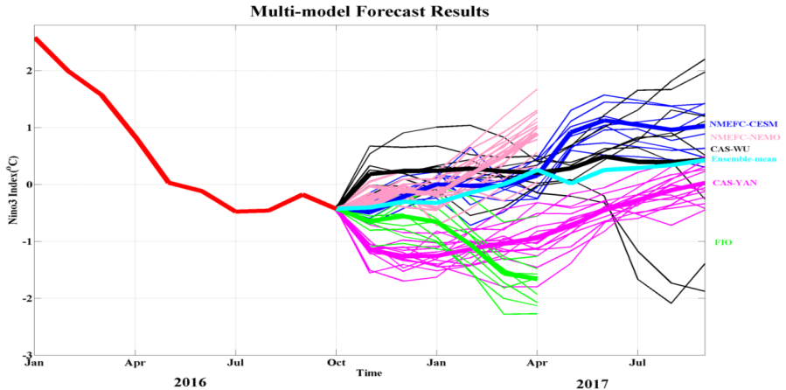
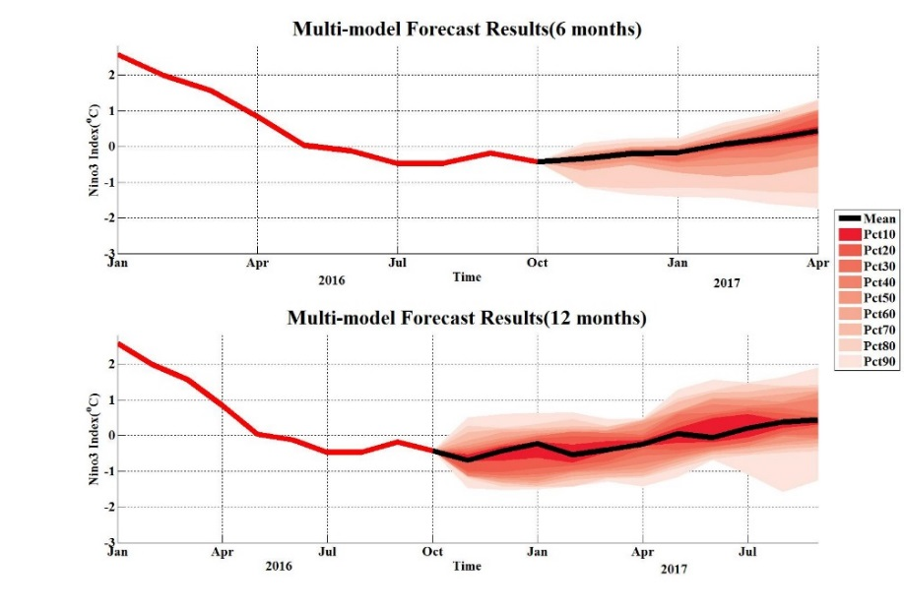
Climate Prediction
Time scale from monthly to annual
El nino dynamic and statistic prediction
Ensemble prediction using different models
SST anomaly
NINO3 index emseble prediction

Slide 11
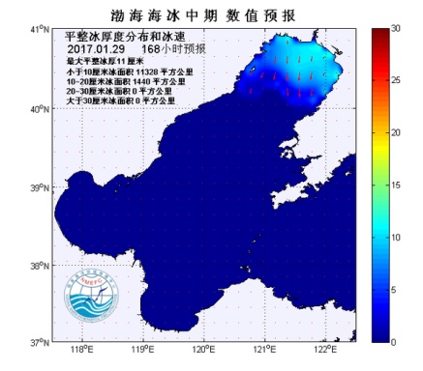
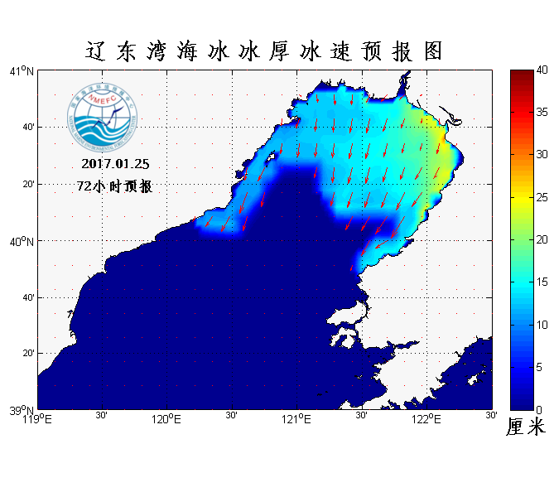
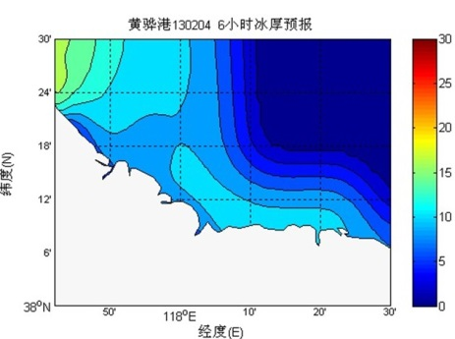
Sea Ice
High resolution Sea Ice numerical forecasting system for Bohai Sea and north of Yellow Sea
Sea ice vibration forecasting system near oil platform
New techniques including Sea ice discrete element method
Mesoscale Sea
Ice V-P Numerical
Forecast System 2.0
Small-scale
Sea Ice Numerical Forecast System 2.0
Refined
E-VP Sea Ice Numerical Forecast System 1.0

Slide 12
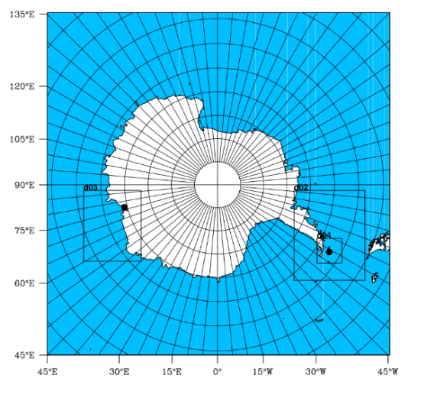
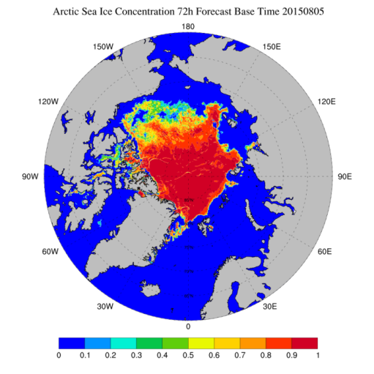
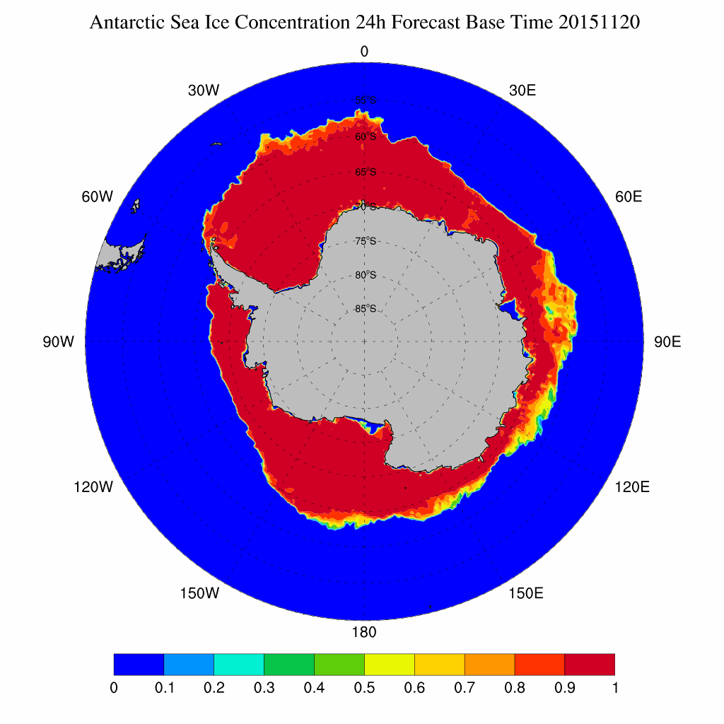
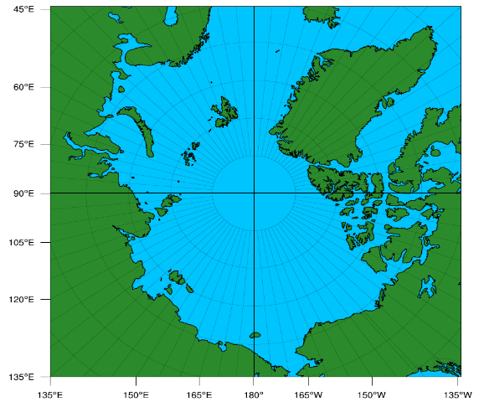
Polar Ice
Polar WRF model (30-10-3km)
MITgcm ice-ocean model (4km)
EnKF ice-ocean data assimilation (in research)
d03
d02
Arctic Antarctic
Notes:
Based on our numerical forecasts and available satellite images, we offer Arctic and Antarctic forecasting service for the Chinese Arctic and Antarctic scientific expeditions, and the Chinese Arctic commercial cruises. In particular, in summer 2016, there are 6 Chinese commercial Arctic cruises passing through the Arctic Passage, NMEFC provided successful sea ice, weather and ocean wave services for all the ships.
We run the Arctic and Antarctic numerical weather and sea ice forecasts. For the weather forecasts, we use the Polar WRF model and the Nudging data assimilation. For the sea ice-ocean operational forecasts, we use the MITgcm ice-ocean model and the nudging scheme to assimilate the sea ice concentration. A new EnKF based ice-ocean data assimilation scheme is under development, and the preliminary results show large improvement in the sea ice concentration and thickness forecasts.

Slide 13
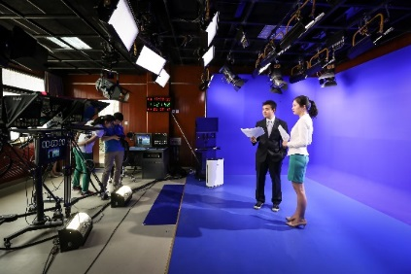
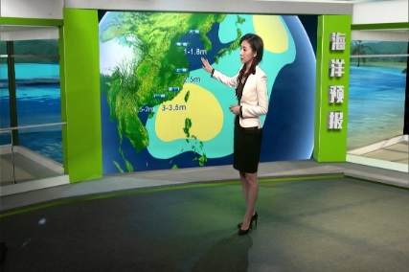
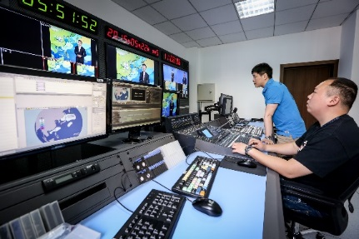
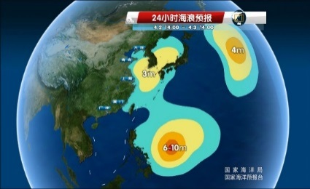
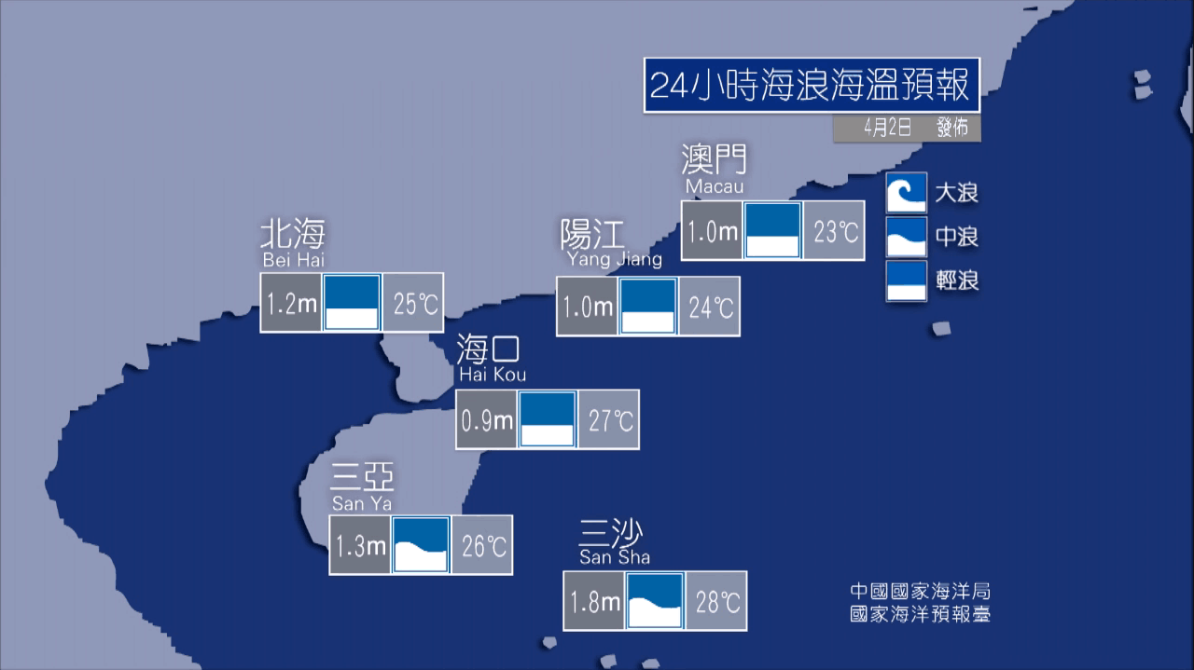
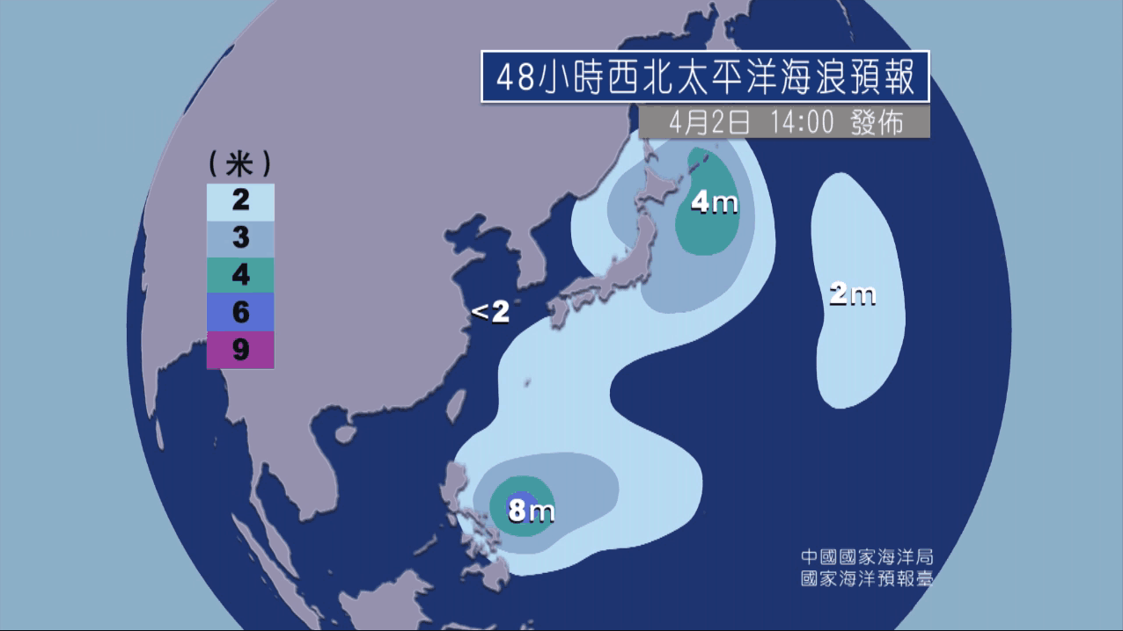
Services
Central Media, CCTV, China National Radio, China Radio International
7 programs in CCTV, CETV, Phoenix Satellite TV and the Travel Channel
Products
Dissemination

Slide 14
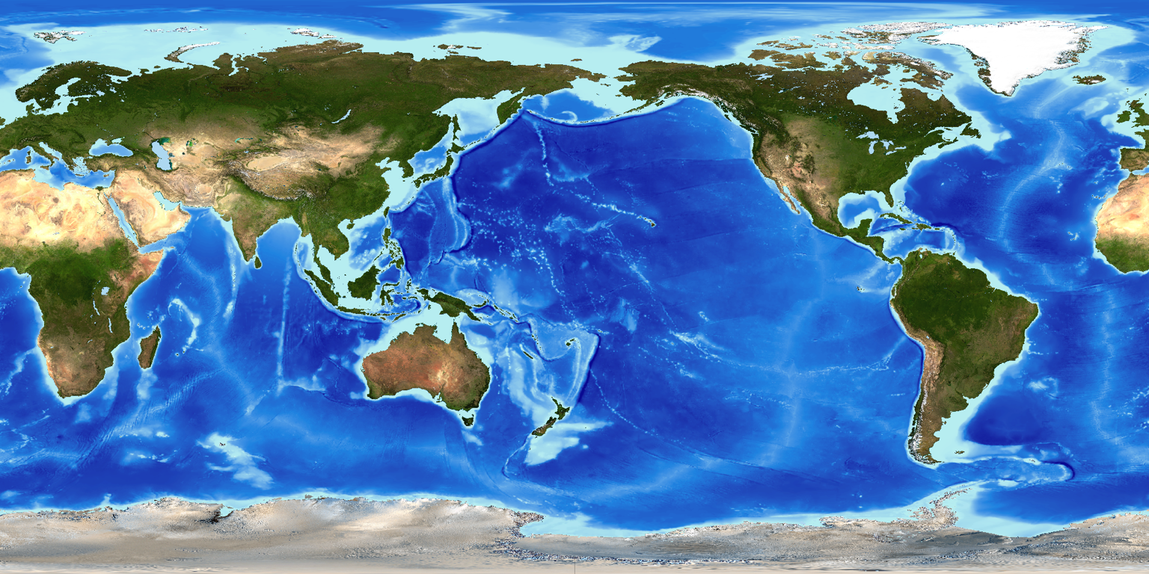
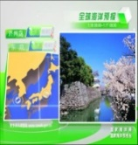
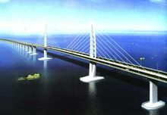
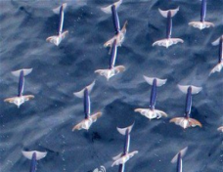
NMEFC provides services to multiple users from the government, society and industry
based on the products it produces
Arctic Expedition
Hong Kong-Zhuhai-Macao Bridge forecasts
Gulf of Aden Escort Guarantee
Radioative material monitoring in West Pacific
Global Coastal Tourist Destinations Forecasts
test guarantee of“Jiaolong”deep submersible device
Fisheries
MH370 search and rescue
Antrarctic Expedition
weather forecast in Zhongshan Station
weather forecast in Great Wall Station

Slide 15
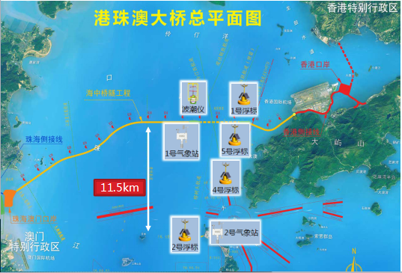
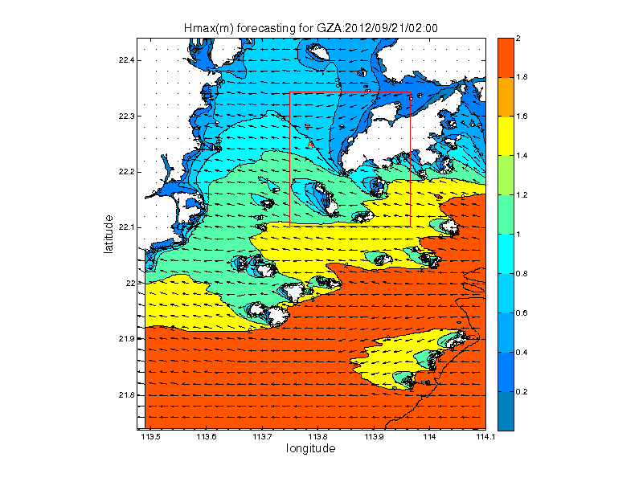
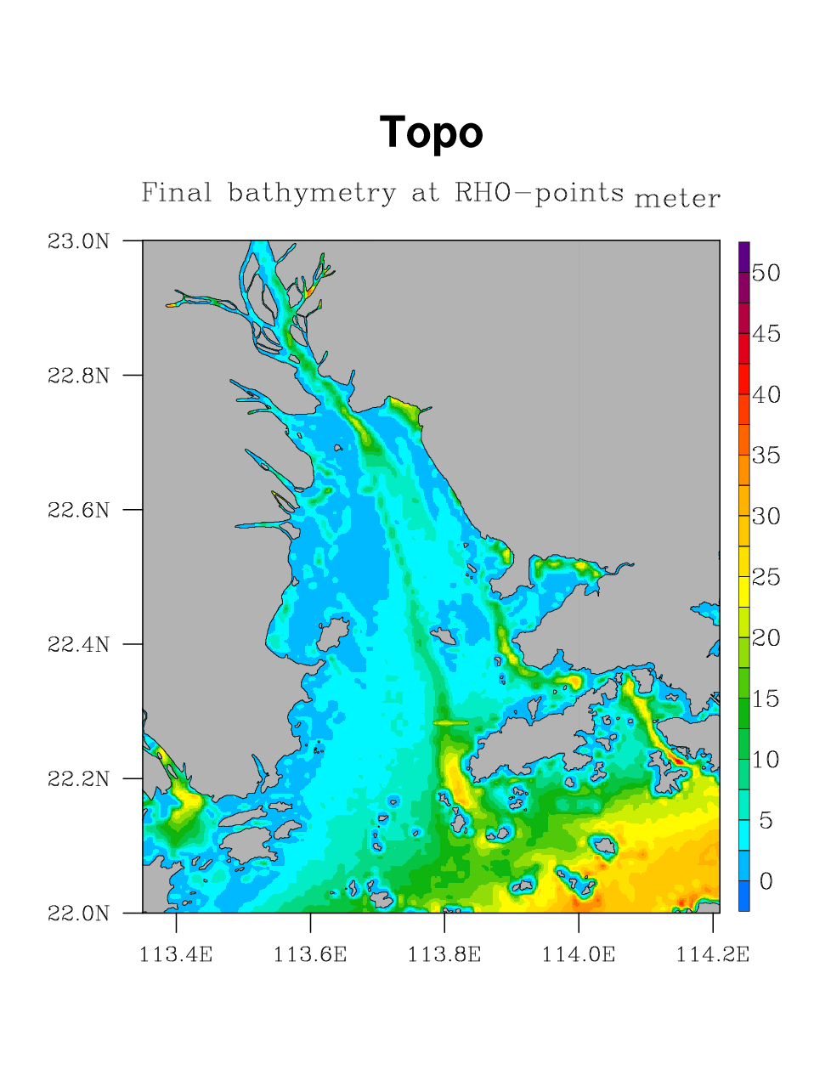
Hong Kong-Zhuhai-Macao Bridge Construction
NMEFC has been providing timely and accurate forecasting service to the bridge construction for over 6 years, and solved multiple technical challenges including the critical requirements of time-window, accuracy, and emergency response
observation
forecasting
channel
foundation trench
weather
wave
current
before one month
before 5 days
before 1 day
operation
select time window
decide time window
confirm time window
In-situ support

Slide 16
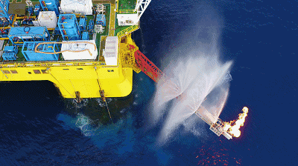
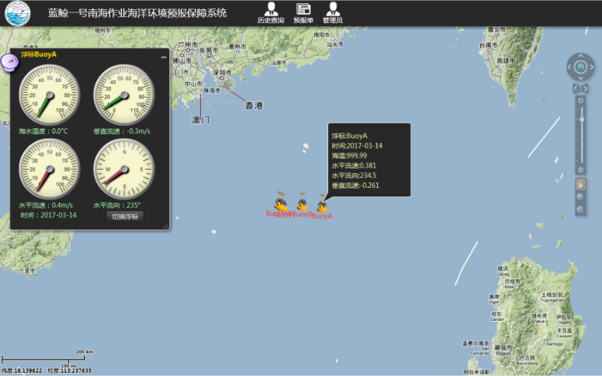
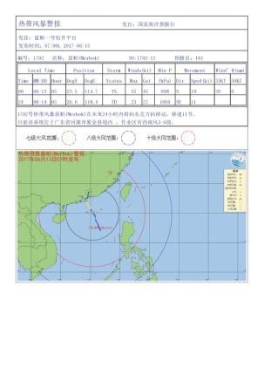
South China Sea Natural Gas Hydrate Test mining
NMEFC provided forecast products and in-situ support for the safety of the mining operation
Region:
North of SCS
inner wave, wind, surface wave, currents, temperature and density
Task：
Feb to Jul, 2017
First mining by Marine Engineering Limited Company of CNPC
Requirements：
Safty of “No.1 Blue Whale”Semi Submersible Platform
Safety of conveying pipe
Notes:
实例3，为2017年南海可燃冰试采开发，成功的提供定制化的预报服务保障，实现了连续一百天全天候的无故障预报业务化稳定运行，为蓝鲸一号在南海的可燃冰试开采成功做出了我们的贡献。

Slide 17
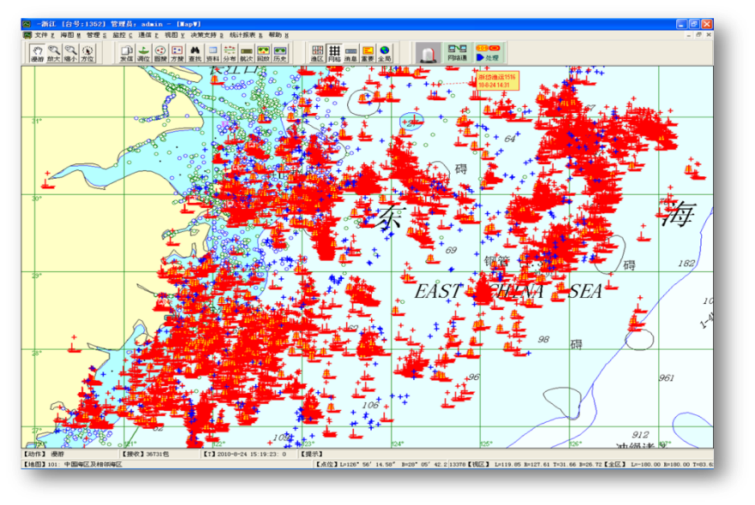
National Ocean Fishery System
NMEFC developed the national ocean fishery system to dynamically monitor and analyze the fishing boats, which started operation on June, 2012, and is providing service of wind, wave and sea ice with a 72-hrs leading time
NMEFC
NMFC
EMFC
SMFC
Liaoning
Hebei
Tianjin
Shandong
Jiangsu
Shanghai
Zhejiang
fujian
Guangdong
Guangxi
Hainan

Slide 18
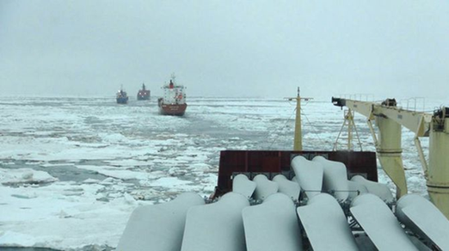
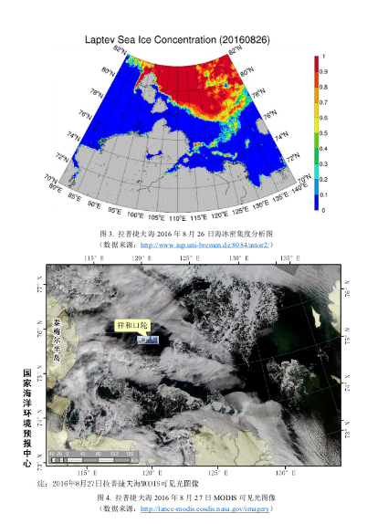
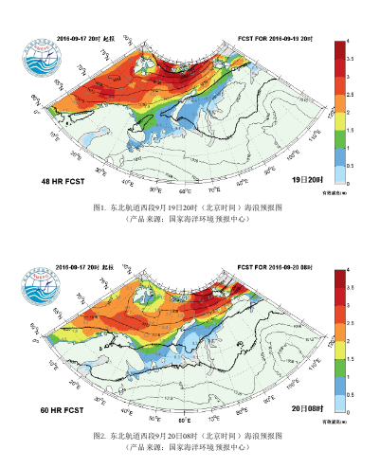
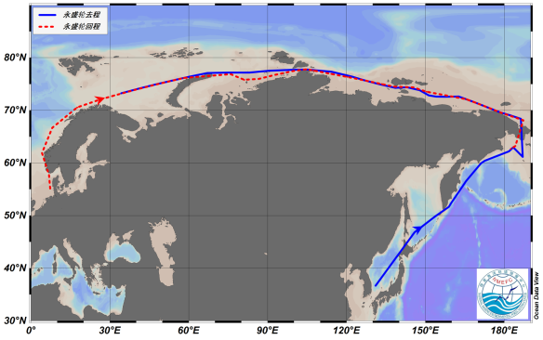
Arctic and Antarctic scientific expeditions
Based on numerical forecasts and satellite images, NMEFC provides forecasting service for the Chinese Arctic and Antarctic scientific expeditions, and the Chinese Arctic commercial cruises. In summer 2016, there are 6 Chinese commercial Arctic cruises passing through the Arctic Passage, NMEFC provided successful sea ice, weather and ocean wave services for all the cruise.

Slide 19
Future
Plan
Smart Forecast
Gridded forecasts
ONE grid for the Global Ocean
ONE grid for the China Seas
Using Artificial Intelligence
to produce warning & nowcasts
Fine forecast
for coastal waters
Independent
Observation database
Future
Needs
Independent Forecast
Independent
Numerical models
Independent
High-performance computing resources

Slide 20
Timely · Accurate · Pioneering · Dedicative
Thanks for Your Attention!
National Marine Environmental Forecasting Center/Tsunami Warning Center
Ministry of Natural Resources,
People’s Republic of China

