Slide 1

Towards an INTAROS Roadmap Sea Ice
Georg Heygster and Gunnar Spreen
Institute of Environmental Physics, University of Bremen
INTAROS Steering Committee Meeting
E-meeting May 27, 2020

Slide 2
Current and future satellite observations
(new or improved parameter or continued with new sensor)
Passive microwave sensors: AMSR2 SSMIS, AMSR3, CIMR
  Sea ice concentration INTAROS contribution
  Sea ice type (also use scatterometer)
  Thickness of thin sea ice
  Snow depth on sea ice
  Sea ice drift
Optical sensors: MODIS, Sentinel-3A, -3B, various high res sensors
  Melt pond fraction
  Snow grain size
SAR: Sentinel-1A…D, COSMO-SkyMed (4 satellites), Radarsat-2, +…
  Sea ice maps, classification
  Altimeter: Cryosat-2 (microwave), IceSAT-2 (optical),
  CRISTAL, a two-frequency SAR Radar Altimeter with capability of interferometry
  SI thickness; land ice elevation

Slide 3
Planned evolution of satellite observations
Passive microwave
AMSR2: 2012-date, 6.9 – 89 GHz, nominal life the 5 yr
AMSR3: approved 2019, critical design 2020, launch planned JFY 2023.
3 new channels 166, 183+-3 and 183+- 7 GHz (G band).
Orbit 666 km, sun synchronous 13.30 ECT (not A-Train member)
CIMR 1.4-36 GHz, 7m antenna reflector →
  SI Concentration at high resolution (5 km) and high accuracy 5 %)
  Thickness of thin SI
Optical: Sentinel-2, -3A, 3B, various high res sensors
SAR Sentinel-1A (2014), B (2016), C, D continuation,
COSMO-SkyMed Second Generation (2 sat.)
Altimeters
  Cryosat-2 (microwave), IceSAT-2 (optical)

Slide 4
Planned evolution of satellite observations
Passive microwave
AMSR2: 2012-date, 6.9 – 89 GHz, nominal life the 5 yr
AMSR3: approved 2019, critical design 2020, launch planned JFY 2023.
3 new channels 166, 183+-3 and 183+- 7 GHz (G band).
Orbit 666 km, sun synchronous 13.30 ECT (not A-Train member)
CIMR 1.4-36 GHz, 7m antenna reflector →
  SI Concentration at high resolution (5 km) and high accuracy (5 %)
  Thickness of thin SI
Optical: Sentinel-2, -3A, 3B, various high res sensors
SAR Sentinel-1A (2014), B (2016), C, D continuation,
COSMO-SkyMed Second Generation (2 sat.)
Altimeters
  Cryosat-2 (microwave), IceSAT-2 (optical)

Slide 5
Consequences: Requirements for Field Observations
For calibration and validation (initial and continued) of
retrievals of new parameters
and of new sensor
Required in situ observations:
Snow depth on sea ice
Sea ice thickness
Sea ice type
Variability of sea ice properties in summer:
  microwave emissivity,
  optical reflectivity (BRDF)
Atmosphere above sea ice, required to correct microwave observations:
  Integrated water vapor,
  cloud liquid water path.
Ideal: more MOSAiC-scale campaigns….
Buys deployed in situ

Slide 6
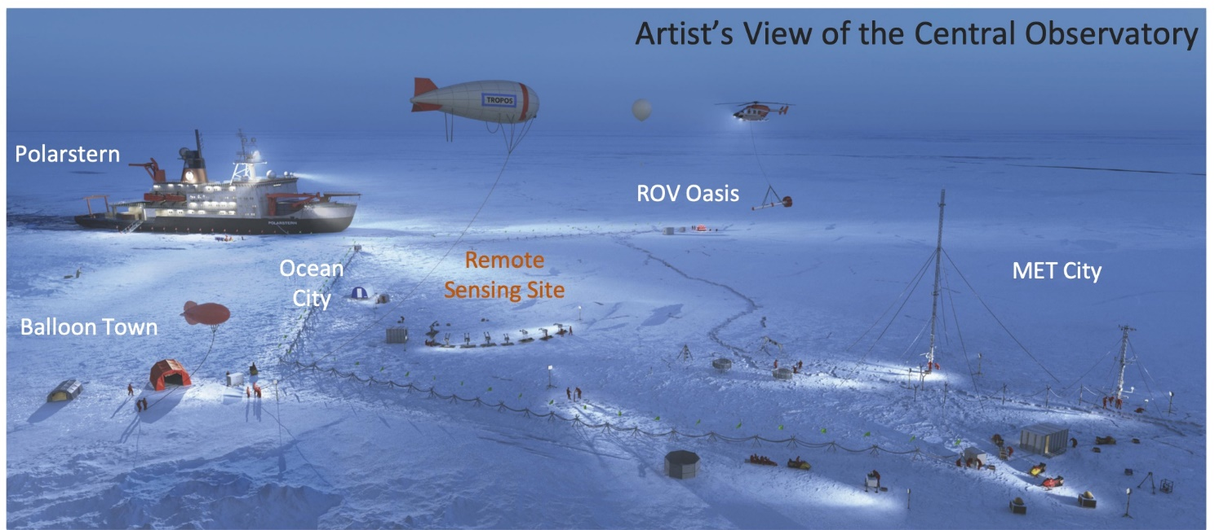
MOSAiC Experiments Overview
MOSAiC:
Comprehensive
collection
for one full year of
  atmosphere,
  ocean,
  sea ice and snow,
  ecology, and
  biogeochemistry
Second MOSAiC unlikely
Dedicated remote sensing validation experiments often missing in field campaigns
Which observations can be done better than in MOSAiC?
What is missing?
GEO info graphic: Tim Wehrmann; GEO magazine 03/2020
MOSAiC Central Observatory

Slide 7
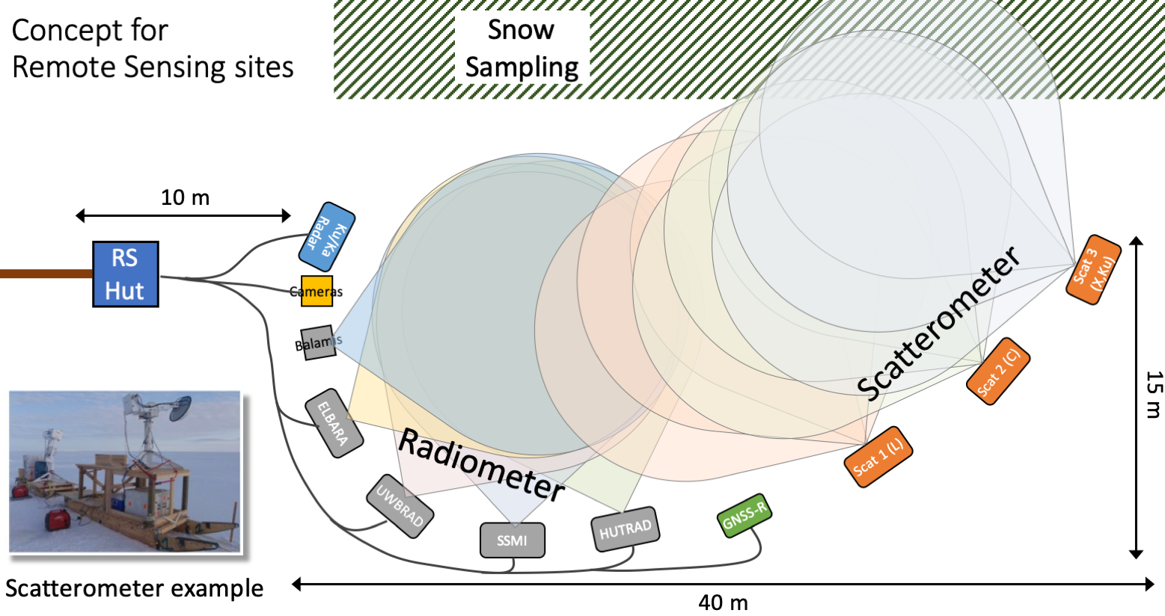
MOASiC Remote Sensing Site Concept
All instruments looking
at similar ice and snow
→ comparability
Mounted on sledges
→ flexible to move site
Accompanied by ice
and snow physics
measurements
Airborne helicopter
measurements to
bridge scales:
Laser scanner,
IR camera, hyperspectral camera, EM ice thickness sounding
Goal: better understand microwave emission and scattering of ice and snow: seasonal cycle, melt – refreeze → improve EM forward models

Slide 8
Validation of remote sensing data with field measurements
  MOSAiC provides ideal conditions for validation of satellite remote sensing observations:
    Is a rare case to observe the complete seasonal cycle including winter.
    The MOSAiC distributed grid of measurements covers the typical satellite footprint scales.
    The helicopter/aircraft campaigns will allow to bridge the scale gap between in situ and satellite observations.

Slide 9
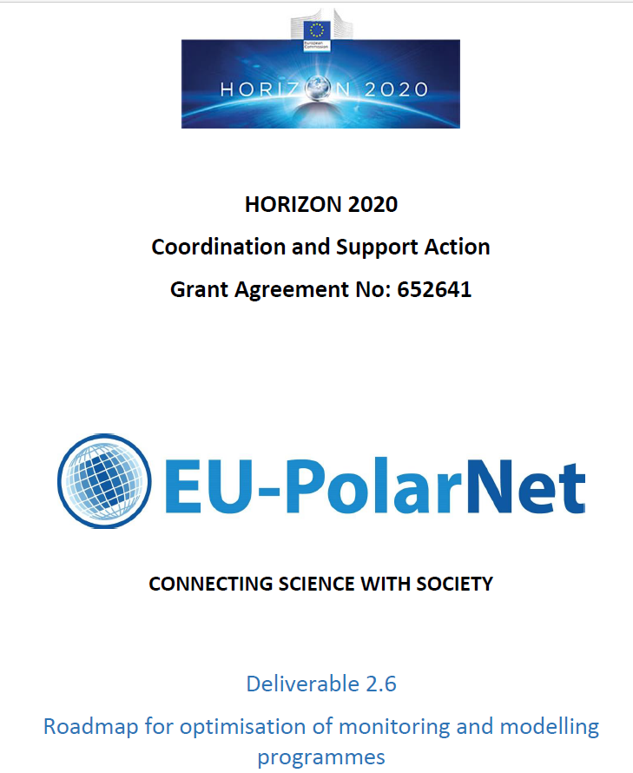
What are others doing? EU-PolarNet
41 recommendation documents analyzed:
Arctic 34
Antarctic 3
Both 4
Deliverable 2.6
Roadmap for optimization of monitoring and modelling programmes
September 2019

Slide 10
EU-PolarNet D2.6: Roadmap for monitoring & modeling
3.3.1 Monitoring/observation recommendations
cryosphere: more accurate snow observations needed, should have a better spatial coverage.
Observations on sea-ice extent, concentration, thickness and motion should also be strengthened.
Many permafrost observational sites not maintained for long-term monitoring; there are significant spatial gaps.
Glaciers: mass balance measurements over long periods are available for only a small subset of Arctic glaciers.
Greenland Ice Sheet: in situ observations are limited. For glaciers, observations are needed for the processes (ice dynamics, subglacial meltwater, ocean interaction) that accelerate melting.
The hydrological cycle in the Polar Regions should be better understood and observed.
Albedo observing (particularly for snow) should be strengthened. There is a general need for harmonizing observing of the cryosphere.

Slide 11
EU-PolarNet D2.6: Roadmap for monitoring & modeling
4. Roadmap for optimisation of monitoring and modelling programmes for the Polar Regions (ROMP)
4.4. Essential Polar Variables (EPVs)
Next slide: Visualization of observing system Global Ocean Observing System (GOOS)) showings the links of Essential Variables to observing networks and applications and how they contribute to societal benefits.

Slide 13
Conclusions
Carefully build on previous work,
Only summarize it
Emphasize INTAROS-specific Δ

