Slide 1
INTAROS Roadmap document
Perspective from the theme
Community-based monitoring & citizen science
Questions
1 Purpose?
2 What do we want to achieve?
3 Who are the target groups or users?

Slide 2
INTAROS roadmap
Perspective from the theme: CBM & citizen science (CS)
Question 1: Purpose?
To guide many kinds of organizations on how they can contribute (technically, financially and in other ways) towards improved observing in the Arctic
To encourage everybody to work in the same direction, to avoid duplication of efforts

Slide 3
INTAROS roadmap
Perspective from the theme: CBM & citizen science (CS)
Question 2: What do we want to achieve?
The process
Important to get broad commitment, through engaging stakeholders (incl. also CBM & CS organizers, representatives of community members, local and nat’l gov’t agencies, civil society organizations, private sector)
The product
An outline of key steps needed towards a sustained AOS, ideally incl. a provisional financing plan. Should include CBM & CS, topics such as CBM & CS data management, communication of CBM & CS findings to decision-makers, and feedback to the observers.

Slide 4
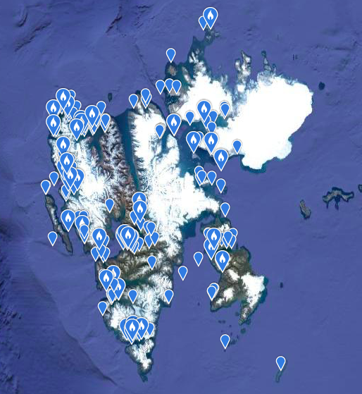
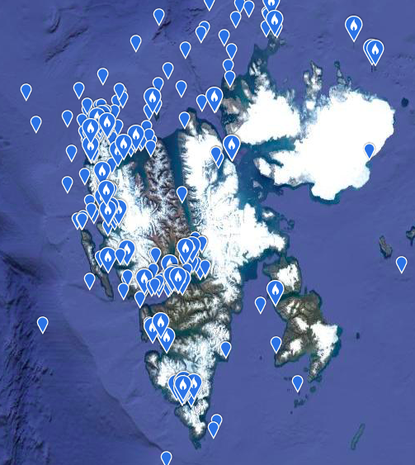
INTAROS roadmap Perspective from the theme: CBM & citizen science (CS)
Figure 9. Records of (A) Pink-footed goose Anser brachyrhynchus (left: n = 583 records) and (B) Atlantic puffin Fratercula arctica (right; n = 622 records) from Svalbard 2002-2019 in the eBird database. Records highlighted with a white flame are from eBird hotspots, areas with “many” checklists.
From Intaros D4.3, May 2020

Slide 5
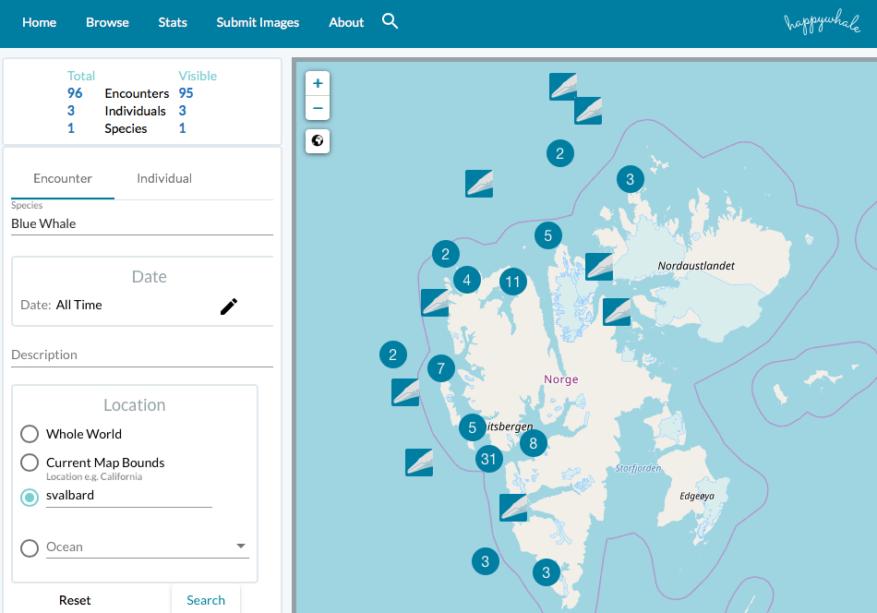
INTAROS roadmap Perspective from the theme: CBM & citizen science (CS)
From D4.3, May 2020
Figure 18. Records of Blue whale Balaenoptera musculus from Svalbard during 2014-2019 in the Happywhale web-based database, verified by photos available at the website (n = 95 encounters). The digits refer to number of encounters and these will show up when zooming in.

Slide 6
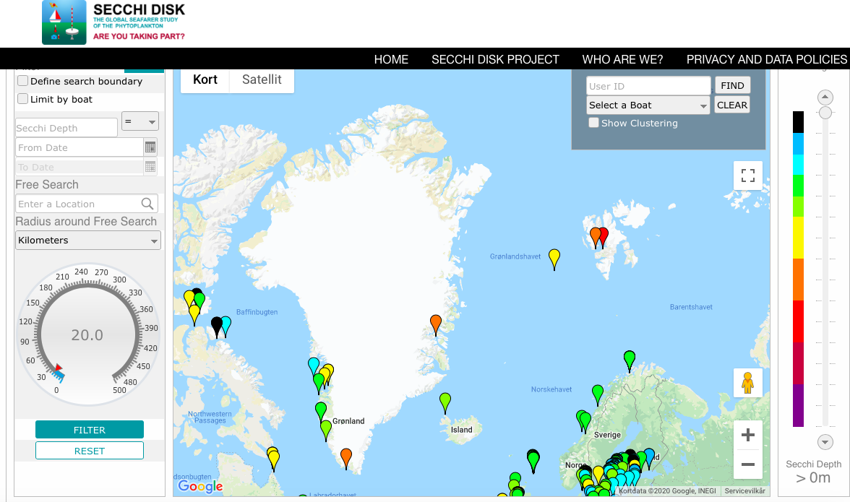
INTAROS roadmap Perspective from the theme: CBM & citizen science (CS)
Figure 20. Location for entries of Secchi depths. Each marker represents a vessel (or reading). Screenshot from the Secchi Disk online database (extracted May 2020). From D4.3, May 2020

Slide 7
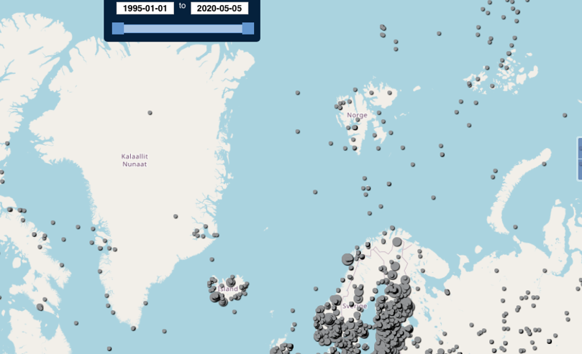
INTAROS roadmap Perspective from the theme: CBM & citizen science (CS)
Figure 22. Extract of global map of positions from where cloud cover records have been obtained by the Cloud Observations program 1995-2019. Screenshot from the Cloud Observations online database (Source: vis.globe.gov; accessed April 2020). From D.4.3, May 2020

Slide 8
INTAROS roadmap
Perspective from the theme: CBM & citizen science (CS)
Question 3: Who are the target groups or users?
- Government agencies, EU, philanthropic foundations
- Research institutes
- Civil society organizations, Indig. Peoples organizations
- International environmental management bodies (NAMMCO, ICES, NAFO, CITES and others who rely on environmental data for management decisions)
- Senior Arctic Observers, Arctic Council Working Groups
= not exhaustive!

