Slide 1
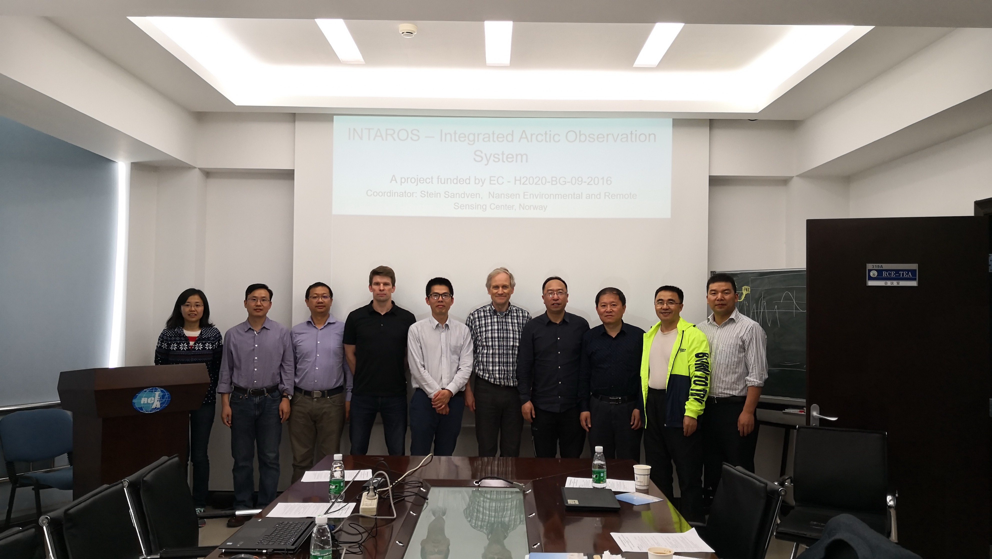
Group photo of participants in the INTAROS – Blue Action workshop 18 April 2018 at Institute of Atmospheric Sciences, Nansen-Zhu Centre, Beijing

