Slide 1
INTAROS – Integrated Arctic Observation System
A project funded by EC - H2020-BG-09-2016
Coordinator: Stein Sandven
Nansen Environmental and Remote Sensing Center, Norway
Total budget: 15.5 mEuro - 49 partners from 20 countries
Start date: 01 December 2016 - Duration: 5 years
General presentation with updated slides October 2017
Notes:
Two Russian partners: All Russian Research Institute for Hydro-meteorological Information (RIHMI-WDC) and Nansen International Environmental and Remote SEnsing Center (NIERSC).
Three Chinese partners: Institute of Remote Sensing and Digital Earth – Chinese Academy of Science (RADI CAS) , National Marine Environmental Forecasting Center (NMEFC) and Polar Research Institute of China (PRIC)

Slide 2
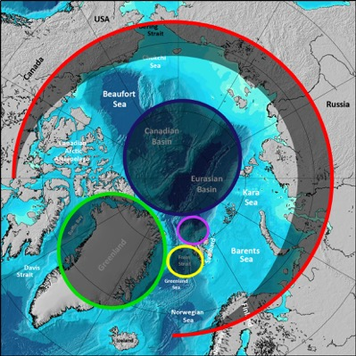
INTAROS overall objective
to develop an efficient integrated Arctic Observation System by
extending,
improving and
unifying
existing and evolving systems in the different regions of the Arctic

Slide 3
An integrated Arctic Observing System needs to cover
Atmosphere themes
Ocean themes
Terrestrial themes
at appropriate temporal and spatial scales and resolution
Copernicus is a major driver to develop satellite-based observing and modelling of many variables. The largest gaps are in the in-situ observation network, which should provide
data not obtained from remote sensing
data needed for validation of remote sensing and numerical models

Slide 4
Workpackage structure
WP1: Requirements and strategy for a Pan-Arctic system
WP2: Exploitation of existing observing systems
WP3: Enhancement of in situ systems
WP4: Community-based observing systems
Scientific data
Scientific data
WP5: Data integration & management - IAOS
Community data
Integrated data, prepared for applications
Feedback to requirements, strategy and roadmap
WP6: Applications towards stakeholders
Feedback to requirements, strategy and roadmap
Climate modelling
Ice – ocean statistics
WP7: Dissemination and outreach

Slide 5


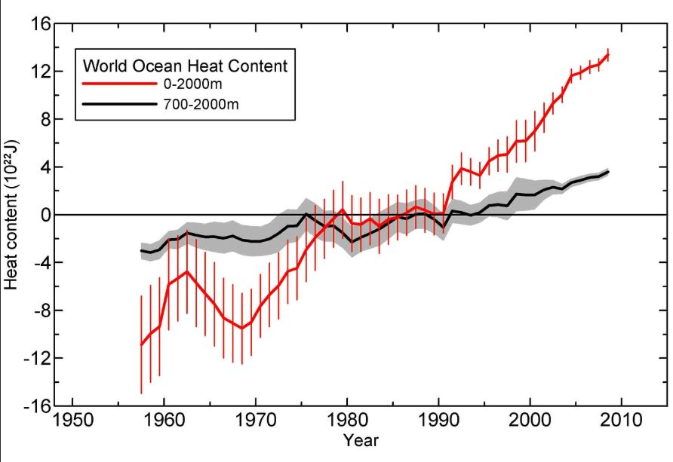
INTAROS Specific objectives (1)
Establish a Pan-Arctic forum for collaboration across EU and non-EU countries and transnational organisations (WP1)
Develop a Roadmap for building a sustainable Arctic observing system (WP1)
Exploit existing observing systems and databases (WP2)

Slide 6
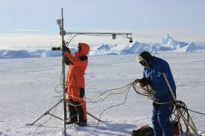
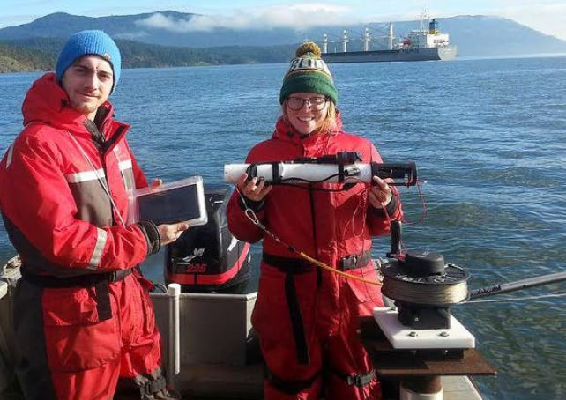

INTAROS Specific objectives (2)
Fill gaps of the present in situ observing systems (WP3)
Enhance community-based observing programmes (WP4)
Develop and implement the iAOS platform for integration of multidisciplinary data from distributed repositories (WP5)

Slide 7
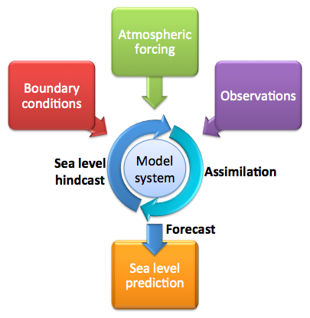
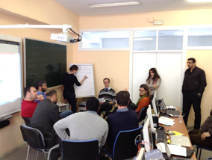
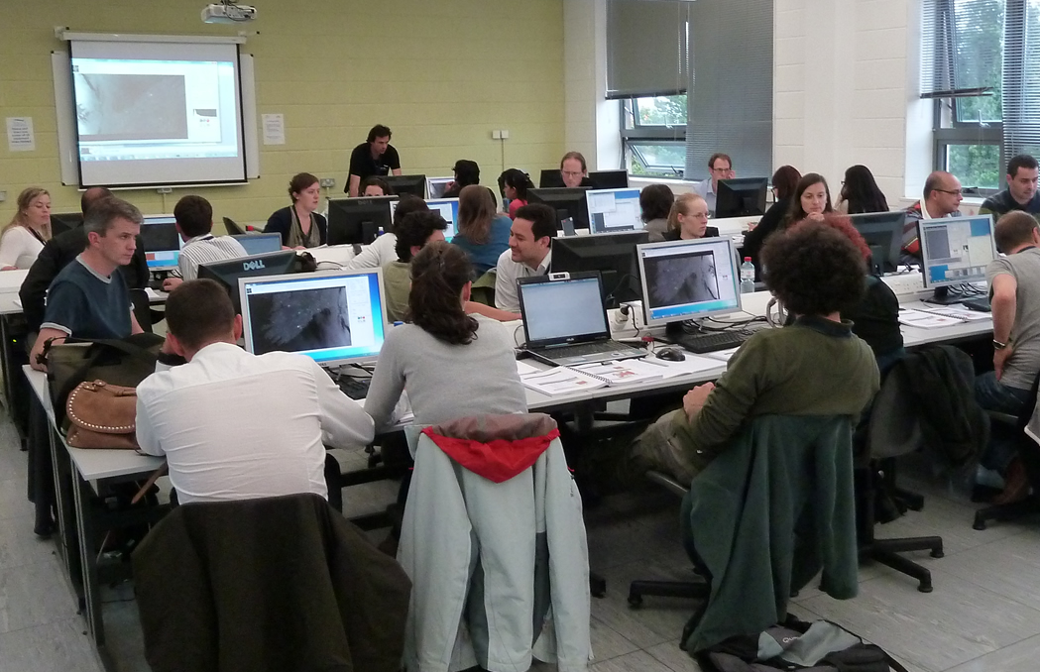
INTAROS Specific objectives (3)
Develop professional skills in using the iAOS platform (WP5)
Use of data in numerical models, collaboration with APPLICATE and BLUE ACTION (WP6)
Demonstrate benefit of data from INTAROS for stakeholder groups (WP6)

Slide 8
Stakeholder categories
Science – through projects and programmes, in particular climate and environment
Service providers: e.g. weather and ice services (Copernicus services)
Government agencies: e.g. national institutes, fishery directorate, oil directorate, coastal directorate, ++
European / international agencies/bodies: EU, EEA, ESA,
Private sector: e.g. shipping, oil/gas, fishery, tourism, ++
International programmes: e.g. SAON, AMAP, IPCC, GCOS, GOOS, WMO or ECMWF, ++
NGO’s
Local communities

Slide 9
Stakeholder engagement in INTAROS
First workshop in Brussels 05 May 2017 addressing requirements in various disciplines and stakeholder groups. Next workshop on community-based monitoring in Fairbanks 10 May 2017
Dialogue with decision makers and policy bodies, jointly with other Arctic projects, programmes and organisations
Stakeholders in each of the thematic areas (Atmosphere, Ocean and Seafloor, Sea ice, Marine Ecosystem, Terrestrial sciences, Glaciology, Natural hazards, and Community-based monitoring
Stakeholder and Innovation Advisory Panel with 5 members
Follow-up workshops: Oslo 09 November and in Quebec City 11-12 December 2017

Slide 10
Atmosphere part

Slide 11
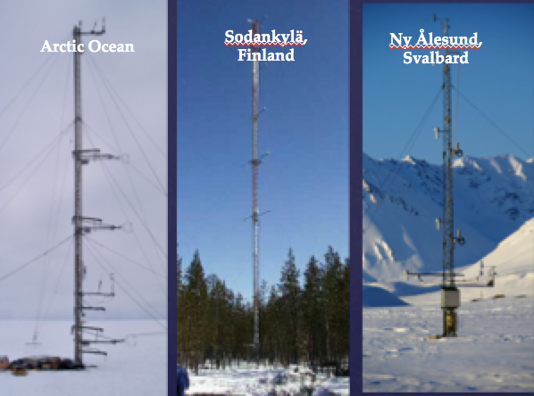
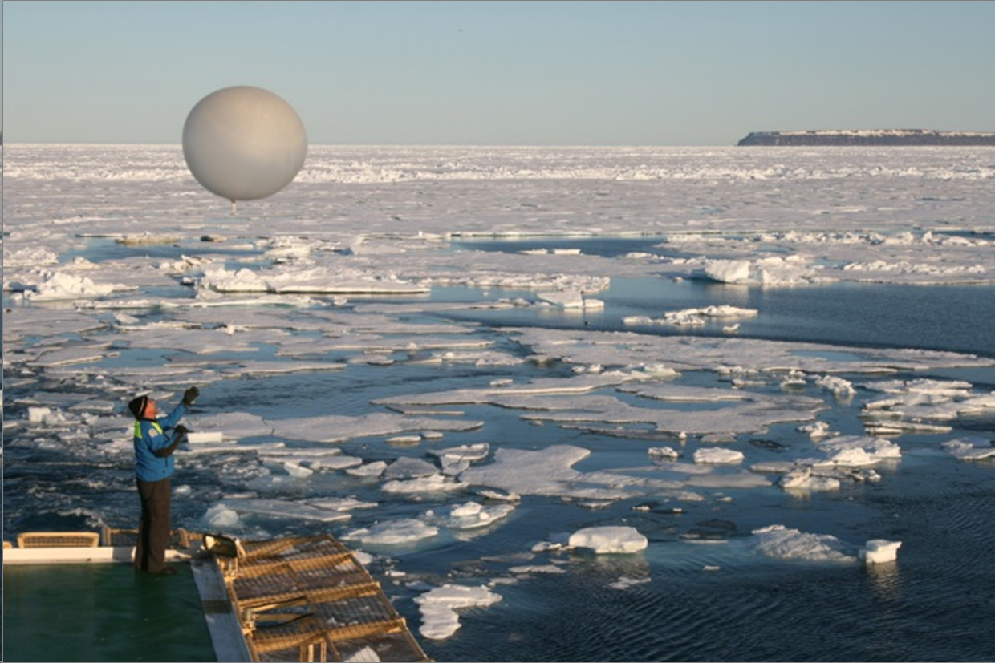
Atmosphere
More in-situ data will be made available from observatories and scientific field experiments.
Improved information about atmospheric vertical structure and clouds from passive satellite sensors
Strategies and best practices for semi-autonomous ship-borne observations will be developed
Provide integrated water vapor fields over sea ice and over open water in a consistent data set suitable for assimilation in atmospheric circulation models.

Slide 12
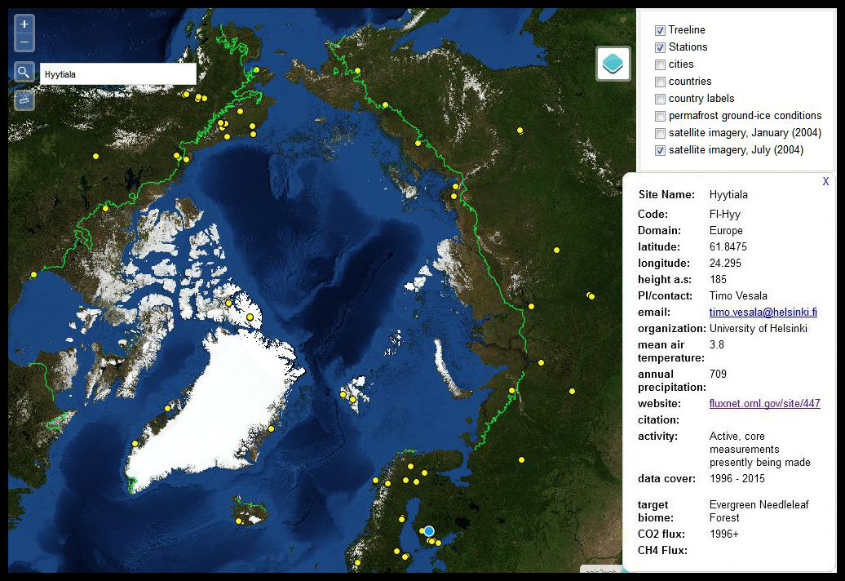
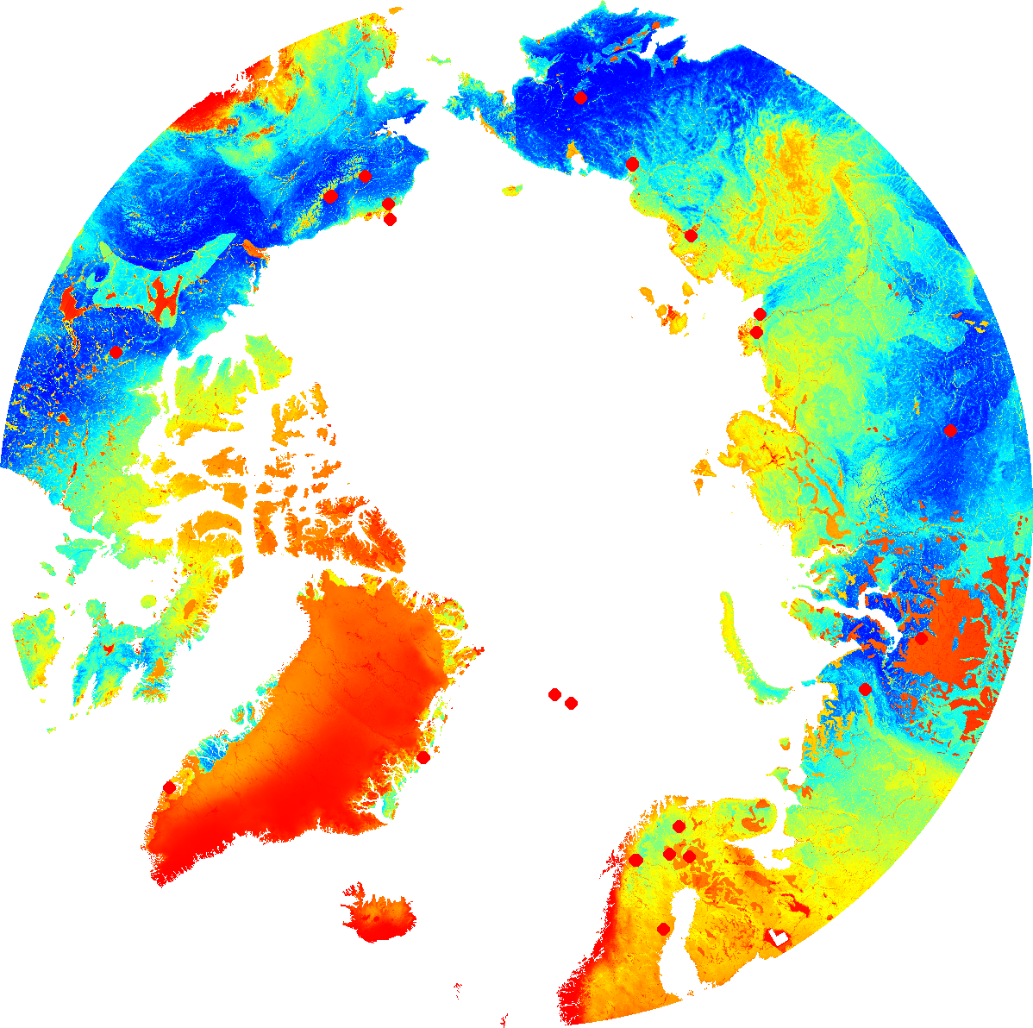

Eddy Covariance Flux Towers in the Arctic
Assessment of the representativeness of the existing in-situ flux network for CO2 and CH4
Survey of existing flux sites
Network representativeness
The yellow dots indicate positions of eddy covariance flux towers (both active and inactive) that can be used for pan-Arctic synthesis studies of surface-atmosphere exchange processes of greenhouse gases
Preliminary analysis of network representativeness, using just 29 ‘prime’ sites (red circles) within the Arctic. Blue background colors indicates a good match, red no match at all. Climate and edaphic variables similar to Kumar et. al. (2016) with the addition of mean and stdev .
Figures: M. Pallandt (MPI-BGC);
J. Kumar (ORNL)
Notes:
Left figure: yellow dots indicate positions of eddy covariance flux towers (both active and inactive) that can be used for pan-Arctic synthesis studies of surface-atmosphere exchange processes of greenhouse gases
Right figure: Preliminary analysis of network representativeness, using just 29 ‘prime’ sites (red circles) within the Arctic, Blue background colors indicates a good match, red no match at all. Climate and edaphic variables similar to Kumar et. al. (2016) with the addition of mean and stdev . Ground temperature and permafrost probability. Barrow and two Norwegian coastal sites missing at this point.
Main target of this activity within INTAROS: Assessment of the representativeness of the existing in-situ flux network in the Arctic domain (Are there in the Arctic any gaps in data collection for CO2 and CH4 fluxes?)
• Are there any ecoregions not covered by the eddy covariance flux network?
• Are there periods not covered by the eddy covariance flux network?
• Can we identify realistic locations for additional sites which would greatly improve spatial gaps in data coverage?

Slide 13
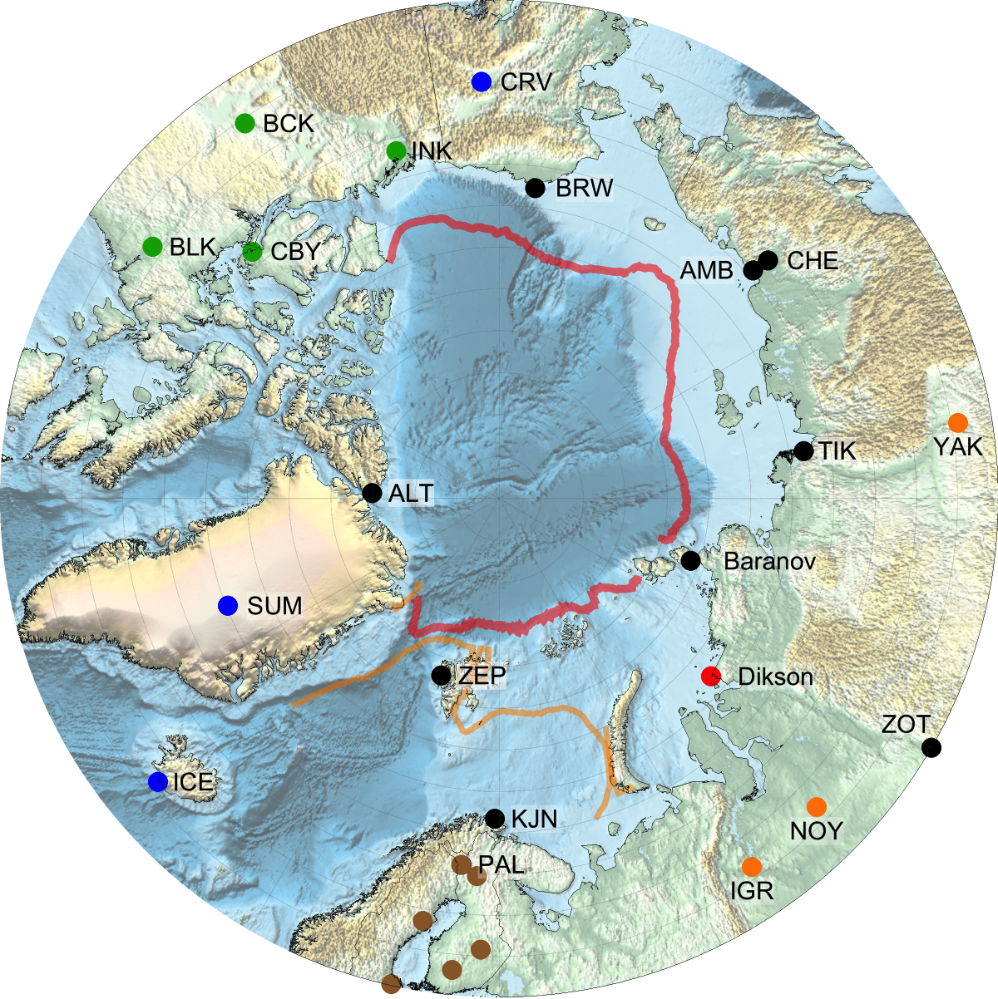
Atmospheric Greenhouse Gas Monitoring Network
Survey of existing sites
Tower footprint analysis
Seasonal variability in the cumulative source weight function (i.e., field of view of a monitoring tower), using the Ambarchik monitoring site in Northeast Siberia as an example. In this case, blue-ish colors indicate a high influence, i.e. the tower receives a lot of information from these regions, while the green areas show sections that do not influence the tower observations much
Overview map of existing pan-Arctic atmospheric monitoring towers for greenhouse gas mixing ratios
Figures: F. Reum (MPI-BGC)
Notes:
Left figure: Overview map of existing pan-Arctic atmospheric monitoring towers for greenhouse gas mixing ratios
Right figure: Seasonal variability in the cumulative source weight function (i.e., field of view of a monitoring tower), using the Ambarchik monitoring site in Northeast Siberia as an example. In this case, blue-ish colors indicate a high influence, i.e. the tower receives a lot of information from these regions, while the green areas show sections that do not influence the tower observations much (i.e. not much information is gained)
Main target of this activity within INTAROS: Assessment of the representativeness of the existing atmospheric monitoring network for greenhouse gases in the Arctic domain (Are there in the Arctic any gaps in data collection of atmospheric CO2 and CH4 concentrations? What types of sources/sinks for Arctic greenhouse gases can be constrained with which level of accuracy? )
• Are there periods or regions in the Arctic that are not covered by the atmospheric greenhouse gas monitoring stations?
• Can we identify realistic locations which would substantially decrease spatial gaps in data coverage?
• Are we able to measure theorized or hard to measure events and processes with the current network?

Slide 14
Geostatistical inverse modeling
Assimilate data layers to improve flux assessment
Information to constrain shelf area CH₄ fluxes
Meteorology
Wind speed
Sea ice
Ice-free ocean fraction
Sea ice growth
Sea ice melt
Bathymetry
Ocean depth
Shelf edge
…
Example of data assimilation study to constrain CH4 emissions from East Siberian Arctic Shelf area. Top panel shows a candidate parameter (open ocean fraction) that holds the potential to better constrain spatio-temporal patterns in CH4 emissions from the shelf region. Bottom figure shows preliminary emission patterns derived for the ESAS region using the geostatistical inverse modeling approach
Figures: F. Reum (MPI-BGC)
Notes:
Left figure: Example of data assimilation study to constrain CH4 emissions from East Siberian Arctic Shelf area. Top panel shows a candidate parameter (open ocean fraction) that holds the potential to better constrain spatio-temporal patterns in CH4 emissions from the shelf region. Bottom figure shows preliminary emission patterns derived for the ESAS region using the geostatistical inverse modeling approach
My specific project part (Task 6.5) aims at constraining budgets of greenhouse gas exchange fluxes between surface and atmosphere in the Arctic, based on geostatistical inverse modeling. For this task, we will test the information content of various (new) data layers from INTAROS partners to support the structuring of spatio-temporal flux patterns, and therefore improve our model results.

Slide 15
Terrestrial part

Slide 16
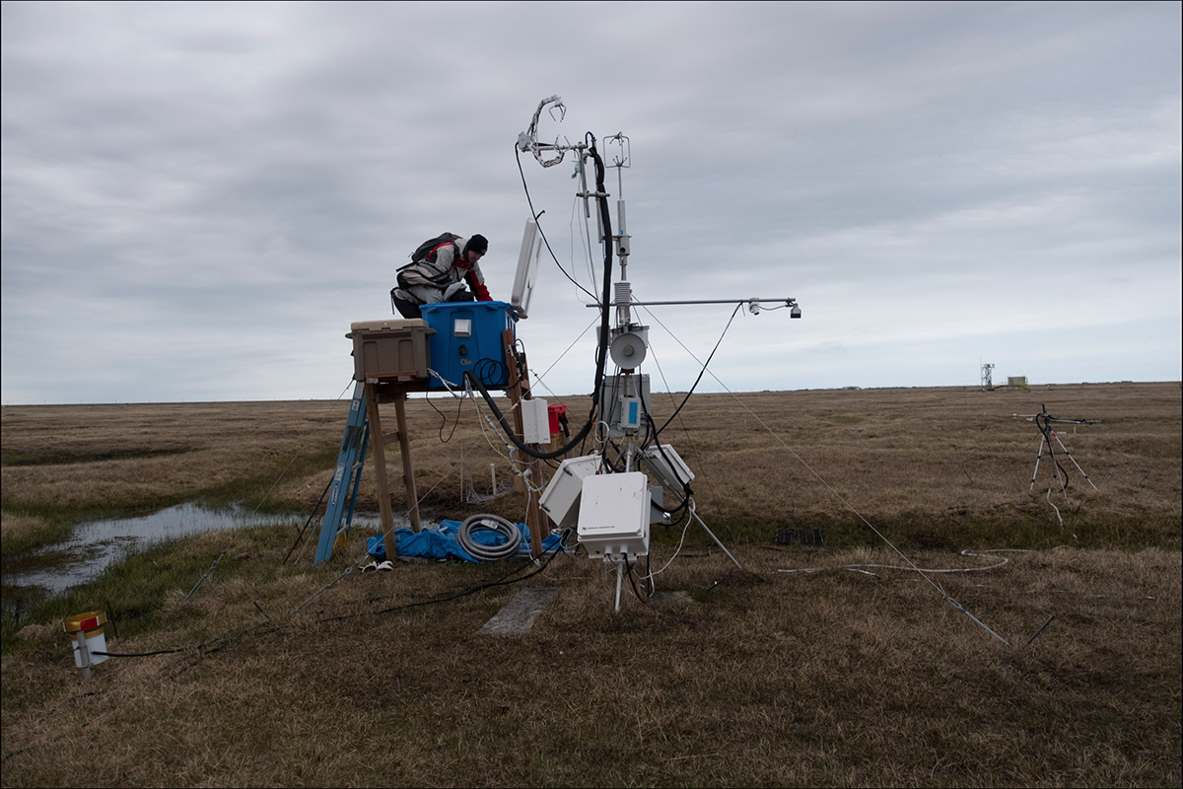
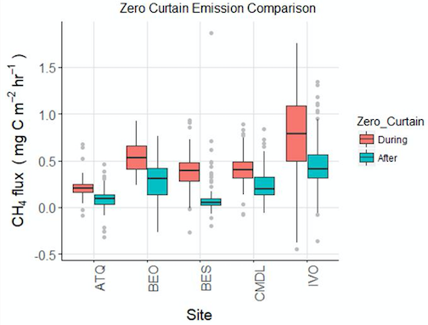
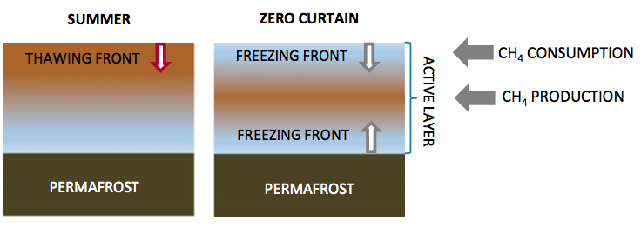
Climate gas emissions from the Alaskan tundra
These are the first year-round CH4 flux measurements from five continuous permafrost sites, and among the first from the fall. The figure shows that there is substantial emissions until the soil freezes during the fall ”zero curtain” period. Daily median of flux rates of CH₄ and CO₂ during and after the “zero-curtain” (i.e. the periods when the soil temperature overs around zero just before freezing) period from 2013-2016. During the zero-curtain, CH₄ rates are significantly higher for all sites (while CO₂ are not different).
Ref. Dona Zola,
University of Sheffield, UK

Slide 17
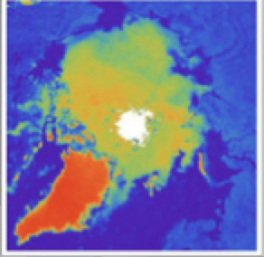
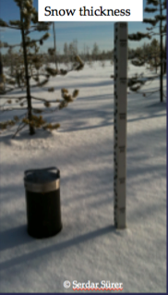
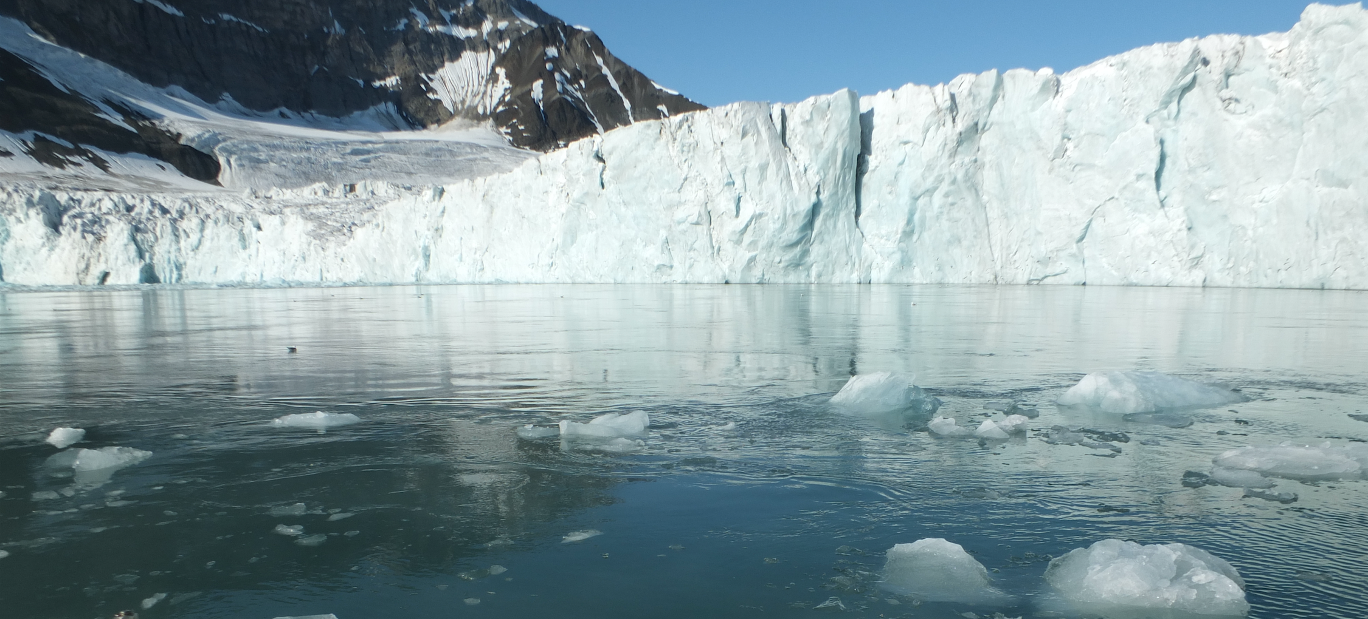
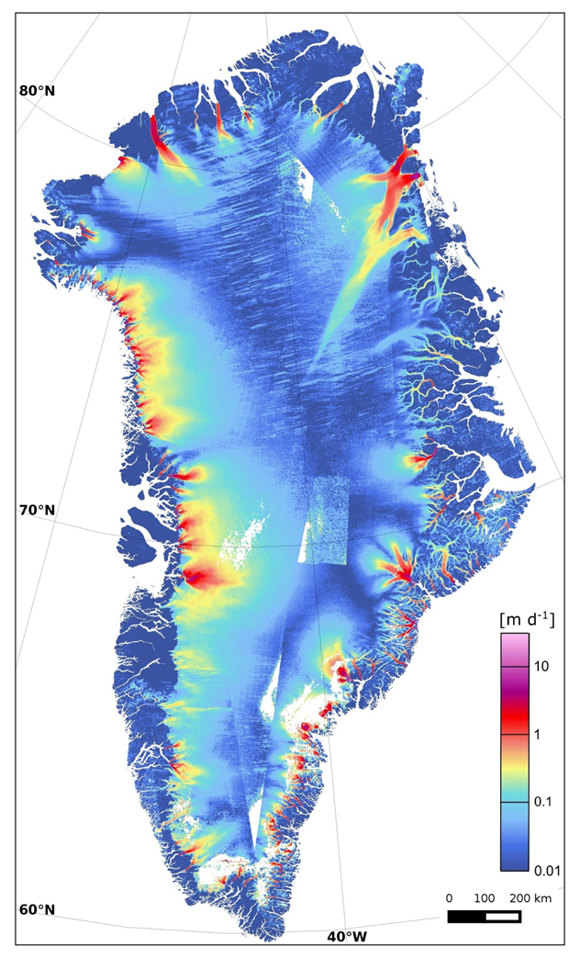
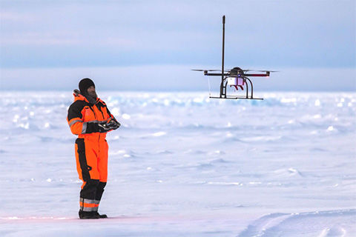
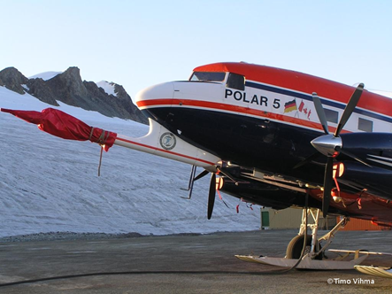
Cryosphere
Sea ice extent from passive
microwave satellite data
Marine terminating glacier (W. Walczowski, IOPAN)
UAV with met sensors (M. Jonassen, FMI)
Surveys of atmospheric and sea ice variables with AWI aircraft (T. Vihma)
Surface velocity of the Greenland ice sheet (A. Ahlström, GEUS)
In-situ cryospheric and land observations from past and new campaigns and research stations
Use of satellite snow, hydrological, and ice mass change products

Slide 18
Ocean part

Slide 19
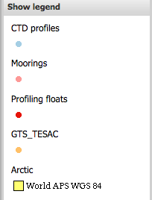
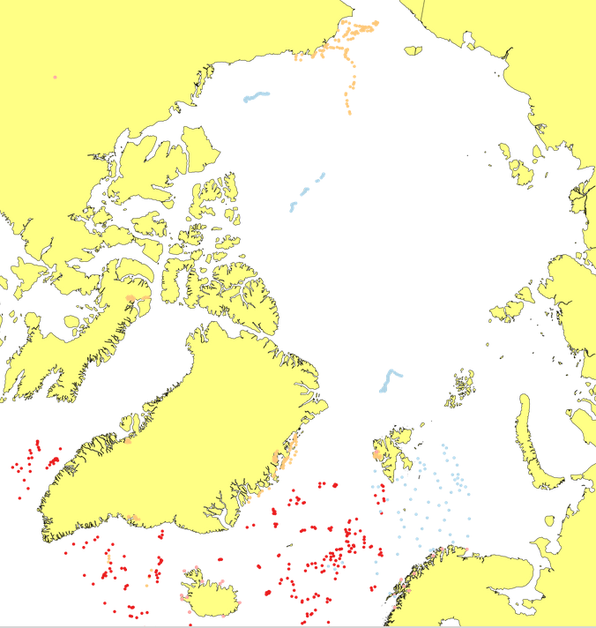
Status map: In situ data in the last 30 days – vertical profiles
From IMR / Arctic ROOS
26 Sept 2017
http://arctic-roos.org

Slide 20
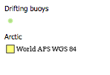
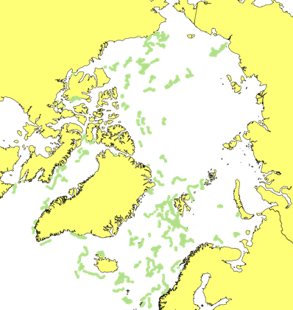
Status map: In situ data in the last 30 days – surface buoys
From IMR / Arctic ROOS
26 Sept 2017
http://arctic-roos.org

Slide 21
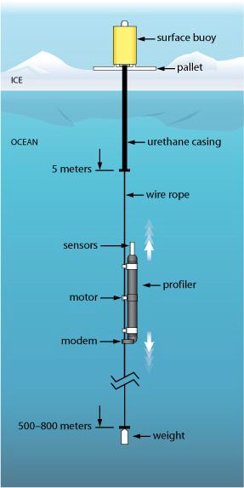
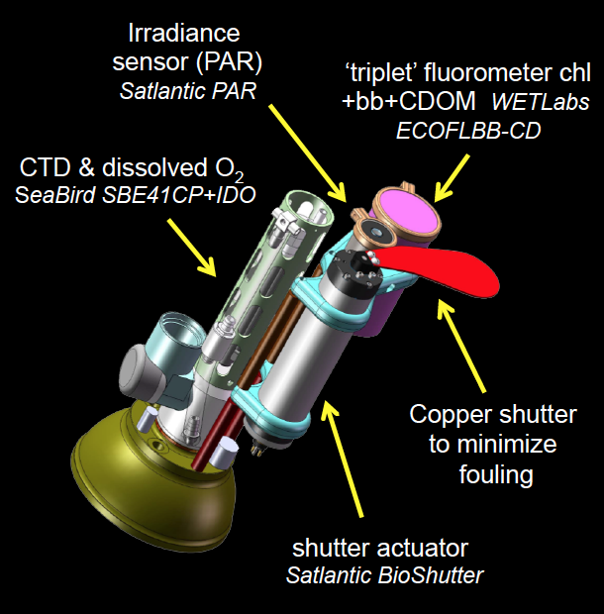
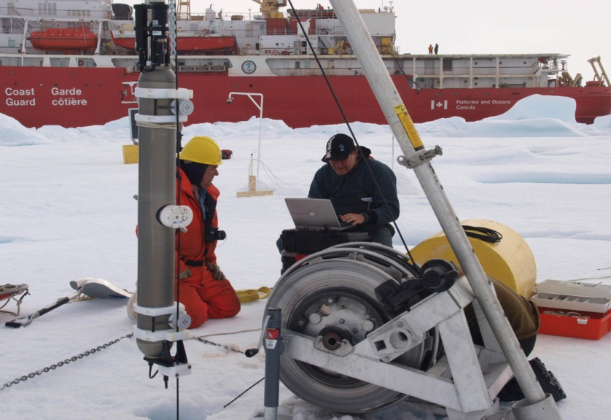
Ice-Tethered Platforms in the Arctic Ocean
Ice-tethered platforms (WHOI) for measurements of ocean physical variables combined with biogeochemical sensors
Laney et al., 2014, 2015
Proposed sensors:
Customized ‘triplet’ fluorometer to measure chlorophyll fluorescence, dissolved organic matter fluorescence, and optical scatter
Radiometer (light levels)
Copper shutter: for biofouling
Toole et al., 2011

Slide 22
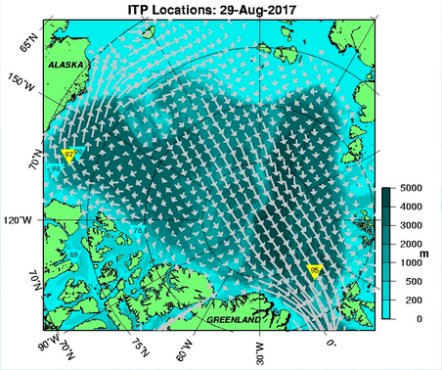
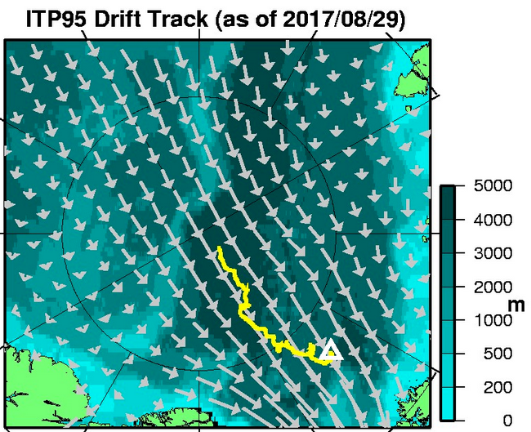
Active Ice-Tethered Platforms
Latest locations of all active ITPs. Systems that are presently providing location and profile data are in yellow, those that are providing locations only (profiler status uncertain) are in cyan, and those that have not transmitted data for over one month are plotted in gray.
Trajectory of ITP95 from April 2017
http://www.whoi.edu/website/itp/overview

Slide 23
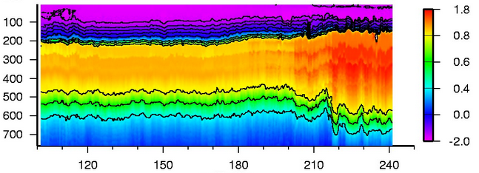
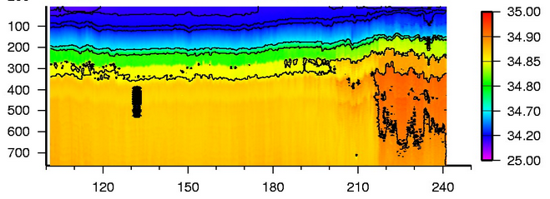
IPT95: Temperature and salinity
Temperature
Salinity
http://www.whoi.edu/website/itp/overview

Slide 24
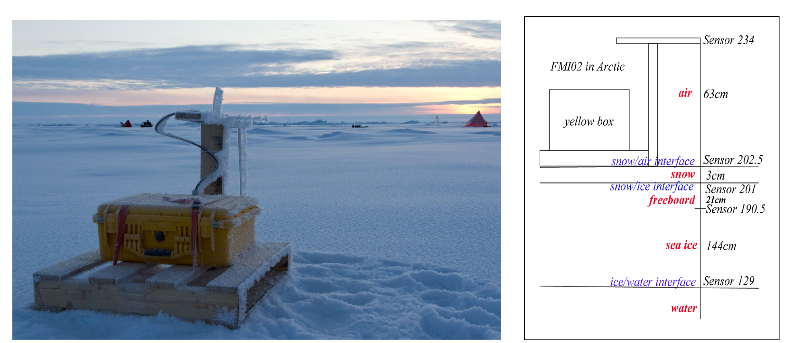
Ice Mass Balance buoys
Cheng et al, 2015
SIMBA measures high resolution temperature profiles in air-snow-ice-water.
Interface detection based on temperature profile.
Temperature rises differently in air, snow, ice, water in response to SIMBA daily heating cycles.

Slide 25
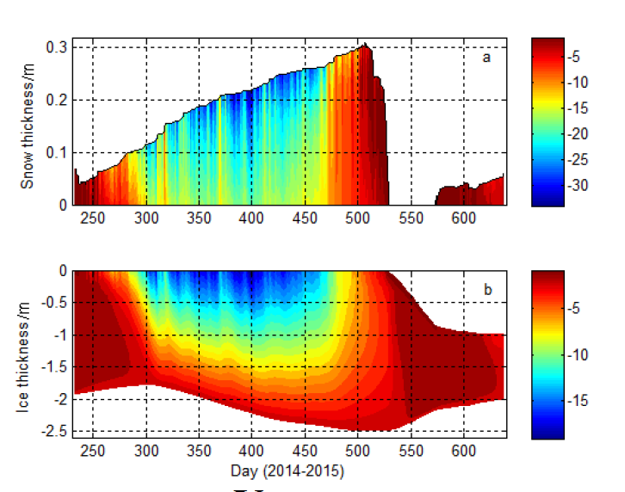
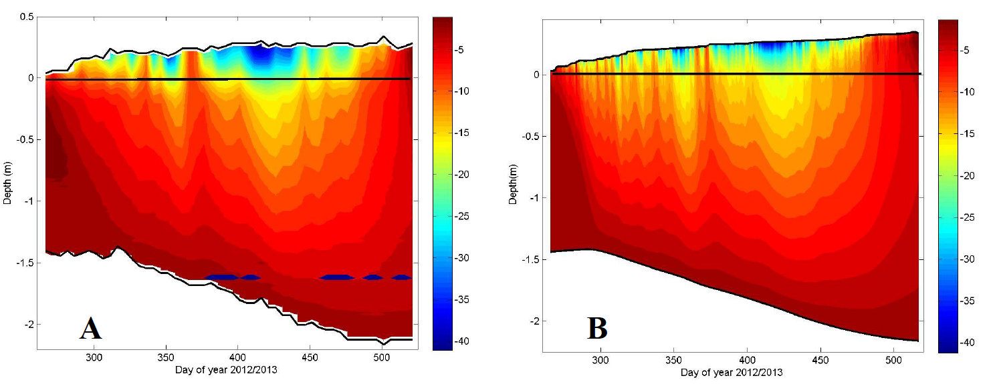
Examples of data from Ice Mass Balance buoys
Snow and ice temperature
Upper: Snow temperature and thickness
Lower: Ice temperature and thickness
Ref. B. Cheng et al., 2015

Slide 26
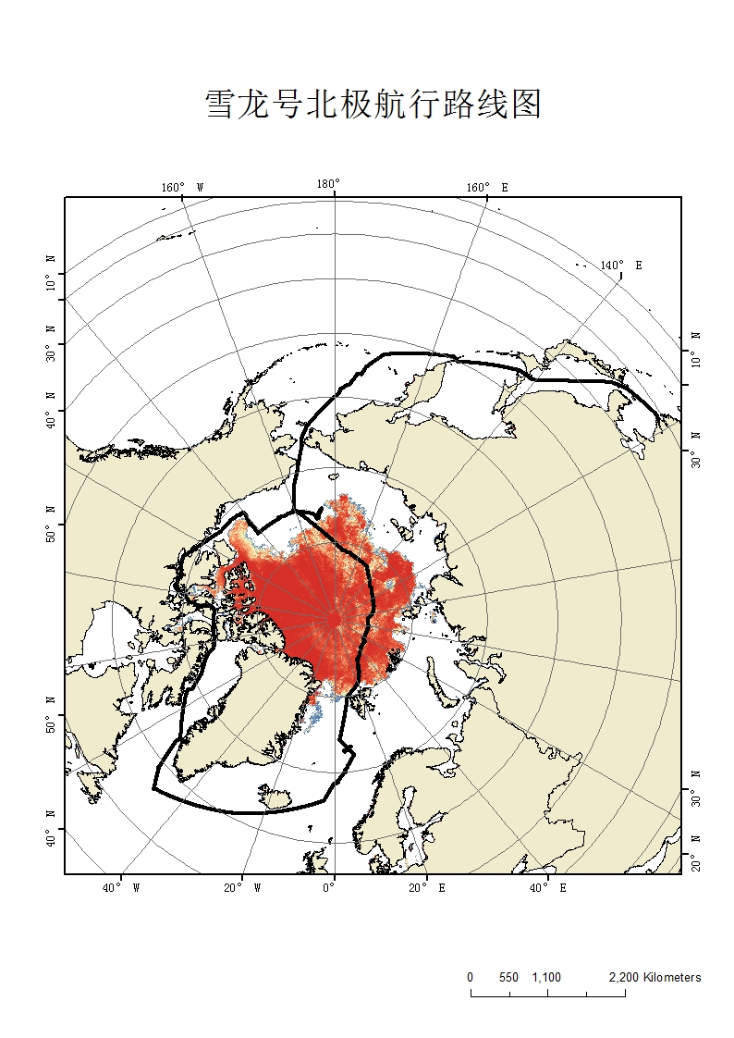
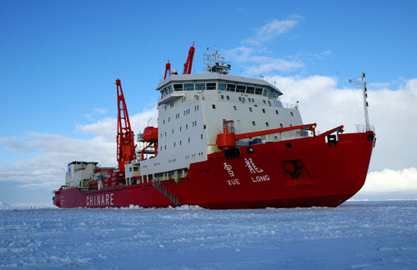
CHINARE 2017 expedition trajectory
Length: 167 m
Max. breadth: 22.6 m
Power max. 13200 KW
Displacement: 21000 t
Max. Speed: 17.9 nm/h
Ice-breaking: 1.5 nm/h
Personal berth: 120
Lift capability: 100 t
Made in Ukraine in 1993 and renovated in China in 2007
Copyright © PRIC
The map shows the Xuelong trajectory from 20 July until 12 September 2017.

Slide 27
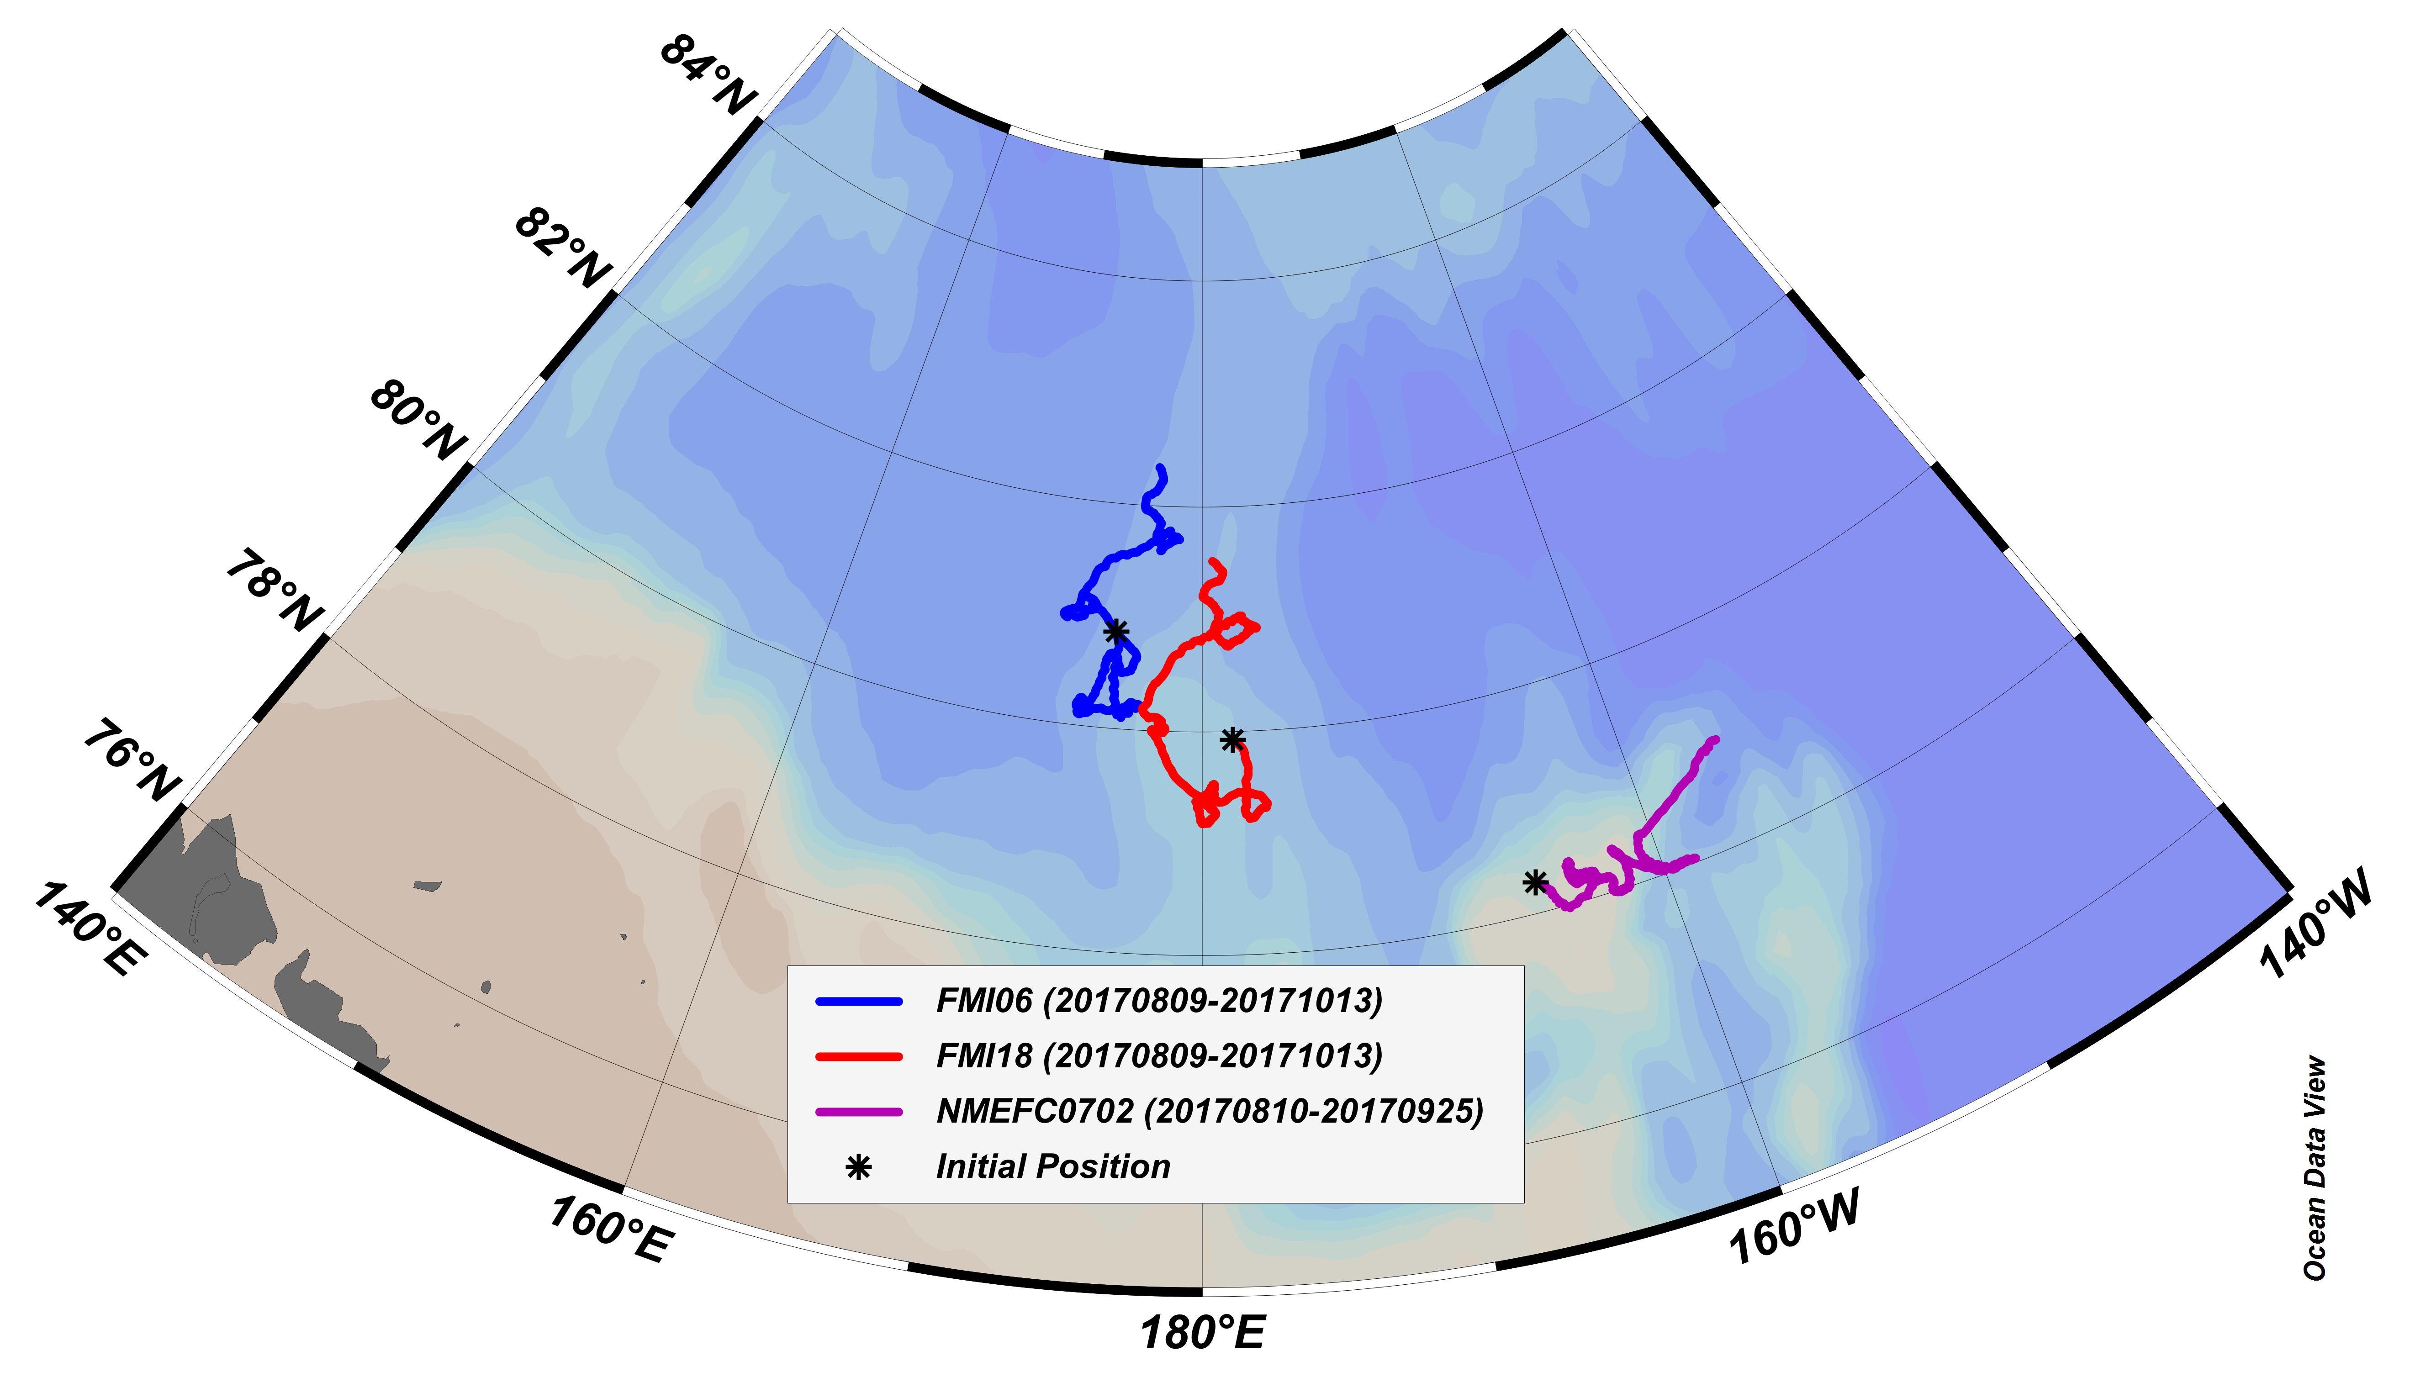
Drift of SIMBA buoys August – September 2017
Deployed SIMBA buoys in East Siberian Sea/Chukchi Sea during the CHINARE 2017 expedition. Trajectories shows the drift from 09 August to 13 Oct 2017. Asterixes indicate the starting points. Map provided by NMEFC.

Slide 28
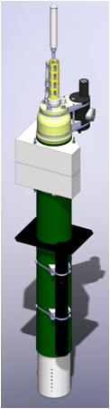
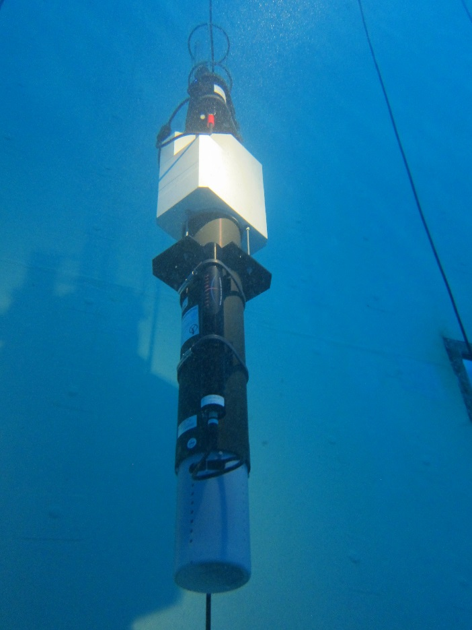

BioArgo floats in Baffin Bay
Contribution from TAKUVIK (CNRS - Univ. Laval)
PRO-ICE Floats
19* Argo NKE** floats equipped with a bio-geochemical payload
- O2 Aanderaa optod
- OCR-504 Ed 380, 412 and 490nm + PAR
- ECO FLBBCD: FL-chla, FL-CDOM , BB
- SUNA (nitrates)
10 funded by Equipex NAOS
9 funded par CFI (Can. Found. for Innovation)
Sea ice detection: to prevent float from surfacing
**NKE Electronics, France

Slide 29
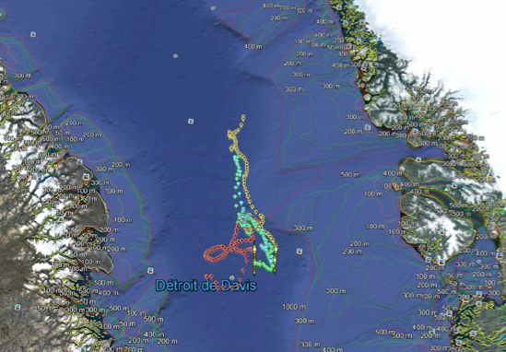
PRO-ICE Float trajectories from 2016
From July 9 to October 30 2016
2017: CNRS Takuvik has deployed 7 Bio Argo floats in Baffin Bay between July 20 and 22, 2017. Information about Takuvik, see http://www.takuvik.ulaval.ca/index.php
Ref. Marcel Babin, TAKUVIK

Slide 30
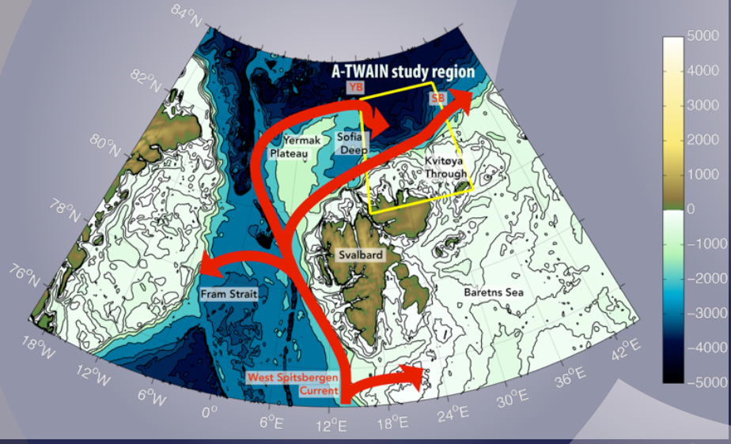
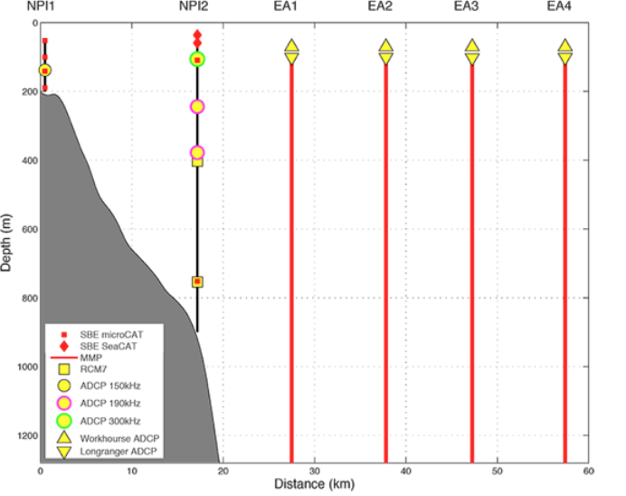
Moorings north of Svalbard
The A-TWAIN moored array has been deployed since 2012 under the project ‘Long-term variability and trends in the Atlantic Water inflow region’ The main partners are IMR and NPI, with collaboration from WHOI, IOPAN (http://atwain.whoi.edu/php/index.php). INTAROS contributed to the deployment of new moorings in September 2017.
2012-2013: 9 moorings (8 recovered)
2013-2015: 5 moorings (4 recovered)
2015-2017: 3 moorings deployed
Notes:
The IOPAN team onboard RV Lance have successfully recovered one and deployed four INTAROS moorings in the area north of Svalbard during the cruise in September 2017. Two IOPAN moorings and two French moorings from CNRS-LOCEAN/Marie-Noelle Houssais. One IOPAN mooring belongs to the ATWAIN line at 31°E and the remaining three rigs are located along 22°E longitude. This will be the most probable
location for the INTAROS deployments in 2018

Slide 31
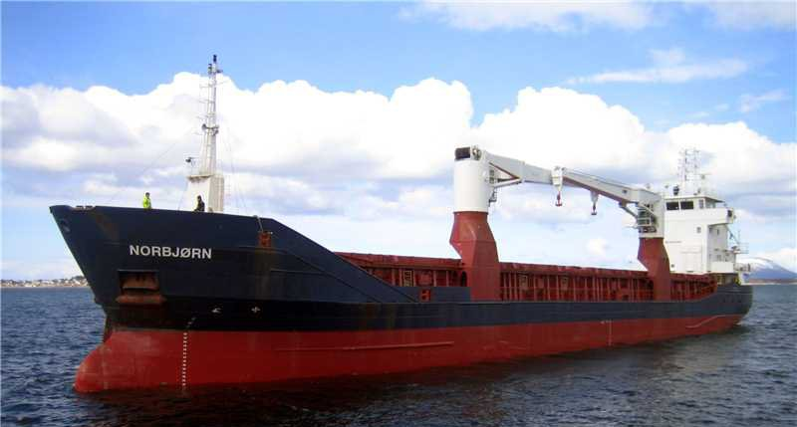
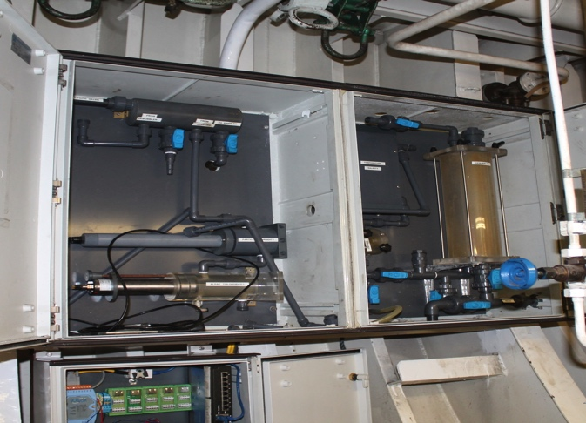
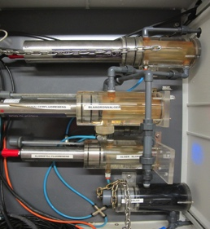
Extending the Ferrybox monitoring between Tromsø and Svalbard
INTAROS contribution: novel sensors for FerryBoxes (ocean acidification and carbonate chemistry, inherent optical properties, microplastic sampler)
(NIVA)
Existing Ferrybox system:
Wind sensor at deck (True wind speed and direction, Gill instruments)
Air temperature (Optional). Weather stations?
Above water radiance/irradiance (TriOS Ramses Ed, Ld, Lu)
Temperature and salinity (Seabird SBE45)
Oxygen sensor (AADI Optode)
+ many biogeochemical sensors
M/S Norbjørm:
30-35 round trips/year

Slide 32
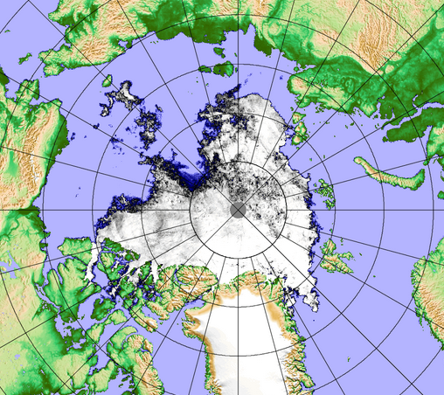
INTAROS depoyment planned in 2018
Sea ice concentration 10 September 2016
Planned deployment of ITP and IMBs in Sept 2018 and tentaive recovery in 2019
Expected deployment area
Tentaive route for CHINARE 2018
Expected drift
Ice maps from Institute of Environmental Physics,University of Bremen

Slide 33

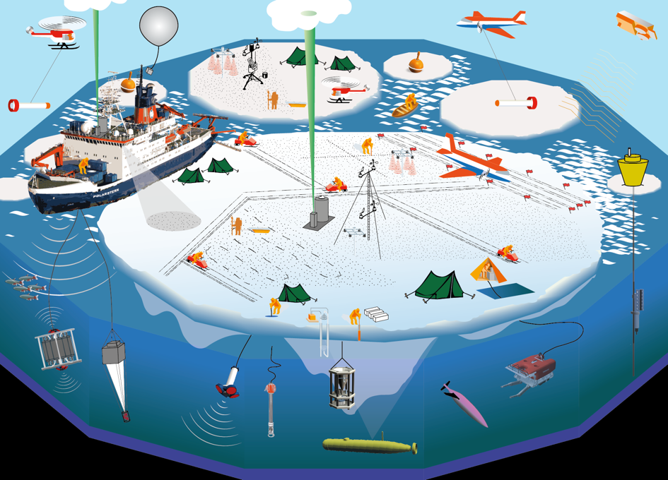
Multidisciplinary drifting Observatory for the
Study of Arctic Climate
www.mosaic-expedition.org
Notes:
To improve the understandng of
coupled atmosphere-ice-ocean-ecosystem processes
in the Central Arctic to support improved sea ice forecasting, regional weather forecasting, and climate predictions.

Slide 34
Challenges in building Arctic observing systems
(1) Develop coordination and collaboration between data providers and stakeholders in the pan-Arctic region in order to better use existing systems and resources (Organisation)
(2) Improvement of the observing platforms and sensors, filling of gaps in the observing network and facilitate for year-round operation, how to go from research to operational systems (Technology)
(3) Data sampling, transmission, calibration, processing, archiving and retrieval of required variables and build distributed and connected databases (Data dissemination)
(4) How to develop sustainability of the observing systems, and what are the funding mechanisms ? (Funding)

Slide 35
EU’s Arctic project cluster 2017-2021
EU PolarNET
Coordination action
APPLICATE
Modelling – forecasting
INTAROS
observing systems
BLUE ACTION
Modelling – forecasting
Arctic permafrost
ARICE
infrastructure
INTERACT
reseach station network
ARC-ICE
FP7
Other infrastruture projects:
ACTRIS, ICOS, SIOS, ENVRI PLUS, ++

