Slide 1
The EU Polar research strategy
Attilio Gambardella
“Climate action and Earth observation”
Directorate-General for Research and Innovation European Commission
INTAROS stakeholder workshop
“Building long-­‐term observing systems in the Arctic – requirements and challenges”, Brussels, May 5th, 2017

Slide 2
Current climate policy framework
Paris Agreement implementation
Implementation of the EU Arctic policy
1st Arctic Science Ministerial and international cooperation
The Arctic as a showcase

Slide 3
The Paris Agreement global goals
Well below 2°C
+ Efforts to limit increase to 1.5°C
Pathway to low-emission, climate resilient future
Global peaking as soon as possible
Rapid reductions
Balance between emissions and sinks after 2050 - based on science
Parties to formulate long-term (2050) low emissions strategies by 2020
Global peaking, climate neutrality means international transport is included
Equity and CBDR-RC remain guiding principles in a contemporary context
Notes:
Fair pathways: developing countries may peak later; equity, sustainable development, poverty eradication efforts recognised.

Slide 4
Science in the COP21 decision and in the Paris Agreement
Asks the IPCC to provide a Special Report on 1.5°C impacts and pathways in order to inform the "facilitative dialogue" foreseen in 2018, and to contribute the "global stocktake" exercise.
Asks Parties to accelerate mitigation and adaptation efforts "in accordance with best available science".
Calls for strengthening cooperation in research, systematic observation and early warning systems that inform climate services and support decision-making.
Recalls the importance of technology development and transfer and innovation for an effective global response to climate change.
Notes:
Moreover, science was essential to achieve the Paris Agreement, and it has a very relevant role in its implementation.
The Arctic, being the place on Earth where climate change runs faster, has to show to the rest of the world the danger of delayed action.
Moreover, with the changes in the US administration, Europe shall be more present than before, and in post-truth times, scientific evidence on climate change shall be presented with the highest relief.

Slide 5
Current climate policy framework
Paris Agreement implementation
Implementation of the EU Arctic policy
1st Arctic Science Ministerial and international cooperation
The Arctic as a showcase

Slide 6
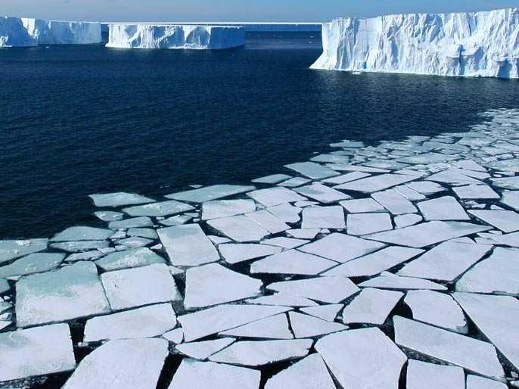
Notes:
The EU Arctic research and innovation policy contributes to three priority areas identified in the Joint Communication on integrated EU Arctic policy adopted in April 2016.

Slide 7
Notes:
In fact, research and innovation is a key component of them, namely: 1) Climate Change and Safeguarding the Arctic Environment; 2) Sustainable Development in and around the Arctic; and 3) International Cooperation on Arctic Issues.
Science, in the Arctic, has demonstrated to be a mean for diplomacy, for maintaining a positive dialogue among countries even during periods of difficult geopolitical tensions.

Slide 8
Current climate policy framework
Paris Agreement implementation
Implementation of the EU Arctic policy
1st Arctic Science Ministerial and international cooperation
The Arctic as a showcase

Slide 9
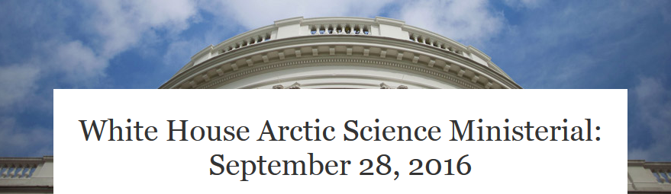
Ministers of 24 governments from all parts of the world (including e.g. China, India, Singapore, etc.), the European Union and representatives of Arctic peoples met for the first time to discuss Arctic science cooperation.
It is recognised that Arctic changes are due to global drivers, and Arctic changes impact the whole planet.
Therefore, Arctic science is of global responsibility.
International scientific cooperation is essential.
Notes:
In fact, the EU and the H2020 partner countries …

Slide 10
International Arctic cooperation
4° year of the EU-US-Canada Transatlantic Ocean (and Arctic) Research Alliance
40 M€ Arctic package in 2016-17
2016: INTAROS, APPLICATE, BLUE-ACTION
2017: ongoing evaluation on Permafrost
EU-PolarNet
Cooperation with the Arctic Council
SAON
GEO

Slide 11
Current climate policy framework
Paris Agreement implementation
Implementation of the EU Arctic policy
1st Arctic Science Ministerial and international cooperation
The Arctic as a showcase

Slide 12
The Arctic: the canary in the mine
Show what climate change is doing in the Arctic
The most evident and undeniable climate change impacts so far
As part of a broader citizens’ empowerment programme
Arctic literacy
Also using art(s) and visual communication
A key programme of the next ArcticScience Ministerial and of the Arctic Council

Slide 13
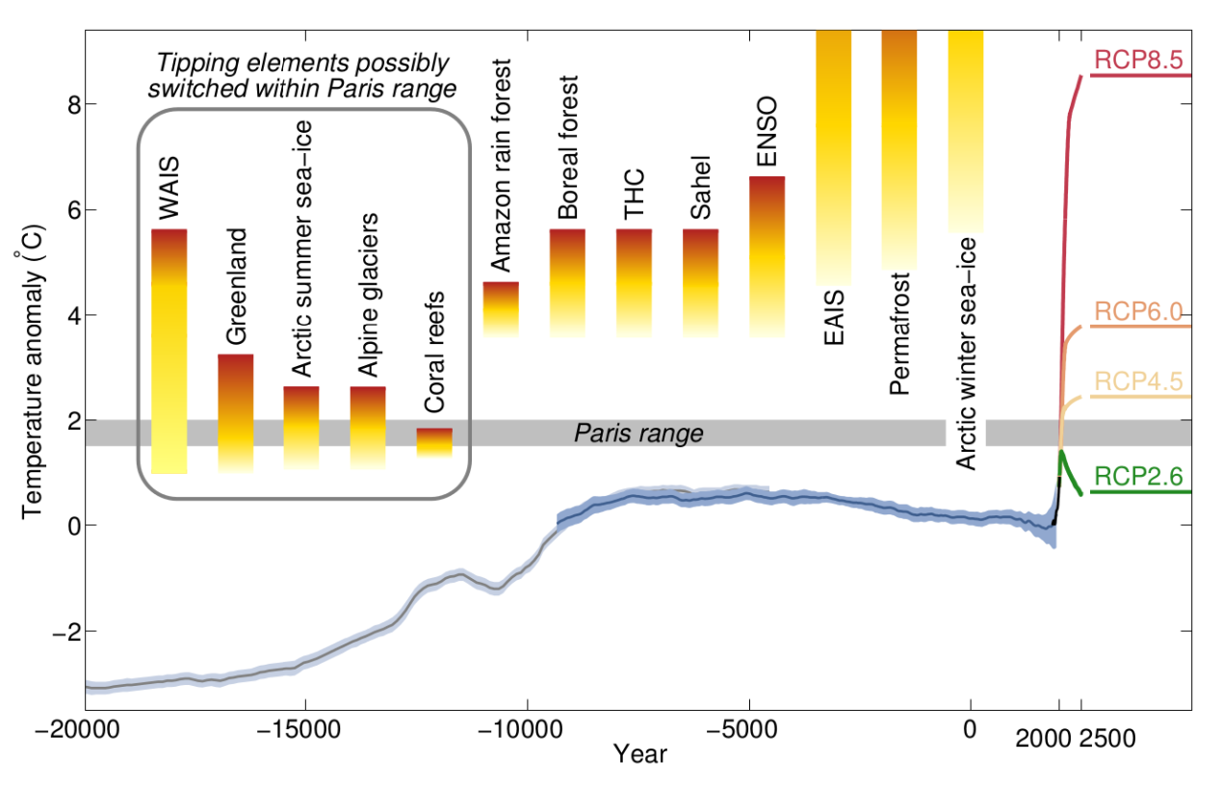
1.5, 2, 3°C, which difference for the Arctic?
Schellnhuber et al. , Nature Climate Change, 2016

Slide 14
Impact assessment on a long-term investment on Arctic observations
The European Commission in June 2017 will start an internal study, run by the DG JRC, that will:
perform a systemic analysis and assessment of benefits and co-benefits of Arctic observations
compare investment and management costs of Arctic observations
provide elements of the "business case" for sustaining in the long-term Arctic observations and, accordingly, to support the decision-making process.

Slide 15
Impact on the EU research strategy
Step-up research and innovation investments
WP 2018-2020, more than 1b€/y in the Focus Area «Building a low carbon climate resilient future»
Reinforce Polar research
Strengthen research support to IPCC assessments
SR 1.5°C, SR Ocean and Cryosphere, AR6

Slide 16
Orientations for EU-funded Polar research
The Commission sent already to the Member States its first proposal of WP 2018-20 for the Societal Challenge 5 « Climate action »
2018:
Climate processes, Tipping points, Ice-core drilling
2019:
Sea-level changes, Arctic biodiversity, Sustainable opportunities in the changing Arctic, Arctic standards
2020:
Polar climate, Polar observations (GEOSS CRI)

Slide 17
Thanks for your attention

